Slide 1
Viva:
Exploring the impact of player attachment on branched narrative decisions
Presented by Gideon Doe Bokomi
Games Development Project

Slide 2
Abstract
First impressions played a key role in how a player will interact with a game’s cast.
This research paper looks at how successful, branched character storylines feedback player feedback as well as measuring the effect a player’s attachment has on decisions towards a character’s ending.
  To support this research with an artefact that handles player interactions by adjusting the game through dialogue and visuals to match the character and user relationship.
  The qualitative analysis from participants via an online survey
The outcome of this research could lead to more interesting narrative directions to personalise narrative experience based on how a player treats and perceives a character.

Slide 3
Viva Structure
Introduction | 4
2. Aims and Objectives | 6
3. Literature Review | 7
4. Research Methodology | 19
5. Results and Findings | 29
6. Discussion and Analysis | 33
7. Conclusion | 43
8. Further Research | 45
9. References | 47
10. Questions | 50

Slide 4
Introduction

Slide 5
Introduction
Within the game industry, there has been an increased in story-driven games.
  One major factor is the ability to story surrounding the game’s world and characters.
Character impression can become a major factor for games that include party limitations, even more so in games where the player's actions impact a character's ending.
Being able to feel joy or pain towards the events of fictional characters is a display of the storyteller’s ability to create the moments that bring out these emotions.
This research recognizes the relationship between the emotional investment of the player and their decision-making in a branched narrative.
It also sets out to explore the weight that a player’s emotions can have on the decisions they will make when significant narrative changes are involved in response.

Slide 6
Project Aims and Objectives
Aim: To explore the strategies employed in the game industry at handling player behaviour and player’s preferences.
Objectives:
  To look at the history of video game narratives with branching pathways and examples of successful releases.
  To analyse how user-avatar relationships impact a player’s decision-making processes.
  To evaluate the research sources regarding its relation to the topic and reliability of the conclusions.
  To discuss the success of narrative driven games at implementing responses according to player actions.

Slide 7
Literature Review:

Slide 8
History of Narrative Games
Key takeaways from over the years:
Games like similar media serve as an excellent medium for storytelling
  Building other aspects of the game around the story helps with immersion and making the worlds feel more alive to the player
  Storylines should be balanced with considerations due to aspects such as playtime and commitment are hard to predict.
  Player-driven stories are an expanding area, however, is greatly reliant on significantly higher hardware requirements. (Lebowitz J, 2011)
A glimpse into evolution of the genre and reasoning for this area of interest and exploration for developers.
Notes:
Lebowitz J. (2011) goes in depth about the history of storytelling and looking into the
limitations of storytelling.
Originally stories began as background info, paragraphs of text or short cutscenes due
to hardware limitations
Text adventures and interactive fiction were the next major progression.
RPGs, Adventures and Visual novels were prevalent throughout the 2000s
Cinematography and the combination of other gameplay elements such as audio and graphics greatly expanded the genres that include detailed stories.
Player-driven stories are an expanding area, however, is greatly reliant on significantly higher hardware requirements.

Slide 9
Storytelling in Media
Storytellers must strive to deliver a believable story to the audience
Skolnick, E. (2014) details the challenges
Storytellers must consider the consistency, coincidence, suspense, and spectacles that creates the world that the audience explores.
Treating the audience with respect further improves the believability
Notes:
Across all media, the storyteller must strive to deliver a believable story to the audience, who in turn choose to disregard the knowledge that the world is fabricated and engage with the world and characters as if they are real.
By treating the audience with respect for uniformity as well as logical reasoning, experiences created are demonstrated in a matter that further improves the believability of the storyteller’s fabricated environment.

Slide 10
Storytelling in Video Games
Types of Storytelling from Berger, R. (2025):
  Episodic Storytelling, Open World Incentivizing, Lore Discovery, Frictionless Narrative and Pixar Storytelling Method.
Nicklin, H. (2022) quickly outlines that ‘not all writing is storytelling’.
  In the context of video games, one example is perspective.
Suter B (2021) describes treating narration as a ‘networked interaction’ between gameplay and story.
    A good example of this concept is environmental storytelling.
    These can help with world-building while acting as a trigger for the player’s intuition when looking at wider contexts.
As a key area of the investigation:
  Artefact builds off an episodic structure
  Research questions analyse players' value of storytelling to a successful game.

Slide 11
Branched Storylines
Heussner, T(2015) discusses the mechanisms of branched decisions
  Some decisions a player may face include:
    Meaningful choices
    Moral choices
  Quests should be designed carefully to prevent:
    Rail-roading
    Retconning
Developers can make more informed decisions and shape storytelling around climatic story decisions.
Noticeable limitations with the small breadth of academic sources.
  Points of discussion here are further expanded upon within research on industry practices and examples of successful games.
Notes:
Rail-roading: Forcing narratives outcomes that are inconsistent with a player's previous decision
Retconning: Establishing a new truth that may sometimes contradict or conflict with established narrative beats or player decisions.

Slide 12
Industry Best Practices
Hudson K (2011) comments on bridging the gap between gameplay and narrative by prioritising player emergency and agency.
Rouse III R (2016) looks at specific techniques to make dynamic stories more interesting for players.
Schell J (2018) looks at the translating patterns to form a connection between story, gameplay, and player neurology
Howard-Arias T (2022) looks at applications of callbacks, heuristics, and cascades.
Laidlaw M (2018) discusses the importance of setting clear goals for all aspects of the story.
Notes:
HK - Designing systems that react to player’s decisions and feedback based on the amplitude of the response creates better player expressivity.
R3R - Explorable story space
Open ended stories
Reacting to player actions
Shifting story elements
Character stimulation
Drama management – steers player decisions back to desired narrative
SJ – Not-separateness – ideas linked in a fundamental way
HT – Cascades – significant moments with consequences.
LM – Focus on theme in order to define clear moments to your team

Slide 13

Successful Games Case Study 1
Life is Strange. By Koch M (2016)
Video games are a strong media
Enables developers to share their opinions on world issues.
Life is strange tackles themes such as coming of age, grief, friendships, and responsibilities.
Developers should avoid including political agendas within their stories
Maintain respectful attitudes.
Figure 1: Life is Strange (Dontnod Entertainment, 2015).

Slide 14
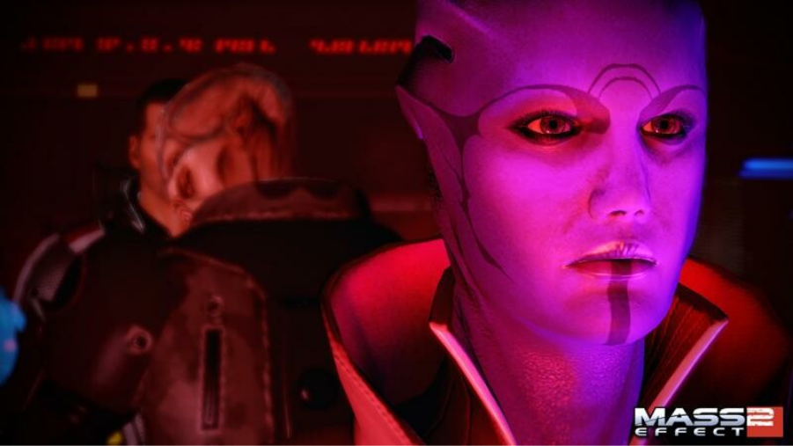
Successful Games Case Study 2
Mass Effect 2 by Troisi A (2010)
  Importance of maintaining the roleplaying flow.
  Use of save import feature that was introduced with Mass Effect 2 and was continued in Mass Effect 3 (BioWare, 2012).
  From the original game, 700 plot hooks were carried over into the sequel.
This provides a continuation serves as a small bonus for long-term players.
Telegraphing allows developers to provide context for making meaningful choices.
Figure 2: Mass Effect 2 (BioWare, 2010)

Slide 15
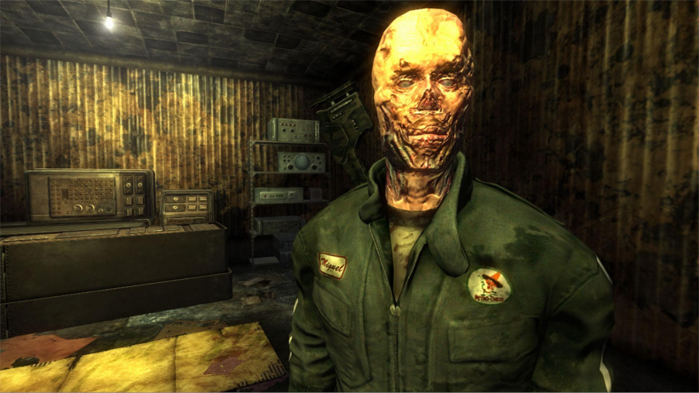
Successful Games Case Study 3
Fallout: New Vegas by Sawyer J (2012)
  Large scope of responses available allowing players to have a large amount of agency.
  Impact on reputation as an indirect response
  Supplemental information seasoning and localised reactivity to providing critical information
This ensures the steps in narrative trees remain informational and independent.
Figure 3: Fallout: New Vegas (Obsidian Entertainment, 2010)

Slide 16
Designing Video Game Characters
Blom, Joleen. (2023) analyses transmedia characters
  These user character relationships can deliver “sources of narrative pleasure and delight.”
Iuppa N (2007) discusses the importance of character bibles to maintain consistency for their actions and motivations.
Isbister, K. (2022) states that Player Characters are experienced on four levels:
  Visceral, Cognitive, Social and Fantasy.
  NPCs should be designed with role clarity
Case J (2024) describes designing characters around the options of choice.
  advises writers to consider adding nuance to decisions.
Garavaglia F’s (2022) Moody5 is a tool to enhance Interactions with non-playable characters by altering the dialogue to fit a given stimulus.

Slide 17
Emotional attachment with virtual agents
Szolin, K (2023) defines the “Proteus effect” (PE) as the phenomenon of gamers’ behaviour or attitude shifting to align with the character of an in-game avatar.
  Peña, J (2020) found in a study a decreased intention towards helping immigrants following gameplay of Papers, Please
Koike, M (2020) offers an insight into some of the reasons why people would choose to play a romantic video game.
Karhulahti, V (2021) details fictophilia as an “intense parasocial love” in relation to a fictional character.
Notes:
One factor that can increase the occurrence of PE is avatar customisation as it enables players to sculpt their avatar to resemble themselves which can directly play a factor in decisions. PE can impact behaviour during playthrough as well as outside and in everyday life.
Research took in quantitative data and compared the results to prove correlative relationships with variables that could be attributed to a desire to play ‘Love Plus’ (a romantic video game from Konami)
Conclusion highlighted that romantic video games are chosen for perceived benefits over personal psychological factors.
Karhulahti, V analyses relevant online discussion and outlines on the key themes:
Fictophilia paradox
Fictophilia stigma
Fictophilia behaviours
Fictophilia asexuality
Fictophilia supernormal stimuli
Due to the nature of this research being explorative, further theoretical and empirical research is needed.
Fictophilia paradox: Knowledge of the desired object being a work of fiction despite the parasocial relationship associated with it.
Fictophilia supernormal stimuli: When compared to real people, discussions mentioned that their fictional partners experience more success and perform more eccentric while maintaining their attractive qualities.
This behavior is also closely compared to parasocial relationships and fan culture.

Slide 18
Emotional attachment with virtual agents (continued)
Bopp, J. A.'s (2019) study concluded that game character attachment leads to more engaged players and emotional experiences.
Tan, Y (2023) studies the relationship between parasocial attachment (PSA) to virtual personalities (for examples, V-tubers) and its influence on the viewer’s stress.
Burgess J (2020) researched the attachment felt by players towards Aloy and the non-playable characters included in the story of Horizon Zero Dawn.
This field is fairly limited in data due to its recency and most results commonly being qualitative in nature.
This area serves as a major area of focus for my aim so is featured heavily within the research survey.
Notes:
Bopp J - he study demonstrated that the nature of emotional attachments is more nuanced and mirrors the variety of real-life liking.
T - The survey results present a positive trend between level of attachment and reduced level of stress, support the proposed idea that PSAs can soothe stress levels during strong stimuli, such as the pandemic.
Burgess J - . The results demonstrated that gender did not play a factor in a player’s ability to form an attachment to Aloy nor when mind-melding and reflecting the emotions felt by the playable character (PC).

Slide 19
Research Methodologies

Slide 20
Platforms
Microsoft Office Software
  Privacy and security
Microsoft Forms
  Quickly generate the questions
  Anonymity
  Demographics
Unity Engine
  Engine and system familiarity.

Slide 21
Procedure
The participants are given a folder package with all necessary components
Firstly, participants are directed to answer the research survey which provides the information sheet and consent form.
They are then asked to complete and submit to uphold the ethics form submitted prior to the release of the research surveys.
  The goal of these questions is to observe whether a player and character bond can cause deviations in the decision-making pathway of a player.
After answering the questions featured in Figure 1 above, participants are then directed to play the build of the artefact and explore the project.
After leaving the prototype, they are asked to complete a playtest form.
  This playtest form features questions focussed on the artefact and how well it serves as a representation of the research results discovered within theory review.

Slide 22
Variables
The research paper is split into three sections and uses a mix of question types to produce quantitative and qualitative data from participants.
The types of questions included are open-ended, ranking, rating and choice based.

Slide 23
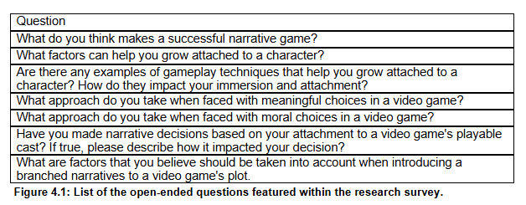
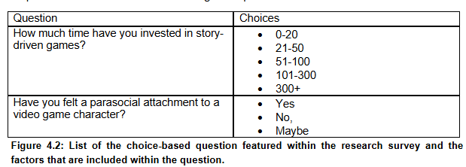
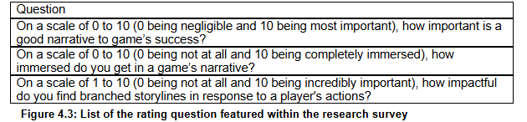

Slide 24
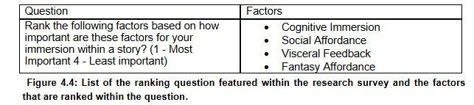
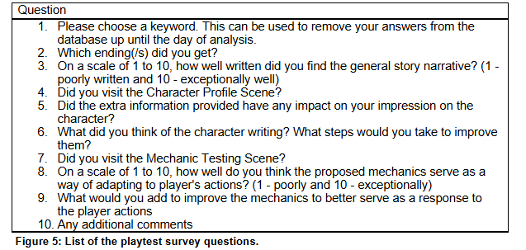

Slide 25
Participants
All participants were students
Individuals were recruited via word of mouth across the social networks of Discord and Microsoft Teams.
Participants sampled were chosen due to a range of factors.
  Key factors were availability and interests.
All participants were above the age of 18 and have a history of playing story-driven games and an interest in working in the game career.

Slide 26
Limitations
While being open-ended, the phrasing of the questions offer little in defining which types of parasocial attachments are being studied.
Some questions rely on participant's knowledge and lack clarification.
While the research is explorative in nature, these limitations suggest that the comparisons will be very surface level

Slide 27

Research Methodology:
Artefact

Slide 28
Artefact Features
The artefact was developed with an episodic structure in mind.
  This was chosen as to ensure more rapid playtest sessions; a smaller script was determined to help limit game length.
The artefact was developed with the goal of adhering to the best practices and advice discussed in the literature review.
  The main level was designed with the knowledge of offering reactive feedback to player choices.
  Endings were designed to be attainable at certain points with optimal routes
  Participants are instructed to begin with the playable demo since it is most directly addressed within the playtest form.
Character profile functions like a character bible.
  Offers additional information that is later referred to in the playtest form for its effect on changing player impression.
The mechanic demonstration scene serves to showcase the impact on the scene that player responses have.
  This is designed around the scene environment changing to match reflect the relationship between player and character.

Slide 29
Results and Findings

Slide 30
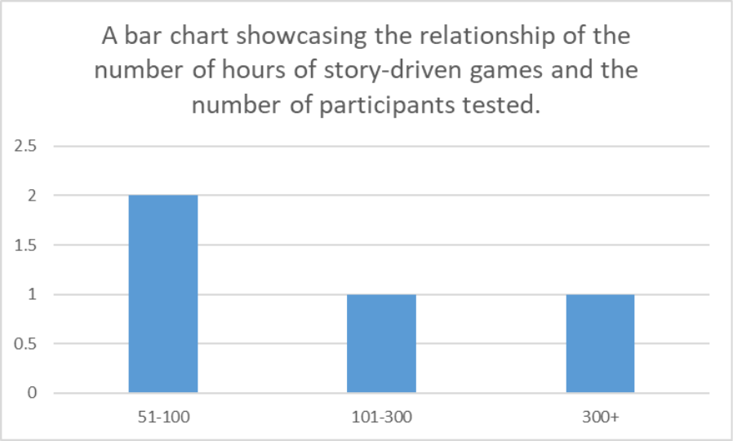
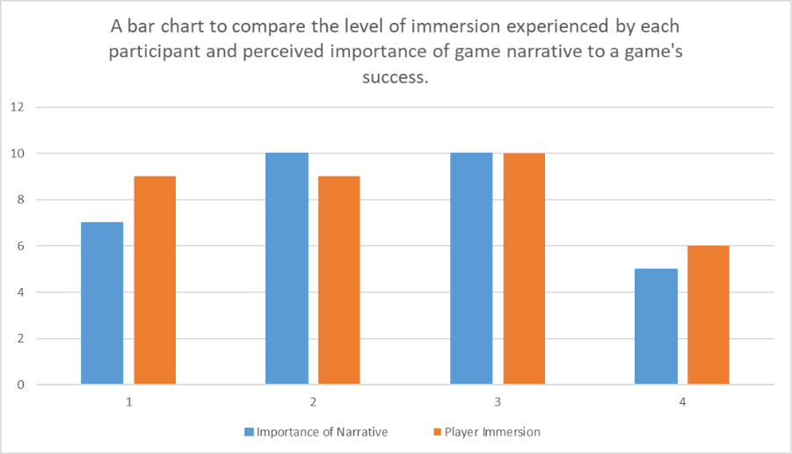
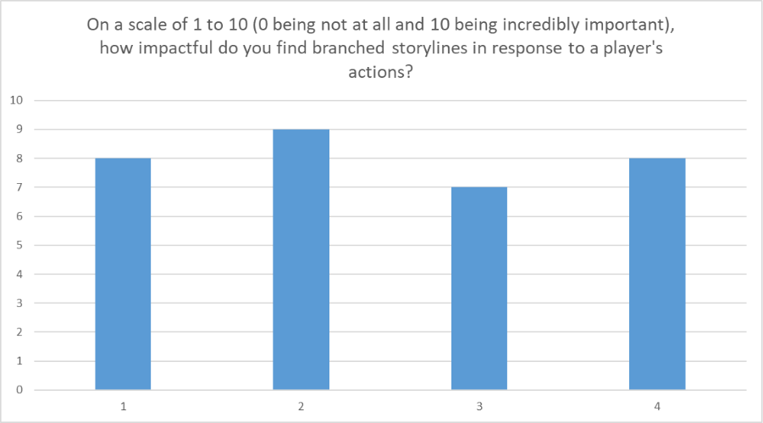
Research Survey Results
Average of 173 hours spent on story-driven campaigns.
  The most common range was 51-100 hours (50%)
Average Likert of 8.00 out of 10.
  Respondents agreed that narrative is important to a game’s success.
Average Likert of 8.50 out of 10.
  Respondents find themselves very immersed into a game’s narrative.
Participants attributed impactful choices and meaningful themes in the cast and story to a narrative game's success.
Participants ranked the following factors discussed by Isbister K (2022) in the following order for their importance.
  Cognitive Immersion
  Social Affordance
  Visceral Feedback
  Fantasy Affordance
Averaged Likert of 8 out of 10.
  Respondents found branching storylines to be very impactful as a feedback mechanism to a player’s actions.

Slide 31
Research Survey Results
When discussing the topic of parasocial attachment and relationships
  50% of participants did not report having felt this type of attachment to a video game character.
  In contrast, 25% reported that they did and the remaining 25% remained unsure.
Answers regarding factors that may increase affection were attached to themes of human emotions, effective character writing and level of exposure.
  Regarding the topic of human emotions, 75% of participants commented on characters having a sense of realism.
  Character writing was mentioned to some extent within all answers submitted. Additional comments addressed the importance of first impressions and prior character building.
  Finally, 50% of answers refer to the effect that regular interactions can have on growing connected to characters.
When discussing techniques within successful series, respondents brought up the series The Walking Dead and The Last of Us.
Outside of connections to individual franchises, other techniques discussed areas such as mechanics and introduction.
When faced with a meaningful decision, most responses initially lean towards to the good outcome..
Unlike the meaningful choices, the responses related to moral decisions were more nuanced.
Most participants mentioned that their narrative decisions can be directly impacted by their attachment to the playable cast.
Respondents agreed that upholding player choice agency was the key attribute for developers to consider when implementing branched narratives.
  One entrant phrased these factors as two questions. How will different branches impact the gameplay? Furthermore, what effect will the player experience by going down each path?

Slide 32
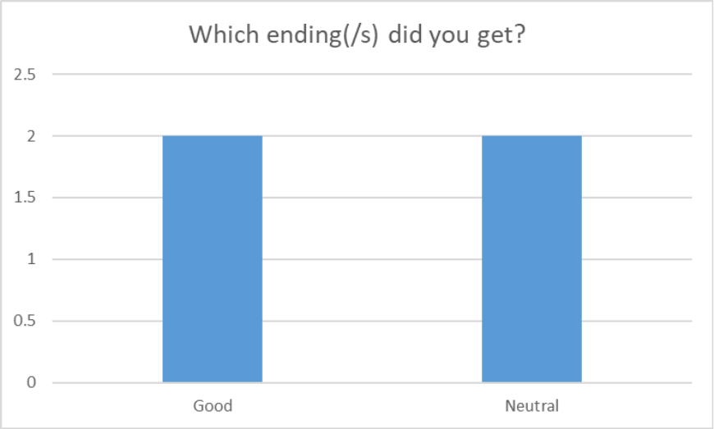
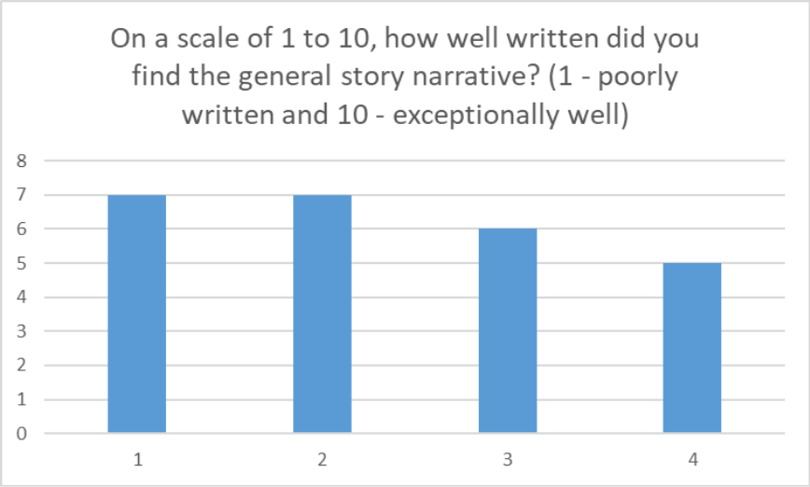
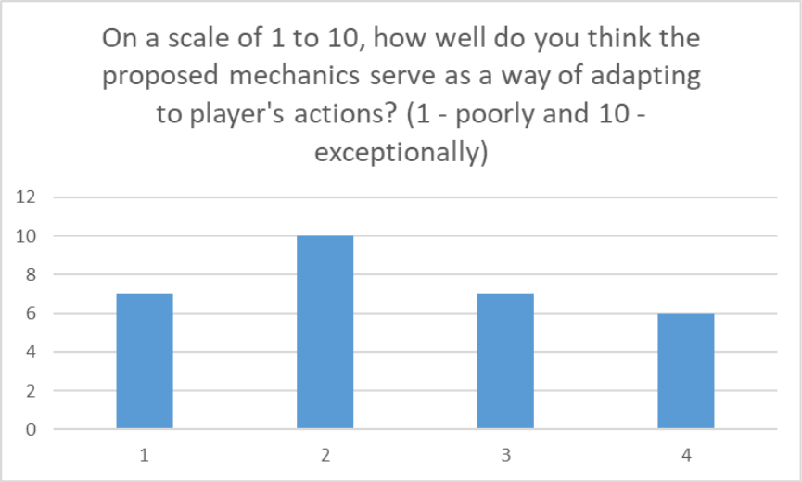
Playtest Results
50/50 split for both the good and neutral endings
All participants visited the Character Profile Scene
75% of participants noted that the extra information impacted their impression of the character.
All participants stated the artefact presented displayed a noticeably fast pace which hurt the character development and broke immersion with the story.
All participants visited the Mechanics Testing Scene and the average rating for the mechanic concept was 7.5 out of 10.
Participants suggested: additional parameters, facial expressions, ambient audio and a sub menu as additions to improve the artefact experience.

Slide 33
Discussion and Analysis

Slide 34
Aim
The literature and theory supported all the results given during the investigation in terms of the best practices and techniques.
  Suggesting that this area of research is well documented.
Within the industry, successful games can interweave their narratives directly with player behaviour and gameplay to create a feedback loop.
  This loop ensures that the player’s actions hold weight and that the game’s story shifts to create a personalised experience.
The investigation showed the significance of immersion and character design.
  Responses from participants demonstrated the importance of development of characters,
Participants when asked to comment, tended to highlights flaws within the artefact.
Notes:
To explore the strategies employed in the game industry at handling player behavior and player’s preferences.

Slide 35
Objective 1
Branching pathways offers developers the opportunity to
  Better implement player agency
  Create a unique narrative for their experience.
Both participants and the research of Heussner, T. (2015) discuss the pitfalls presented in the implementation.
  Both sources addressed invalidating the player’s choices as an area of concern.
Overall, the freedom of decision granted to the player must be upheld
Notes:
To look at the history of video game narratives with branching pathways and examples of successful releases.

Slide 36
Objective 2
Emotional connections to fictional characters can be formed due to writing a character as human.
Survey answers support the idea that:
  Player will prioritise significant narrative decisions that prevent harm to the characters that they care for.
  Players are more likely to choose to place disliked characters in disadvantageous positions.
Notes:
To analyse how user-avatar relationships impact a player’s decision-making processes.

Slide 37
Objective 3
Previous researchers' practices involved
Bopp J (2019) utilised thematic analysis to categorize the type of emotional attachment described in participant’s arguments from their survey.
Karhulahti, V (2021) however performed systematic analysis on online discussions.
In comparison, the methodology of this investigation has followed similar research techniques
Low sample size hurts the investigation outcomes on being statistically significant.
Notes:
To evaluate the research sources regarding its relation to the topic and reliability of the conclusions.

Slide 38
Objective 4
Successful story driven games have implemented a range of techniques, the adapt the gameplay around a player’s actions.
‘Life is Strange’ makes use of real-world issues as the themes for the franchise.
  Incorporating real-world issues or emotions creates characters that appear more human. Koch M (2016)
  Answers for the corresponding question within the research survey discussed character building or realism could be intricately linked to the ideal outcomes of thought-provoking experiences.
‘Fallout New Vegas’ chooses to scope widely for player response options. (Sawyer J, 2012)
  One respondent finding side content more appealing than the main questline when asked on any changes to the logic that determines a narrative decision.
  Greater spread of story directions help characters further standout in memorable moments
Notes:
To discuss the success of narrative driven games at implementing responses according to player actions.

Slide 39
Objective 4 (Continued)
Survey results also highlighted ‘The Last of Us’ and ‘The Walking Dead’
  Higher immersion because of watching the growth of another character over the course of the game.
  This offers an example of defining interaction moments as addressed Isbister K. (2022)
‘Mass Effect 2’ which the reasons for maintaining narrative flow was discussed.
  The introduction of save-file importation
  Legacy players can continue their previous story
  Developers can use saves as presets during development.
Notes:
To discuss the success of narrative driven games at implementing responses according to playeractions.

Slide 40
Explanations
Exposure to the type of game highlighted.
Participants with more time spent playing these types of game also demonstrated being more immersed into the game narrative.
  To a less extent they were more aware of experiencing parasocial attachments.
Character interactions spread over the course of the game can be attributed to creating a connection between the player and the video game character.

Slide 41
Criticisms
Methodology
  Online survey format.
  Individual interviews
Playtest sessions
  Data limited by singular playthrough
  Introducing a second playthrough
Artefact
  The writing of the artefact needs further revisions.
  Broken Immersion due context, environment and interactions being mishandled.
  Scope and mechanic design
  Iterative Design and Scheduling Adjustments

Slide 42
Changes
In recognition of the criticism that were raised. Some potential impact on the results include:
Heuristics profiles
Parasocial relationships
Time Investment
Wider examples of games
Impact on the individual.

Slide 43
Conclusion

Slide 44
Conclusion
Based on the qualitative analysis of 4 participants results as well as an explorative review of current research:
Identified effective strategies employed in the game industry at handling player behaviour and player’s preferences within branching narratives games.
Existing research suggested that player attachment is a nuanced and varied measure as the formation of attachment will occur under different circumstances from player to player.
While the conditions of the attachment are less fixed, substantial evidence suggest that it is a major determining factor for narrative decisions in a branched storyline.
The artefact in contrast to the research displayed a few areas to improve on but the playtest feedback has offered direction on how to tackle these issues.
Further research is heavily suggested to better incorporate the psychological field.

Slide 45
Further Research

Slide 46
Further Research
The fields of player narrative and measuring human affection have extraordinarily little research that explores any correlations between the two.
Psychological impact that branched decisions can have on a player
Individual types of affection on decision making (E.g. Admiration or Love)
Rewards and Punishments for player decision
Whether prior attachments hold any significant weighting in that decision.
Transmedia characters and whether the origins of a character can impact the emotions a player can feel towards them.

Slide 47

References
Notes:
Other Proposal Points that I have yet to cover:
Planning:
Kanban Board
Before:
After:
Previous Experience:
Game Artificial Intelligence: Working with C# scripting in the Unity Engine. After some careful consideration, I’ve chosen to develop my project within the Unity Engine. This is one of my many Unity modules, but this project was selected as a recent example of my programming skills within my chosen game engine. Building up from this foundation, I plan to make an artefact that will be portray my research findings and showcase a unique interpretation of the affection mechanic, common in many games within the genre.
https://digitalacademy.staffs.ac.uk/forum/index.php?/topic/71752-doe-bokomi-gideon-d012396n/#comment-979545
Introduction to Mechanics Design: Understanding of the mechanics which can be helpful to apply for a new genre. The techniques learnt with lighting and the use of the camera will be applicable to the planned deliverables, specifically the visual additions that I plan to include in my final project.
https://digitalacademy.staffs.ac.uk/forum/index.php?/topic/68556-doe-bokomi-gideon-d012396n/#comment-965095
Game Prototyping: Scoping and working with an agile game development cycle within a set timeframe. This showcases my experience of working on set sprints and time constraints. Additionally, it features my use of kanban boards which are equally central to this project as one of my chosen forms of planning documentations.
https://digitalacademy.staffs.ac.uk/forum/index.php?/topic/64699-doe-bokomi-gideon-d012396n/

Slide 48
Lebowitz, J. et al (2011). Interactive storytelling for video games: a player-centered approach to creating memorable characters and stories (1st edition). Focal Press. https://doi.org/10.4324/9780240817187
Skolnick, E. (2014). Video game storytelling: what every developer needs to know about narrative techniques (1st ed.). Watson-Guptill.
Nicklin, H. (2022). Writing for Games: Theory and Practice (1st ed., Vol. 1). CRC Press. https://doi.org/10.1201/9781003182832
Suter, B. et al (2021). Narrative Mechanics Strategies and Meanings in Games and Real Life. In Suter et al. (eds.), Narrative Mechanics Strategies and Meanings in Games and Real Life (1st ed.). transcript Verlag. https://doi.org/10.14361/9783839453452
Berger, R. (2025). Dramatic Storytelling and Narrative Design: A Writer’s Guide to Video Games and Transmedia (Second edition.). CRC Press.
Heussner, T. et al (2015). The Game Narrative Toolbox (1st ed.). Taylor & Francis Group. https://doi.org/10.4324/9781315766836
Julialicia Case Salvatore Pane, E. F. (2024). Story Mode: The Creative Writer’s Guide to Narrative Video Game Design (1st ed.). Bloomsbury Publishing. https://doi.org/10.5040/9781350301405
Hudson K et al (2018) Player-Driven Stories: How Do We Get There?, YouTube. Available at: https://www.youtube.com/watch?v=qie4My7zOgI (Accessed: 12 February 2026).
Rouse III R et al (2016) Dynamic Stories for Dynamic Games: Six Ways to Give Each Player a Unique Narrative, YouTube. Available at: https://www.youtube.com/watch?v=SsSh62mSPZE (Accessed: 12 February 2026).
Howard-Arias T et al (2022) Making Player Choices Feel like They Matter in Your Narrative, YouTube. Available at: https://www.youtube.com/watch?v=KU3FlTpxSyk (Accessed: 12 February 2026).
Schell J, GDC 2025 (2018) The Nature of Order in Game Narrative, YouTube. Available at: https://www.youtube.com/watch?v=E-qnXNUSUMA.
Laidlaw M et al (2018) Empires to Ages: Storytelling Lessons Learned in 14 Years at BioWare, YouTube. Available at: https://www.youtube.com/watch?v=Gsh-aYdFWws (Accessed: 12 February 2026).
Reference List

Slide 49
Reference List
Koch M et al (2016) Life is Strange: Using Interactive Storytelling and Game Design to Tackle Real World Problems, YouTube. Available at: https://www.youtube.com/watch?v=fDVuH20c0zw. (Accessed 12 February 2026)
Troisi A et al (2010) Interactive Storytelling in Mass Effect 2, YouTube. Available at: https://www.youtube.com/watch?v=pMd5SS35KgM. (Accessed 12 February 2026)
Sawyer J et al (2017) ‘Choice Architecture, Player Expression, and Narrative Design in Fallout: New Vegas’, YouTube. Available at: https://www.youtube.com/watch?v=LR4OxNfzTvU. (Accessed 12 February 2026)
Blom, Joleen. (2023). Video Game Characters and Transmedia Storytelling: The Dynamic Game Character. (1st ed.). Amsterdam University Press. https://doi.org/10.1515/9789048553495
Iuppa, N., et al (2007). Story and Simulations for Serious Games: Tales from The Trenches (1st edition). Focal Press. https://doi.org/10.4324/9780080467207
Isbister, K. (2022). Better Game Characters By Design A Psychological Approach. CRC Press.
Garavaglia, F. et al (2022). Moody5: Personality-biased agents to enhance interactive storytelling in video games. CoG, 175–182. https://doi.org/10.1109/CoG51982.2022.9893689
Szolin, K. et al (2023). “I am the character, the character is me”: A thematic analysis of the use-avatar relationship in videogames. Computers in Human Behavior, 143, 107694.
Peña, J.et al (2020). Game perspective-taking effects on willingness to help immigrants: A replication study with a Spanish sample. New Media & Society, 22(6), 944–958. https://doi.org/10.1177/1461444819874472
Koike M et al (2020). What factors attract people to play romantic video games? PLOS ONE, 15(4), 1–14. https://doi.org/10.1371/journal.pone.0231535
Karhulahti, V.-M. et al (2021). Fictosexuality, Fictoromance, and Fictophilia: A Qualitative Study of Love and Desire for Fictional Characters. Frontiers in Psychology, Volume 11-2020. https://doi.org/10.3389/fpsyg.2020.575427
Tan, Y. (2023). More Attached, Less Stressed: Viewers’ Parasocial Attachment to Virtual Youtubers and Its Influence on the Stress of Viewers During the COVID-19 Pandemic. SHS Web of Conferences, 155, 03012. https://doi.org/10.1051/shsconf/202315503012
Bopp, J. A. et al (2019). Exploring emotional attachment to game characters. Proceedings of the Annual Symposium on Computer-Human Interaction in Play, 313–324.
Burgess, J. et al (2020). The female video game player-character persona and emotional attachment. Persona Studies, 6(2), 7–21.

Slide 50

Any Questions?

Slide 51

Gameplay Video

Slide 52

Technical Demonstration Video

