Slide 1
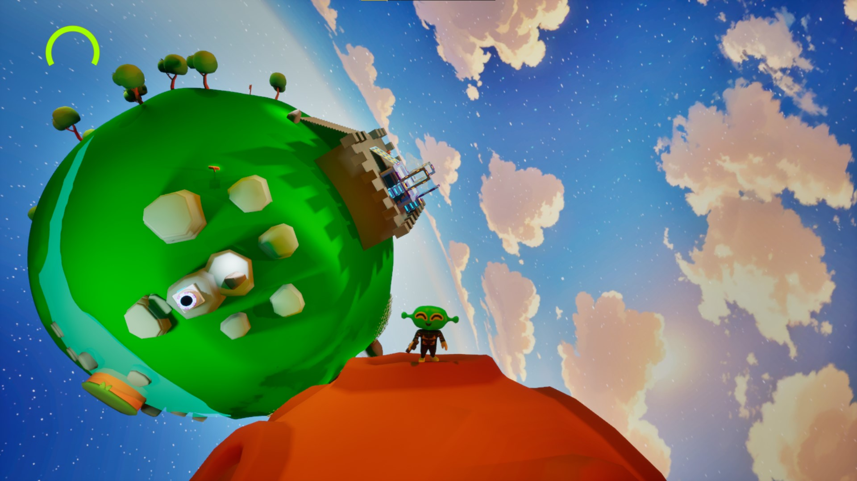
“Zeb’s orbit”
Exploring Custom Gravity With
A Hub And Spoke Level
Artefact Development Report
By Toby Smith

Slide 2
Contents
1. Introduction
2. Aims, Objectives, and Deliverables
3. Research Methodologies
4. Documentation of Production
5. Final Artefact
6. Evaluative Review
Bibliography
Closing Page

Slide 3
Introduction

Slide 4
1a. Introduction
When playing games, people tend to have a natural desire to explore what is beyond the perceived limits of the level. Linear levels tend to box the player in to create a tailor-made experience that the player cannot deviate from.
For my project, I wanted to create a more non-linear approach to level design whilst taking inspiration from some of my favourite 3D platformers.

Slide 5
1b. Introduction
So how do you pursue a non-linear approach to level design?
For the project, I went with a “hub and spoke” level design. This is tied together with the hub being a planet and the spokes being other planets in the distance.
A platformer where the player can choose which planet to explore in which order before returning to the hub, would effectively fit the non-linear approach.
Planetary gravity would enhance this further, as players could planet hop in a 3D space, as opposed to entering a cutscene or loading screen.

Slide 6
Aims, Objectives and Deliverables

Slide 7
2a. aims
The aims of the project are to create a non-linear level, that utilises planetary gravity to create a sense of space exploration and planet hopping.

Slide 8
2b. Objectives
The objectives are to create a hub and spoke type level, that allows the player to explore and choose which level to pursue, in whatever order they want.
This creates a non-linear approach to level design within 3D platformers, that encourages players to explore and feel that they have a choice.
The feeling of planet hopping is another objective that will enhance the sense of adventure and exploration, as the player can see a planet in the distance and make the choice to go out and explore it.
Utilising custom gravity within Unreal Engine, will also allow for the creation of planetary gravity, which is essential for the planet hopping experience.

Slide 9
2b. Objectives
Furthermore, ensuring that the game is easily understood and accessible is crucial. As the project orbits around non-linearity, I will have to make sure that the level is well balanced so that players do not have a hard time, simply because they have chosen one spoke rather than the other.
Each spoke should offer a different experience, either in terms of hazards, layout or the custom gravity.
This ensures that the hub and spoke offers variety as well as non-linearity.

Slide 10
2b. Deliverables
To achieve my objectives, I am going to:
Create a design document
Create a playable hub and spoke level
Playtest and gather data
Make a commentary video
Create this development report I am currently typing out

Slide 11
Research methodologies

Slide 12
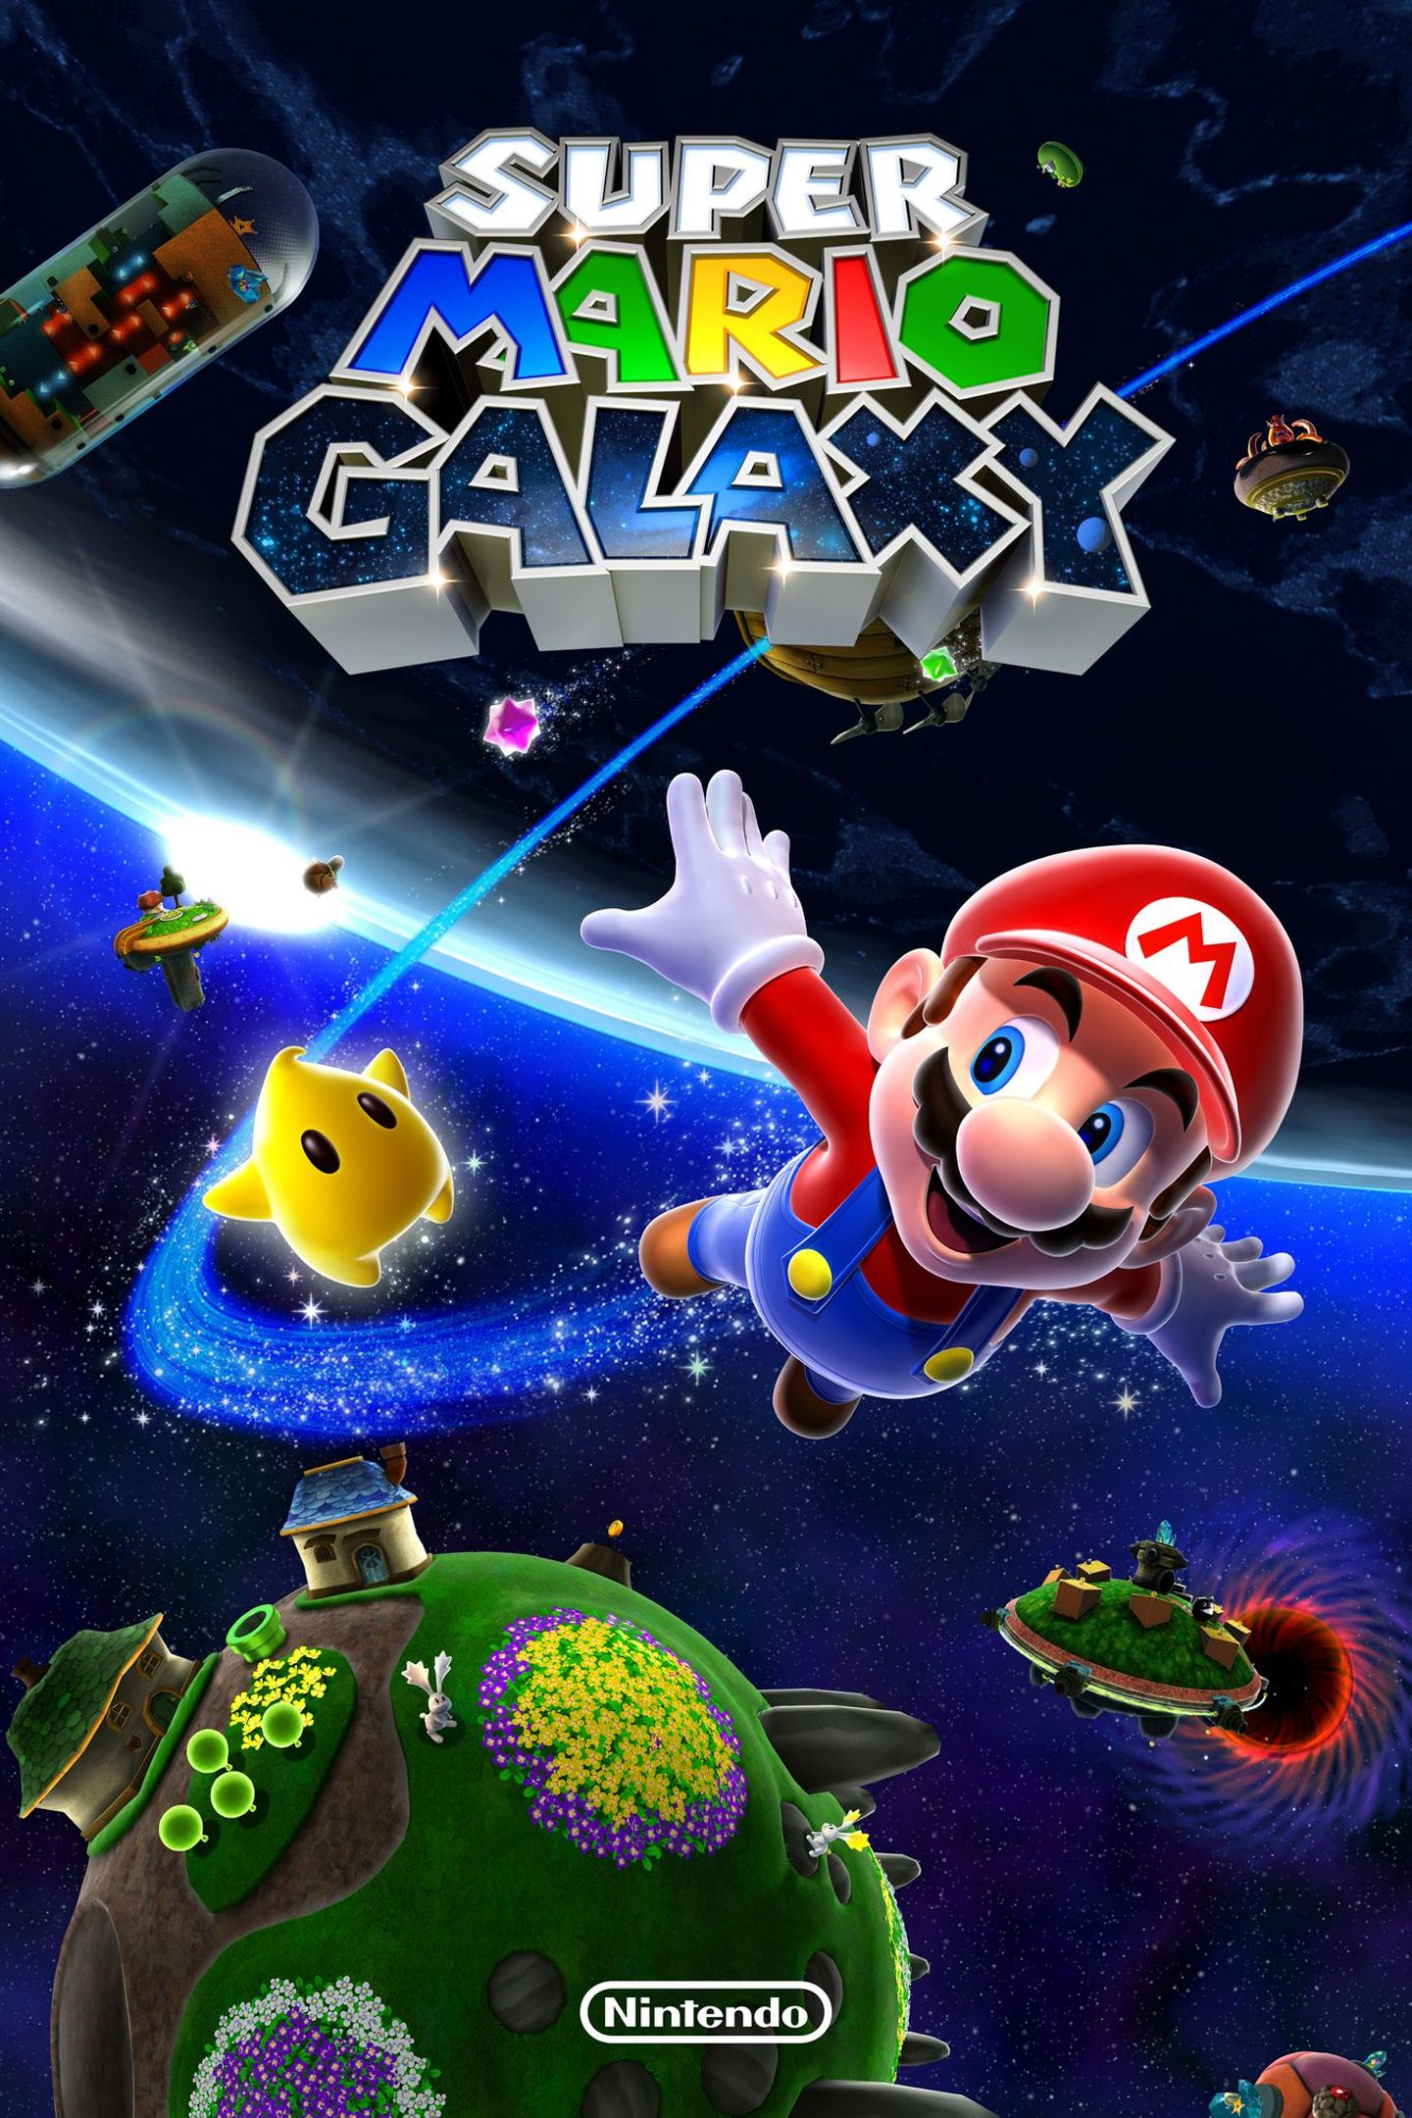
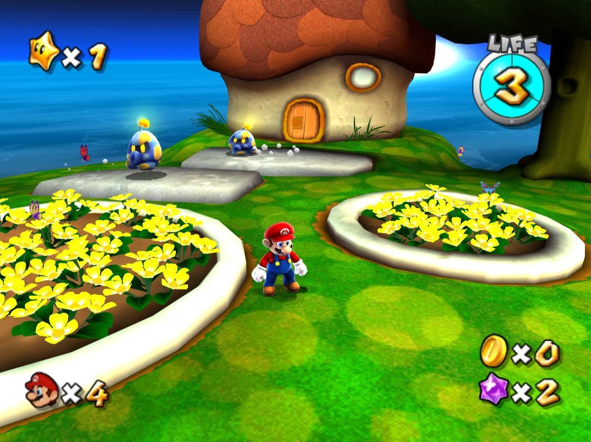
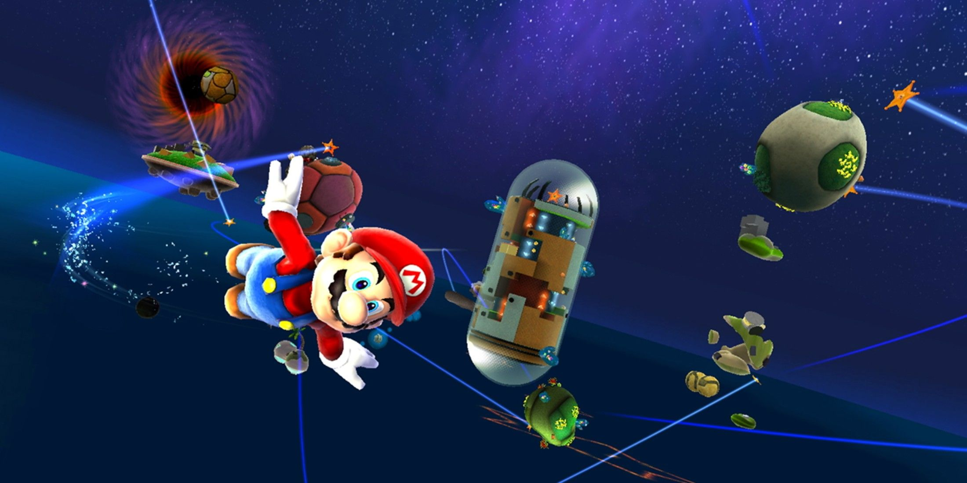
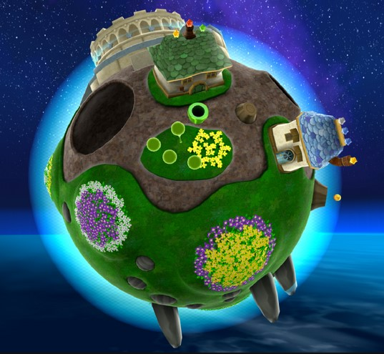
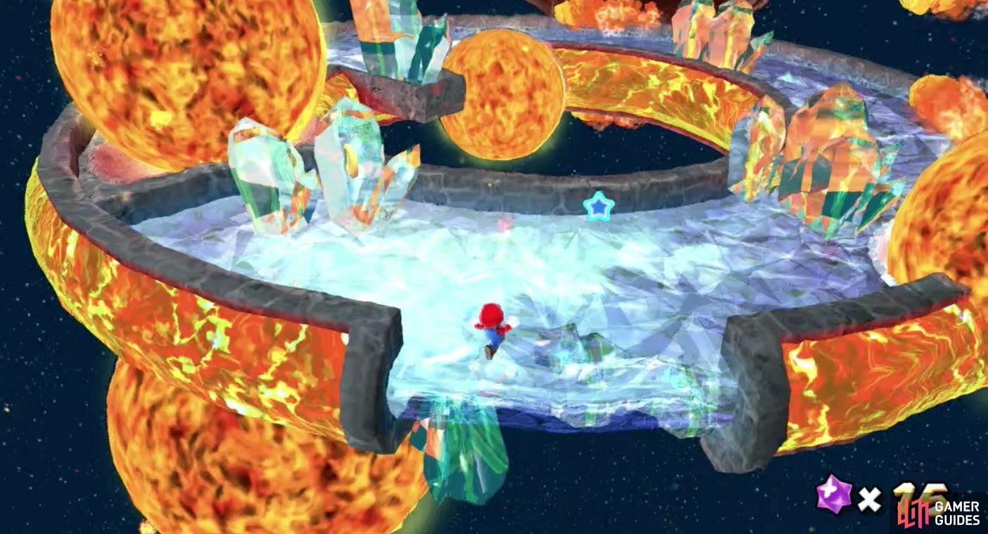
3a. Game inspirations
The very first aspect of research is analysing the game that inspired the project.
This game has a plethora of mechanics that change with almost every level. This provides the player with a fresh and non-repetitive experience as each level has a tremendous amount of variety.
The interesting gravity mechanics as well as the space theme and level variety is very much something I want to incorporate into my own project. As amazing as Super Mario Galaxy is, it does tend to be quite linear and I want to encourage more exploration, which can perhaps be achieved with a network or hub and spoke level design.
(Super Mario Galaxy, 2007)r

Slide 13
3b. Design Literature
Another approach to research is to find relevant reading material as well as other sources that might be relevant to the project, such as websites or videos.
I have compiled a list of literature that has been useful, conducting researching into non-linear level designs.
Journals and Books​
Level design layouts - https://book.leveldesignbook.com/process/layout​
“Challenges for Game Designers” – by Brenda Brathwaite and Ian Schreiber​
The Art of Game Design” – by Jesse Schell ​
GDC​
Prototyping techniques used to create “Astro Bot” - https://gdcvault.com/play/1035283/Rapid-and-Creative-Gameplay-Prototyping​
Crafting a tiny open world - https://gdcvault.com/play/1028679/Independent-Games-Summit-Crafting-A​
YouTube​
Spherical Planets in Super Mario Galaxy - https://www.youtube.com/watch?v=QLH_0T_xv3I&t=217s​
Custom Gravity in Unreal Engine 5 - https://www.youtube.com/watch?v=Jw4Q27ZurO4​

Slide 14
3c. Playtest data
The last and perhaps most useful form of research is gathering quantitative and qualitative data.
This data can be obtained through playtesting and at least two different ways:
For quantitative- Provide a feedback form, with scales that can be collected into a graph or chart.
For qualitative- Conduct a post playtest interview, asking questions directly to the playtester and receiving in-depth answers to specific questions.

Slide 15
Documentation of production

Slide 16
4a. Creating the design document
The first stage to creating the project was to nail down the design.
In needed to ask questions such as:
What is the genre?
Who is the target audience?
What is the theme?
What is the gameplay loop?
What are the design pillars?

Slide 17
What is the genre?
A 3D platformer.
Who is the target audience?
Both inexperience and experience players alike, intended for all ages.
What is the theme?
Space with planets that each have their own subtheme and environment.

Slide 18
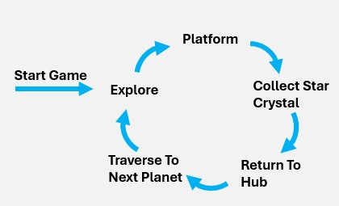
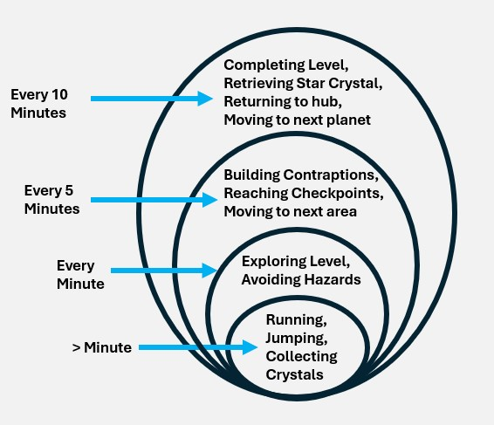
What is the gameplay loop?
The player crash lands on a garden-like planet, surrounded by 4 other planets.
They must explore the surrounding planets to find Star Crystals, so that they can repair their spaceship.
The garden planet acts as a hub that the player returns to, each time they retrieve a Star Crystal.
Each planet will have its own theme and ecosystem that is unique.

Slide 19
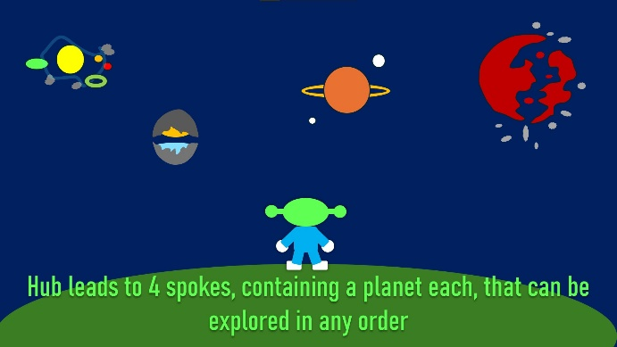
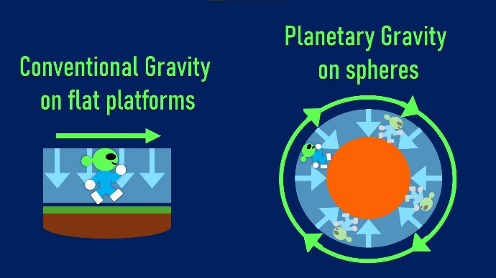
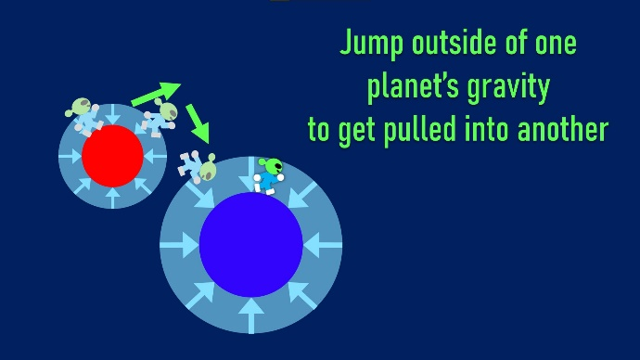
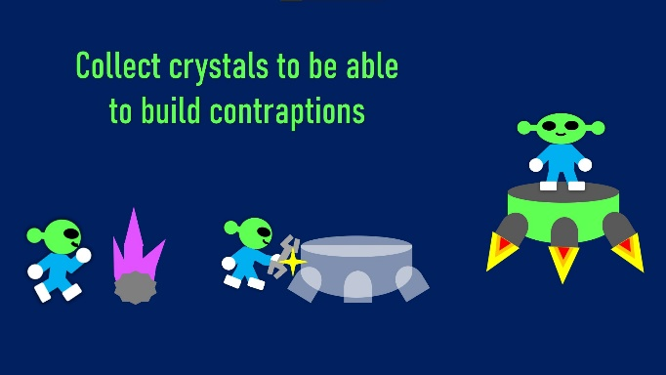
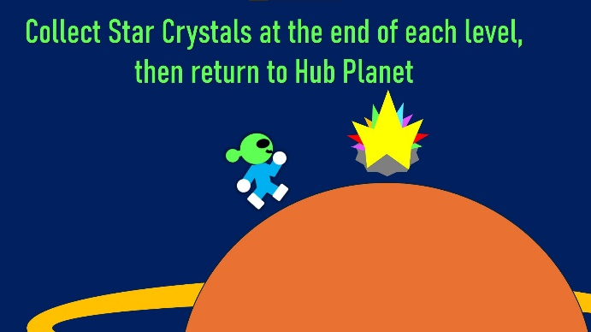
Gameplay loop Diagrams

Slide 20




What are the design pillars?
Fluidity
Does the movement feel smooth? Does the level flow well?
Variety
Are there a variety of mechanics? Does each spoke feel unique? Is the gameplay fresh and non-repetitive?
Exploration
Can the player freely explore? Is there non-linearity in the level? Are there multiple approaches to achieving a goal?
Sense Of Adventure
Does it feel fun to traverse across space? Are the spoke transitions exciting? Does the loop back to the hub feel rewarding?

Slide 21
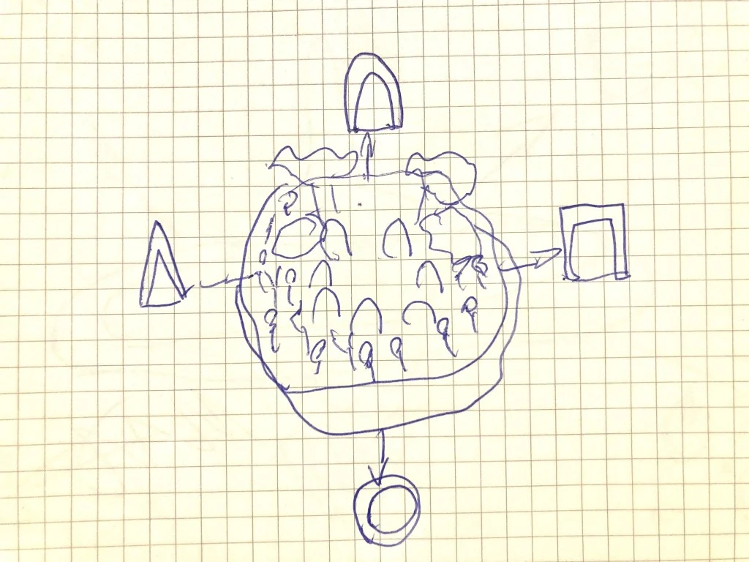
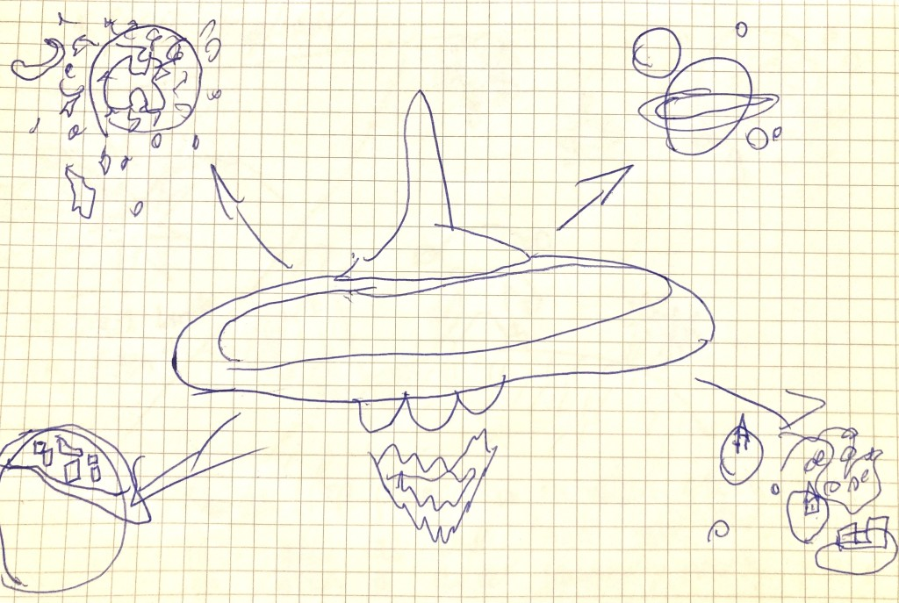
4B. Level Design sketches
Here is my first idea sketch. I was thinking of a flat grassy plane with doorways that teleport the player to the next spoke, but this idea clashed with the non-linearity aspect, so I moved on.
My second sketch, I thought of a large spaceship or station that serves as the hub, with planets around it but it didn't really make sense. Why would the player need to travel to those other planets if they already had a working ship?

Slide 22
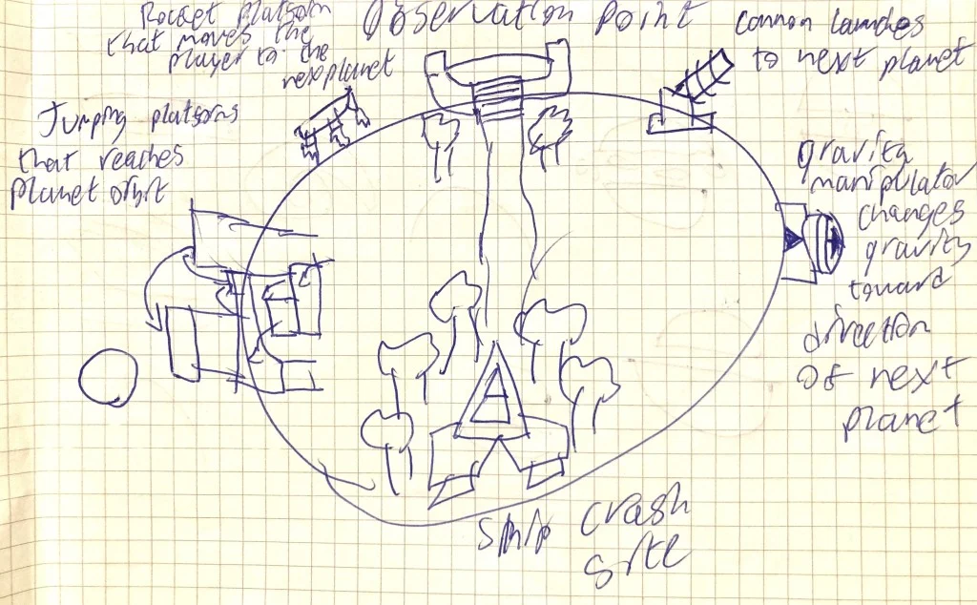
4c. Level Design iterations
Map Iteration 1
This my first paper iteration of the hub level. The player crash lands on a garden-like planet.
The idea for this was that the entrances to the next planets would be built into the hub, with no need for loading screens or teleporters.
This sketch was quite messy, so I moved to the next.

Slide 23
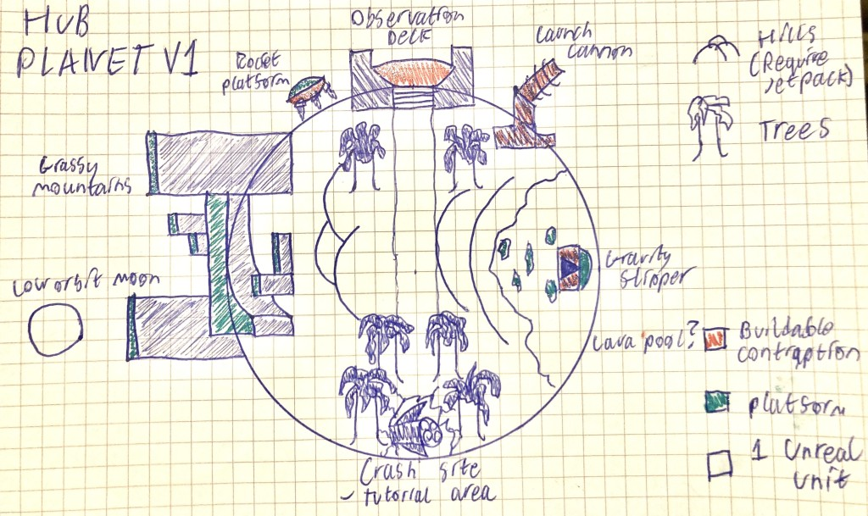
Map Iteration 2
This is my second iteration with cleaner lines adhering to the grid as well as a better sense of scale. Each square represents a 1x1x1 Cube in Unreal Units, which is also about the same size as the player character.
It certainly lacks the "cozy" feel that I wanted my hub to have and jut doesn't look very interesting to explore. The huge hills on the left look out of place and on the right, the lava pool is a stupid idea for a hub, as the player should feel safe. So I moved on.

Slide 24
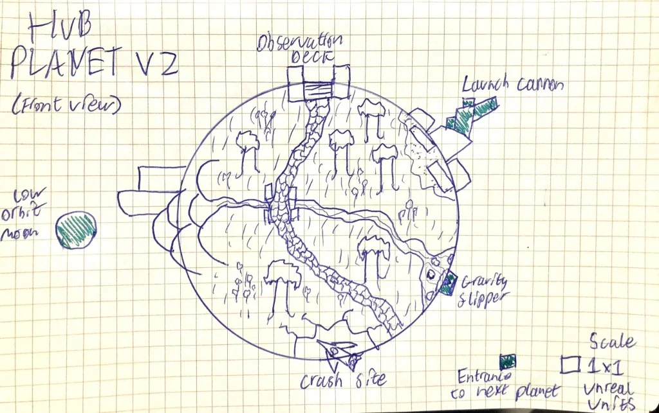
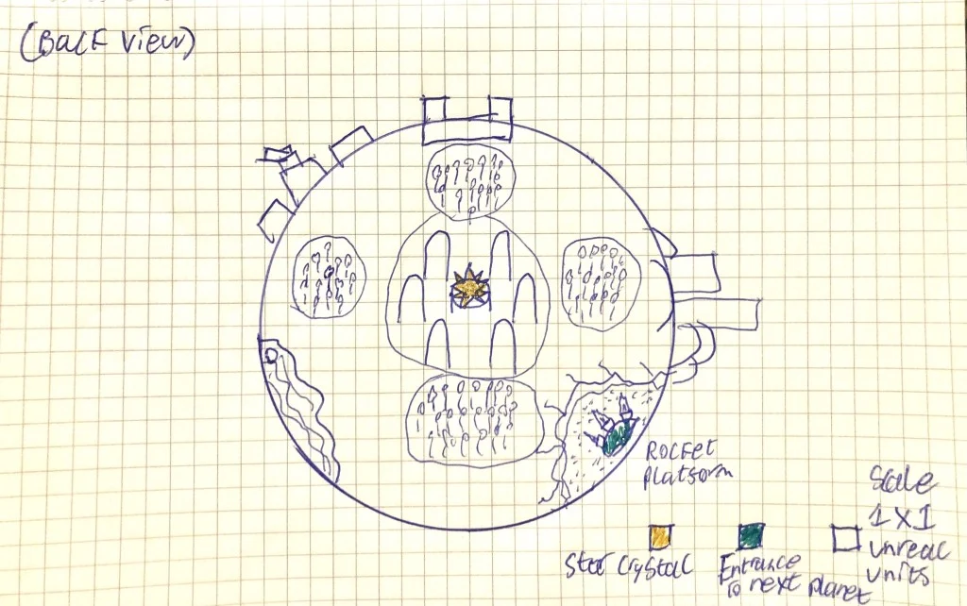
Map Iteration 3
Immediately, this hub design feels a bit cozier so I'm glad I iterated. It is covered in grassy fields, trees, flower beds and a cobbled path that leads to the observation deck.
The observation deck will take the player to an overhead camera where they can see all of the other planets top-down.
This area will also serve as the diegetic counter for the "Star Crystals" the player will collect, at the end of each planet level.

Slide 25
4d. Sourcing assets
As the focus for this project is creating a hub and spoke level with planetary gravity, it is unlikely that I will have the time to create all of the assets from scratch.
The assets I will need to source are:
Sound Effects and Music
Environmental Art and props

Slide 26
Sound effects and music
I decided to collect all of my assets from a single free source known as “Freesound.org” (Freesound.org, 2012).
Below are the credits for the music and sound effects.
​
Music:
"Space Blueberry Picking" by Romariogrande
"Hopeful Cinematic Emotional Orchestra" by EvanBoyerman
​
Sound Effects:
-Freesound.org
​
​

Slide 27
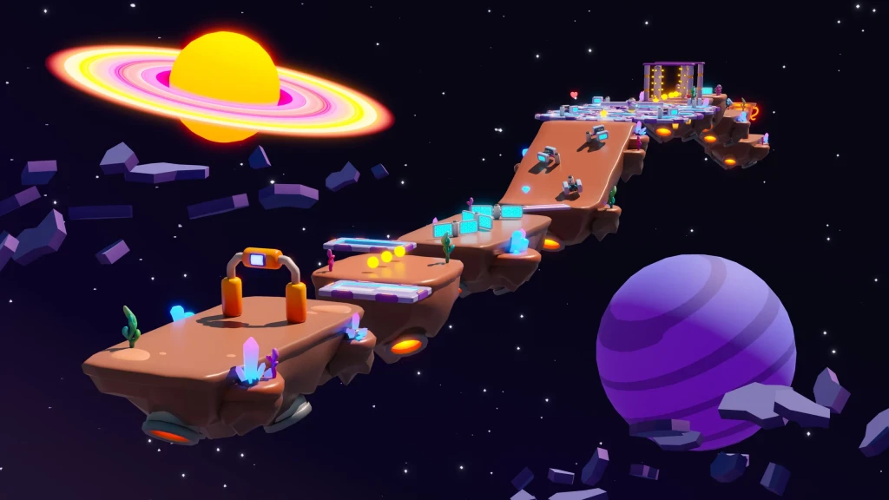
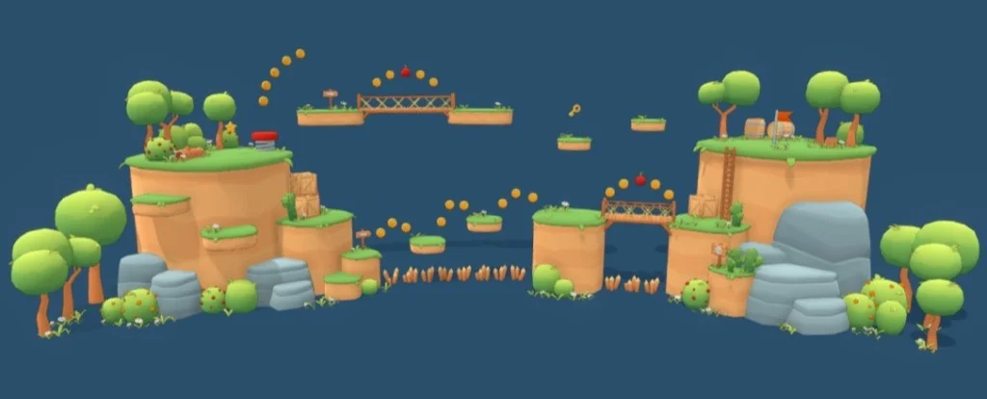
Environmental Art and props
As I wanted the game to have a similar low poly style the that of other 3D platformers such as “Super Mario Galaxy” (Super Mario Galaxy, 2007) or “Astrobot” (Astrobot, 2024), I needed to find art assets that were cartoonish or low poly.
​
I managed to find two great asset packs, that fit the style perfectly:
​
​
​
"joaobaltieri - Lowpoly Platformer Kit (Asset Pack)"
​
​
"itHappy Studios - Platformer 11 Space"

Slide 28
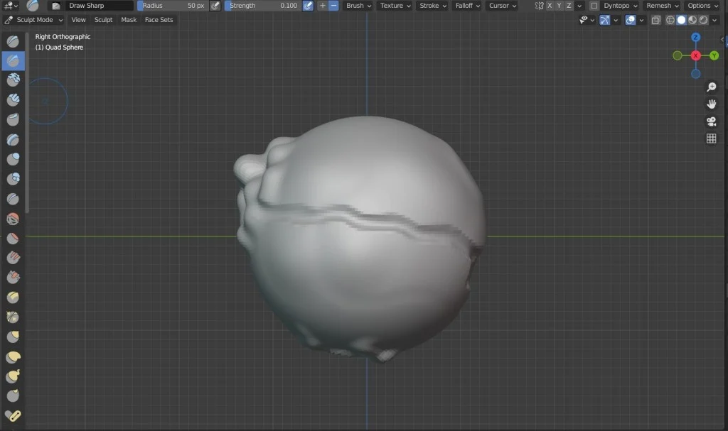
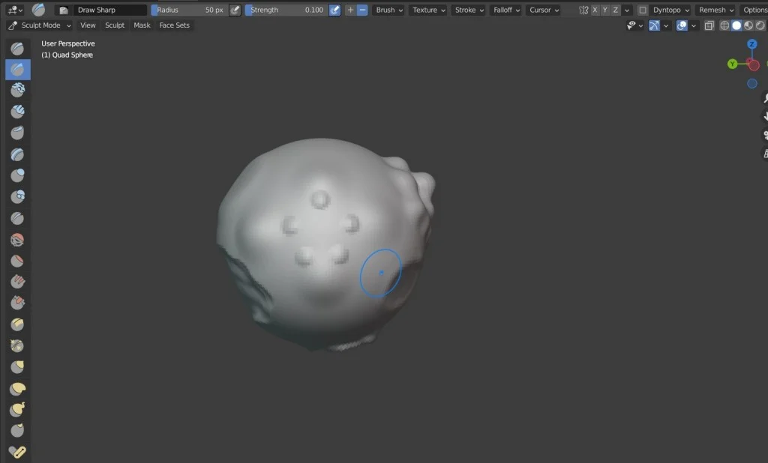
4d. Hub Plant blockout
With design document, design iterations and assets, I was ready to start blocking out in Unreal Engine.
I first creating a planet model in blender for the hub planet.

Slide 29

4e. Gravity system
Using the “custom gravity” function that was updated into Unreal Engine 5.4 (Epic Games, 2024), I started to create the planetary gravity system.

Slide 30
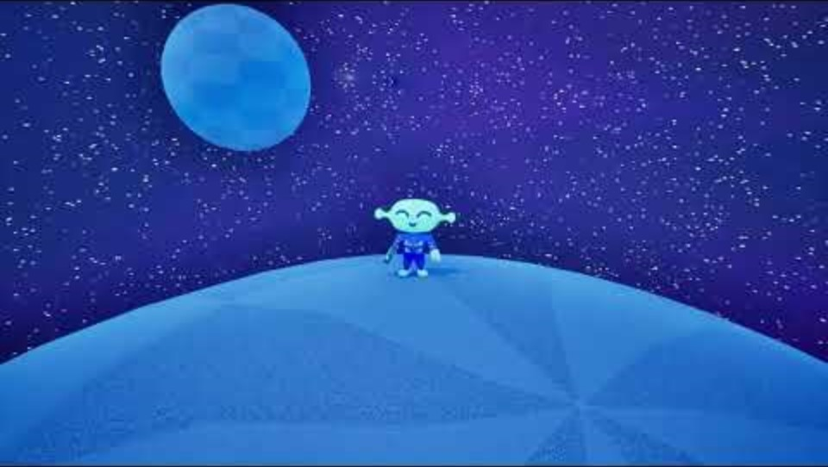
Using interpolation as well as adjusting the camera lag and rotation speed, I managed to make the camera movement smoother when hopping from one planet to another.
This small adjustment, effectively eliminated any potential motion sickness and felt much nicer to transitions to other planets.

Slide 31
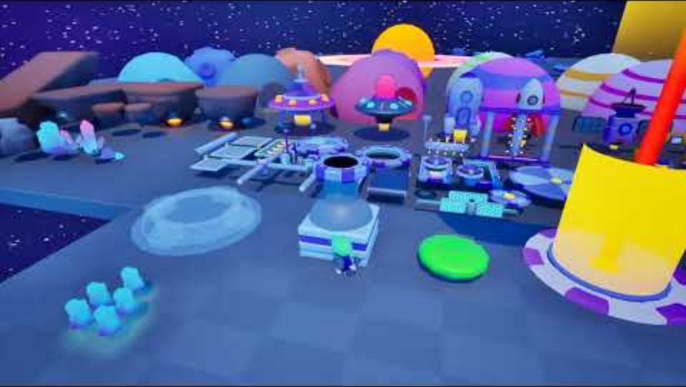
4f. Further systems
In order to have a playable gameplay loop, I created a variety of systems, such as buildable contraptions, gravity manipulators, moving platforms and hazards.
With these systems now in place, I could move on to creating a gameplay loop within the engine.

Slide 32
4g. Finishing hub planet
With the systems functional, I could now focus on set dressing the hub planet, with the sourced assets. (Hopefully these gifs actually play, next slide)

Slide 33
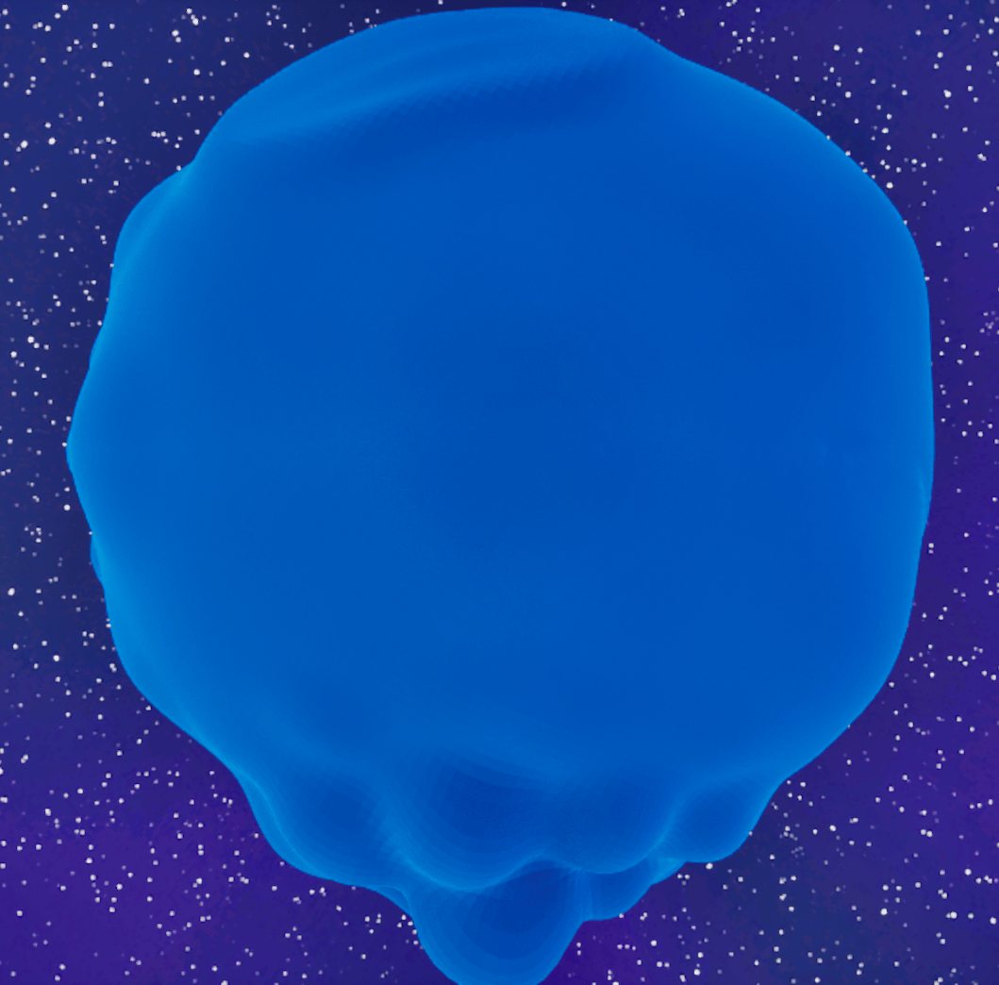
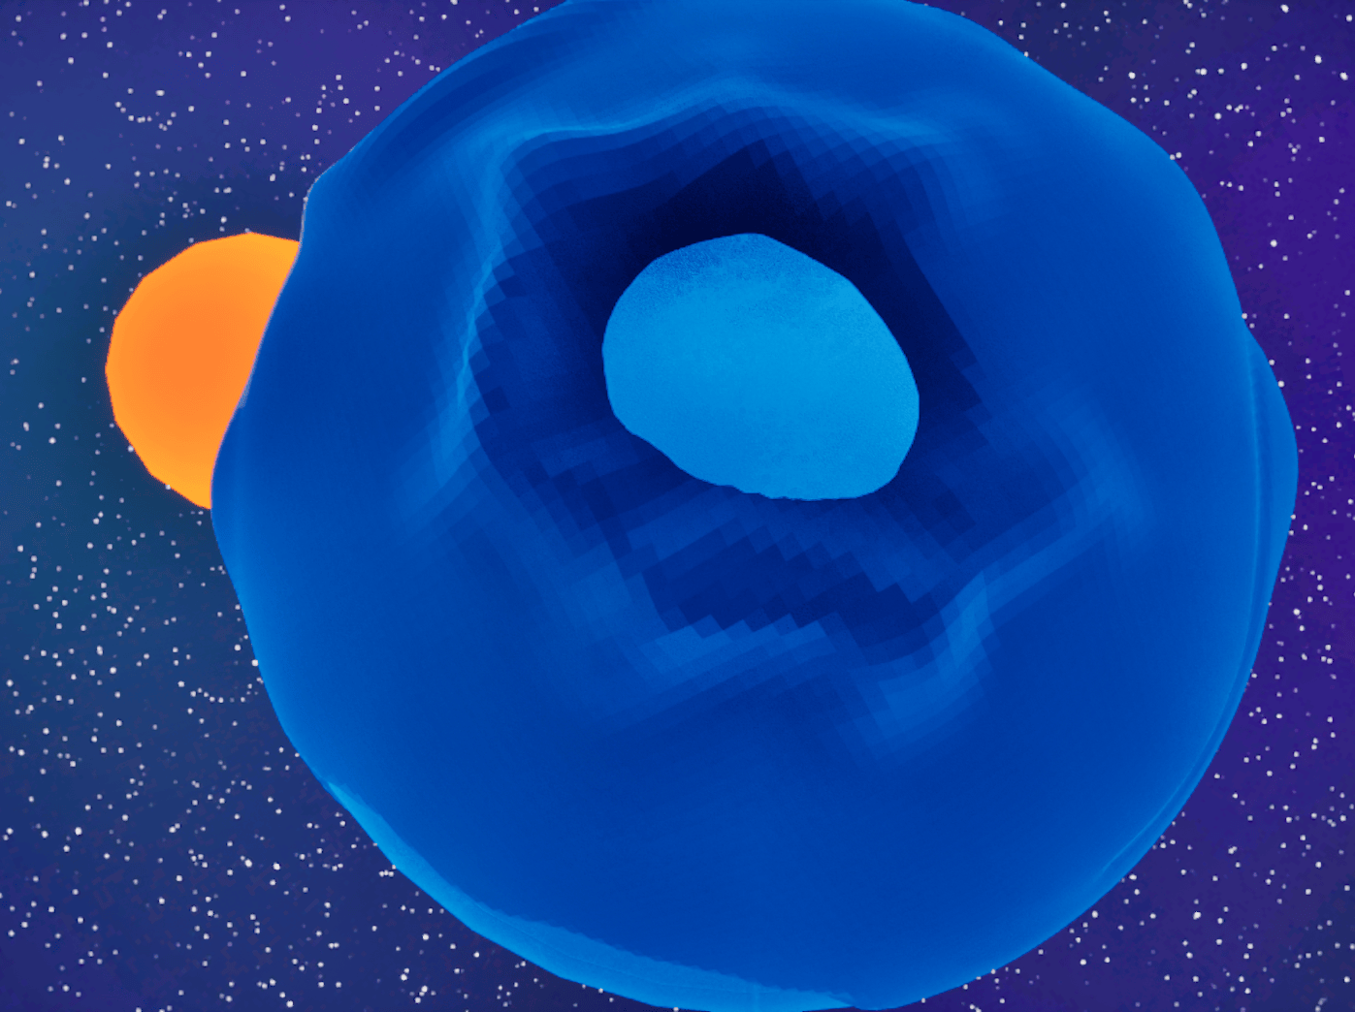
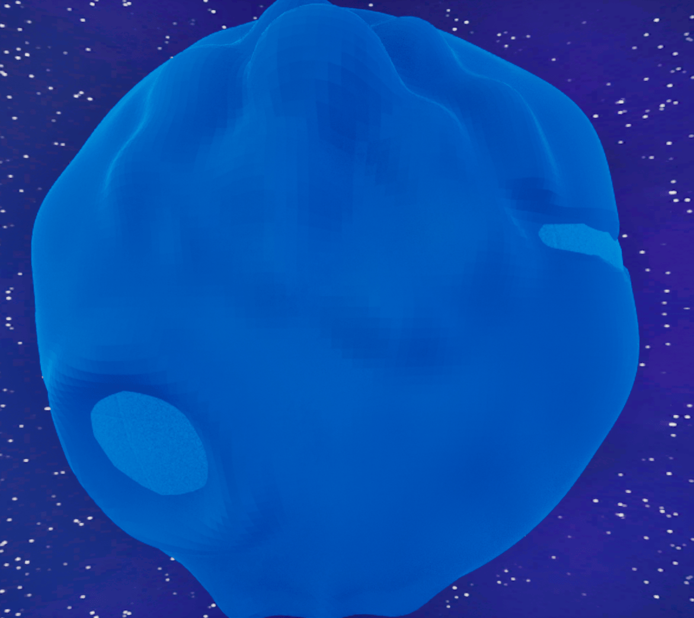
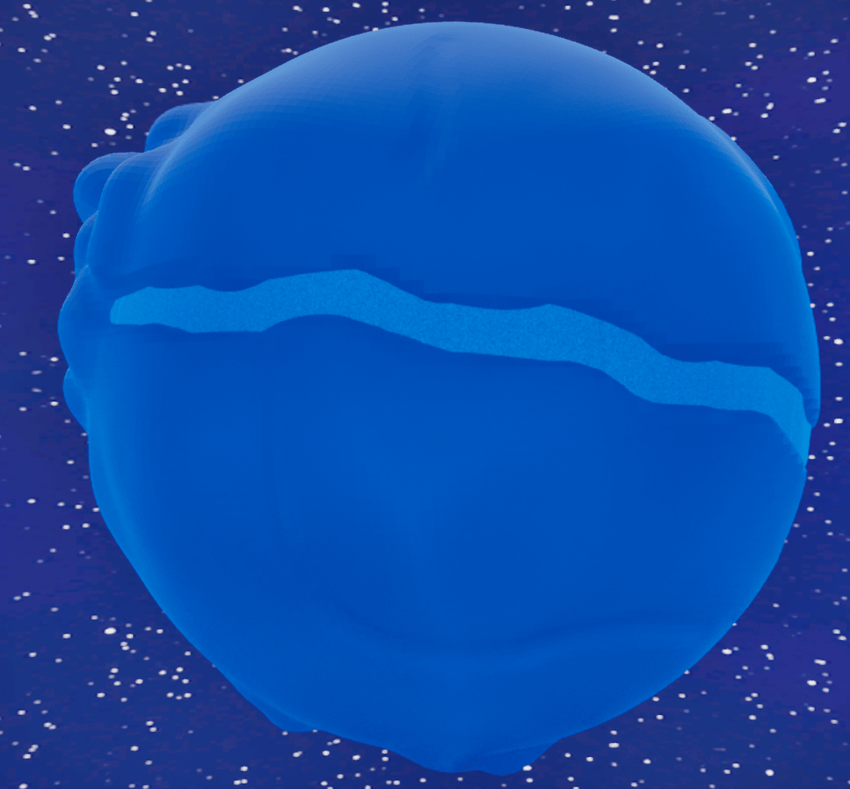
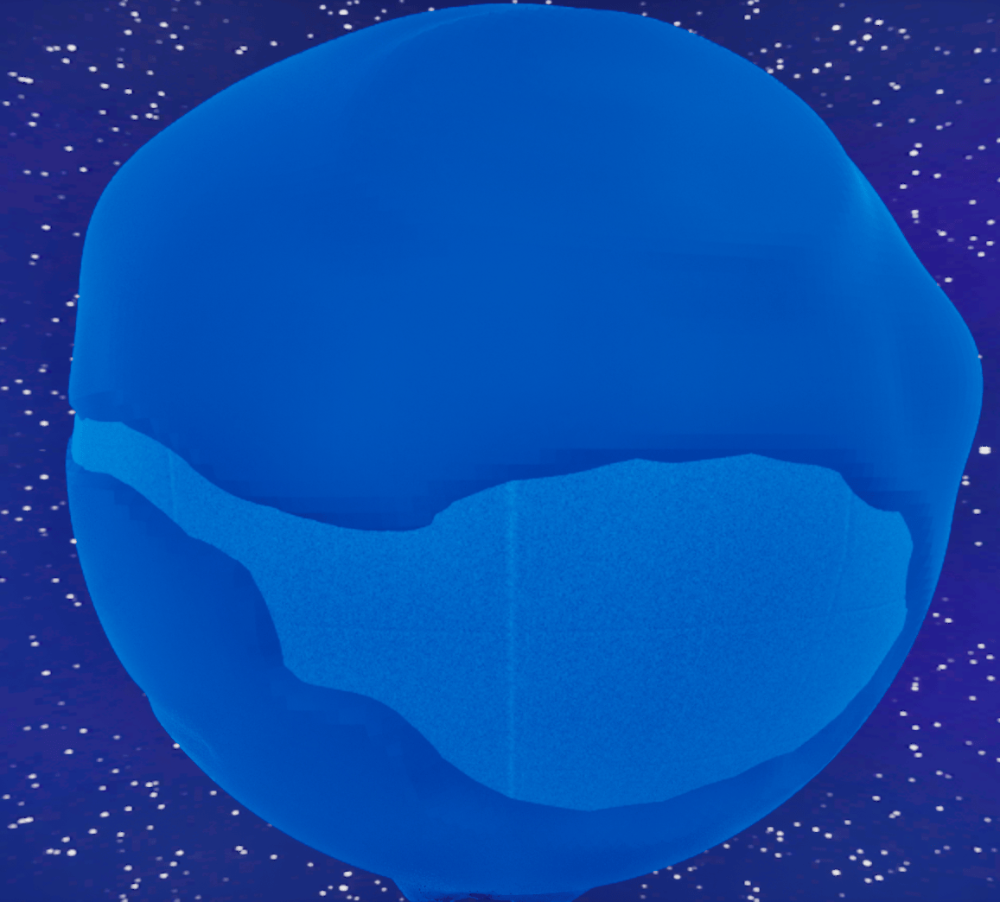
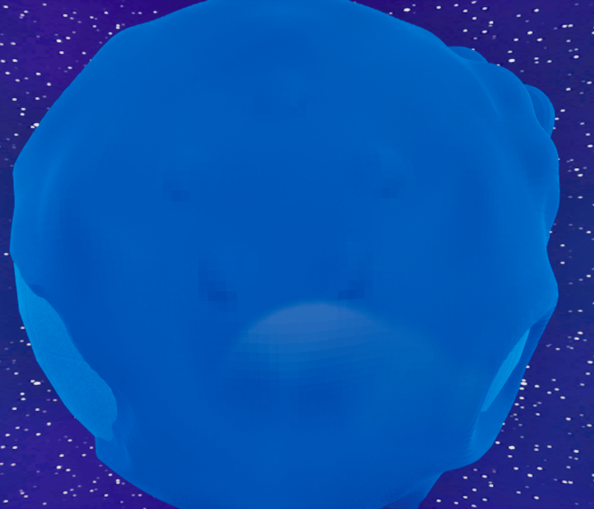

Slide 34
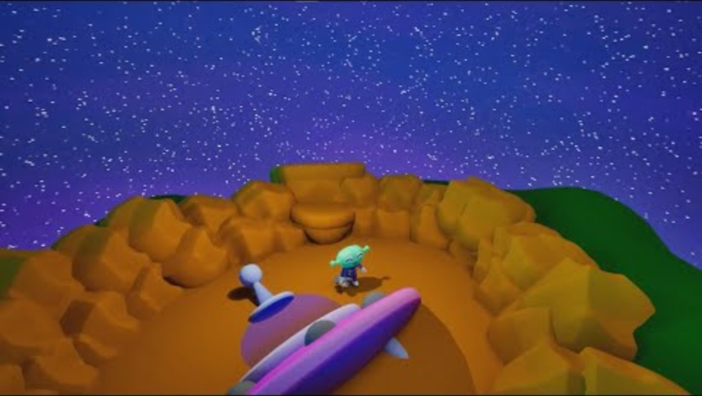
4h. hub planet Demo
Starting at the crash site, the player has no way out unless they jump. This quickly teaches the player to use an essential mechanic, very early.
The cobbled path is used to direct the player to the observation deck, where they can build a new space ship. The Hub Planet contains 1 of 5 Star Crystals, they need to use to build the ship. The smaller crystals can be used to build the contraptions that transition the player to each of the 4 spokes.
Currently this hub iteration feels like it is in a near finished state, perhaps requiring some more affordance and tutorialisation to aid the player. The hub planet has a good cosy feel, with a garden, earth like aesthetic, as well as lots of space for the player to move around and familiarise themselves with the controls.

Slide 35
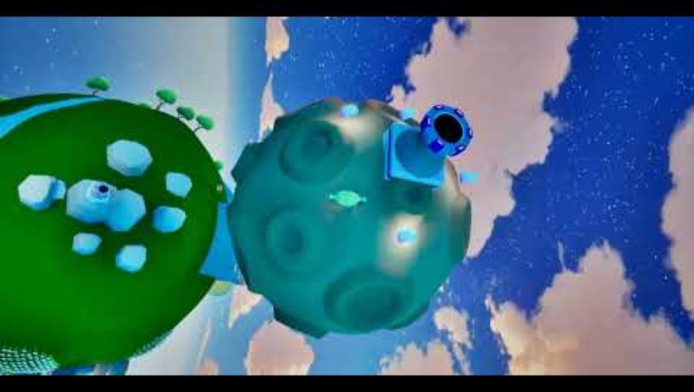
4I. hub to Spoke transition
Here is a short video demonstrating the working hub to spoke transition.
I was able to fix the gravity bug so that the player can now properly move outside of the hub's planetary gravity, onto a nearby moon and then back down onto the spoke with conventional downwards gravity for platforming.

Slide 36
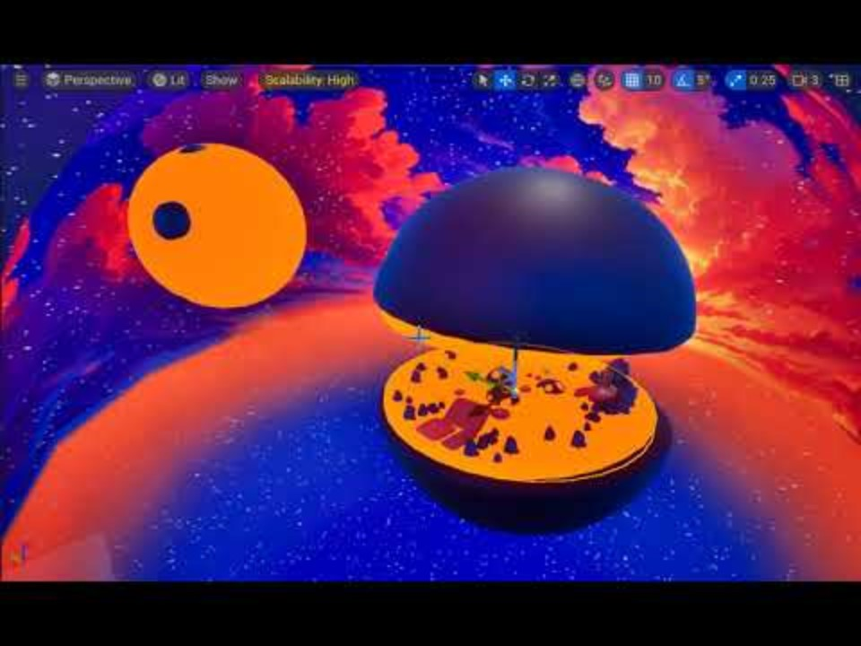
4K. Lava Planet iteration 1
I have decided to scrap what little progress I had made on the first spoke blockout and started again. After speaking with my supervisor in the last meeting, we both agreed that the blockout was far too static.
To increase the difficulty and liven the level up a bit, I have added some moving and rotating platforms the player must traverse, to avoid the lava. This is is only half finished, as I intend for the other half of the level to take place on the top half of the planet, after the gravity has flipped.

Slide 37
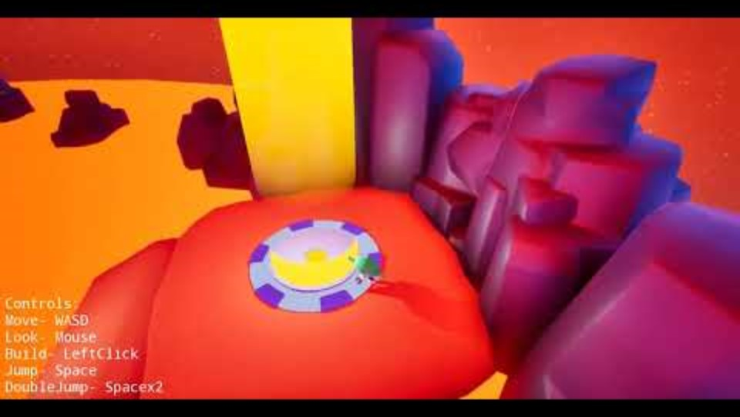
4L. Lava Planet Iteration 2
Here is the revised lava planet that now contains the second half of the level and is ready for playtesting.

Slide 38
4m. Initial playtest results
Through playtesting it was made immediately obvious there were issues such as:
Lack of tutorialisation. (The player needed guidance on the objective and some mechanics.)
No UI (It was impossible to tell how much health the player had left without a healthbar.)
Lack of precision with movement (Platforming was very difficult on keyboard and mouse)
No checkpoints (The player died often and restarting made the experience frustrating)
The positives were that:
The aesthetic overall was unique and interesting
The gravity mechanic provided a fun twist, connecting different sections of the level.

Slide 39
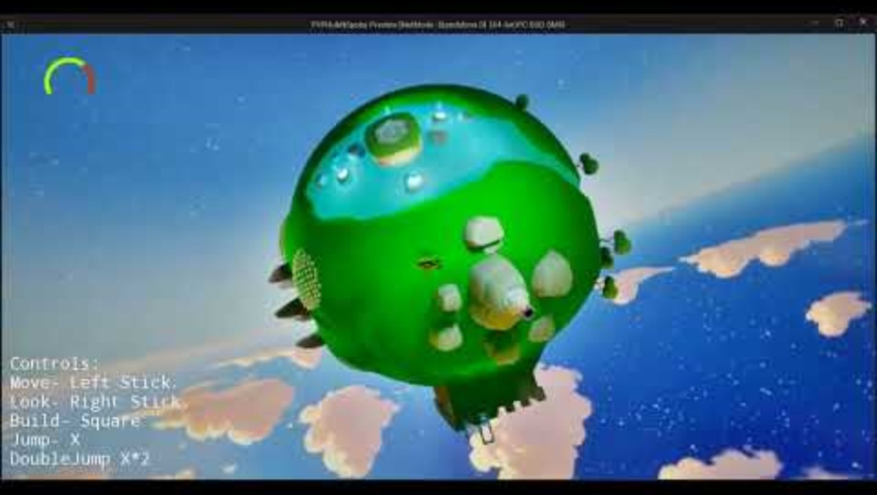
4n. Hub To spoke complete loop
After receiving feedback from playtesting, I decided to make the lava planet much easier by switching the input from mouse and keyboard to controller. Following the advice of my supervisor I also removed the fast platforms as well as making the rotating platforms much larger and colour coding the falling platforms.
The platforming feels much smoother and easier to control now using my PS5 controller. However the performance seems to be quite terrible, which impacted the gameplay causing me to miss a few jumps. This may be since I had updated the engine from 5.4 to 5.6, where the lighting system was changed completely. I need to spend some time fixing the lighting and hopefully that will solve the performance issue.
Here is a video demonstrating a full loop from the starting hub planet to the lava planet and back to the hub planet again.

Slide 40
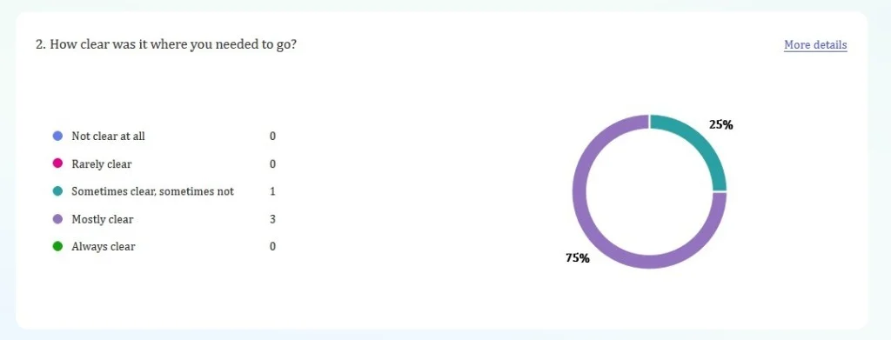
4o. Further Playtesting
Clarity
It seems that it was mostly clear where the player had to go, perhaps through affordance. However, I think this question was badly phrased as it doesn't necessarily mean the objective was clear, just the destination. Next time I will word these questions with far more specificity.

Slide 41
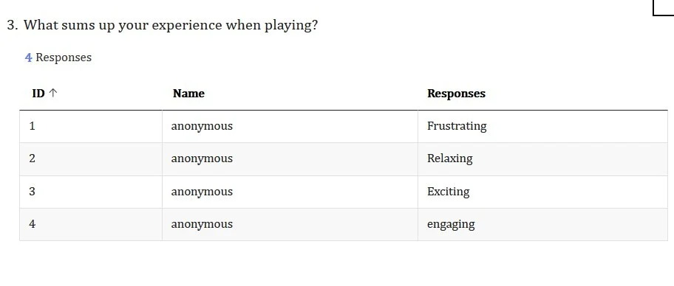
Player Experience
Most players seemed to enjoy their experience based on this feedback, varying from relaxing to exciting depending on the player. The player who submitted frustrating was my very first playtester from last week, the reason they may have found it frustrating was because the lava planet was far too difficult and the game still used mouse and keyboard controls. I have since iterated on this original feedback which is probably why the second round of playtesters had a more enjoyable experience.

Slide 42
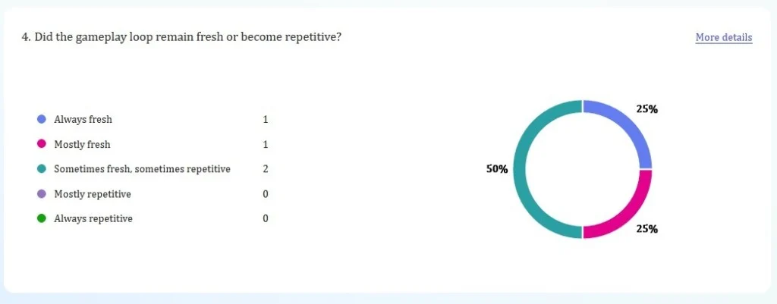
Gameplay Loop
These results seem mixed as half said that the gameplay loop was mostly fresh whereas the other half said it was sometimes fresh. This may be since I used the cannon twice in a row and that the pickups on the hub are not very interesting. I might remove the second cannon right after the first and tutorialise the hub area so that it is both easier to understand and more engaging.

Slide 43
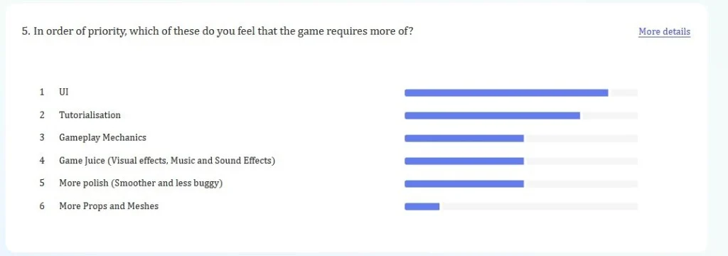
Priorities
UI and tutorialisation are not surprising as the game lacks both of those however it is encouraging that those are the priorities at this stage. This means that there is nothing fundamentally wrong with the gameplay loop, which allows me to focus on polishing the game and incorporating UI and a tutorial. These two elements are often left to the later stage of development, at least for my projects, so I am glad that players suggested these. More game mechanics, Juice and bug fixing are all tied meaning they still have some importance but not nearly as much as UI and Tutorialisation. Props and meshes was left dead last, which makes sense because the game does look pretty. (Although I cant take too much credit for that as I did source most of the assets except for the hub planet terrain and player model.)

Slide 44
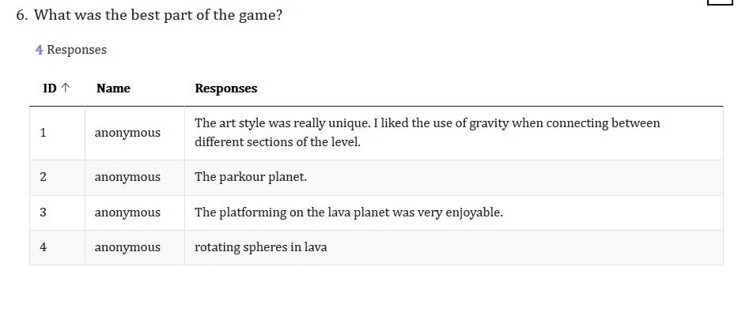
The Best
Other than the first playtester, who unfortunately had to suffer the old version of the lava planet, the playtesters seemed to enjoy the lava planet are the most. This is very encouraging to hear as this is where most of the gameplay takes place and is effectively the first level/spoke. Whereas the hub serves as more of a safe area the player can return to, after beating a level.

Slide 45
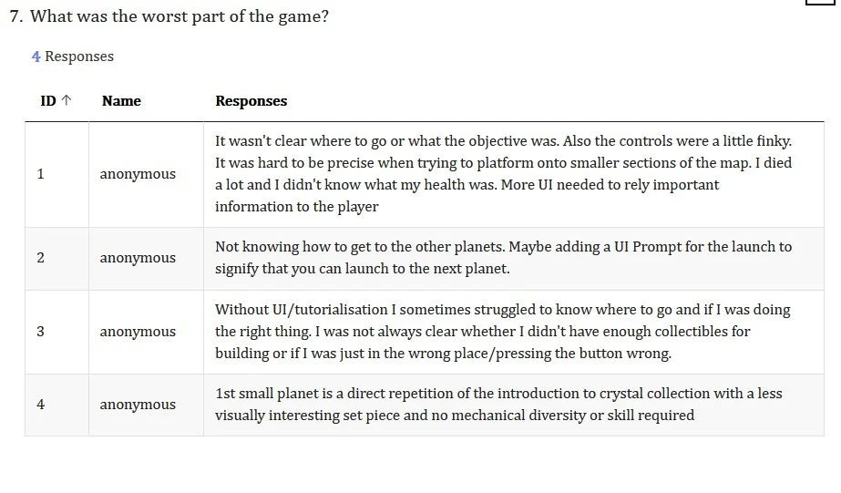
The Worst
Unsurprisingly, the lack of UI and tutorial was overwhelmingly seen as the worst part of the game. Playtesters didn't know what the objective was, without guidance and with the non-linear aspect of the starting hub planet, this made the problem worse. My supervisor suggested that the player starts on a smaller planet before they get to the hub, as the hub can feel overwhelming for a new player.

Slide 46
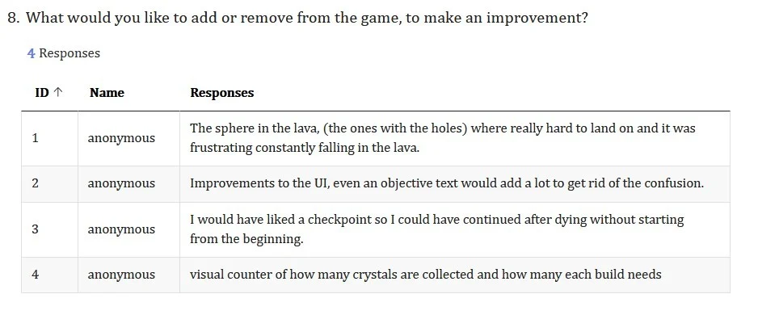
Suggestions
The first criticism had already been addressed as I have since iterated on the lava planet. Objective and crystal counter UI were good suggestions as it allows the player to keep track of their progress and guides them in the right direction. A good checkpoint system is a must and is something I have neglected due to the fact that I am very good at my own game but obviously as the developer I am used to it, for new players, the game will be far too difficult without a checkpoint. This is probably why only half the players managed to get to the end.

Slide 47
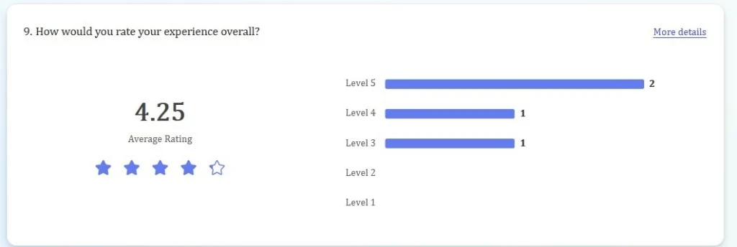
Rating
Overall the end rating is quite good. Still in need of some improvement though. I feel that what I have here has good foundations and a solid gameplay loop. I really just need to focus on polish, so that any bugs or lack of UI and tutorialisation doesn't tarnish the experience.

Slide 48
Rating
Overall the end rating is quite good. Still in need of some improvement though. I feel that what I have here has good foundations and a solid gameplay loop. I really just need to focus on polish, so that any bugs or lack of UI and tutorialisation doesn't tarnish the experience.

Slide 49
Final Artefact

Slide 50
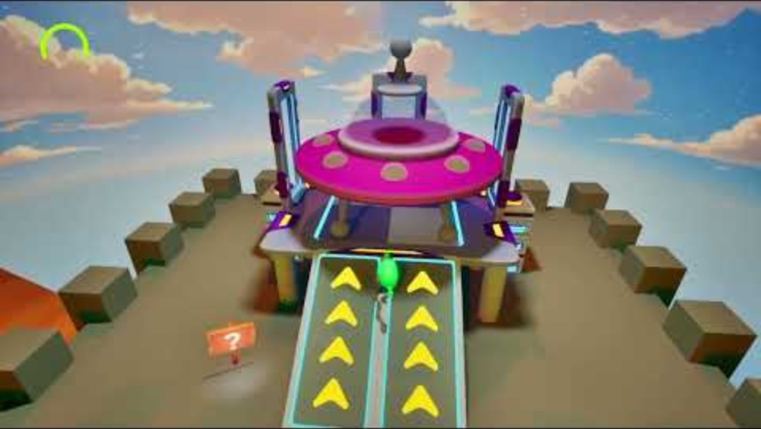
5a. Final artefact playthrough
Here is a playthrough of my final artefact. I have attempted to address the issues brought up by the playtesters, such as adding more UI and tutorialisation.
Now there are signs placed around to guide the player, when the start on the hub.
Also, I added music changes so that each area feels different as well as hiding the skybox from the other planets when they are far away.

Slide 51
Evaluative Review

Slide 52
6a. Final reflection and artefact analysis
From the start I wanted to create an experience that was inspired by my childhood self playing the games I love. Super Mario Galaxy was and is the best game I have ever played, so I have taken very heavy inspiration from that, to create my own project.
I started by experimenting with the custom gravity, that was introduced into Unreal Engine in 5.4. This was tricky to implement at first and I had problems with the camera. With some tinkering I managed to get the gravity working to a point where the transitions between planets felt smooth, although it still needs some more refining.
Ultimately, I am disappointed with myself that I couldn’t create 3 for even 2 fully functioning spokes. This would have massively aided the hub and spoke level as the player would be able to choose which spoke to traverse to , in whatever order they like. Only having one functioning spoke, hampers the non-linear design intent quite a bit. Although, the hub planet does still feel non-linear, only having one path to choose from is ultimately a linear experience.
Still, there are things that I am proud of in this project. There are no major bugs (that I know of) and the playtesters seemed to really enjoy what they played. The custom gravity is not flawless, but it does work quite work in creating a planetary gravity system. I originally intended for the player to hop from one planet to the next and I feel that the end artefact creates that experience quite well.

Slide 53
Overall, I think the gameplay loop is solid for what is there and simply needs some more fresh mechanics and spokes to keep the gameplay loop fresh. Some polish would also aid the experience, although I implemented UI, it is still quite lacking and doesn’t really have any style. I am also aware that collecting pickups is not that interesting after a while. My original intention was to have a new hazard or secondary mechanic for each spoke that would freshen things up. I standby the building mechanic though, as it adds a secondary gameplay loop on top of the platforming and offers a sort of mid-term progression.
For next time, or whenever I have the time to further this work on this project, which I am very likely to do. There are a few things I would to implement.
Proper checkpoints will be necessary for a hub and spoke level, as dying and being reset to the beginning is too old school for most people. I was able to get away with this as the gameplay is only 3-5 mins long and currently very easy but with more spokes and more difficulty, checkpoints are a must.
A menu as well as proper UI would be nice to implement in the future as well, as it adds to the polish and makes the game experience feel more complete as a whole.
Lastly, enemies. I shied away from enemies, other than hazards, as I was worried about the nightmare of having to get AI to work on spherical planets with planetary gravity. I never really attempted this though, so I am not actually sure how difficult of not this would be to implement. In the future, it’s a challenge I definitely want to attempt.

Slide 54
That’s all, thank you and goodbye

Slide 55
Bibliography
Super Mario Galaxy. (2007). Wii [Game]. Kyoto, Japan: Nintendo.
Astrobot. (2024). PS5[Game]. Tokyo, Japan: Sony.
Epic Games Developer. (2024). Custom Gravity in UE 5.4 | Tutorial. [online] Available at: https://dev.epicgames.com/community/learning/tutorials/w6l7/unreal-engine-custom-gravity-in-ue-5-4.
Freesound (2012). Freesound. [online] Freesound.org. Available at: https://freesound.org/.

