Slide 1
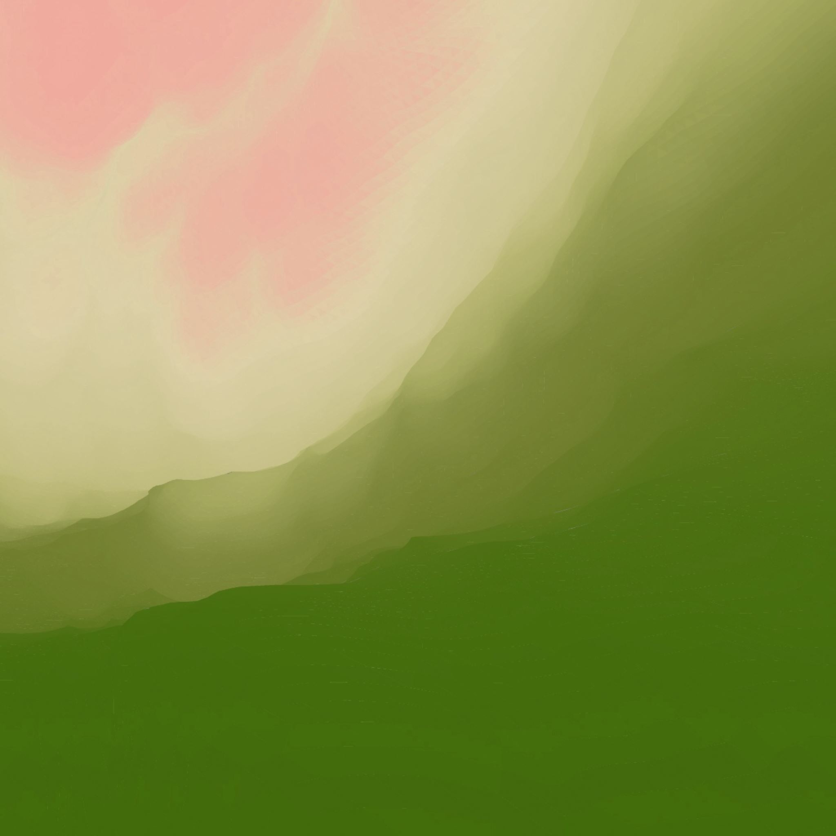
Zombie SRPG
Artifact Development Report by Alfie Cordon

Slide 2
Introduction

Slide 3
Introduction to the Problem
Games in the RPG genre often have some of the most in-depth and emotionally effective narratives of any game. However, oftentimes the way these stories are told can feel alienating or unengaging to some players. Battles will often begin or end with lengthy cutscenes where the player has nothing to do but sit and watch as the characters talk. While I personally enjoy cutscenes, I have met many players who hate them or have become uninterested in the RPG genre altogether because of how prevalent they are.
With this project I plan to explore alternative methods of conveying a narrative in an SRPG level. I will be using techniques such as environmental storytelling and encounter design to tell a simple story throughout the level that can be understood without interrupting gameplay for long dialogue scenes.
By creating a project like this, I hope to create an SRPG game that is still enjoyable for players who are more interested in the gameplay than the narrative, while still allowing players who enjoy a well thought out story to get the experience they want.

Slide 4
Aims, Objectives and Deliverables

Slide 5
Aims and Objectives
The aim of this project is to create an SRPG level that can convey a short, simple narrative without using cutscenes that interrupt the gameplay. My intent is to be able to use this project as an important portfolio piece, so it will need to be of a professional standard with a high level of polish.
In order to create this, I will need to create
A simple combat system inspired by existing SRPG games, such as Pokémon Conquest (Tecmo Koei, 2012) and the Fire Emblem (Intelligent Systems and Nintendo, 1990) series.
2 different playable characters with different abilities to represent the two main characters in combat encounters.
A plan for a narrative that can be understood just by playing the level, with minimal additional explanation from outside the game. This narrative should also avoid being intrusive to the gameplay experience.

Slide 6
Deliverables – What I’m Making
The deliverable for this project will be a short game made in the SRPG genre. This game will consist of a single level. The aim is for the level to be around 5-10 minutes long, although this is not a set in stone limitation.

Slide 7
Research Methodology

Slide 8
Research Method
The main approach I intend to take towards gathering data is the use of questionnaires, as this will allow me to record both quantitative and qualitative information from playtesters. I plan to have players test the game at multiple points throughout development and then answer a short questionnaire about their experience. Many of the questions asked will be focused on asking the playtesters about the narrative of the level and if it was successfully conveyed, as well as its emotional impact.
Alongside this, I will be using various books and games as part of my research in order to inform my solution. The books I intend to read will focus on both level and narrative design, as both will be important for creating a strong solution to my problem. The games I will look at will include various existing SRPG games, as well as games in other genres that have made use of the techniques I plan to use in my solution.

Slide 9
Judging Success
I plan to be present during the playtesting so that I can watch how each player approaches the level. If the player gets lost or is confused about how any mechanics work, then I may try to help them, although I will keep intervention like this to a minimum. However, I will avoid pointing out any specific narrative details, especially in the environment and encounters. If a player misses anything during their playthrough, then that will be a sign that my solution can be improved by making that specific narrative beat clearer.
One way I intend to analyse the data I receive from my testing will be to create emotion and intensity charts. This is a process that I learned about in my literature review that was used in the development of Mass Effect 3 (Bioware, 2012). It involves creating charts that lay out the intended level of intensity of each section of the level, as well as the emotions I want each section to invoke.
Once I create these, I can use my questionnaire to ask players which areas of the level they found to be most intense, as well as the emotions they felt while playing through each part. I can then compare this data to the charts I make to see if the level is having the intended emotional impact. If the results of the questionnaire closely match the charts, that would be a good indicator that my solution is working.

Slide 10
Development

Slide 11
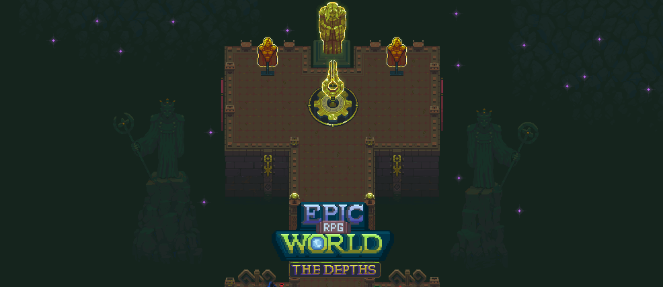
Asset Selection
One of the most significant decisions I had to make when beginning development of my project was also the first one I made. The assets that I chose to use for the game influenced almost all my future decisions about both the narrative and systems of my game.
As I lacked the skills with art and animation required to create my own assets for the game, I used Itch.io to look at existing assets that I could utilize. I was specifically looking for a pack that both had a theme that could inspire an interesting story for the game, as well as one that had enough different assets to not limit what I could do with environmental storytelling.
An alternate asset pack I considered but ultimately decided against, called Epic RPG World by RafaelMatos.

Slide 12
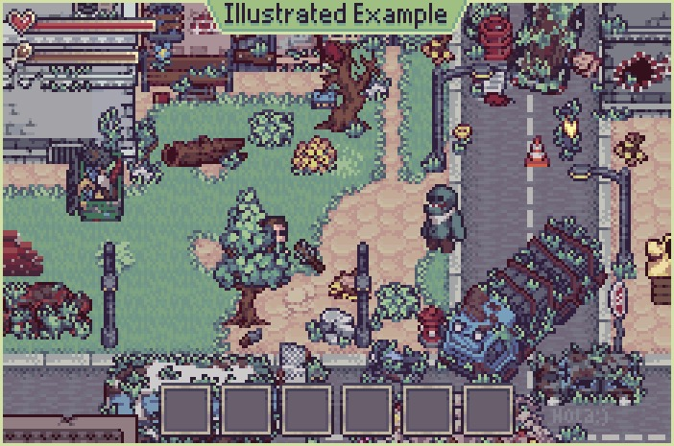
Asset Selection
After looking through many of the assets on offer, I found myself gravitating towards those that featured a post-apocalyptic setting. Eventually I settled on this pack, which I felt fit my needs perfectly.
The example images shown on the Itch.io page showed the assets used in a traditional 2D level; however I was struggling to replicate this in a way that looked right. My research into existing SRPG games had led me to Octopath Traveller (Square Enix and Acquire, 2018) quite quickly, and I found its 2.5D visual style incredibly memorable. Replicating that style was very time-consuming compared to if I had just used fully flat tile maps, but looking at the final product, I feel it was worth the effort.
Post-Apocalypse Pixel Art by TheLazyStone

Slide 13
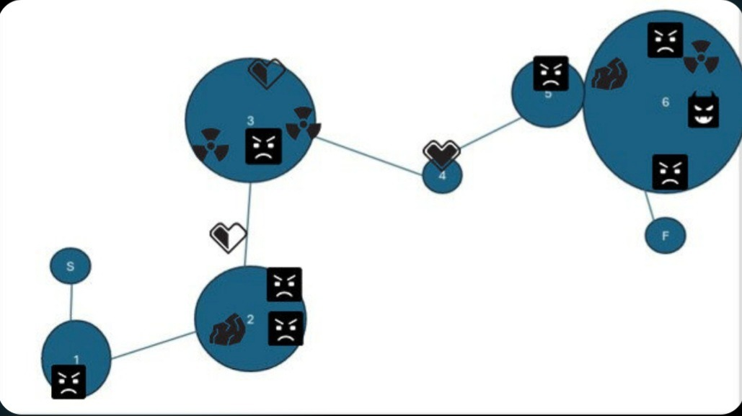
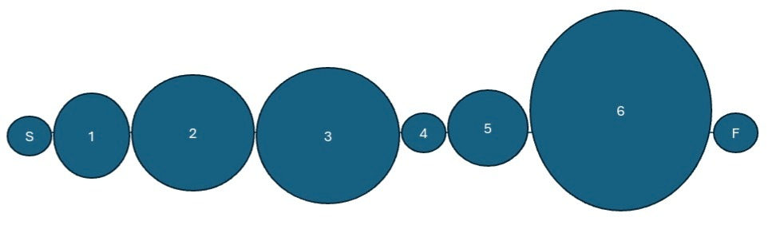
Level Design - Overview
One book I read during my research was Michael Beardwood’s Fundamental Level Design and Analysis: A to B (Beardwood, 2025). In this book I found the concept of Bubble Maps, a way of laying out a level using simple shapes. Each circle (or ‘bubble’) shows a different section of the level, with the size of the circle showing the relative intensity of that section and the distance between each one showing the relative time taken between each section.
While this iteration of the Bubble Maps would've made for an interesting level, I quickly found that it was unhelpful as a solution to the problem I had set out to tackle. The main problem was that I was trying to plan out the level before having a clear idea of the narrative. I had some general ideas in mind, but not a concrete picture of what the story beats were and how the player would go from one to the next.

Slide 14
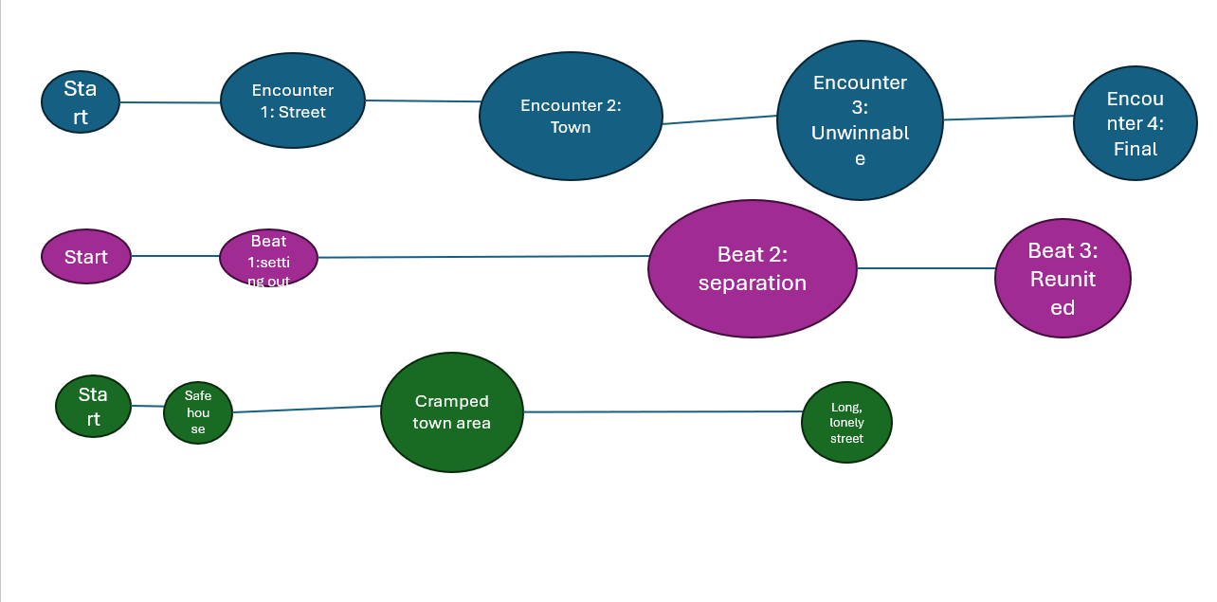
Level Design - Overview
In order for my solution to be effective, the narrative had to inform the level design, not the other way around. This led me to create this second version of the Bubble Map, which Michael Beardwood calls a Cascading Bubble Map. Here I am not only planning out the enemy encounters, but the narrative beats and locations as well.

Slide 15
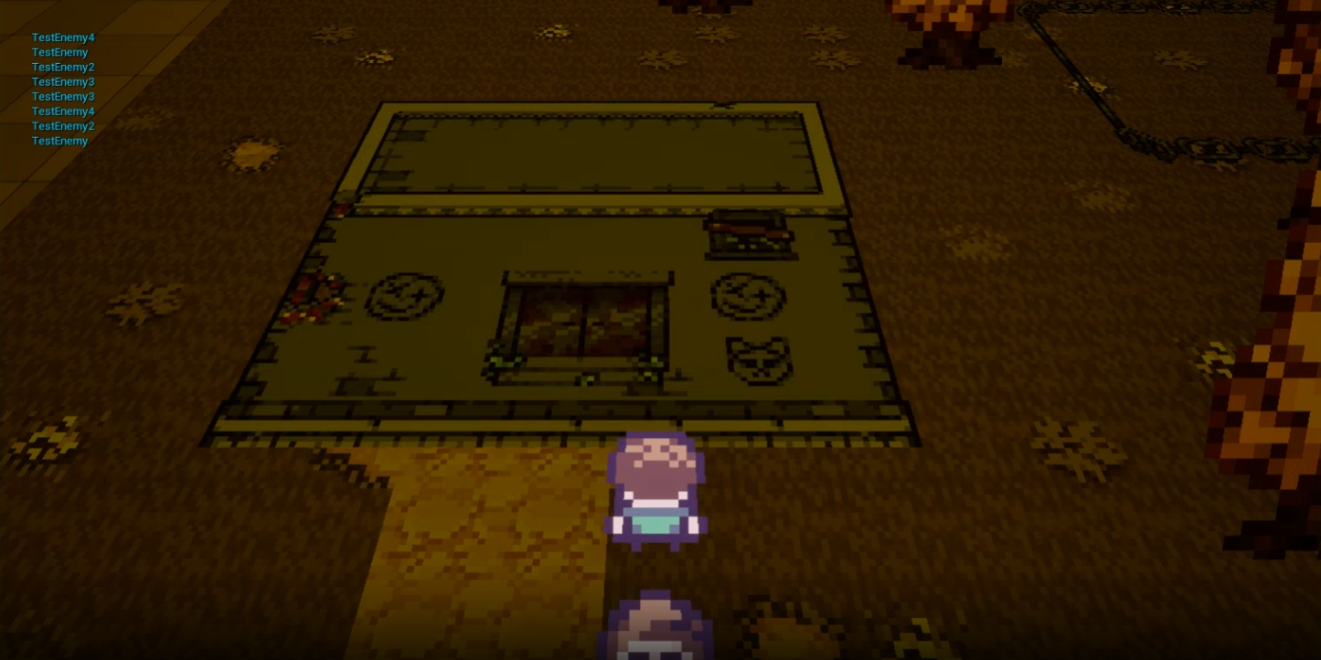
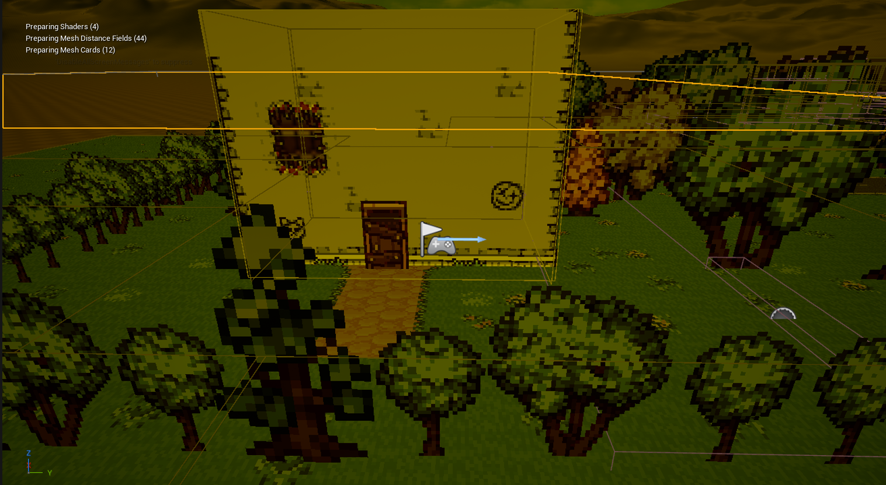
Level Design – Section by Section
With the bubble maps I had made giving me a much clearer vision of what the level would look like, and how the narrative would be conveyed to the player, I started to home in on specific sections of the level to ensure that they got across the emotions that I was looking for.
One section I felt was particularly important was the safe house at the beginning. For the first section of my level, I wanted the game to open in an area that made the player feel safe. I did this by using brighter, green scenery compared to the rest of the level that gradually fades out into less inviting browns and reds. The first version of this section wasn’t received well, and didn’t have the desired effect for playtesters, with one saying it was “a derelict area, pretty dark and grimy”.

Slide 16
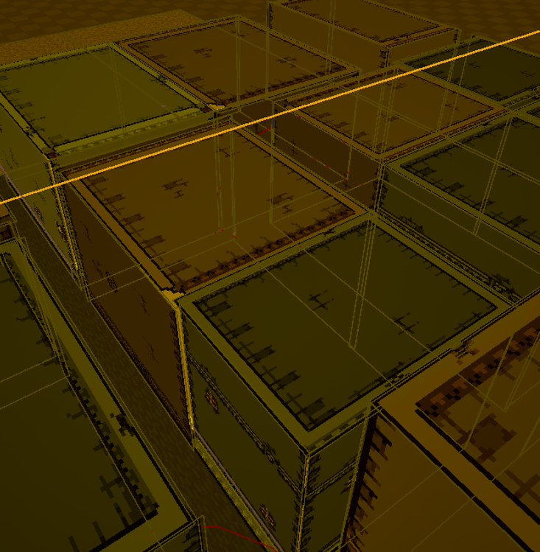
Level Design – Section by Section
Another section of the level that I put speficic attention into was the city area right before the second enemy encounter. I wanted this area to feel oppressive and dangerous, adding more tension to the level. For this section, the player is surrounded by tall buildings and confined to narrow pathways, creating a claustrophobic atmosphere. I also added some enemies to the overworld that aren’t able to hurt the player, but add to the intensity of the moment.

Slide 17
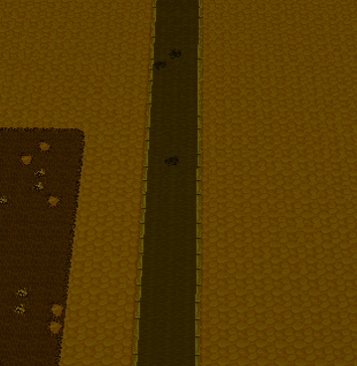
Level Design – Section by Section
The third and final section that I wanted to convey a specific emotion was the walk to the last two encounters. This is the moment in the game where the two main characters separate, and so I wanted the level design to invoke a feeling of loneliness. I tried to do this by creating a long, empty path without much decoration. This creates an emptiness that reflects the character’s isolation in this section.

Slide 18
Combat System
As the narrative and level design of the game were the main focuses of my project, I tried to simplify the SRPG combat system as much as possible. Games in this genre are often notorious for their depth complexity, with incredibly wide possibility spaces.
One game that I was heavily influenced by in the creation of my more basic system was Pokémon Conquest. In this game, each Pokémon has a limited movement range, as well as a single attack that they can perform. Complexity in the game mostly comes from having a team of 6 Pokémon that you build before each fight.
In my project, each of the two characters have two abilities that they can use, with one having abilities that deal damage and the other have a support role. This creates a simple party dynamic like those seen in other RPGs. I had hoped to include other common SRPG mechanics such as elevation and cover, as well as areas of the map with special effects, but these ideas were cut when I scoped the project down.

Slide 19
Encounter Design
The game Hollow Knight (Team Cherry, 2017) was a big inspiration behind the creation of my project. It's a game with a lot of interesting worldbuilding and characters, yet the way all this information is given to the player is quite indirect. Dialogue is limited and often incredibly vague, and cutscenes are practically non-existent.
One moment of narrative design that really stood out for me came in the final boss battle of the game, against the titular Hollow Knight. In this battle, the Knights abilities change throughout as they struggle to battle, but an infection that has corrupted their mind. Another boss battle that uses a similar concept is the Toriel fight at the start of Undertale (Toby Fox, 2015). In this battle, Toriel's attacks change when the player's health gets low, and she starts deliberately missing her attacks, making it near impossible to die. This shows her unwillingness to hurt the protagonist.
Ultimately, it became quite clear quite quickly that my original plans for the project were too large in scope, and it had to be cut down dramatically. One thing that I had to cut from my plans was the boss battle idea. But this setback led me to another idea. The principle of a character’s abilities changing throughout a level or single encounter to show a progression in character could be applied to the player, instead of the enemy.

Slide 20
Encounter Design
This actually worked better than my original idea, as in my narrative, it is the player characters who needed to develop over the game, not the enemies. In my project, one of the characters, the younger brother Cyrus, has his abilities change over the course of the game. In the first two encounters, he serves only as a support character, with two abilities that just help Liam to stay alive and deal more damage.
For the third encounter, Liam fights alone, fearing the battle ahead and not wanting to endanger his brother any further. This encounter is unwinnable, and Liam's movement is slower in the overworld after it, representing him picking up an injury during the fight.
In the final encounter Cyrus is given access to the same shotgun attack that Liam has, allowing him to fight directly. This is meant to show Liam accepting that he needs to let his brother stand on his own instead of just trying to protect him.

Slide 21
Testing Results
I began my testing much later into the project than I would've liked. As narrative integration was the main focus, testing early wouldn't have allowed me to research the areas most relevant to my game.
My first testing results didn't go nearly as well as I had hoped. Of the people I tested with, most were unable to even finish the game let alone understand a narrative. The players felt they lacked direction, and while I tried to point them in the right direction as best I could, it was very clear that there was a fundamental issue with my solution.
After thinking about it more. I decided to go back to some of the games I had researched, to see what I was missing that made them work. The problem, I deduced, was that the player wasn't given any context. They didn't really know who they were or what they were doing. This led not only to confusion during gameplay, but a lack of understanding of the narrative as well. Taking the Toriel fight from Undertale as an example, the fight doesn’t just portray Toriel’s character through the encounter design, but also with short dialogue barks. These barks don’t interrupt the gameplay, as they take just seconds to read, but add a lot in terms of understanding.

Slide 22
Inventory System
The inventory system was my attempt to solve this flaw in my solution. My main inspiration was the enemy guide in Hollow Knight: Silksong (Team Cherry, 2025). In that game, killing a certain number of each enemy will grant the player a note from the protagonist Hornet. Some of these notes provide interesting details about her character and backstory.
The inventory system in my project gives each item a short dialogue exchange from the two main characters. These bits of dialogue give the player more context for the narrative beats, as well as providing more idea of where they need to go, reducing player confusion.
One thing I felt was important to this system was to give it a gameplay purpose, alongside just a narrative one. If the items had no gameplay purpose, then it wouldn’t be an effective part of my solution, as the player would need to keep looking in their inventory and reading the dialogue to understand the story. I added descriptions to the gun items to have an in-game explanation of what they do, as well as creating a bandage item that can be used one during each combat encounter. Unfortunately, I didn’t get to expand on this feature as much as I would have liked, given it was a last-minute addition, but I still feel it adds a lot to the game.

Slide 23
Reflection

Slide 24
Things that went well
Overall, I feel one of the greatest strengths of this project was in the literature review. I spent a lot of time going over various books and games to ensure I created an informed solution to the problem. I feel that this allowed me to come up with innovative ways of conveying the game's narrative. One example of this was my use of encounter design, which was inspired by the battles in Hollow Knight and Undertale. Instead of just using the same idea of having the boss’ abilities change, I was able to come up with something more creative that better fits my project.
I do feel like I have been able to produce at least a somewhat effective solution to the problem I set out to solve. Even though my testing didn’t go very well, I feel that the later addition of the inventory system addresses many of the problems my playtesters had and provides enough additional context to understand the narrative. Crucially, none of this narrative interrupts the core gameplay of the level, which means the player is free to interact with it as much or as little as they wish.

Slide 25
Things that didn’t
One thing that I definitely regret about the way my project turned out is the lack of effective testing. While I did conduct some tests and iterated based on the results, leaving testing too late left me no time to perform a second round of testing. This means that, even though I am confident that the changes I have made have resulted in a much-improved solution to the problem, I lack the data to be able to say this definitively.
Another thing that I wish I had paid more attention to while making this project was tutorialisation. This is something that I mostly overlooked when creating my project, as it wasn’t a core part of my solution and so easily slipped through the cracks when scoping down. However, it made testing the project much more difficult as I had to constantly interject to explain things that players thought were unclear.
Another area that my project falls short in is polish. The game is missing many animations, VFX and has absolutely no sound. While I like the 2.5D visual style I used, compared to the game I based it off, Octopath Traveller, it's clear that my project is somewhat messy and not up to the standard of industry work in this regard. For example, some of the buildings are poorly put together and walls and roofs don’t always line up perfectly. There are also some bugs remaining in the project, especially in the inventory system as it was added so late into development.

Slide 26
Closing thoughts
I wouldn't feel confident adding this project to a portfolio in its current state, but I also don’t think it’s very far away from that level. I plan to do a few more weeks of work on the game at a later date, mostly on animation and VFX, in order to get it up to that level. One area that needs specific attention in this regard is the combat system. I could do this by having a visual pop up before an ability is used showing the range of that ability and which players will be affected by it. This would hopefully help to make combat easier to understand.
In summary, my project was flawed in many ways, but it does achieve what I set out to do and meets the deliverables well. Comparing it to the industry examples I based the game on, such as Pokemon Conquest, my game holds up quite well in many ways, such as its simple but effective combat system and solid narrative design. Polish and tutorialisation are definitely areas that it falls short, but I would still call this at least mostly successful despite that.

Slide 27
Citations
1. Pokémon Conquest. (2012). Nintendo DS[Game]. Tecmo Koei. The Pokémon Company.
2. Fire Emblem: Shadow Dragon and the Blade of Light. (1990). Famicom[Game]. Intelligent Systems and Nintendo.
3. Mass Effect 3. (2012). PC[Game]. Bioware. Electronic Arts.
4. Octopath Traveller. (2018). Nintendo Switch[Game]. Square Enix and Acquire.
5. Fundamental Level Design and Analysis: A to B. (2025). Michael Beardwood.
6. Hollow Knight. (2017). PC[Game]. Team Cherry.
7. Undertale. (2015). PC[Game]. Toby Fox.
8. Hollow Knight: Silksong. (2025). PC[Game]. Team Cherry.

Slide 28
Fin

