Slide 1
Exploring Dynamic Difficulty in a 3D action game
Daniel Whilock
Dissertation Viva

Slide 2
Agenda
Introductions
Aims and Objectives
Literature Review
Research Methodology
Artefact Demonstration
Results and findings
Discussion and Analysis
Conclusion
Recommendations
Questions

Slide 3


Introduction
Difficulty in games are very common, as it’s a way for the player to customise their experience. However, often these levels are static.

Slide 4


Introduction to DDA
This is where Dynamic Difficulty Adjustment(DDA) comes in.
Does DDA improve a player's experience in action games?

Slide 5
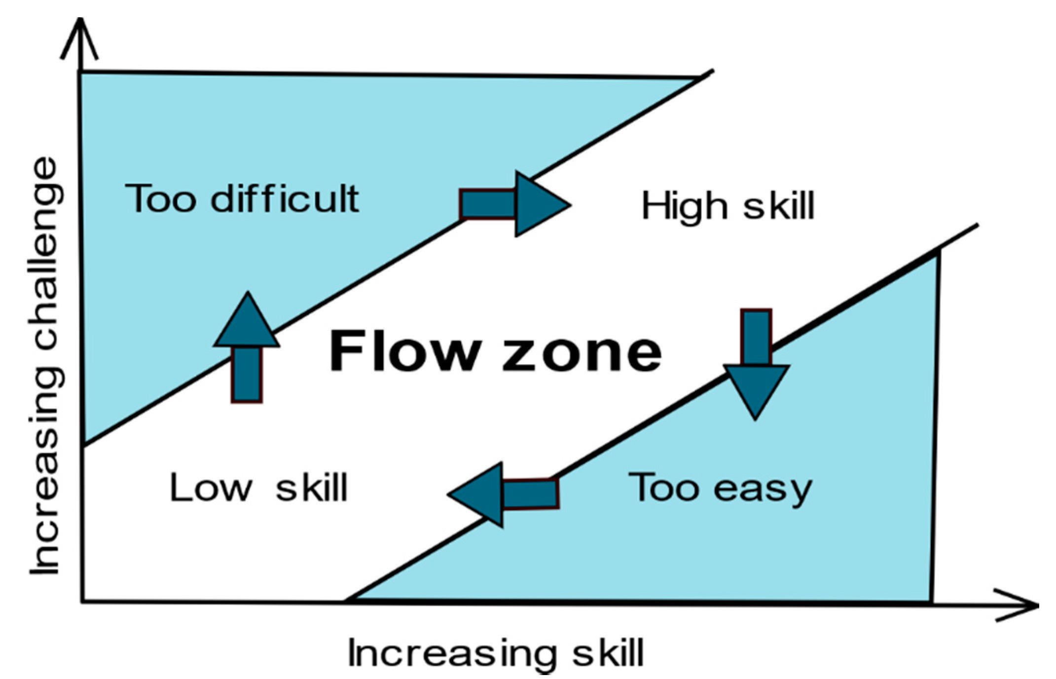
Project Introduction
This project is about exploring DDA, with researching how it’s been done, theories and drawbacks.
Then with a created artefact using that information, to test and compare with a static counterpart.
Theory by Mihaly Csikszentmihalyi
Dissertation Viva

Slide 6
Aims
This project aimed to explore how players will see and interact with an artefact with both DDA and a static system.
Created a successful artefact, using comparisons and research as a basis
Found out how people opinions from comparing static to DDA.
Looked at psychological effects, such as chances of noticing DDA based on start type

Slide 7
Met Objectives
With made objectives used to succeed these aims.
Researched into depth into the different systems and theories of DDA
Applicants tested and submitted forms for the created artefact
Analysis of data collected to study and determine if an aim has been reached

Slide 8



Literature Review
The literature review will consist of research involving:
Dynamic Difficulty in depth
Director system
Enemy behaviour system

Slide 9

Literature Review
Dynamic Difficulty in depth
Stretching skill range in Designing Games , by Tynan Sylvester, 2013:
DDA adapts based on the how the player interacts
DDA works best when the player is not aware of it
Resident evil’s system has a hidden difficulty range of 1 – 10

Slide 10


Literature Review
Dynamic Difficulty in depth
Revolutionizing Communication, Chapter Mario Kart AI in Education, by Kris Alexander and Thoreau Bakker, 2024:
Rubber banding of AI
Players did not enjoy the game not following its rules

Slide 11

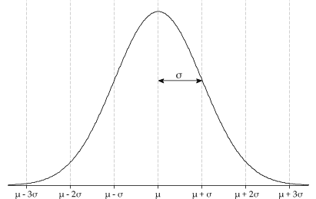


Literature Review
Dynamic Difficulty in depth
The case for dynamic difficulty in games, by Robin Hunicke, 2005:
Worked on their own action game for DDA Analysis
DDA can improve players performance, while still giving the player a sense of accomplishment
Death probability based on Gaussian distribution with enemy damage as a bell curve
Gaussian (Normal) distribution
Cumulative probability
Error Function(Erf)

Slide 12

Literature Review
Director System
Left 4 Dead GDC lecture, Mike Booth, 2009:
Directors will guide the game from monitored player data
Director phases of build up, peak and relax

Slide 13

Literature Review
Director System
Should the monster play fair?, Jaroslav Svelch, 2020:
Alien isolations uses an AI director to give information about the player to the alien
However, this seemed unfair to the player.

Slide 14

Literature Review
Enemy Behaviour system
Reactive Behaviour trees in Game AI uncovered, Sarat Rallabandi and Paul Roberts, 2024:
Behaviour trees can get complex
Reactive behaviour trees consist of smaller behaviours trees inside a stack.
A reactive behaviour tree system uses 2 stacks. Long term and reactive.

Slide 15
Research Methodology - Research
The first step was to use the research from the literature review for a successful artefact

Slide 16
Research Methodology - Feedback
Testers would either play type 1 or type 2 first
Once both types were played, they submitted data into office forms
A balance of qualitative and quantitative, Likert scale and non leading questions
Sample Questions:
What difficulty do you prefer playing on?
Which Type was more difficult?
Type 1/2 felt appropriate and fair for my skill level
Knowing that type 2 had DDA(adjusts the game based on performance), does that change how you feel about type 2?

Slide 17
Research Methodology - Analysis
The last step was to then analyse the gathered feedback
Charts consisting of bar charts, doughnut charts, dot charts and box charts
Comparisons of different questions to identify patterns
Interpreted based on those charts and qualitative answers, looking back to previous research

Slide 18

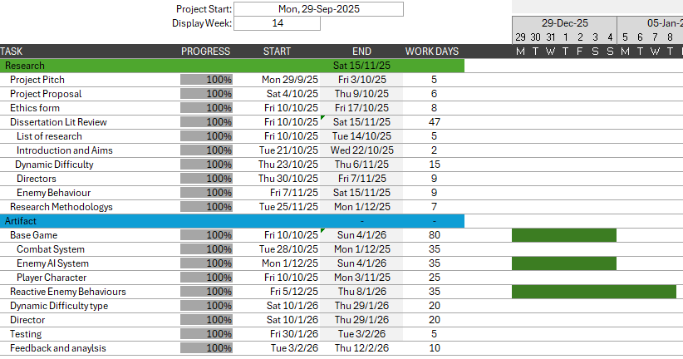
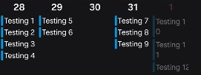
Research Methodology - Organisation
Gannt Charts
Trello
Calendar

Slide 19
Artefact Demonstration

Slide 20
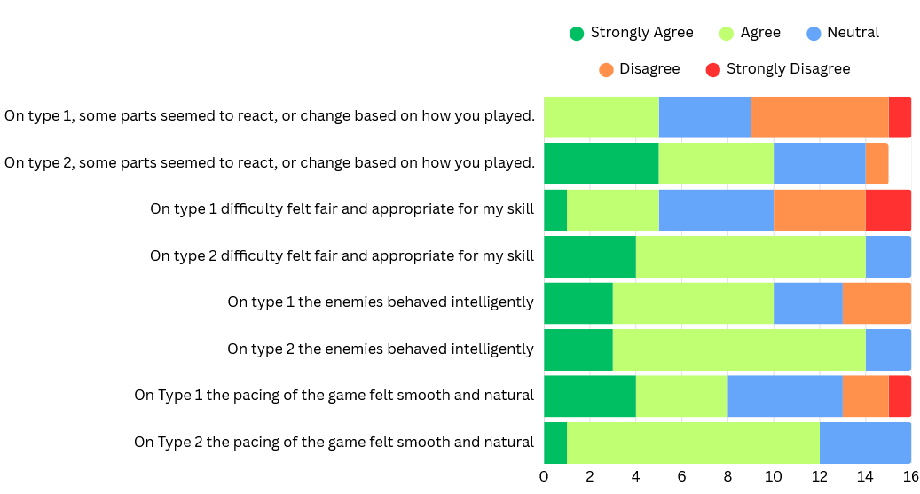
Results and Findings – Likert Scale
30% in agreement, 45% in disagreement
66% in agreement, 30% neutral
30% in agreement, 40% in disagreement
90% in agreement
60% in agreement, 20% in disagreement
90% in agreement
50% in agreement, 20% in disagreement
75% in agreement, 25% neutral

Slide 21
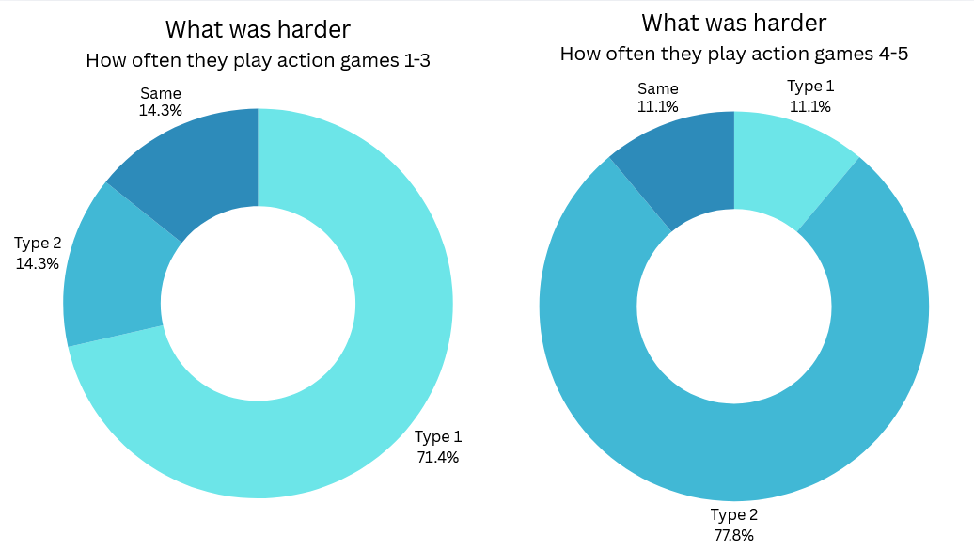
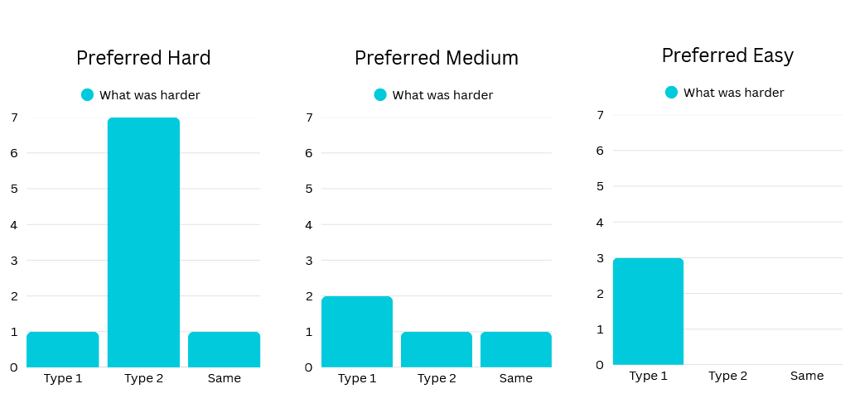
Results and Findings – What was harder

Slide 22
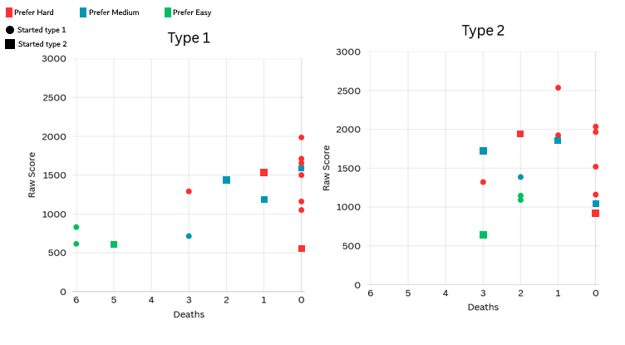
Results and Findings – Scores and deaths
Start Type | Playing | Average Raw Score | Average Deaths
Type 1 | Type 1 | 1177 | 1.5
Type 1 | Type 2 | 1567.5 | 0.8
Type 2 | Type 1 | 1275.5 | 2
Type 2 | Type 2 | 1422.5 | 2

Slide 23
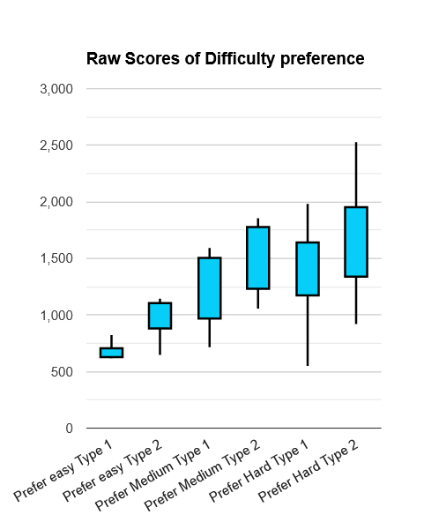
Results and Findings –
Scores and deaths

Slide 24
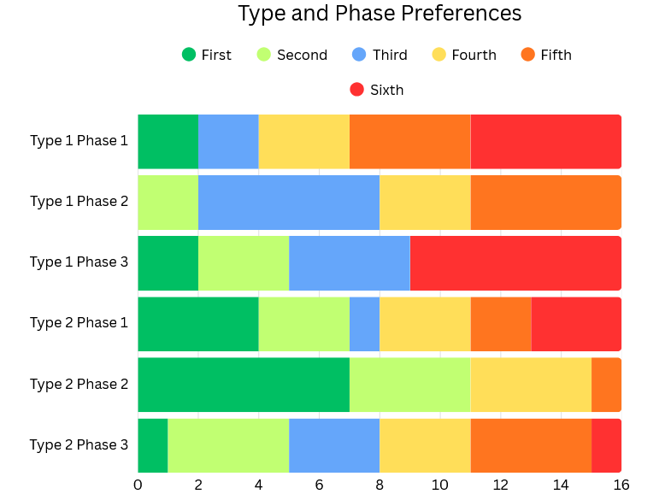
Results and Findings – Phase preferences
50% in 5th or 6th
50% in 4th or 5th, 40% in 3rd
45% in 6th
70% in 1st or 2nd

Slide 25
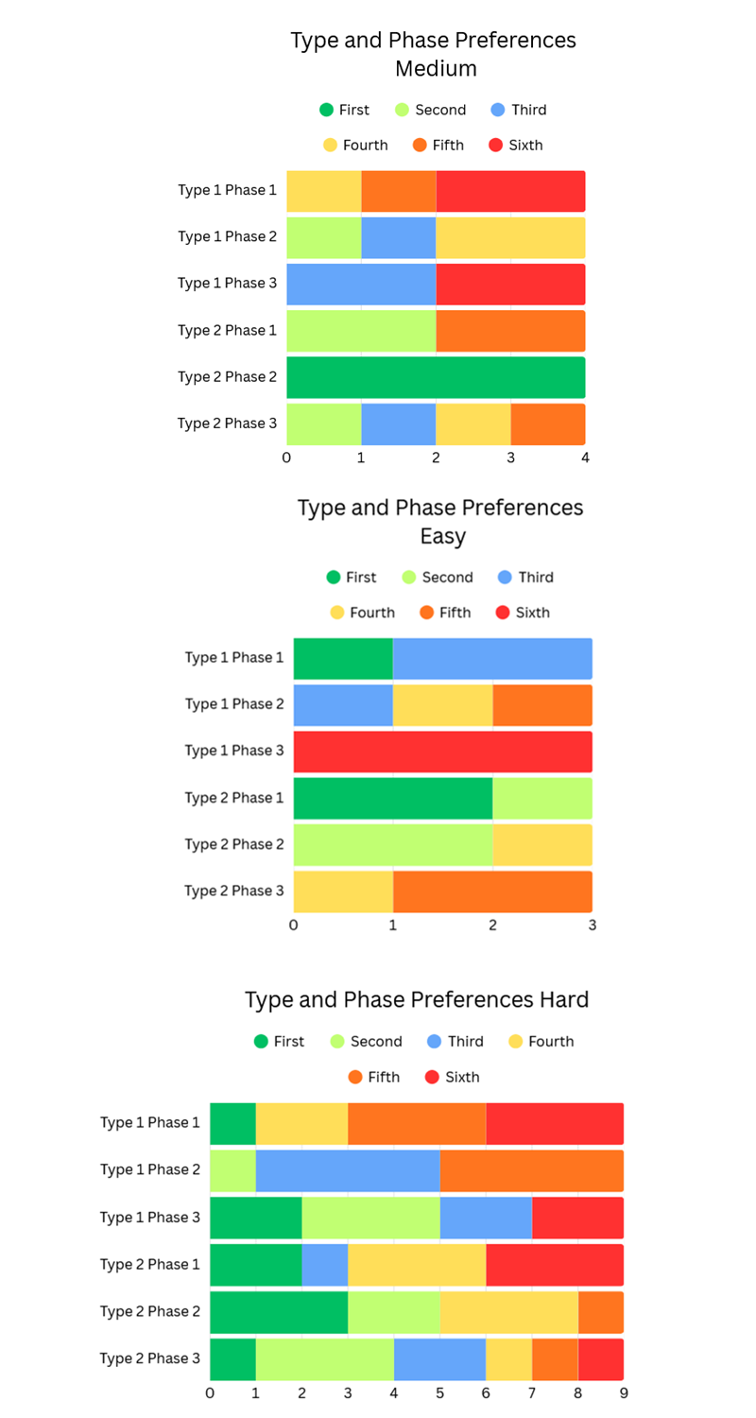
Results and Findings – Phase and difficulty preferences

Slide 26
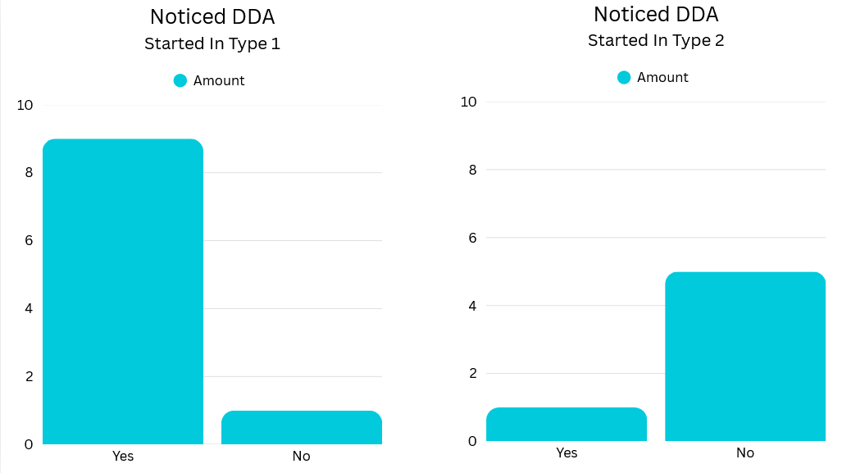
Results and Findings – DDA Noticed
90% noticed
15% noticed

Slide 27
Discussion and analysis
Artefact DDA success
Comparable opinions to the two types
Perceived psychological effects

Slide 28
Discussion and analysis –
Artifact success
Supports | Neither Support or Opposes | Opposes
A 90% agreement in being appropriate for their skill level | Struggle level answers were not reliable | DDA was often noticed
DDA was more difficult for skilled testers while easier for low skilled
DDA testers felt that it had smooth progression

Slide 29
Discussion and analysis –
Comparisons
On average, testers performed better on DDA than static
Phase 2 of DDA was the most liked, the “Tense” phase

Slide 30

Discussion and analysis –
Perceived effects
Did start type influence noticing DDA?
Does knowing DDA exists effect enjoyment?
Did start type affect results?

Slide 31
Conclusion
DDA was implemented successfully
People will prefer DDA systems over static, even when knowing it exists
Balanced correctly, DDA will only be seen positively
Supporting flow theory and self determination, people will find being tense the most engaging

Slide 32
Recommendations
Group 1 – Only DDA
Group 2 – Only Static

Slide 33
THANK YOU//
QUESTIONS
Daniel Whilock
23020139
w020139n@student.staffs.ac.uk

