Slide 1
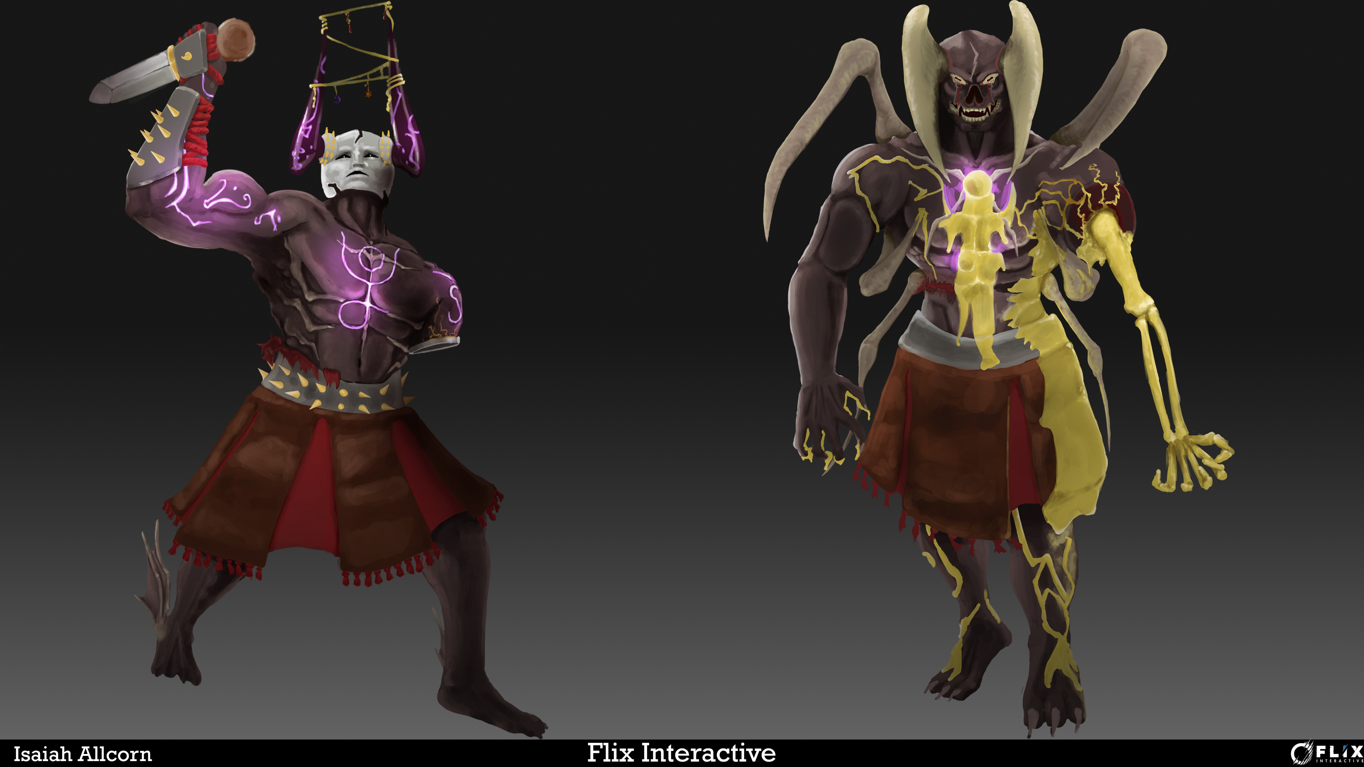
Flix Character Concept

Slide 2
First designs
When I started the module, I tried to do al of my first blue skies traditionally. This made me feel like a lot of my designs were able to be a bit more original, I felt like I had more freedom.
At first I only slightly read the brief, and missed the part where it says it can’t fly and that it’s the first proper boss of the game. This meant that a lot of my designs were quite extravagant, and even biblical.
I didn’t mind the biblical imagery however, I thought that it could have definitely been some of the most interesting designs if I took those forward.
I also wanted to keep a very elegant/holy

Slide 3
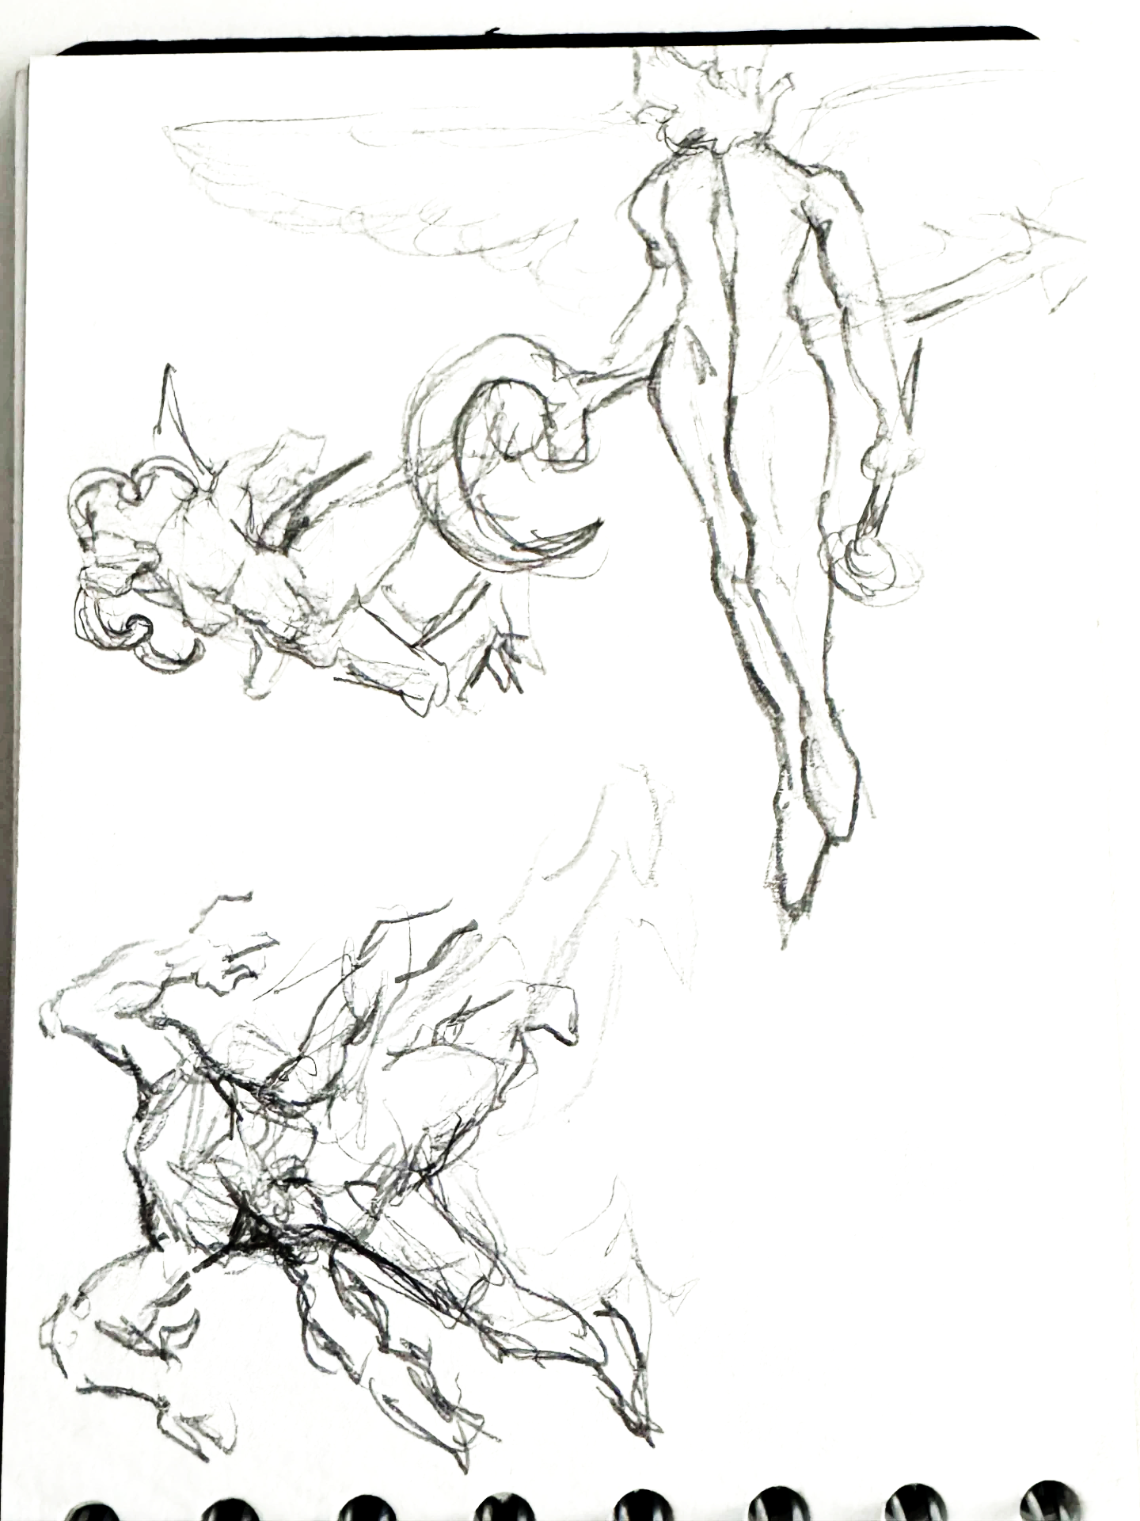
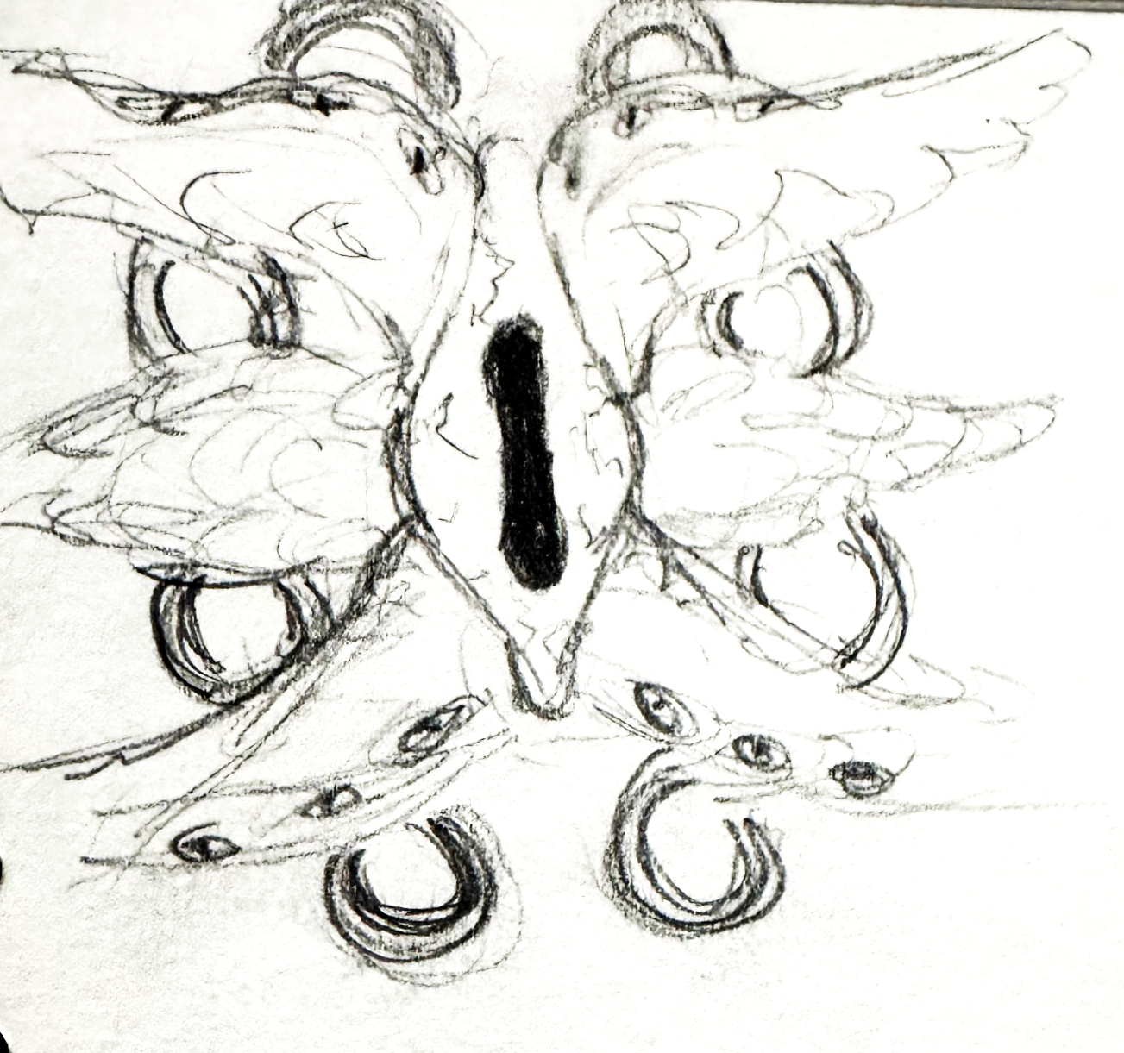

Slide 4
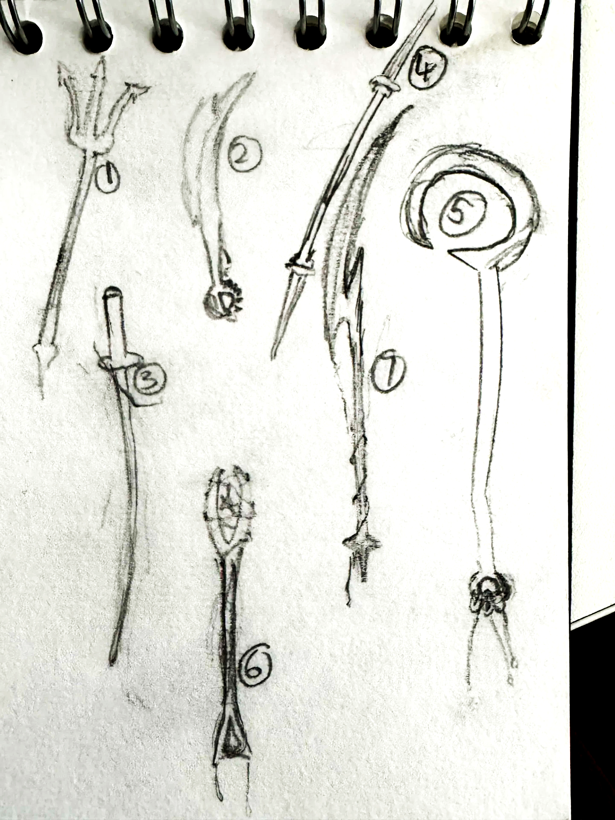
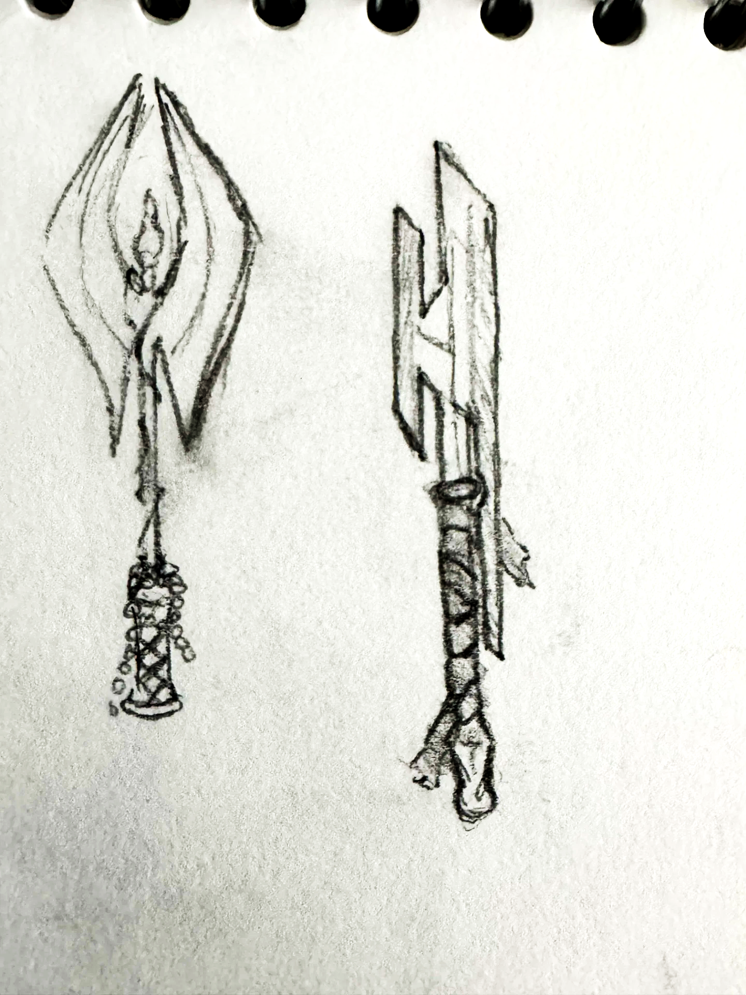
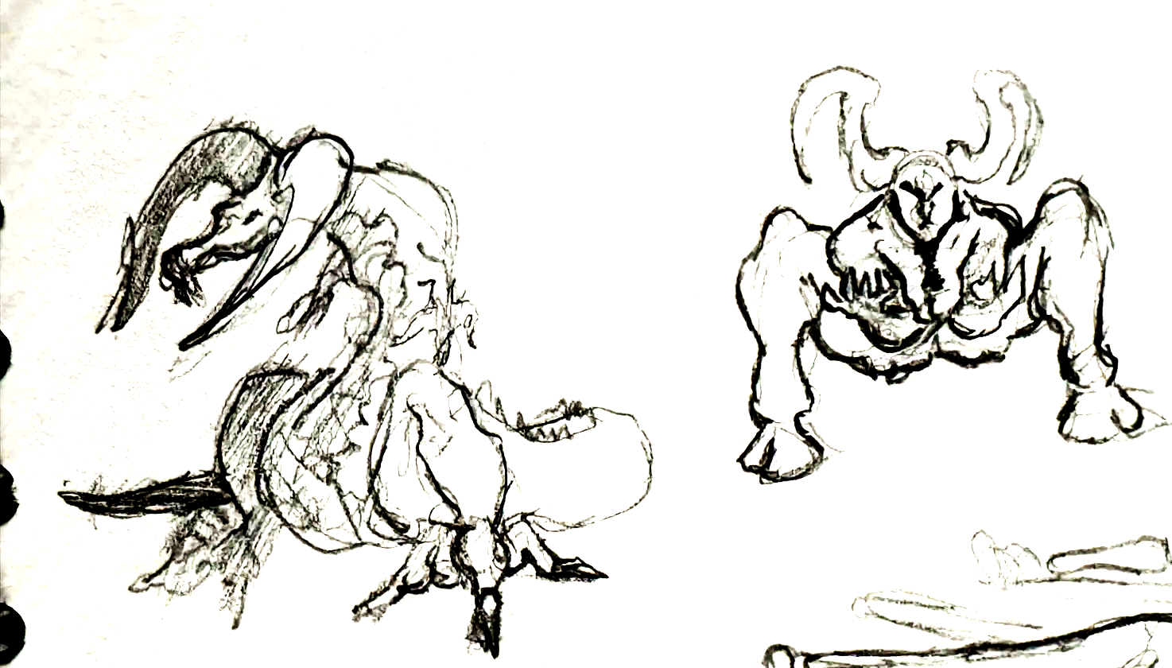

Slide 5
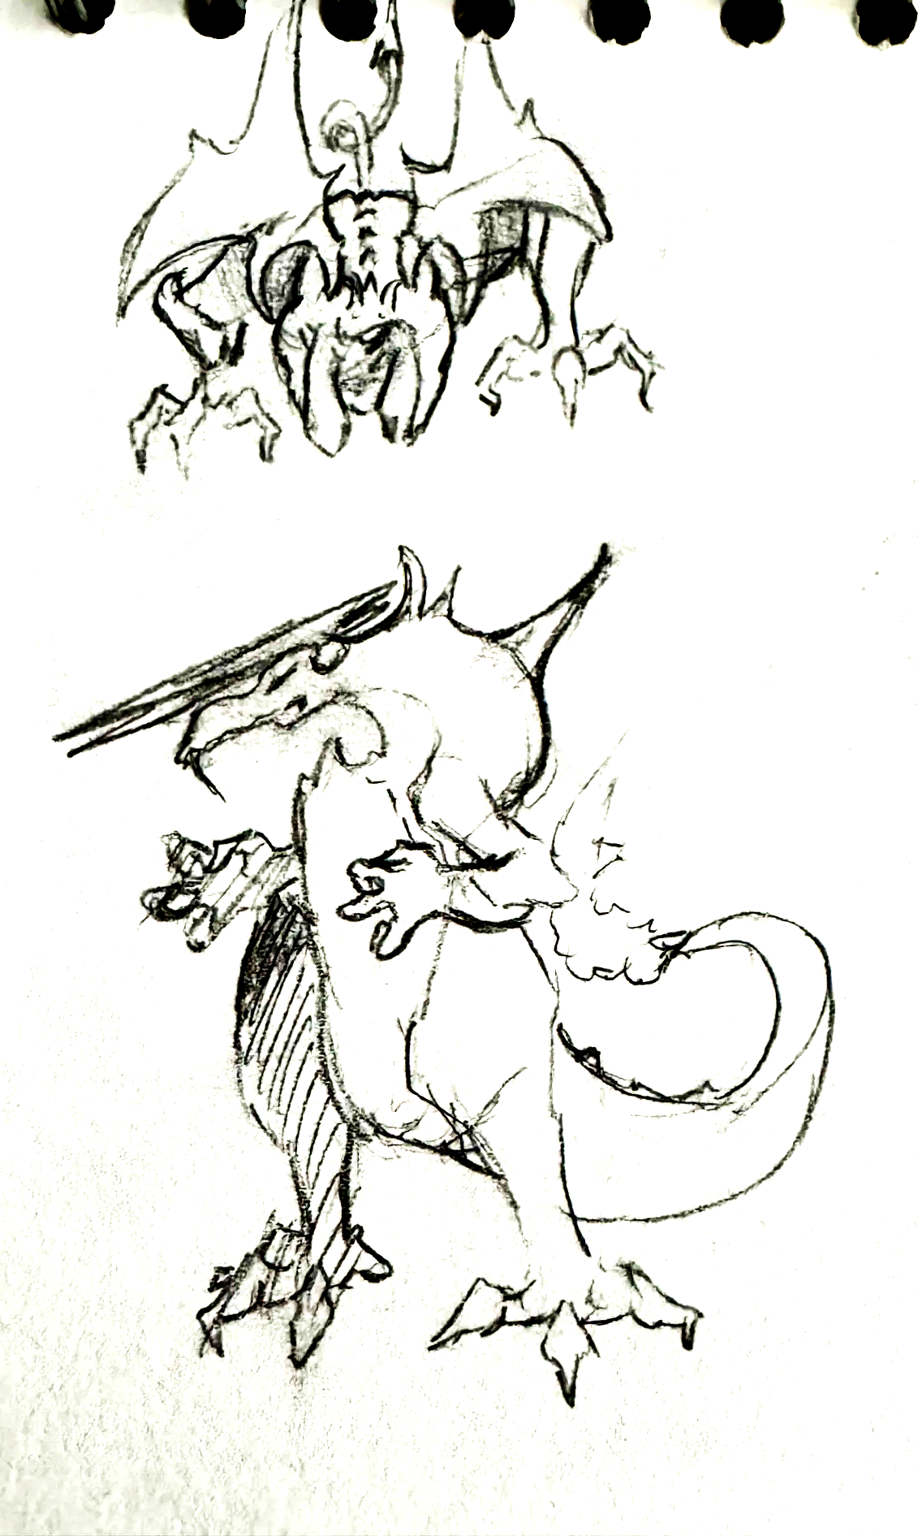
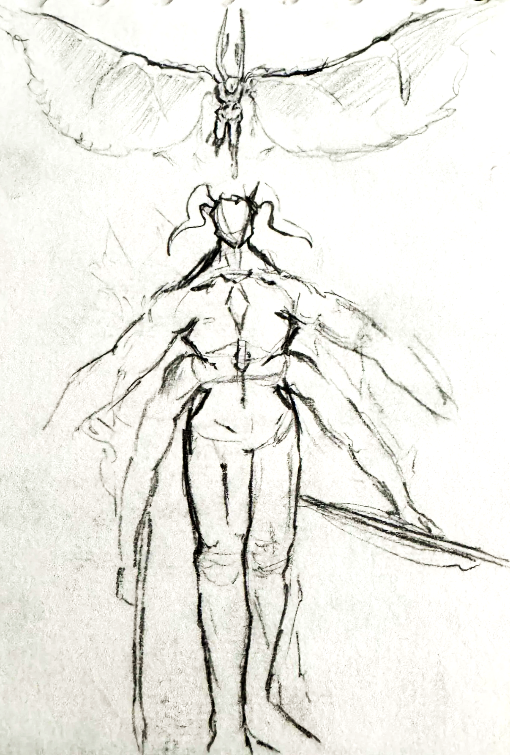

Slide 6
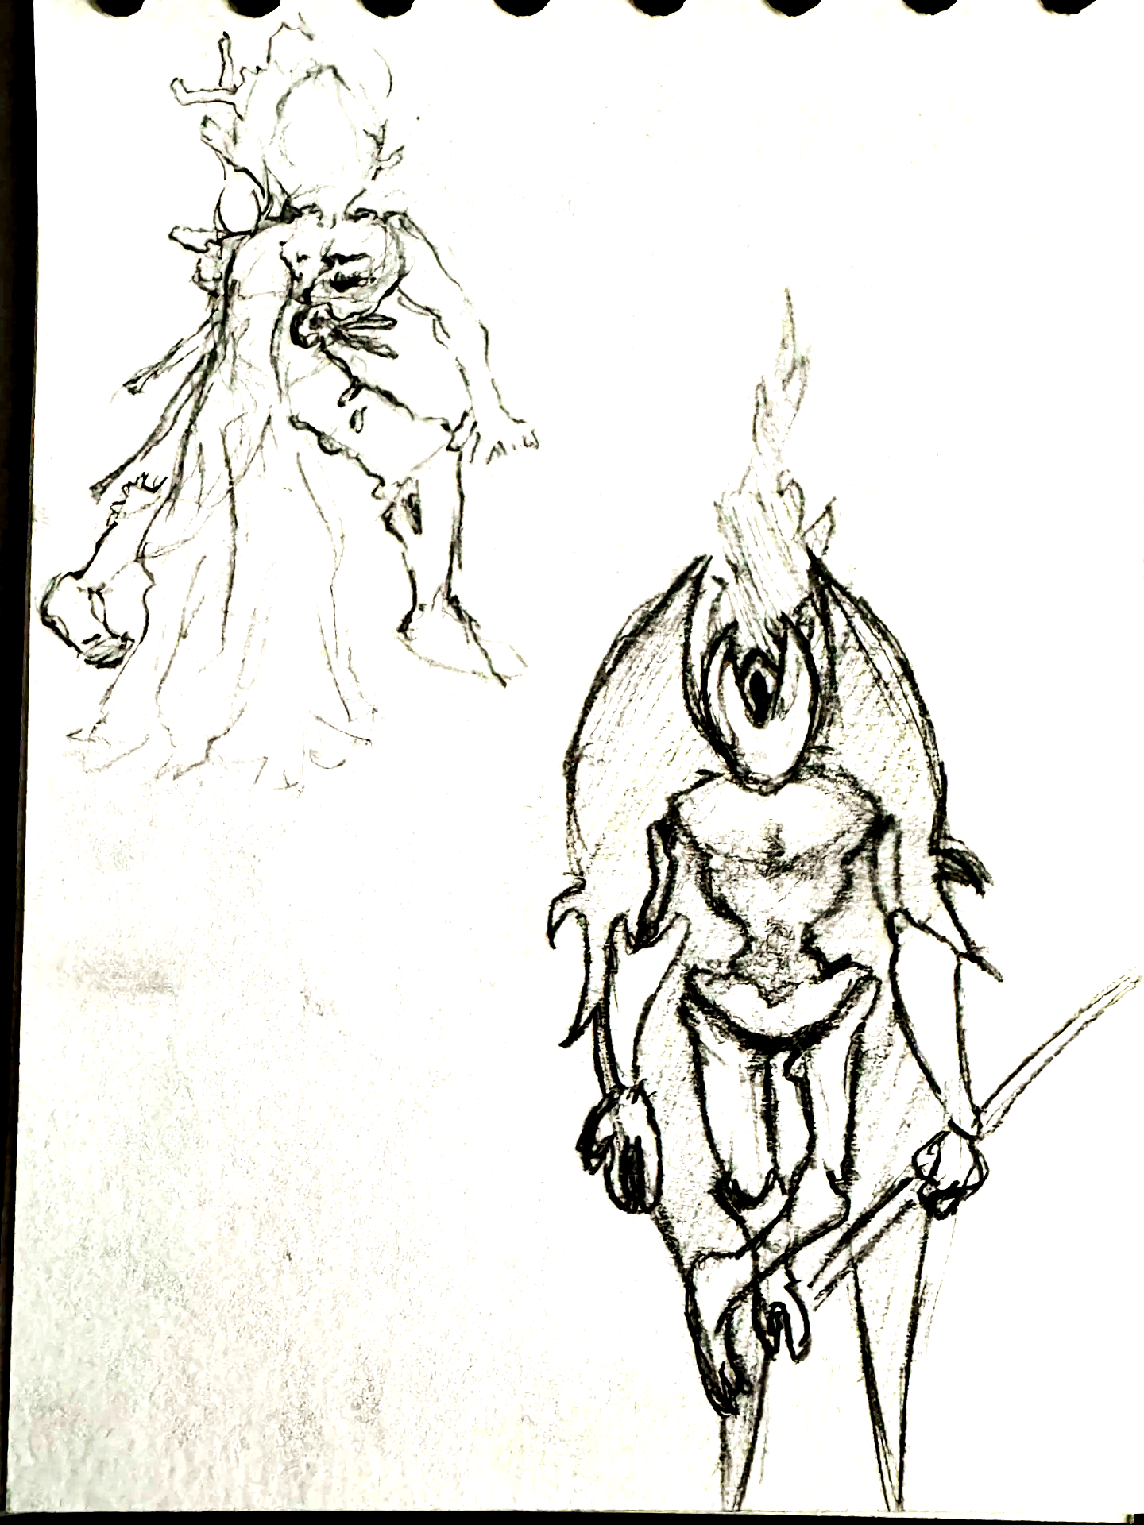
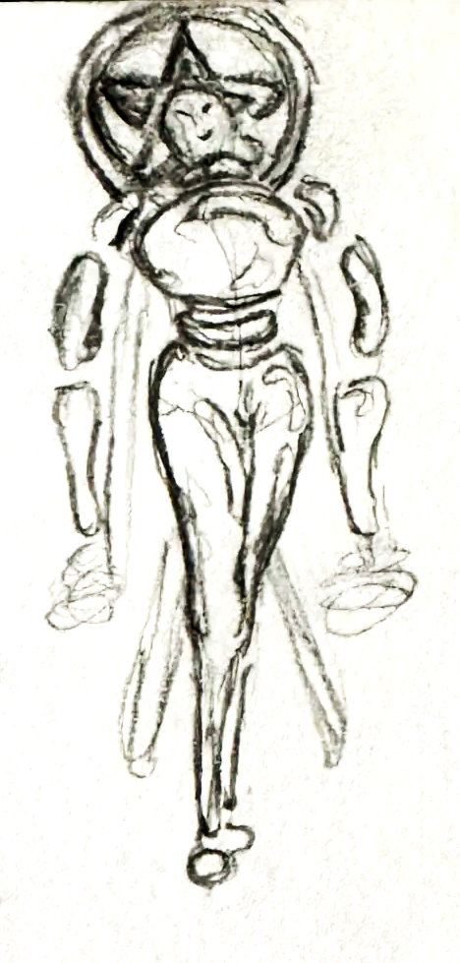

Slide 7
Early research
I started doing research on games that are heavily demon based of course, for example, I looked into DOOM Eternal, Devil May Cry 5, and even destiny for the extravagant aliens..
I did want to keep going in the direction of holy, maybe biblically accurate, however it was a bit too much for an introductory boss.

Slide 8
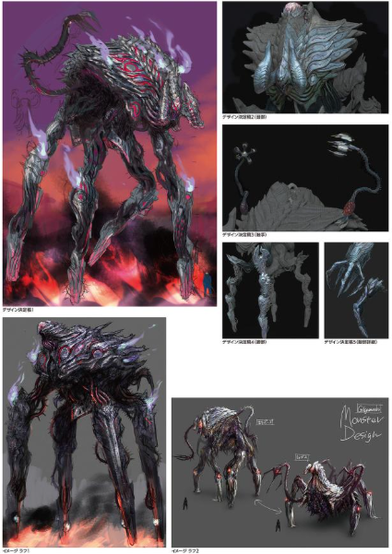
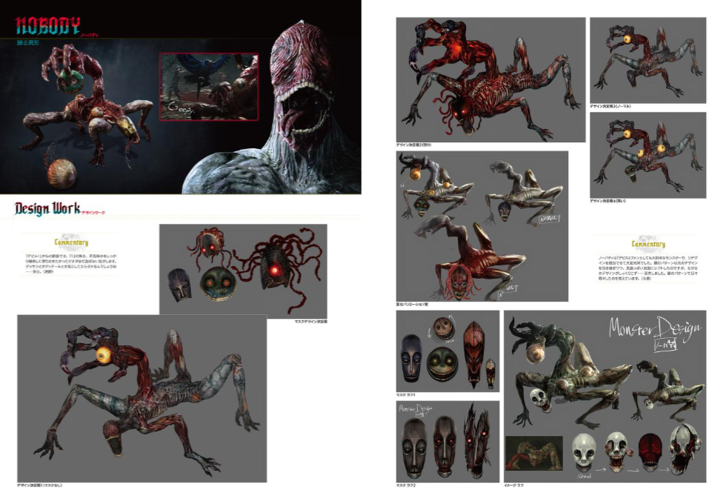
Research

Slide 9
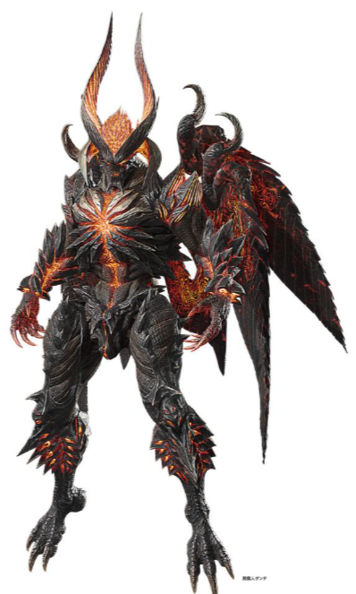
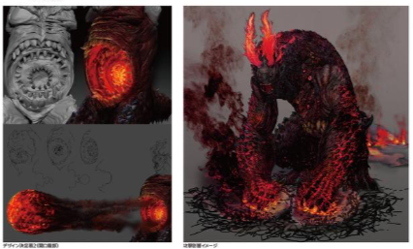
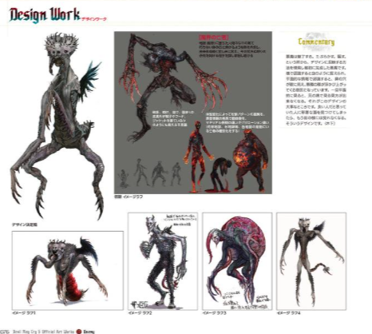
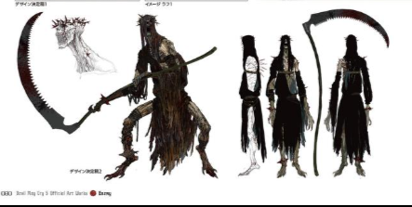
Research

Slide 10
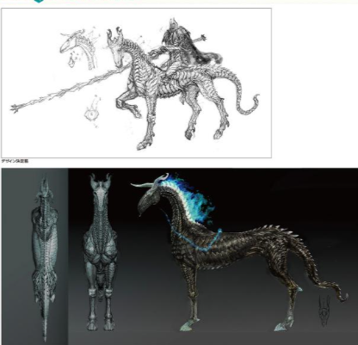
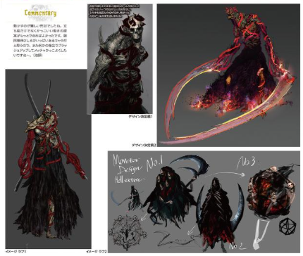
Research

Slide 11
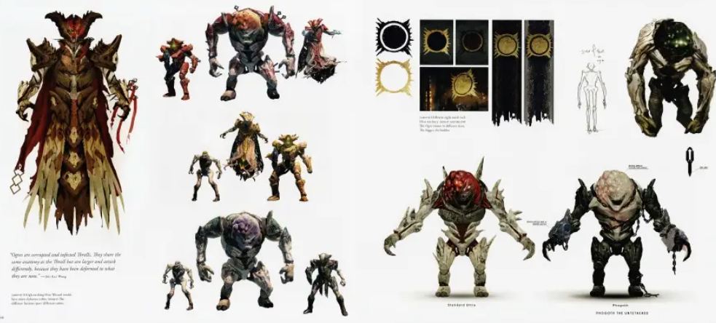
Research

Slide 12
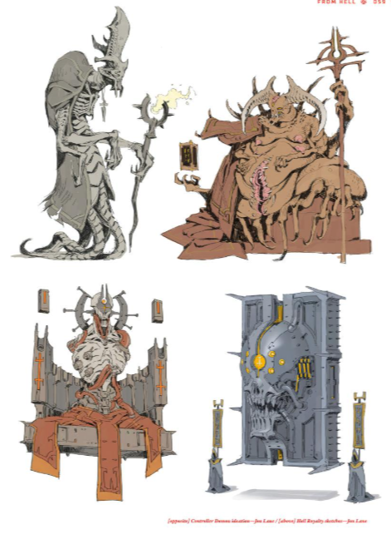
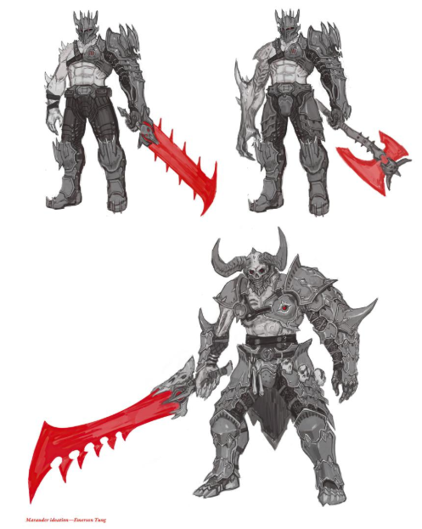
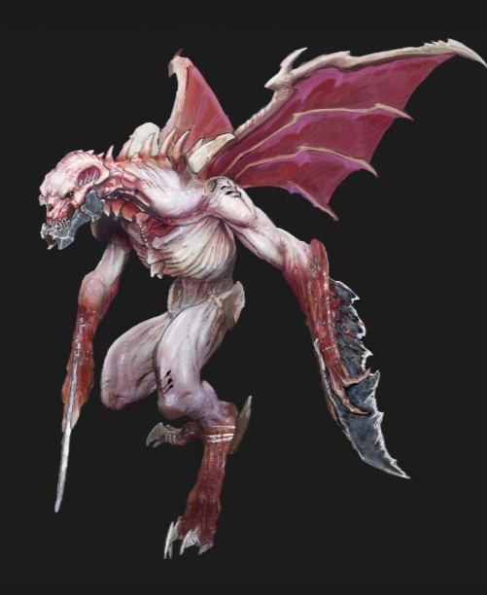
Research

Slide 13
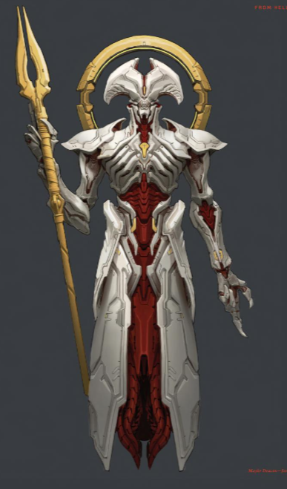
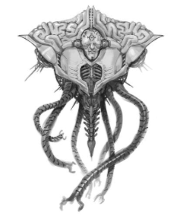
Research

Slide 14
Blue sky
My early blue sky phase was a struggle for me. I thought I had so many ideas, but I had seemed to struggle to find new ideas.
throughout most of my blue sky, I was making most of my designs very humanoid, and I do feel like that was hindering my progress. I started to look more into animals and making animalistic designs in the process, even looking into different insects and taking inspiration.
Once I felt like I had exhausted all of my ideas, I went back to making more humanoid designs, taking things like wizards into consideration. The wizard designs do feel very interesting and fun to create, however the more I made the more I realised that the design does not really work with the brief given.
I then tried to push body shapes a lot, trying to get bigger and more different body types. This really let my find a couple designs that I wanted to take forward.

Slide 15
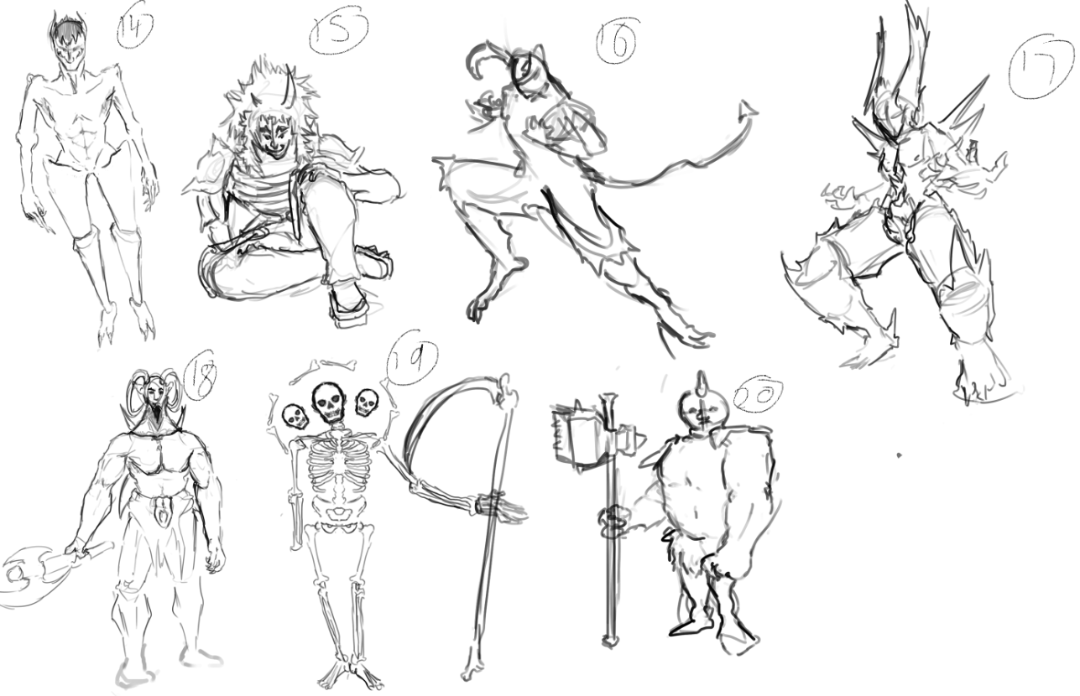
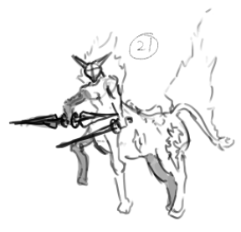

Slide 16
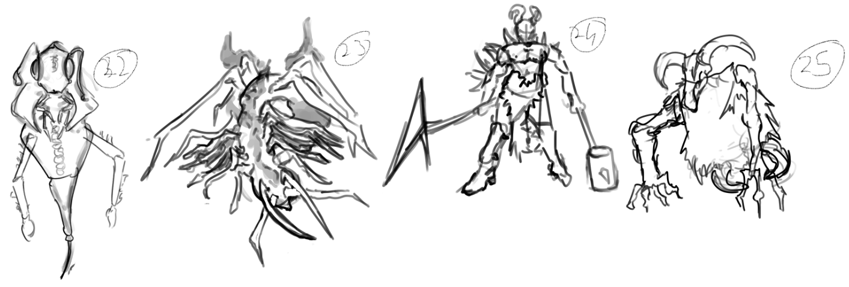

Slide 17
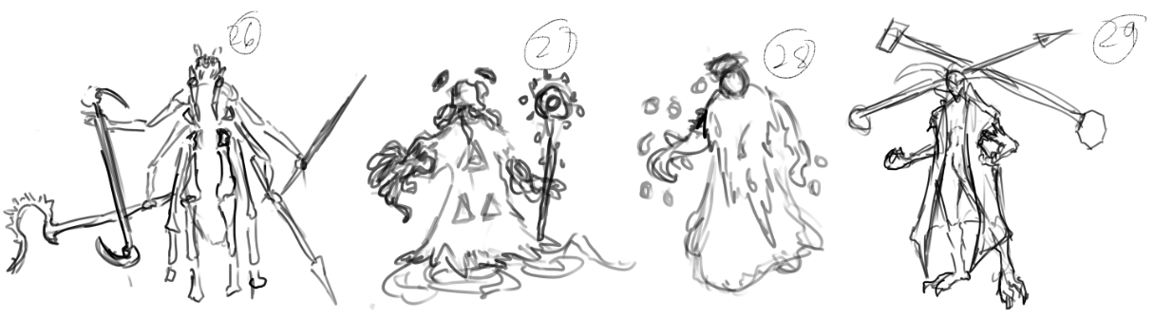
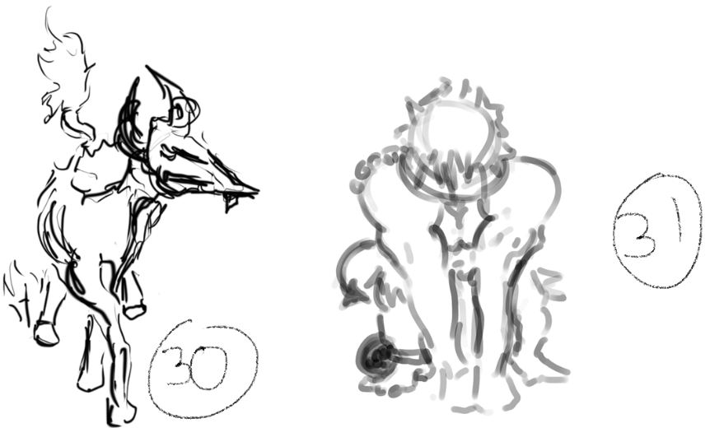

Slide 18
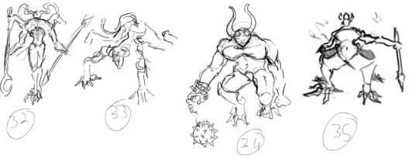

Slide 19
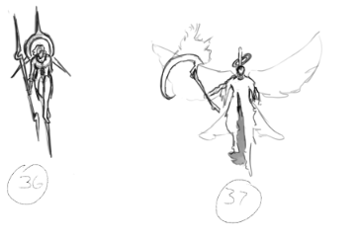
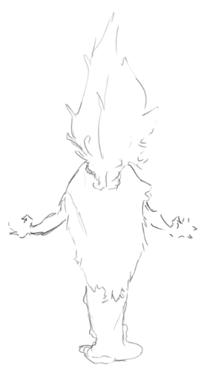
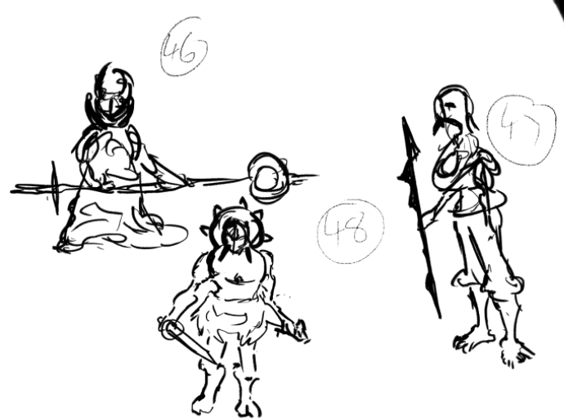

Slide 20
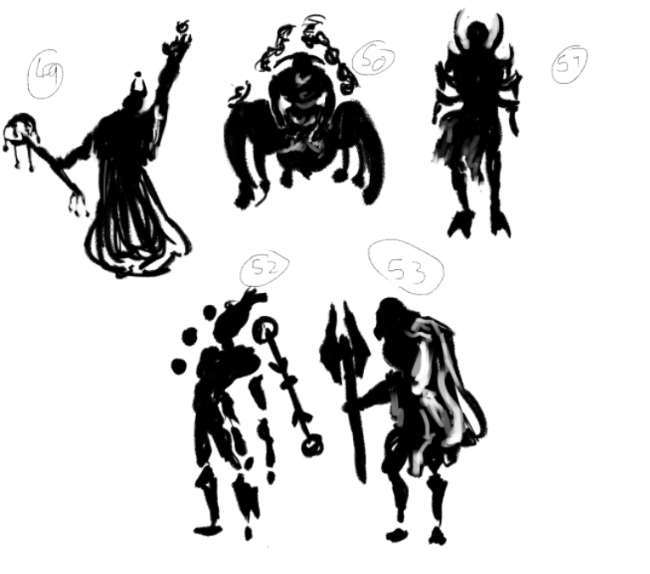
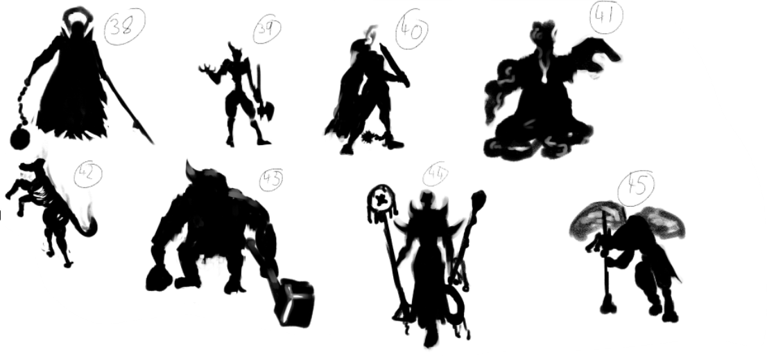

Slide 21
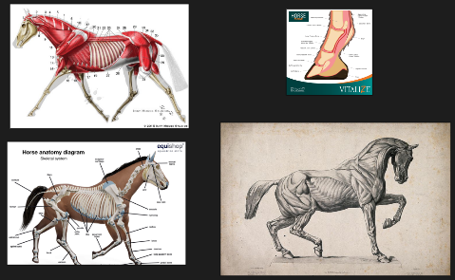
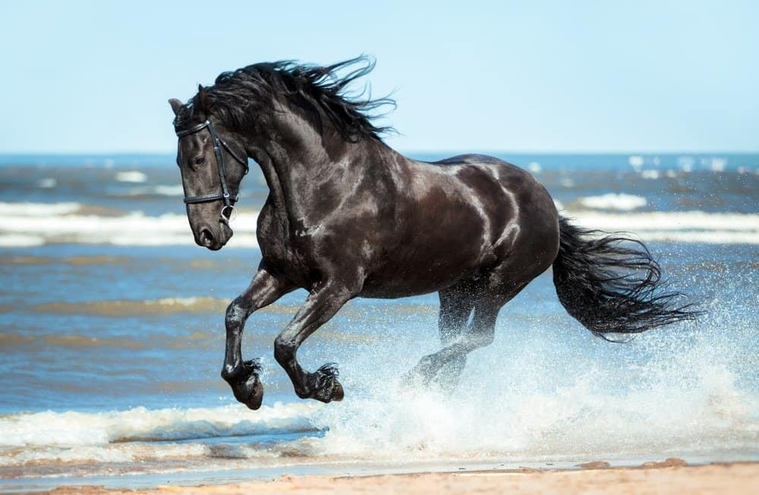
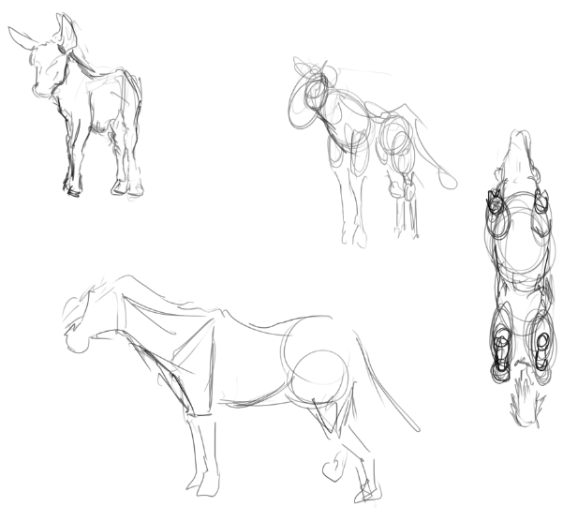
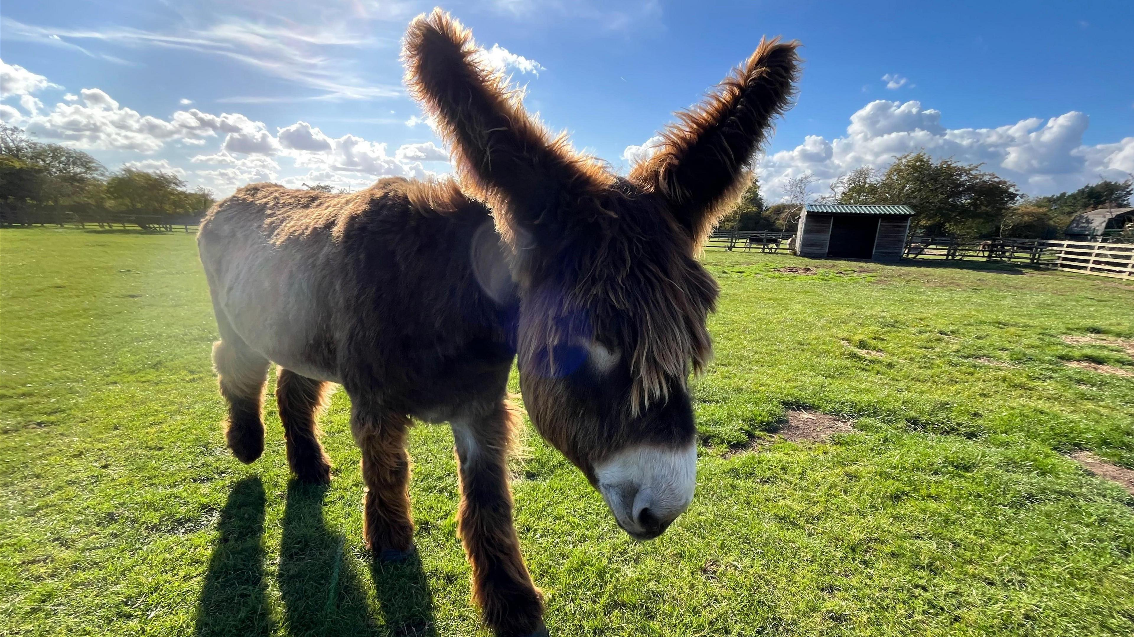
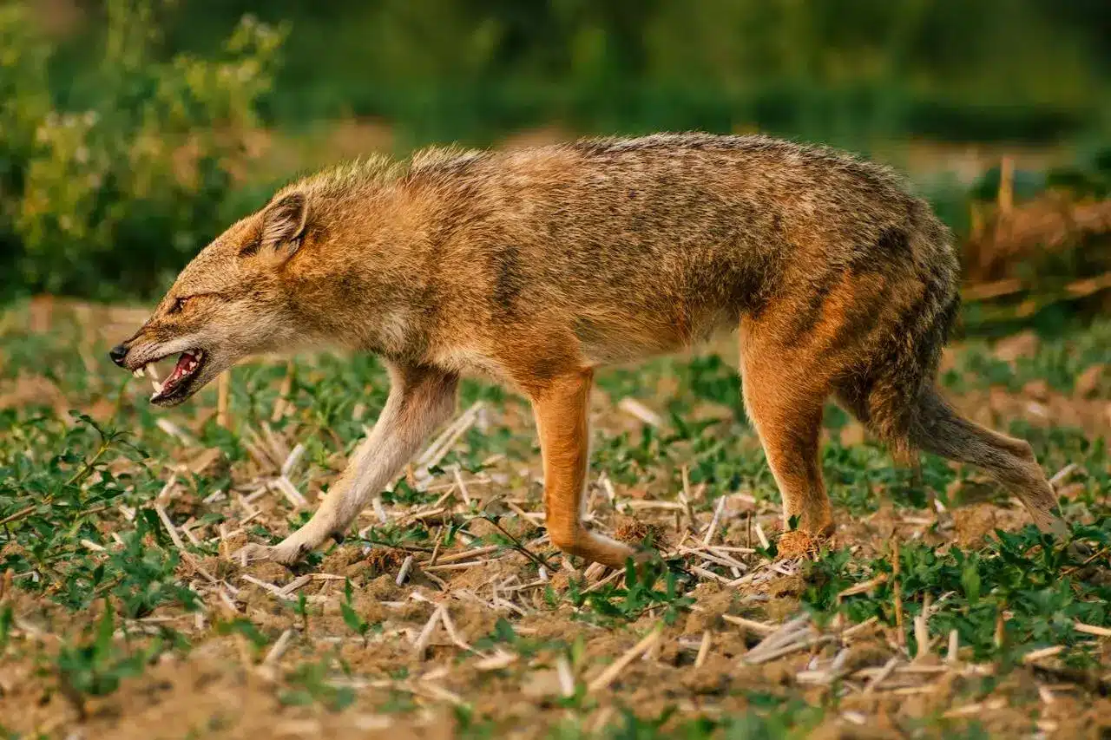
Studies

Slide 22
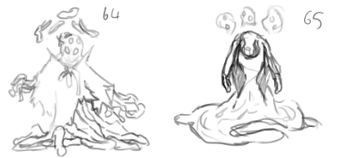
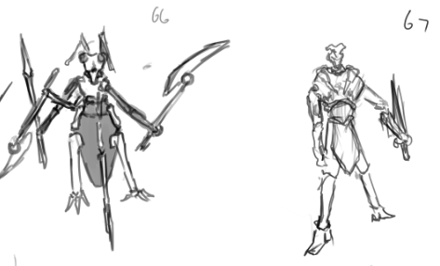
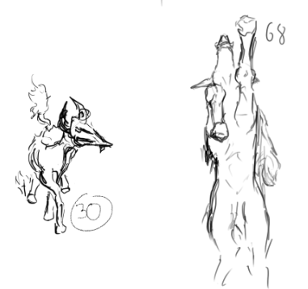
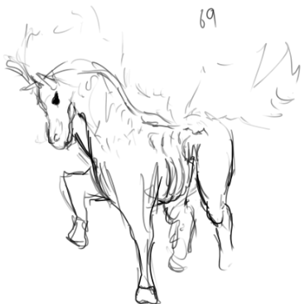

Slide 23
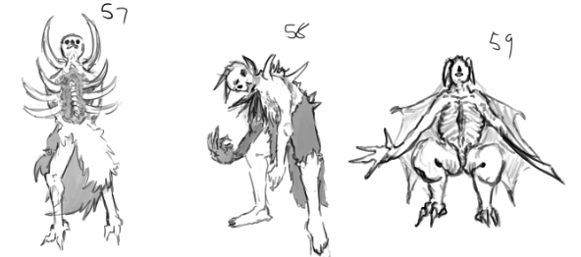
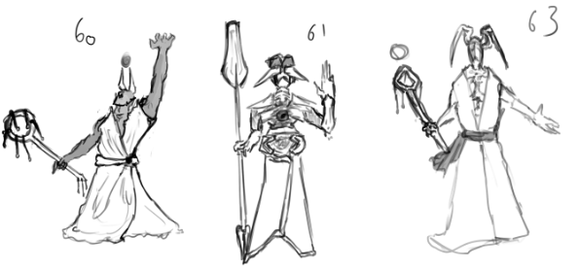

Slide 24
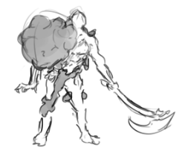
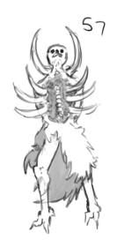
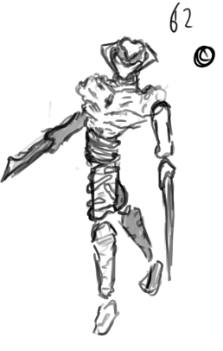
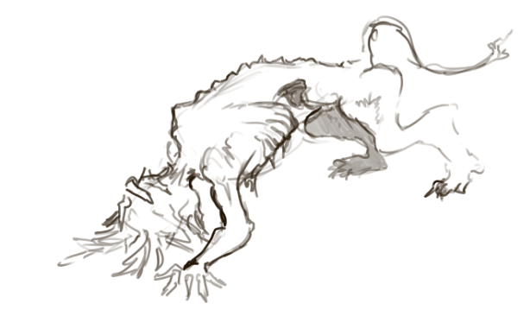


Notes:
A couple new ideas
I chose a few out of these that really interested me

Slide 25


Notes:
I drew only 4 that I wanted to take forward
A puppet mannequin like
Ogre demon brute

Slide 26


Notes:
Some malnourished creature
An infected test subject

Slide 27



Notes:
Wanted the infected guy to be like a castaway demon, with his horns ripped out
Second phase he could grow them back and the virus could like explode into something

Slide 28



Notes:
Demon o hatred will help with getting some of the malnourished demon ideas in my head,
Arlecchino will further help with the puppet/mannequin like design

Slide 29
Blue sky
After picking a few designs I decided to do some more research into what I thought would be useful.
One of my designs was a couple characters from the game Lies of P, based around puppets. I thought a puppet character would be very cool and different to be shown as a demon.
But the main thing that really got me was a design I did of just a beastly man. I felt like I could really push that character somehow, even though it may seem boring. Feedback from my peers allowed me to realise that I needed to get a theme. The one glaring issue the boss I had wanted to take forward had was that it lacked consistency, a proper theme.
My first few choices was, what I thought, pretty basic, going straight to Japan. However, though it does feel a bit saturated the designs can still be very cool and well thought out.
I wanted to use mythological creatures, or ‘gods’ to show the power of my demon boss, and the one that stood out to me for the Japanese boss, was one called Amatsu-Mikaboshi, the god of death as my research revealed.
I did a few sketches of these creature, but I quickly came to a stop and became pretty bored of the designs very quickly, so I went back to revisit the original designs and immediately made something I felt like I loved, inspired by Greek culture this time.

Slide 30





Research

Slide 31





Research

Slide 32




Research

Slide 33





Research

Slide 34





Research

Slide 35
I thought that the boss having a prosthetic arm could be something very interesting, but not a normal prosthetic, something barbaric, like having a ball and chain attached to it. Though once again an issue was pointed out to me about the realism of it all, how it would stand, and how it carries all of that weight while also being in the first stage of a battle and would get slower.
As I moved on I tried to really make the arm much lighter while also being practical, and as I progressed the more Greek figure, I choose to completely get rid of any attachments, keeping the arm gone, only for it to return in the second half of the fight in some way.

Slide 36



Notes:
I will be doing other variants of this design, different body shapes and maybe some additions to clothing and maybe some armour or something

Slide 37

Notes:
Researched into some horrible headgear, as he is a demon making him wear something horrid would kinda suit him

Slide 38







I wanted the boss to also have a very cool mask, but as I am not used to making something like that, I don’t feel as though I explored that effectively, it could’ve been better.
Notes:
Same with the masks, this isn’t something I am used to creating so any feedback

Slide 39




Slide 40

Notes:
Same with the masks, this isn’t something I am used to creating so any feedback

Slide 41




Slide 42


Notes:
Same with the masks, this isn’t something I am used to creating so any feedback

Slide 43



Notes:
Same with the masks, this isn’t something I am used to creating so any feedback

Slide 44


Notes:
Same with the masks, this isn’t something I am used to creating so any feedback

Slide 45
When making the details for my boss, I repeated the same thing of wanting to have some sort of ethereal influence on them.
This time I wanted to research into Greek gods, and their symbols. There are many gods to choose from and so I chose the one that spoke out to me the most, Styx, and the symbol that I found of them was also very cool.
Cursed by Styx, given neigh immortality and ‘blessed’ by Hermes giving speed the man had to sacrifice himself and become a pawn to gain ultimate power.
Hermes gave him the winged feed, turned into demon wings, they gave him immense speed all the while he is glowing purple from the symbols themselves.
The arm he had lost has been infused with the gods (golden) blood and sealed. Parts of his ribs tried to break out of the skin in the strength gaining process but are now a permanent lump in his sides.

Slide 46


Notes:
Same with the masks, this isn’t something I am used to creating so any feedback

Slide 47



Notes:
Same with the masks, this isn’t something I am used to creating so any feedback

Slide 48



Slide 49


Notes:
Same with the masks, this isn’t something I am used to creating so any feedback

Slide 50

Notes:
Same with the masks, this isn’t something I am used to creating so any feedback

Slide 51

Notes:
Same with the masks, this isn’t something I am used to creating so any feedback

Slide 52

Notes:
Same with the masks, this isn’t something I am used to creating so any feedback

Slide 53

Notes:
Same with the masks, this isn’t something I am used to creating so any feedback

Slide 54


Notes:
Same with the masks, this isn’t something I am used to creating so any feedback

Slide 55
The second form comes from his want for power becoming too much, he rips of the wings and calls them useless, and breaks the seal on his arm, releasing the golden blood, gaining new power all while bleeding from the symbol on his chest, his arm grew a golden skeleton, unbreakable from the god golden blood. This was unfortunately a last minute change from what it was before, being a giant arm, only because I had struggled with making it make sense.
The rib cages grow and one rips from his side causing his to bleed.
The 6 extra ribs give him another way of both attacking and defending.

Slide 56



Notes:
Same with the masks, this isn’t something I am used to creating so any feedback

Slide 57




Notes:
Same with the masks, this isn’t something I am used to creating so any feedback

Slide 58


Notes:
Same with the masks, this isn’t something I am used to creating so any feedback

Slide 59


Notes:
Same with the masks, this isn’t something I am used to creating so any feedback

Slide 60


Notes:
Same with the masks, this isn’t something I am used to creating so any feedback

Slide 61

Notes:
Same with the masks, this isn’t something I am used to creating so any feedback

