Slide 1

Creatures of the Dark Realm
William Mizon

Slide 2
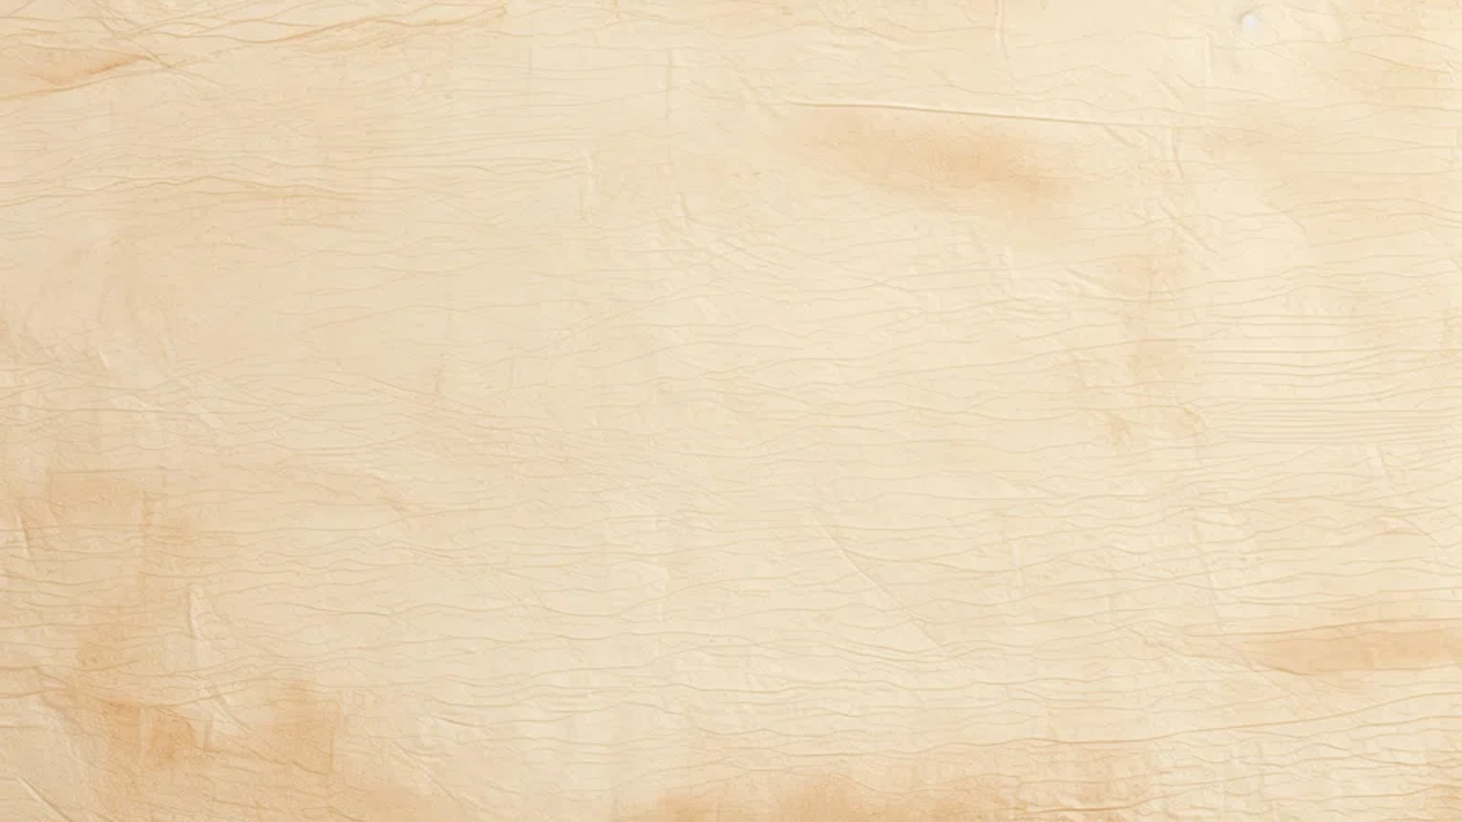
Pages
Brief info
Research
  references
  Moodboards
Trolgre
  Iteration
  Initial design
  turnaround
  Call out sheet
Wendigo
  Iteration
  Initial design
  turnaround
  Call out sheet

Slide 3
The Swordsman
  Iteration
  Initial design
  Design exploration
  Props & weapons
  Turnaround
  Call out sheet
Final piece

Slide 4
Self project brief
Project Goal
Create concepts for a player character and two creatures for a single-player, third-person dark fantasy game that the player will hunt and fight.

Slide 5
Research References
The photo ark (2026) Joel Sartore. Available at: http://www.joelsartore.com/photo-ark/ (Accessed: 20 May 2026).
(No date) Troll | mythology, Scandinavian, folklore | Britannica. Available at: https://www.britannica.com/topic/troll (Accessed: 20 May 2026).
Adegun, A. (2025). Cannibal giants of Europe: The truth behind the ogre legend - old folklore, Old Folklore - Exploring the Creatures, Gods, Legends, and Beliefs of the World. Available at: https://oldfolklore.com/cannibal-giants-of-europe-the-truth-behind-the-ogre-legend/ (Accessed: 20 May 2026).
The wendigo: Hunger, folklore, and the Swift Runner Case (2026). What is a Wendigo? Available at: https://www.americanghostwalks.com/the-wendigo-legend-real-stories-native-folklore-and-hauntings (Accessed: 20 May 2026).
Royal Armouries. (2026). Collections Online. [online] Available at: https://royalarmouries.org/collection/object/object-71 [Accessed 25 May 2026].
Royal Armouries. (2026). Collections Online. [online] Available at: https://royalarmouries.org/collection/object/object-16005 [Accessed 25 May 2026].
SALLY ANTIQUES - Antiques For Sale Old Portsmouth. (2024). British Army, WW1, Officer Long Field - Trench Boots, with original leather laces, Marked 011759, No 1 - Sally Antiques. [online] Available at: https://sallyantiques.co.uk/product/british-army-ww1-officer-long-field-trench-boots-with-original-leather-laces-marked-011759-no-1/ [Accessed 25 May 2026].

Slide 6
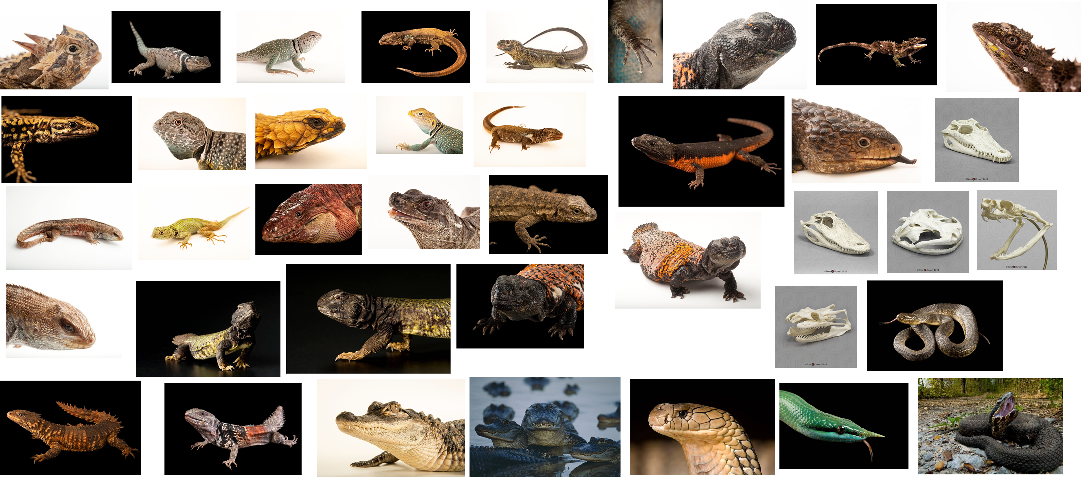
Mood board 1

Slide 7
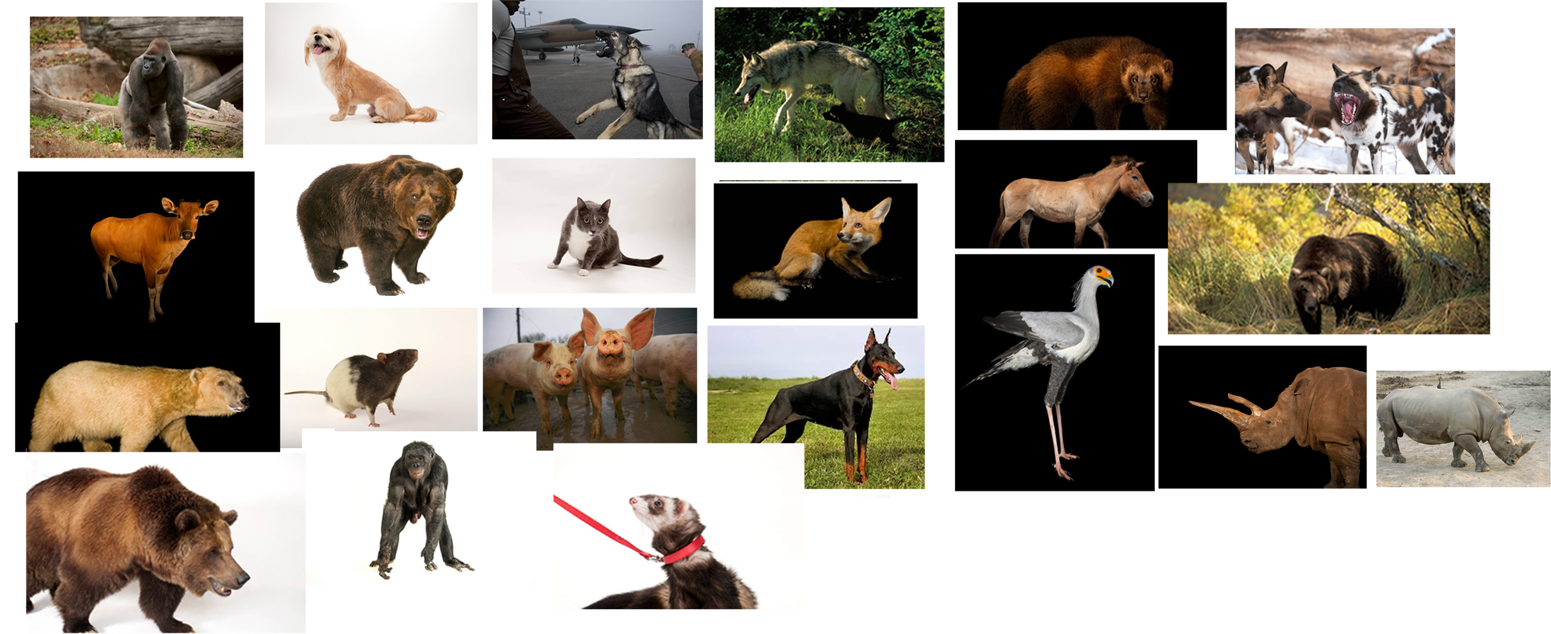
Mood board 2

Slide 8
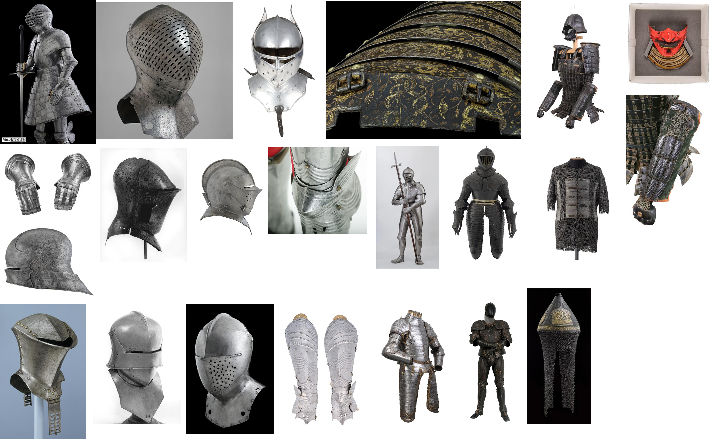

Slide 9
Information
The Trolgre is a hybrid of a Troll and an ogre, as I wanted to create something that felt natural. I decided to combine features to make something original.
Troll
In early Scandinavian folklore, Trolls were giant, monstrous beings, sometimes possessing magical powers. Hostile to men, trolls lived in castles and haunted the surrounding districts after dark. If exposed to sunlight, they burst or turn to stone. In later tales, trolls are often man-sized or smaller beings similar to dwarfs and elves. They live in the mountains, sometimes steal human maidens, and can transform themselves and prophesy.
In the Shetland and Orkney Islands, Celtic areas once settled by Scandinavians, trolls are called trows and appear as small, malign creatures that dwell in mounds or near the sea. They are also used as symbols of destructive instincts. Trolls in modern tales for children often live under bridges, menacing travellers and exacting tasks or tolls.
Ogre
In early tales, ogres were savage beasts who lived on the fringes of civilization, representing the raw threat of violence, the terror of famine, and the cruel authority of unchecked power.
From medieval France to the forests of Germany and the highlands of Scotland, ogres were the giants who lurked in woods, waited in castles, and preyed on the weak—until clever heroes outwitted them.

Slide 10
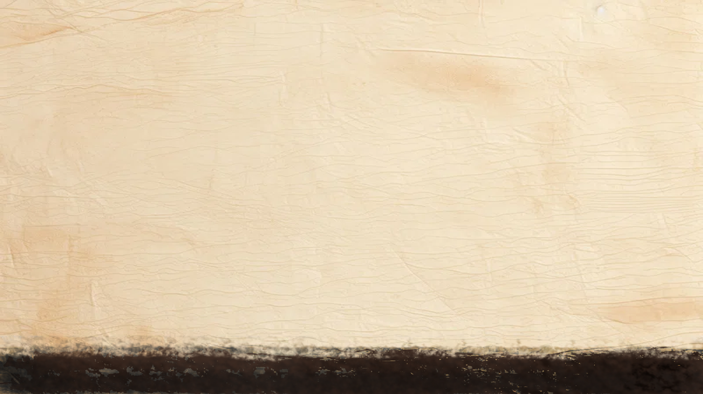
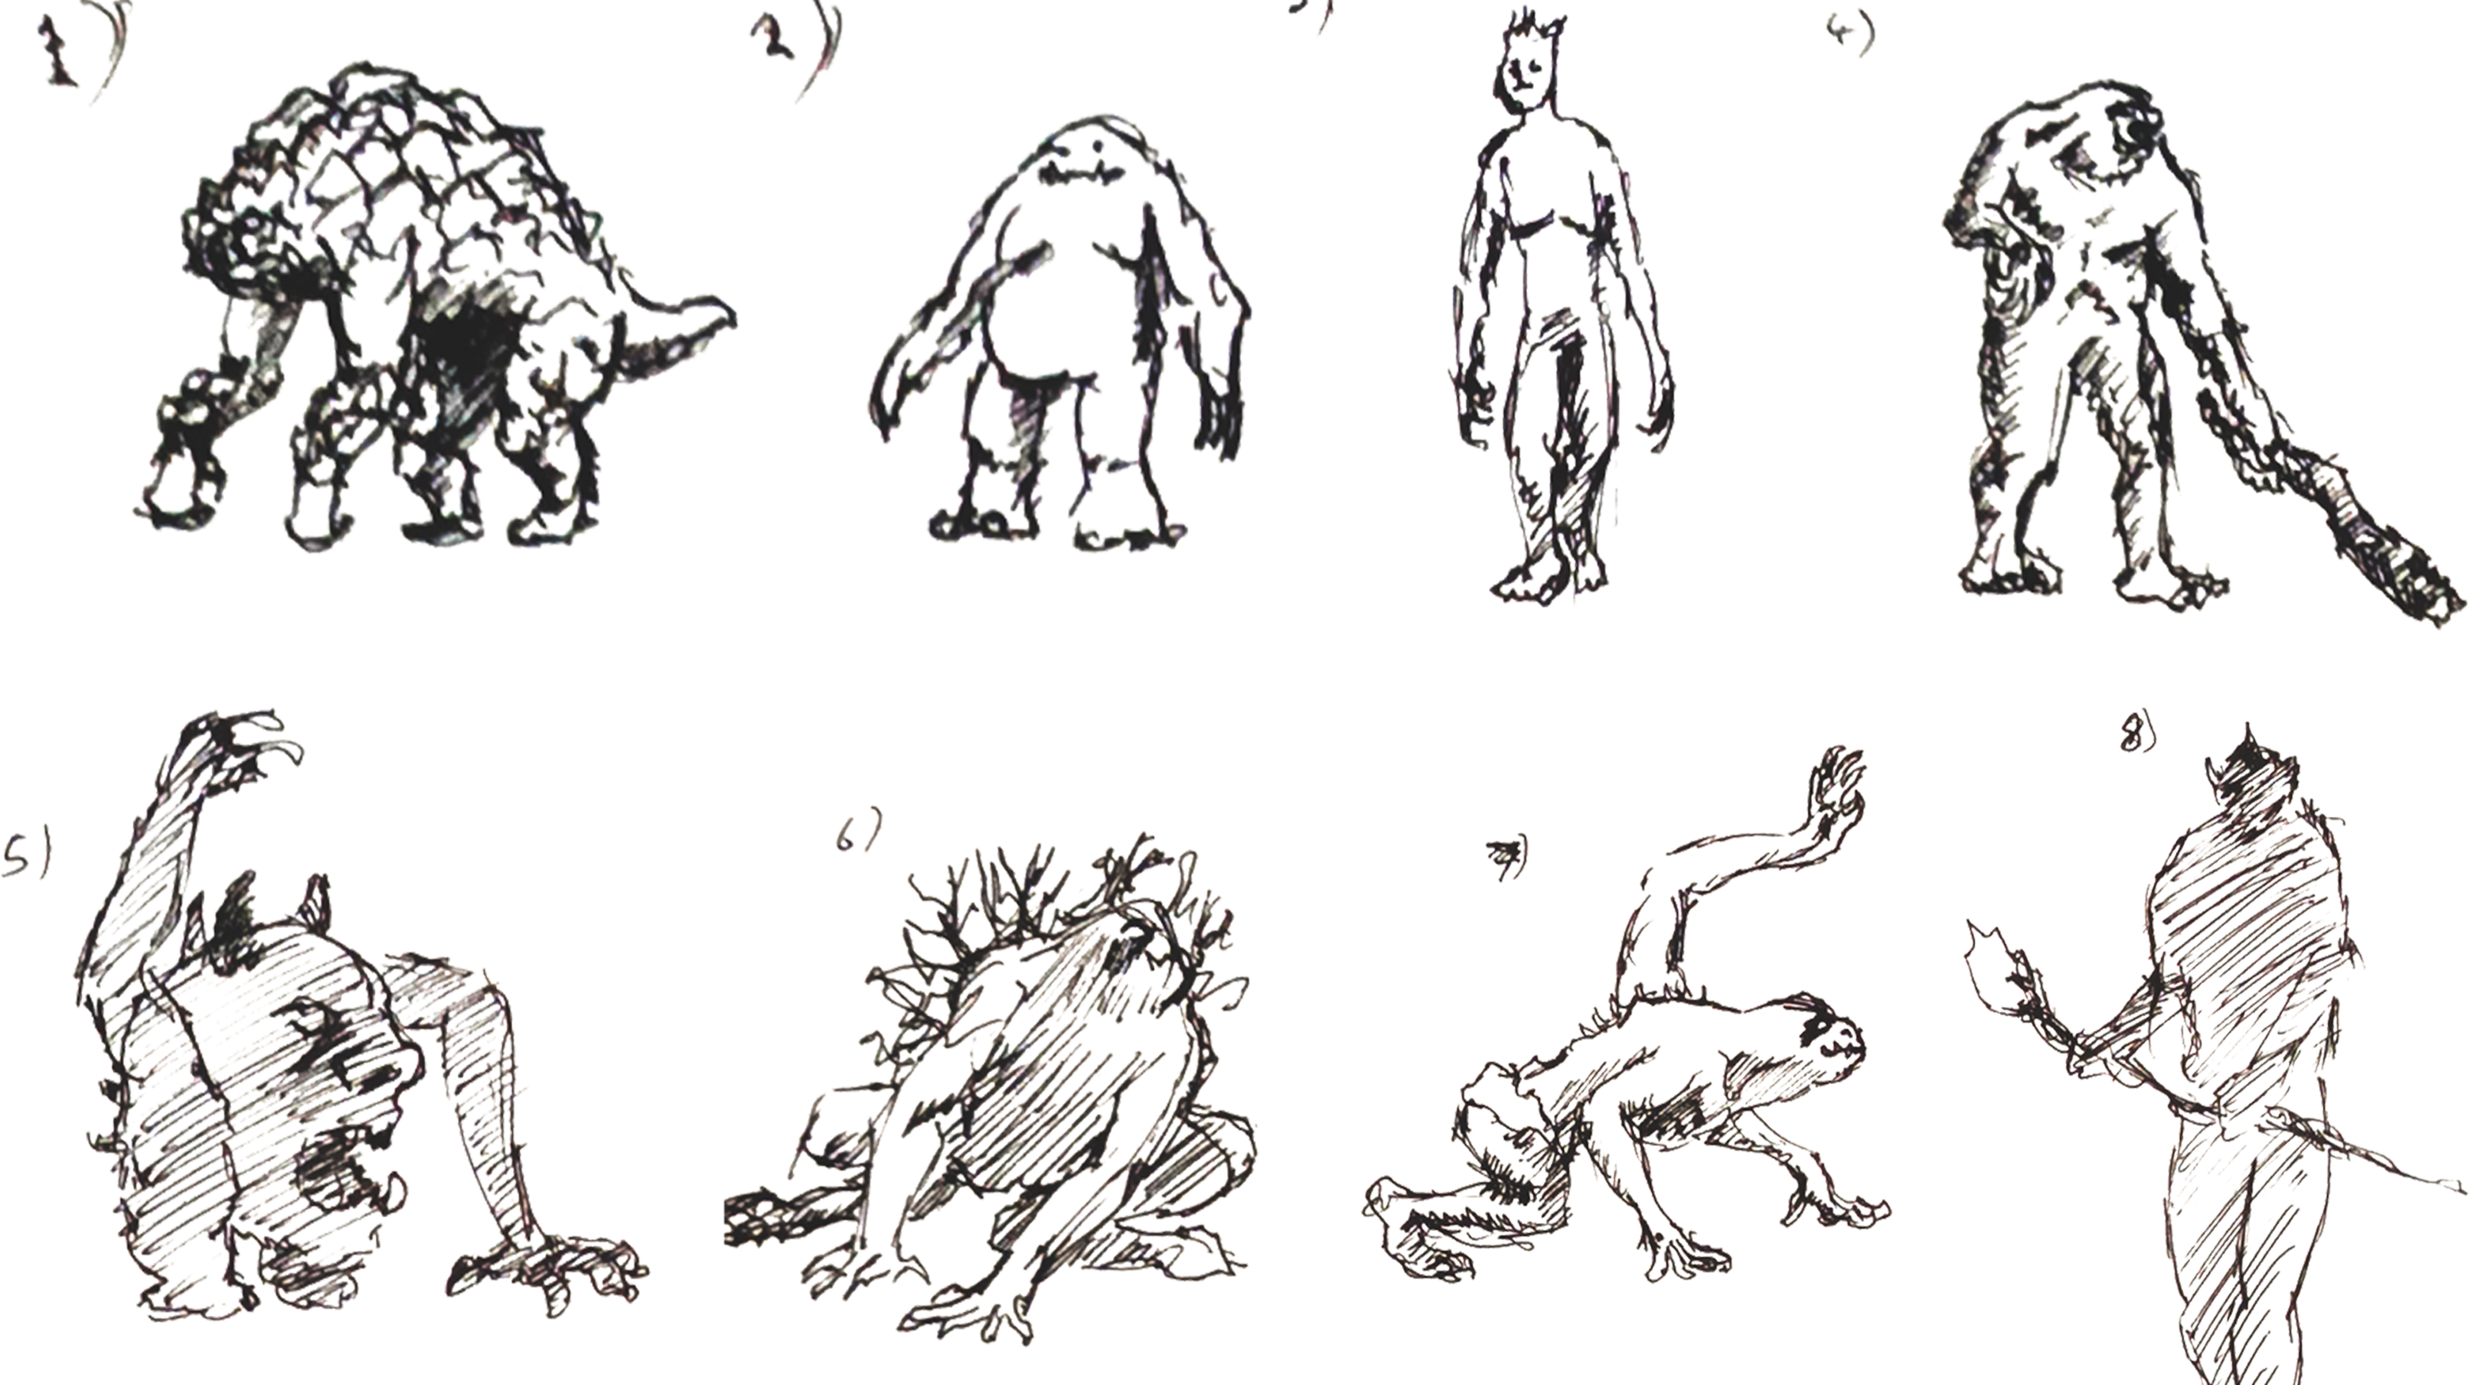
Iteration

Slide 11
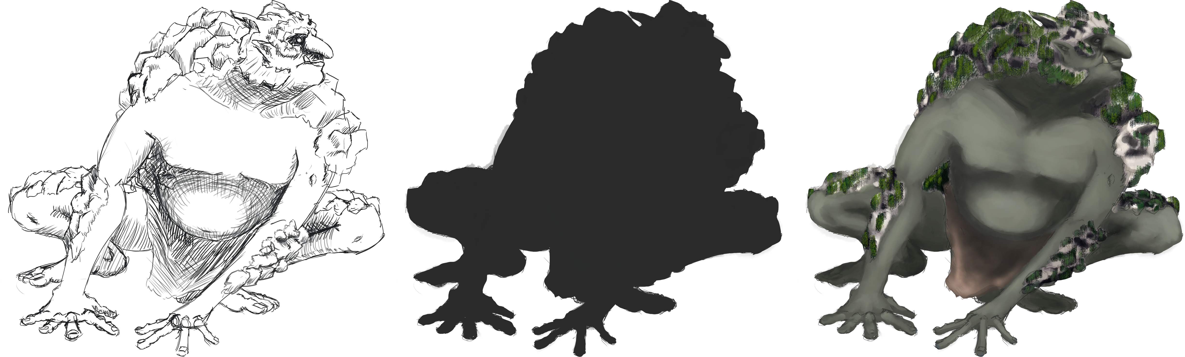
Initial design

Slide 12
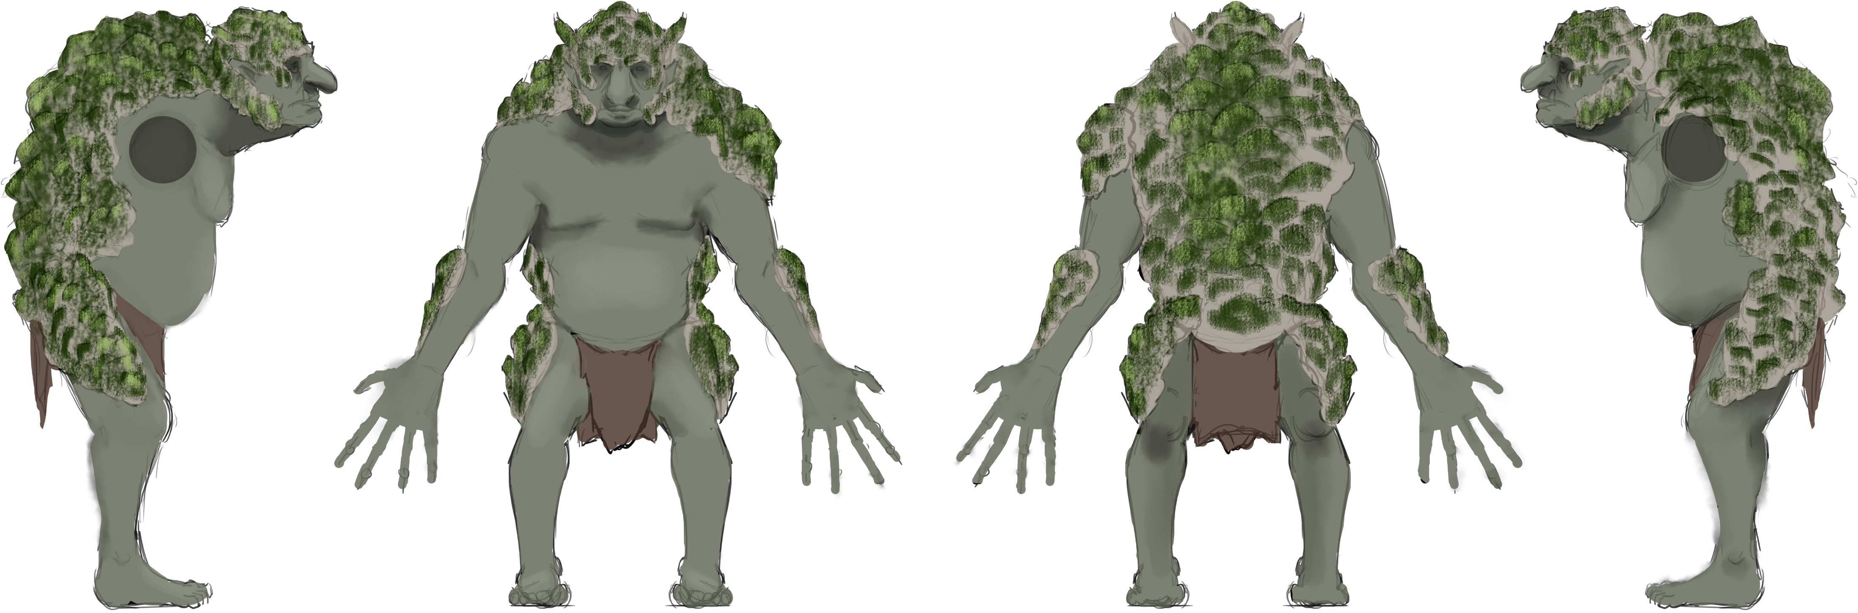

Slide 13
Information
A creature from American Indian folklore, from the Algonquin-speaking tribes of the Great Lakes region in Canada and the northeastern U.S., serving as a metaphor for the horror of insatiable greed, selfishness, and cannibalism, born of winter famines and spiritual imbalance. Described as Emaciated and towering, sometimes 15 feet tall, with Gaunt, pale skin stretched tight over bones, Bloody, chewed lips, and gnawed fingers. Known to have a heart encased in ice, and so ravenous it eats its own body. Its terrifying transformation symbolizes the way greed can consume a person—literally and spiritually.

Slide 14
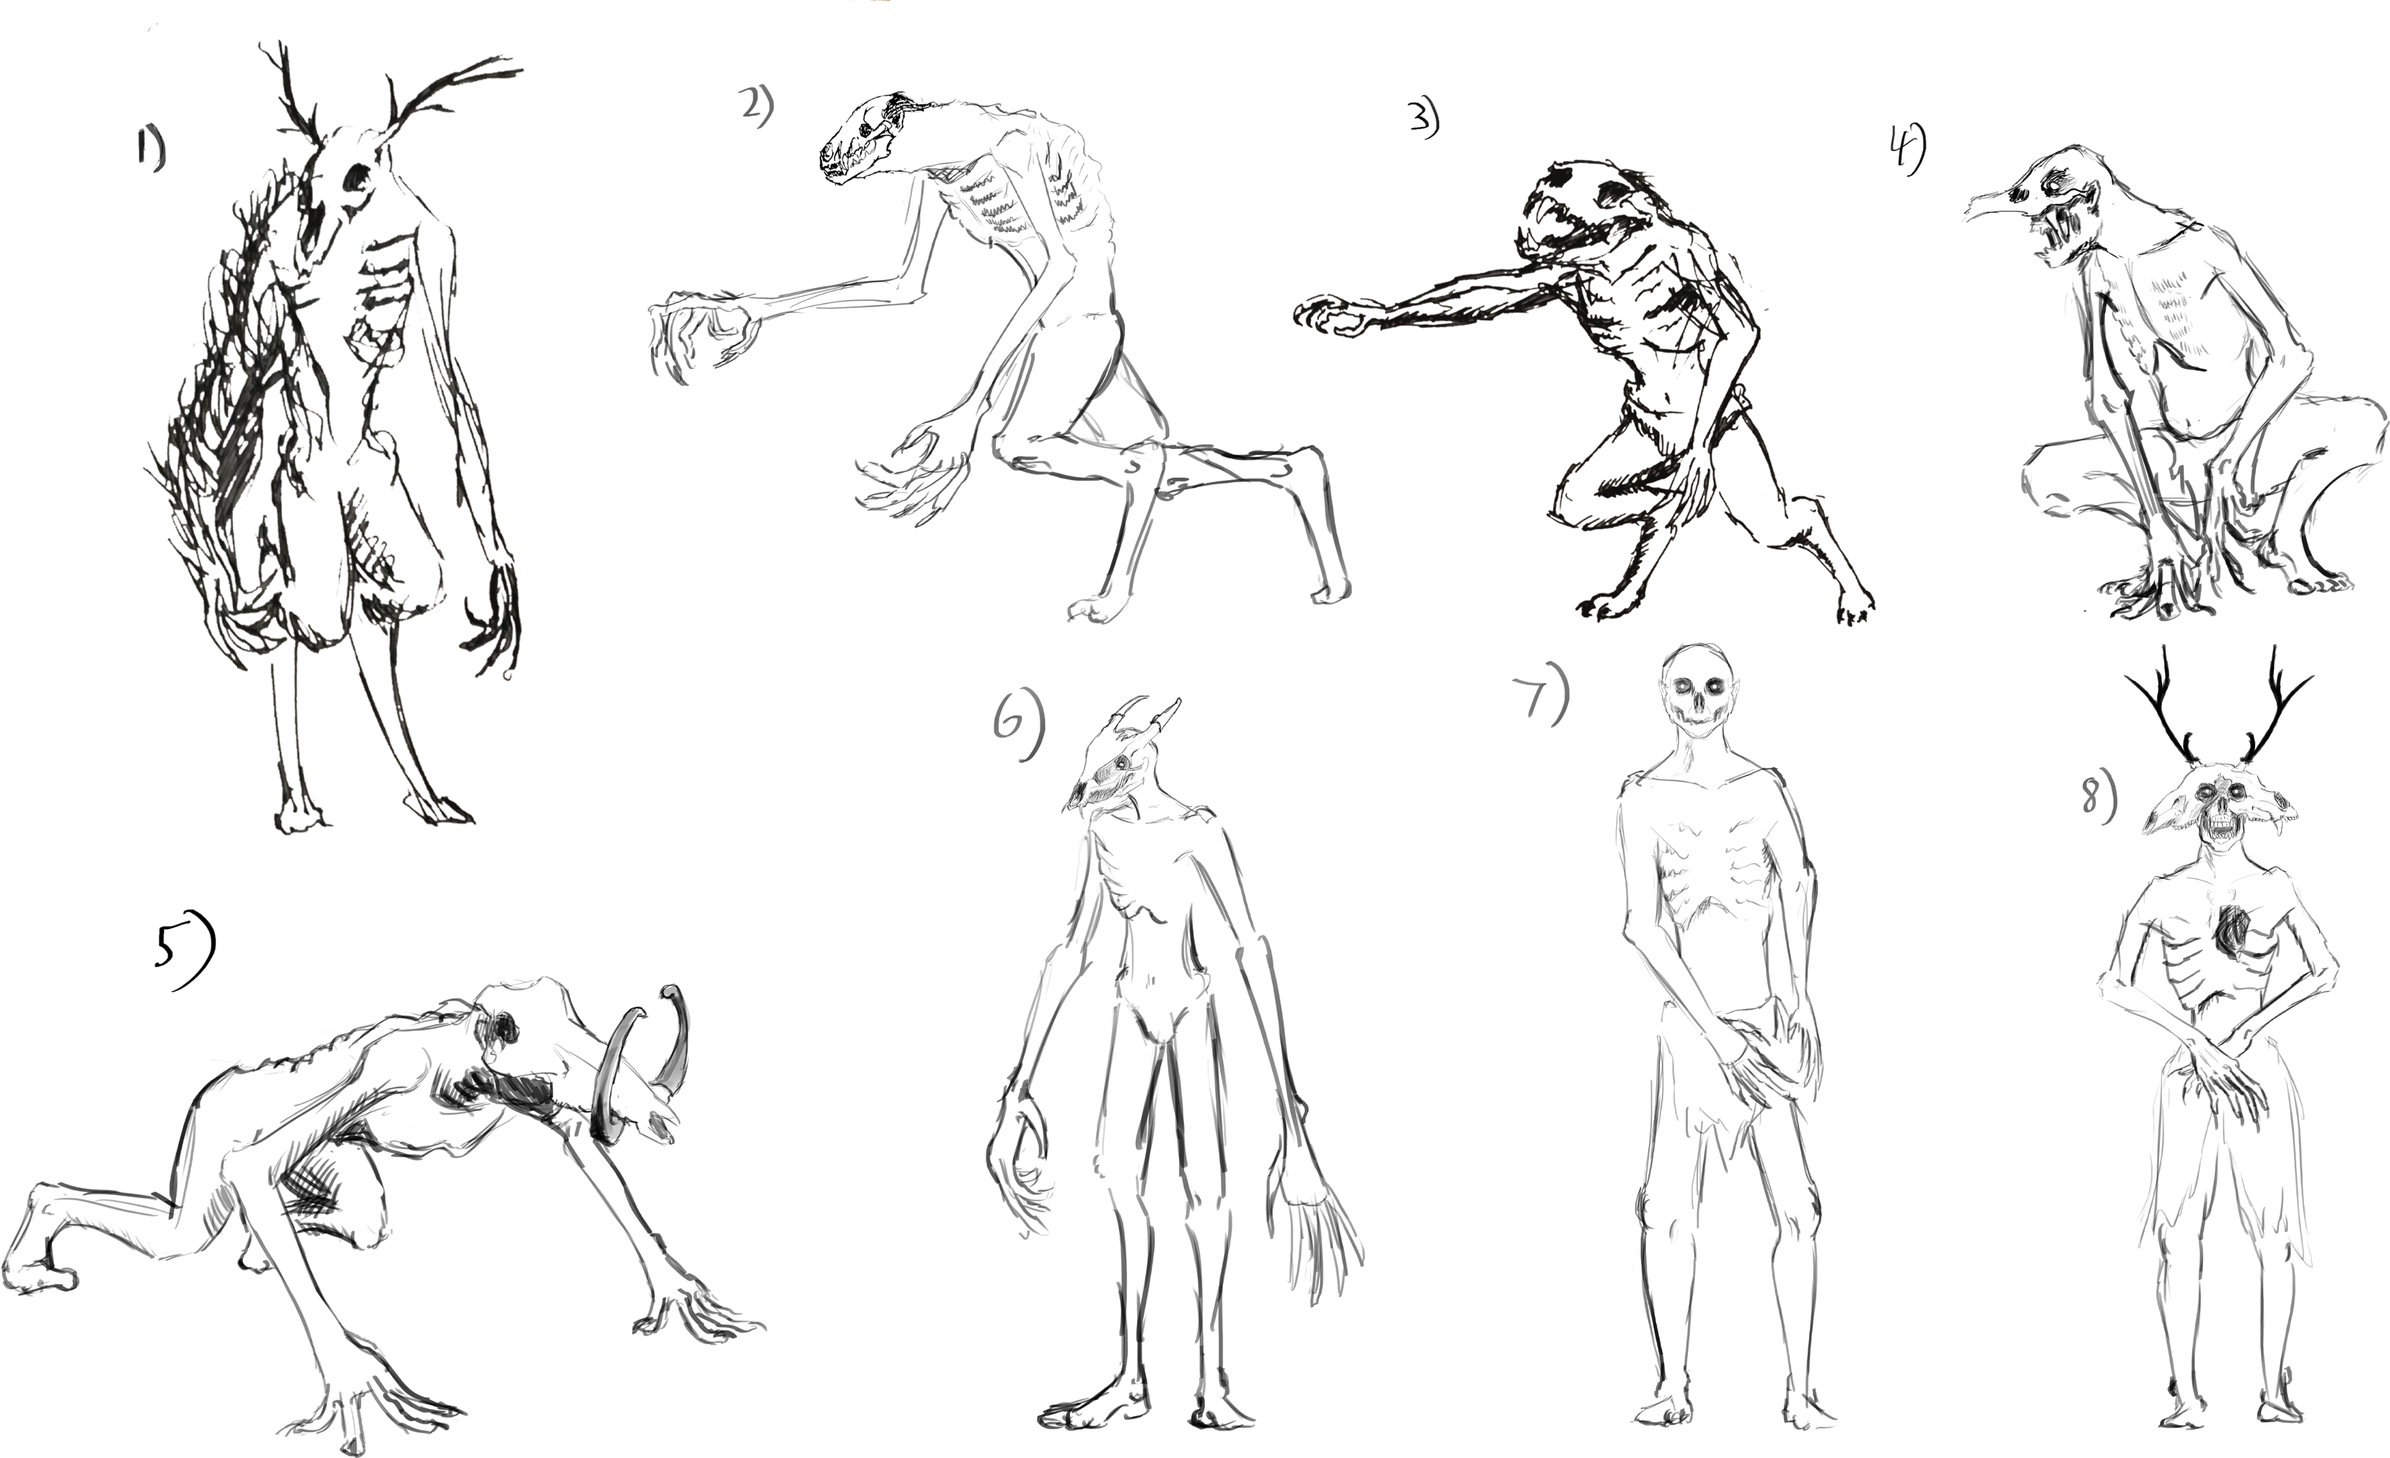
Iteration

Slide 15
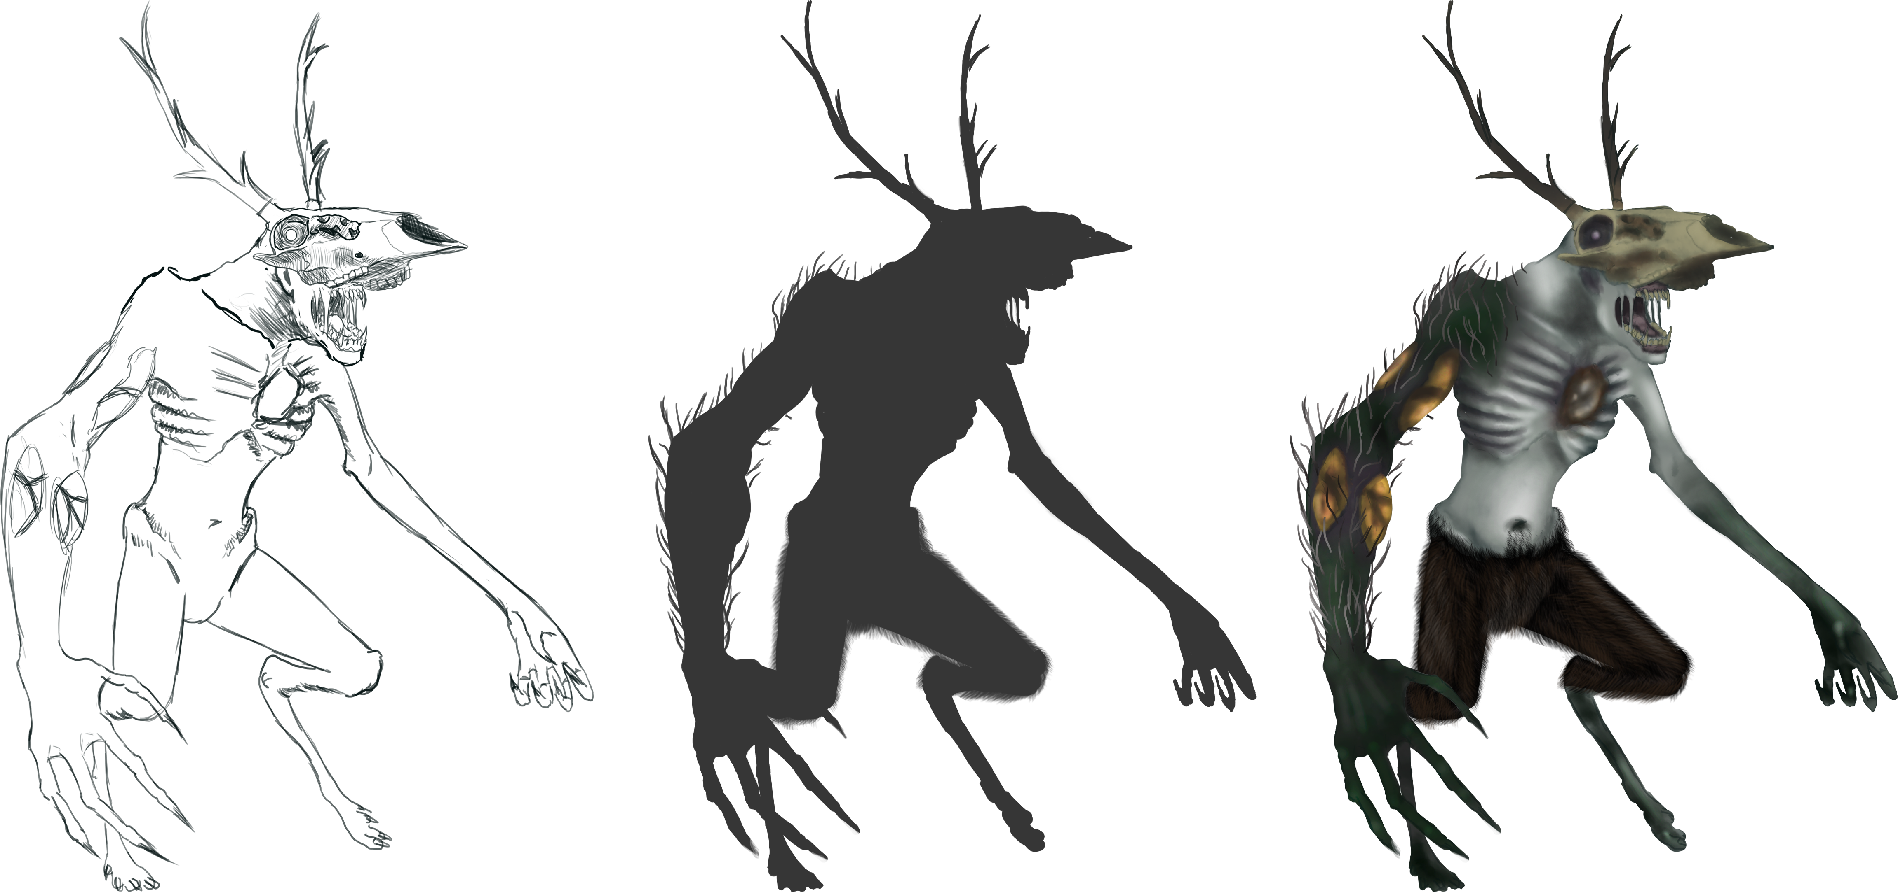
Initial design

Slide 16
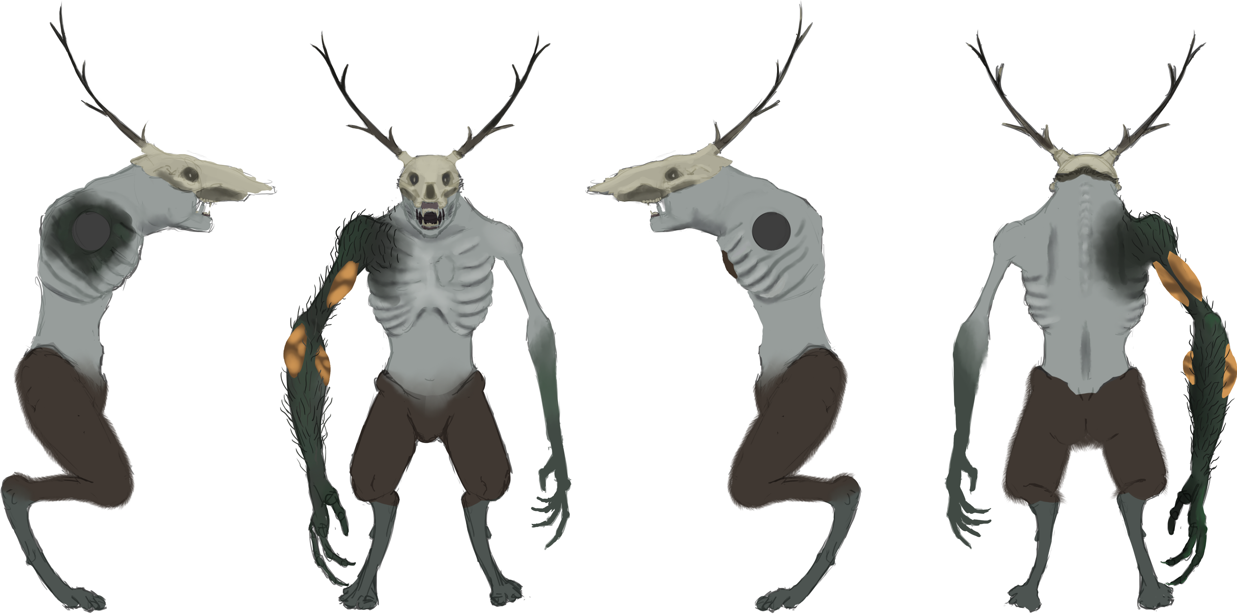

Slide 18
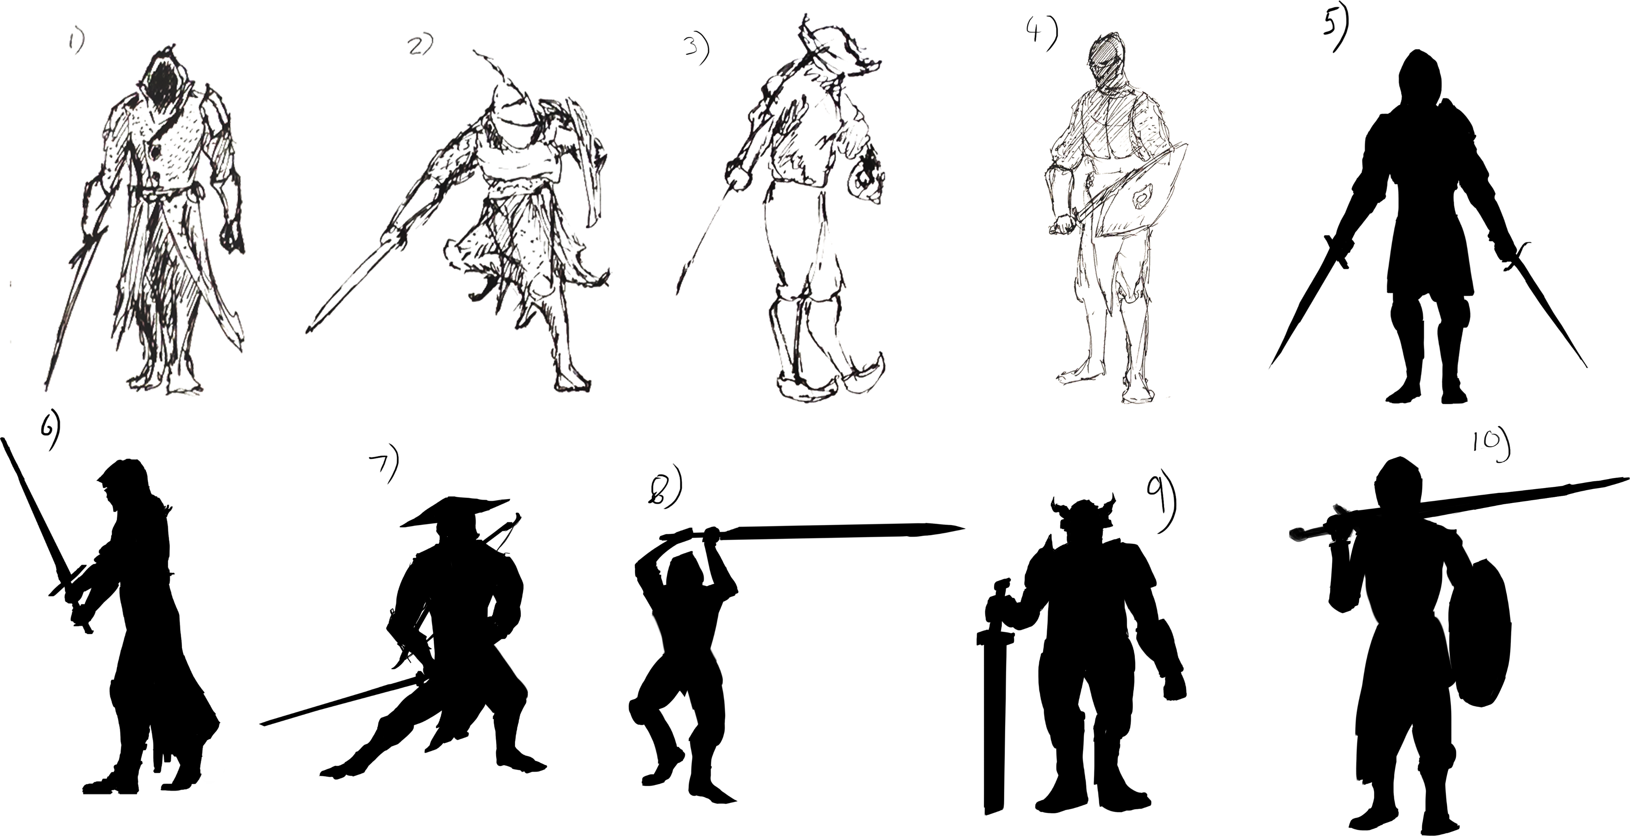
Iteration

Slide 19
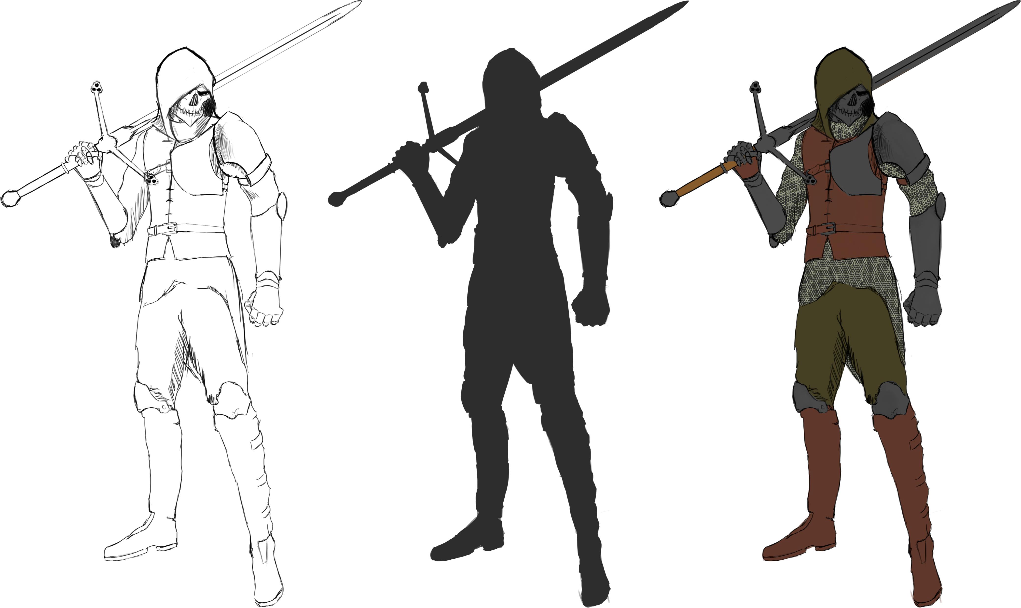
Initial design

Slide 20
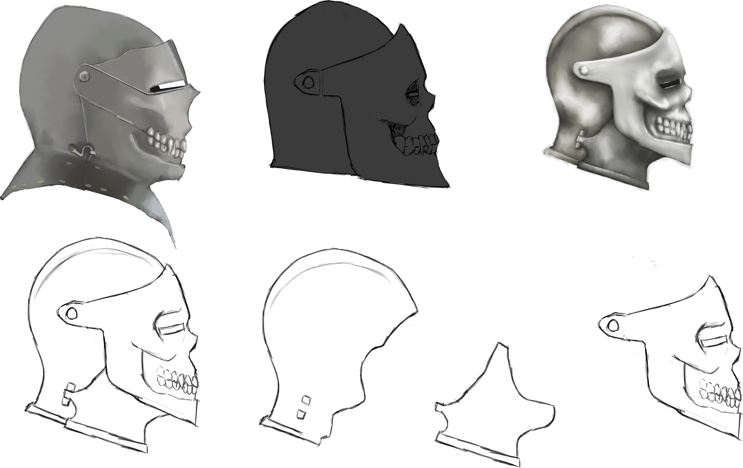
Design exploration
Began making alternat designs for the shape of the helmet and began to design a modified version of the armet with deviations in the shape of parts and how it assembles.

Slide 21
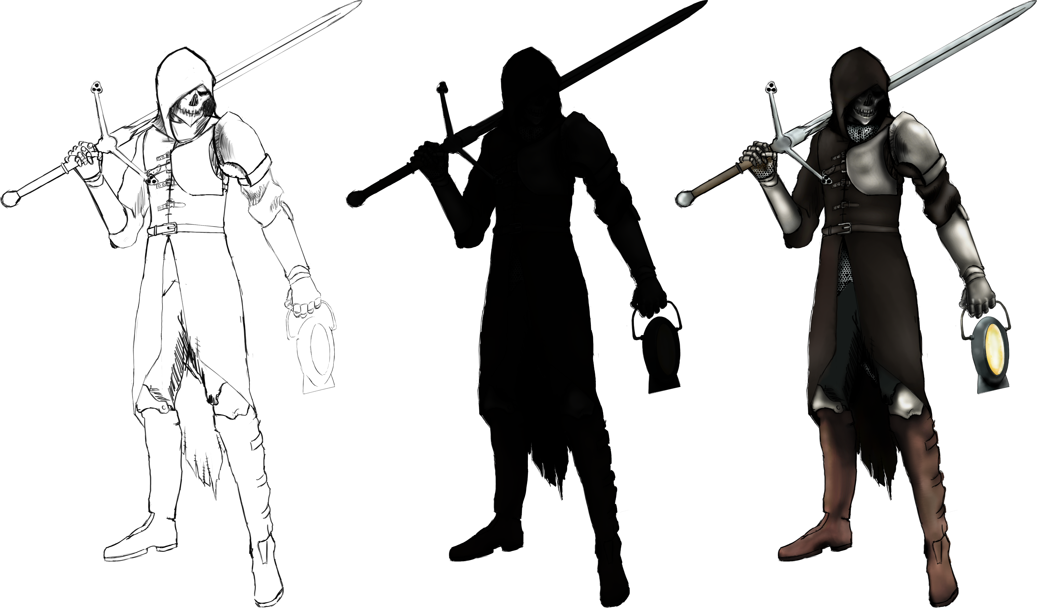
Design exploration 2

Slide 22
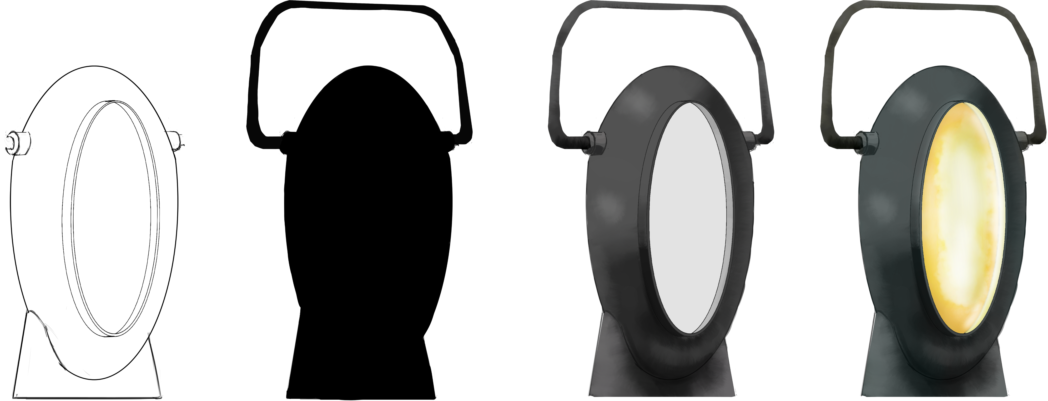
Props and weapons

Slide 23
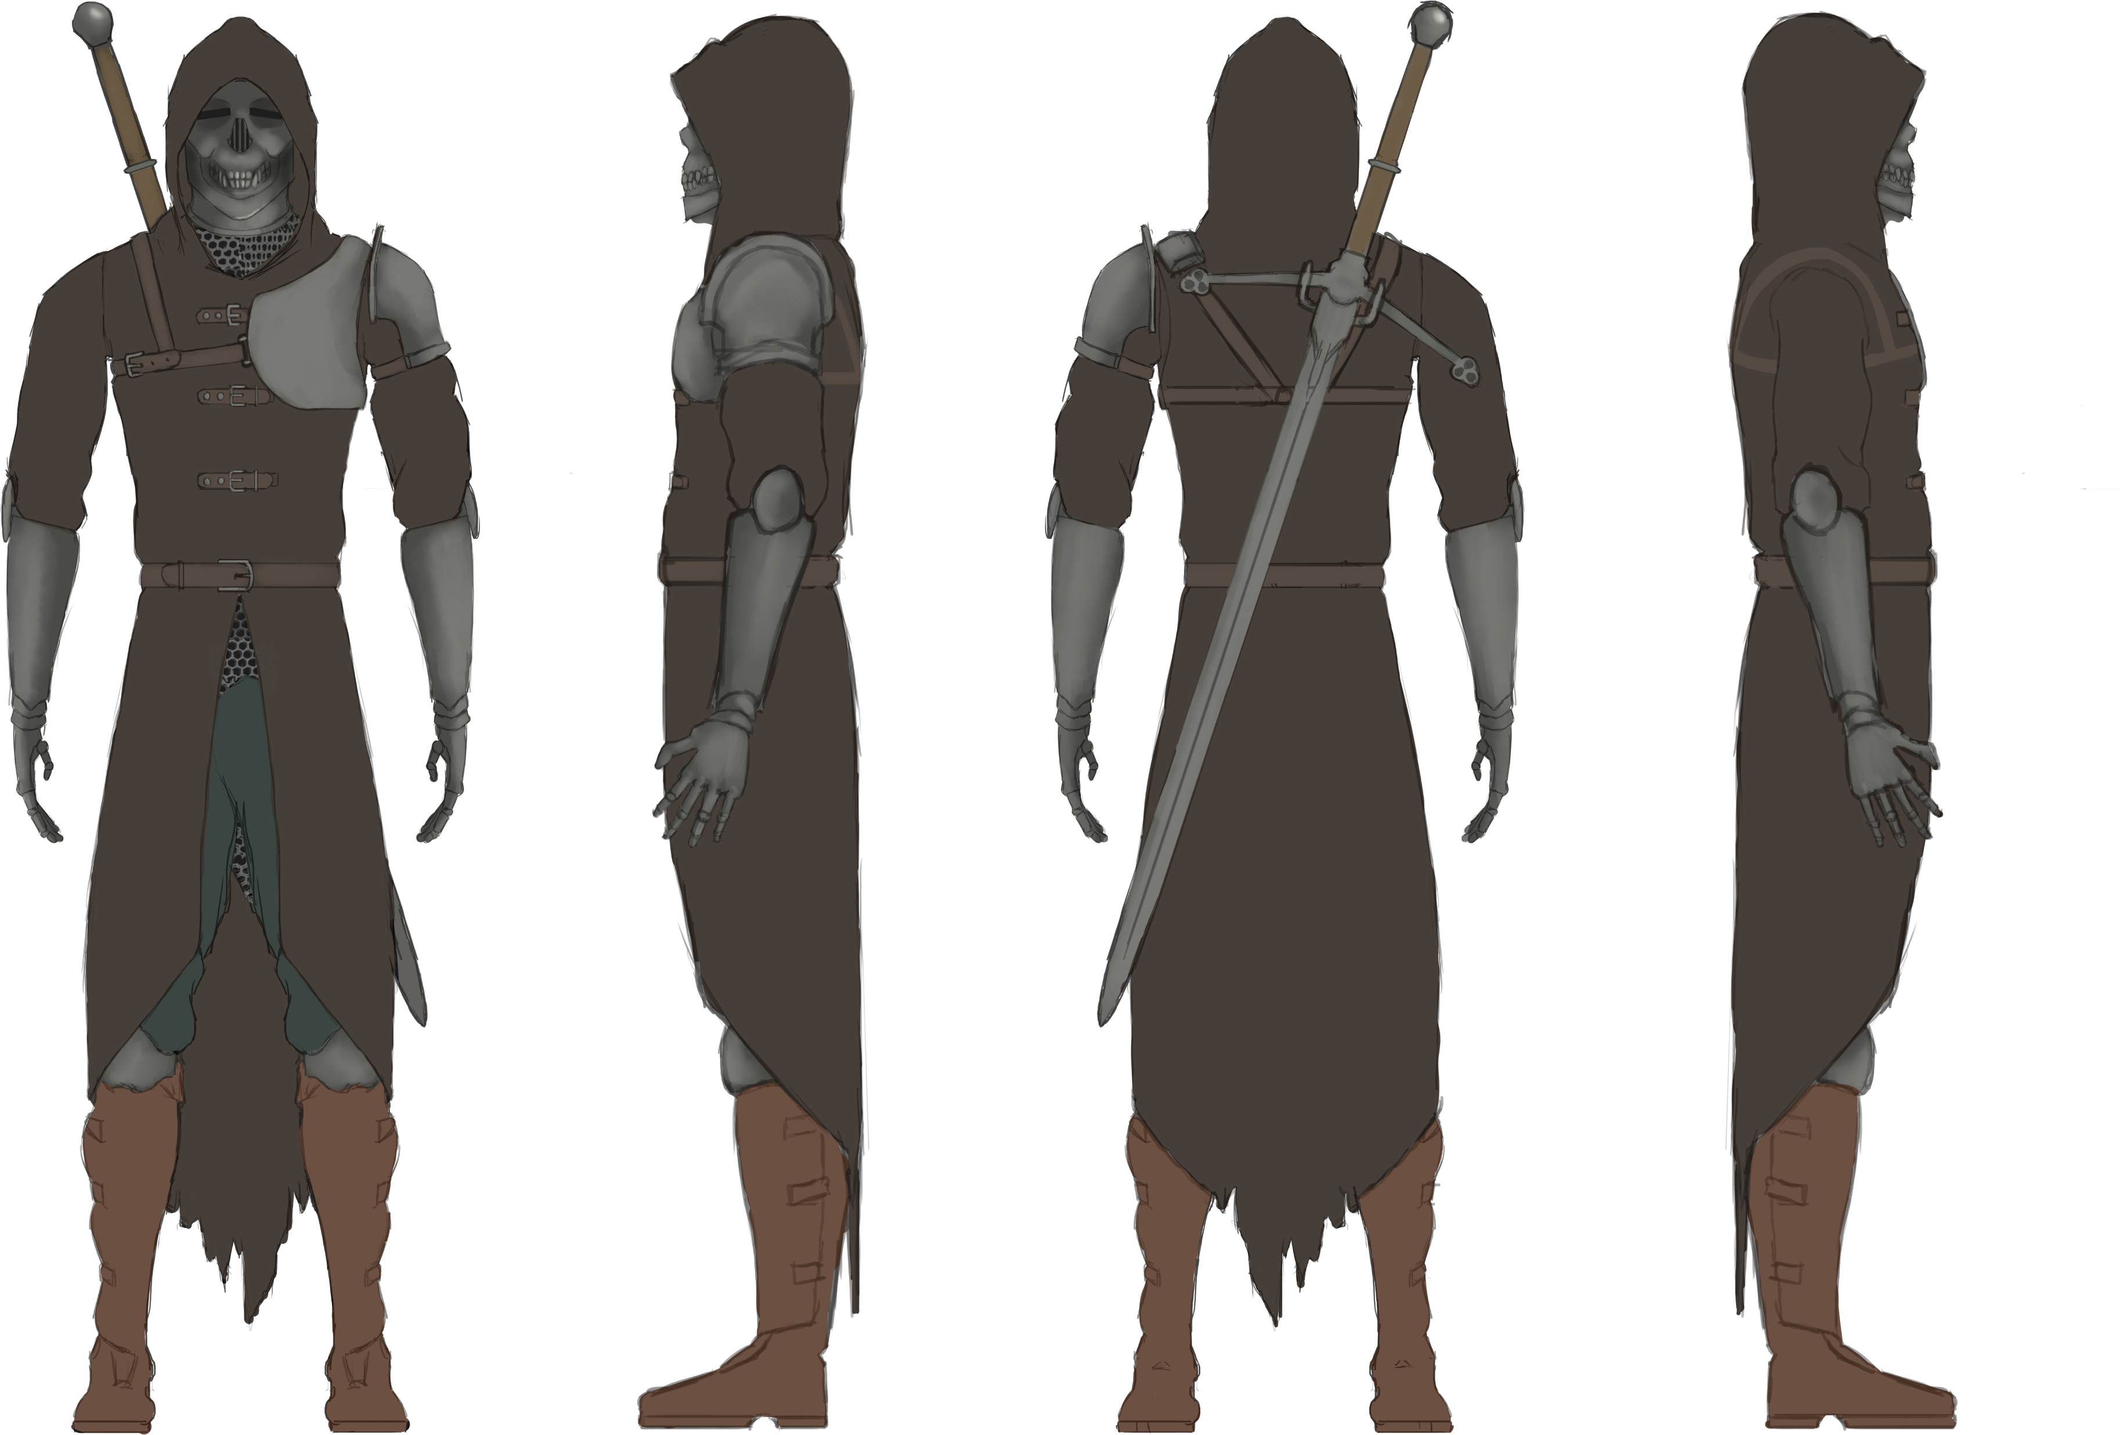

Slide 24
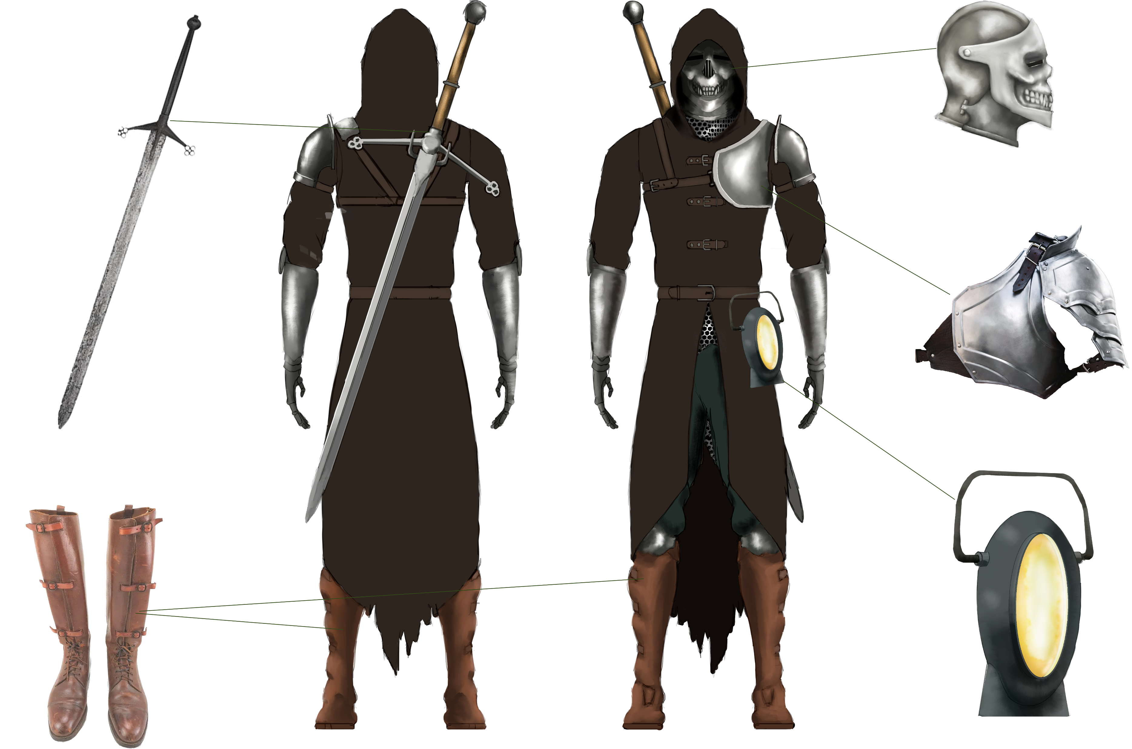

Slide 25
Final piece
All characters together in a pose.

