Slide 1

Wushu Weapon Art Brief Development Logbook
Leo Follows - F012722M

Slide 2
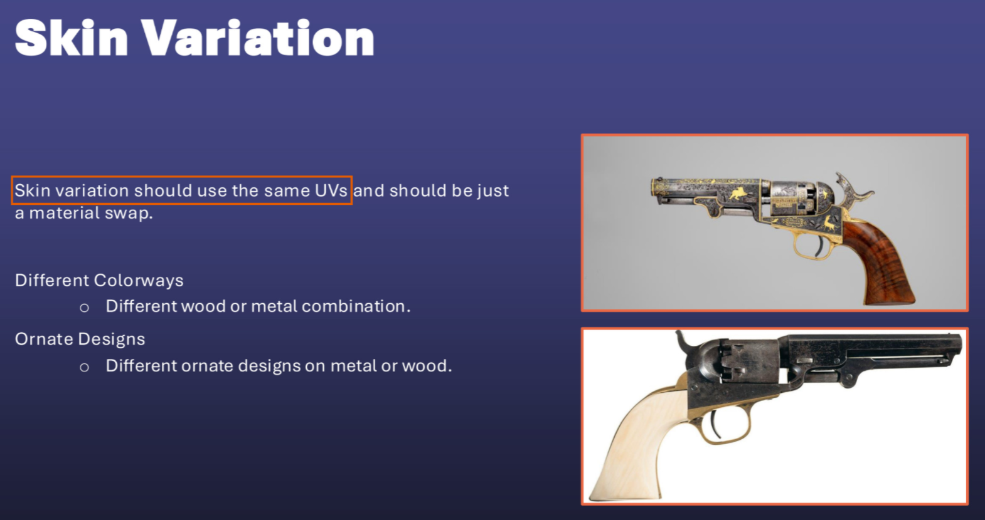
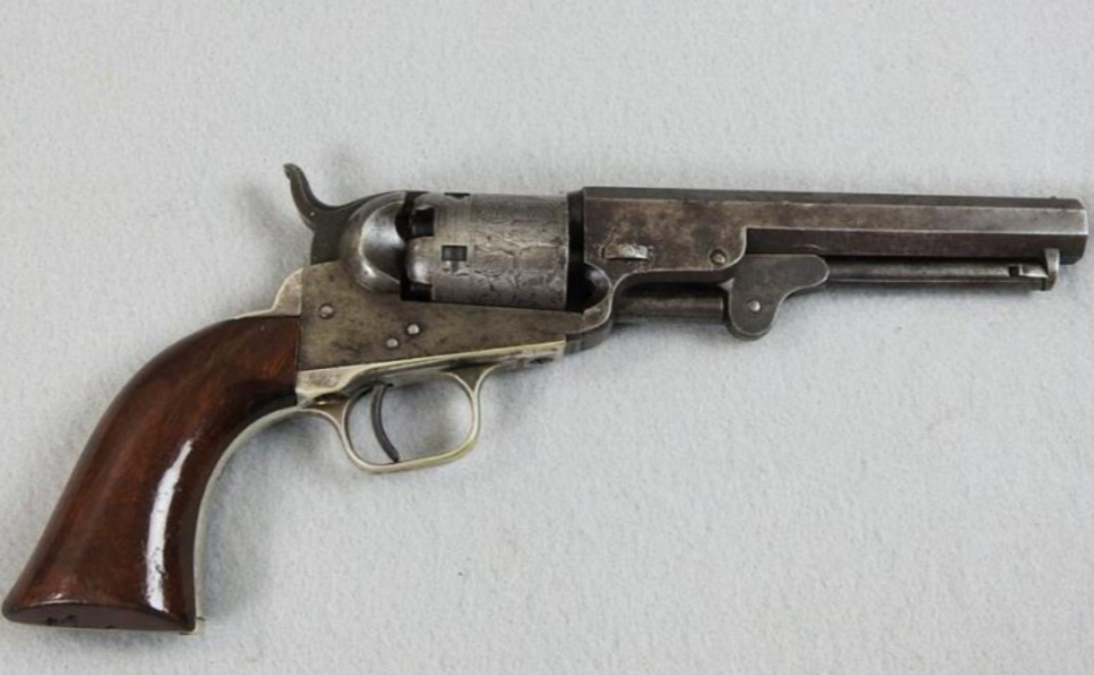
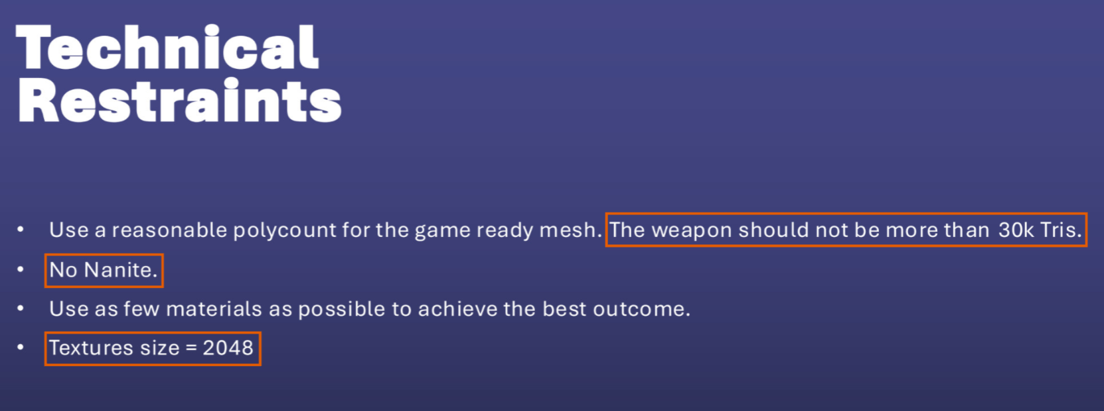
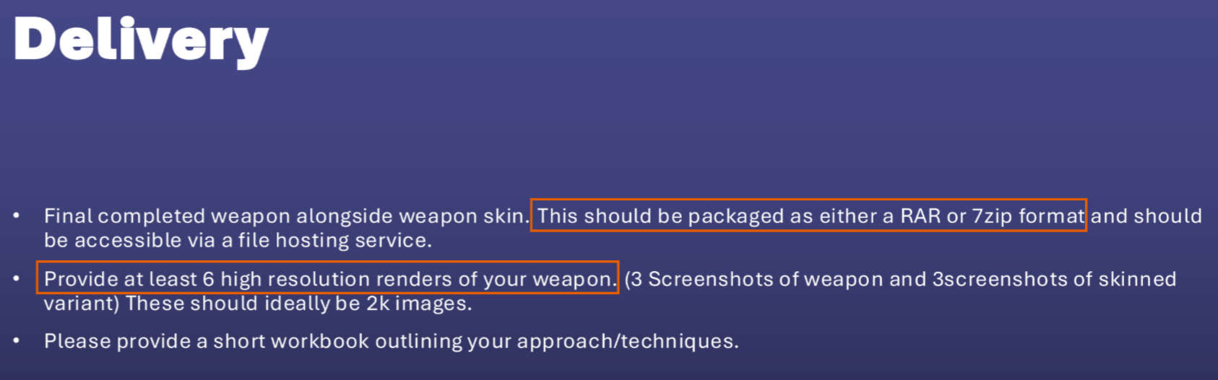
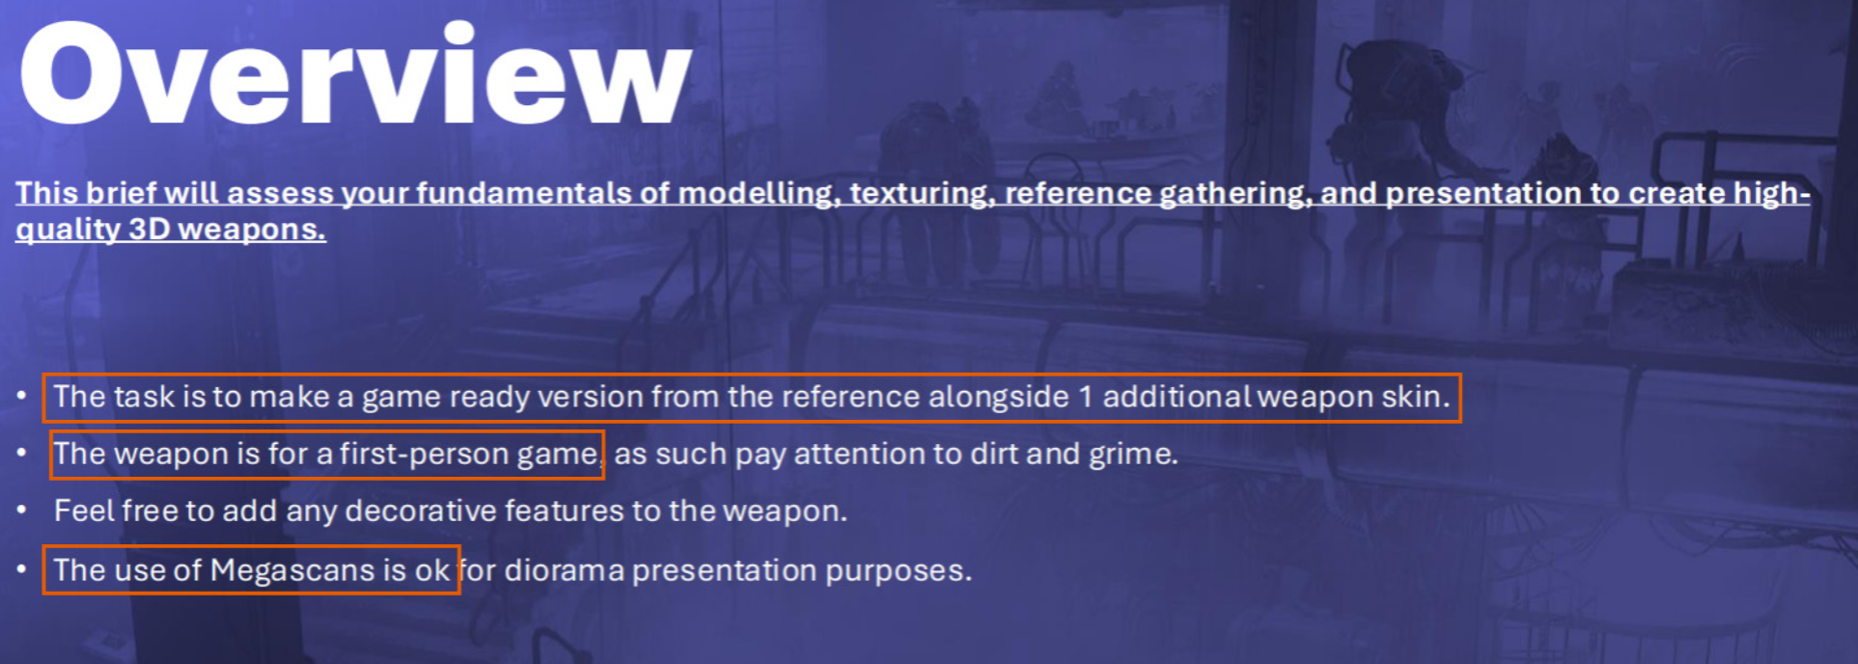
Understanding The Brief
Brief Breakdown
Create a game ready version of the cold model 1849
Create a skin variation for the weapon
30k Tri Limit
2048x2048 Texture Size Limit
No Nanite
At least six renders (three of each skin)
Mega scan assets can be used for background purposes
Colt Model 1849

Slide 3
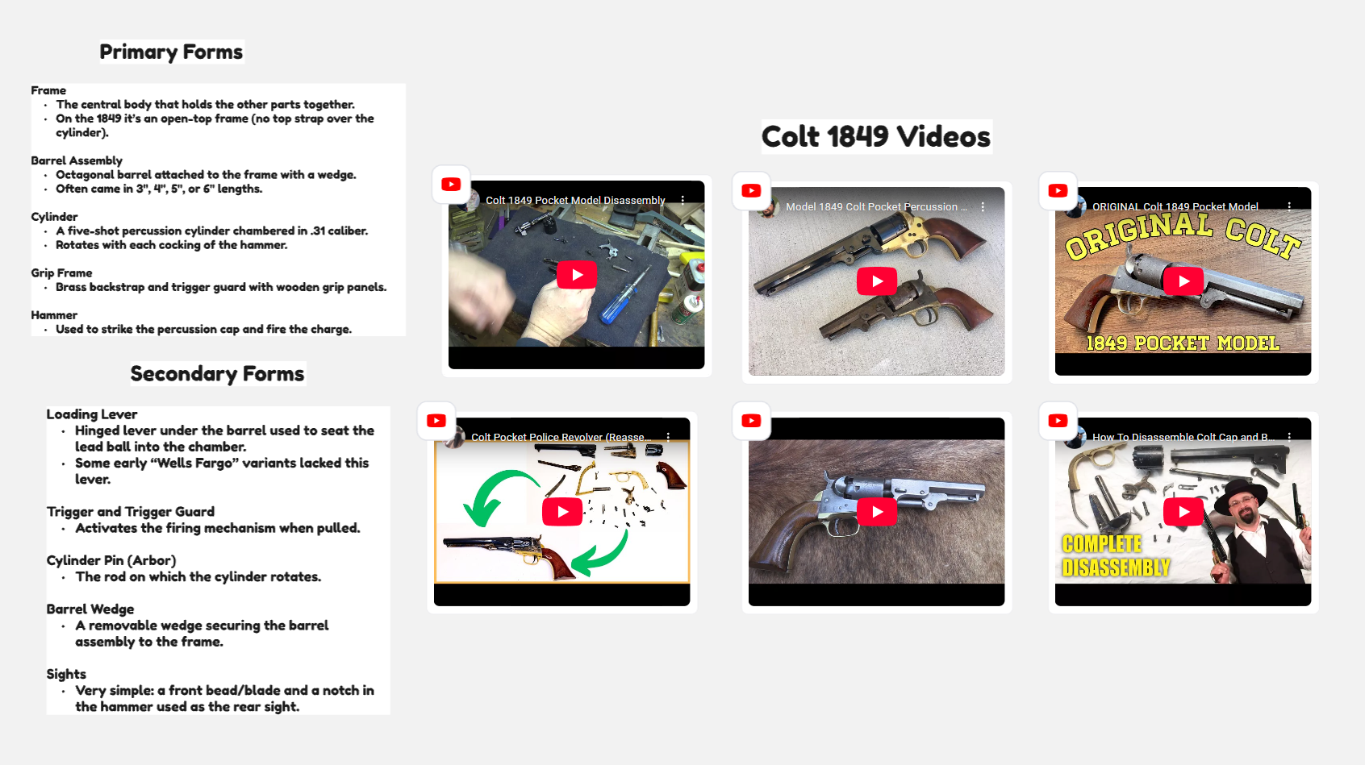
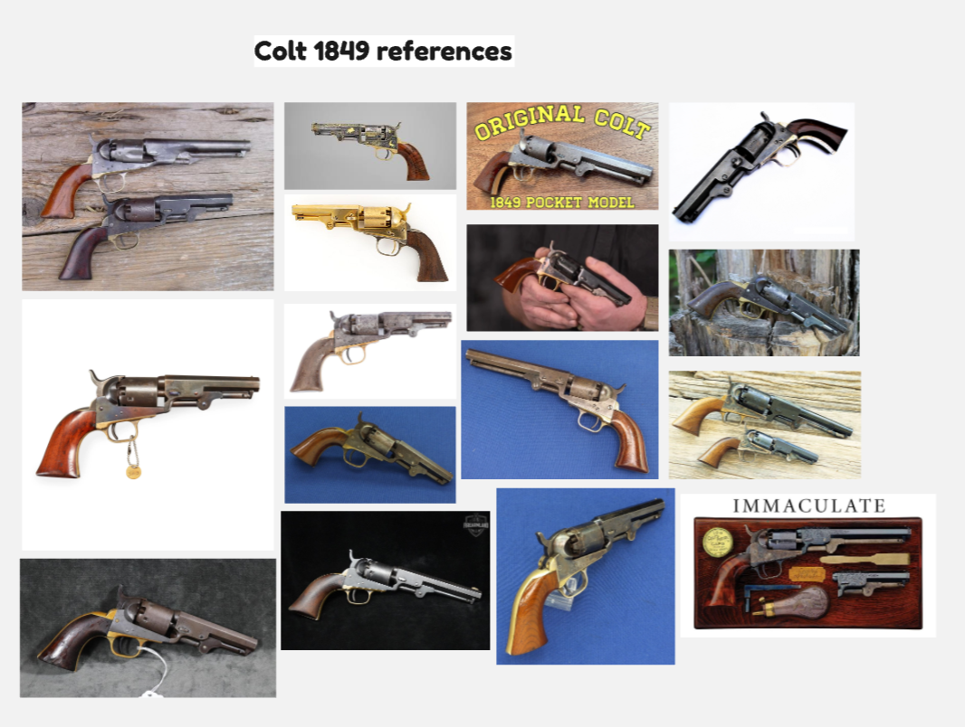
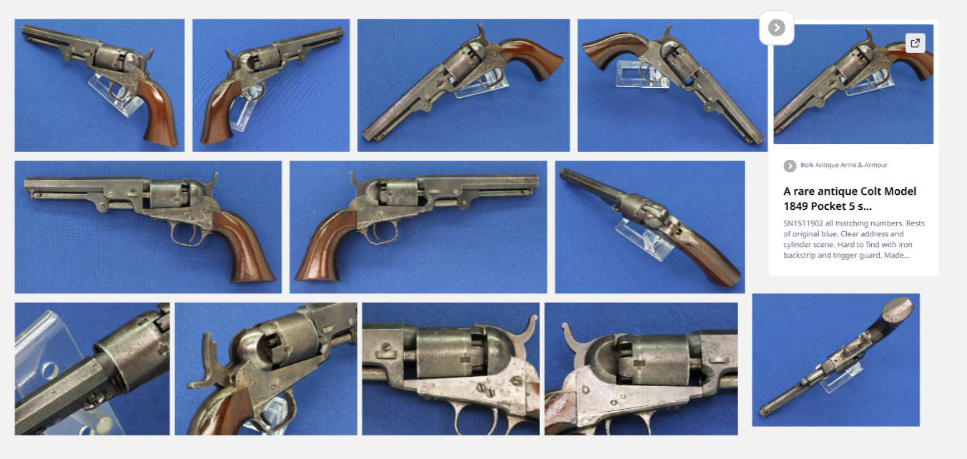
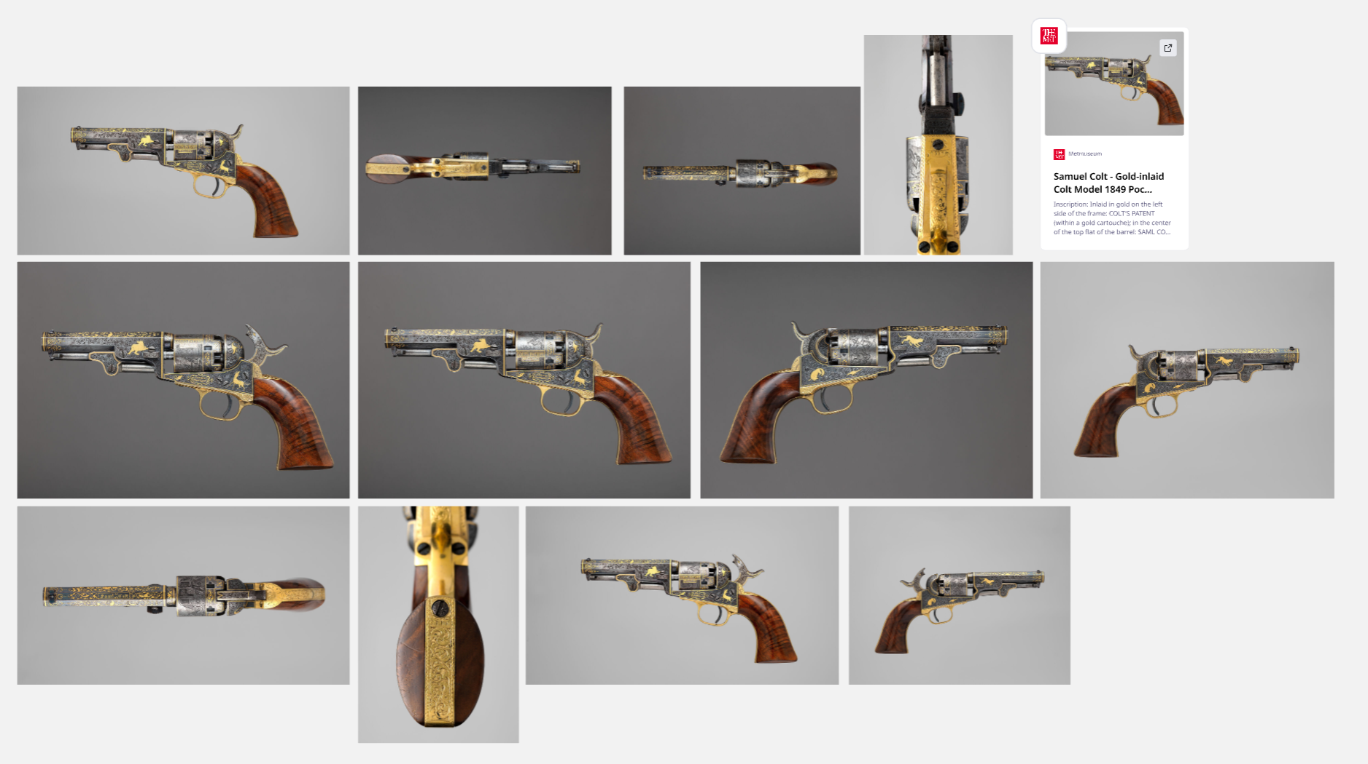
Reference Gathering
https://miro.com/app/board/uXjVG2q9Ib8=/?share_link_id=658008029312

Slide 4
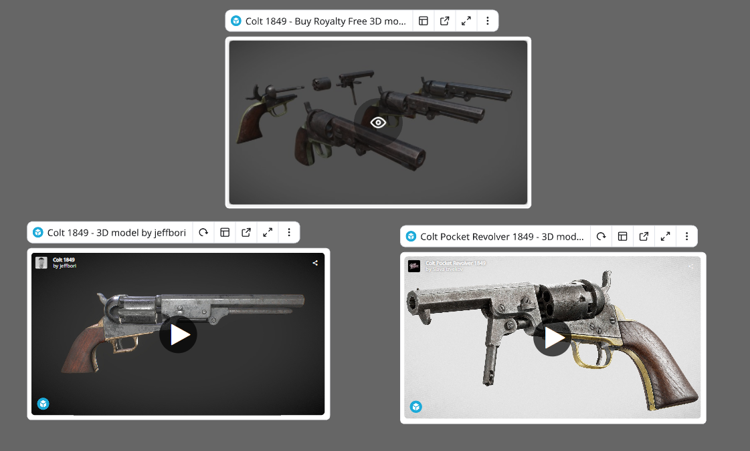
3D References
Using Websites like Sketchfab during my research development. Sketchfab allows me to inspect models closely to look at the finer details of the gun, this also gives me access to look closely at mechanisms inside of the gun from zooming the camera inside, Its perfect for example references

Slide 5
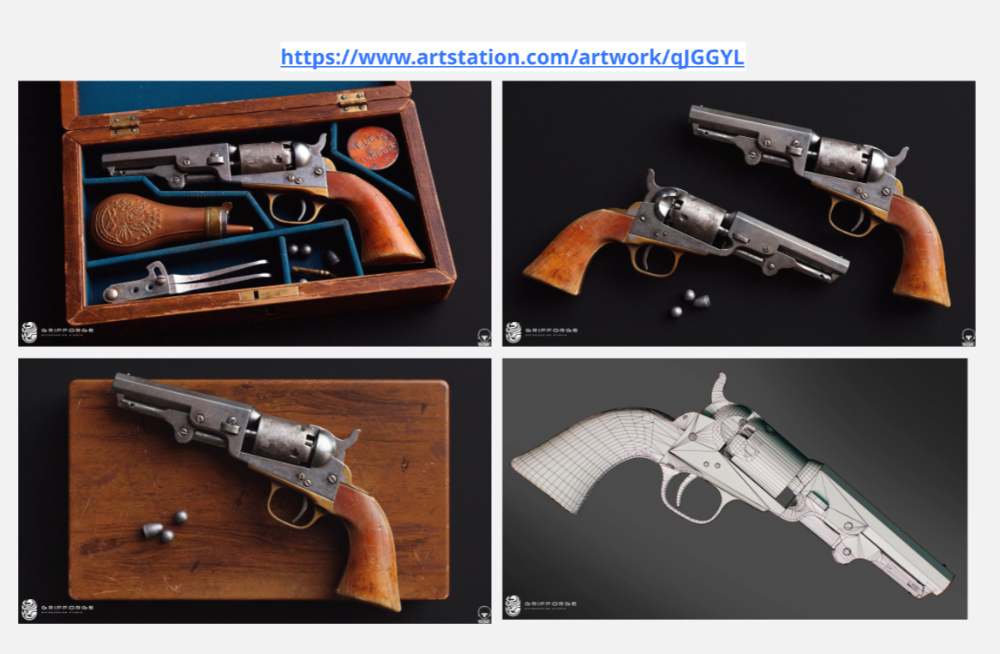
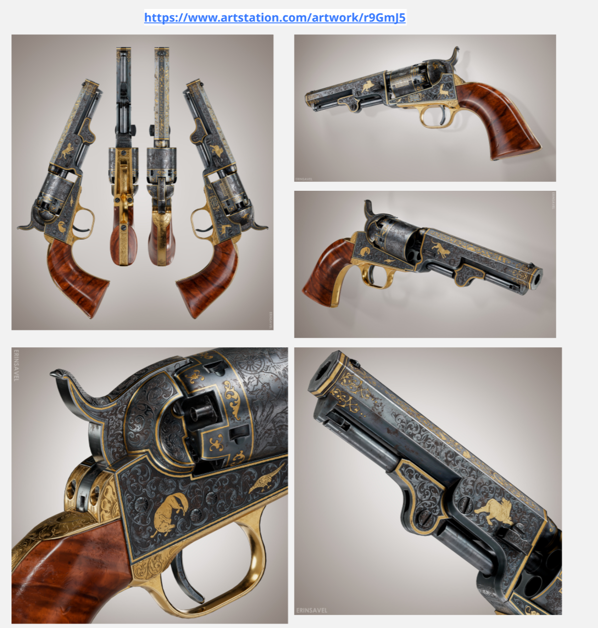
Industry/Professional Comparison
Looking at industry comparisons mostly was looked into the texturing quality and lighting presentation; I was really aiming towards on making a authentic weapon with realism. I was heavily inspired by the engraving work on some of the colt pieces since ive never got to do any engraving work on my models in the past.

Slide 6
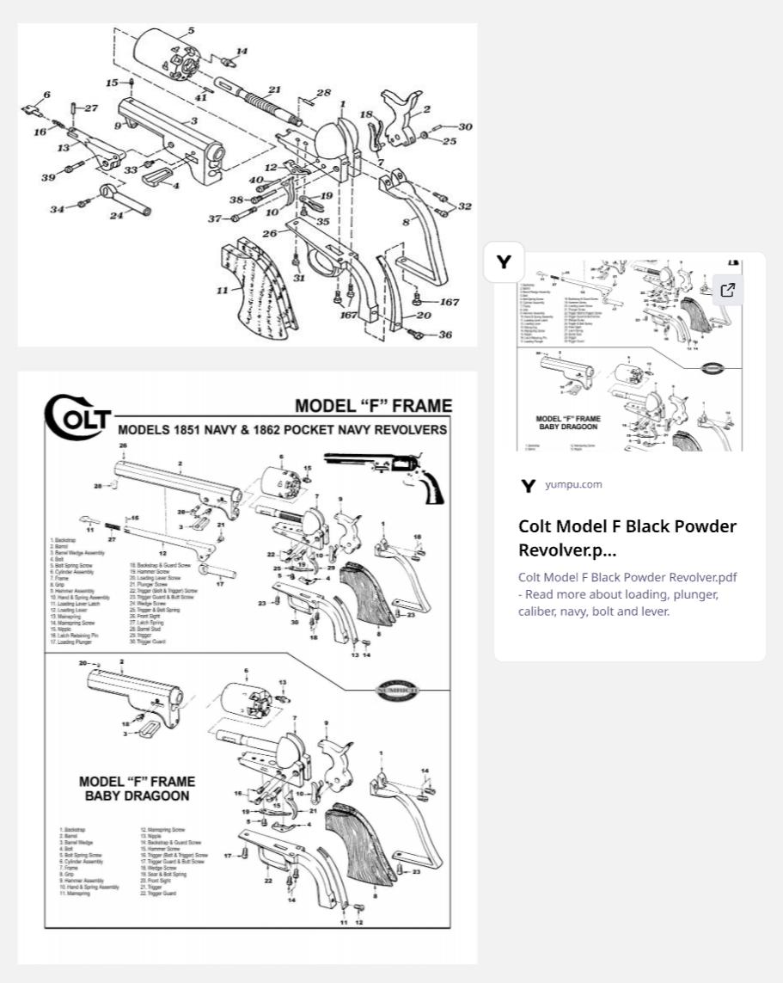
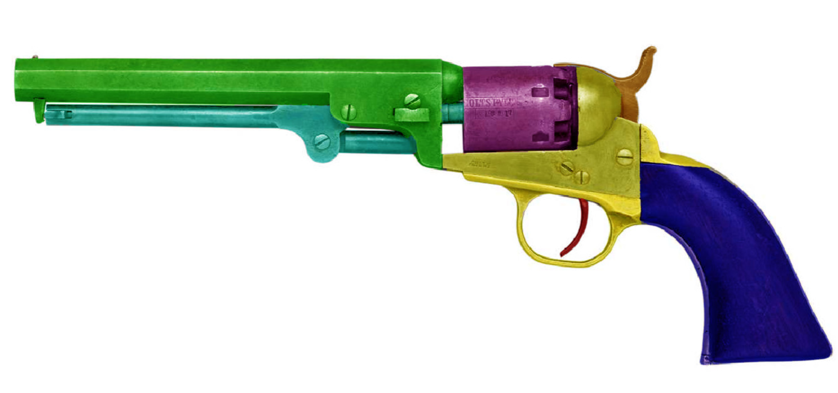
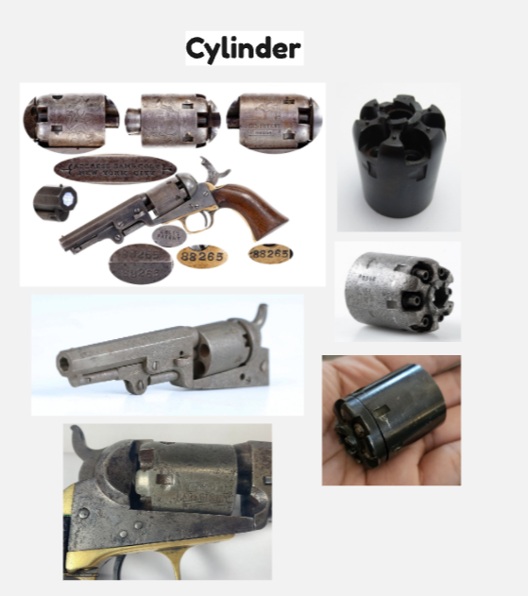
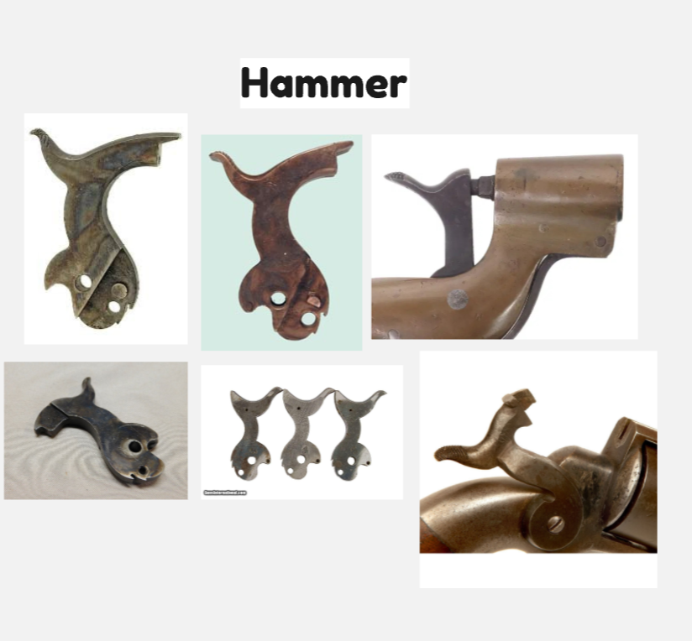
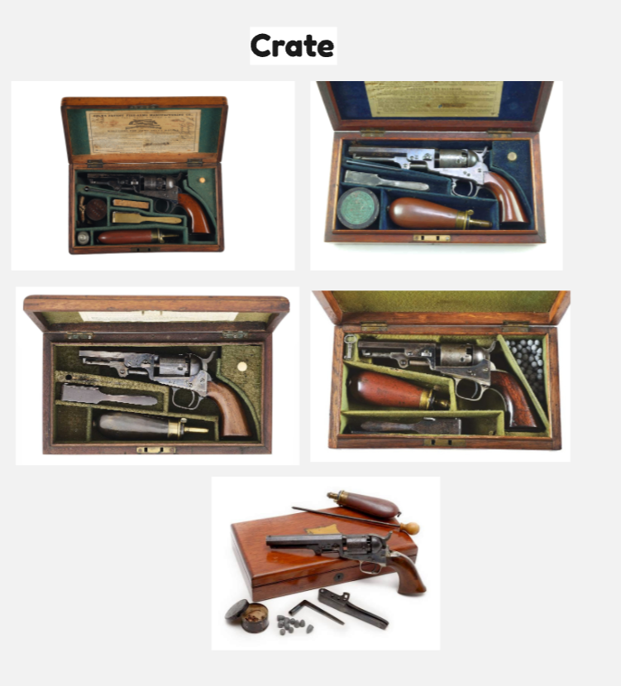
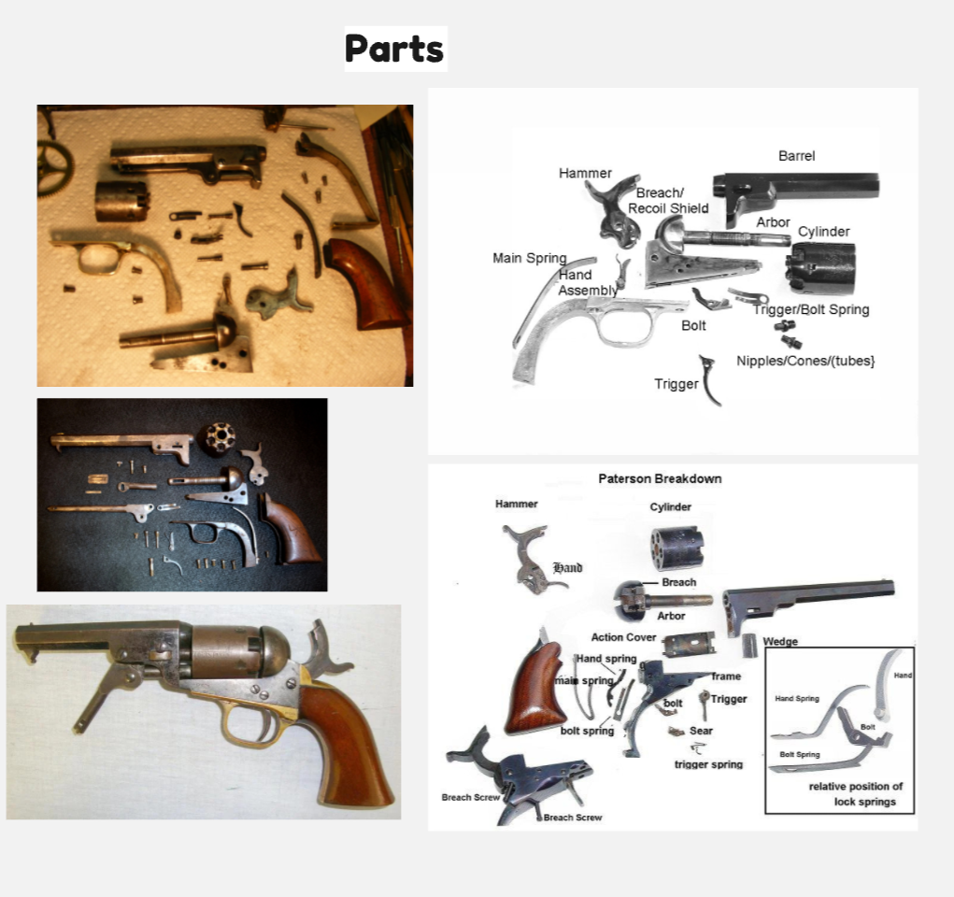
Weapon Breakdown
Breakdown
Barrel
Cylinder
Hammer
Grip
Trigger
Trigger Guard
Lever

Slide 7
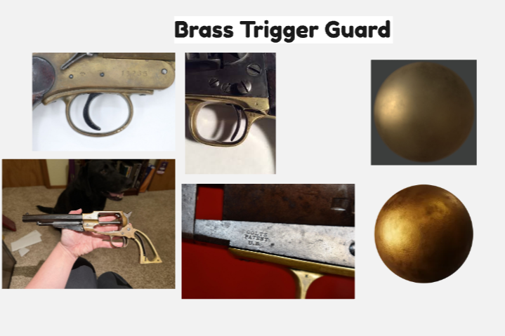
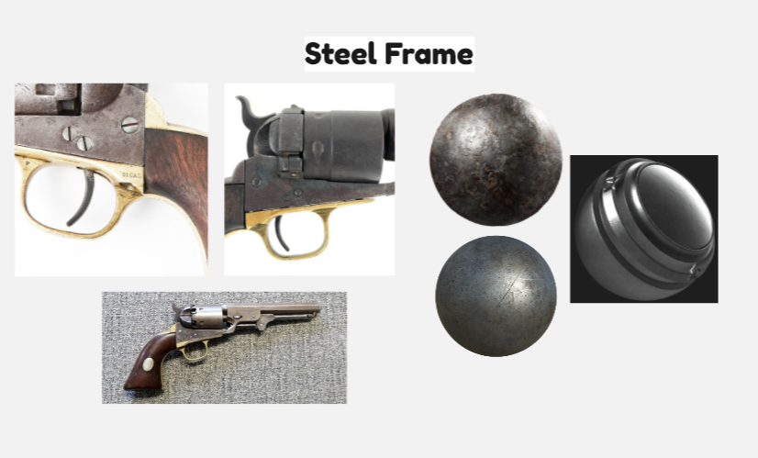
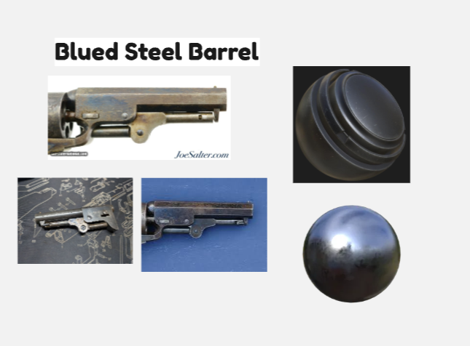
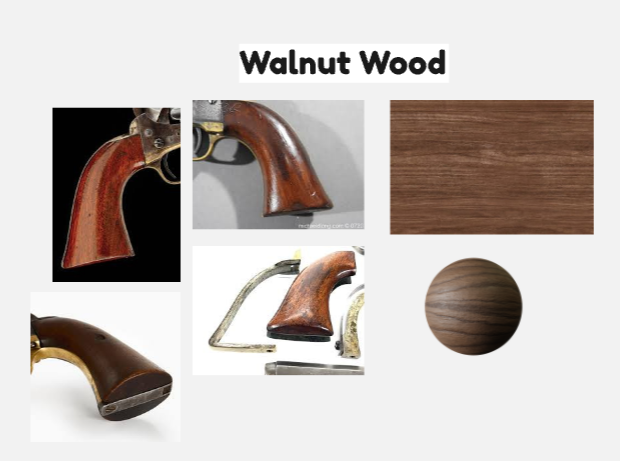
Material Breakdown

Slide 8
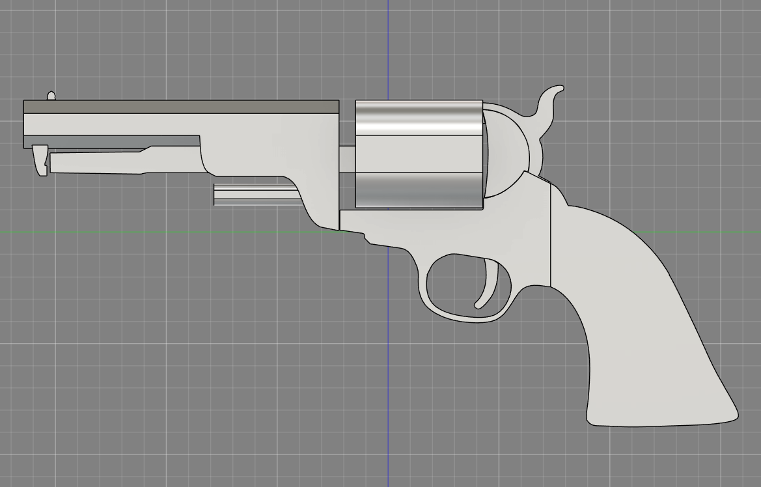
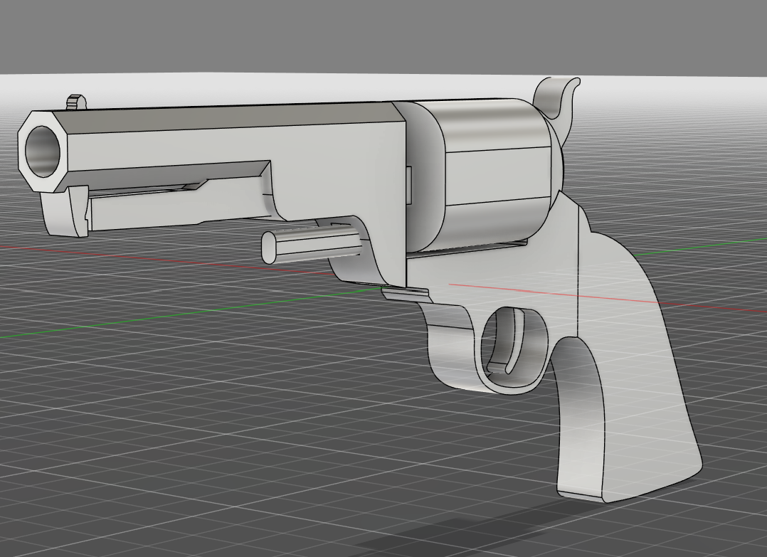
Production Progress
Fusion Macro Block-out
Notes:
starting by blocking out major primary forms first
Under barrel needs re-creating since the edges around the body do not align properly
What to be working on next:
Finish Macro/Micro Block-out then tessellate and get ready for export into 3ds max
Look into weapon skins from relevant video games that use the same weapon, get inspired by designs
Research online for free brushes packages for Zbrush to create metal edgewear and wood chips

Slide 9
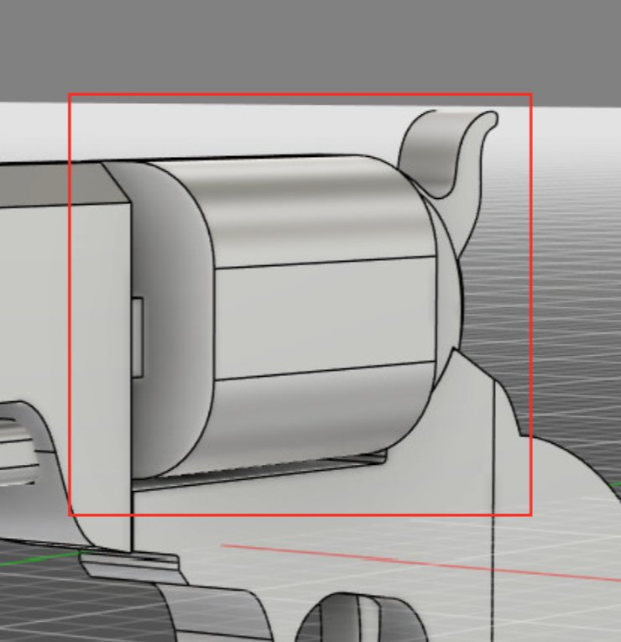
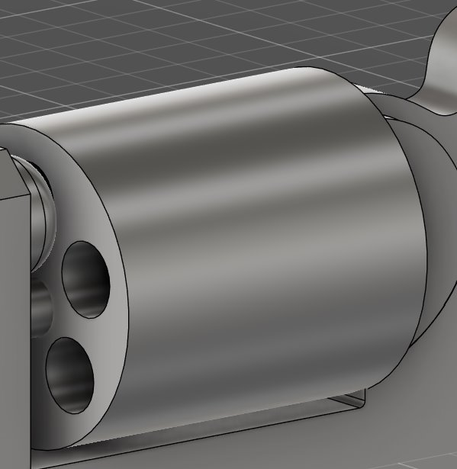
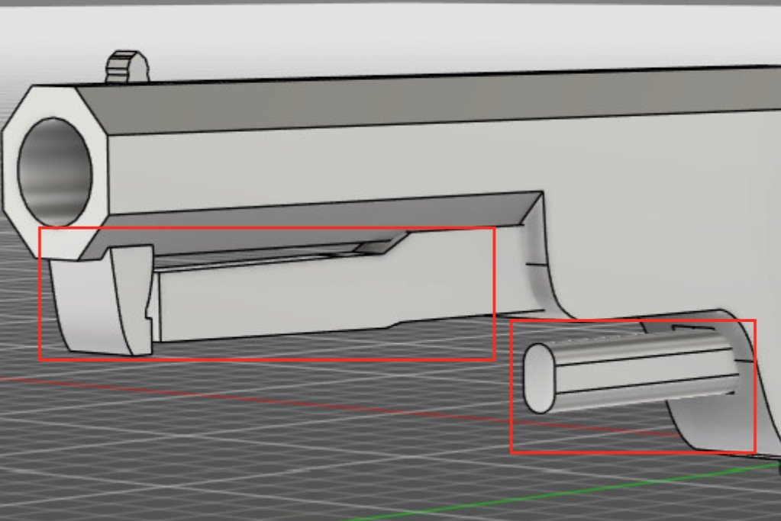
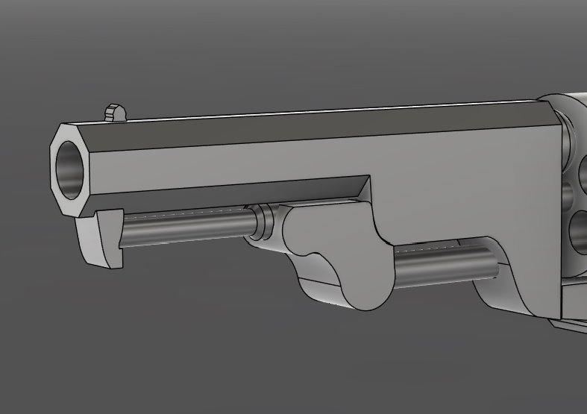
First Stand-Up Feedback and response
Before
After
1st stand up feedback
the weapon chamber does not look as cylindrical as everyone was hoping for, this needs to get re-modelled.
The weapon form is noticeably off, the proportions compared to reference look scaled differently in areas, specifically the under barrel and chamber got pointed out to me.

Slide 10
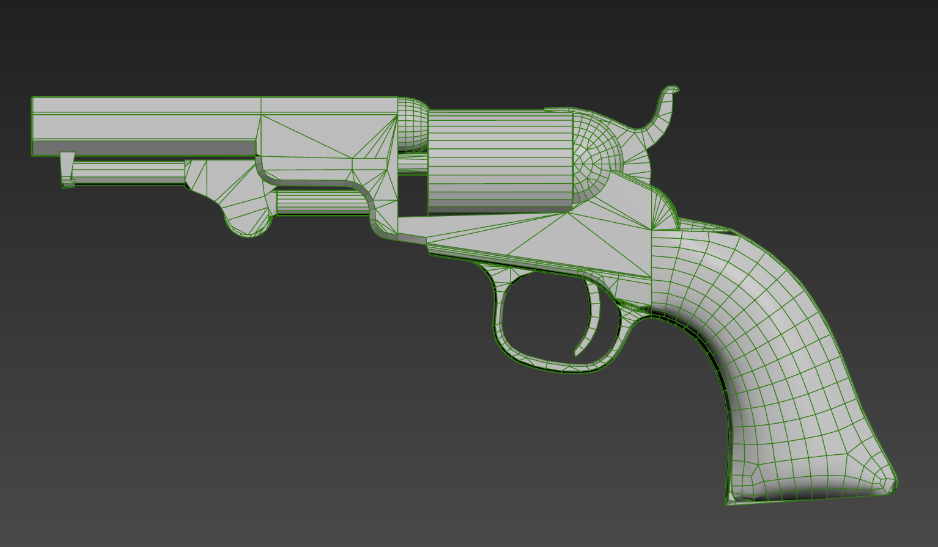
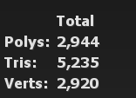
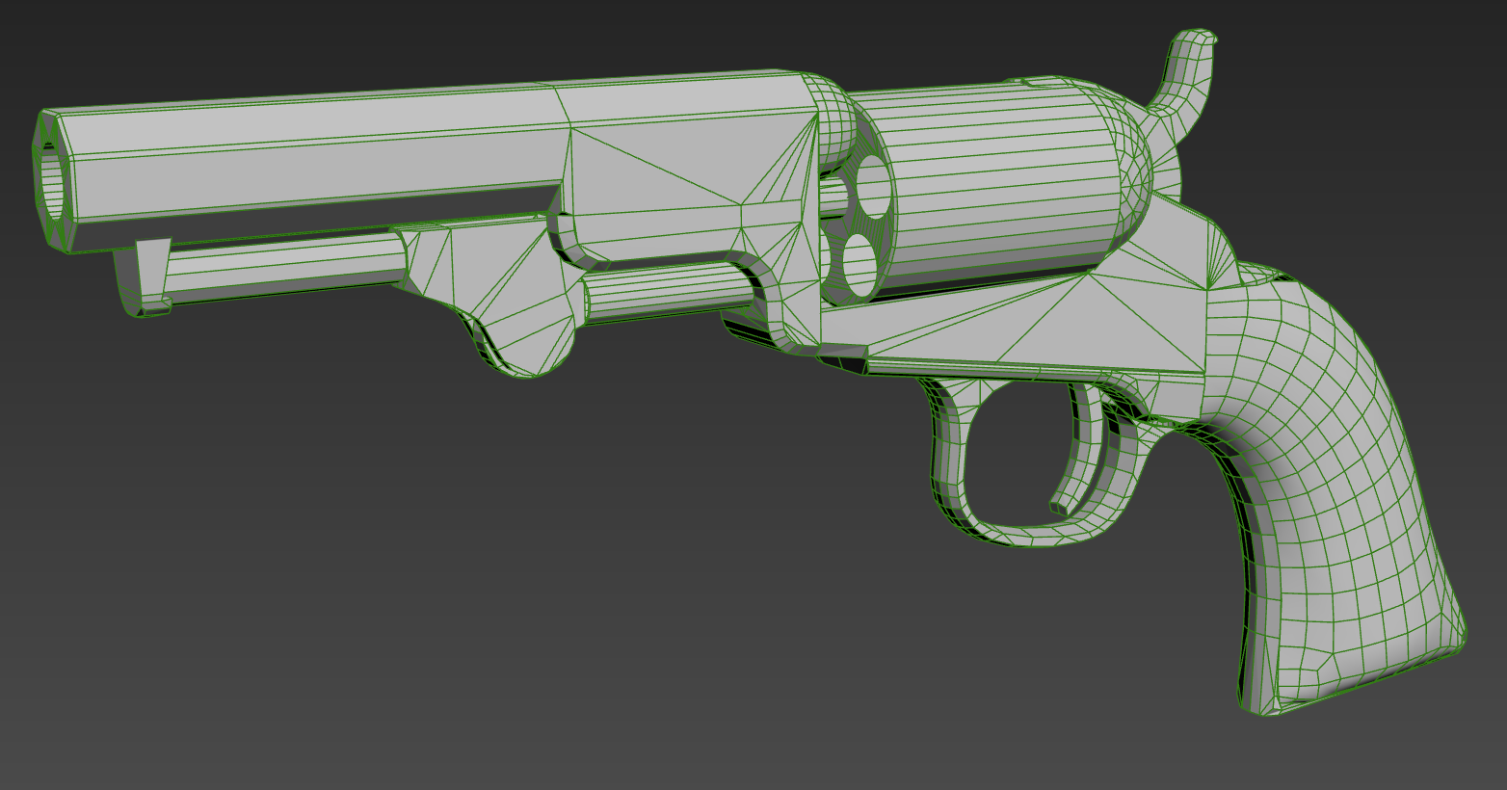
Production: Low Poly
After exporting my weapon file from fusion into 3ds max I then began to start chamfering and smoothing faces and edges that I couldn’t get to work properly in fusion.
Afterwards it then began to evolve into my mid poly stage where I would start creating my miro and hybrid blockout, This means I would now start making my weapon shapes more defined and accurate

Slide 11
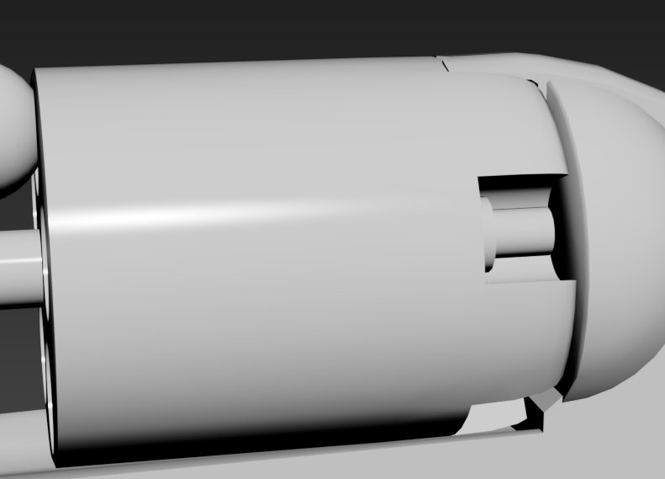
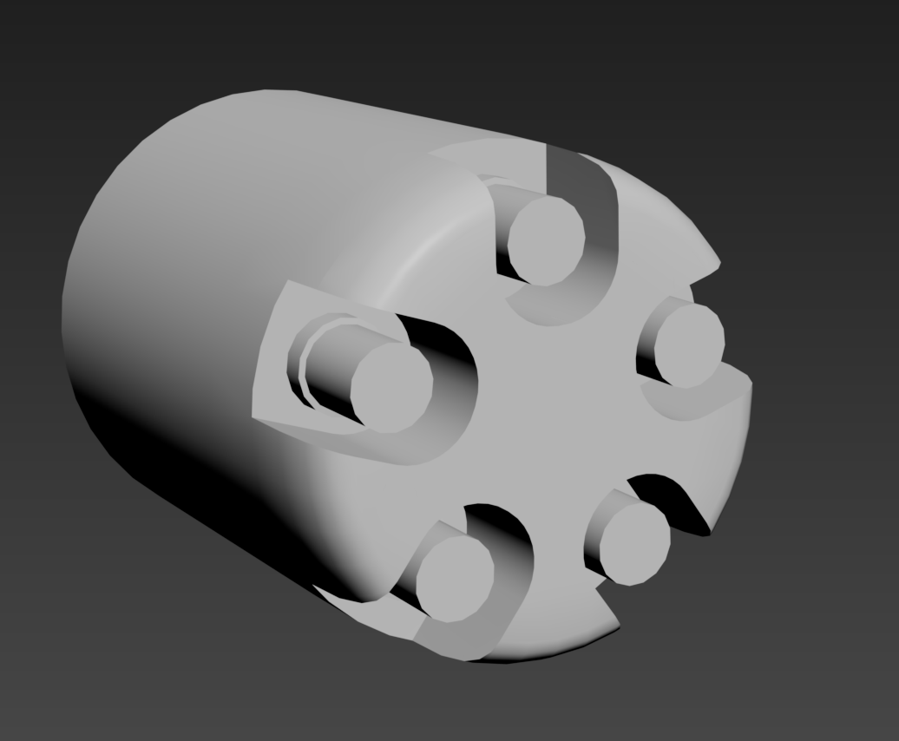
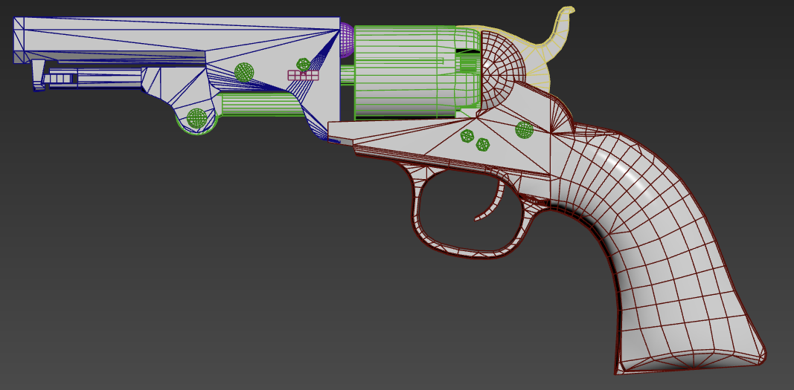
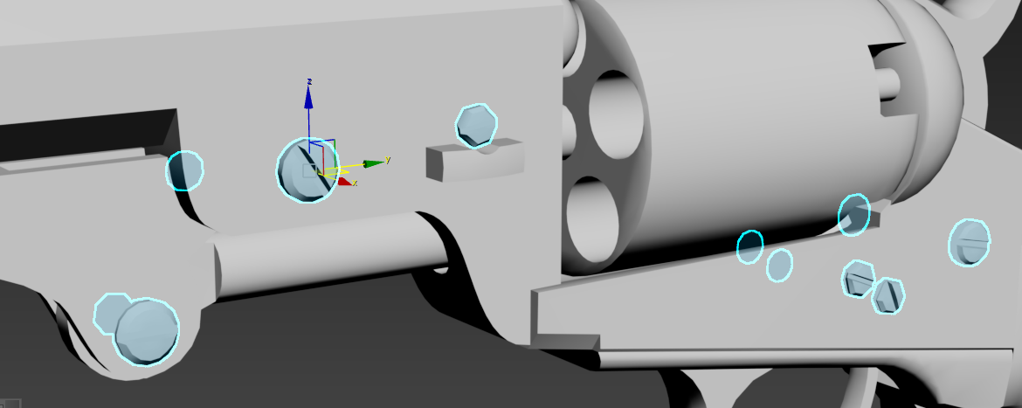
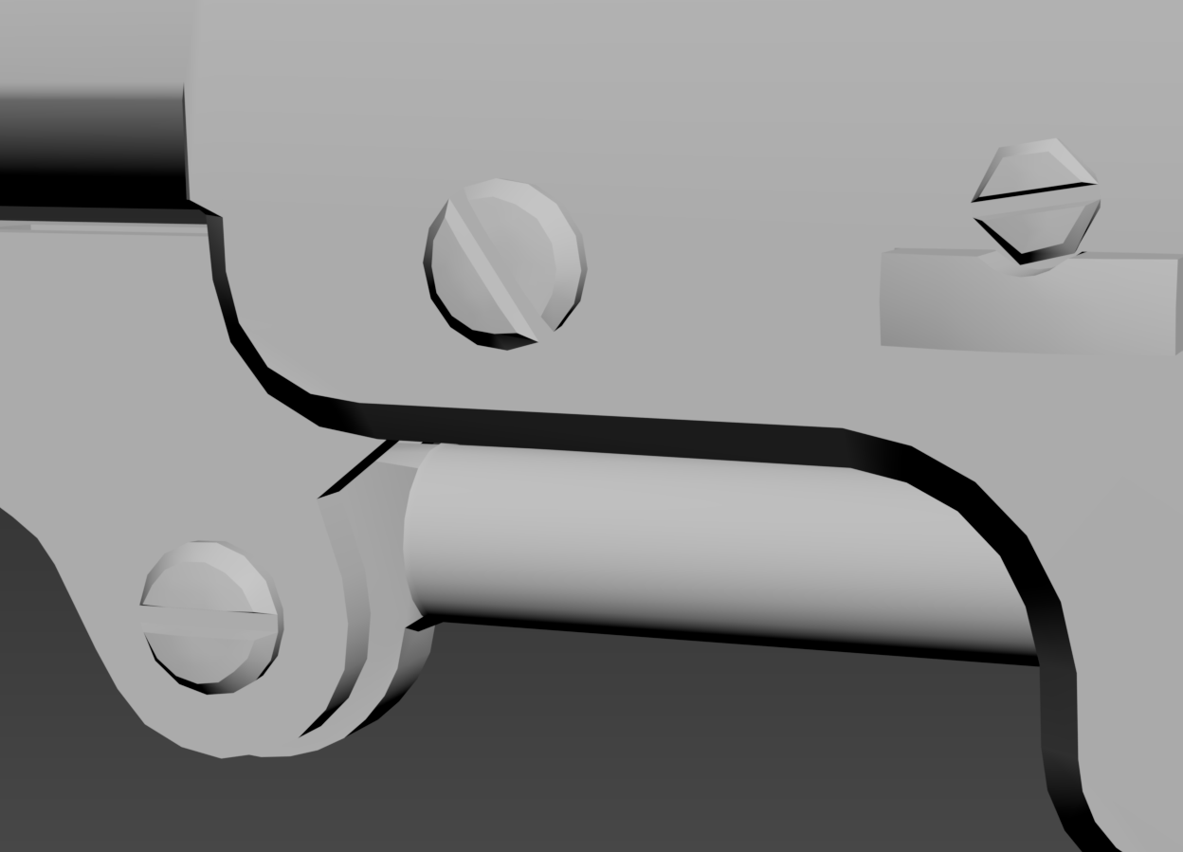
Production: Mid Poly
Mid Poly Block-out
Boolean & Smooth Modifer Added
I would start using a lot of chamfer tools and Boolean operations on different parts of my gun, this included Boolean intersects on the chamber and trigger guard. I also included things like bolts and floating geometry objects that stick out of the gun in my references.
Afterwards some edge loops and smoothing modiferes were applied to see if there was any visible smoothing erros happening across my gun, I noticed a lot of the time this error would mostly be seen in cylindrical parts of the gun.

Slide 12
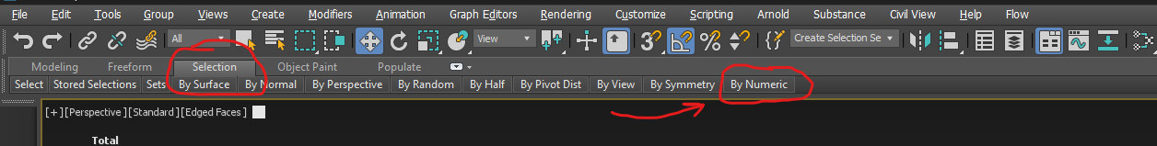
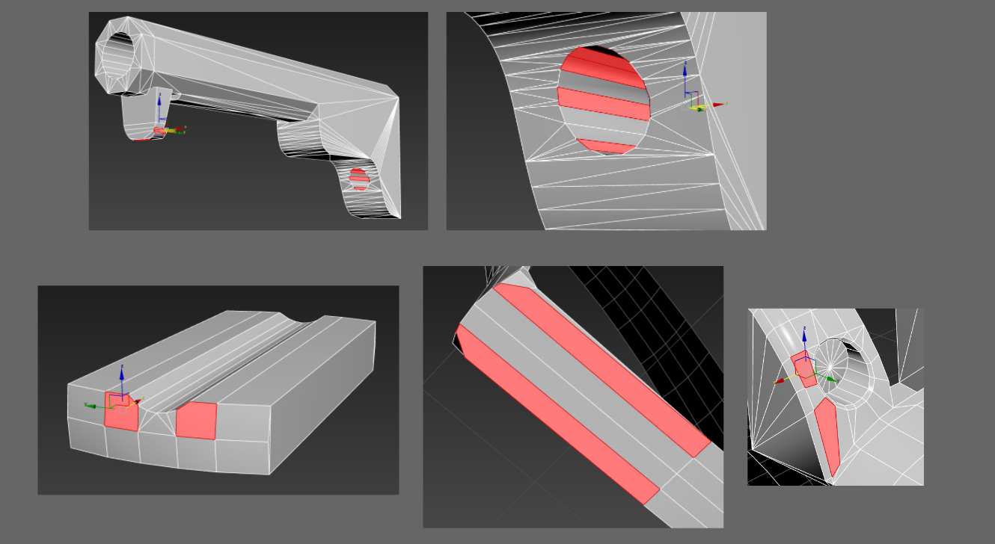
Production: Mid Poly
Polishing included going over my gun using the selection tool after turning the model into an editable poly and selecting areas with more then 5 edges to scan for ngons on faces of my models
I went over a lot of areas of my gun that had ngons on some faces that I missed and simply selected all the vertices on that face and connected them together.

Slide 13
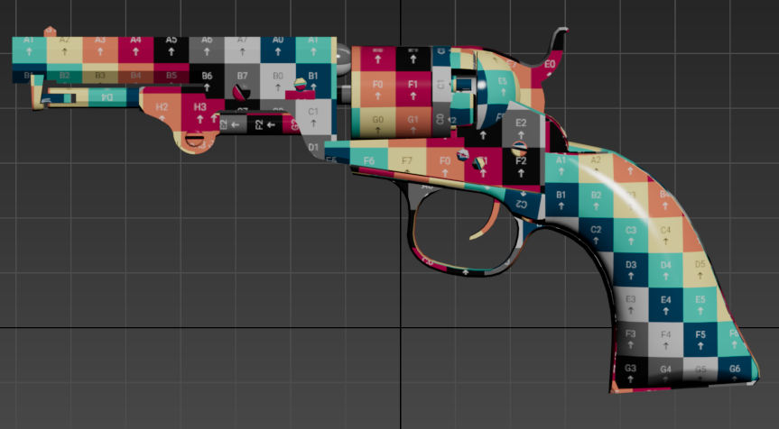
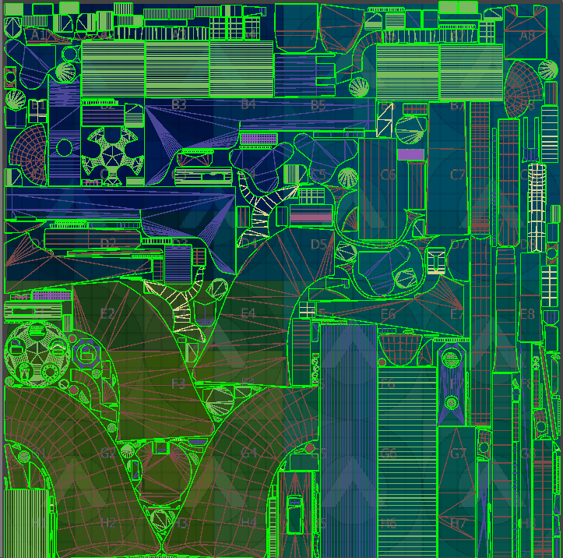
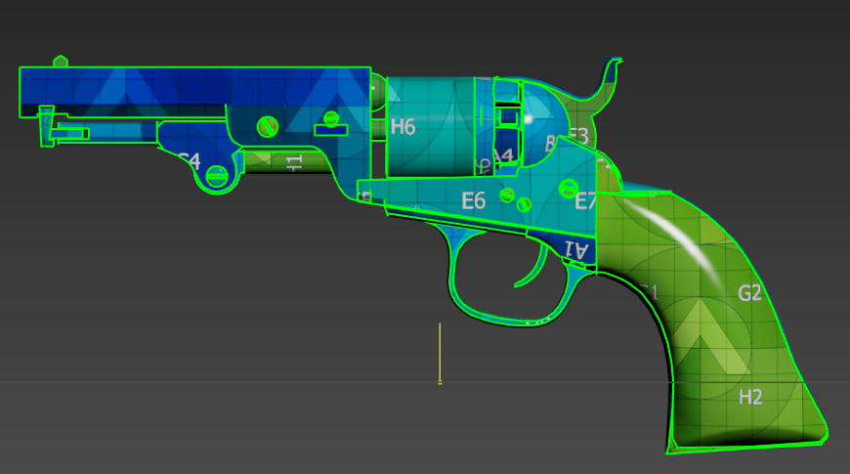
Production: Unwrapping
UV Checker Map Maker - Custom UV Textures - Atlux
I manually unwrapped some pieces of my model like the major important areas of my gun like the chamber, barrel and grip of my gun but most of the unwraps were done automatically from max.
I tried my best to neatly pack everything closely together whilst preventing any loss of texel density for my gun.
A UV checker map was then thrown on top of my weapon to make sure everything was facing the correct way that I intended most of textures to face.

Slide 14
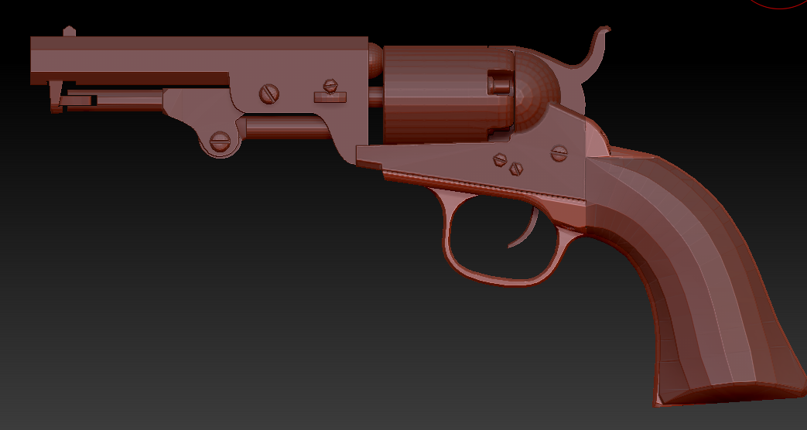
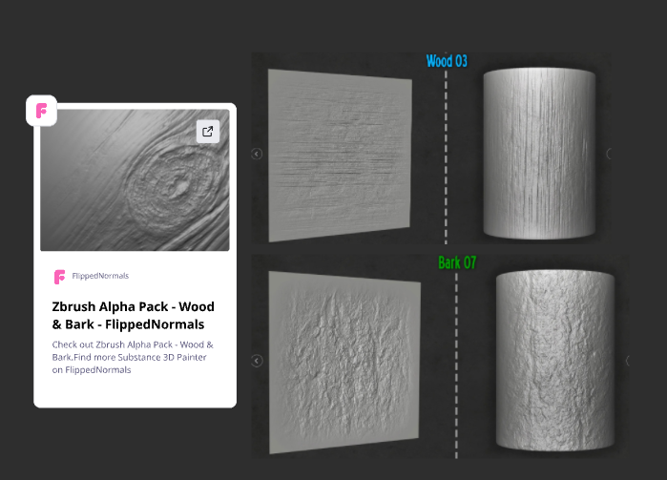
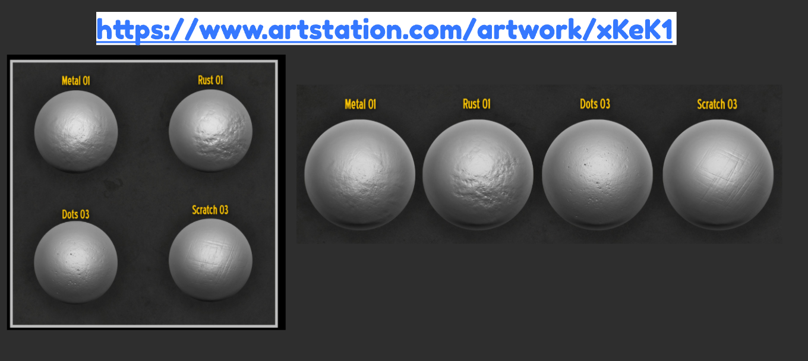
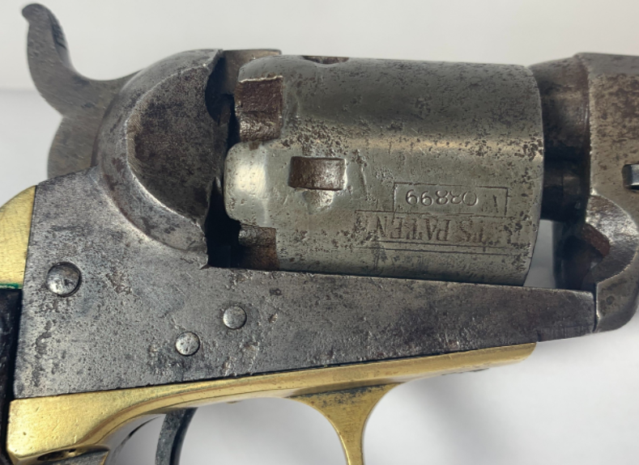

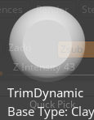
Production: High Poly
Block-out Exported into Zbrush
Online Wood Brushes
Using the wood alpha pack to add chips and worn surface to the handle of my gun
Online Metal Brushes
Using these metal brushes to add pitting and texture on the metal pieces of my gun

Slide 15
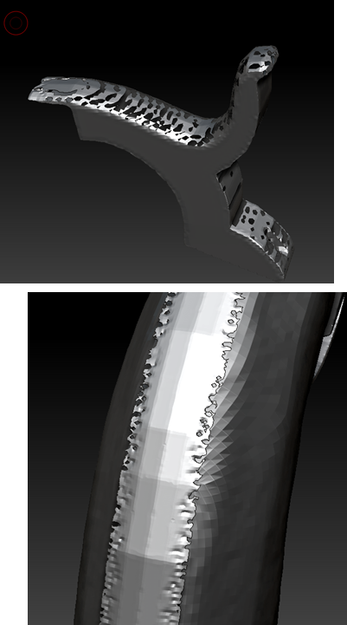
Production: Zbrush Issues
Zbrush Issues
I've been having a lot of problems with dynameshing some of my pieces of my weapon, These issues included a lot of holes eating away the model once I kept increasing the poly count. After receiving some feedback from peers, the problem suggested that the model was too dense.
Ultimately, I couldnt find a solution to completely get rid of this problem, Although I did manage to fix some of these issues happening on some of my models by taking a step

Slide 16
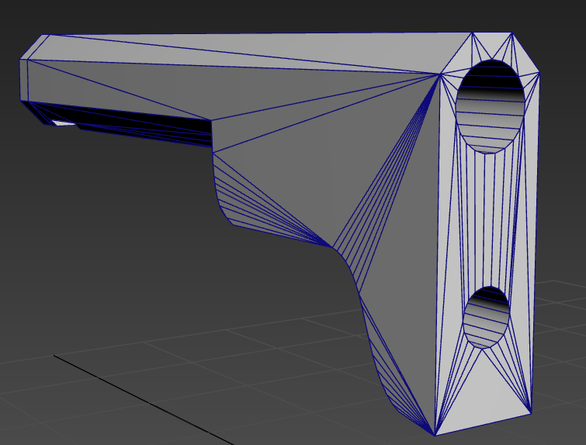
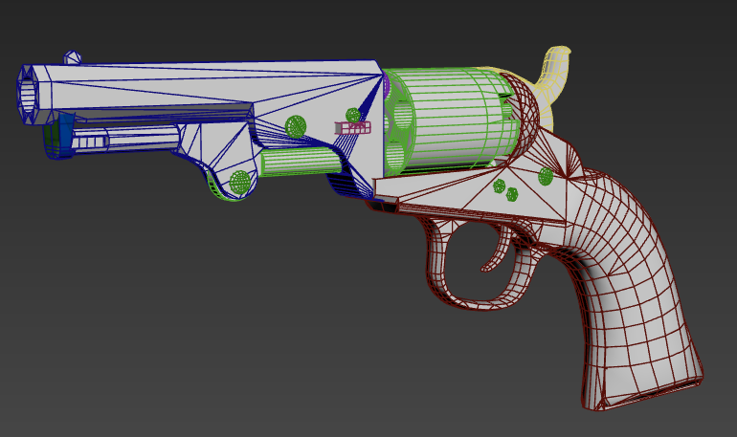
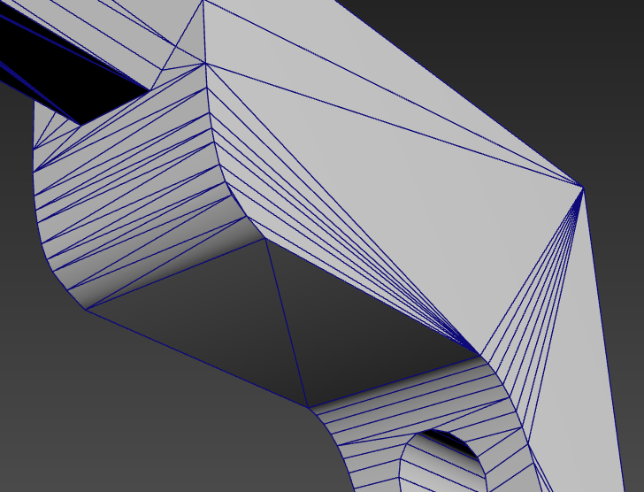




Production: Further Polishing
I changed the edges of my barrel since it was messing up a lot in zbrush, I instead replicated the detailed edgewear in zbrush using a brush instead of modelling it in like last time.
Underneath my grip the metal underneath was too squashed and caused a lot of baking issues on my model. To fix this I made the metal thicker and stick out more this then fixed my issues
A lot of noticeable lines and baking errors were happening on my grip. I added some more edges and completely filled in the face using the cap tool to make it all one solid geometry

Slide 17




Production: High Poly
(1)
(2)
Polishing Example
I always started by increasing the polycount on all my models which I had in many separate pieces. I did this by using the dynamesh tool increasing the resolution.
After I was comfortable with the model being high poly enough to start sculpting on, I then used the deformation tools. I mostly used this to further polish the edgewear of my model and increase the smoothness of the surface detail
This is an example of how I approached polishing and moulding my weapon to make it look as accurate to metal as possible

Slide 18





Production: High Poly
I approached this workflow for every single individual piece of my gun, Using the brush packs I downloaded online I was able to closely replicate real life textures of metal over my weapon.
After using the deformation tools I use the trim dynamic brush on the edgewear of all the metal pieces to make them look more worn and slightly damaged since I want my weapon to feel more used then pristine

Slide 19



Production: Clay Renders

Slide 20




Production: Baking
After Zbrush I began to put my model into painter to begin the texturing phase.
The weapon bake came out a lot nicer this time since I worked back on the retopoloy and sculpting again, There was many issues taking place which are now mostly sorted out

Slide 21






Production: Texturing
Wood Grip Material
The grip of my weapons base texture was from using the American cherry wood texture provided by substance in the library, After getting some feedback I changed the direction of the skin by a 45 degree angle
I did not add my own chips or cuts into the grip of my gun in zbrush, instead I used a dripping rust generator and a fill mask to manually add my own levels of damage to the gun
I wanted to create some tiger stripes and surface detail to my gun, Uisng a dirt generator and fill mask I covered the whole model in a grainy texture and then added white dirt in corners of the grip where I think a lot of dust and germs would pick up

Slide 22






Production: Texturing
Metal Brass Material
I used a smart material for the base of my brass texture, I then altered the colour to a more yellow colour as well as using the smart material presets roughness values and changed them to be more rough.
Using a dripping rust generator to add some old looking wear to the surface of the metal. I then used a paint brush to manually get rid of some of the rust buildup since there was too much of it and I want it to feel more authentic and less obvious.
After I examined my reference images closely I wanted to replicate the same sort of dirty grime colour building up on the edgewear of the brass material. I did this using a dirt generator and brush tool to manually paint on the dirt

Slide 23






Production: Texturing
Blued Steel Material
Creating the steel was the most complicated compared to the other two materials I wanted on my gun. I first added a steel smart material and changed the colour of my material with a ligh tint of purple and then a layer of low opacity blue on top
I then wanted to add some marks around the surface of my gun that suggested a lot of heat has altered the colour of the trigger guard around the chamber
I wanted to add further edgewear around my gun to really show off the edges of the trigger guard, Using the same metal and a paint brush I changed the colour to a more white base and brushed around parts of the chamber

Slide 24





Production: Texturing
Using online resources I found some engraving designs that I could paint over my gun with using the height mask, I had a lot of fun with this part of the workflow, I wanted several images since I didn’t want the engraving to feel too boring and all the same

Slide 25


Production: Weapon Skin
The weapon skin was created by using the same engraving patterns but completely changing the weapons colour scheme and roughness values. My inspiration for the gun design came from how I would colour my guns in the game red dead redemption 2, I used a black steeled metal with golden engravings and a white pearl grip, I would say its pretty basic design but still looks really cool and fits the term luxury nicely

Slide 26





Unreal Engine: Dressing Scene
I used some free assets off of sketchfab to use as my setup for my renders, I went with a plain wooden table for my weapons base variant and a poker table for the skin, the idea behind this was to imagine a person of high status and wealth with this gun in his holster with gold engraving playing a game of high-stake poker.

Slide 27



Unreal Engine: Lighting Setup
My camera and lighting setups consisted of using three light sources and three different camera angles for both the skin and base weapon. My lighting included one directional low intensity light and two spotlights.
My camera setup consisted of two close up detail shots and one context shot from further away showing more of the surroundings and body of the entire gun.

Slide 28



Unreal Engine: Beauty Renders

Slide 29



Unreal Engine: Beauty Renders

Slide 30
analysis on renders
The resolution texture on the table is very low resolution compared to the resolution of my gun, the uniform and connection of the models together don’t match properly. The lighting is a big issues in this render, the source angle wasn't adjusted correctly causing very harsh outline of the shadow beneath the grip of the gun which makes the render looks very unauthentic.
The lighting in this image looks very weird and flat on the handle, the shadow going across the gun looks far too sharp, if the light was very close shadows are a bit more defused in reality

Slide 31
Final Reflection
this project was mainly focused on the creation of a detailed 3D revolver model with the emphasis on realism with ornamental craft design. The main objective of the project was to fulfill the live brief art test for wushu studios, second objective was to improve my technical workflow and artistic decision making.
One of the strongest aspects of the project was the texturing and material work. The engraved gold and aged steel surface added visual depth and helped establish a strong historical accurate depiction of real-world weapons. The modelling quality also significally pushed this piece due to having a good quality neatly packed unwrap which helped push the material surface detail and detailed high poly sculpt with intention of pushing realism by manually painting metal surface detail and edgewear around several areas of the gun.
During development one of the biggest challenges was the material quality and presentation outcome, a lot of the areas that took up most of the time was presenting the asset to its full capability, There was a lot of overlooked areas for improvement when it came down to lighting quality and material definition, Making the model seem as authentic as possible was the main priority but was strongly let down due to lack of attention and possible experimentation with the post process settings.
Overall, the model quality was produced to a satisfactory standard with a nicely detailed high poly model that has been baked carefully on top of the low poly. The material work was also created to a good standard with still little areas of improvement to be tweaked to really make it shine. The presentation quality Definitely needs more work and care after submission since there's still a lot of area of improvement to really make this project shine.

