Slide 1
Embodying Fear
By: Sam Moss
Gradex presentation

Slide 2
The problem I found
Modern media utilises facial expressions to show emotion
obscurity does not equal emotionless
Action sequences do not always allow faces to be seen

Slide 3
Can fear be communicated without seeing someone's face?

Slide 4
My aim during the project
See if body language as primary emotional communicator?

Slide 5
Objectives
Gather audiences' opinions
Apply it to a cinematic
Analyze nonverbal communication

Slide 6
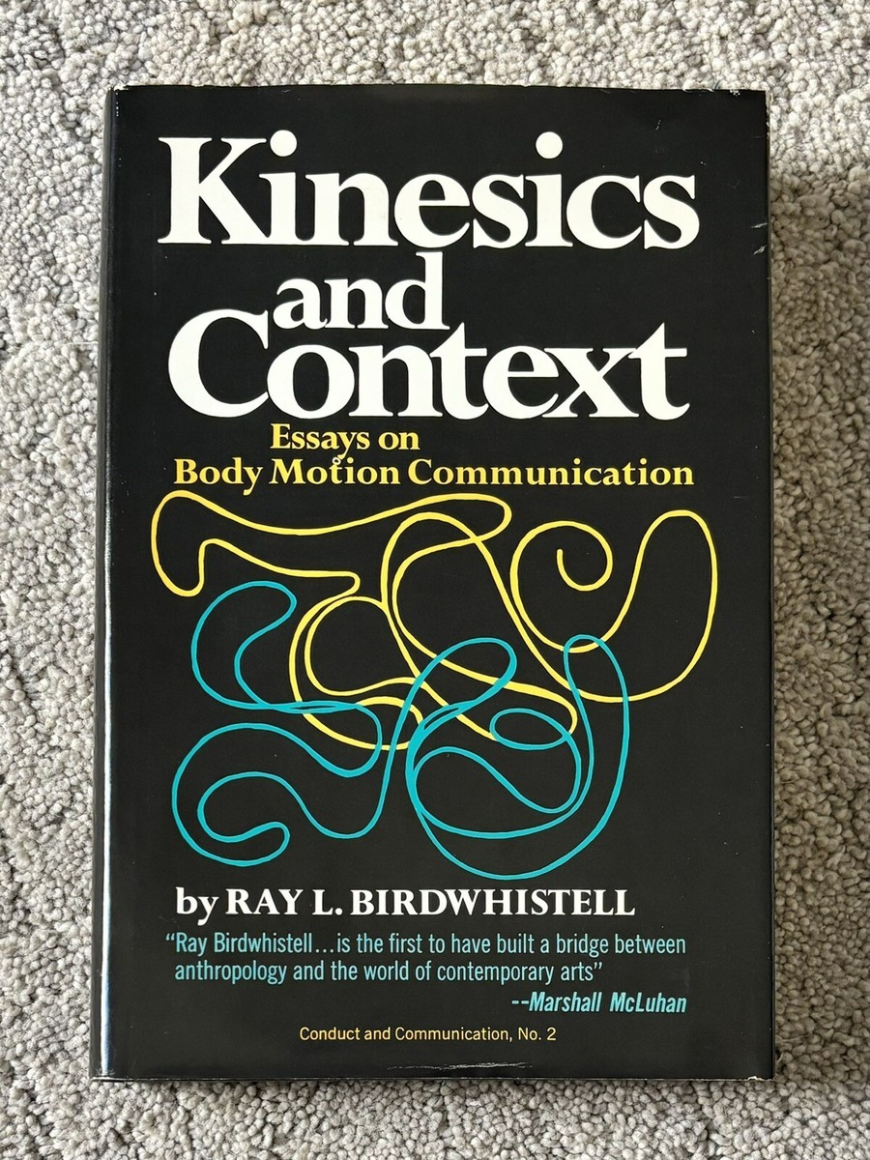
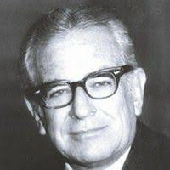
None verbal communication
Ray birdwhistell - kinesics
Body movement as structured communication
Fear expressed through tension and contraction

Slide 7
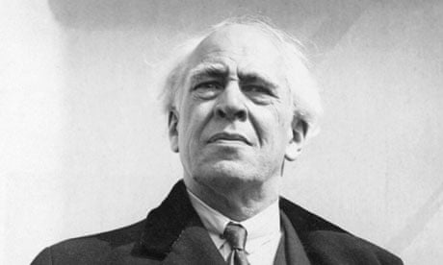

Performance theory
Konstantin Stanislavki
Emotion through physical action
External movements that help show a hidden emotion

Slide 8

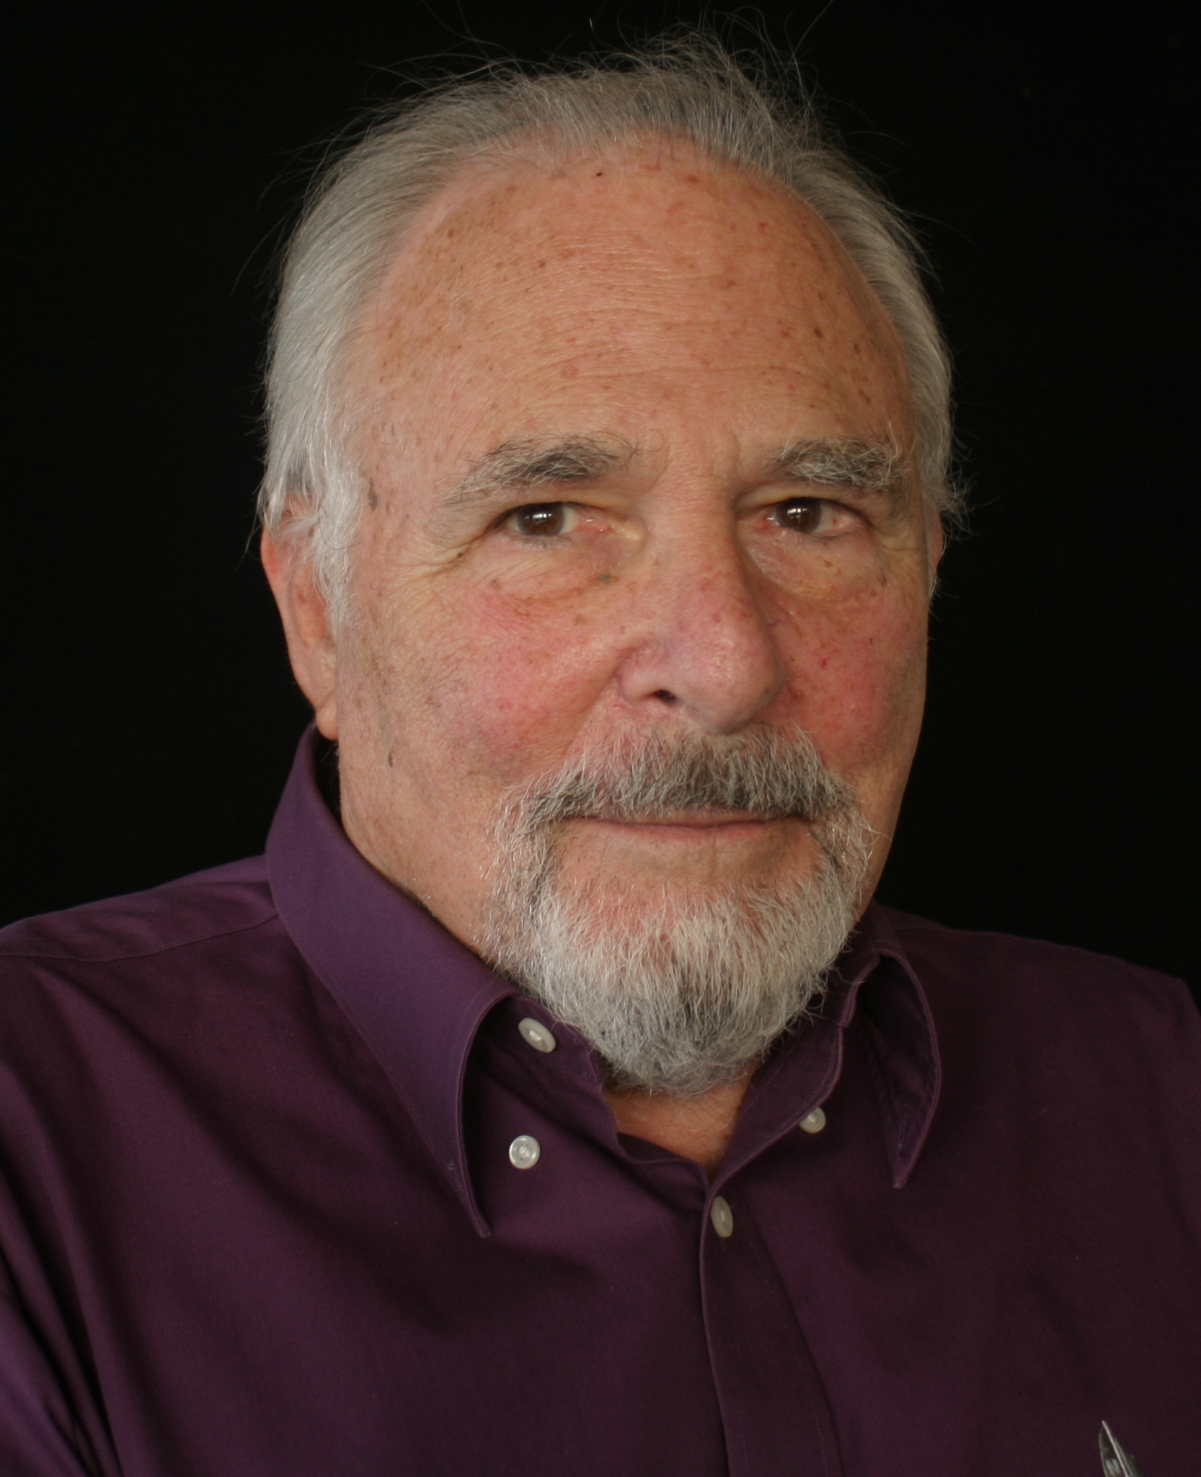
Psychology of fear
Paul Ekman
Fear = fight or flight

Slide 9
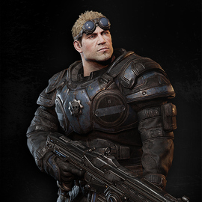
Research methods
Literature reviews
Practical experimentations from earlier acting
Case study analysis

Slide 10

Production methods
Use of camera work
Subtle body movements to show emotion
Chaotic environment

Slide 11
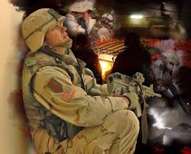

How I showed fear
Posture of character
Scanning the environment
Reactions to certain scenes

Slide 12
What were the strengths I found
What was effective with my solution?
Effective physical performance?
The strengths of my cinematic was my ability to perform the tension needed to show fear through physical activity without the use of my face

Slide 13
What did I find that limited my solution
Subtle movements would not show the emotions I wanted during recording
Time constraints of my cinematic forced me to compress it into a short animation
Trying to find a balance of a real reaction and overdramatization

Slide 14
Conclusion
Emotions don't equal just face movment
Body language can sustain emotional storytelling
Fear during a combat can be shown and be effective

