Slide 1




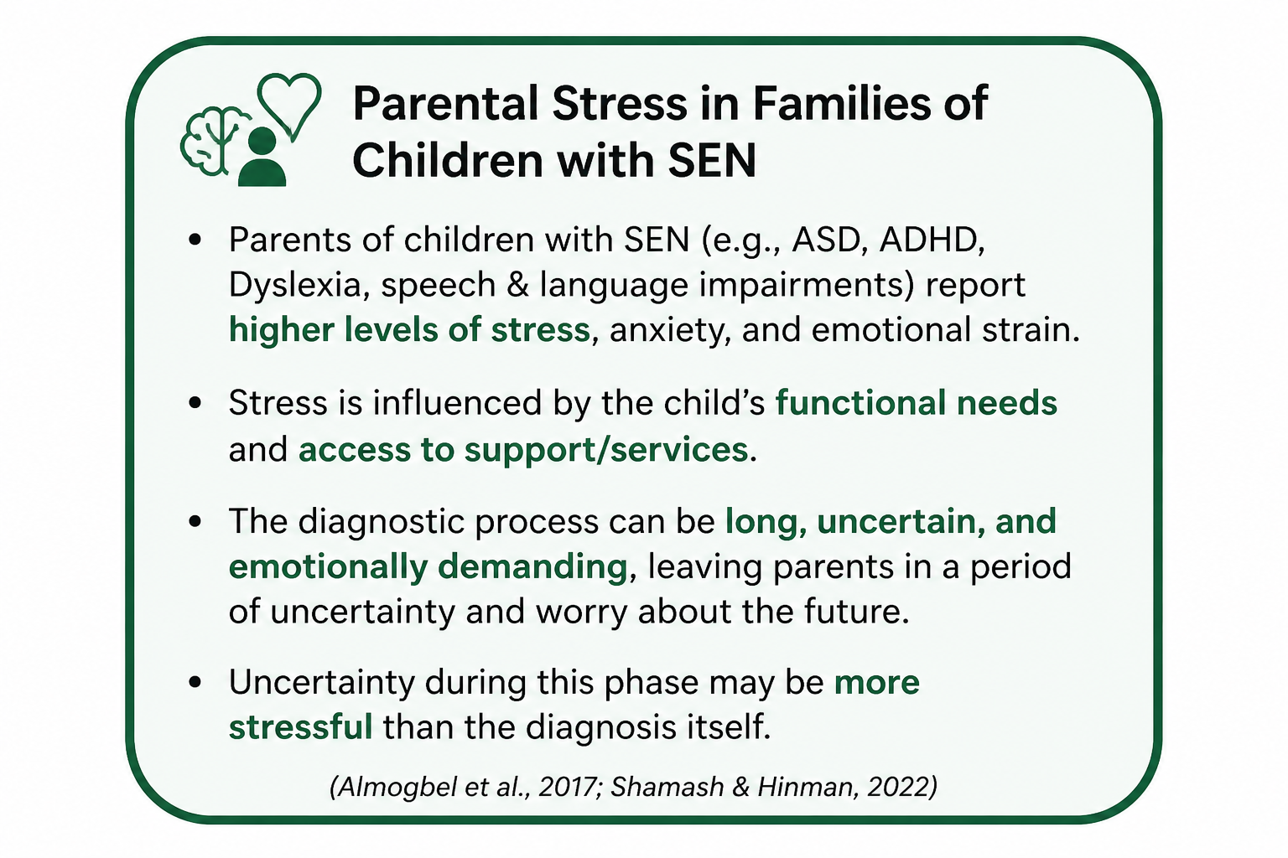

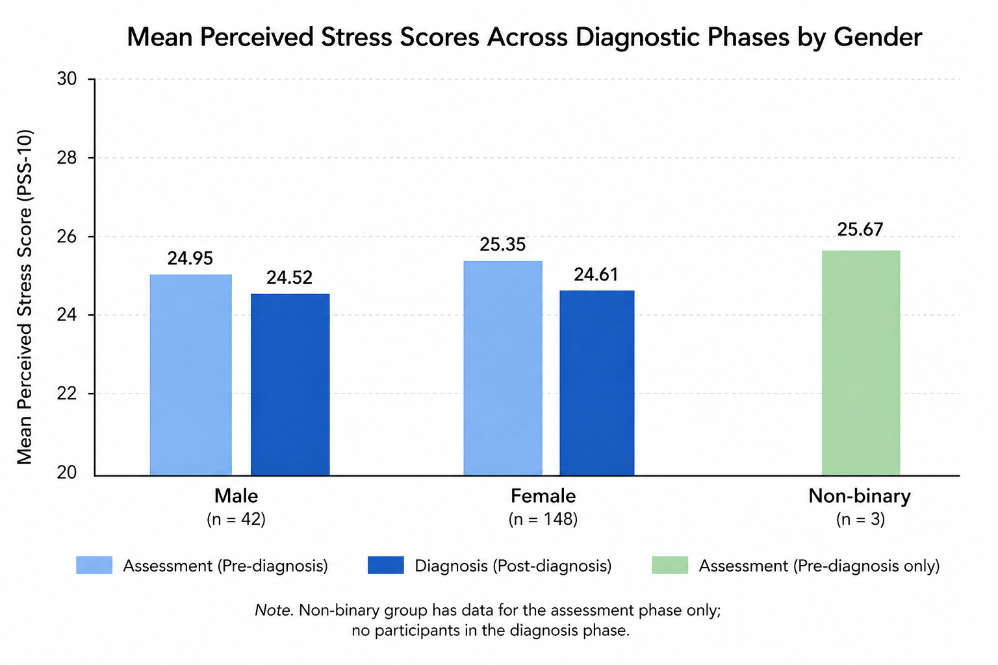
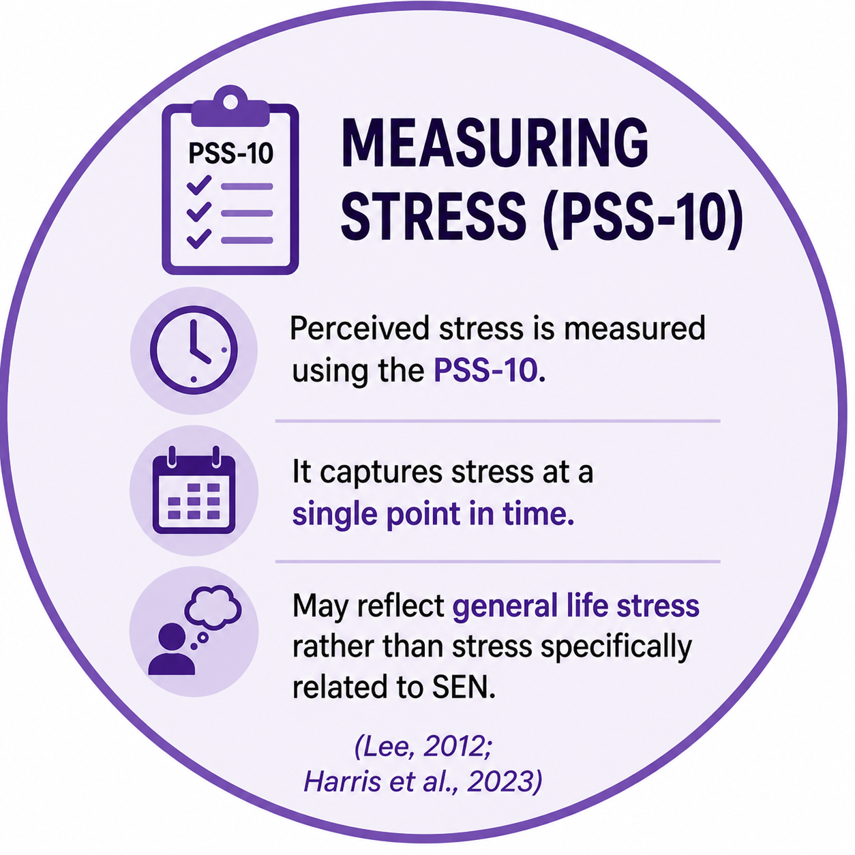
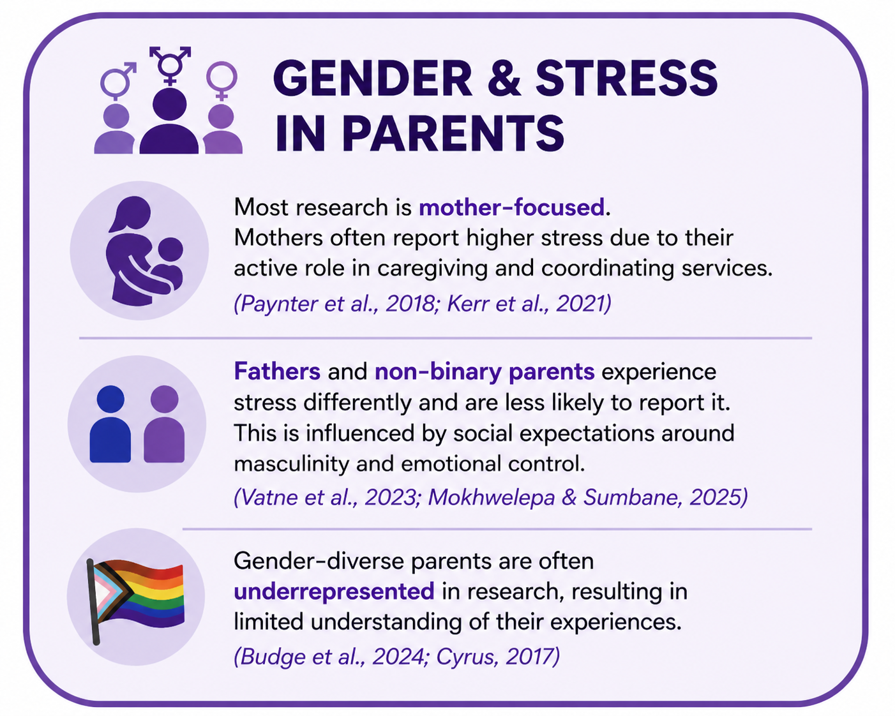
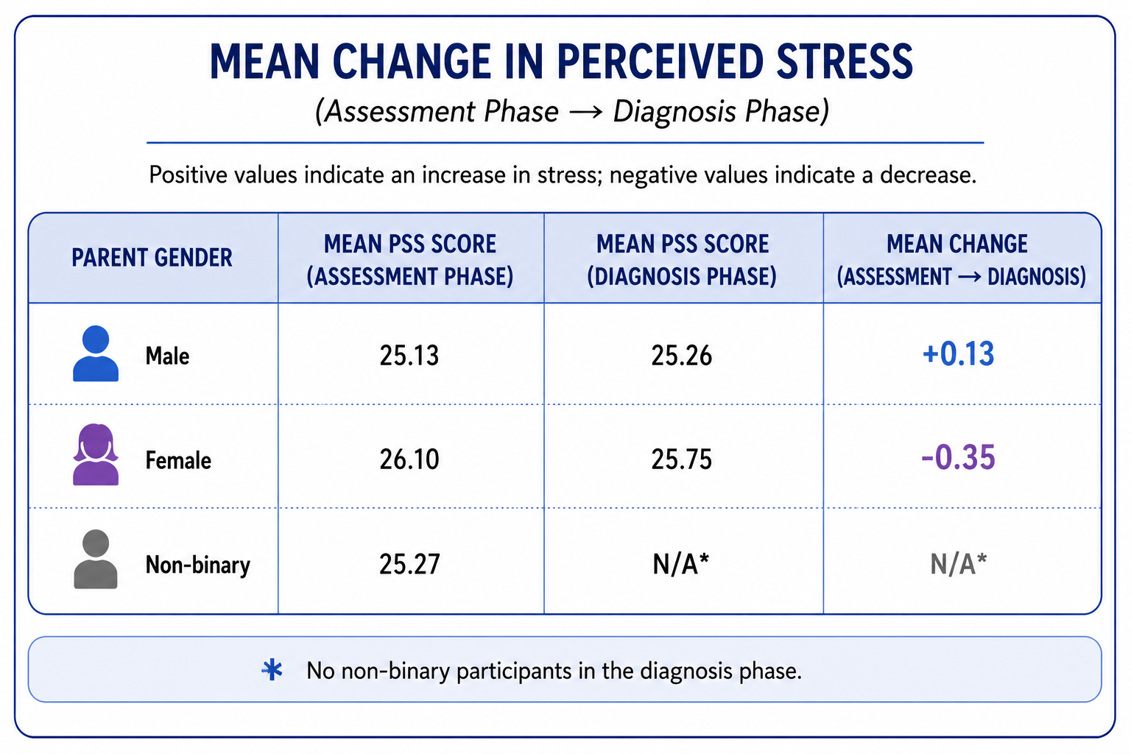

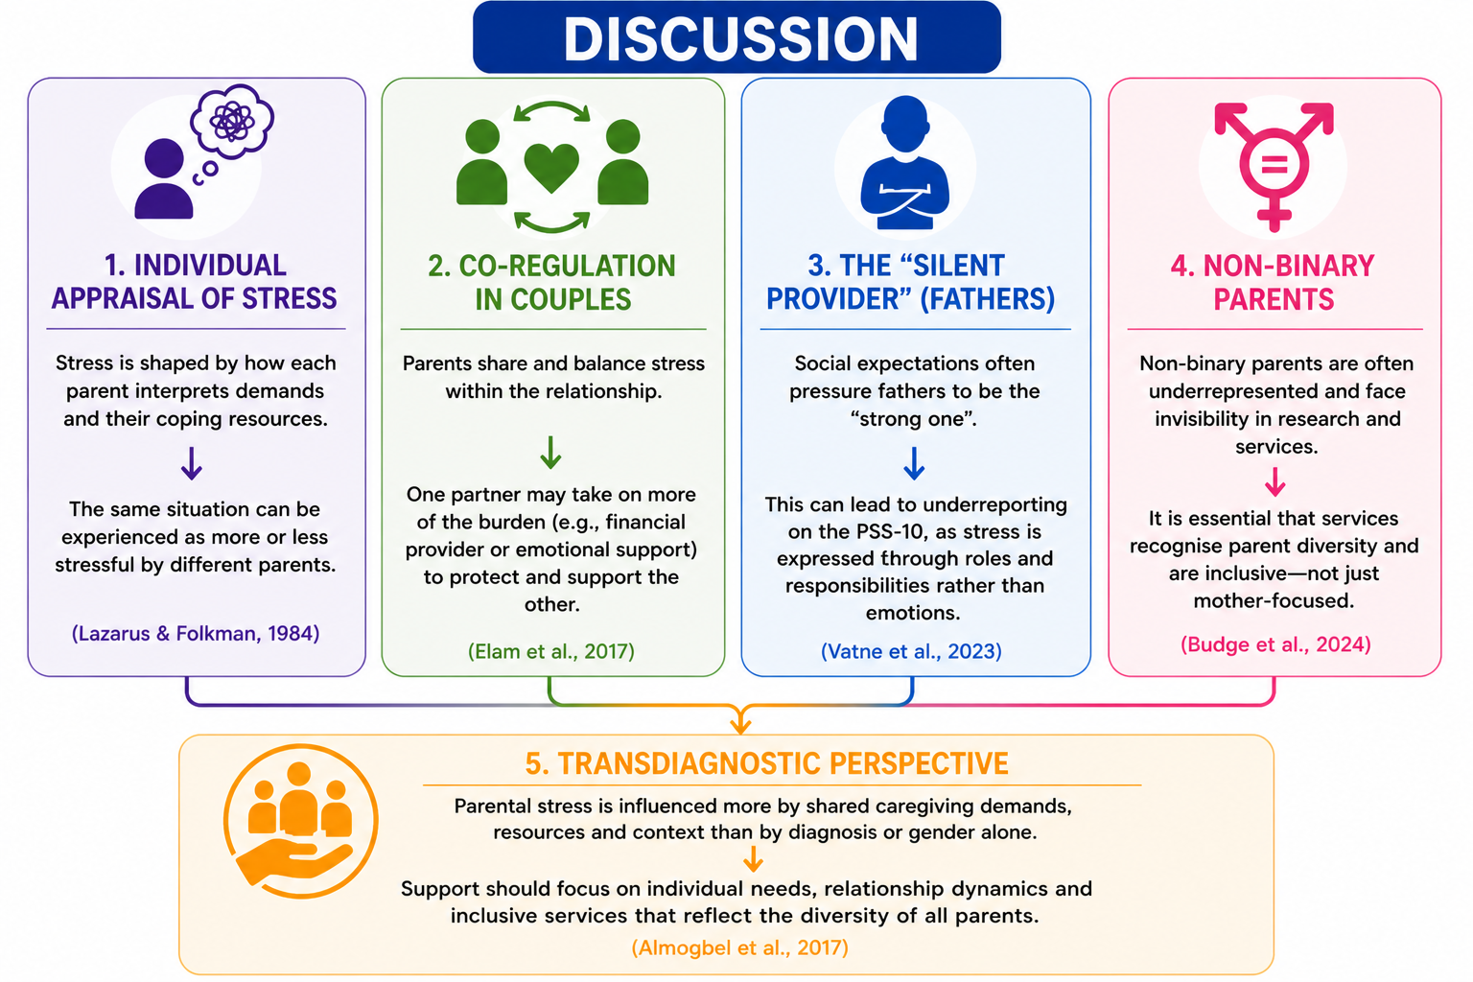
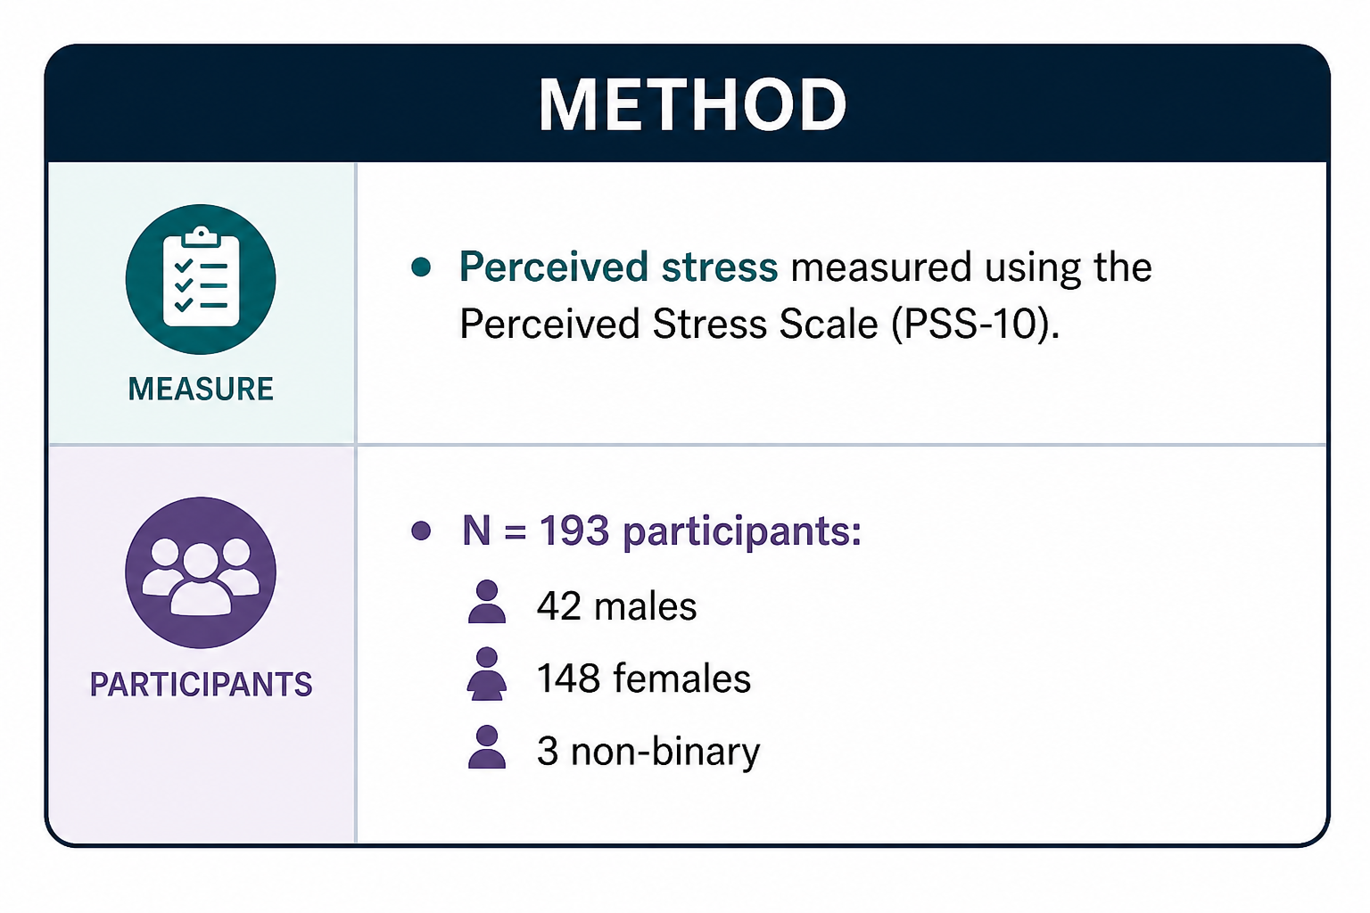
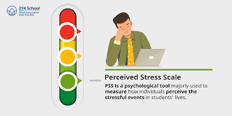

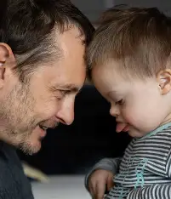

Effects of diagnostic phase and parent gender on perceived stress
Jerusha Lear: l027004n:student.staffs.ac.uk
Andrew Edmonds: a.edmonds@staffs.ac.uk
INTRODUCTION
RESULTS
No significant differences in parental stress across diagnostic phase or gender.
The interaction between the diagnostic phase and gender remained unexplored.
Aim: Examine effects of diagnostic
Phase and parent gender on
Perceived Stress.
The mean change shows that stress levels barely changed from pre- to post-diagnosis, which supports the finding that stress is relatively stable rather than influenced by diagnosis alone.
REFERENCES
Shamash, E. R., & Hinman, J. A. (2022). Assessing caregiver stress and coping at time of autism diagnosis. Early Childhood Education Journal, 50(1), 97–106.Voliovitch, Y., et al. (2021). Parenting stress prior to autism diagnostic evaluation. Journal of Autism and Developmental Disorders, 51(10), 3432–3442.
Cohen, S., Kamarck, T., & Mermelstein, R. (1983). A global measure of perceived stress. Journal of Health and Social Behavior, 24(4), 385–396.
Lee, E. H. (2012). Review of the psychometric evidence of the perceived stress scale. Asian Nursing Research, 6(4), 121–127.
Lazarus, R. S., & Folkman, S. (1984). Stress, appraisal, and coping. Springer.
Almogbel, Y. S., Goyal, R., & Sansgiry, S. S. (2017). Association between parenting stress and functional impairment among children diagnosed with neurodevelopmental disorders. Community Mental Health Journal, 53(4), 405–414.
Masefield, S. C., Prady, S. L., Sheldon, T. A., Small, N., Jarvis, S., & Pickett, K. E. (2020). The caregiver health effects of caring for young children with developmental disabilities: A meta-analysis. Maternal and Child Health Journal, 24(5), 561–574.
Zampini, L., Zanchi, P., Riva, P., & Tobia, V. (2024). Associations between social isolation and parenting stress in children with special
educational needs. International Journal of Developmental Disabilities.
Vatne, T. M., Dahle, S. S., Haukeland, Y. B., & Fjermestad, K. W. (2023). A qualitative study of men’s experience of being a father in families with childhood disability. Journal of Developmental and Physical Disabilities, 35(1), 111–131.

