Slide 1

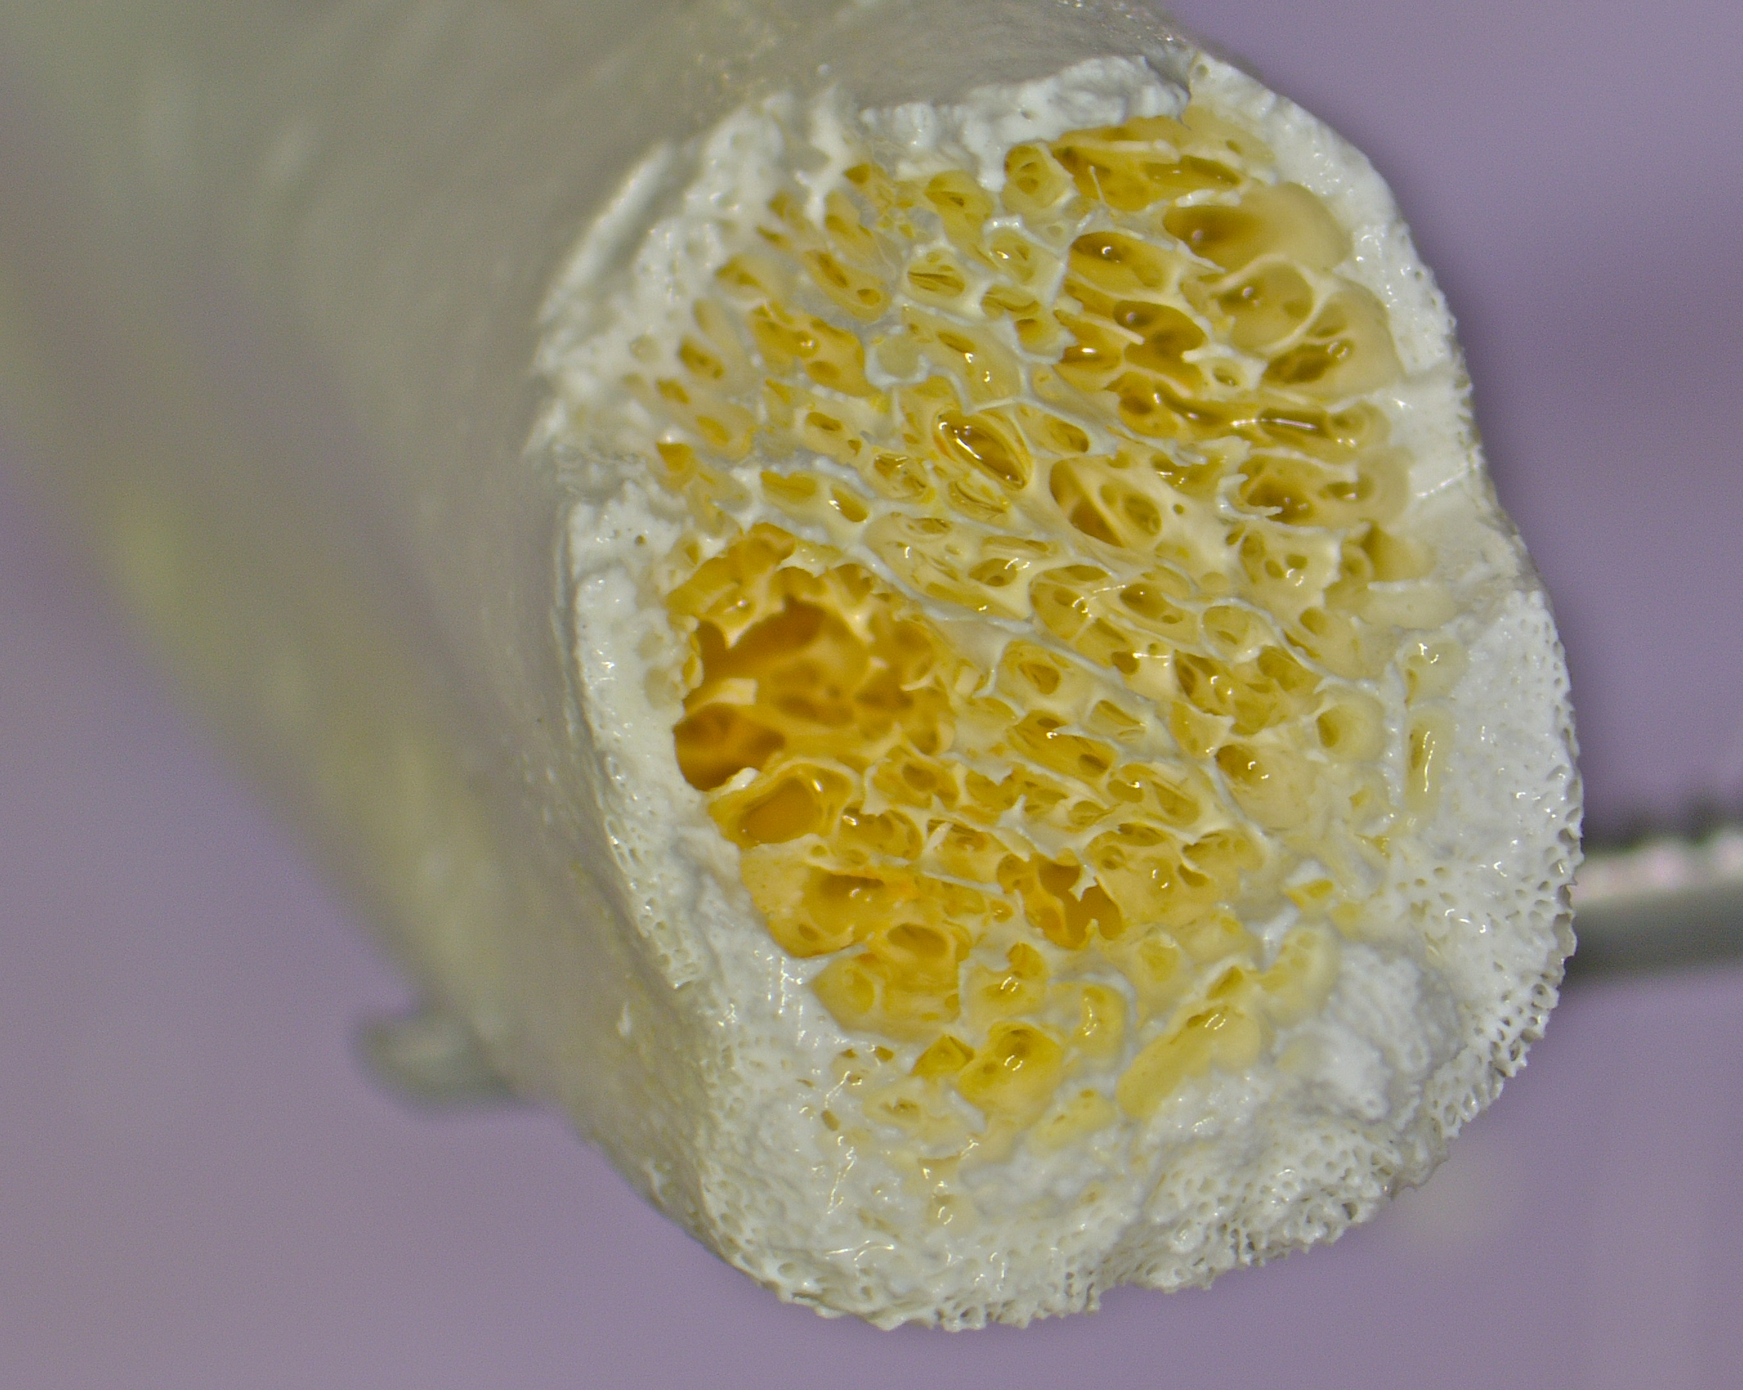
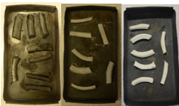
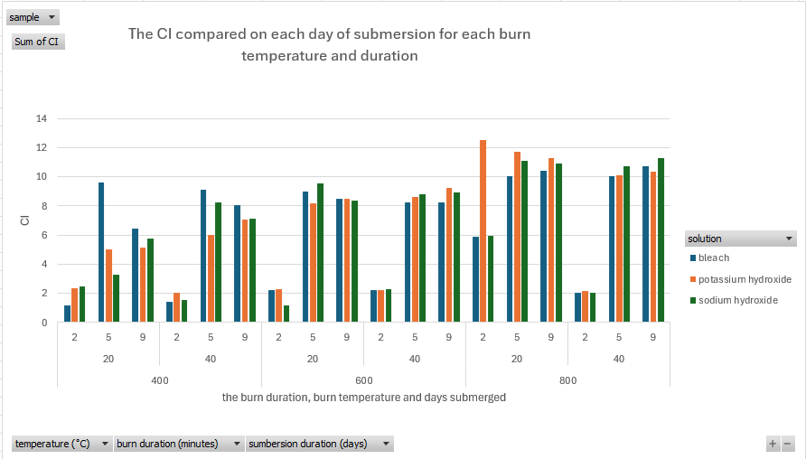
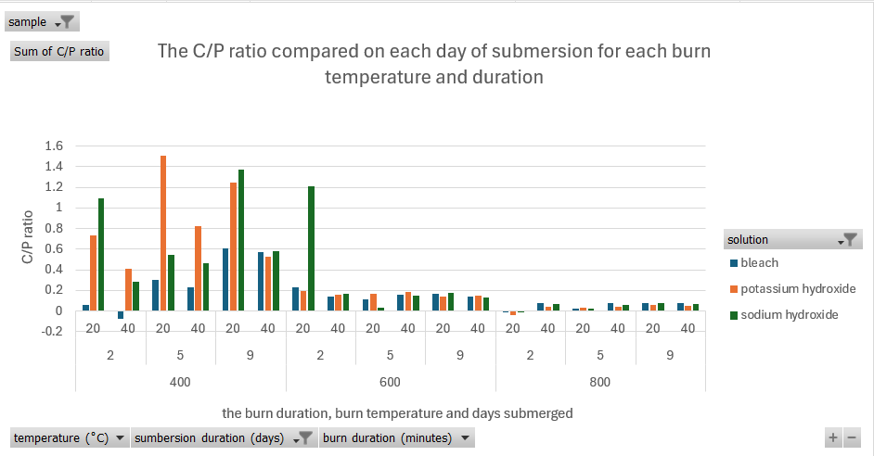
The Effect of Alkali on Burned Bone Micro- and Macrostructure
Holly Baker-Carpenter, Professor Kirsty Squires
School of Health, Education, Policing & Sciences, University of Staffordshire, ST4 2DF
For references see QR code:
Introduction
In forensics, bodies can be disposed of by dismembering, burning, submersion in water and dissolving in chemicals (Udristioiu et al, 2025). Bone is made from dense and spongy bone consisting of inorganic/organic components and water (Burns et al, 2016; Shehata and Krap, 2024). Porcine (pig) bones are used in research due similarities to human bones (Lunney et al, 2021). When burning bones there are various stages which they go through (dehydration, decomposition, inversion and fusion) occurring between 100˚C and 1000˚C (Ellingham et al, 2015; Gallo et al, 2023). When burning bones they go undergo various colour changes from light/translucent to darker then blueish grey to finally white (Rosa et al, 2023). Due to heating, bones have different heat induced fractures that may occur (transverse, longitudinal, step, delamination and patina) (Mata Tutor et al, 2021). Alkalis can have various effects on bone when submerged for different time periods such as dissolving the organic components of bone, affecting hardness of the bone and cortical bone erosion (Amadasi et al, 2015; Amadasi et al, 2017; Kalsbeek and Ritcher, 2006). Fourier Transform Infrared Spectroscopy with attenuated total reflectance (FTIR-ATR) was used between 400cm⁻¹ and 40cm⁻¹ to analyse any structural changes using the crystallinity index (CI) and the carbonate to phosphate (C/P) ratio (Thompson, Gauthier and Islam, 2009; Taylor et al, 2021). This project aims to observe how alkalis affect burnt porcine bones when burnt at different temperatures/durations.
Method
46 pieces of porcine bone were defleshed using scalpels and cut into 5cm long pieces then grouped into 6 groups based on burn temperature/time, one unburnt sample group and what alkali they were submerged into (bleach, sodium or potassium hydroxide). Burn temperatures included 400˚C, 600˚C and 800˚C for 20 or 40 minutes. The samples were placed onto a metal tray and burnt in a Stanton TC100 furnace. Once burnt and cooled the samples were photographed, visually examined, colours recorded using Munsell colour charts and observed under a LEICA INVESTA 3 microscope. The alkali solutions were a Tesco’s 24-hour fresh thick bleach, 1M solution of sodium hydroxide and a 0.5M potassium hydroxide solution. A measuring cylinder was used to pour 100ml of one of the alkalis over each bone sample. The bone samples were photographed on day 0, 2, 5 and 9 of submersion. On each day the samples were rinsed, photographed, had its colour compared with Munsell coloured charts, visually examined and small amount taken for FTIR-ATR using a scalpel. The FTIR-ATR samples were dried, crushed to a powder then analysed using a Perkin Elmer UATR-2 FTIR.
Figure 2.: the colour change from 400˚C to 600 ˚C to 800 ˚C (left to right)
Figure 1: Potassium hydroxide (sample 2) day 5
Table 1: Observations from the burn temperature/ duration groups
Burn duration/ temperature | Observations
400˚C 20 minutes | All samples were black, unbroken with a silver sheen/flaking. Microscopy showed samples having uneven surface textures and patina with some having cortical bone wearing/delamination Day 0: bleach samples had colour leach into the solution and the potassium/sodium hydroxide solutions turned pale yellow. Day 2: all were fragile/crumbly, bleach samples turned brown. Microscopy showed cortical bone wearing/flaking, uneven surfaces with some having fractures (longitudinal/patina), spongy bone visible ad areas having a bubbly surface Day 5: all were crumbly, bleach samples stayed brown and sodium/potassium hydroxide fragmented/crumbled. Microscopy showed cortical bone wearing/flaking, fractures/patina and a bubbly surface Day 9: all were fragile, bleach samples changed colour, the rest stayed black. Microscopy showed cortical bone wearing/uneven surfaces with some having honeycomb like spongy bone and areas of lighter/smoother surfaces.
600˚C 20 minutes | All were white/pale grey with minor flaking/cracking and powdery surfaces. Microscopy showed fractures (patina/longitudinal/step), flaking/cortical bone wearing and some areas of a yellow/cream or blue/grey colour. Day 0: no changes observed Day 2: all were crumbly but unbroken, bleach sample 2 was fragile and sodium/potassium hydroxide samples were blueish grey. Day 5: all were unbroken but crumbly and were grey/blueish grey. Day 9: all were crumbly/fragmented with no colour change.​
800˚C 20 minutes | All were white with flaking/surface cracking and powdery surfaces. Microscopy showed surface pitting, cortical bone wear and fracture revealing spongy bone. Some had uneven surface textures/ smoother areas, yellow colouration, cortical bone wearing and honeycomb like spongy bone Day 0: no changes observed Day 2: all were white, fragile/crumbly and bleach samples had flaking/fractures. Day 5: most crumbled/fragmented when cut, all were white with a bleach sample having spongy bone a pale-yellow colour. Day 9: most were white, intact, crumbly/ fragmented and bleach sample 2/sodium hydroxide samples crumbled/fragmented. Bleach sample 2 had flaking revealing spongy bone.
400˚C 40 minutes | All were black with flaking/surface cracking. Microscopy showed flaking/fractures (patina/longitudinal/delamination/step) and some having cortical bone wearing with small holes appearing. Day 0: bleach samples had colour leaching into the solution, sodium hydroxide solution tuned pale yellow and potassium hydroxide had no changes. Day 2: all were unbroken with bleach samples turning brown and crumbling and the sodium/potassium hydroxide samples remained black. Day 5: all were unbroken, the bleach samples were brown and the sodium/potassium hydroxide samples were black. Day 9: all were fragmented/crumbly, the bleach samples were dark brown and the sodium/potassium samples remained black
600˚C 40 minutes | All were light/slightly darker grey, unbroken with surface cracking, cortical bone wearing and minor flaking. Areas of yellow/black/dark grey were observed. Microscopy showed all had cortical bone wearing, pitting, fractures/flaking, powdery surfaces, possible soot and some with an uneven surface texture or smoother areas. Day 0: no changes observed. Day 2: all were intact but slightly fragmented with some being crumbly and grey or blueish grey. Day 5: all were unbroken but fragmented and blueish grey with some being crumbly and broken off cortical bone. Microscopy showed most samples had uneven surfaces, cortical bone wearing and fractures/cracking with some having lighter/yellow areas and smoother areas with spongy bone observed. Day 9: all crumbled/fragmented and were grey or blueish grey. Microscopy showed all had cortical bone wearing and uneven surfaces with some having flaking/fracturing, honeycomb like spongy bone at the ends and some yellow/cream areas observed.​
800˚C 40 minutes | Samples were white, unbroken with cortical bone wearing, slight flaking/cracking and powdery surfaces. Microscopy showed uneven surface textures, fractures, yellow coloration and spongy bone at the end of the samples. Day 0: no changes observed. Day 2: all were white and fragile/crumbly. Day 5: all were white, unbroken and fragment/crumbly. Microscopy showed all had cortical bone wearing/ uneven surfaces with some having small holes and honeycomb like appearance (figure 1) and most had minor flaking. Day 9: all were white and crumbly/fragmented. Microscopy showed all had cortical bone wearing, most had uneven surfaces and some had small holes, slight flaking and spongy bone observed.​
Figure 3: CI of each submersion day for each burn temperature/duration
Figure 4: C/P ratio of each submersion day for each burn temperature/duration
Results and Discussion
The observations of each burn temperature/burn duration and microscopy along with observations at each day of submersion can be seen in table 1.
Unburnt bones: light grey/pale brown or pale red/light pink. Microscopy showed all had uneven surface textures with a slight shine. Day 0 – no changes observed but a white coating on the bleach sample. Day 2 – bleach sample had no changes, but the sodium/potassium hydroxide samples had a jelly film and most were pink/light beige. Day 5 – no changes from day 2. Microscopy showed some has a smooth surface or uneven surface with the jelly film, light areas and spongy bone observed. Day 9 – no changes from day 5 but the sodium/potassium hydroxide samples were pink. Microscopy showed some had cortical bone wearing, uneven surfaces, dark spots and spongy bone observed.
Both 20/40 minute’s CI increases (Figure 3) and C/P ratio decreased (figure 4) as temperature increased. Day 2 – saw the lowest CI but increased the longer submerged, 20 minutes had a higher C/P ratio than 40 minutes and was lower at 800˚C than 400˚C. All alkalis had a decrease in CI on day 2 which increased on day 5 and 9. Across time of submersion the C/P ratio decreased as temperature increased and the longer submerged the more affected the bones became. Bones become crumbly the longer they are submerged making them more fragile due to alkaline solutions affecting collagen (Amadasi et al, 2017). When bones are in alkaline solutions fragmentation becomes more severe (Reidsma et al, 2022). When in alkaline solutions bones burnt at low/medium temperatures change colour (Reidsma et al, 2022) that correlates to observations at 400˚C. Kalsbeek and Ritcher (2006) used burnt deer bones and found the hardness was affected. This relates to observations of bones submerged becoming more fragile the longer they were in an alkali. An increase in CI was due to bone crystals being larger and more ordered (Thompson; Islam and Bonniere, 2013; Thompson et al (2011). A decrease in C/P ratio was due to carbonate being gone/barely present (Gallo et al, 2023).
Conclusion
The colour changed as burn temperature increased from black to grey then white (figure 2). Heat induced fractures, cortical bone wear and flaking were observed. The most common fractures were longitudinal, patina and step. Over the days submerged in alkali it made a difference in the macrostructure as bones were more fragile/brittle with minor colour changes (black to strong brown). The unburnt bones were less affected but most effected on day 0 and overall were less fragile/crumbly when in alkali. The bones burnt at 400˚C submerged in bleach had the colour from the bone go into the solution. CI increased as burn temperature increased and C/P ratio decreased as burn temperature increased for the controls. The bones in the various alkalis generally had the same pattern. The overall macrostructure become more brittle/fragile the longer in alkali. The alkalis affected the crystal structure causing the CI into increase and loss in carbonate causing the C/P ratio to decrease. Overall, it was seen than burnt bones are affected when submerged into alkaline solutions

