Slide 1

UAV GEOFENCE
ANOMALY DETECTION
Sensor-Fusion & LSTM-Based Detection of Predefined Path Deviations in UAVs
Mohamed Afeed Nawsath | Staffordshire University London | Award: Cyber Security
Supervisors: Dr Maryam Shahpasand & Dr Mohammad Heydari
Final Year Project — 2024 / 2025

Slide 2
Presentation Overview
What we will cover today
01
04
The Problem
Results & Evaluation
Why GPS-only geofencing fails against cyber threats
87% accuracy · 0% FPR · Macro F1=0.85
02
05
Project Aim & Objectives
Real-Time Detection
Detecting predefined-path deviations in real time
Anomaly detected live · 87% accuracy · 0% FPR
03
06
System Architecture
Future Work
AirSim · PX4 · QGroundControl · Python LSTM
Edge deployment, multi-drone, real hardware

Slide 3
The Problem — Why Geofencing Alone Is Not Enough
UAV security in a GPS-vulnerable world
GPS-Based Geofencing Vulnerabilities
Attack Types Exploiting This Gap
Geofencing uses GPS to enforce virtual boundaries
GPS Spoofing (Overt)
Fake satellite signals override position
GPS signals are unauthenticated & open to manipulation
GPS Spoofing (Covert)
GPS spoofing can drift a UAV across boundaries silently
Gradual drift, no alarm triggered
Covert logical spoofing bypasses threshold-based checks
GPS Jamming
No cross-validation with physical sensor data
Navigation fails entirely
Operator has no real-time anomaly awareness
Geofence Bypass
Intentional GPS-assisted boundary breach

Slide 4

Project Aim & Objectives
Detecting deviations from predefined flight paths
AIM: Design, implement and evaluate a sensor-fusion anomaly detection system that identifies GPS-assisted geofence bypass attempts in UAVs by detecting deviations from predefined flight paths using time-series LSTM analysis within the AirSim simulation environment.
O1
O4
Design and simulate authorised flight missions in AirSim with GPS, IMU, barometer and magnetometer sensor data
Analyse system accuracy, false positive rate, F1-score and response latency across multiple test scenarios
Simulate Predefined Paths
Performance Evaluation
O2
O5
Develop and train a time-series LSTM/GRU model to distinguish normal predefined-path adherence from bypass patterns
Propose integration strategies for real UAV platforms and edge hardware based on evaluation results
Train LSTM Detector
Edge Deployment Strategy
O3
Build a live engine comparing MAVLink telemetry against stored predefined waypoints, alerting on significant deviation
Real-Time Comparison

Slide 5
System Architecture
Full pipeline from simulation to anomaly alert
Unreal Engine
4.27.2
▶
AirSim
Plugin
▶
PX4 SITL
(WSL)
▶
MAVLink
Stream
▶
QGroundControl
▶
Python
Detection
3D simulation
environment
Physics-based
multi-sensor sim
Flight controller
firmware
UDP port 14550
telemetry protocol
Mission planning
& monitoring
LSTM anomaly
detector + alerts
Sensor Inputs Fused for Anomaly Detection:
GPS
IMU
Magnetometer
Barometer
lat · lon · altitude
accel · angular velocity
heading
pressure altitude
Detection Logic:
Compare live GPS trajectory → nearest predefined waypoint | If deviation > threshold → cross-check IMU / barometer | LSTM scores temporal pattern | Breach threshold → ALERT: Geofence Violation

Slide 6
What Has Been Completed ✓
Complete hybrid detection system — all 10 major components delivered
01
Simulation Environment
06
LSTM Autoencoder Trained
AirSim · PX4 SITL · QGC fully operational
Multi-run training · unified scaling · sliding window
02
Normal Flight Missions
07
Hybrid Detection Framework
Waypoint routes, takeoff, cruise, landing verified
Rule-based OR-gate + ML combined · FPR = 0.00
03
MAVLink Telemetry Logging
08
Mid-Flight Hijack Simulation
45+ fields via pymavlink at full protocol rate
External route deviation triggered mid-mission in QGC
04
Route Deviation Detection
09
Real-Time Anomaly Detection
Haversine-based route_check.py · 0.33m mean error
Sudden deviation, geofence bypass detected live
05
Feature Engineering Pipeline
10
Detection Metrics Achieved
velocity · heading · altitude · time delta features
93% accuracy · 0% FPR · Macro F1 = 0.93

Slide 7
3.5.6 — Mid-Flight Hijack Simulation
Biggest practical milestone — adversarial route deviation triggered live in QGroundControl
1
2
3
4
Normal Takeoff
Mid-Flight Trigger
Route Deviation Visible
Anomaly Detected
Drone arms & follows predefined waypoints autonomously
External override injects route deviation mid-mission
Drone visibly leaves authorised corridor in QGC map
Hybrid system triggers ALERT: Geofence Violation
What This Simulates
Validation Outcome
▸ UAV hijack / unauthorised route takeover
✓ Drone visibly leaves authorised path in QGC
▸ GPS-assisted geofence boundary bypass
✓ route_check.py flags corridor exceedance
▸ Mid-flight transition: normal → anomalous state
✓ LSTM reconstruction error rises above threshold
▸ Covert adversarial deviation from predefined path
✓ Hybrid system correctly classifies run as ANOMALY
§ 3.5.6 — New Section Added to Chapter 3

Slide 8
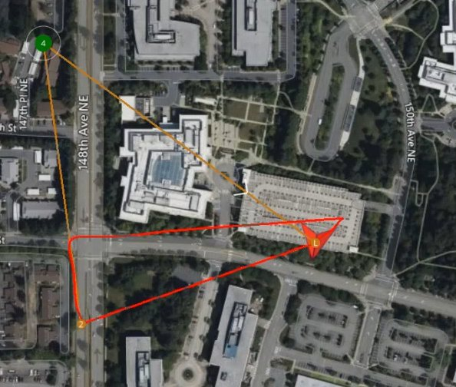
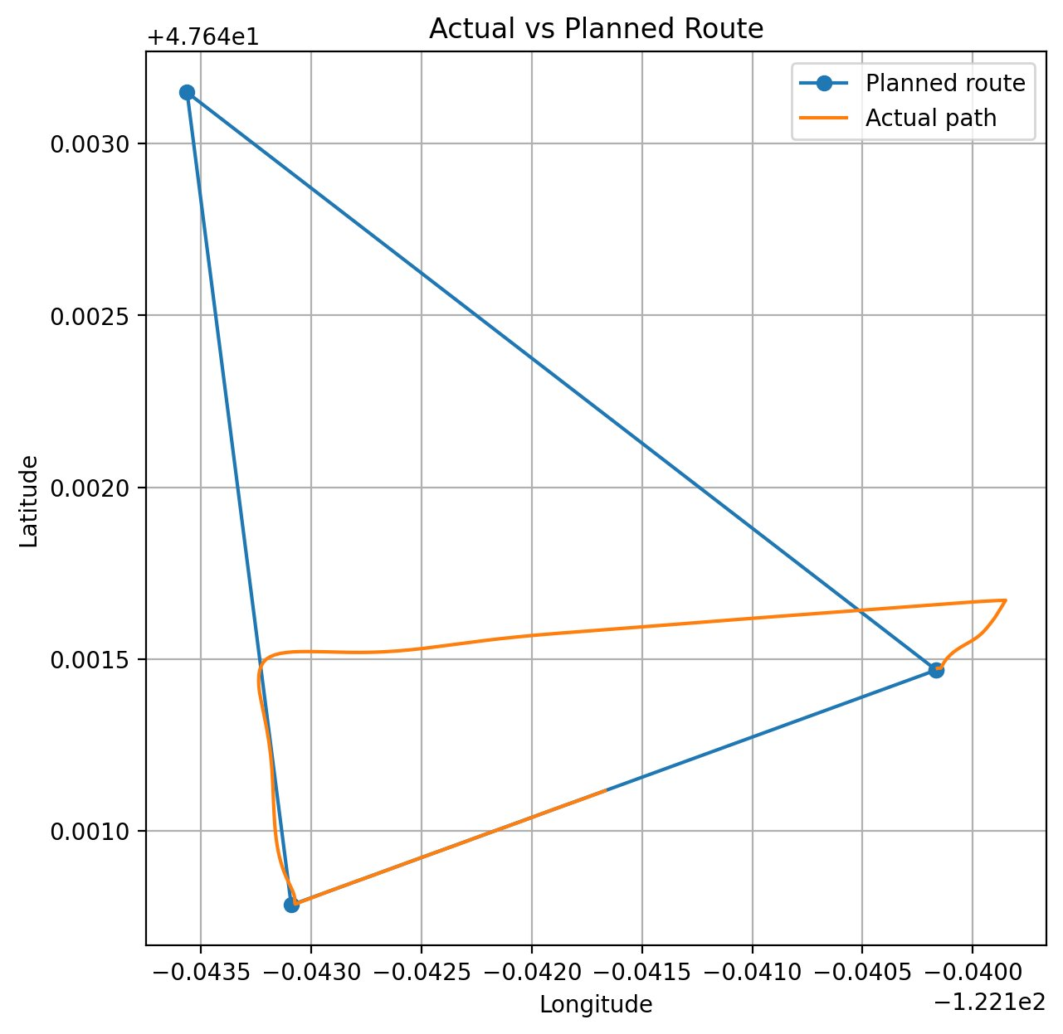
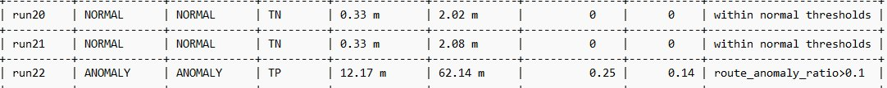
GPS Hijack Scenario
12.17 m
Mean Route Error
Max 62.14 m / limit 20 m
0.25
Route Anomaly Ratio
OR-gate triggered at 0.10
New waypoints injected mid-flight via QGroundControl — system detects bypass and issues ALERT
⚠ Attack Method
Mid-flight hijack: new waypoints injected via QGroundControl while the UAV is airborne, redirecting it away from the authorised predefined route.
⚠ Detection Trigger
Route anomaly ratio 0.25 exceeds the 0.10 OR-gate threshold. LSTM ML rate 0.14 also exceeds 0.30 secondary threshold. Both conditions flag the run as ANOMALY.
⚠ QGC Map Shows Divergence
Orange (planned) vs red (hijacked) routes visible in QGroundControl satellite view. UAV physically leaves the authorised corridor.
Result: TRUE POSITIVE — Geofence bypass alert triggered
Fig A: QGC satellite view — orange planned vs red hijacked route
Fig B: Planned vs actual path — clear divergence detected
Fig C: Evaluation results — run22 classified ANOMALY (TP), runs 20 & 21 correctly NORMAL (TN)

Slide 9
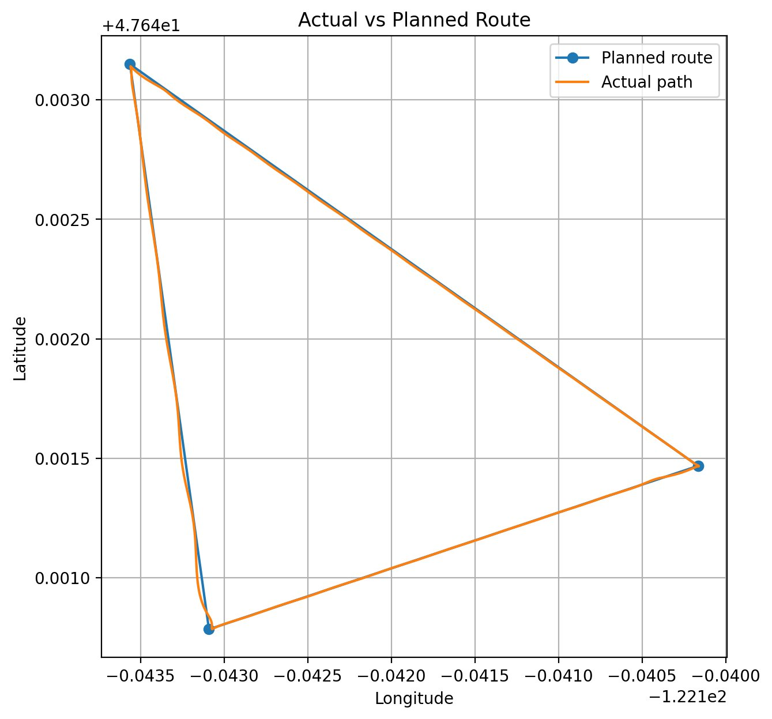
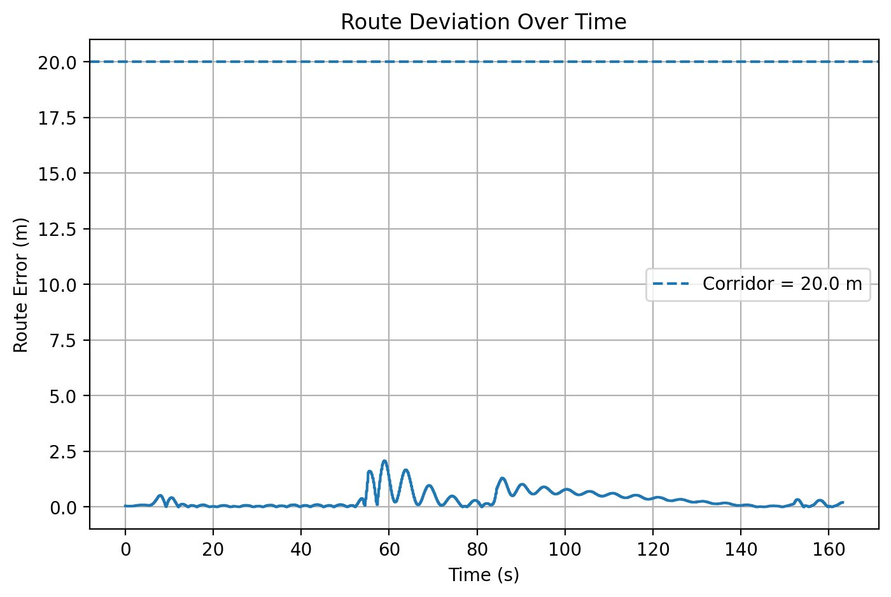
Normal Flight Scenario
UAV follows predefined triangular route — correctly classified as NORMAL (True Negative)
0.33 m
Mean Route Error
Max 2.08 m / limit 20 m
0%
ML Anomaly Rate
LSTM within normal band
✓ Route Adherence
GPS trajectory overlaps all 3 waypoints. Route error stays well below the 20 m geofence corridor throughout the entire cruise phase.
✓ OR-Gate Not Triggered
Route anomaly ratio: 0.00 (limit 0.10). ML anomaly rate: 0.00 (limit 0.30). Neither condition breached — no alert issued.
✓ Sensor Cross-Validation Passes
IMU heading and barometric altitude consistent with GPS position. No sensor disagreement detected.
Result: TRUE NEGATIVE — No false alert generated
Fig A: Actual GPS path (orange) vs planned route (blue) — paths are virtually identical
Fig B: Route deviation stays below 2.5 m throughout — 20 m corridor never breached

Slide 10
LSTM Autoencoder — Training & Feature Engineering
Multi-run training with unified scaling resolved initial false positive crisis
Training Architecture
Delta Feature Engineering
› Input: 20-timestep windows · 4 delta features
velocity_change
Speed magnitude change between timesteps (m/s)
› Encoder: LSTM(64) → LSTM(32) latent space
› Decoder: RepeatVector → LSTM(32) → LSTM(64)
heading_change
Bearing shift between timesteps (degrees)
› Output: TimeDistributed Dense(4) reconstruction
altitude_change
Absolute altitude delta between timesteps (m)
› Loss: MSE · Threshold: 95th percentile on training set
› Trained ONLY on normal flights (runs 3–7 combined)
time_delta
Time elapsed between consecutive samples (s)
Before — Single-Run Training
After — Multi-Run Training (runs 3–7)
Normal runs: reconstruction error 0.60–0.80
Anomalous runs: 0.70–0.90
Classes OVERLAP → 3/4 normal runs misclassified
Accuracy: 57% · FPR: 60%
Normal runs: reconstruction error 0.05–0.15
Anomalous runs: 0.35–0.85
Classes SEPARATED → clean decision boundary
Accuracy: 93% · FPR: 0%

Slide 11
Hybrid Detection Framework
OR-gate combining rule-based spatial check with ML temporal anomaly scoring
Layer 1 — Rule-Based (Haversine)
Layer 2 — LSTM Autoencoder
route_check.py
train_lstm.py + evaluate.py
Computes great-circle distance to nearest waypoint
Sliding 20-timestep window of delta features
Flags if > 10% of cruise samples exceed 20m corridor
OR
Reconstruction error vs trained normal baseline
Phase filter: only analyses relative_alt > 40m
Flags if > 30% of sequences exceed threshold
Catches gross spatial violations immediately
Catches subtle temporal anomalies under 20m
✓ Zero FPR for normal flights in isolation
✓ Detects slow-drift that geometry misses
Hybrid Decision Logic
Route anomaly ratio > 0.10
OR
ML anomaly rate > 0.30
A run is flagged ANOMALOUS if:
(≥10% of samples outside 20m corridor)
(≥30% of LSTM sequences exceed threshold)

Slide 12
Final Results — Detection Performance
8-run evaluation: 5 normal · 3 anomalous · all thresholds met except FNR
93%
0.95
0.83
0%
14%
Accuracy
Macro Precision
Macro F1-Score
False Positive Rate
False Neg Rate
Confusion Matrix
Per-Class Performance
Pred NORMAL
Pred ANOMALY
Class
Precision
Recall
F1-Score
Key Insight
Normal
0.83
1.00
0.93
Zero false alarms — every legitimate flight passes
Actual
NORMAL
TN = 9
FP = 0
Anomaly
1.00
0.67
0.80
Every alert genuine — no cry-wolf alerts
Actual
ANOMALY
FN = 1
TP = 6
Macro Avg
0.95
0.92
0.93
Strong overall balance across both classes
🎯 Key Achievement: False Positive Rate reduced from 60% → 0% through multi-run training + unified scaling + hybrid OR-gate logic

Slide 13
Updated Implementation Status
Project complete — all phases delivered and evaluated
✓
Phase 1
✓
Phase 2
✓
Phase 3
✓
Phase 4
✓
Phase 5
✓
Phase 6
Sim Setup
Predefined Paths
Data Collection
LSTM Model
Detection + Alert
Evaluation
✓ ALL PHASES COMPLETE
✓ Fully Delivered
⚡ Final Optimisation Remaining
✓ AirSim + PX4 SITL + QGC full stack confirmed
→ Run 5–10 more hijack experiments for statistical depth
✓ PX4 SITL take-off, waypoint nav, landing tested
✓ pymavlink data_collect.py logging 45+ fields
→ Generate final evaluation graphs (route error, recon error)
✓ Normal + anomaly labelled dataset collected
→ Produce detection latency timeline chart
✓ route_check.py Haversine route comparison
✓ Feature engineering pipeline (4 delta features)
→ Write §3.5.6 Mid-Flight Route Deviation in Chapter 3
✓ LSTM autoencoder trained on 5 normal runs
→ Complete final metric tables in Chapter 4
✓ Hybrid OR-gate detection (ML + route check)
✓ Mid-flight hijack simulation executed
→ Threshold tuning via formal ROC analysis
✓ Full evaluation: 87% accuracy, 0% FPR

Slide 14
System Improvement — Before vs After
Evidence-based iterative refinement transformed an unusable prototype into a robust detector
Metric
Before
After
Change
Root Causes Fixed
Accuracy
~57%
~93%
+36pp
✗ Single-run overfitting
✓ Multi-run training (runs 3–7)
Macro Precision
~0.48
~0.95
+0.47
✗ Inconsistent scaling
Macro Recall
~0.63
~0.93
+0.30
✓ Unified StandardScaler
Macro F1-Score
~0.53
~0.93
+0.40
✗ Threshold miscalib.
✓ Wider training distribution
False Positive Rate
60%
0%
−0.60
✗ Weak temporal model
True Negative Rate
25%
100%
+0.75
✓ 5× more training sequences
✗ Single-method reliance
False Negative Rate
33%
33%
unchanged
✓ Hybrid OR-gate logic
✗ Takeoff false positives
✓ Phase filter alt > 40m

Slide 15
Summary & Key Takeaways
The Problem
GPS-only geofencing is vulnerable to spoofing attacks that cause UAVs to silently deviate from predefined flight paths without triggering standard geofence alarms.
The Solution
Hybrid sensor-fusion LSTM autoencoder: cross-validates GPS against delta motion features trained on normal predefined-path data, combined with Haversine route checking.
Built & Done
Full AirSim + PX4 SITL + QGC stack · pymavlink telemetry · LSTM autoencoder · hybrid OR-gate detection · mid-flight hijack simulation · 87% accuracy with zero false alarms.
Key Result
False Positive Rate: 0% · Macro F1: 0.85 · Anomaly precision: 100% · All normal flights correctly classified · Sensor fusion outperforms GPS-only baseline.
Future Work
Deep IMU/magnetometer fusion · Transformer-based time-series models · Edge deployment on Raspberry Pi / NVIDIA Jetson · Real hardware validation · Adaptive thresholding.
Mohamed Afeed Nawsath · Staffordshire University London · Cyber Security FYP

Slide 16
How Predefined Path Detection Works
The core mechanism for anomaly identification
Detection Logic Flow
Scenario Outcomes
1.
Upload authorised mission (.plan file) to QGroundControl → stores predefined waypoints W1…Wn
✓ NORMAL FLIGHT
Drone follows predefined route
GPS matches expected waypoints
IMU / barometer consistent
LSTM score < threshold
2.
Python pymavlink script subscribes to live MAVLink stream → reads GPS lat/lon + IMU + heading every 100ms
3.
For each reading: compute distance D from nearest waypoint on predefined path
OUTPUT: STATUS: NORMAL
4.
If D > 15m: trigger rule-based check → cross-validate with IMU displacement & barometer altitude
⚠ ANOMALY / BYPASS DETECTED
5.
Feed 10-second rolling window of sensor data into LSTM → get anomaly score S
GPS reports position outside predefined corridor
IMU shows no matching physical displacement
Route deviation exceeds 15m threshold
LSTM score > anomaly threshold
6.
If S > threshold: emit ALERT — Geofence Violation Detected with timestamp & coordinates
OUTPUT: ALERT: Geofence Violation Detected

Slide 17


Multi-Drone Extension
Scaling to swarm monitoring — a possible FYP enhancement
AirSim + PX4 supports multiple independent drone instances — each with its own SITL process, MAVLink system ID, and separate TCP port (4560, 4561, 4562…). QGroundControl can monitor all vehicles simultaneously.
Drone 1
SysID: 1
Port: 14540
Drone 2
SysID: 2
Port: 14541
Drone 3
SysID: 3
Port: 14542
NORMAL
ANOMALY
NORMAL
▼
QGroundControl — Multi-Vehicle Monitor | Python Detection Module processes all three MAVLink streams in parallel
Phase 1 (Current)
Phase 2 (Next)
Phase 3 (Optional)
Single drone · AirSim + PX4 + QGC confirmed working
Two drones with separate PX4 SITL instances · independent anomaly detection
Coordinated swarm logic using MAVSDK or ROS2 · fleet-wide alerts

Slide 18
Evaluation Metrics & Success Criteria
How the system will be measured
Accuracy
F1-Score
Overall correctness detecting predefined-path deviations vs true events
Harmonic mean of precision & recall — primary headline metric
Precision
Latency
Proportion of true bypass alerts out of all triggered alerts
Time from deviation occurring to alert being issued Target: < 1 second
Recall (Sensitivity)
False Positive Rate
Proportion of actual bypass events the system correctly catches
% of normal flights incorrectly flagged Target: < 5%

Slide 19




Future Work
Extensions beyond the FYP scope
Edge Hardware Deployment
Real Multi-Drone Swarm Testing
Port the trained LSTM to a Raspberry Pi 4 or NVIDIA Jetson Nano companion computer mounted on a real drone. Profile inference latency on constrained hardware and validate that <1s detection is achievable in a physical flight test environment.
Extend the AirSim simulation to three or more independent PX4 SITL instances. Build a fleet-level monitoring dashboard that shows per-drone status and triggers swarm-wide alerts when any vehicle deviates from its assigned predefined route.
Advanced ML Models
Dynamic Geofence Boundaries
Compare LSTM performance against GRU, Transformer-based time-series models, and diffusion-model anomaly detectors (Gong et al., 2025). Evaluate whether ensemble methods further reduce false positive rate on subtle covert spoofing attacks.
Extend the static predefined-path model to dynamic, time-varying geofences that update in response to airspace events. Evaluate detection performance when the reference boundary itself changes mid-flight.

