Slide 1
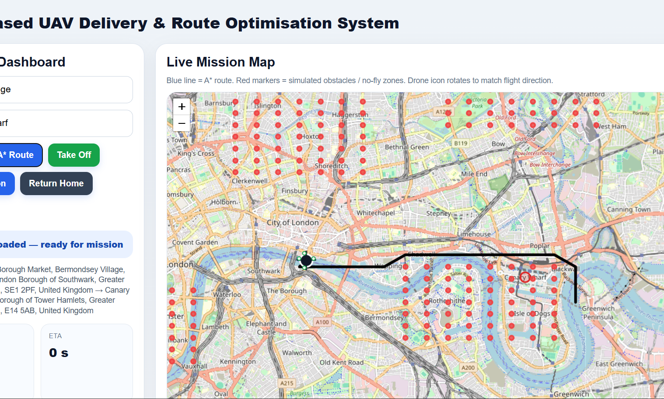
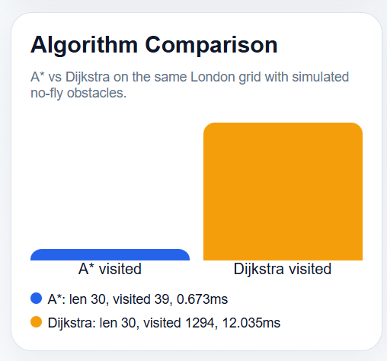
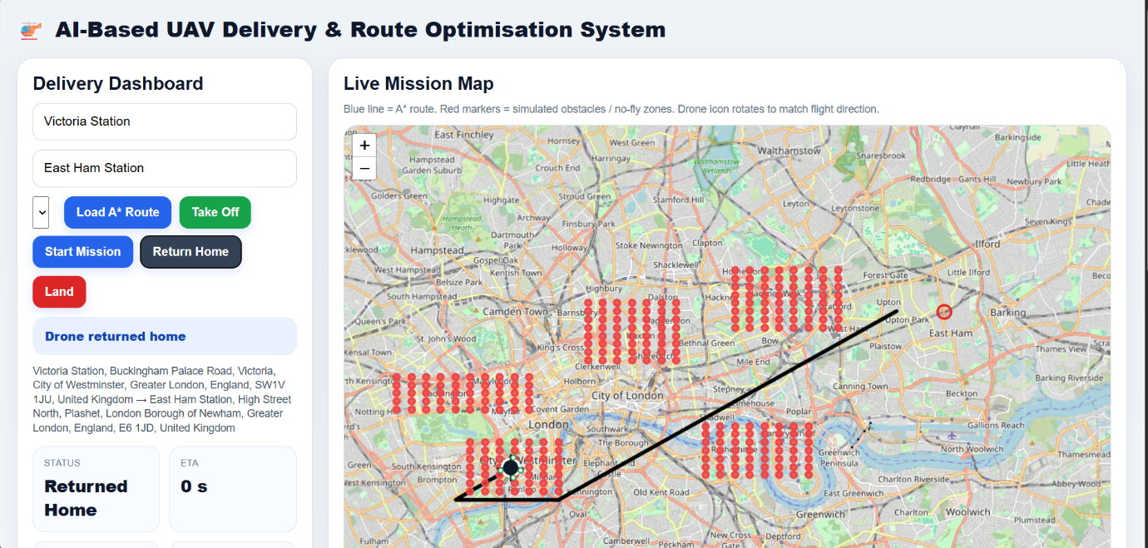
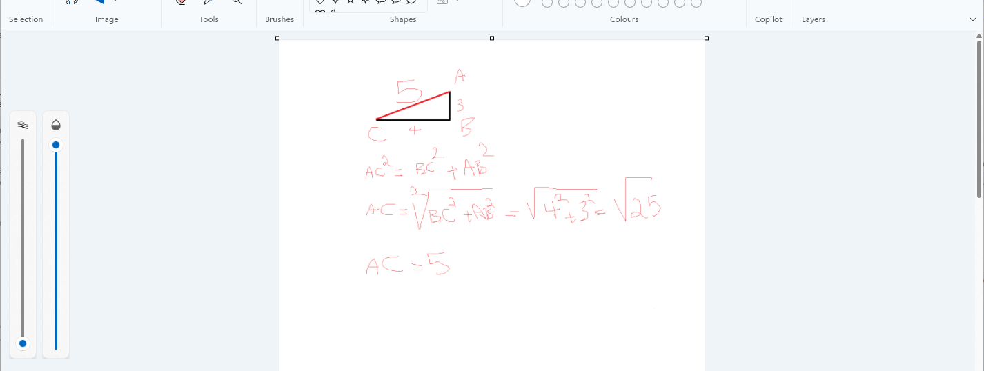
Latency, Accuracy, and Optimisation
for UAV Mapping Systems
Brandon Castillo Ortega • Student ID: 23036082 • COMP60066 Dissertation
AI-Based UAV Delivery & Route Optimisation System
Project Summary
This project developed a web-based UAV delivery simulation that calculates drone routes, avoids simulated no-fly zones, displays live movement on a map, and compares A* with Dijkstra. The aim is to demonstrate how route optimisation can improve route efficiency, response time and visual understanding in a simulated UAV delivery system.
Aim & Hypothesis
System Design
Evaluation Metrics
Aim:
20.6
191
Design, implement and evaluate a UAV delivery route optimisation prototype using a live map and simulated drone movement.
same average path length
A* avg visited nodes
Hypothesis:
887
1.382ms
A* with Euclidean distance and diagonal movement will be more efficient than Dijkstra because it uses a heuristic to reduce unnecessary searching.
Dijkstra avg visited nodes
A* avg time
Five London route tests were used to compare route quality and algorithm efficiency.
Live mission dashboard showing input fields, mission buttons, map route, obstacle markers and telemetry.
Objectives
Frontend: dashboard and live map.
Backend: FastAPI route calculation and drone state.
Simulation: drone position, ETA, battery and heading.
Algorithm Comparison
Build a working UAV simulation prototype.
Implement A* and Dijkstra pathfinding.
Use Euclidean distance and diagonal movement.
Display routes, obstacles and telemetry on a live map.
Compare path length, visited nodes and execution time.
Data Flow & Architecture
Main test: A* and Dijkstra produced the same route length, but A* visited far fewer nodes and calculated faster.
Research Method
User enters start and destination.
Locations are geocoded into coordinates.
Coordinates are mapped to a grid.
A* or Dijkstra generates waypoints.
Drone state updates are shown on the map.
Route Accuracy
Practical development: build a working artefact.
Simulation-based testing instead of real UAV hardware.
Comparative testing: A* versus Dijkstra.
Quantitative evaluation using route length, visited nodes and time.
Visual testing of map route, obstacle zones and drone movement.
Implementation Code Structure
Diagonal movement is based on Euclidean distance. This avoids unnecessary grid-only movement and makes the UAV path shorter and more realistic.
main.py
FastAPI endpoints, routing requests and backend communication.
Tools & Technologies
pathfinding.py
A*, Dijkstra, obstacle handling, Euclidean heuristic and path reconstruction.
Limitations & Future Work
Python • FastAPI • Uvicorn • JavaScript • HTML/CSS • Leaflet.js • OpenStreetMap • A* • Dijkstra • VS Code
drone_sim.py
Drone movement, battery, ETA, altitude, heading and mission state.
2D simulation only; future work could include 3D route planning.
Static obstacles; future work could add dynamic obstacle detection.
Simulated battery; future work could use real UAV battery data.
Manual no-fly zones; future work could integrate airspace data.
The system uses a Python backend for algorithm logic, a FastAPI REST API for communication, and a Leaflet/OpenStreetMap frontend for live route visualisation.
index.html
Dashboard, controls, JavaScript API calls, map display and telemetry cards.
A* core formula: f(n) = g(n) + h(n)
Euclidean distance improves route realism by supporting diagonal movement.
Conclusion
The project successfully produced a working UAV route optimisation prototype. The evaluation showed that A* maintained route quality while reducing visited nodes and calculation time compared with Dijkstra. The system demonstrates route optimisation, obstacle avoidance, live telemetry and interactive map visualisation in one practical artefact.
Selected References
Cormen et al. (2022); Debnath et al. (2024); European Union Aviation Safety Agency (2023); FastAPI (2026); LaValle (2006); Leaflet (2025); OpenStreetMap Contributors (2026); Russell and Norvig (2021); Sommerville (2016).

