Slide 1
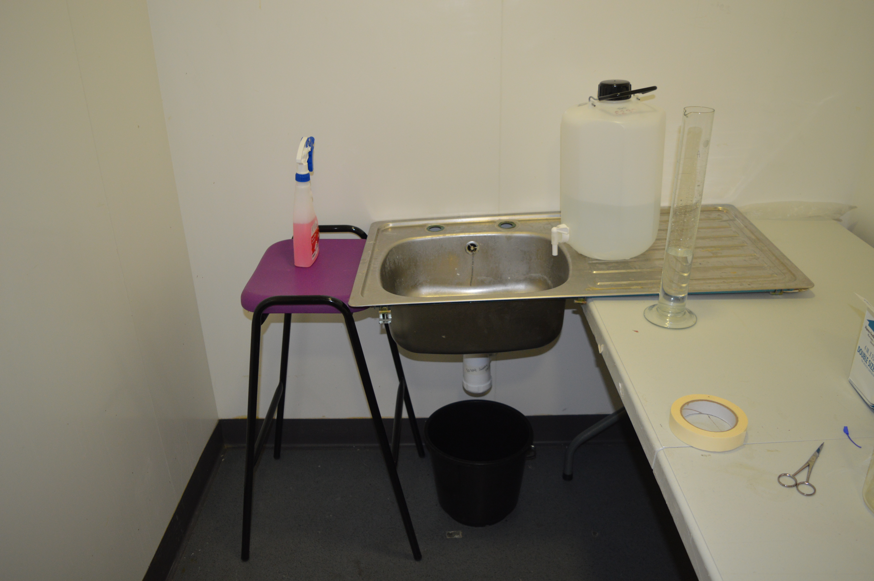
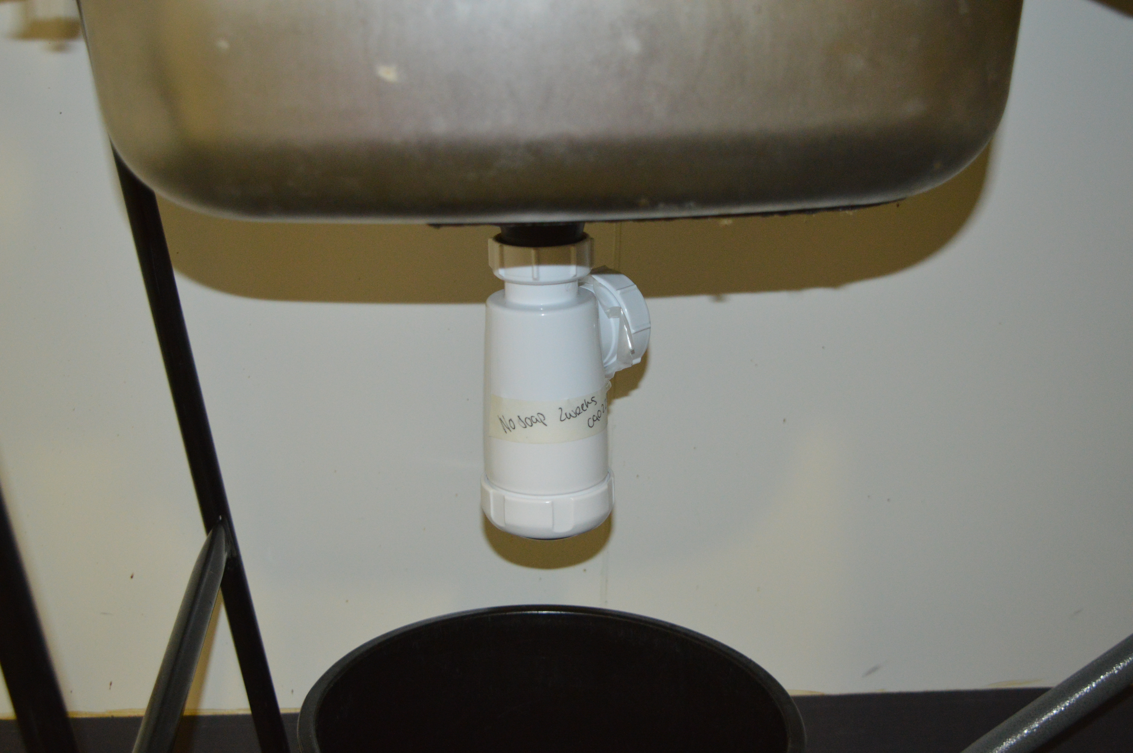
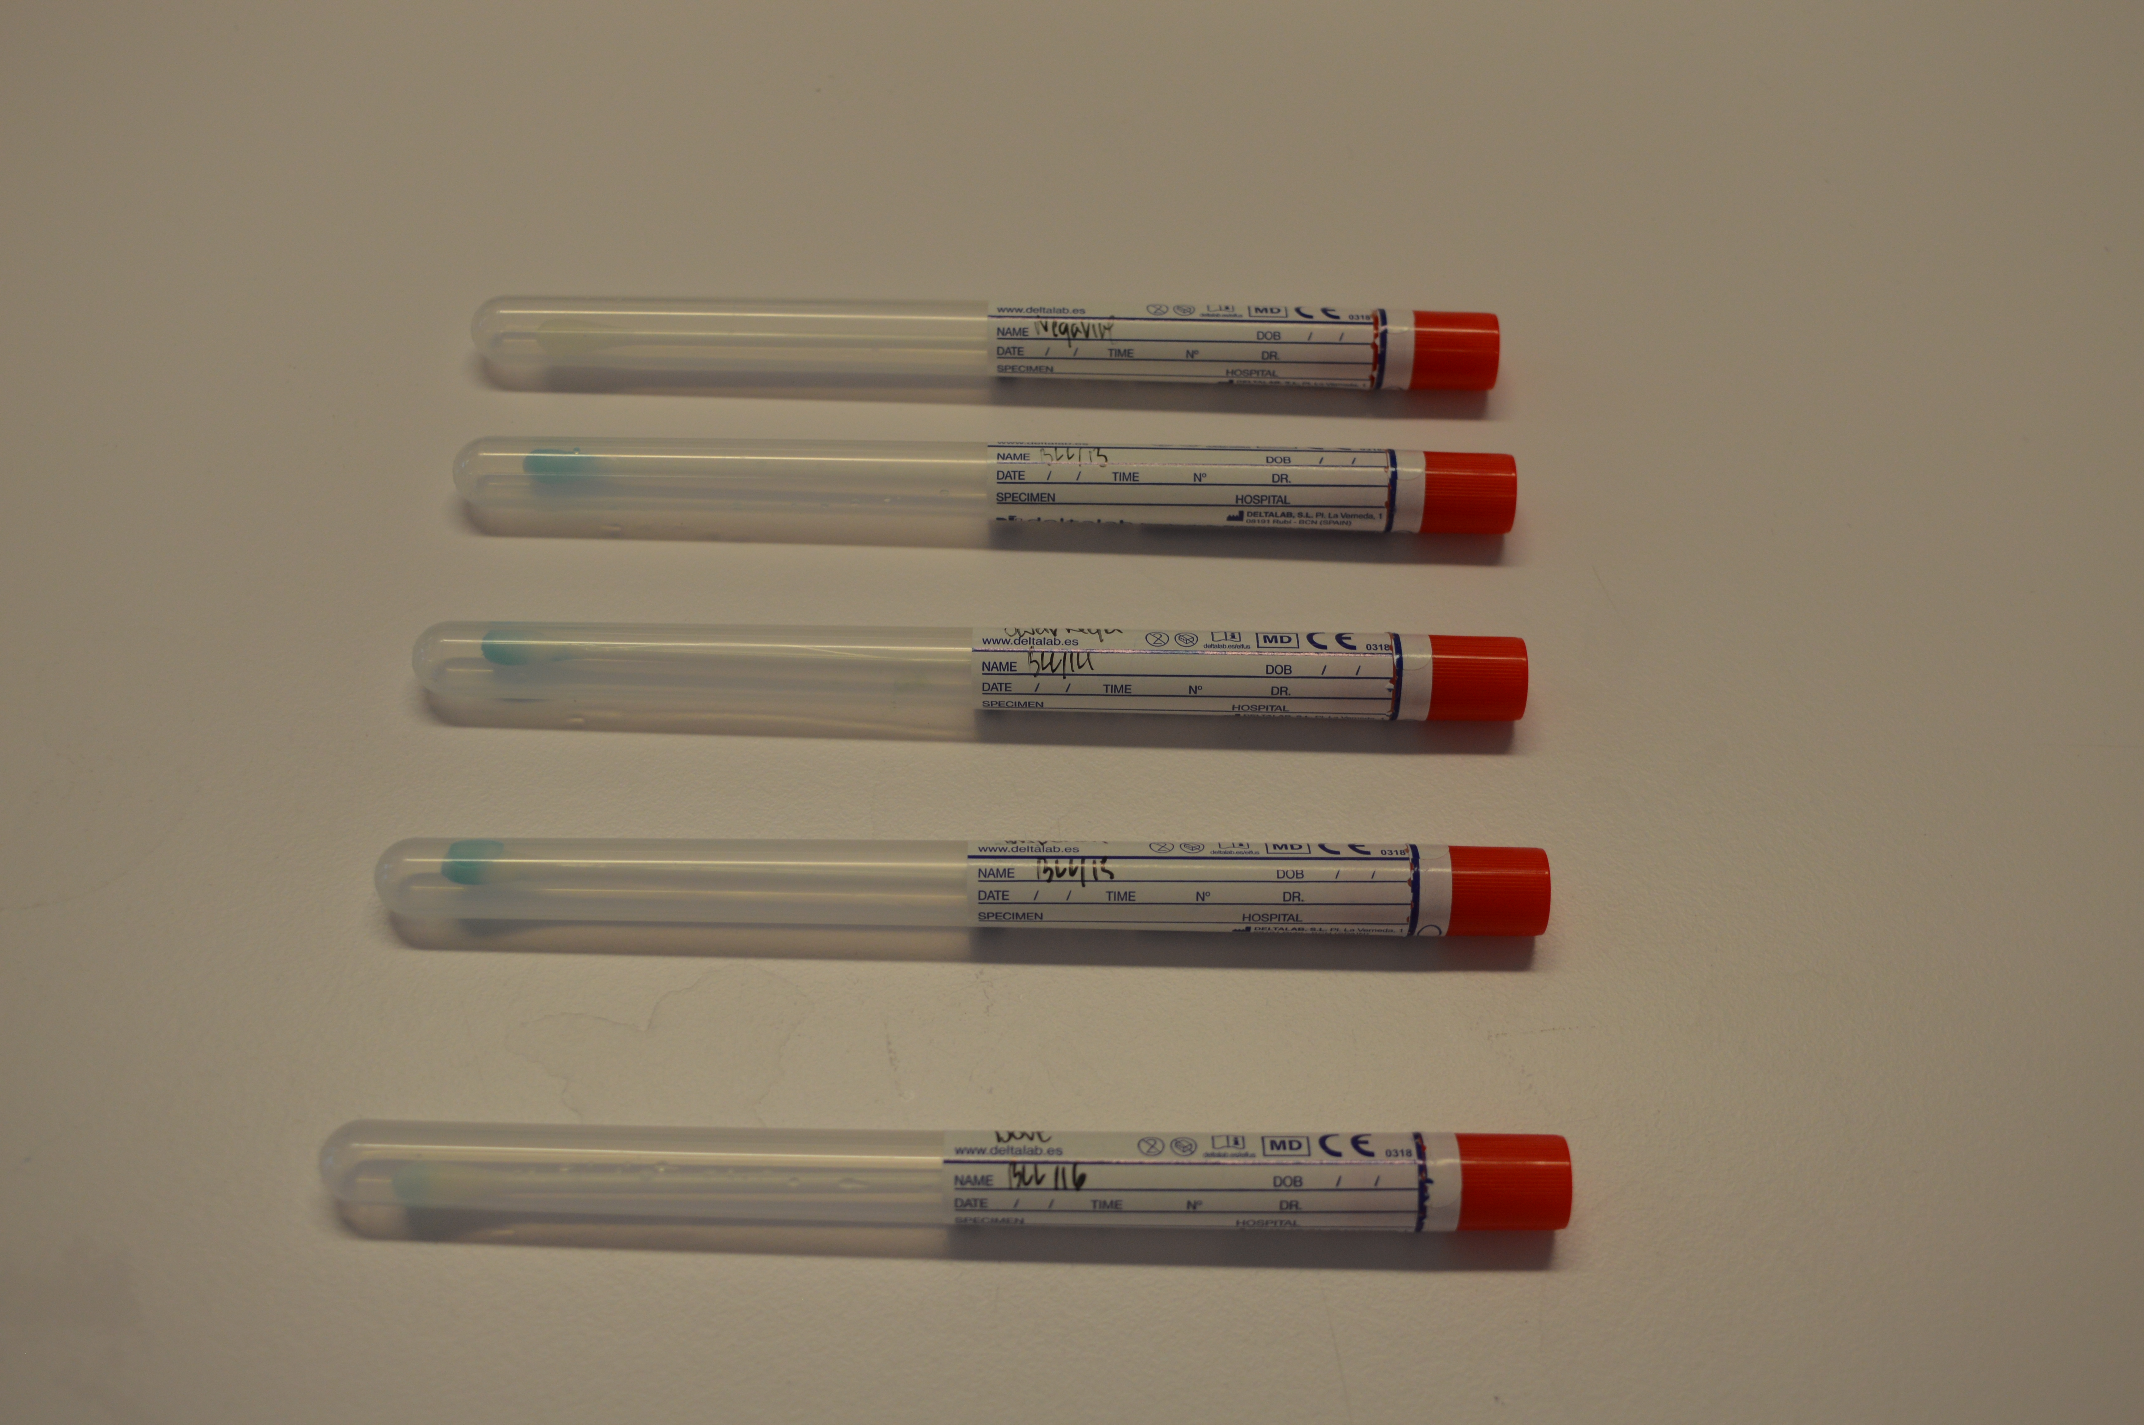


Blood Detection in Sinks Following Washing of Bloody Hands
Bonnie Long, Michelle Hogg
School of Health, Education, Policing & Sciences, University of Staffordshire, ST4 2DF
Introduction
In around 45% to 56% of violent crimes there is some form of evidence destruction or cleanup strategy deployed by suspects. The most frequent type of suspect cleanup is biological and physical trace cleanup. Using household chemical cleaning agents to destroy DNA within blood and body fluids along with machine laundering blood stains are just some of the ways blood cleanup attempts are committed.
Statistics regarding blood cleanup attempts vary significantly based upon the type of crime committed however it is increasingly common to encounter scenes where blood evidence has been tampered with. Cleaning of scenes and blood tampering was once unheard of but is now considered not unusual in planned crimes due to the influence of media, and forensic awareness. General homicides, sexual homicides and child abduction murders are types of crime facing mass cleanup attempts due to the severe legal and societal consequences faced.
Despite the rise in forensic awareness and media influence there is a total lack of research into the effects blood tampering faces from crime scene clean up. Literature has been published on household cleaning agents such as bleach and machine laundering; however, investigations into handsoap and sink environments are still in their infancy.
‘Blood Detection in Sinks Following Washing of Bloody Hands’ aims to evaluate quantity and quality of blood DNA following the washing of bloody hands in a sink environment focusing on the effects soap types have on degradation. This aim was completed by washing bloody hands in a sink with a bottle trap plumping system. Either No Soap, Swarfega Orange Soap, Imperial Leather Soap, or Dove Bar Soap was applied before the bottle traps were left in a timing condition of two-weeks, one-week, twenty-four-hours, or one-hour.
Pokupcic, (2017), notes that blood is highly valued forensic evidence due to its many analytical uses. Blood can be analysed from the patterns it creates to reveal the sequence of events that occurred or profiles of suspects and victims can be determined by the DNA recovered (Pokupcic, 2017), however the evidence most important to this project is quantity and quality. DNA quantity and quality from blood residue exposed to different handwashing methods in a sink environment is being investigated, with degradation interpreted from these results provided alongside the DNA profiles created.
Degradation of blood in a sink environment following washing of bloody hands, focusing on the effects soap types have overtime is the overall aim, with degradation being investigated through DNA quantity and quality.
The objectives of the project ‘Blood Detection in Sinks Following Washing of Bloody Hands’ were:
To examine latent and patent blood inside sinks after washing of blood-contaminated hands,
To evaluate the reliability and effectiveness of blood detection methods utilised,
To compare the impact different handwashing soaps, have on DNA degradation,
To analyse already published data to identify overlapping patterns or trends.
Methods
To start, a sink was set up for the handwashing station which was made up of a stainless-steel kitchen sink (length=94cm, wash basin=43cm, depth=15cm) which rested between a lab stool and folding table at the same height of 73cm. Once the sink was set up a Flomasta round bottle trap white 40mm was sealed with Parafilm 'M' Laboratory Film over the waste pipe and screwed onto the sink drain. Once the bottle trap is sealed and securely attached onto the sink, 200ml of water is then added to a Thermo Scientific™ Nalgene™ Polypropylene Graduated Cylinders 500ml measuring cylinder. Then using a Sartorius Micropipette 155μl of blood and 155μl of saliva, is pipetted onto their gloved hands. Hands are then washed for 10 seconds, following the NHS handwashing guidelines, with the differing conditions; No soap, Swarfega Orange, Imperial Leather and Dove Bar soap. For the 10 seconds of handwashing, a Traceable Nano Timer will be set for that amount of time, for each handwashing condition. There are four handwashing conditions which the experiment is repeated for, No Soap, Swarfega Orange Soap, Imperial Leather Soap and Dove Cream Bar Soap. Alongside the four handwashing conditions, there are four timing conditions in which the bottle traps are left for, two-weeks, one-week, twenty-four-hours, and one-hour. For the DNA extraction the researcher will use a sartorius micropipette to add 2000μl of water from the bottle traps, following each method repeat, onto a piece of Fisherbrand filter paper inside of a Thermo Scientific™ Nunc™ Petri Dishes. The petri dish and filter paper will have already been sterilised with a UV Crosslinker for 2 minutes before the researcher added the water. Once the filter paper is saturated with the water, it will then be folded in half and then half again. The filter paper will be folded so that the tip of it can be cut off and added to a Sigma Aldrich Screw-Top Tube with O-Ring Cap 2ml centrifuge tube, so that the Qiagen DNA extraction process can begin, which will follow the QIAamp Microkit Extraction procedure (Qiagen, 2010). Once all the water has been emptied out of each of the bottle traps, LMG presumptive testing will then be completed. The access cap from the bottle trap will be removed before a Deltalab plain sterile swab in a tube, will swab around the rubber washer ten times. Onto the swab, two drops of LGM reagent will be added via a Fisherbrand Soda Lime Glass 150mm Pasteur Pipette before two drops of hydrogen peroxide is added onto the same swab. The colour change reaction will be monitored with any relevant observations being noted. For the SYBR Green part of the DNA extraction, the method follows the Bio-Rad Protocol, (Bio-Rad, n.d). Following the Bio-Rad protocol, primers are changed depending on the requirement for quantification or degradation index. For the quantification protocol, GAPDH is the primer used in the Bio-Rad protocol and for degradation index, both DS2441 and FGA are used respectively. Following the SYBR Green protocol, the Liz/HiDi method from NGM was followed. ONce the main DNA extraction was followed concentration and purity of the samples DNA was measured with a NanoDrop™ One/OneC Microvolume UV-Vis Spectrophotometer, following the completed method from section 2.6 to 2.6.3. The NanoDrop concentrations and purity were completed by first adding 1.5μl of molecular biology grade water to blank the instrument. Wiping clean after each use, 1.5μl of the sample can be added to give their concentrations. Once the NanoDrop was completed for all samples, calculations were completed of the results by turning the results into fractions before timesing by 10, see Appendix I. The calculations were then diluted with water depending on their calculation outcome before vortexing for 5 seconds and then centrifuging for 5 seconds. The dilutions of the samples were diluted so that 5μl of the sample could be combined with 7.5μl of the PCR mastermix which was briefly centrifuged and vortexed, both for 5 seconds, before placing into the Bio-Rad MyCycler™ Thermal Cycler for two and a half hours.
Fig 1.: Experimental handwashing set-up including sink
Fig 2.: Bottle Trap attached to the Sink Drain
Results and Discussion
The first set of results found were to do with the visual observations recorded when the DNA was being extracted during the method. After each time period in which the bottle traps were left and the water was emptied from them, it was noted that certain time conditions had a distinct smell to them, especially some of the no soap ones which had a strong pungent smell. All bottle trap conditions were noted to also have a slightly reddish-brown translucent water to them, with certain soaps like Swarfega orange and dove bar soap, to still have small flakes of soap floating within the water. The No Soap visual examinations noted that there was a very red colour to the water especially during the two-week, one-week, and one-hour conditions while the twenty-four-hours condition noted a strong smell and a very murky brown colouring which stain the pipettes. Swarfega Orange had a prominent red water colouring but was slightly faded compared to the no soap, yet there were observations of soap particles floating around in the bottle trap. Imperial Leather was consistently noted to have a very faded red colouring in the water and had no smells or floating particles, however during the twenty-four-hour and one-hour observations there will still bubbles within the bottle trap. For the last set of observations for the Dove Bar Soap, these were noted as leaving a murky and grey water with only the slightest red tinge. Not many observations were made about the Dove Bar Soap besides from the water colour alongside the twenty-four-hour and one-hour which found there were still bubbles inside the bottle trap however no smells were ever noted.
Following on from the water observations, Leucomalachite Green reagent was used, and all the results were recorded as positive reactions, but the timing of each reaction and the colour change was of different brightnesses. No matter the timing condition, No Soap had the fastest and brightest colour change which was implied to be because of the experimental condition only consisting of water with the blood, saliva mixture. The slowest reaction came from Imperial Leather as every test completed for that handwashing condition was very slow reaction which was 30 seconds or longer. The ingredients of Imperial Leather include two surfactants, Sodium Laureth Sulfate, and Cocamidopropyl Betaine which are both DNA degraders with Sodium Laureth Sulfate reducing the detection limit of the presumptive test due to the physical erosion and dilution caused by the wetting power. Cocamidopropyl Betain causes protein denaturation, like Sodium Laureth Sulfate, and structural damage to the DNA by disrupting the hydrogen bonds and therefore causing the degradation within blood and DNA. Imperial Leather was not the only one with DNA degraders as Dove Bar Soap also included Cocamidopropyl Betain but not Sodium Laureth Sulfate and Swarfega Orange included none.
The use of the GAPDH primer was for the DNA quantifications to be generated and thus interpreted. For the total DNA yield calculations, the buccal sample had a mean yield of 246.37 meanwhile the overall mean, combining the average from each sample repeat, was 0.37. Compared to the buccal, the samples all have small concentrations of DNA which implies varied degradation but could also mean poor sampling or extraction loss during the GAPDH method. The difference in total DNA yield demonstrates the handwashing condition Imperial Leather as being the biggest degrader due to the low sample means. Although BLL/06, BLL/03 and others have smaller means for DNA yield, the Imperial Leather samples are clustered together compared to the spread-out ascension in means from the other conditions. The range in means for Imperial Leather is 0.055, Dove Bar Soap is 0.064, Swarfega Orange is 0.723 and the range for No Soap is 1.272. Imperial Leather having the lowest range indicates data points are closely clustered together with high consistency, whereas bigger ranges imply a bigger variation of samples. The results from the GAPDH primer were created to make descriptive statistics which identified that there was no trend in the data as the means were all clustered around zero besides from the reference buccal sample. The tight clustering of the data suggests uniformity of the sample preparation which implies the variation in DNA quantity comes from the degradation of the soap ingredients or the water exposure.
D2S441 was used as a primer when following the SYBR Green protocol because this primer is used for degradation index. The total DNA yield means for D2S441 were much more scattered compared to the GAPDH results, where it was clear one of the handwashing conditions caused the most degradation due to the low amount of total DNA. The D2S441 total DNA yield means were highly scattered which indicated the varied degrees of degradation across the samples with Imperial Leather having the smallest range in means. Imperial Leather having the smallest range implies that this handwashing condition caused the greatest DNA degradation consistently. Compared to the GAPDH, multiple sample repeats within D2S441 unfortunately turned out to be undetermined which lowered the overall statistical mean, but when they were excluded from the set, the lowest mean then came from a one-hour timing condition with the Swarfega Orange handwashing condition. Swarfega Orange was previously reported as having no DNA degrading ingredients, so the low mean is surmised to be from factors such as allele dropout, poor DNA quality or a reduced sample of DNA after the previous GAPDH testing. Descriptive statistics were produced for both GAPDH and D2S441 which were then compared with a box and whiskers plot of their means. Only descriptive statistics were compared to avoid bias due to the high number of undetermined samples from the D2S441, and due to the fact, there was no way of knowing if the degradation was because of the experiments or underlying factors such as poor quality or low detection thresholds. However, the results of these comparisons found that GAPDH had a right skew where most values were low, indicating a stable baseline for successful DNA extraction. D2S441, conversely, had a left skew and there was a widespread within the box and whiskers plot which further emphasised the varying degrees of degraded DNA.
FGA was another primer that the DNA was prepped for however the DNA quality was undetermined for all the samples and no comparisons or implications could be discussed.
Using the NanoDrop™ One/OneC Microvolume UV-Vis Spectrophotometer, concentration and purity of the DNA samples was generated and computed into a Table for result discussion. While the NanoDrop recordings give valuable insight into the concentration and purity each sample had, there are many limitations with this method. One of the biggest limitations of the NanoDrop is that the detection limits for it mean it is not suitable for measuring low-concentration samples (AAT BioQuest, 2022). The results from the NanoDrop demonstrated that 52.17% of the 23 samples were contaminated. 23 samples were created despite the 16 experiements beinf investigated due to numerous repeats having to be run because of the NanoDrop limitation, but despite this out of the 52.17% (12 samples), the most degradation came from Imperial Leather and Swarfega Orange. Swarfega Orange had 6 repeats for one of the samples during the NanoDrop method which voids its status as being one of the most degrading conditions. The DNA concentrations are highly unreliable for comparison due to the variation and multiple retrials needed. It is implied that limitations already discussed about NanoDrop recordings are the possible reasoning for this, therefore a more accurate measure of concentration might be needed such as Qubit Fluorometry. Qubit Fluorometry is noted as being significantly precise with low concentrations and contamination as it utilises fluorescence-based dyes for target molecule selection (Versmessen et al., 2024). The completeness of DNA profiles varied across the samples, indicating the DNA quantity differences and contrast success in amplification. The handwashing condition exhibiting the most allele matches with the buccal sample is No Soap. The way in which the LMG results are impacted by SLS and CAPB is replicated within the DNA profiles as certain samples have heavy degradation compared to others.
Compared to the LMG results where Imperial Leather was continuously noted as having slow and dull colour changes, a side effect of degradation, in the DNA profiles, BLL/07, has the biggest profile percentage, 47.06%. The sample profiles are analysed against the reference Buccal sample taken and the percentage is determined upon how many matching alleles they have with this reference. The smallest profile percentage found within the DNA profiles is BLL/08 and BLL/14, both with a profile percentage of 2.94%. BLL/08 is from the one-week time with the Dove Bar Soap while BLL/14 is from the one-hour time with Swarfega Orange. As only Dove bar Soap has a known DNA degrading ingredient within its formula compared to Swarfega Orange, this could mean that the DNA within BLL/14 has been degraded due to temperature, humidity, water exposure or even researcher error. The one-hour time condition that BLL/14 was a part of had the smallest profile percentages as the median between BLL/13, BLL/14, BLL/15 and BLL/16 was 7.35. The outlier within this set was BLL/13 which had a profile percentage of 38.24%, being in the No Soap condition. BLL/15 used Imperial Leather and had a percentage of 5.88% while BLL/16 with Dove Bar Soap was 8.82%. It can be inferred that if the handwashing soaps came back as heavily degraded with only partial profiles yet the samples using no soap had a high allele count, the soaps are the cause for the degradation.
Twenty-four-hours was the timing condition which had the highest median of 29.41% for profile percentage as most other samples had heavy skewing in their data sets. By reviewing these results, it is suggested that twenty-four-hours is a vital time for blood and DNA detection due to the high profile percentages, with following times only degrading the samples more. One-hour was predicted to be the best time but instead it was the twenty-four-hour time. This might be because hands have freshly been washed with the blood, saliva mixture sitting on the bottom of the bottle trap causing an uneven distribution of degradation. After twenty-four-hours the mixture and water would have had time to fully integrate yet blood components would still be relatively intact, this can be backed up by the findings from Frippiat, Gastaldi and Van Grunderbeeck, (2017). Their experiment on blood in sink pipe water found that seventy-two-hours was the longest incubation time before degradation of a significant amount occurred. Frippiat, Gastaldi and Van Grunderbeeck,(2017) further stated that DNA recovered after twenty-four-hours dropped to 34.0% of its initial quantity and plummeted to 0.5% after seven days but remained detectable. The DNA profile results vary compared to the LMG results as the presumptive test is based upon the timing and colour of the colour change to indicate the result. DNA profiles are determined by STR profiling to give the profile percentage. While the LMG can give an indication of degradation, it is not as accurate as the DNA profiling process, hence the findings of LMG resulting in Imperial Leather being the most degraded while the smallest profile percentage median comes from Swarfega Orange. The complete table of results found from the DNA profiling can be found in Table 1: Profile Percentage of Each Sample Type, Ordered in Groups of Handwashing Condition.
Two Repeated Measures Analysis of Variation (ANOVA) tests were conducted, one of the handwashing conditions and one of the timing conditions. Both tests used the profile percentages calculated from the DNA profiles to test for significant difference. From the handwashing experiment, the significance value here is .184, indicating no statistically significant difference between the degradation and types of handwashing soaps used, while the ANOVA for the timing conditions reported the significance as .223, implying no significant difference between the timing period used and the amount of degradation of the DNA profiles recorded. During previous results discussion, there was an obvious trend in which handwashing condition and which timiing condition were responsible for the most DNA degradation from the samples however the results from the two ANOVA tests completed demonstrated different with their significance values being higher than 0.05. There are many reasons as to why this might have happened but one of the theories is that small sample sizes reduce the power of the ANOVA and might cause an overestimation within the effect size which in turn misses the true differences between the samples. Further hypothesis testing would need to be completed in order to decipher if there are underlying factors causing the significance outcome or whether the value was correct from the data but considering that ANOVA testing is highly accurat, and sphericity was assumed between the samples, this implies the outcomes are not due to small sample sizes and there was no significance in the difference between the handwasing or timing condition and the amount of degradation that occurred within the bottle trap housing the blood, saliva mixture.
Table 1.: Profile Percentage of Each Sample Type, Ordered in Groups of Handwashing Condition
Conclusion
The results from this investigation were designed though a method of washing a mixture of blood and saliva on the hands alongside four handwashing types encountered in day-to-day life, No Soap, Swarfega Orange Soap, Imperial Leather and Dove Cream Bar Soap. The blood, saliva and handwashing soap was caught inside of a bottle trap attached to the sink to also replicate real-world in order for the investigation to be as close to a crime scene environment as possible. Latent DNA housed inside the bottle trap was then presumptively tested with Leuchomalachite Green Reagent before later on being analysed for DNA profiling through Short Tandem Repeat Polymerease Chain Reaction.
Between two analysis of variation tests completed no significant difference was identified for the results. There was no significant difference between the types of soap used and the profile percentages calculated; there was no significant difference between the timing conditions used and the profile percentages calculated. Despite there being a lack of significant difference in the hypothesis testing completed, there were obvious signs of higher levels of degradation made by the soaps through previous methods of analysis. The leuchomalachite green results implied that Imperial Leather was the biggest DNA degrader as its results showed slow and faint colour changes meanwhile during the DNA profiling , Swarfega Orange had the smallest profile percentage median out of its 4 bottle trap experiments. The smallest profile percentages represent the samples with the lowest number of matching alleles with the reference buccal sample, therefore implying they have encountered degradation.
Methods and results surmised from the investigation into ‘Blood Detection in Sinks Following Washing of Bloody Hands’ are of notable importance and value. The importance and value of the project is because it aids in criminal investigations by understanding avoidance-detection tactics deployed by offenders to avoid conviction. The findings help to explain the persistence of blood and DNA within sink environments alongside their recoverability success.
Handwashing Condition | Sample | Matching Alleles | Profile Percentage | Median |  | Range | Timing Condition
No Soap | BLL/04.1 | 6 | 17.64705882 |  |  |  | Two Weeks
 | BLL/05 | 11 | 32.35294118 |  |  |  | One Week
 | BLL/09 | 11 | 32.35294118 |  |  |  | Twenty-Four-Hours
 | BLL/13 | 13 | 38.23529412 |  |  |  | One Hour
 |  |  |  | 32.35294118 |  | 20.58823529
Swarfega Orange | BLL/01 | 0 | 0 |  |  |  | Two Weeks
 | BLL/06 | 2 | 5.882352941 |  |  |  | One Week
 | BLL/10 | 15 | 44.11764706 |  |  |  | Twenty-Four-Hours
 | BLL/14 | 1 | 2.941176471 |  |  |  | One Hour
 |  |  |  | 4.411764706 |  | 44.11764706
Imperial Leather | BLL/02 | 8 | 23.52941176 |  |  |  | Two Weeks
 | BLL/07 | 16 | 47.05882353 |  |  |  | One Week
 | BLL/11 | 9 | 26.47058824 |  |  |  | Twenty-Four-Hours
 | BLL/15 | 2 | 5.882352941 |  |  |  | One Hour
 |  |  |  | 25 |  | 41.17647059
Dove Bar Soap | BLL/03 | 2 | 5.882352941 |  |  |  | Two Weeks
 | BLL/08 | 1 | 2.941176471 |  |  |  | One Week
 | BLL/12 | 8 | 23.52941176 |  |  |  | Twenty-Four-Hours
 | BLL/16 | 3 | 8.823529412 |  |  |  | One Hour
 |  |  |  | 7.352941176 |  | 20.58823529
Fig 3.: Leuchomalachite Green Reactions from one-hour DNA extraction
QR Code – Dissertation
QR Code – Reference List

