Slide 1
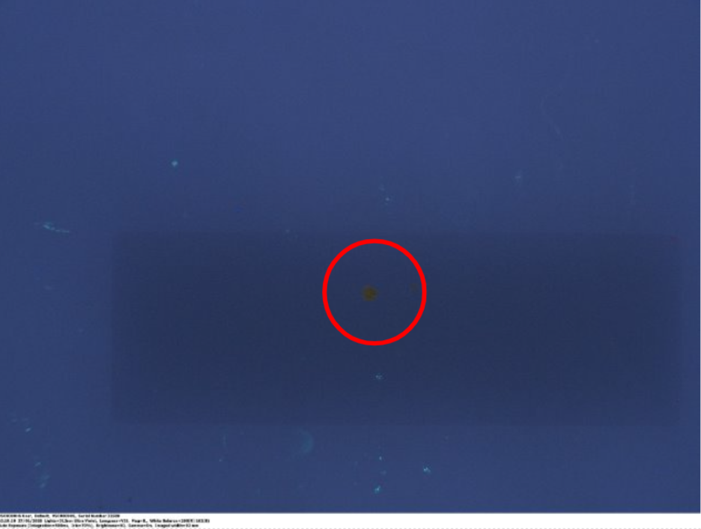
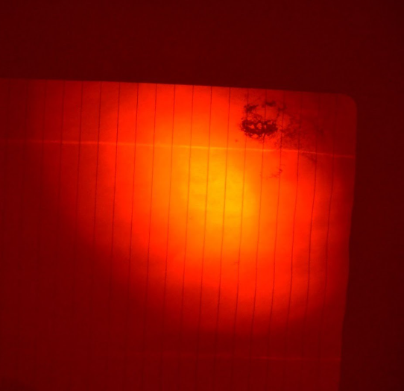

Alternative Light Sources to Detect Synthetic Cathinones Soaked into Paper
Leala Eliza Ward, Dr Mia Abbott
School of Health, Education, Policing & Sciences, University of Staffordshire, ST4 2DF
Introduction
The presence of drugs in UK prisons has been a large issue for decades, with cocaine previously being the most used substance. Recently Novel Psychoactive Substances such as synthetic cannabinoids and cathinones have been used much more (Craft et al. 2023; Montanari, 2024); this is due to their legal ambiguity and how quickly they are created (Krotulski, 2022).. This made them much easier to smuggle into prisons through the postal system.
Current methods of detection work to increase the number of known synthetic cannabinoids in drug databases, seen in Abbott et al., (2023), but while this method is effective, it lacks the efficiency needed to be applied on a national scale.
Fluorescence is a property exhibited by many drugs including cocaine, it can be observed under UV light using Alternative Light Sources, which is a non-invasive method that is used to visualize things like injuries (Pollitt et al., 2016). This can theoretically be used to indicate the presence of drugs like cocaine and MDPHP when soaked into paper to prevent them from entering prisons.
Method
The powder forms of each drug were first observed under the VSC and different Labino torches to see if any fluorescence happened without the influence of a solvent or medium. Pieces of paper were soaked in acetone, methanol and then both cocaine and MDPHP using each one as a solvent. This was done at a relatively high concentration to ensure that there was enough of each drug in the samples to produce results. Each sample was observed under the VSC apparatus using different wavelengths of light in the visible light, infrared and ultraviolet spectrums. They were also observed using Labino torches with different wavelengths of light, and they were photographed alone and with red, orange and yellow camera filters. Plain paper was also observed in this way to eliminate any potential influence of the medium used. Any fluorescence or other observations were recorded.
Fig 1.: Image of seized MDPHP powder on a microscope slide under UV 312 nm under the VSC apparatus, with annotation.
Results and Discussion
The plain paper showed nothing of note with no trace of extra fluorescent fibres.
Samples containing acetone alone did not fluoresce. There was a pattern of uneven coverage and a clear discolouration of pink/purple, so it may be easy to identify these kinds of seized samples in future. Samples containing methanol alone did not fluoresce as methanol only shows intrinsic fluorescence so it would not be visible in these conditions (Azmi et al., 2025).
All fluorescence or other observations are not caused by the solvent or medium, but by the nature of the drugs themselves meaning that detection by UV light is a viable way to distinguish between regular prison letters and those containing MDPHP or Cocaine.
MDPHP samples were dark under UV light, as MDPHP has a structure that can absorb UV, but cannot re-emit it as another form of light (Marshall and Johnsen, 2017).
Cocaine samples showed fluorescence under 254nm under the VSC due to the high purity of the sample, cocaine not being able to absorb wavelengths longer than 290nm (PubChem, 2019).
These visual differences make it clear that these drugs can be presumptively identified using alternative light sources when soaked into paper.
Conclusion
This research was conducted to investigate the potential use of ALS to screen prison letters for the presence of drugs.
There is a clear distinction between paper soaked in cocaine and in MDPHP, with cocaine showing fluorescence and MDPHP appearing much darker.
The paper also showed discolouration when soaked with different solvents, which can be used to identify letters that have been added to.
This research makes it clear that ALS devices are a reliable potential method for screening materials like paper for the presence of MDPHP and cocaine.
Fig 2: Image of MDPHP-infused paper soaked with methanol under UVG2 spotlight torch with red camera filter.
References
Abbott, M.J., Dunnett, J., Wheeler, J. and Davidson, A. (2023). The identification of synthetic cannabinoids in English prisons. Forensic Science International, [online] 348, p.111613. doi:https://doi.org/10.1016/j.forsciint.2023.111613.
Azmi, N., Rathod, S., Ceccato, B.T., Mikkelsen, R.K. and Fossum, J.O. (2025). Intrinsic fluorescence in Moringa Oleifera seed extract. Talanta Open, [online] 12, p.100500. doi:https://doi.org/10.1016/j.talo.2025.100500.
Craft, S., Austin, A., Tooth, T., Glover, C., Garrett, T., Blagbrough, I.S., Sunderland, P., Pudney, C.R. and Freeman, T.P. (2023). Synthetic cannabinoid use in an adult male prison in the UK. International Journal of Drug Policy, [online] 122, p.104219. doi:https://doi.org/10.1016/j.drugpo.2023.104219.
Marshall, J. and Johnsen, S. (2017). Fluorescence as a means of colour signal enhancement. Philosophical Transactions of the Royal Society B: Biological Sciences, [online] 372(1724), p.20160335. doi:https://doi.org/10.1098/rstb.2016.0335.
Montanari, L. (2024). Towards better prepared prisons: monitoring and response to the use of new substances inside prison. European Journal of Public Health, [online] 34(Supplement_3). doi:https://doi.org/10.1093/eurpub/ckae144.674.
Pollitt, E.N., Anderson, J.C., Scafide, K.N., Holbrook, D., D’Silva, G. and Sheridan, D.J. (2016). Alternate Light Source Findings of Common Topical Products. Journal of Forensic Nursing, 12(3), pp.97–103. doi:https://doi.org/10.1097/jfn.0000000000000116.PubChem (2019). Cocaine. [online] Nih.gov. Available at: https://pubchem.ncbi.nlm.nih.gov/compound/cocaine.

