Slide 1
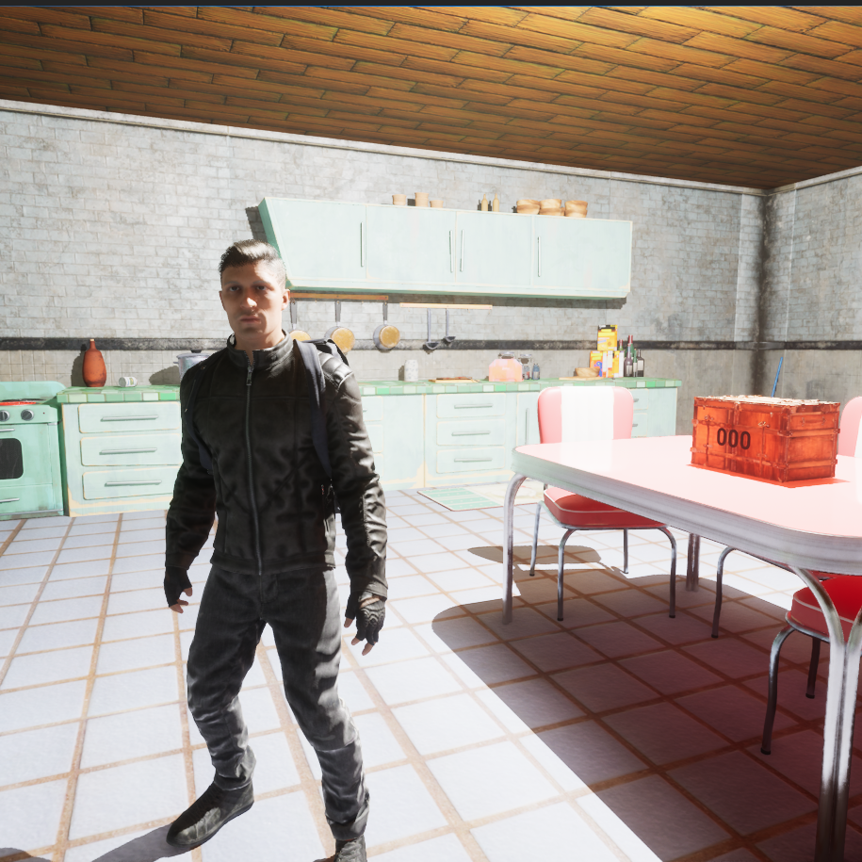
Hollow Rooms
Cheris Quessou
q017158n
MID-POINT REVIEW

Slide 2

List of Content
Project Introduction
Project Aim and Objectives
Research
Developments
  Phase one – set up
  Phase two – puzzles
  Phase three – Meshing
Evaluation

Slide 3
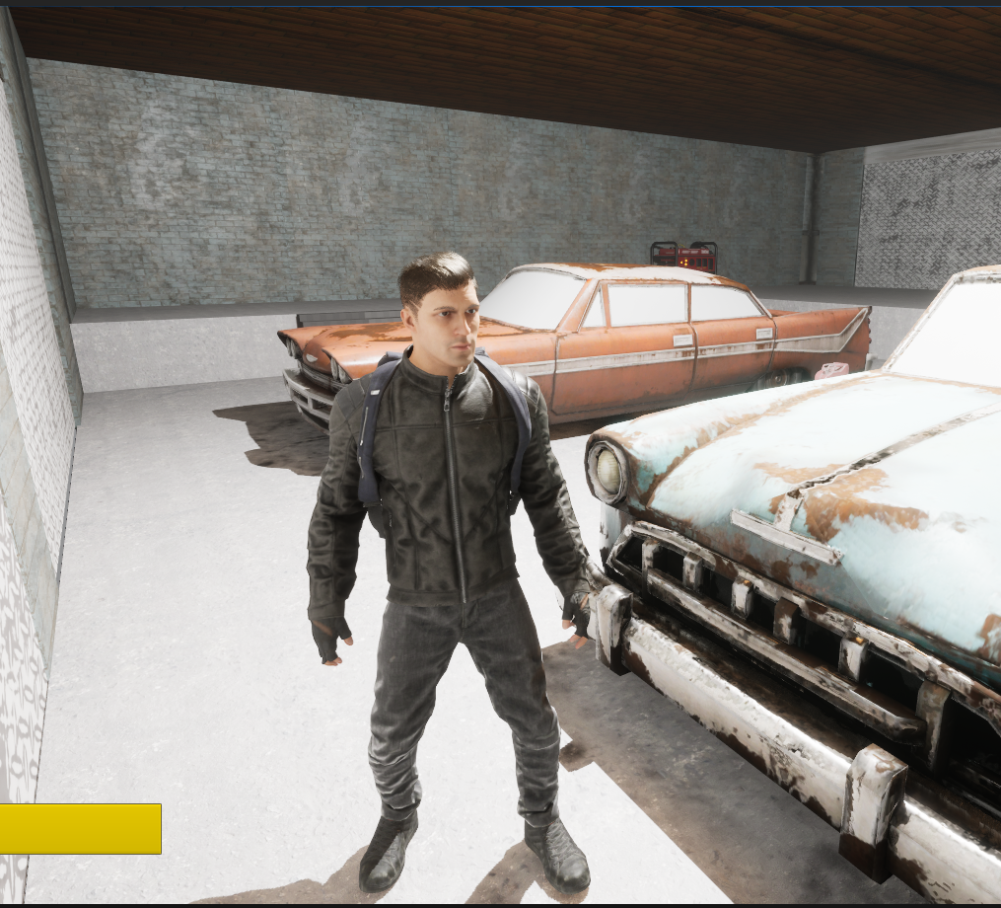
Introduction
The problem:
Improving animation/camera transitions for seamless and immersive gameplay
My solution – Hollow Rooms
What is Hollow Rooms:
A game where the player will be taking control of a character that will enter a creepy old house and will have to solve puzzles to progress further into the house until they reach the attic and reclaim a lost treasure they have been searching for.
The end purpose of Hollow Rooms is not to create an engaging horror experience, but to demonstrate how thoughtful animation and camera work can significantly enhance immersion. By combining puzzle solving gameplay with polished visual transitions the game should prove that technical game design is essential in deepening player immersion and player engagement.

Slide 4
Aim, Objectives and deliverables for Hollow Rooms
Aim:
Objectives:
Deliverables:
The aim of this project is to create an animation-focused horror puzzle game that priorities seamless transitions between cutscenes and gameplay.
Rather than concentrating mainly on complex mechanics or large-scale systems, the core intention is to demonstrate how smooth animations and carefully planned camera work can maintain player immersion.
By ensuring that transitions feel natural and uninterrupted, the project seeks to bridge the gap between cinematics in games and interactive gameplay.
At the end of the project the aim is to create a simple but challenging experience where the player remains fully engaged from beginning to end.
To achieve this aim, the project will:
Develop seamless transitions from the opening cutscene directly into playable gameplay without abrupt cuts or loading interruptions.
Create realistic and responsive player animations that reflect movement and interaction, to enhance immersion.
Incorporate a small but meaningful narrative element to enhance emotional engagement and provide context for gameplay.
Design a fun and intuitive puzzle solving gameplay loop that helps the player progress through the environment while maintaining tension.
The final deliverable will be a playable, single player horror themed puzzle game.
The game will feature a intro cutscene, in-game animations, smooth camera transitions, environmental assets, interactive puzzles, and a short narrative arc. It will serve as a proof of concept demonstrating how animation and cinematic flow can improve immersion within a game.

Slide 5
Research Methodology
Part 1
To allow the project to be made using industry practices. I will begin with research into animation and camera techniques used in successful narrative driven games.
This will involve analysing developer talks (GDC), post-mortems, and stage presentations from studios known for making immersive games.
For example: examining the seamless cinematic transitions in Spiderman 2 and the environmental storytelling and camera work in Silent Hill F will help me identify professional standards when blending between gameplay and cutscenes.
To evaluate the success of my solution, I will conduct playtesting sessions. Participants will be asked to play a short section of Hollow Rooms and complete a questionnaire measuring perceived immersion, smoothness of transitions, and overall engagement. If most participants report that transitions feel natural and do not disrupt gameplay I will consider it a success. However, if there are comments about jarring cuts or stiffness in movement I will refine those areas.
While gathering and analysing data. I will record observations I make during testing sessions to compare responses against my initial objectives and identify recurring point of interests in my player feedback.
I will then draw conclusions by evaluating whether the animation-focused gameplay enhances immersion. This structured research approach ensures that my project is backed up by industry standards and supported by measurable outcomes rather than personal assumption.

Slide 6
Research Methodology
Part 2
I intend to evaluate how efficient seamless animation and camera transitions contribute to player immersion, engagement and overall experience. The focus will be on whether players notice transitions between cutscenes and gameplay or whether the experience feels continuous and natural. If players report that they did not feel interrupted or distracted, this will indicate that the transitions are working successfully.
Another key area of evaluation is emotional engagement. I will assess whether the narrative elements, combined with cinematic presentation, strengthen the flow and context of the game which should encourage players to feel invested in reaching the attic and reclaiming the treasure.
Finally, I will evaluate the balance created between the focus on animation and gameplay functionality. While animation and camera work is the priority, the puzzle-solving loop must be enjoyable and intuitive. By analysing player feedback. I will determine whether the animation-driven design enhances immersion without impacting gameplay and ruining the experience.

Slide 7
Preproduction research
For my preproduction research I played games such as silent hill f and resident evil to understand how horror-based puzzles works and I also played games such spiderman 2 and god of war R to help me understand how animation transition works.
Along side that I focused on watching developer talks on YouTube to understand how industry level pipelines operate when it comes to putting together gameplay elements along with animation practices.
Using the silent hill and resident evil games along with the shrines in Zelda BOTW as reference I created this list of puzzles I want to add to the game.
Alter puzzle
Generator puzzle
Code Lock puzzle
Door puzzle
Weight balance puzzle
Painting puzzle

Slide 8
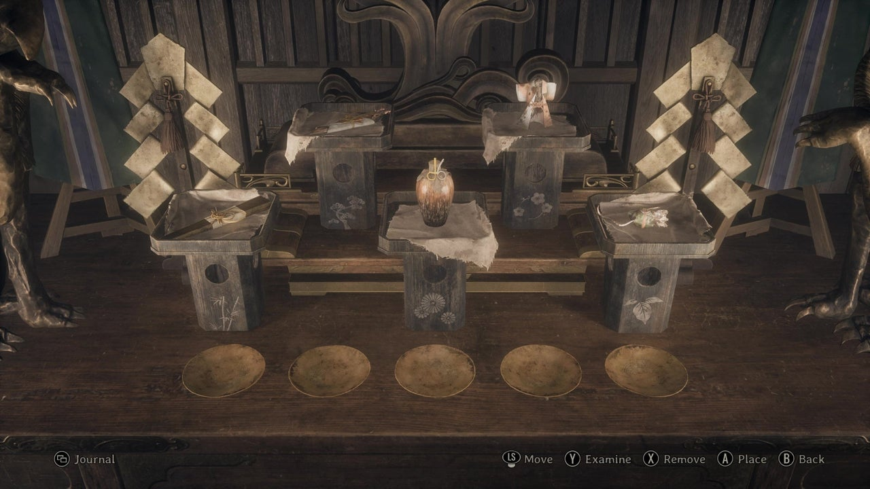
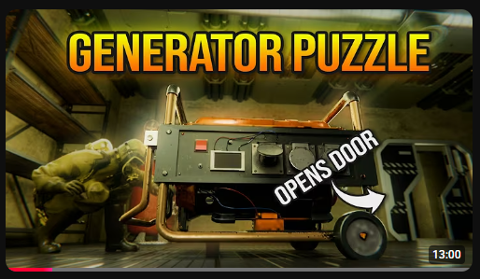
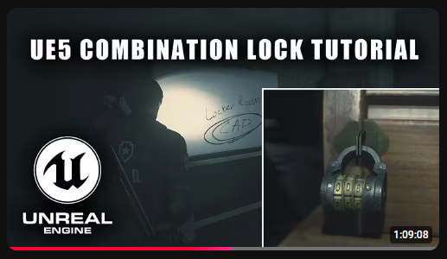
Preproduction research
Alter puzzle
Generator puzzle
Code lock puzzle
This is the main reference for the code lock puzzle.
I found this video alongside the generator puzzle, and I followed mainly one section of the video as I already had a good idea on how I was going to blueprint the check event to see if the player has inputted the right code.
The section I followed was the rotating dial one as I had no idea how I could implement that.
This is the main reference for the generator puzzle.
I found this YouTube video while researching puzzle designs.
It was a good video since the puzzle was short and quite easy making it a good fit for the first section of my game.
I will follow along with this video to make this generator puzzle.
This is the main reference for the alter puzzle.
In the game it works by having the player select one item at a time and allows them to place it in any spot they choose.
My one will work almost the same as this with the main difference being that I want the player to go collect the items first and bring them to the alter before they start placing.

Slide 9
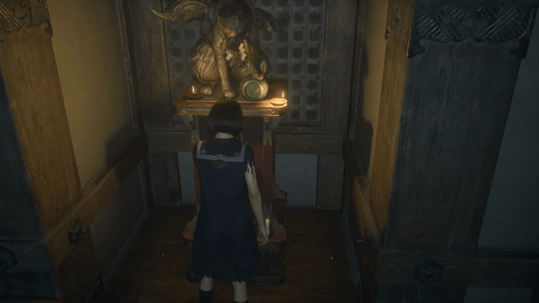
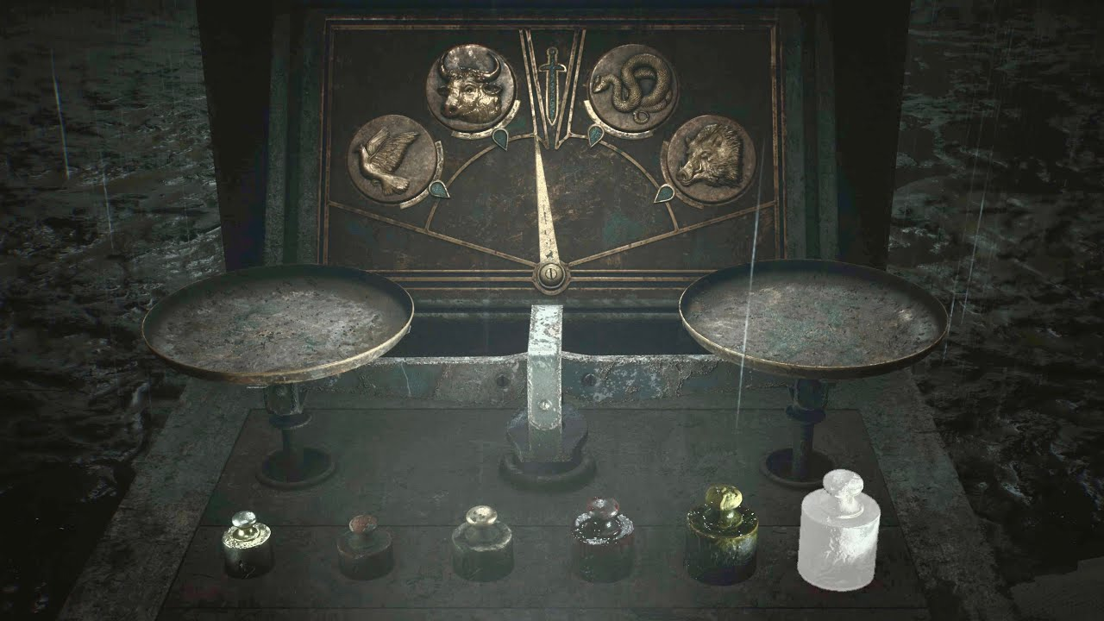
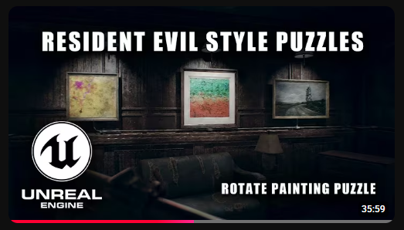
Preproduction research
Door puzzle
Weight balance puzzle
Painting puzzle
This is the main reference for the painting puzzle.
I found this video along side the generator and code lock puzzle videos.
This was a nice and short tutorial on how to make a rotating painting puzzle that opens the door for the player to progress once complete.
This is one of the reference for the weight balance puzzle.
The way I wanted it to work was the player would place items on the scale and by pairing up the right items they would get the correct weight and receive the item they need to continue through the game.
This is the main reference for the door puzzle.
In the game it works by having one coloured door open at a time. The player can use the swich to control what coloured door is open at any given moment.
Using this the player needs to have the right combination of doors open to get to the objective.

Slide 10
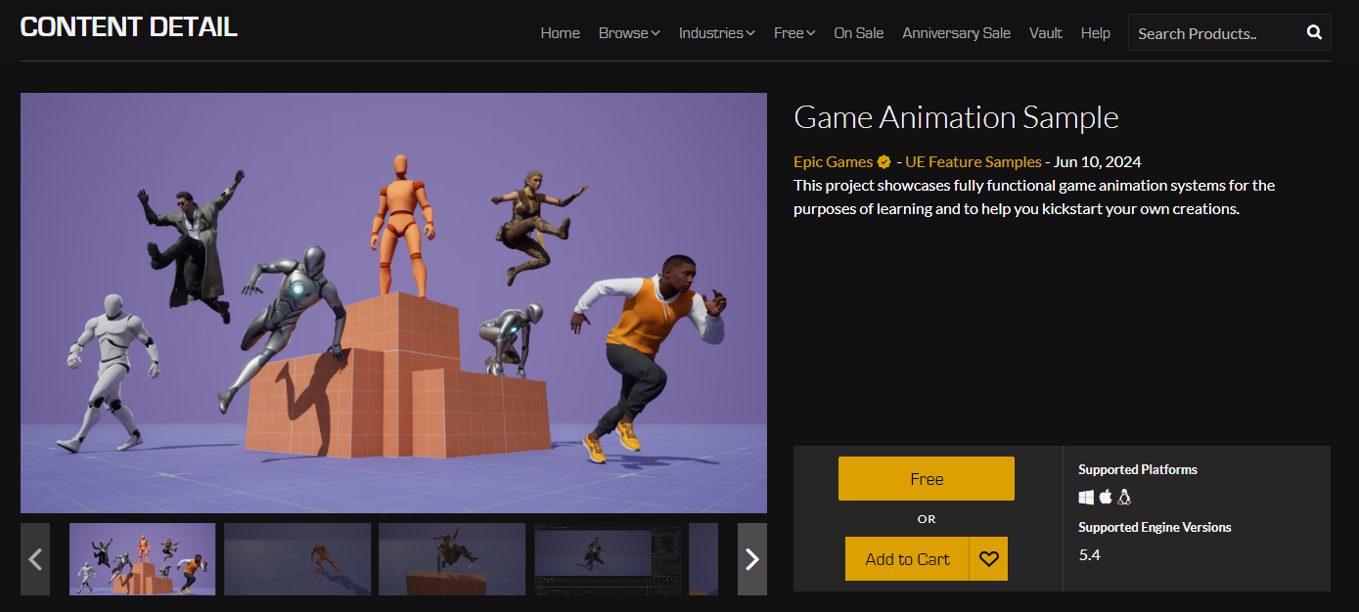
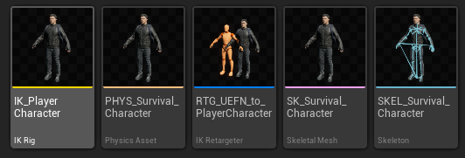
Development phase one – set up
To start out I created the Game Animation Sample project as the template for hollow rooms and then I downloaded a player character model
I imported the mesh and retargeted him to the base character model used in the project template

Slide 11
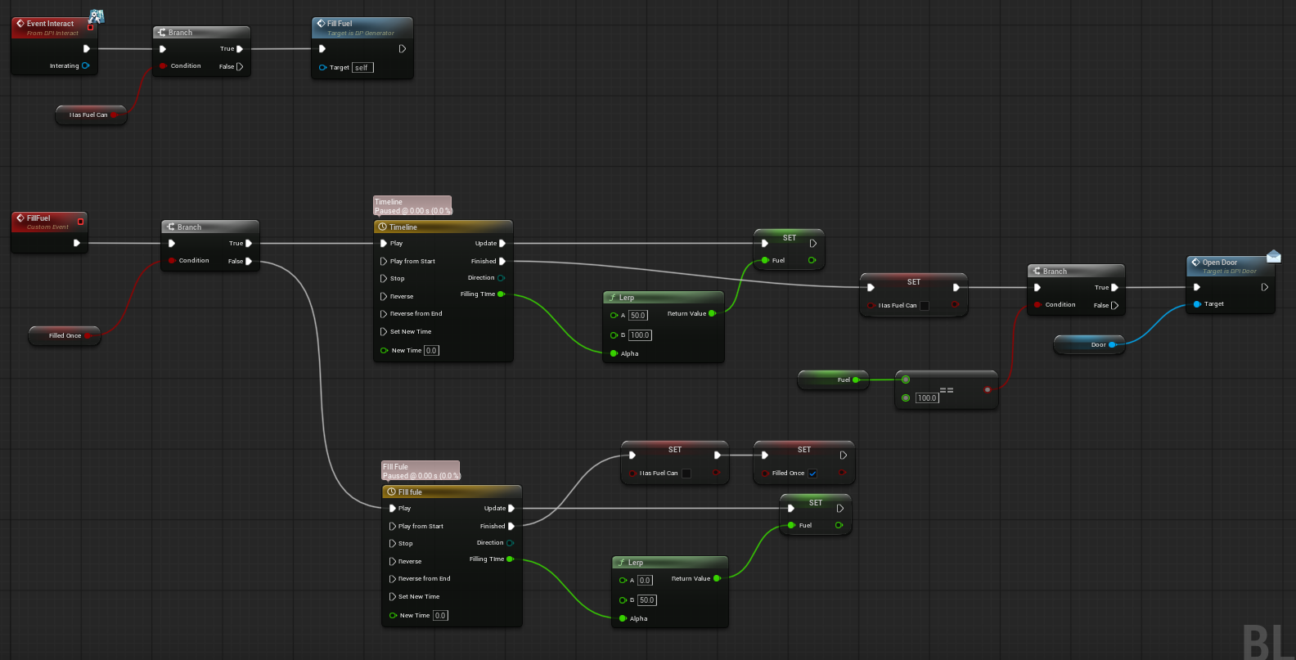
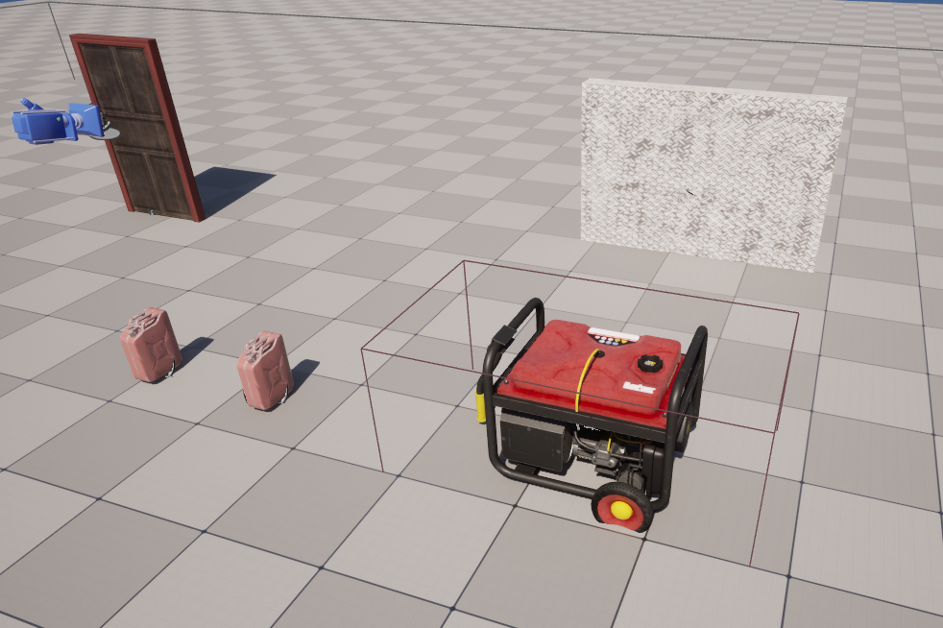
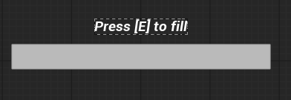
Development stage 2 - Puzzles
The generator was my first puzzle, It works by having a progress bar as a UI element and using fuel cans the player can fill up the generator to max and open the door.

Slide 12
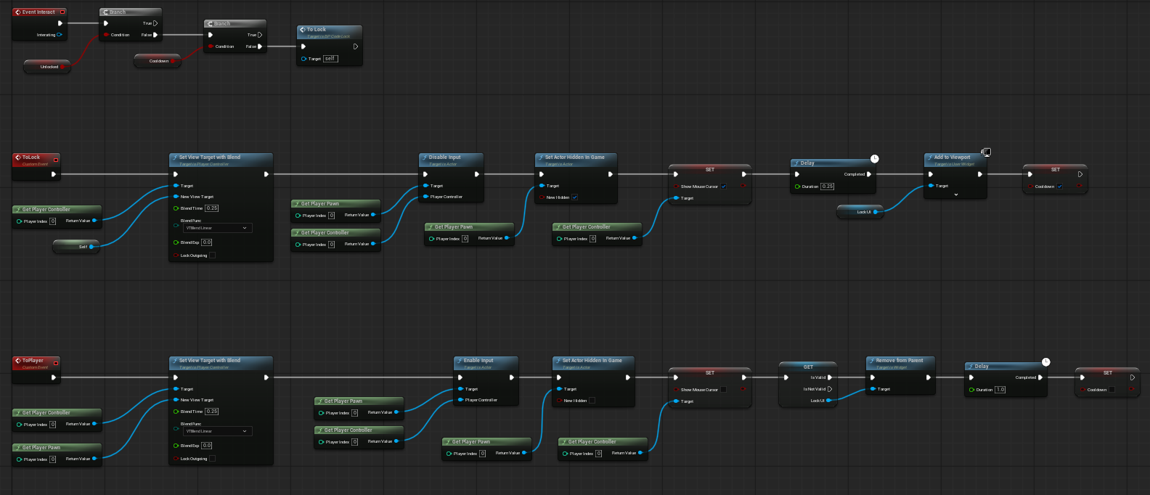
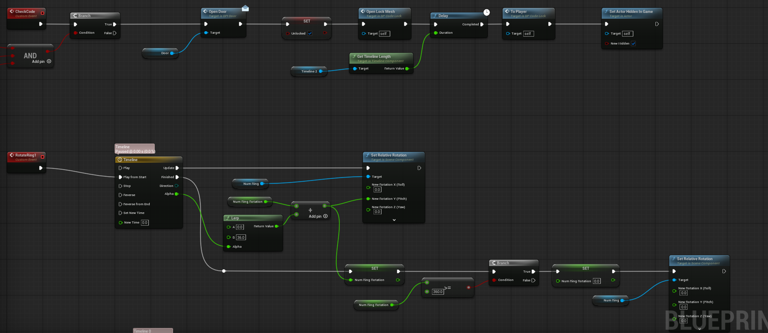
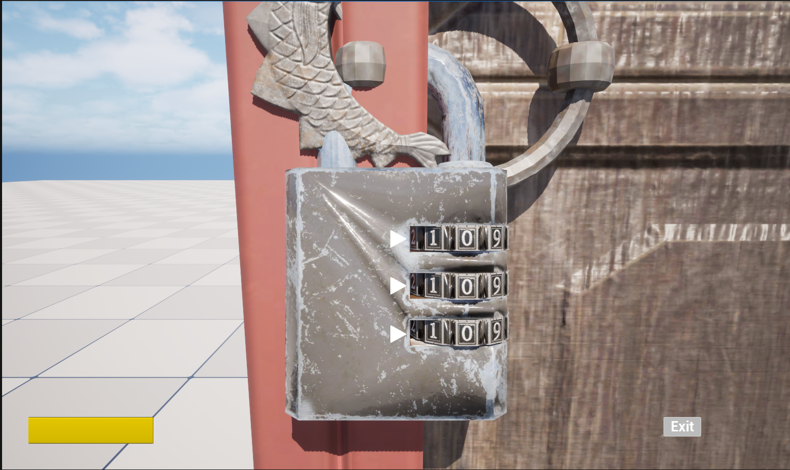
Development stage 2 - Puzzles
The next puzzle I made was the code lock. This one works by using a camera blend to get a visual on the lock and then by pressing UI buttons the player can move 3 induvial dials on the lock to try and open it.

Slide 13
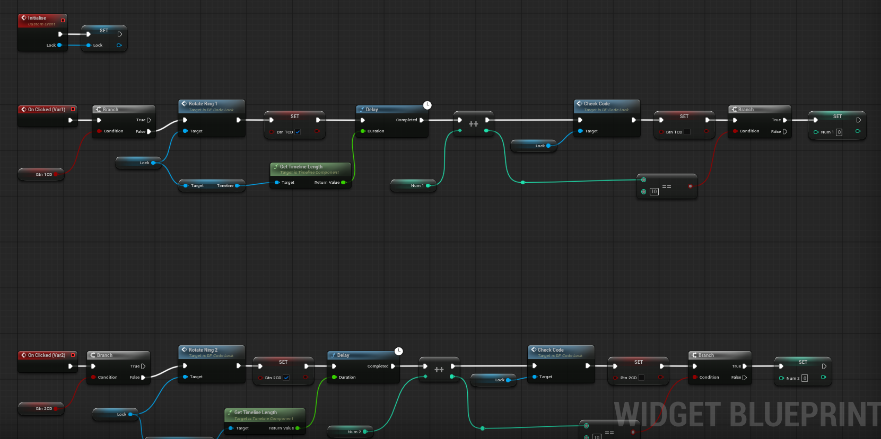
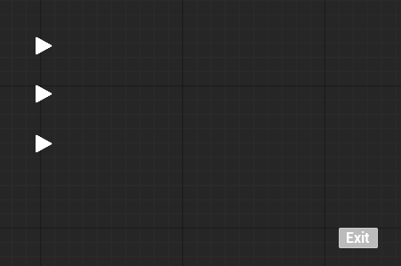
Development stage 2 - Puzzles
The lock puzzle once complete allows the player to open the door it is connected to

Slide 14
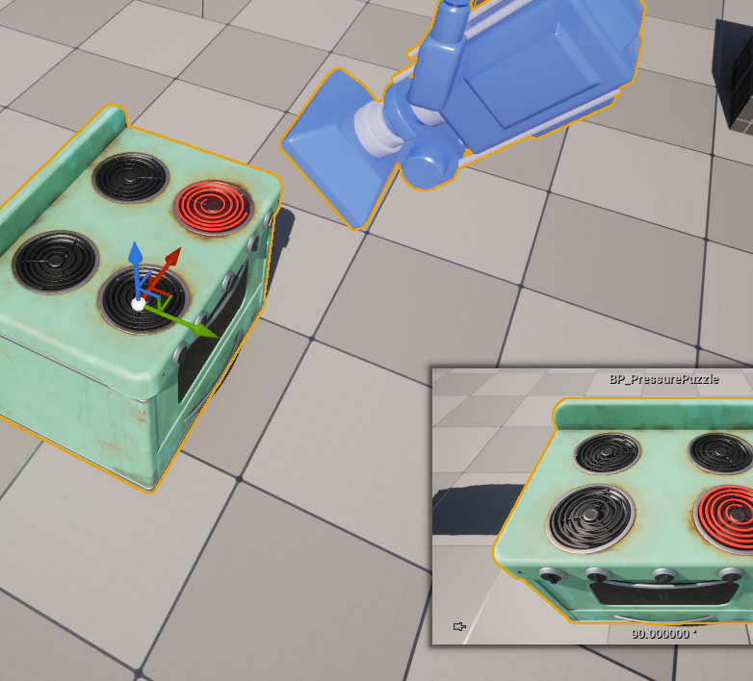
Development stage 2 - Puzzles
The next puzzle I made was the pressure stove. This puzzle works by using a camera blend to get a view of the stove top and using UI buttons to increase the pressure produced by each gas emitter. The puzzle is also connected to a pressure gauge to show the player how much the current pressure is. Once the puzzle is solved the player can obtain a item they need to open the door
I made this puzzle to replace the weight balance puzzle as I thought I fitted the theme of the kitchen a lot more then the weight balance puzzle.
For this puzzle I didn’t really use any reference as I made it if my own intuition on how I would assume a puzzle like this should work.

Slide 15
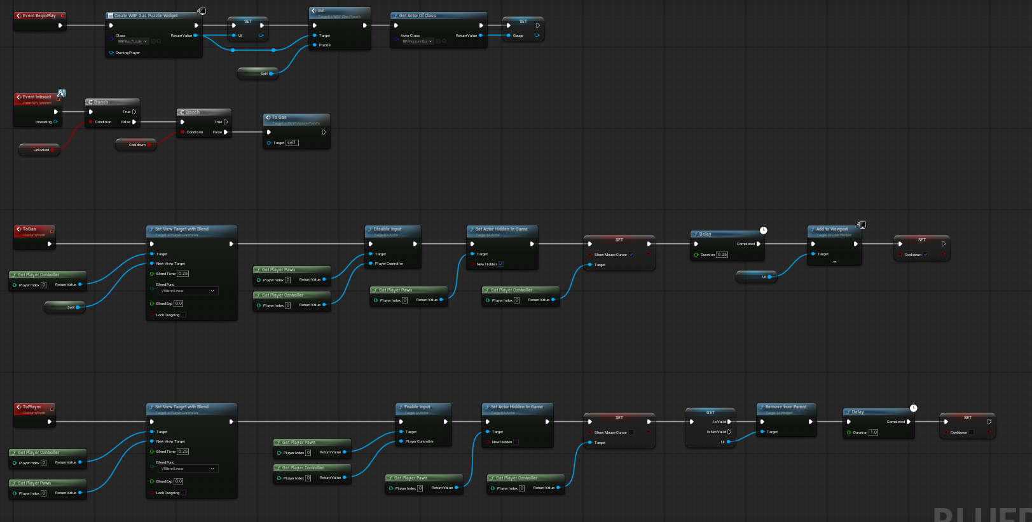
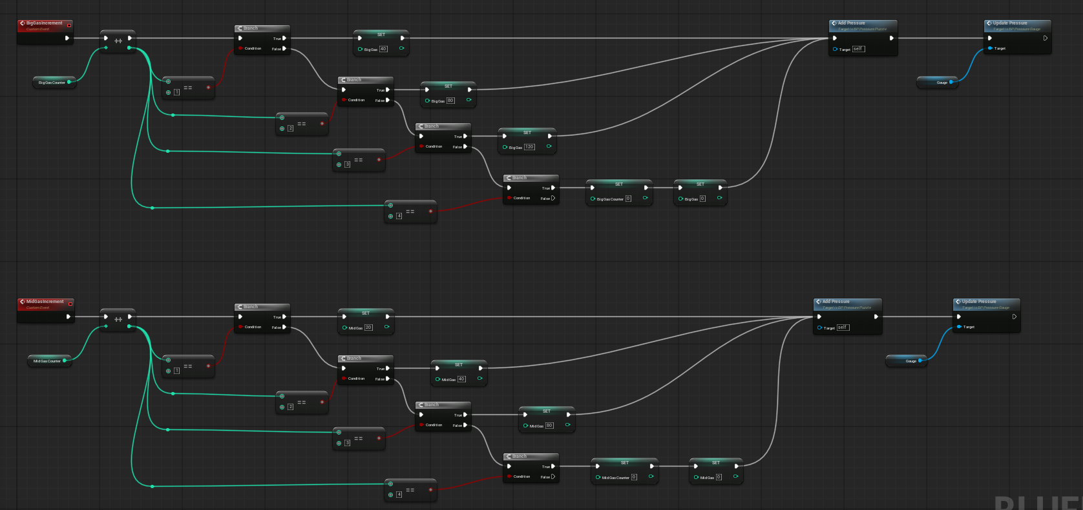
Development stage 2 - Puzzles

Slide 16
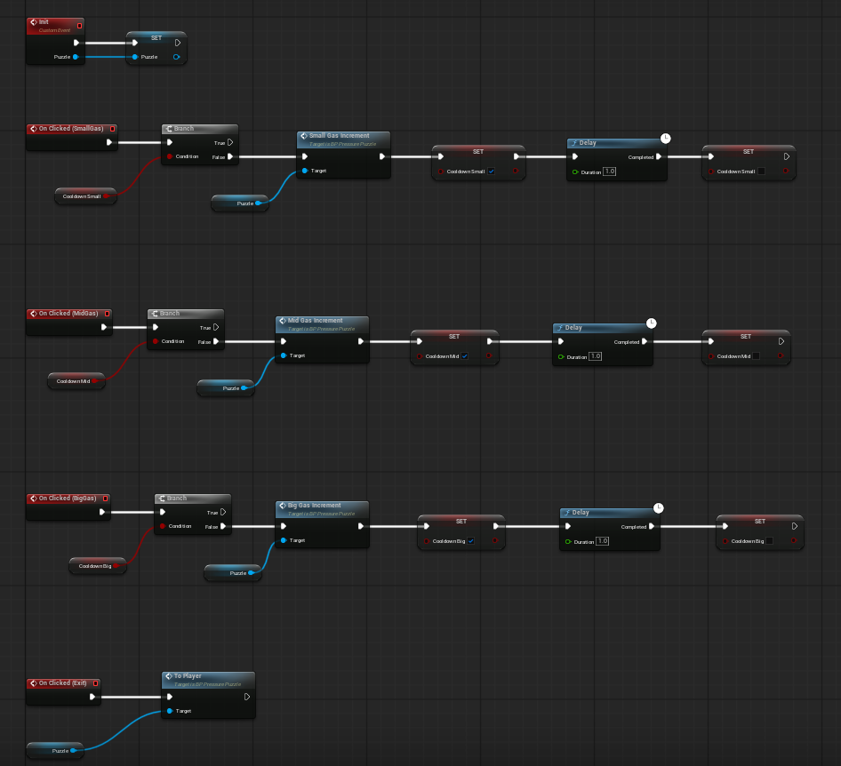
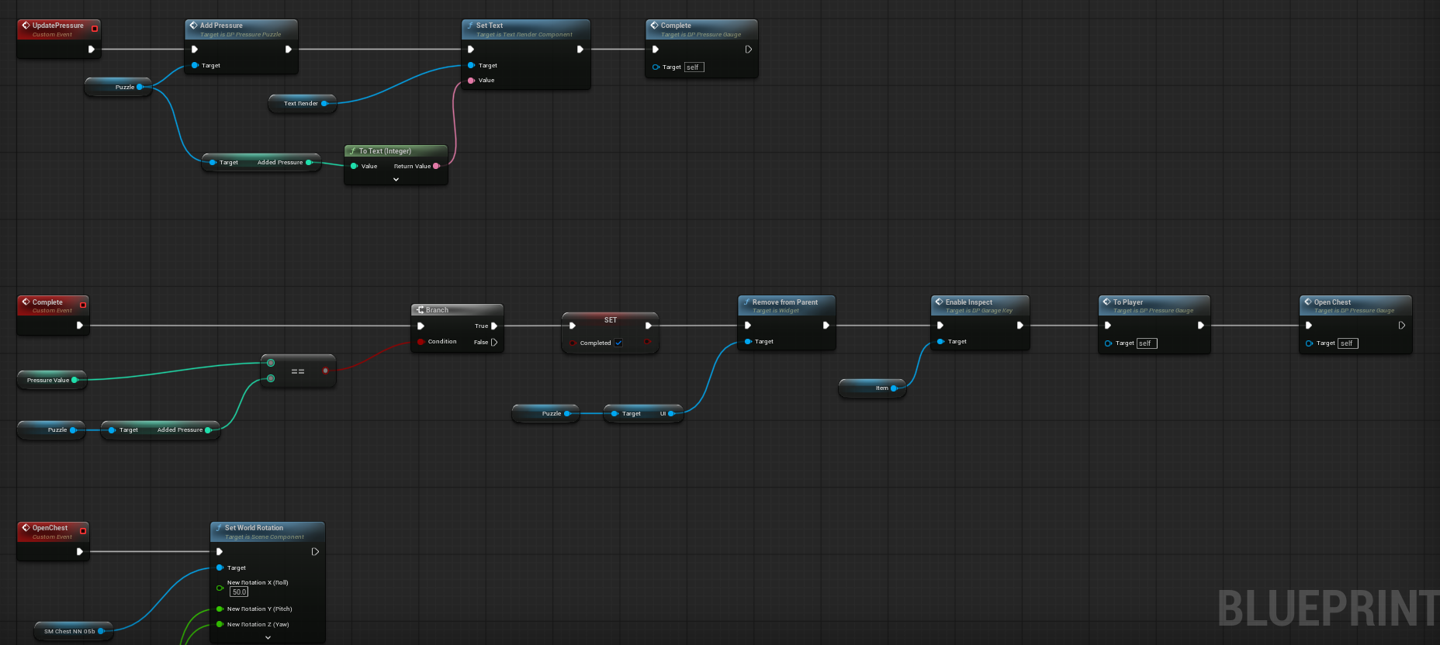
Development stage 2 - Puzzles

Slide 17
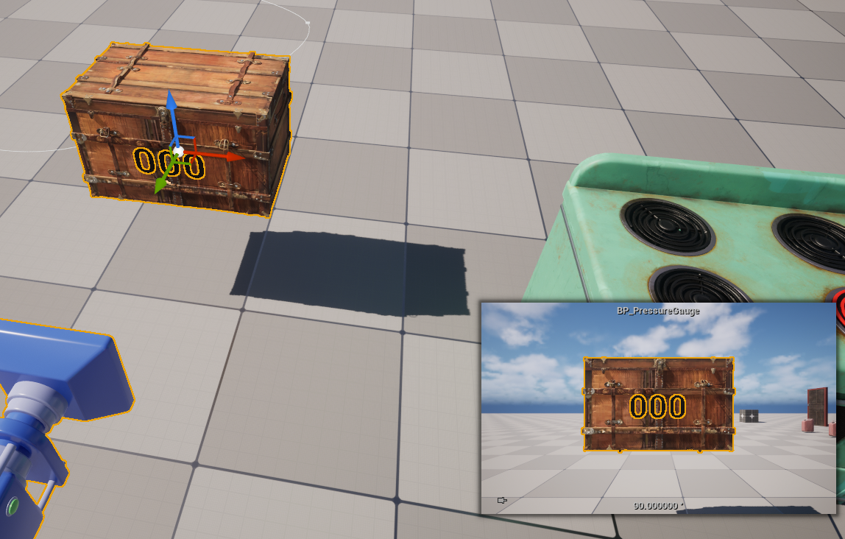
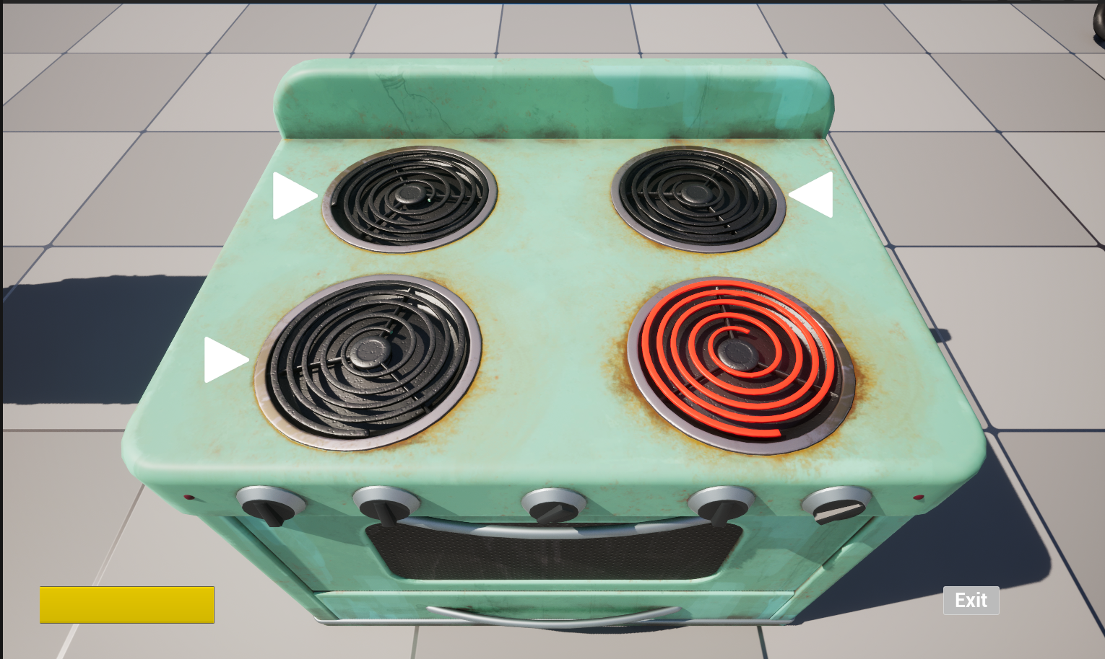
Development stage 2 - Puzzles

Slide 18
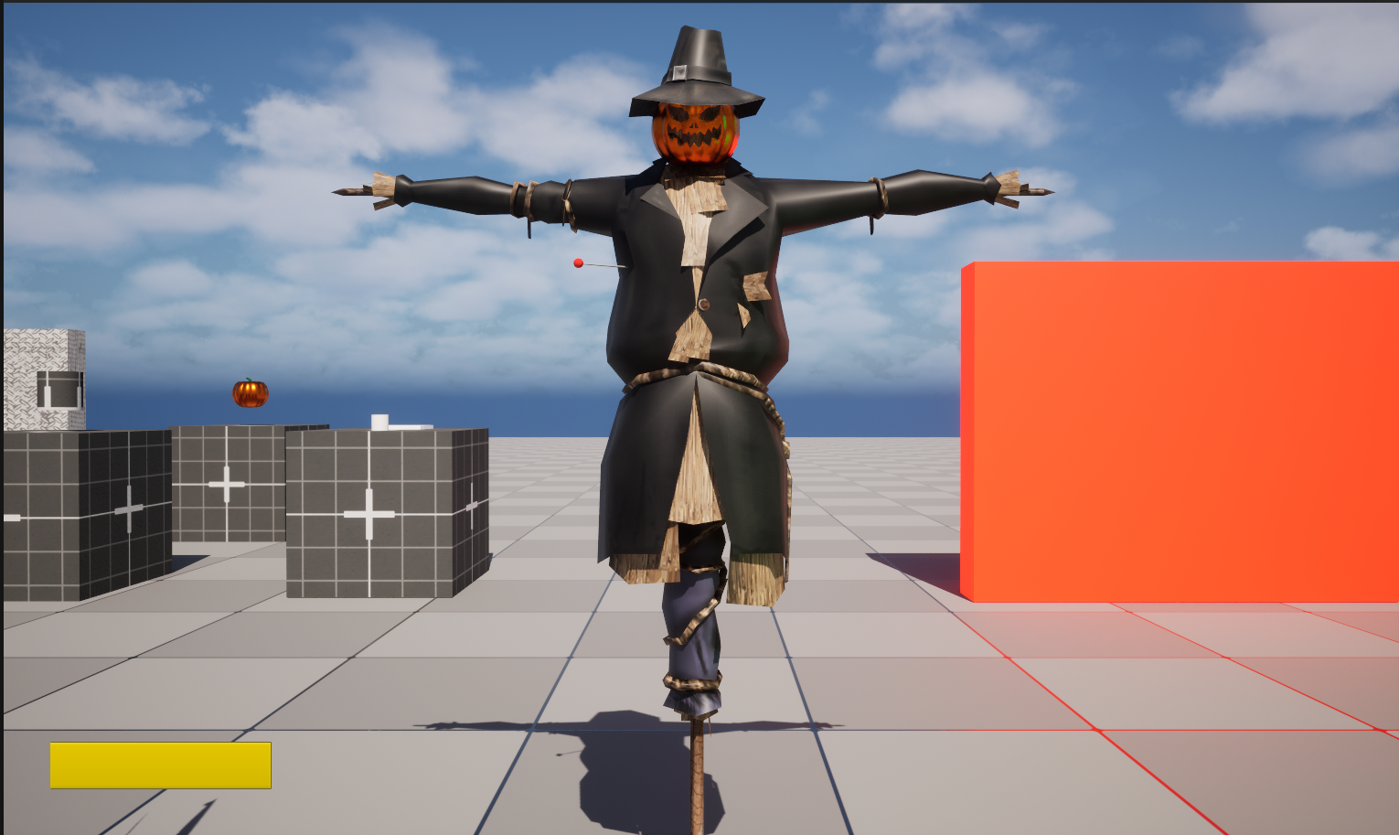
Development stage 2 - Puzzles
The next puzzle I made was the scarecrow puzzle. This puzzle works by changing the camera the player controls to the camera attached to the scarecrow. The player can use the camera to look around the scarecrow and find a red pin that when interacted will play a little animation and then one of two things will happen. Either the player take damage or a sign above the scarecrow is shown. This depends on if the scarecrow the player picks is the correct one or not.

Slide 19
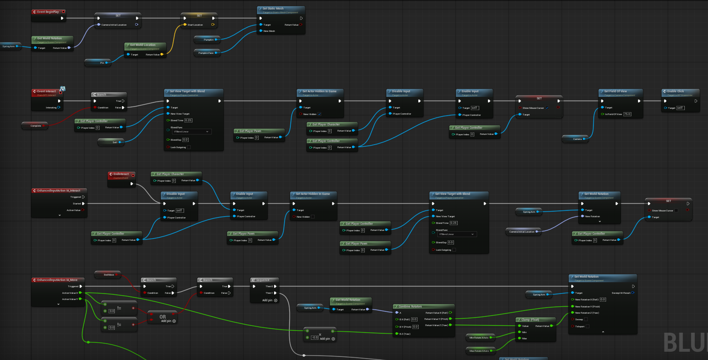
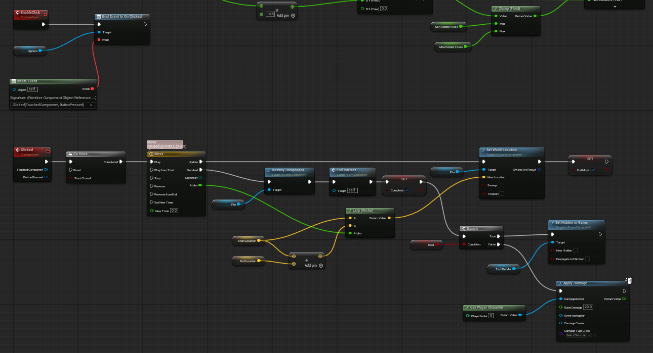
Development stage 2 - Puzzles

Slide 20
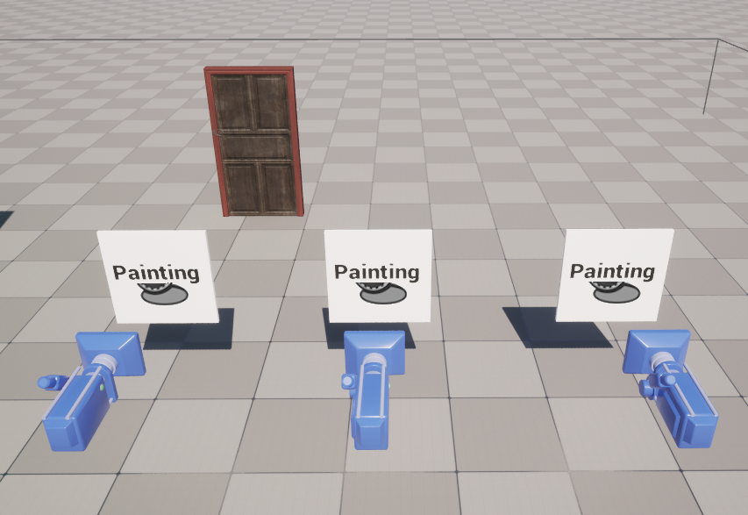
Development stage 2 - Puzzles
The last puzzle I made that made the final game was the painting puzzle. This one works by having the player rotate the painting a few times to get the correct orientation. Once the orientation is correct the door connected to the painting can be opened.

Slide 21
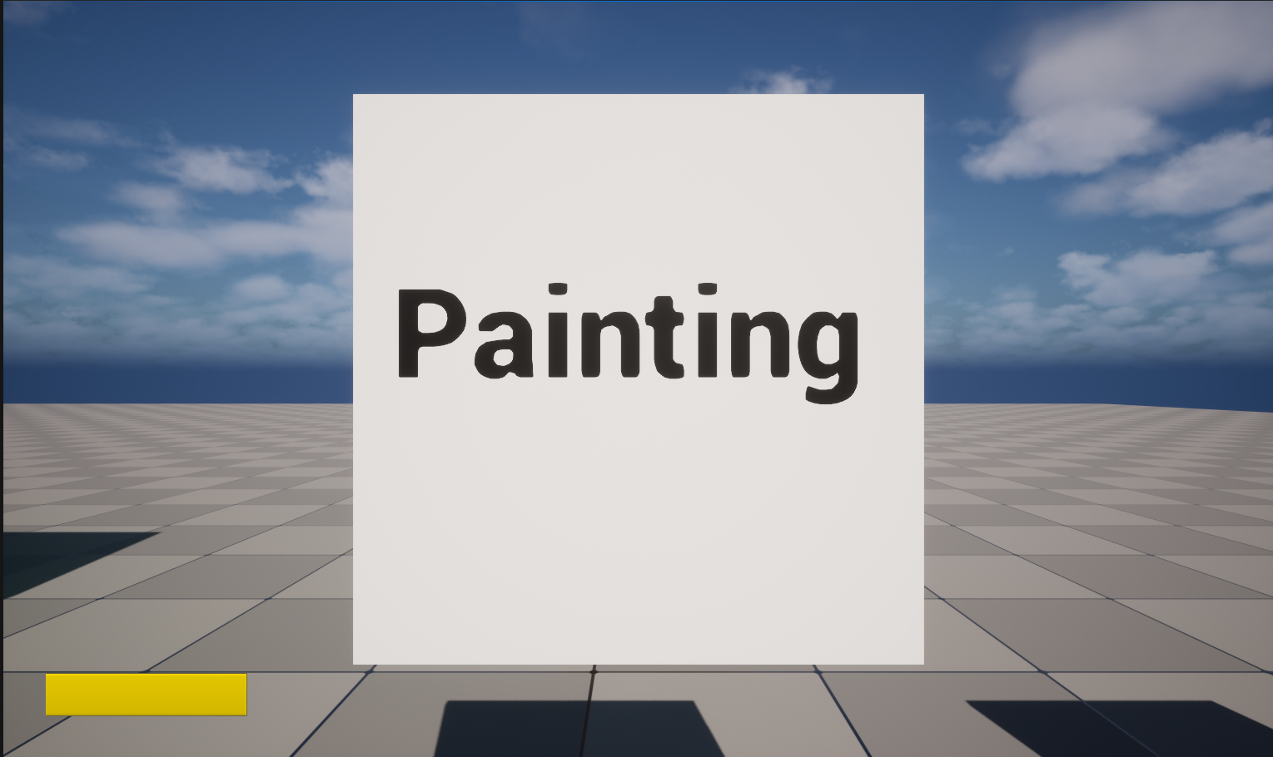
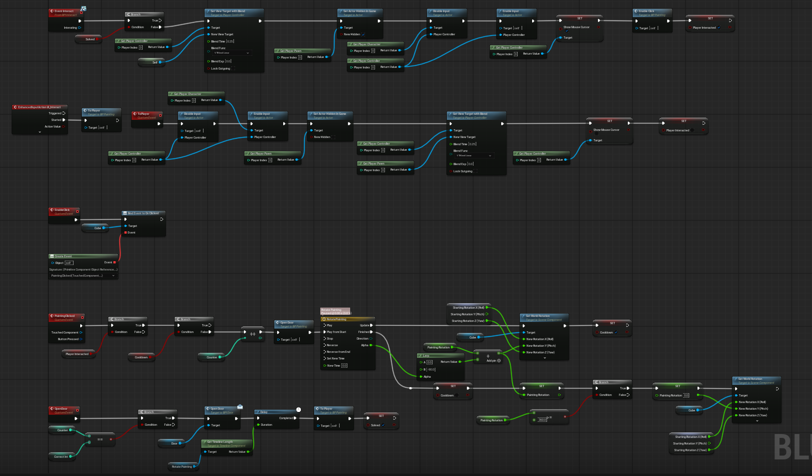
Development stage 2 - Puzzles

Slide 22
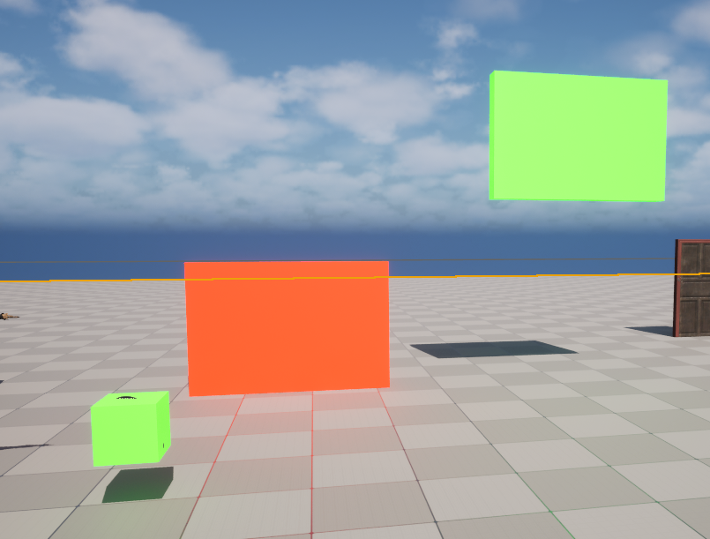
Development stage 2 - Puzzles
Here are a few puzzles that didn’t make the cut, but I still wanted to include in this write up.
The first is this door puzzle.
This one simply works by having only one door open at a time and the player can control that by using a switch.
When the switch is pressed the doors open and close receptive to their colour

Slide 23
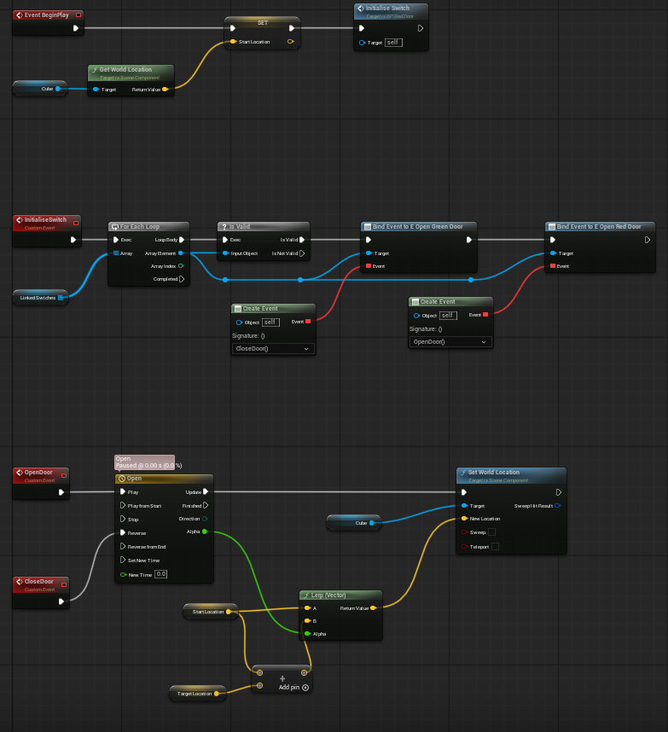
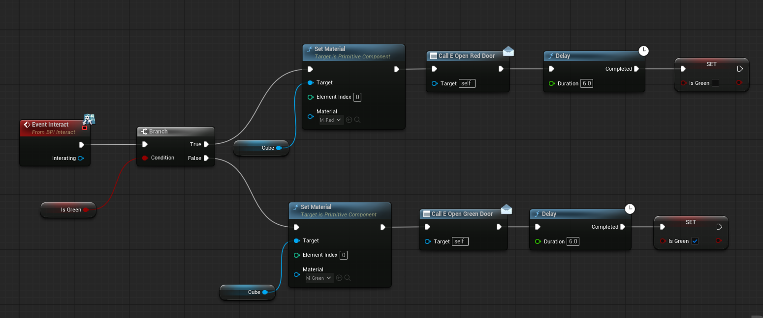
Development stage 2 - Puzzles

Slide 24
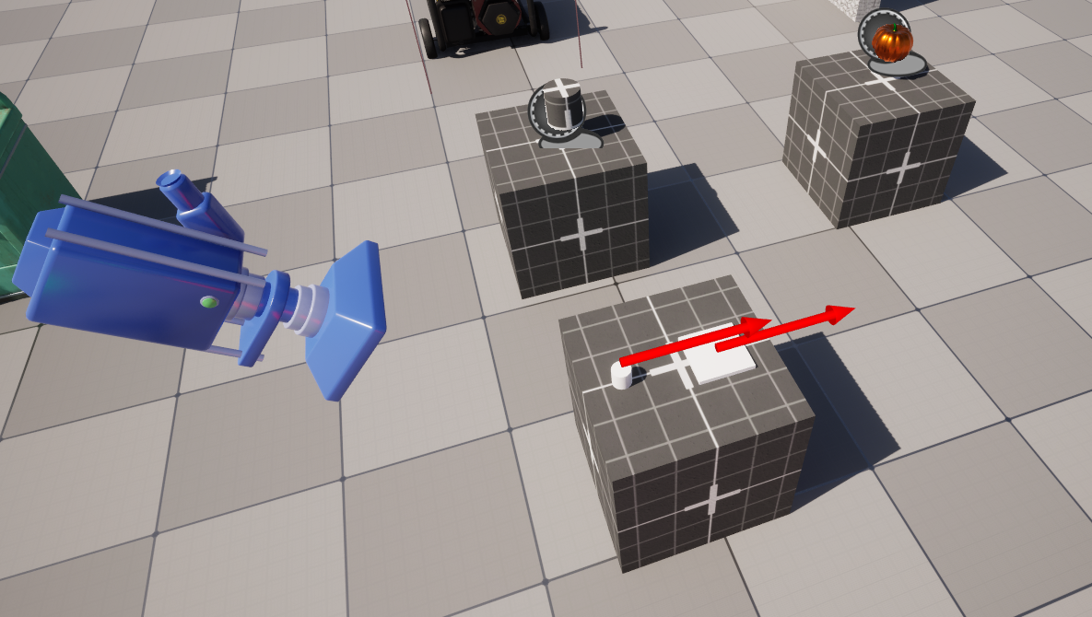
Development stage 2 - Puzzles
The alter puzzle was the most difficult puzzle to make and it didn’t make the cut since there are still significant issues with the blueprint.
It works by allowing the player to place certain objects on the pedestal by clicking on them and if the item is correct the player will be able to open the door connected to the alter

Slide 25
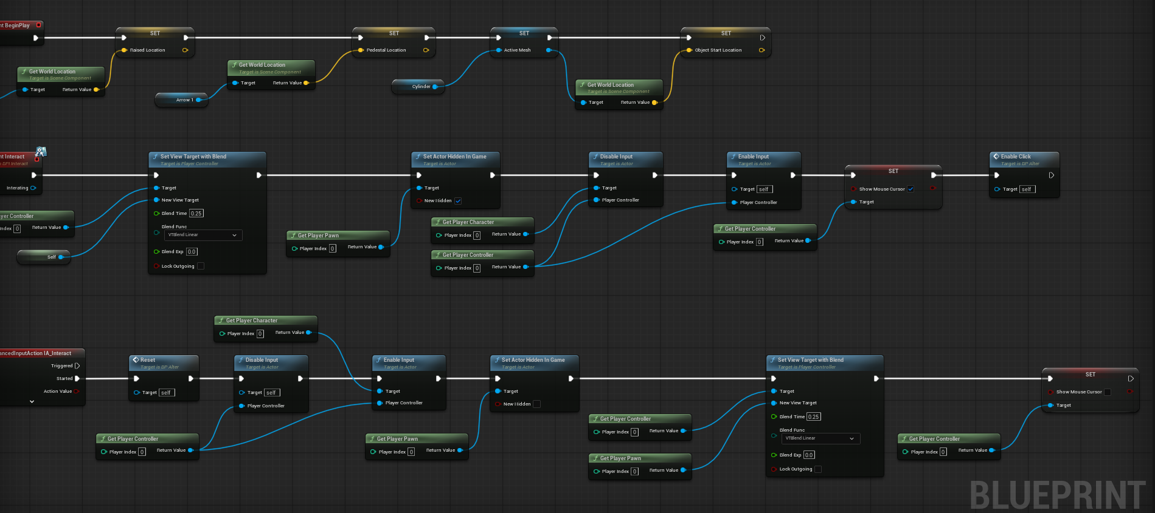
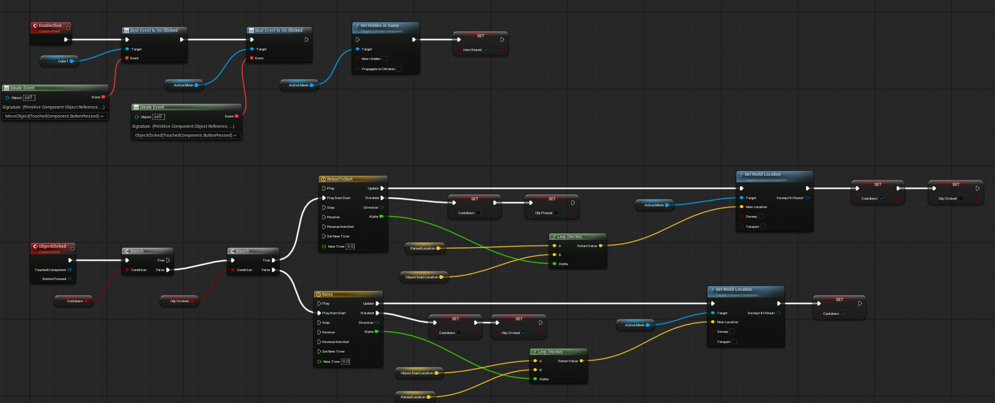
Development stage 2 - Puzzles

Slide 26
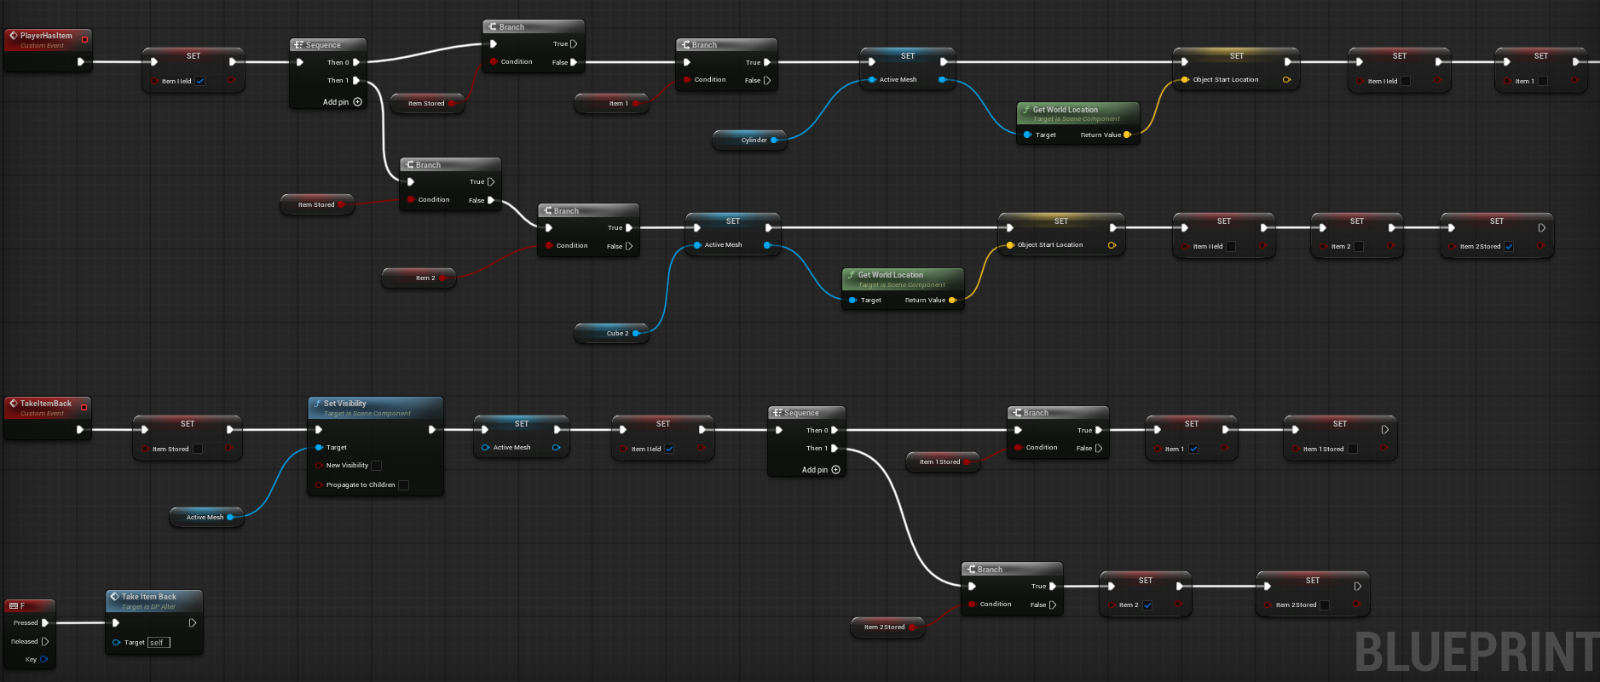
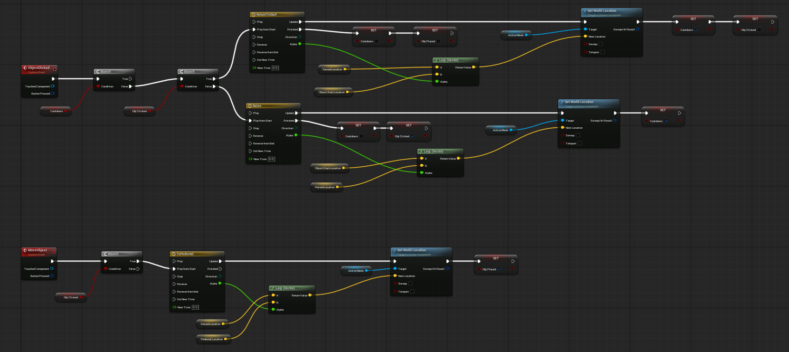
Development stage 2 - Puzzles

Slide 27
Development stage 3 - Meshing
I wish I spent more time on meshing as I underestimated the meshing process and ended up having to mesh out the whole game within a few weeks.
Using lots of asset libraries I managed to get in a good amount of high level of detail assets and textures without over bloating the project .
The template itself was about 2-3gb and all the meshes only added another 1-2gb of data.
In my opinion that is a good amount of data saved considering my asset dump project was filled with over 5gb of meshes and textures
The kitchen turned out to be the best meshed out room and most play testers said they liked this room the most.

Slide 28
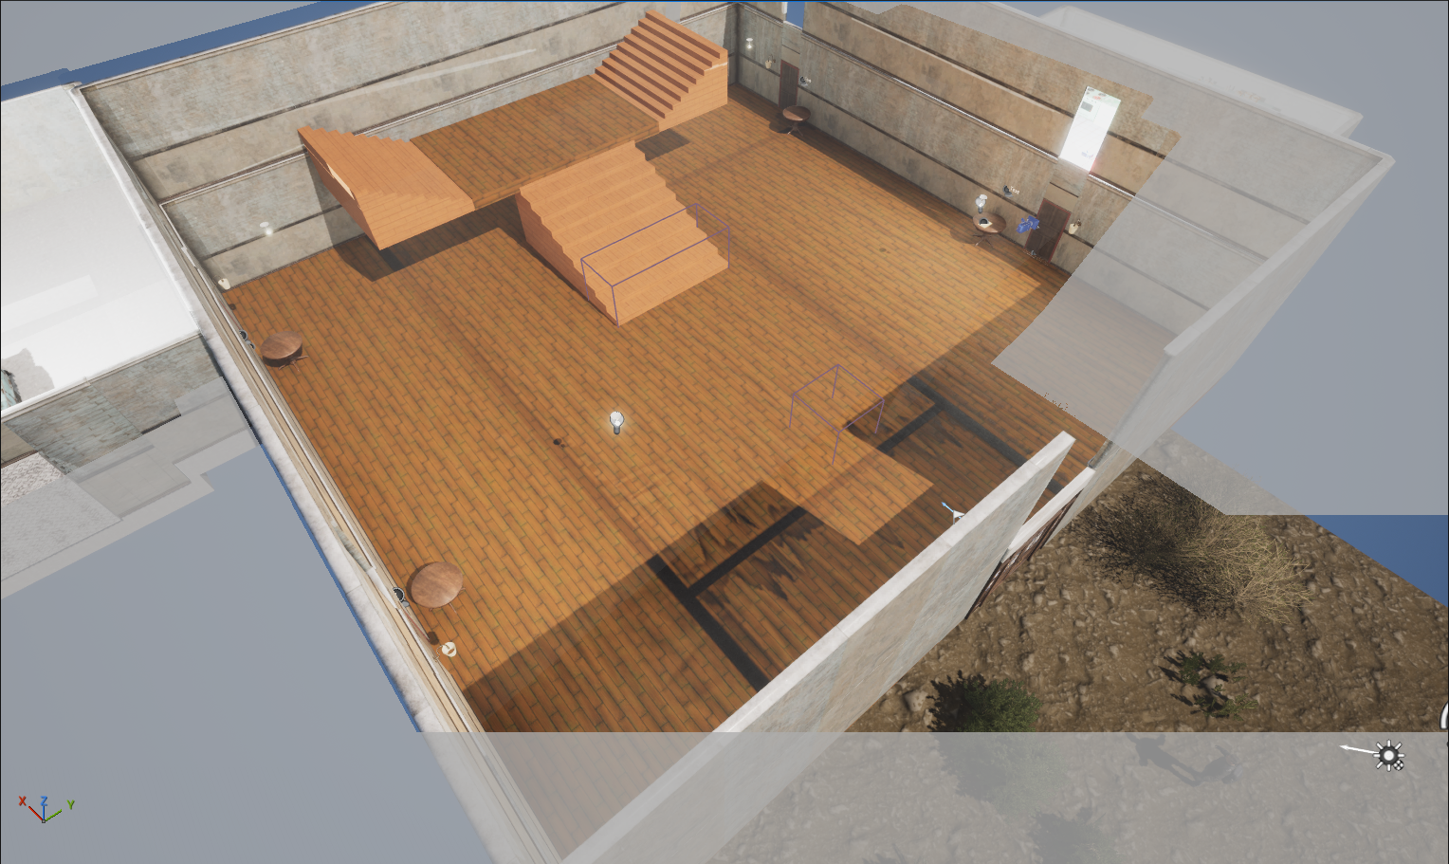
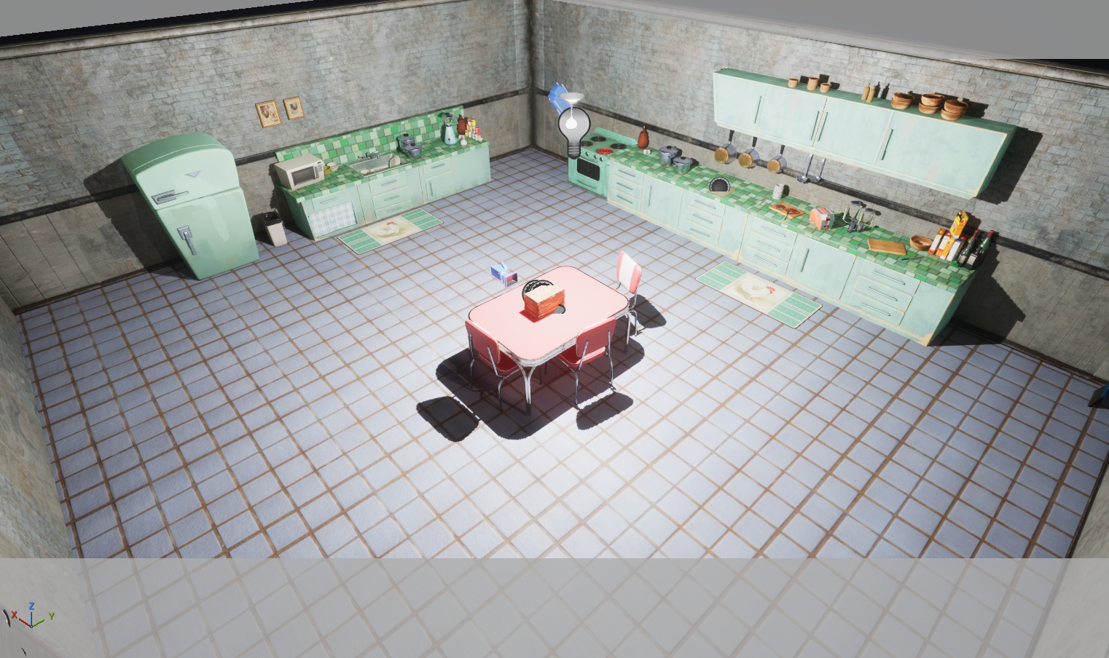
Development stage 3 -Meshing
Here is the meshed out levels in game:

Slide 29
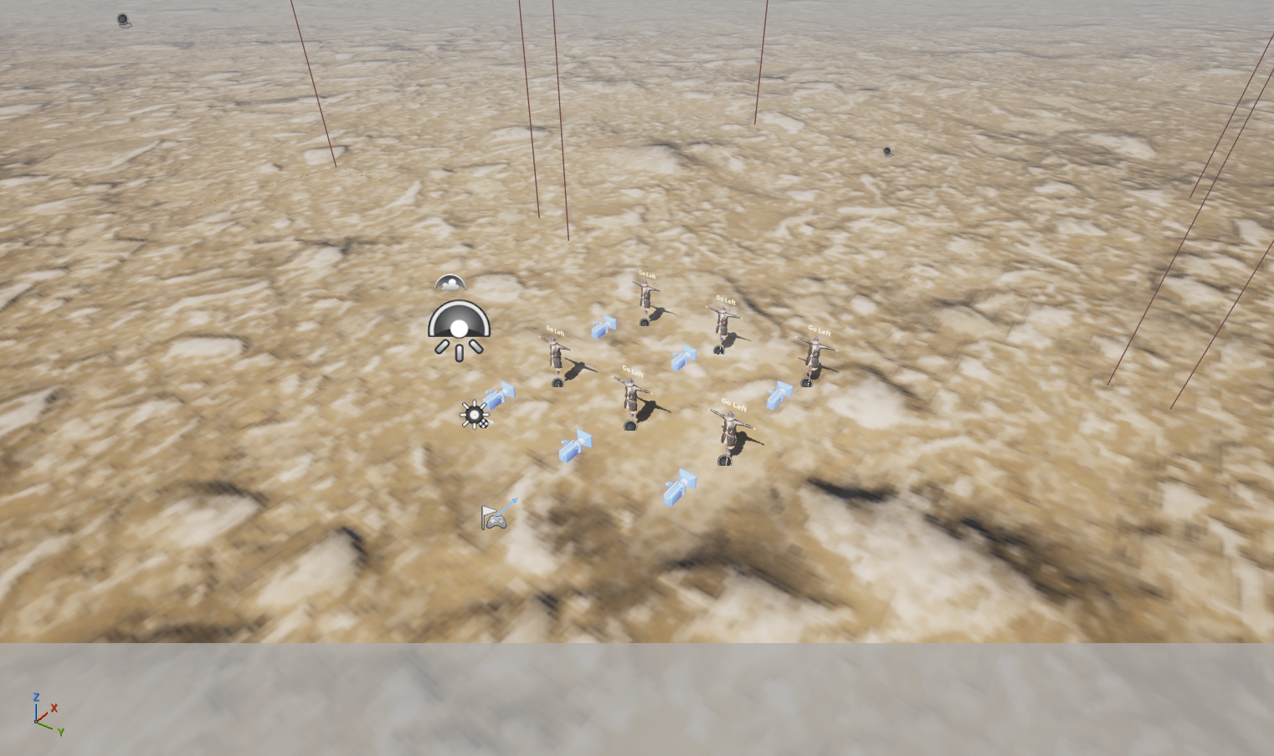
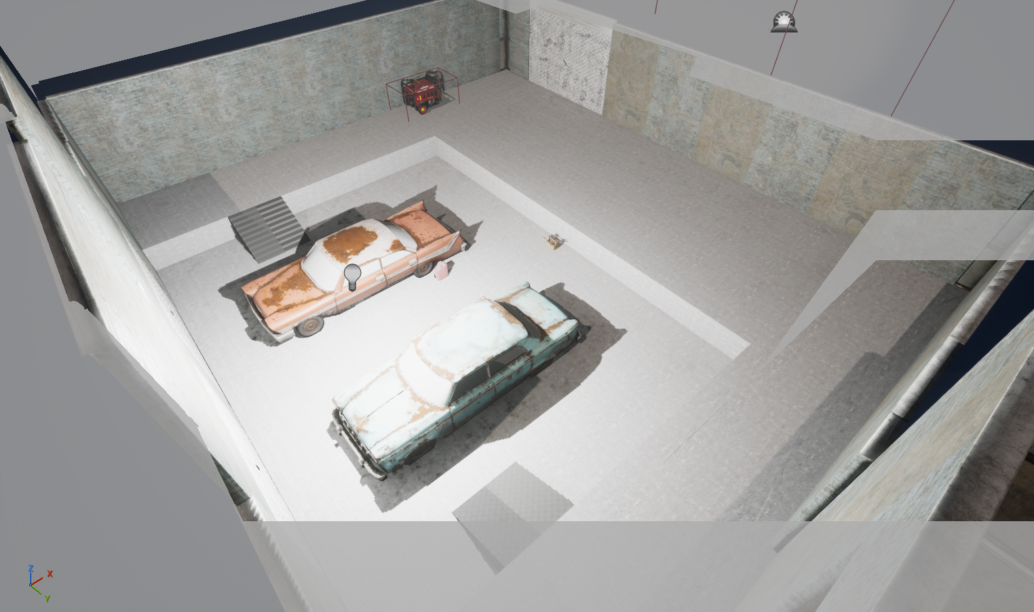
Development stage 3 -Meshing
Here is the meshed out levels in game:

Slide 30
Evaluation
Overall, the project largely met the intended deliverables that being a playable horror themed puzzle game demonstrating a clear focus on animation and camera transitions. Although personal circumstances prevented the project from being fully completed to the original scope the outcome was a near complete experience that in my opinion successfully communicated the core concept of my designs. Key systems, including the opening sequence and early puzzle interactions were implemented and polished to a good near industry standard.
The original problem was improving animation and camera transitions to enhance immersion. During this project this was effectively addressed. The most refined section of the game shows how smooth transitions and responsive animation can maintain player immersion. User testing also supported this outcome. Most participants reported feeling immersed during the opening section. Most testers commented that they wished the project had been fully polished this sugests that the core idea was being solved and the project had strong potential to deliver an even more immersive horror experience.
The main pitfall encountered during development was me underestimating the intensity of the meshing process. As a result, I was only able to fully mesh and polish one room of the environment, specifically the kitchen. This space became the most complete and refined area of the game and best represents the intended level of visual quality for maximum immersion.
Meshing should have been treated as a core development task rather than something I rushed through the final weeks of production. Attempting to complete it under time pressure limited how many environments could reach the same standard as the kitchen. This experience highlighted the importance of realistic time management.
Despite this, the use of asset libraries proved extremely valuable. High-quality premade assets allowed me to quickly enhance visuals and maintain a horror aesthetic. These assets significantly contributed to polishing the game and helped offset some of the limitations caused by the rushed meshing process, ensuring the final build still delivered a strong sense of atmosphere and immersion.
Future plans for the project include completing remaining puzzles, refining horror elements such as lighting and sound design and further meshing the levels to a industry standard.

Slide 31
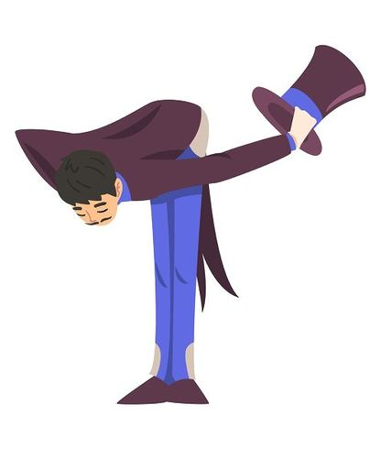
THANK YOU//
Wirtten by
Cheris Quessou
q017158n

