Slide 1
Guideline Framework to find a balance of UI/UX design in Game Industry
Student: Long Nok Chan (22010313)
Supervisor: James Vickers
Second Supervisor : Luke Barsby
Notes:
My FYP is to have a guideline tool that can support UI design in game industry.

Slide 2
Introduction

Slide 3
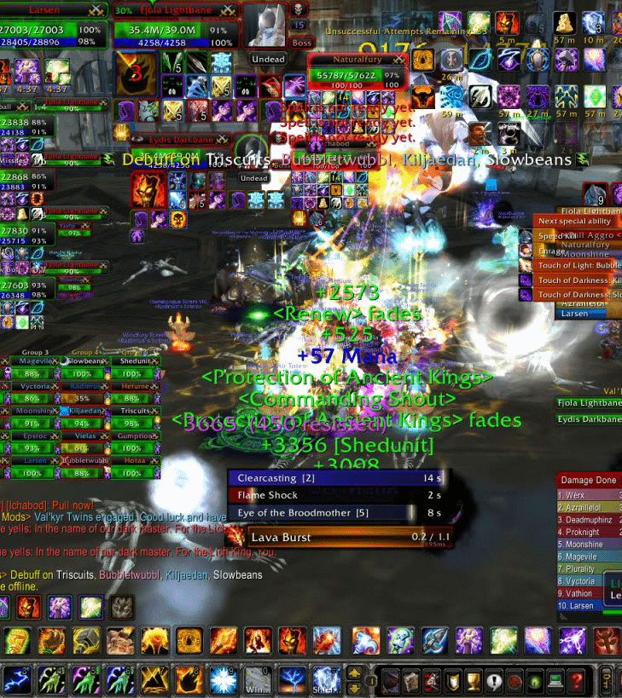
UI is important in game
Common UI criticism
Messy layout
Not matching game theme
Hard to navigate
UI design understanding conflict
Design Principle
Technical issue
I love UI
Notes:
I love UI and experience the conflict in UI (my education background)
Point 1: No UI how can I use inventory/ map/ even start a game
Point 2: Just read it
Point 3: And the reason is due to the conflict in the following
The image is World of Warcraft
I love UI and experience the conflict in UI

Slide 4
Aim & Objective

Slide 5
Aim:
"Provide support on 2 professionalisms regarding UI in game development"
Objective:
Create an artefact achieve to
support UI design contain different professional perspective.
raise the importance of balancing in UI design
get insight in different professionalism

Slide 6
Literature review

Slide 7
UI Design
Visual
Programme
User Experience
UI in game
Game Example
Notes:
Literature review focus on:
The above
Visual – Thing related to visual appearance in UI
Programming – Coding method and perspective
User Experience – different UX practices link to visual and programming
What and how UI could bring influence in game production

Slide 8
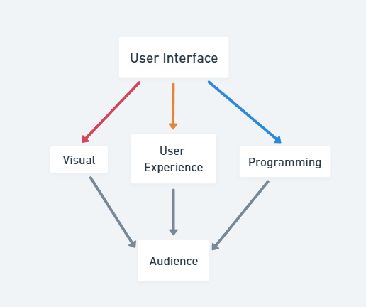
3 perspectives
Designer
Visual communication
Developer
UI functionality
UX
Understanding audience
Notes:
Just give a background understanding, UI require several professional (separate into 3 in this project)
Designer Focus on …
Developer focus on...
UX focus on...
The aim of all is the same
Perspective in designer and developer conflict
PSD file to developer (need more than that)
Difficulty understanding the relationship
(Wood, 2014, pp.140)

Slide 9
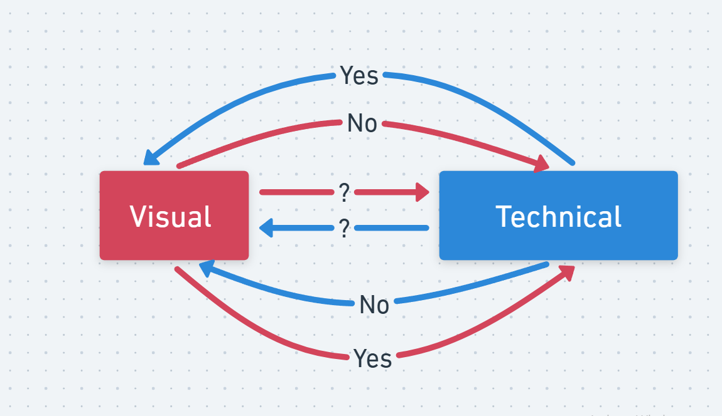
The Chaos
Notes:
Diagram: They are not speaking the same language

Slide 10
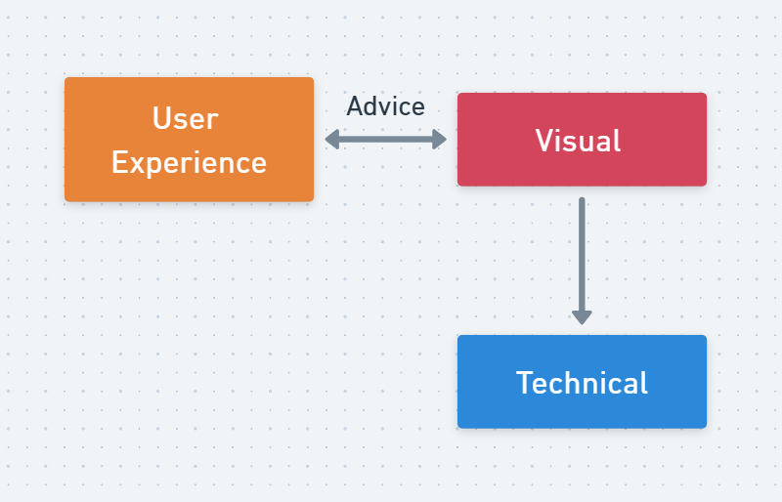
VISUAL Designer Perspective
Notes:
I will break down into graph:
Visual perspective
Working with UX but not Technical

Slide 11
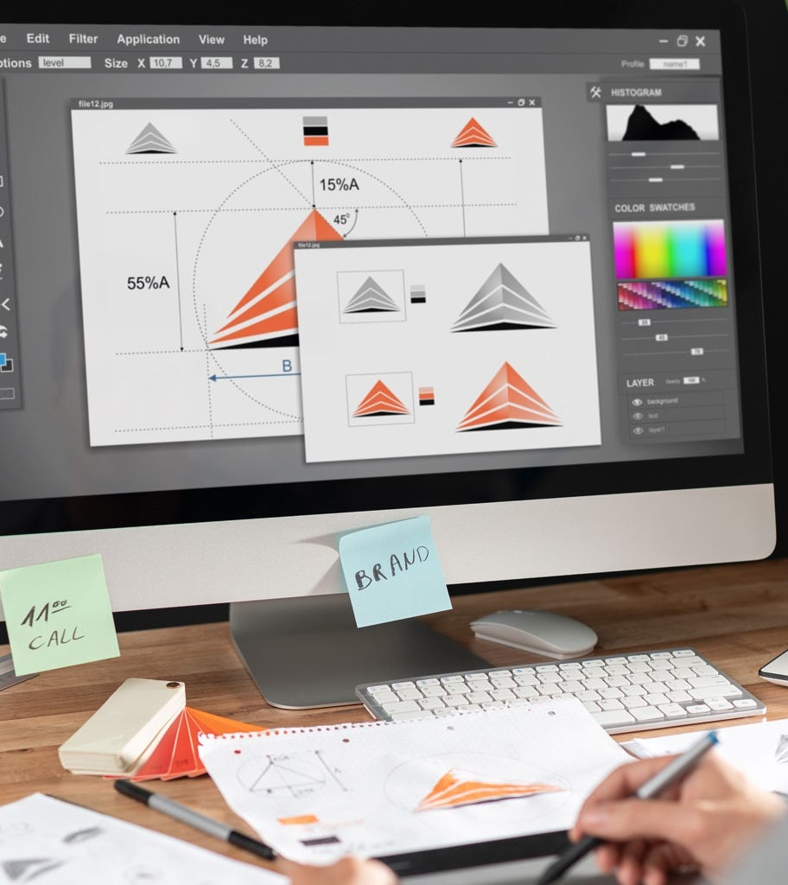
VISUAL/ graphic/ art
Simplify complex information for user be able to understanding(Poulin, 2011; Riot Game, 2018)
A writer/ editor, cultural anthropologist and sociologist (Cullen, 2005)
Visual expression balancing (positive and negative) (Cullen, 2005, Chapter Two Inspiration)
Using graphics elements to get user interest and attention (Jackson, 2017)
Visual presentation impacting users and also impact by users (Jitnupong & Jirachiefpattana, 2018)
Notes:
Point 1: no one want to read large amount of data in game
Point 2: Rewrite the game data and present in a different way
Point 3: Consider the layout, color use, typo and font selection etc. (Size and Resolution in game) --> god of war game example
Point 4: Understanding what is the hierarchy to show the important of game data
Point 5: Designer also in challenge to special user/ too boring common/ game competition (concept art and UI get the attention)
Point 4 & Point 5: Persona 5 game example

Slide 12
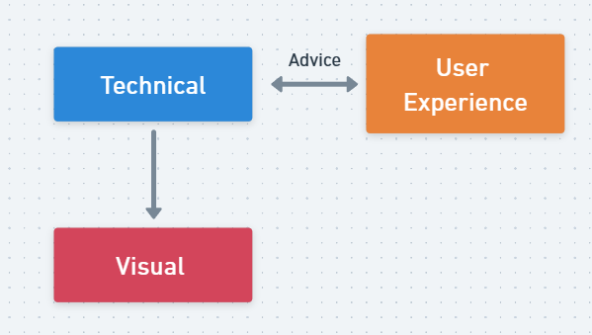
Programmer Perspective
Notes:
I will break down into graph:
Programmer perspective reverese
Usability is important --> a funny example in-game example mentioned later

Slide 13
Technical/ Programming
Functionality and usability are the first priority (Game Maker’s Toolkit, 2021; Spolsky, 2001)
Code and testing from programmers’ view not from users (Burckhardt, S. et al., 2013)
Reuse UI code could reduce development time (Wood, 2014)
Notes:
Point 1: If you can't use it what is the point?
Point 2:
have the function work but less from user perspective
focus on efficiency and unaware outcome could be less user-centre
Point 3: UI system are very similar so just duplicate it; also hard to found the issue in UI --> about data linking (minor mistake)

Slide 14
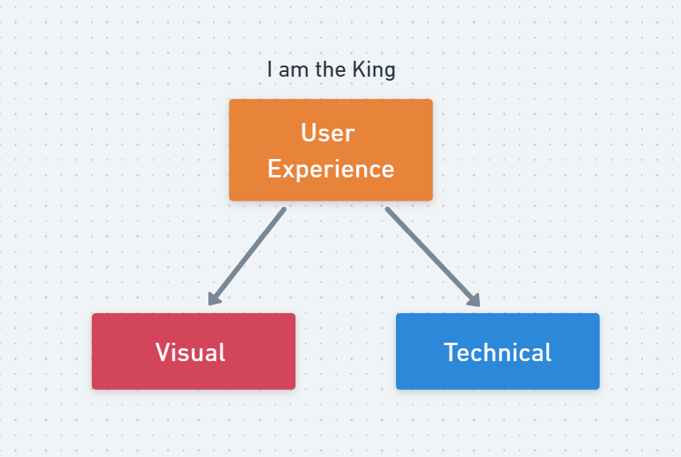
User Experience Approach
Notes:
I am supporting both professionalism

Slide 15
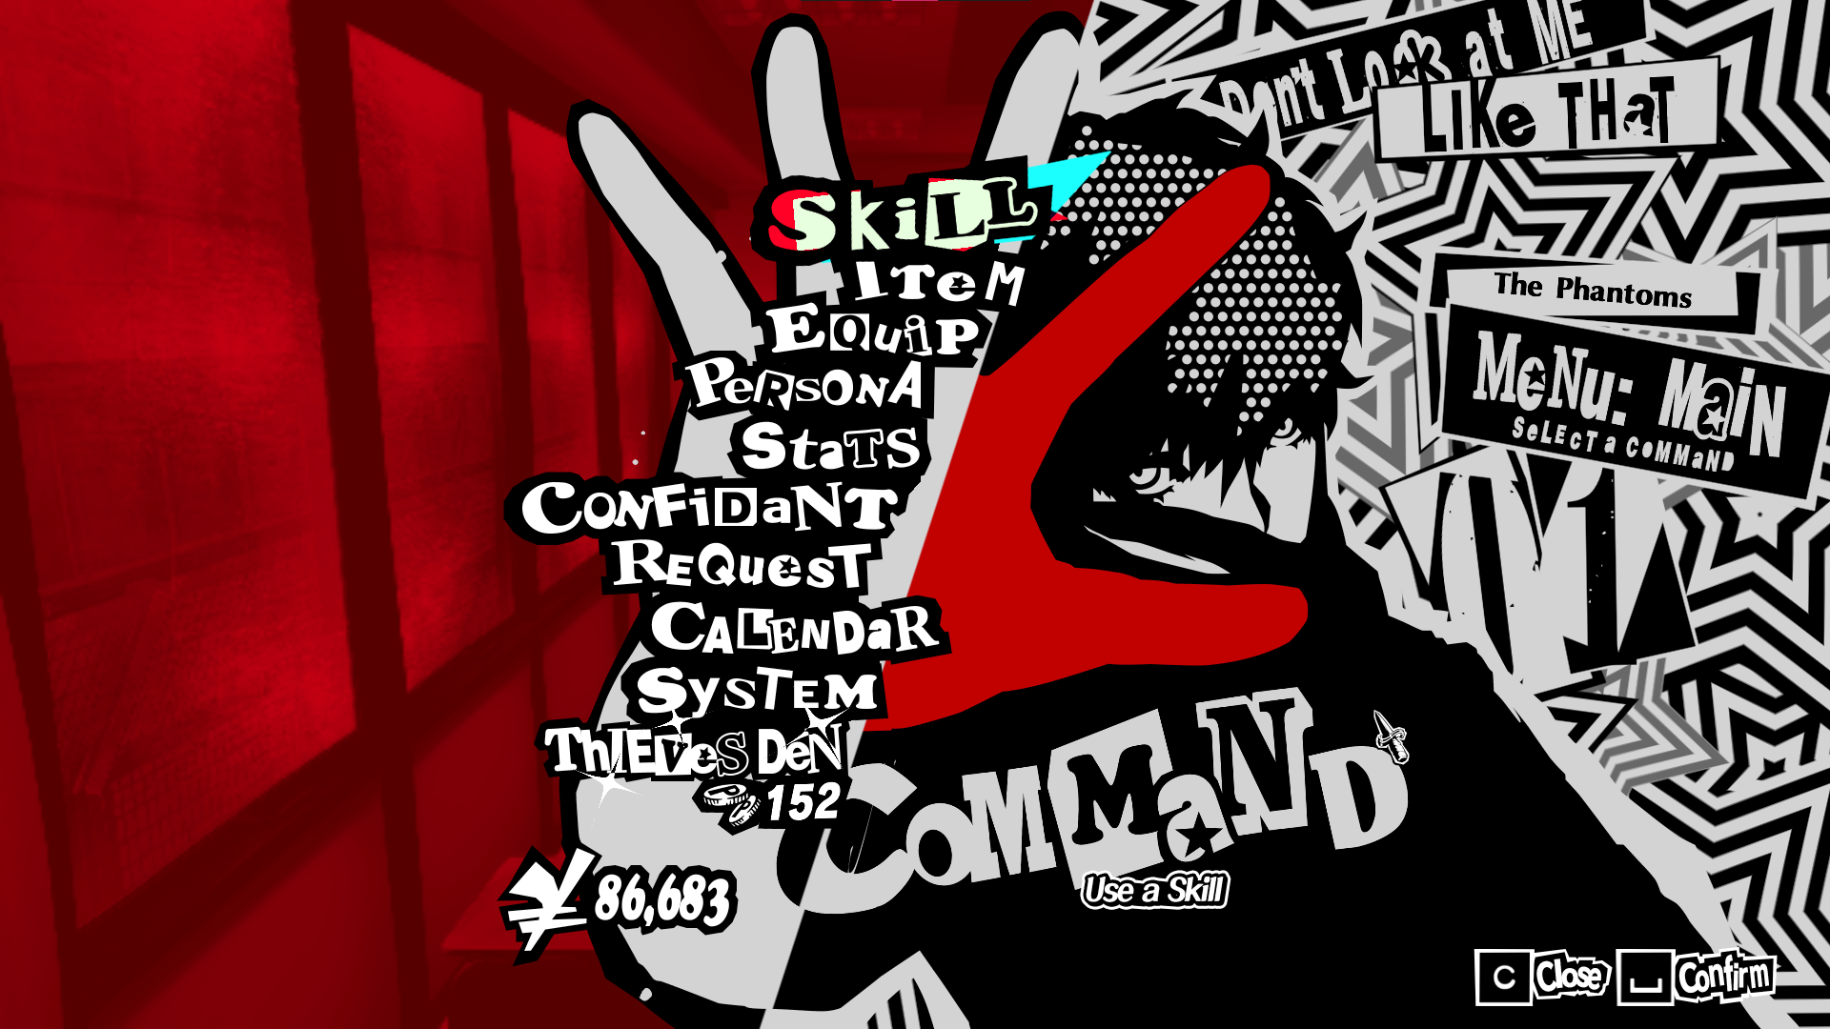
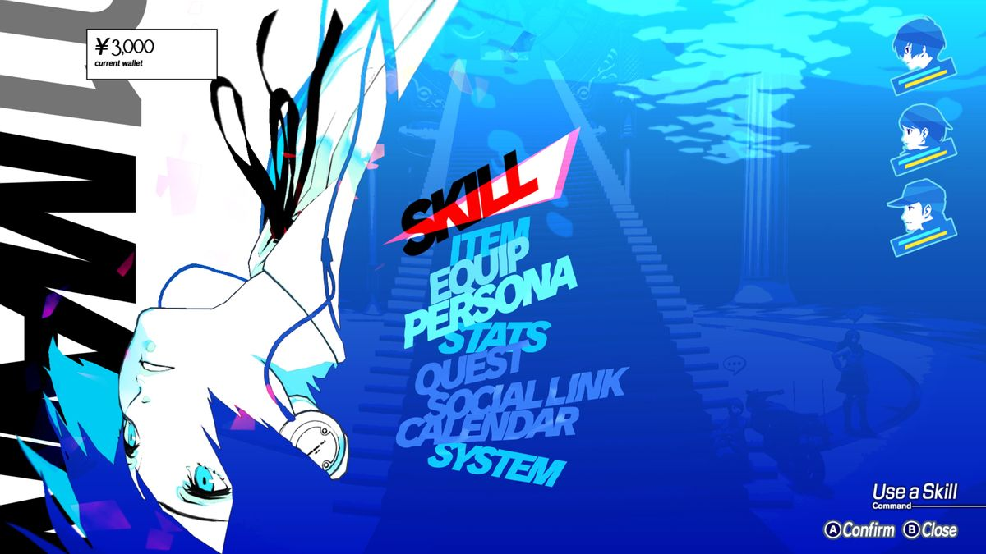
User EXPERIENCE/ user-CENTER
A bridge connect UI and game
Approach (Wilson, 2014):
Perspective-based inspection (Observation)
Heuristic Inspection (System base)
Cognitive Walkthrough (Common sense)
Improve functionally by testing and evaluating usability
About understanding audience's expectation (Wood, 2014)
Notes:
Point 1: UX in UI is...
Point 2:
Visual: Perspective-base --> observe people
Programmer: Heuristic --> Checklist/ simply yes or no
UX: Cognitive: Cognitive --> Psychology knowledge, human habit
Point 3: UI that contains UX is about
Point 4: Not every people with the same experience
Game Persona 3/ Persona 5/ Metaphor from Atlus

Slide 16
UI In Game
Notes:
Literature review focus on:
The above
Visual – Thing related to visual appearance in UI
Programming – Coding method and perspective
User Experience – different UX practices link to visual and programming
What and how UI could bring influence in game production

Slide 17
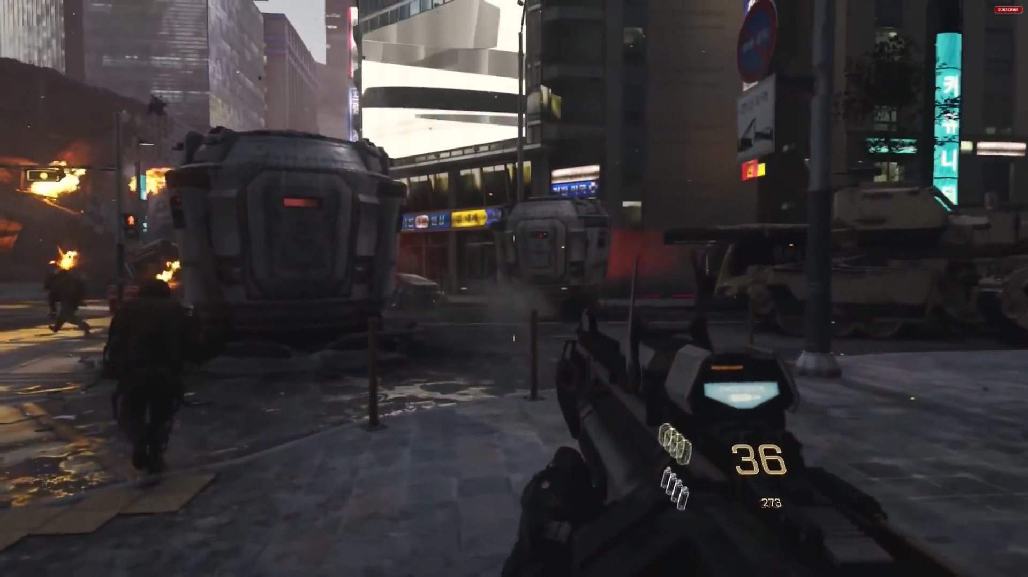
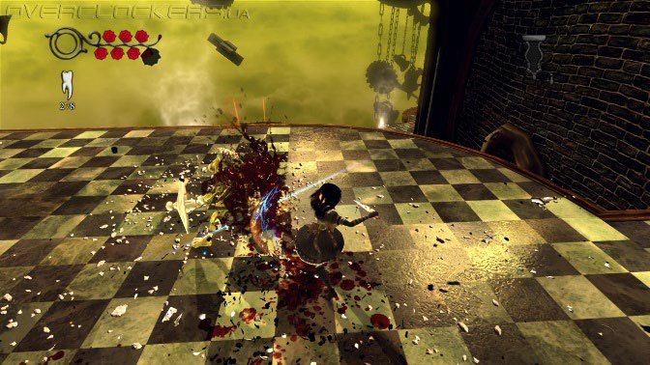
UI influence in Gameplay
UI choice affect players' game immersion (Tran & Berg, 2021)
Difficulties of UI = player experience trouble in game
Player vision and UI
Eyes saccade count refer to player understanding in UI (Jiang .et al., 2019)
Visual focal point
Rendering and GUI (Chen. et al., 2021)
UI crash is the second common issue face in game

Slide 18
GAME research
Notes:
Literature review focus on:
The above
Visual – Thing related to visual appearance in UI
Programming – Coding method and perspective
User Experience – different UX practices link to visual and programming
What and how UI could bring influence in game production

Slide 19
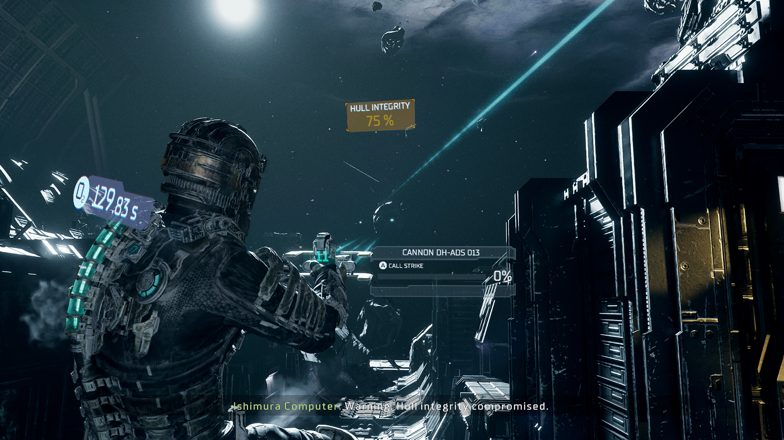
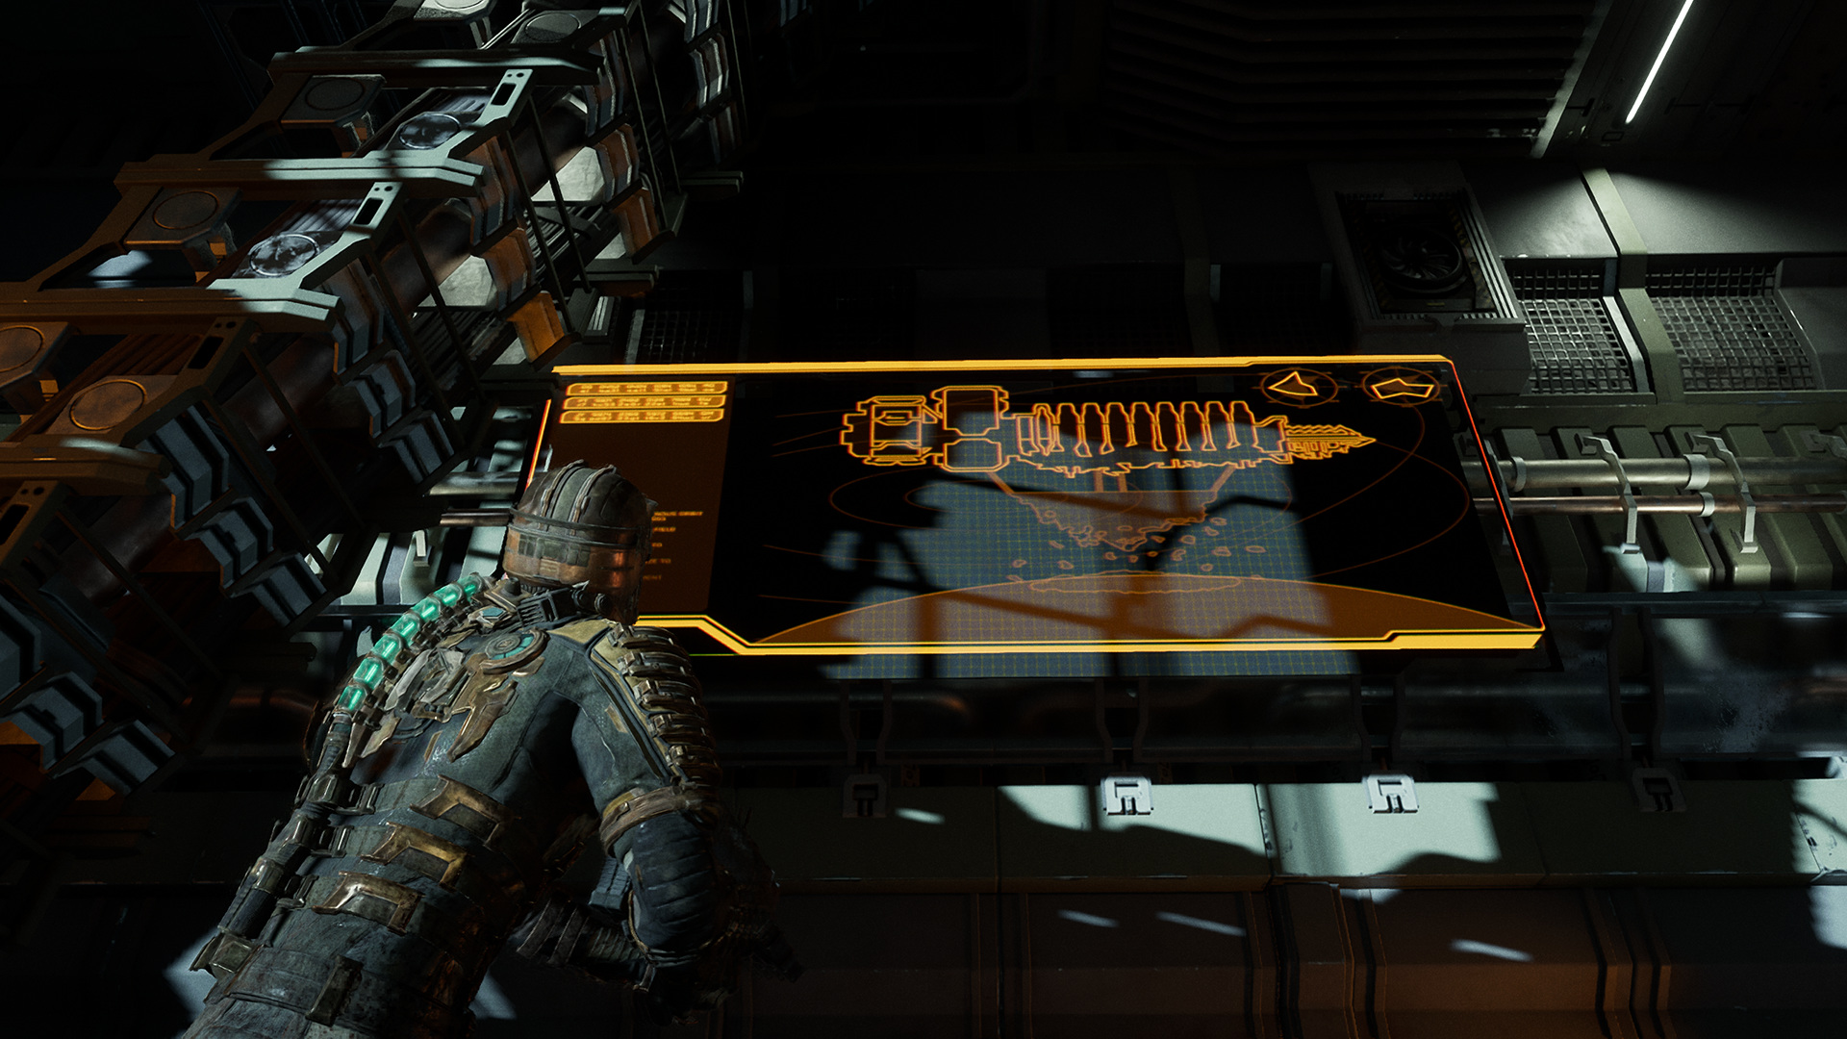
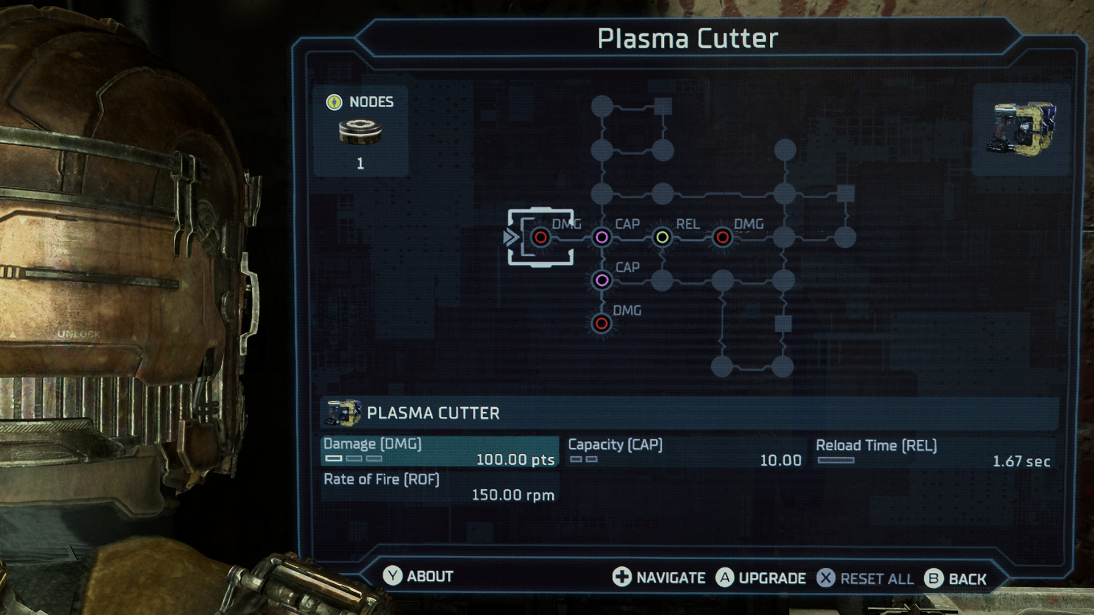
Notes:
Dead Space
Fit to the game backstory, visual balance with system to keep players' level of immersion
Full use on diegetic, communication during development
Bench's experience --> Usability always got first

Slide 20
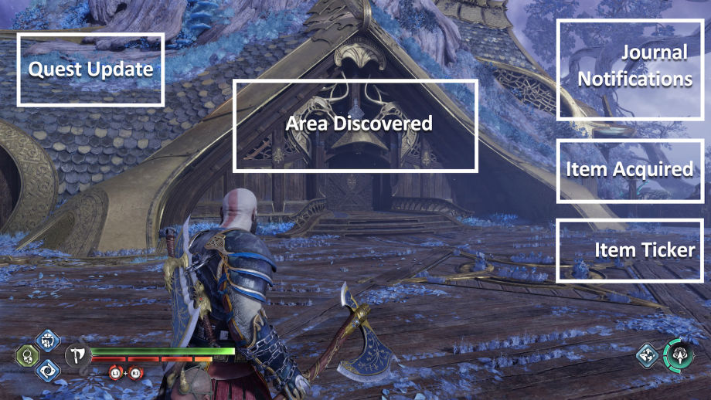
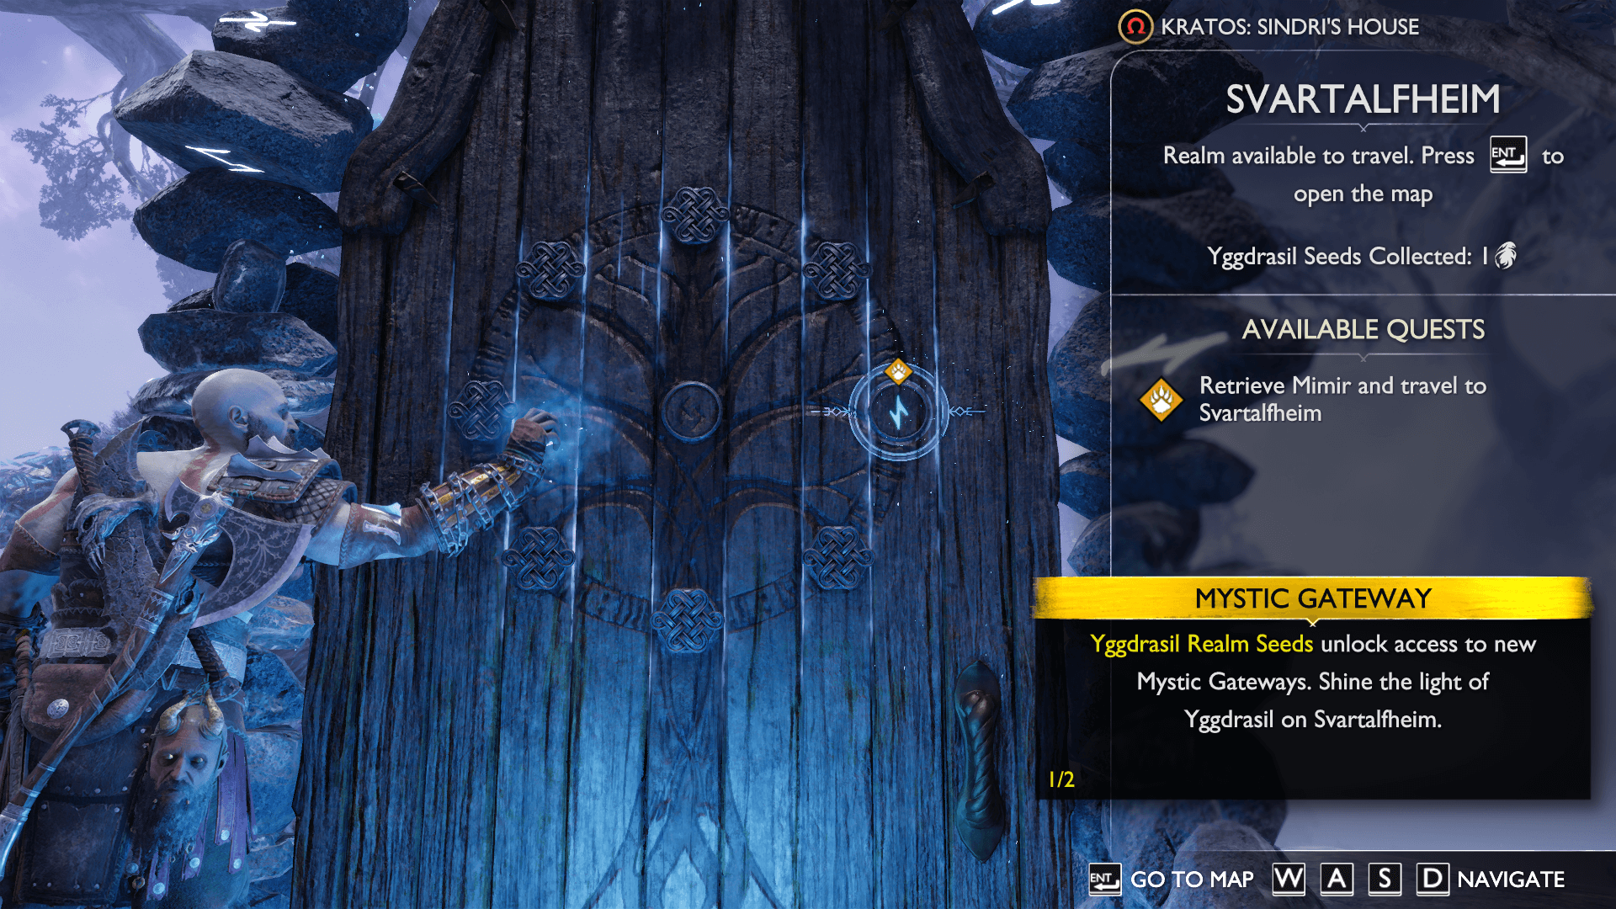
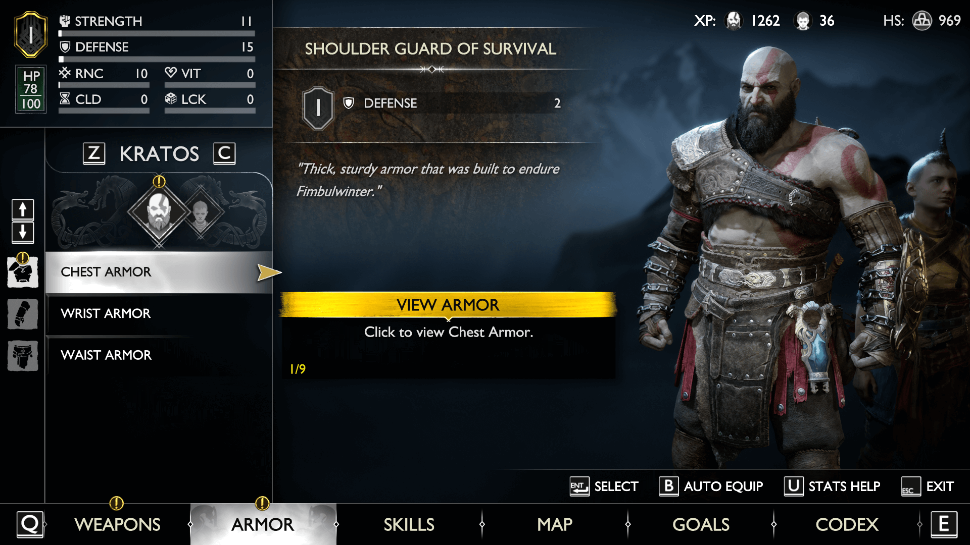
Notes:
'God of War Ragnarök’
Limit visual element (only one section of UI element be on HUD at a time)
Max up UX (Gate travel including diegetic UI on area unlock + available task)
Customization (system for text size arrange and maintain layout)

Slide 21
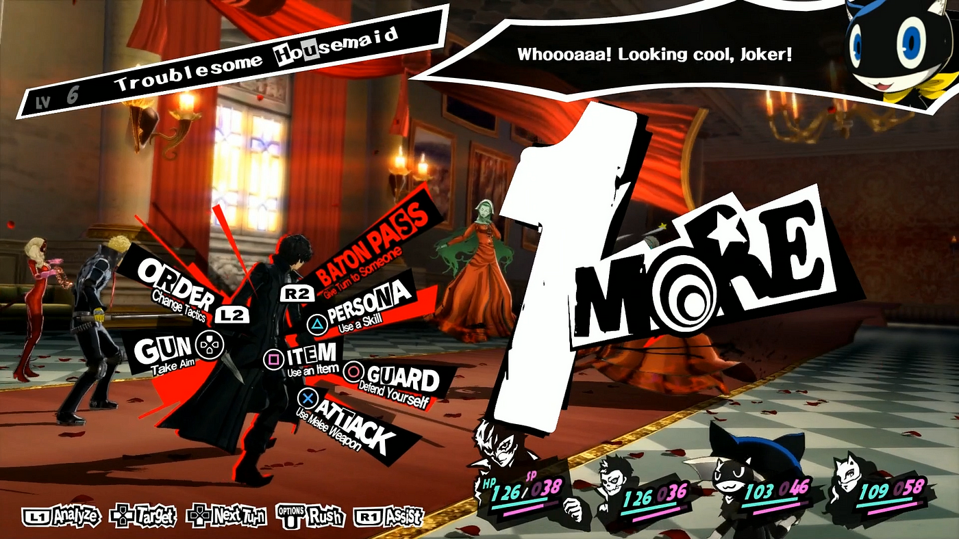
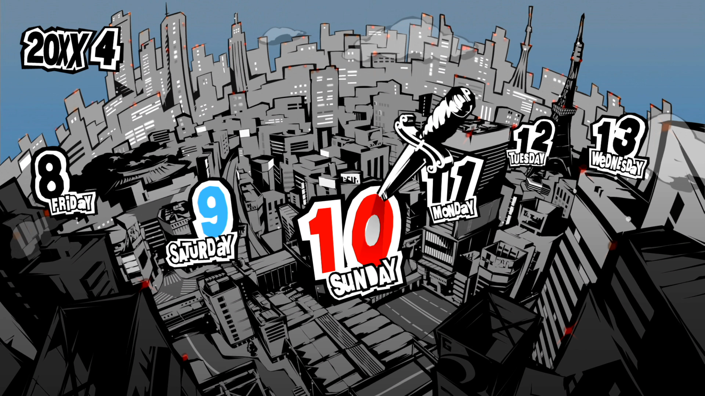
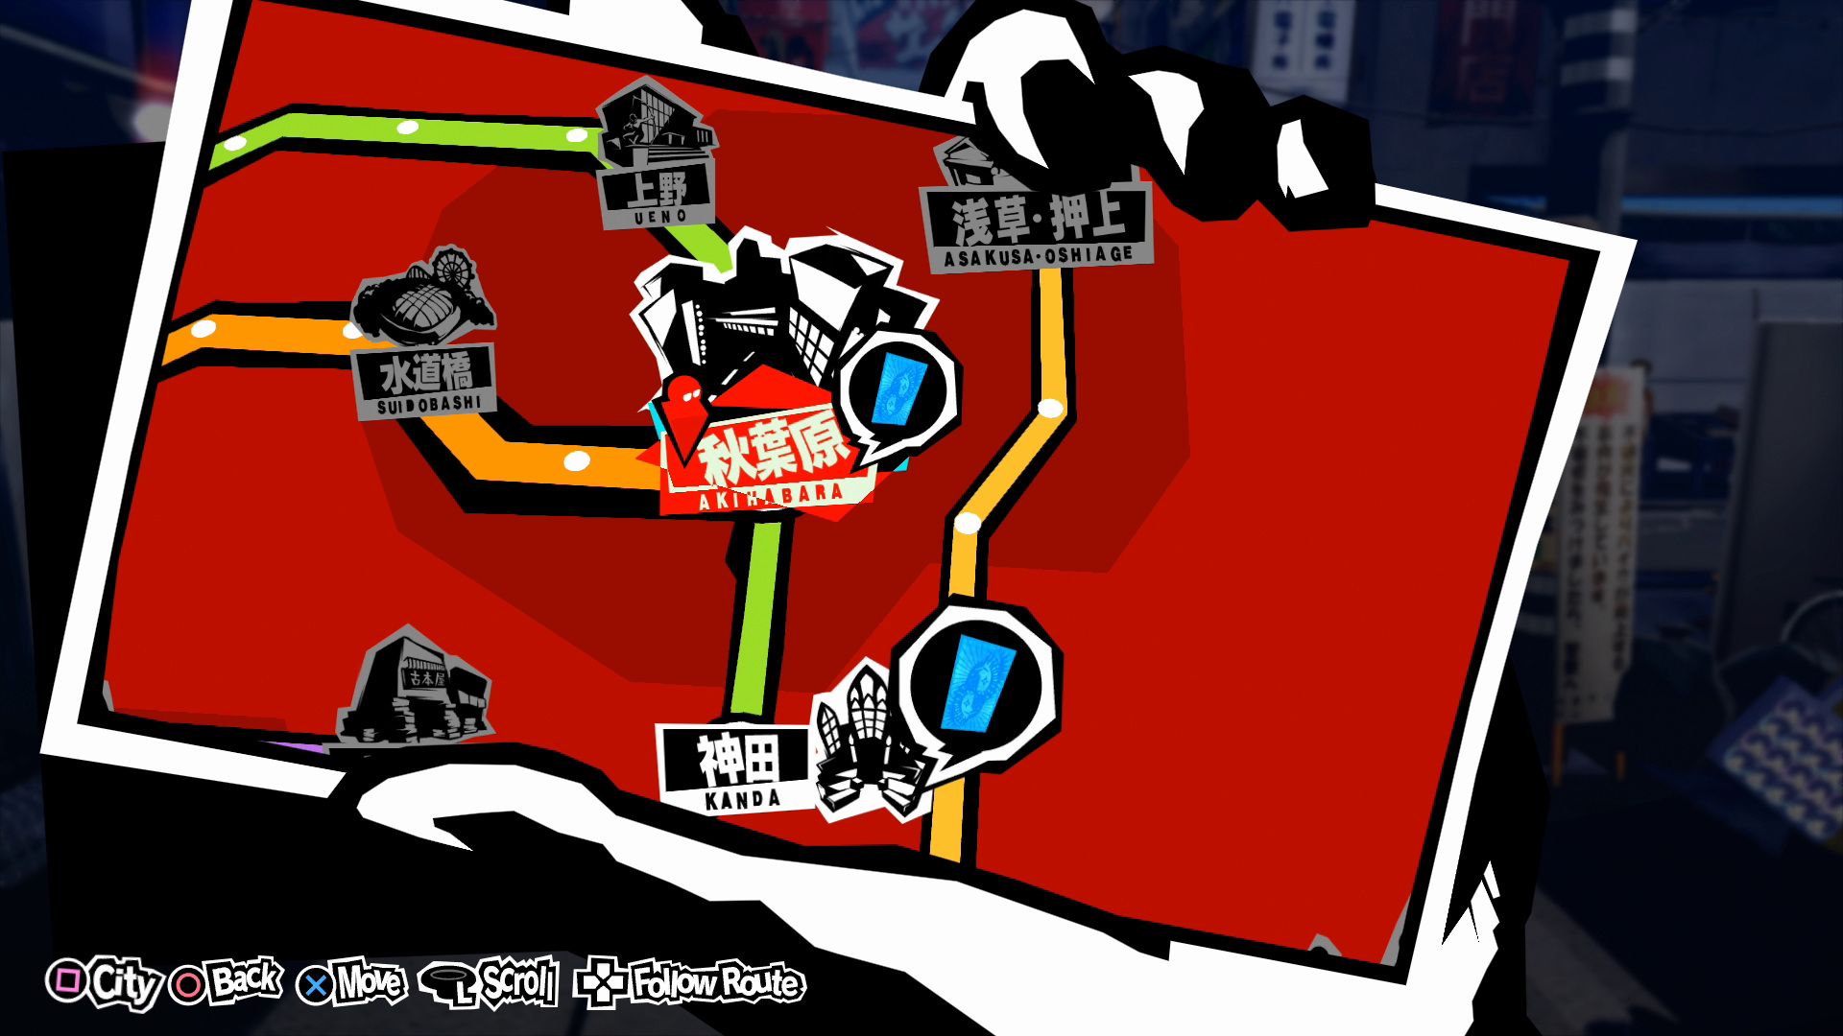
Notes:
Persona 5 (Alex, 2017)/ (Khan, 2019)
UI change Altus
An example on how UI help branding the game
UX of giving player feedback in battle

Slide 22
Methodology
Research:
Research Questionnaire
Framework Research
Artefact Development:
Level Mapping
Widget Blueprint
Node Commenting
Framework Playtest
Playtest Questionnaire

Slide 23
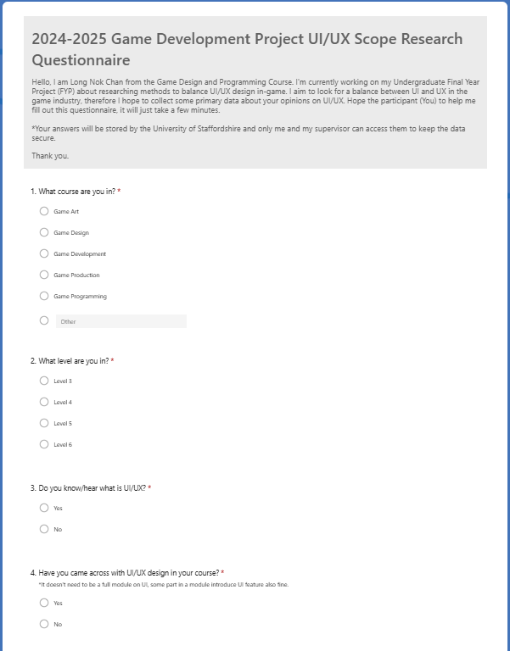
Questionnaire
Scope the artefact development direction
What should contain
What can help in UI design
https://forms.office.com/Pages/ResponsePage.aspx?id=8nivV33IZkS3u2tsyZ7RJM0GhYyFqa9AnJuIe0AUOQVUOVJHUlgzTkw3VzNLUkpMMTFVSTJNUUJHNC4u

Slide 24
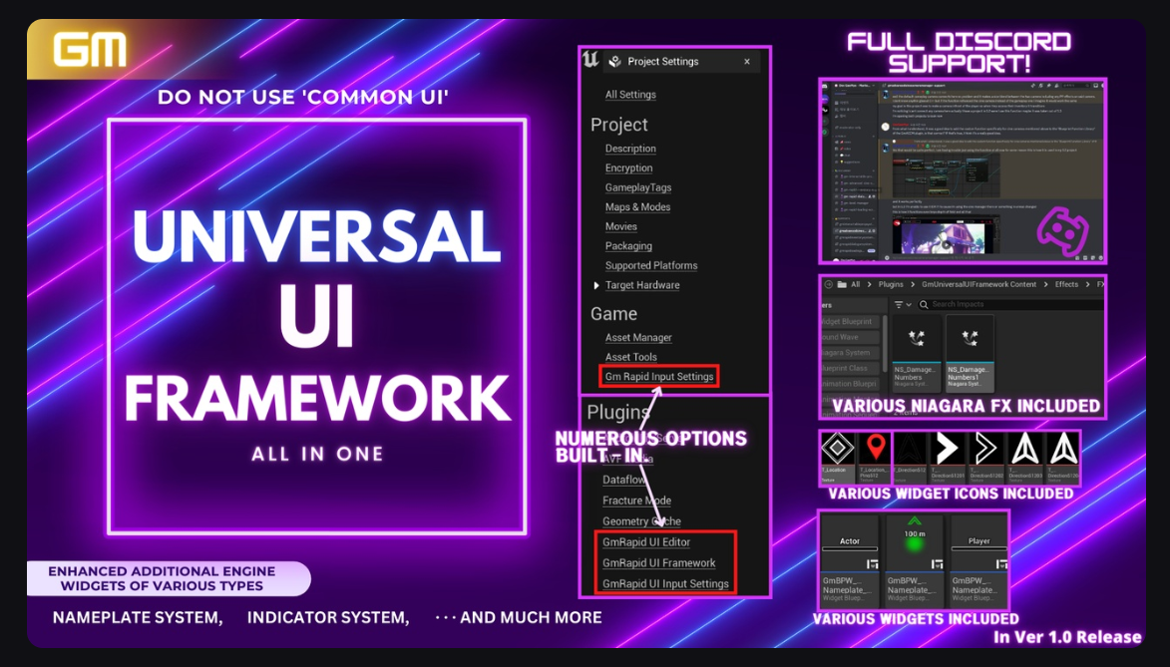
Framework Research
Existing framework example:
What it contain?
What it looks like?
What can I reference?

Slide 25
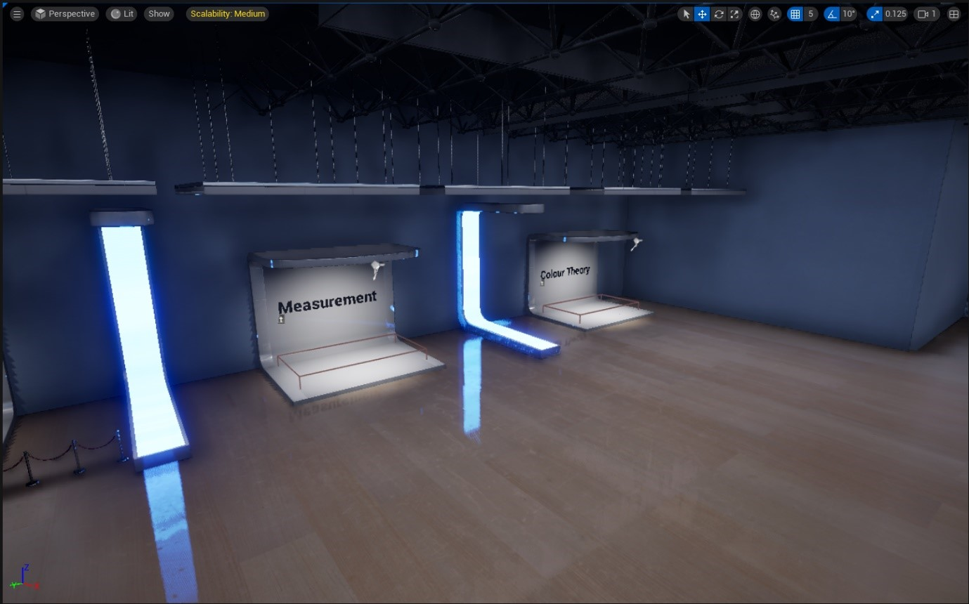
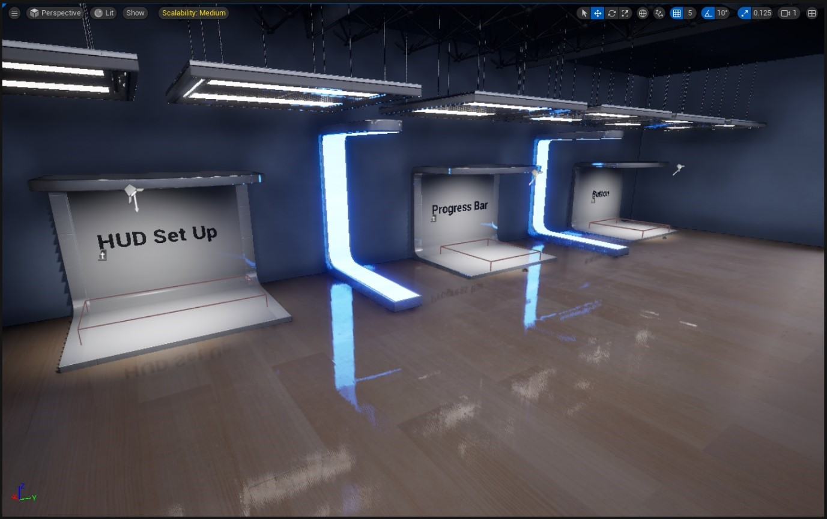
Framework Level Mapping
Notes:
Level Mapping

Slide 26
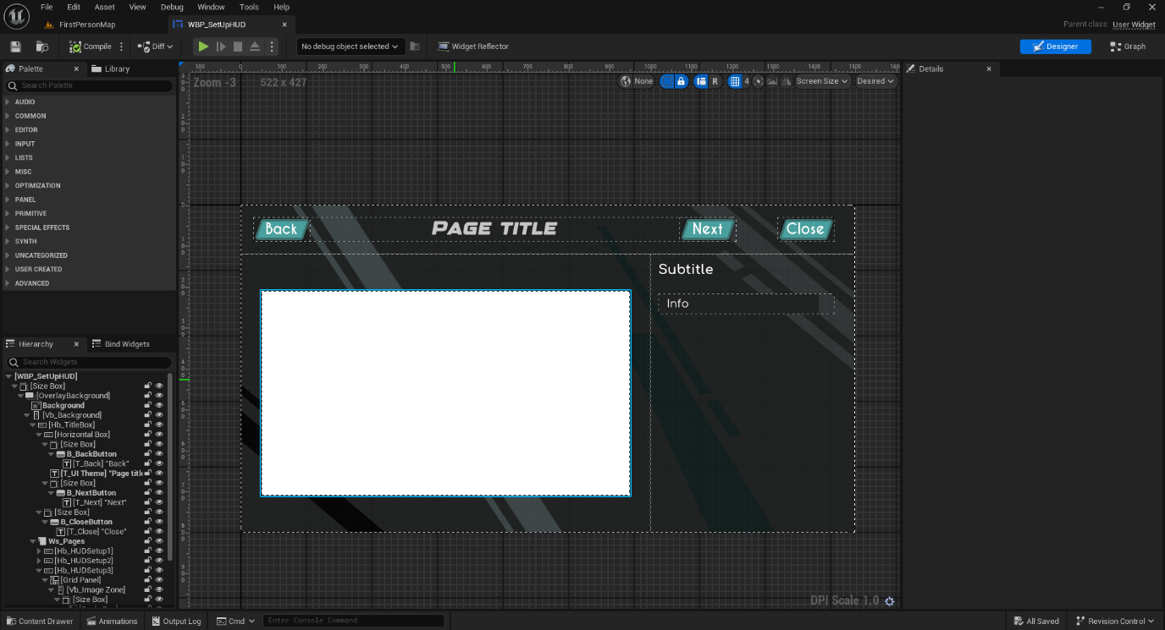
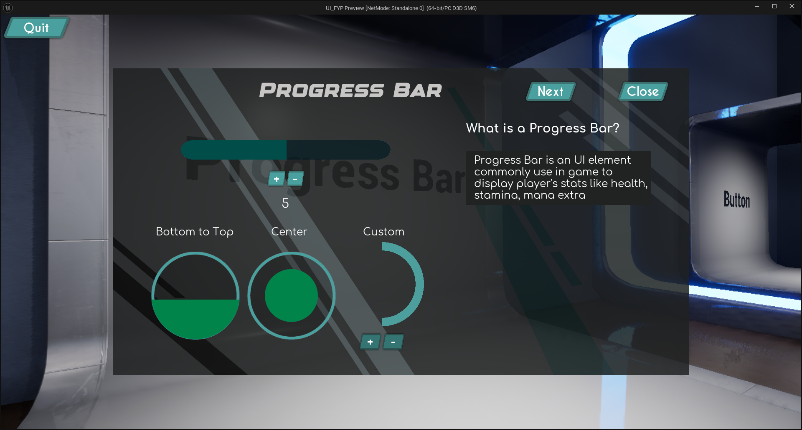
Widget Blueprint

Slide 27
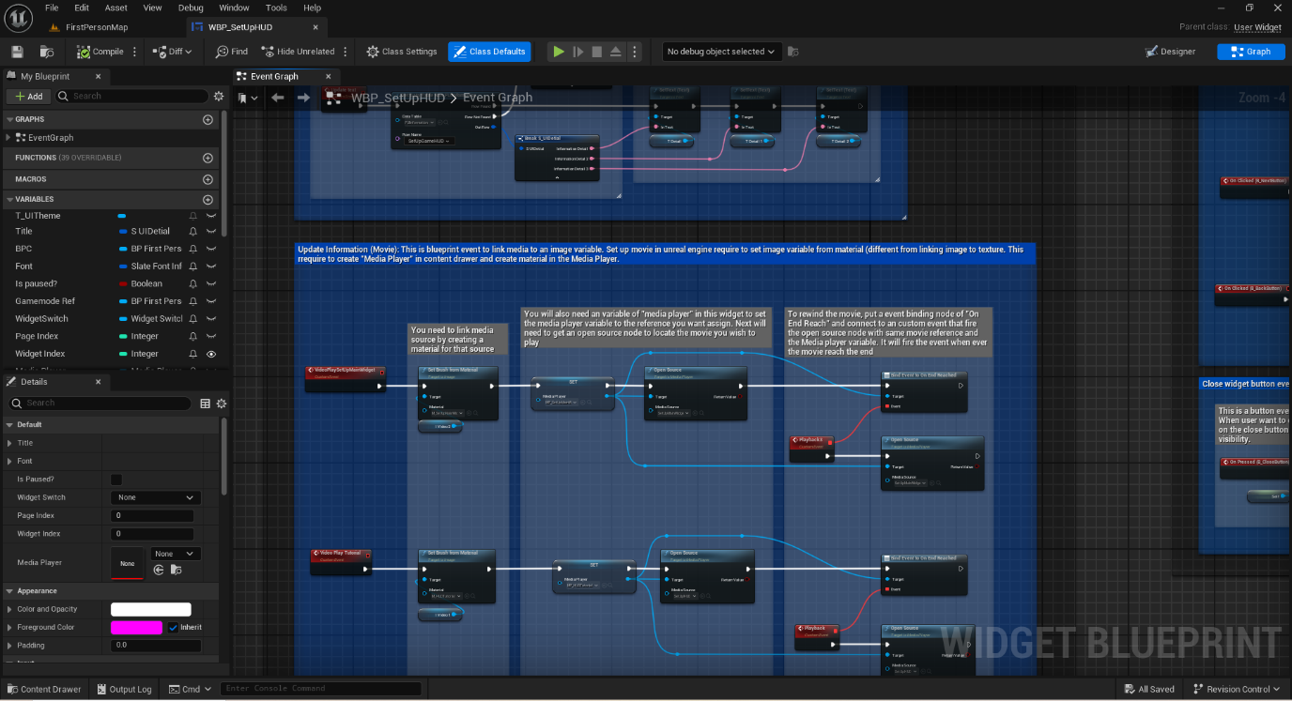
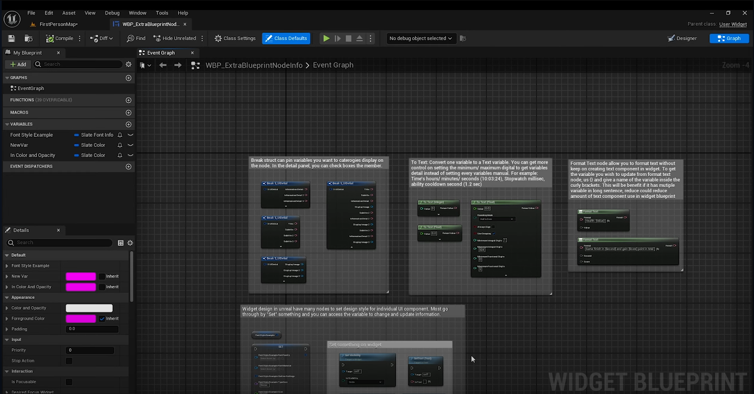
Commenting

Slide 28
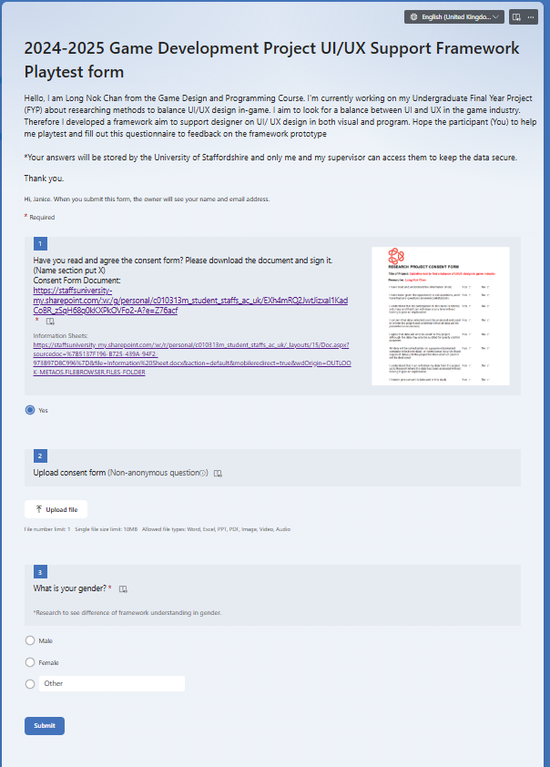
PLaytest and questionnaire
Asking student to play the framework
Fill out the questionnaire
https://forms.office.com/Pages/ResponsePage.aspx?id=8nivV33IZkS3u2tsyZ7RJM0GhYyFqa9AnJuIe0AUOQVUQU1PVktQRlBRNFZWRjJINDMwV0I5NjIxTS4u
Notes:
Questionnaire detail
What is your gender?
Are you use to/ experience on Unreal Engine?
Have you look up Unreal Engine UI/ Widget design tutorial?
Have you heard or explore Unreal Engine "Content Example" created by Epic Game?
What impress you in this framework?
Rank the booths unreal widget design in the framework. *From most useful to less useful.
Which booths you found most helpful?
Did you encounter any difficulties when exploring the framework?
What are the difficulties?
Any suggestion or improvement need to make on this framework?
Please scale the helpfulness of this framework in overall.
Overall, what is your opinion about the framework?

Slide 29
Artefact Demonstration

Slide 30
Video

Slide 32
Results and Findings

Slide 33
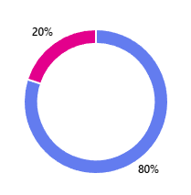
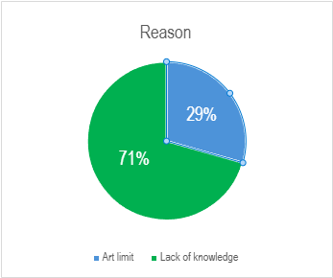
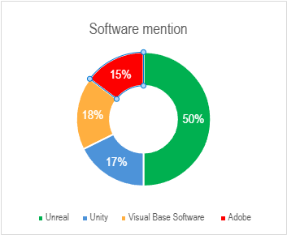
Questionnaire (Artefact Development)
20 people
Quarter of three student experience difficulties in UI
Difficulties
Visual support
Program conflict
Common Software/ Engine Use
Notes:
Point 2: proof my research importance
Point 3: Visual colour and layout
Point 3: Program -> Don't know other ways to do it/ don't know other effinicy way/ new to engine/ lack of information detail (out date tutorial)
Point 4: Which engine should the framework develop on?

Slide 34
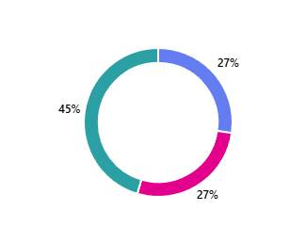
Questionnaire (Framework Playtest)
10 participant
Average Unreal engine experience: 2-3 years
Framework compare result: 50/50
Most helpful booths
Overall comment very positive : 8.10 rating
Notes:
Point 1: Right amount of number for prototype framework
Point 2: 2 got more experience
Point 3: Question ask do they know content example --> compare with it
Point 3: 4 people and 2 said yes (keep them interest/ have a better understanding then the content example/ give you detail) and 2 said no (just said I know/ no significant reason)
Point 4: People really love it
45% Interactable Widget
27% Video
27% Blueprint Comment
Point 5: Surprise me --> not Set up HUD
Point 5: reason was unaware color is important in UI/ interactable widget could observe the variable change
Point 6: People feel this framework provide strong help in UI design

Slide 35
Discussions and ANALYSIS

Slide 36
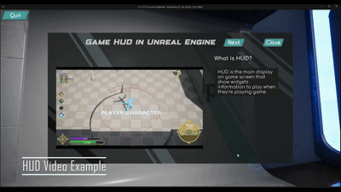
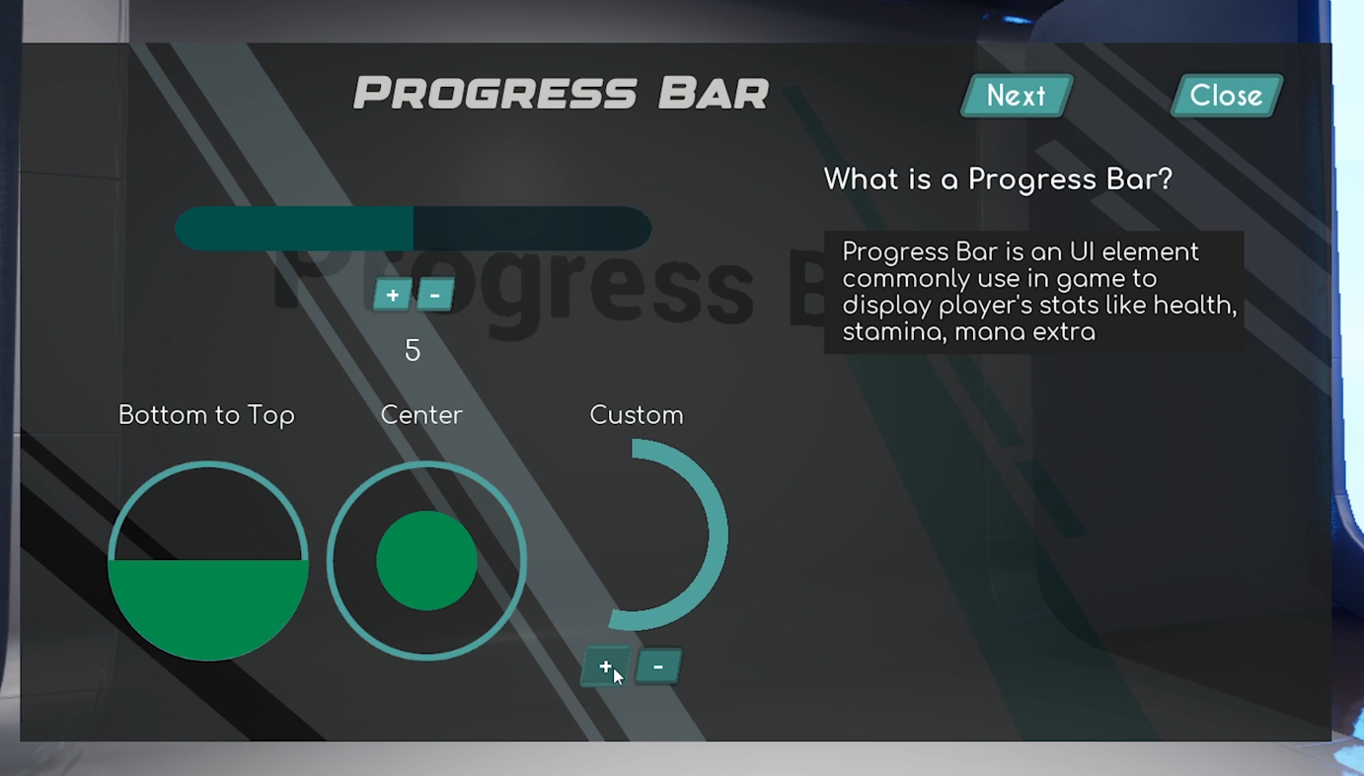
The Framework...
Playtest result shows framework does give huge support in UI design
Provide visual support in framework help to relieve understanding difficulties
No significant result show user gains opposite professional perspective from framework
Framework including interactable/ engagement feature helps on understanding
Visual importance in UI is not enough
Great support in UI compare with "Content Example"

Slide 37
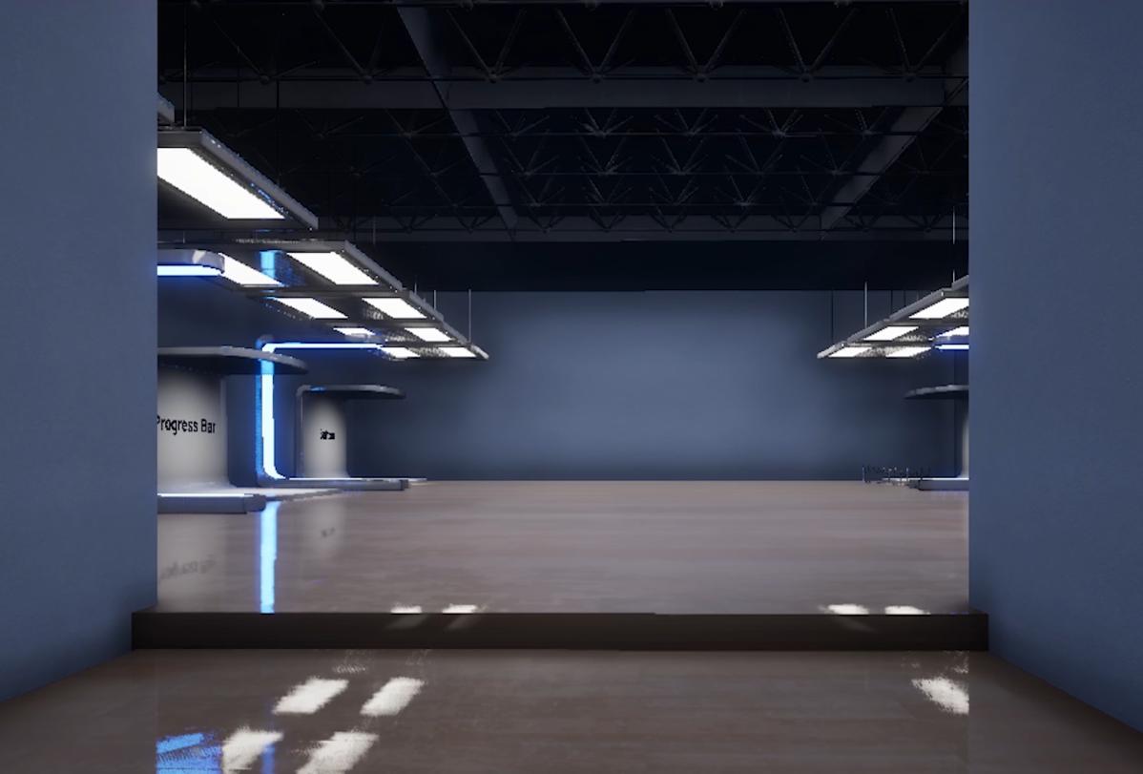
SOME weakness...
Framework navigation/ walkthrough not enough
Control question
Didn't include time spending
Concentration/ interest to the framework
No comparison with poor version UI
Measurement between balance and unbalance UI
Questionnaire not narrow enough for detail scoping
Reuse some question from first questionnaire
Narrow question

Slide 38
Conclusion

Slide 39
The framework is a success
The research point me to the right direction
UI design exist a conflict and could be improve
Further develop the framework
Lack of poor example for comparison
Contain more UI related information (Size box, grid, animation etc.)
The project planning is kind of on track
Clear vision
Artefact development
Question gaps
Notes:
Point 4: question using software type question, some not right fill into the research.

Slide 40
Reference
Game Maker’s Toolkit (2021) The Power of Video Game HUDs, YouTube Video. Available at: https://www.youtube.com/watch?v=4Bv45aPMGyI&t=357s
‘God of War Ragnarök’ (2022). PC, PlayStation 4, PlayStation 5[Game]. Sony Interactive Entertainment: San Mateo.
goukigod (2021) The Call Of Duty User Interface / User Experience Is Broken! | Game GUI Analysis, YouTube Video. Available at: https://www.youtube.com/watch?v=7psu42EGvTk
Hannah, J (2023) What is the rule of thirds in UX/UI design? A complete guide on how to use it. Available at: https://www.uxdesigninstitute.com/blog/guide-to-the-rule-of-thirds-in-ux/#:~:text=At%20its%20core%2C%20the%20Rule,gridlines%20or%20at%20their%20intersections.
Hendrickson, J.C. & Wissink, T. (2023) Unleashing the power of UX analytics: proven techniques and strategies for uncovering user insights to deliver a delightful user experience. 1st ed. Birmingham, England: Packt Publishing.
Ignacio, D (2013) Crafting Destruction: The Evolution of the Dead Space User Interface. YouTube Video. Available at: https://www.youtube.com/watch?v=pXGWJRV1Zoc&t=1s
Jackson, W. (2017) ‘Android Graphic Design: Making UI Designs Visual’, Android Apps for Absolute Beginners. United States: Apress L. P, pp. 209–249. Available at: https://doi.org/10.1007/978-1-4842-2268-3_9.
Jennett, C., Cox, A. L., Cairns. P., Dhoparee. S., Epps. A., Tijs. T. & Walton. A. (2008) ‘Measuring and defining the experience of immersion in games’. International Journal of Human-Computer Studies, 66(9), 641-661. Available at: https://doi.org/10.1016/j.ijhcs.2008.04.004.
Armstrong, H (2009) Graphic Design Theory: Readings From the Field, Princeton Architectural Press, New York. Available from: ProQuest Ebook Central.
Bohn, Z (2023) 'God of War Ragnarök': Building the UI for a AAA Sequel. YouTube Video. Available at: https://www.youtube.com/watch?v=C5gfkeFXDq8
Brown, J (2018) Bridging the Gap Between UX Principles and Game Design, YouTube Video. Available at: https://www.youtube.com/watch?v=73Pqsk74Jc0
Burckhardt, S., Fahndrich, M., Halleux, P. D., McDirmind, S., Moskal, M., Tillmann, N. & Kato, J. (2013) ‘It’s alive! continuous feedback in UI programming’. ACM SIGPLAN notices, 48(6), pp. 95–104. Available at: https://doi.org/10.1145/2499370.2462170.
Chen, K., Li, Y., Chen, Y., Fan, C., Hu, Z. and Yang, W. (2021), ‘GLIB: towards automated test oracle for graphically-rich applications’, In Proceedings of the 29th ACM Joint Meeting on European Software Engineering Conference and Symposium on the Foundations of Software Engineering, pp. 1093-1104. Available at: https://doi.org/10.48550/arXiv.2106.10507.
Chow, S (2018) Immersing a Creative World into a Usable UI, YouTube video. Available at: https://www.youtube.com/watch?v=ONYmBBZiBj8&list=PLq2_De3TJyzhBn-pUH42iCHe5UnPada18&index=4&t=2s
Dead Space 3 (2013). PC, PlayStation 3, Xbox 360[Game]. Electronic Arts: Redwood City
Fallout 3 (2008). PC, PlayStation 3, Xbox 360[Game]. Bethesda Softworks: Rockville.

Slide 41
Nabuco, M., Paiva, A. C. R. & Faria, J. P (2013) ‘Inferring UI patterns with Inductive Logic Programming’. Lecture Notes in Computer Science, 8583, pp. 311-326.
Park, J.W. & Doo, K.I. (2021) ‘A study on cognitive affordance analysis and BX design of flight reservation application UI’, Turkish journal of computer and mathematics education, 12(6), pp. 773–779. Available at: https://doi.org/10.17762/turcomat.v12i6.2094
Persona 5 (2016). PC, PlayStation 3, PlayStation 4, PlayStation 5, Nintendo Switch, Xbox One, Xbox Series X/S[Game]. Atlus: Tokyo.
Persona Central (2017) Panel on the Concept and Development Behind Persona 5’s UI. Available at: https://personacentral.com/persona-5-panel-concept-development-ui/
Platt, D.S. (2007) Programming Microsoft® Composite UI Application Block and Smart Client Software Factory. Microsoft Press.
Poulin, R. (2011) The language of graphic design an illustrated handbook for understanding fundamental design principles. 1st edition. Beverly, Mass: Rockport Publishers.
Riot Games (2018) So You Wanna Make Games?? | Episode 9: User Interface Design, YouTube Video. Available at: https://www.youtube.com/watch?v=sc3h5JXtIzw
Sagae, J.Y.B., Battaiola, A.L. & Moreira, V.E.M. (2020) ‘Análise da Interface do Jogo Persona 5’. CIDI2019BH, pp.56-65. Available at: https://pdf.blucher.com.br/designproceedings/9cidi/1.0048.pdf
Savole. C (2017) Lessons Learned Creating UI For The Division, YouTube Video. Available at: https://www.youtube.com/watch?v=H1MLtML0np0&list=PLq2_De3TJyzhBn-pUH42iCHe5UnPada18
Jiang, J. Y., Guo, F., Chen, J. H, Tian, X. H and Lv, W. (2019) ‘Applying Eye-Tracking Technology to Measure Interactive Experience Toward the Navigation Interface of Mobile Games Considering Different Visual Attention Mechanisms’, Applied sciences, 9(16), pp. 1-15. Available at: https://doi.org/10.3390/app9163242.
Jitnupong, B. & Jirachiefpattana, W. (2018) ‘Information System User Interface Design in Software Services Organization: A Small-Clan Case Study’. EDP Sciences, 164, pp.1-12. Available at: https://doi.org/10.1051/matecconf/201816401006
Khan, R. (2019) The UI and UX of persona 5, Medium. Available at: https://ridwankhan.com/the-ui-and-ux-of-persona-5-183180eb7cce
Kristiadi, D.P. et al. (2017) ‘The effect of UI, UX and GX on video games’, in 2017 IEEE International Conference on Cybernetics and Computational Intelligence (CyberneticsCom). IEEE, pp. 158–163. Available at: https://doi.org/10.1109/CYBERNETICSCOM.2017.8311702
Levkovskyi, B. et al. (2022) ‘Toward a Game-like Experience: Design of a Modern User Interface of a Simulation Game for Teaching Business Process Digitalization’, in 2022 IEEE Global Engineering Education Conference (EDUCON). IEEE, pp. 1849–1857. Available at: https://doi.org/10.1109/EDUCON52537.2022.9766496.
MacDonald, D. (2019) Practical UI Patterns for Design Systems : Fast-Track Interaction Design for a Seamless User Experience. 1st ed. 2019. Berkeley, CA: Apress. Available at: https://doi.org/10.1007/978-1-4842-4938-3.
Masahiro Sakurai on Creating Games (2022) Clarity vs. Style [UI]. YouTube Video. Available at: https://www.youtube.com/watch?v=UjW_TTNtXEM&t=2s

Slide 42
Spolsky, A.J. (2001) User Interface Design for Programmers. 1st ed. 2001. Berkeley, CA: Apress. Available at: https://doi.org/10.1007/978-1-4302-0857-0.
Tom Clancy’s The Division (2016). PC, PlayStation 4, Xbox One. Ubisoft: Saint-Mande
Tran, T., & Berg, S. (2021). User Interfaces and Gaming Performance: How the Type of UI Elements Impact Player Performance in FPS Games.
Whaiduzzaman, M., Sakib., Khan, N. J., Chaki, S., Shahrier, L., Ghosh, S., Rahman, S., Mahi, J. N., Barros, A., Fidge, C., W, S. T. & Jan, T. (2023) ‘Concept to Reality: An Integrated Approach to Testing Software User Interfaces’. Applied sciences, 13(21), pp. 1-23. Available at: https://doi.org/10.3390/app132111997.
Wilson, C. (2014) User interface inspection methods : a user-centered design method. 1st edition. Waltham, MA: Morgan Kaufmann.
Wood, D. (2014) Interface design : an introduction to visual communication in UI design. London: Fairchild Books.
World of Warcraft (2004). PC[Game]. Blizzard Entertainment: Irvine.
Younas, O (2018) Art Direction for AAA UI, YouTube Video. Available at: https://www.youtube.com/watch?v=kjbxxbmJCh0

Slide 43
Thank you

