Slide 1
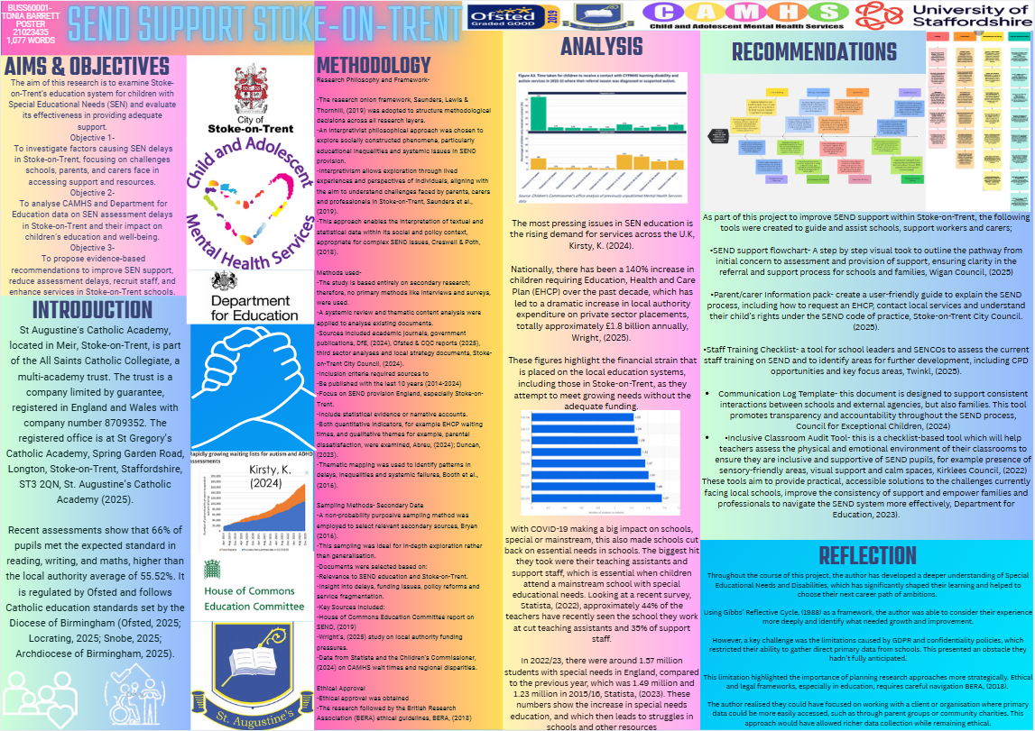
Notes:
Add fishbone to this!!!
Add more pictures and box the writing make it look pretty
1

Slide 2
References-
BERA (2018). Ethical Guidelines for Educational Research. 4th ed. London: British Educational Research Association.
Bryman, A. (2016). Social Research Methods. 5th ed. Oxford: Oxford University Press.
Children’s Commissioner for England (2024). The State of Children's Mental Health Services. London: Office of the Children’s Commissioner
Creswell, J.W. & Poth, C.N. (2018). Qualitative Inquiry and Research Design: Choosing Among Five Approaches. 4th ed. London: SAGE
Department for Education (DfE) (2024). SEND Review: Right Support, Right Place, Right Time. London DfE.
Duncan, H. (2023). Listening to Voices: Parental Experiences in the SEND System. British Journal of Special Education, 50(1), pp.12-24.
House of Commons Education Committee (2019). Special Educational Needs and Disabilities: First Report of Session 2019. London: The Stationery Office.
Ofsted & Care Quality Commission (2025). Joint Area SEND Inspection Framework. London: Ofsted. Saunders, M., Lewis, P. & Thornhill, A. (2019). Research Methods for Business Students. 8th ed. Harlow: Pearson Education.
Stoke-on-Trent City Council (2024). SEND Strategy 2023–2026. Stoke-on-Trent: Stoke City Council.
Wright, E. (2025). Local Authority SEND Funding and EHCP Demand Pressures. Journal of Education Policy, 40(2), pp.134–148.
Stoke-on-Trent City Council. (n.d.). Parent/carer requests for an education, health and care needs assessment (EHCNA). Retrieved April 15, 2025.
https://localoffer.stoke.gov.uk/send-ehc-needs-assessment-1/parentcarer-requests-education-health-care-needs-assessment-ehcna
Abreu, L. (2024). Understanding EHCP Delays in England: Regional Trends and Impacts. London: Policy Press
Booth, A., Papaioannou, D. & Sutton, A. (2016). Systematic Approaches to a Successful Literature Review. 2nd ed. London: SAGE
St. Augustine’s Catholic Academy (2025) 'Academy Committee'. Available at: https://www.staugustinescatholicacademy.org/key-information/governance/academy-committee (Accessed: 22 April 2025).
Gibbs, G., 1988. Learning by Doing: A Guide to Teaching and Learning Methods. Oxford: Oxford Polytechnic. [ Accessed 30th April]
BERA (British Educational Research Association), 2018. Ethical Guidelines for Educational Research. [online] Available at: https://www.bera.ac.uk/publication/ethical-guidelines-for-educational-research-2018 [Accessed 23rd April 2025]
Kirsty, K. (2024) 'Rapidly growing waiting lists for autism and ADHD assessments', Care Talk Business, 5 April. Available at: https://caretalk-business.co.uk/2024/04/05/rapidly-growing-waiting-lists-for-autism-and-adhd-assessments/ (Accessed: 7 April 2-25).
Wigan Council. (2025). Education, Health and Care Pathway. Retrieved April 15, 2025, from https://www.wigan.gov.uk/Business/Professionals/SEND/Education-health-and-care-plans.aspx
Stoke-on-Trent City Council. (n.d.). Parent/carer requests for an education, health and care needs assessment (EHCNA). Retrieved April 15, 2025, from https://localoffer.stoke.gov.uk/send-ehc-needs-assessment-1/parentcarer-requests-education-health-care-needs-assessment-ehcna
Abreu, L. (2024). Understanding EHCP Delays in England: Regional Trends and Impacts. London: Policy Press.
Booth, A., Papaioannou, D. & Sutton, A. (2016). Systematic Approaches to a Successful Literature Review. 2nd ed. London: SAGE
Twinkl. (2025). Special Educational Needs (SEN) SENCO Staff Training. Retrieved April 15, 2025, from https://www.twinkl.com/resources/support-send-inclusion-teaching-resources/senco-support-send-inclusion-teaching-resources/specialeducationalneeds-sen-senco-staff-training​
Locrating Ltd. (2025).
Locrating: School and Local Area Information. Retrieved April 17, 2025, from https://www.locrating.com/
Snobe. (2025). Find Best School for Your Child. Retrieved April 17, 2025, from https://snobe.co.uk
Archdiocese of Birmingham. (2025). Archdiocese of Birmingham. Retrieved April 17, 2025, from https://www.birminghamdiocese.org.uk
Saunders, M., Lewis, P. and Thornhill, A. (2019). Research Methods for Business Students. 8th ed. Harlow: Pearson Education.
Ofsted. (2025). Improving the way Ofsted inspects education: Consultation document. Retrieved April 17, 2025, from https://www.gov.uk/government/consultations/improving-the-way-ofsted-inspects-education
House of Commons Education Committee. (2019). Special Educational Needs and Disabilities. HC 20. London: House of Commons. Retrieved April 17, 2025, from https://committees.parliament.uk/work/2311/special-educational-needs-and-disabilities-inquiry/publications/​
Council for Exceptional Children. (2024). Home-School Communication Log for Parents and Practitioners. Retrieved April 17, 2025, from https://exceptionalchildren.org/teacher-resources/other/home-school-communication-log-parents-and-practitioners
Kirklees Council. (2022). Inclusive High Quality Teaching Audit Tool. Retrieved April 17, 2025, from https://www.kirkleeslocaloffer.org.uk/sendco-professional-information-and-resources-page/inclusive-high-quality-teaching-toolkit/inclusive-high-quality-teaching-audit-tool
Department for Education. (2023). SEND and alternative provision improvement plan: Right support, right place, right time. Retrieved April 17, 2025, from https://www.gov.uk/government/publications/send-and-alternative-provision-improvement-plan

