Slide 1
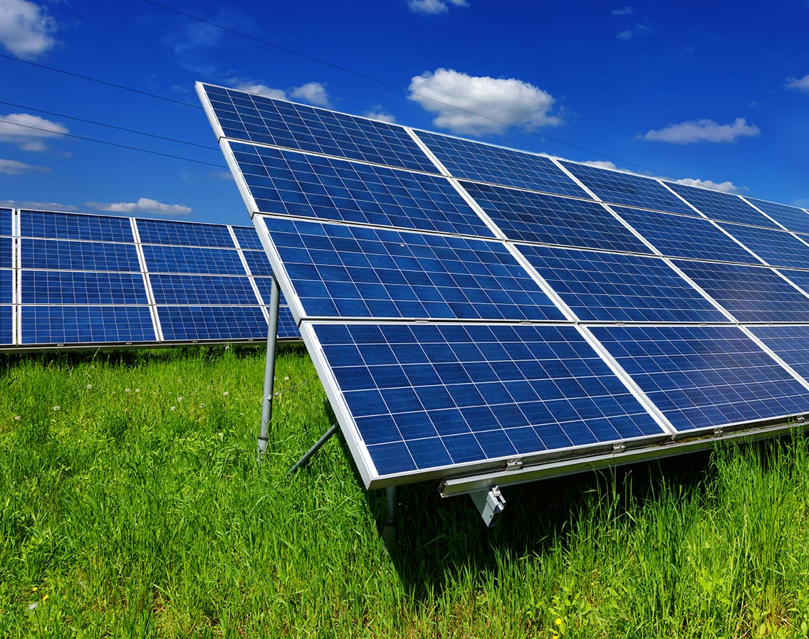
HOMES POWERED BY THE SUN A SOLAR FARM PROJECT
By
NYAKEH KAMARA: 24010205
SUPERVISOR: MOHAMMAD MOGHIMI ARDEKANI

Slide 2
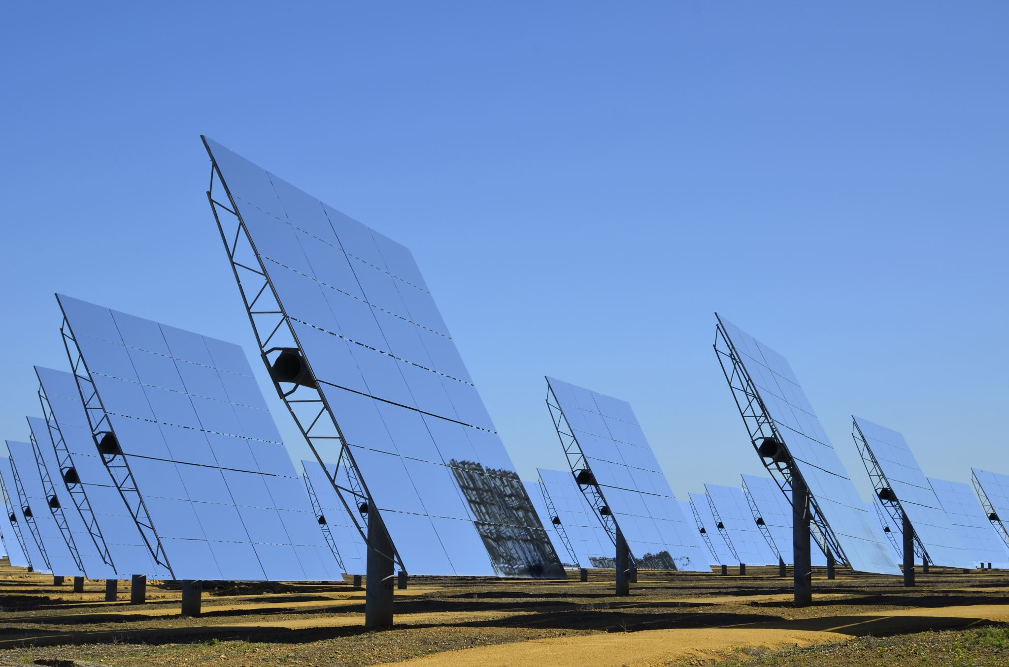
INTRODUCTION
This presentation will hopefully give a more in-depth and concise look into why solar farm projects are so useful by expanding upon:
-What a solar farm is
-How to make one
- The contribution solar farms have in relation to energy/fossil fuels, as well as sustainability.
-The recommendations and limitations of a solar farm project

Slide 3
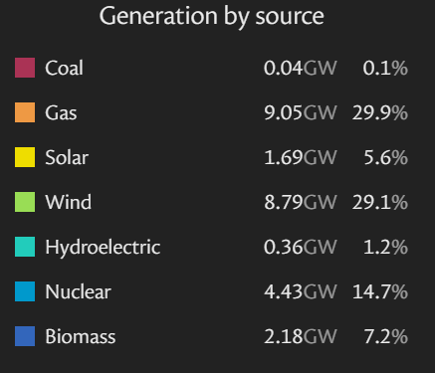
Background Information
As stated by Repsol (ND) a solar farm refers to a piece of land solely dedicated to the installation of solar panels/photovoltaic systems with the purpose of capturing solar radiation and converting it into renewable electrical energy. With it being renewable it emphasises the conversion from fossil fuels for sustainable options.
Currently within the UK, the biggest solar farm is Shotwick Solar Park, as stated by BritishRenewables (ND). With its main usage being generating electricity for a paper manufacturing plant and the excess runoff energy being sold back to the national grid biggest solar farm is Shotwick Solar Park, as stated by BritishRenewables (ND).
Meaning although it is our biggest solar farm available, it is not our primary source for renewable solar energy.
And with the national grid stating that the UK’s most utilised source of renewable energy is wind energy, clearly there is an untapped market for the usage of solar energy.

Slide 4
Main Points
According to Sunsave (2025) there are roughly 1,336 operational solar farms within the UK, with 142 under construction, 1,957 awaiting construction and another 684 submitted applications for new solar projects. This as a whole just signifies the emergence of solar farms as a sustainable energy project.
With that being said, the average costs of a solar farm- especially a small-scale farm generating 8548.5kWh annually (roughly 40 panels) would be that of £16,000 to £30,000
OpenAI (2023) states that the building of a solar farm should be split between 3 stages: Pre-development, Construction and Operation; detailing from initial idea phase to active operation
However, within this project, a model of potential values and results were simulated in order to showcase what a small-scale solar farm could generate.

Slide 5
Methods
Using PVsyst software to model specific countries weather data, simulations were formed.
For the simulation of the solar farm, rather than just making a simulation for England to include the rest of the UK and a few other proposed locations to compare results and illustrate the relation between energy generated and location.
Within this project the sample data simulated were: England, Northern Ireland, Scotland, Wales, New Zealand, South Africa and Chile

Slide 6
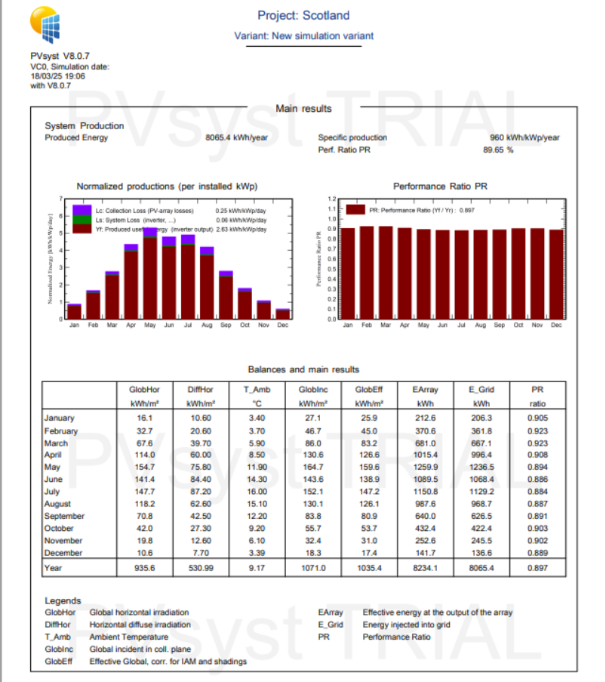
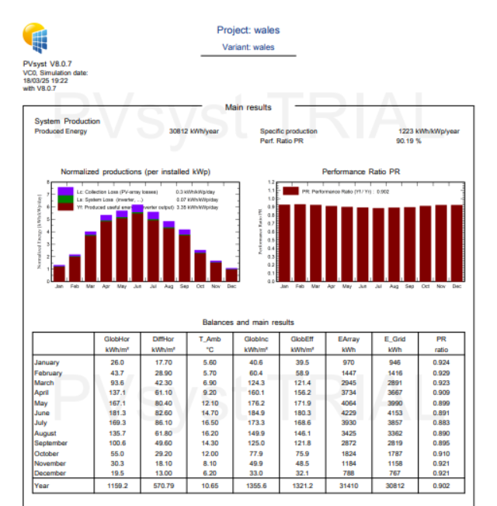
Simulations Results

Slide 7
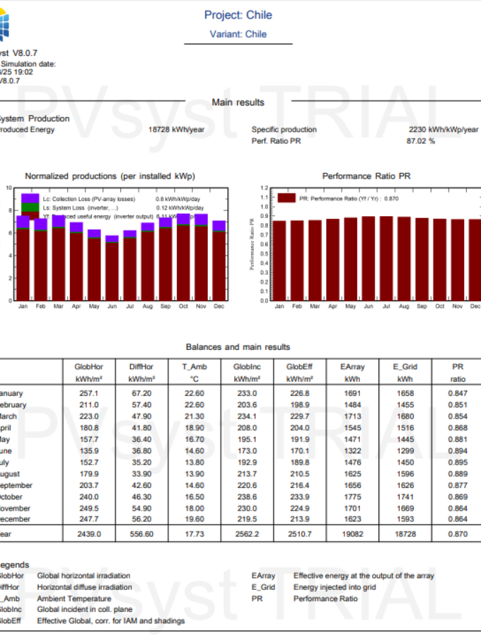
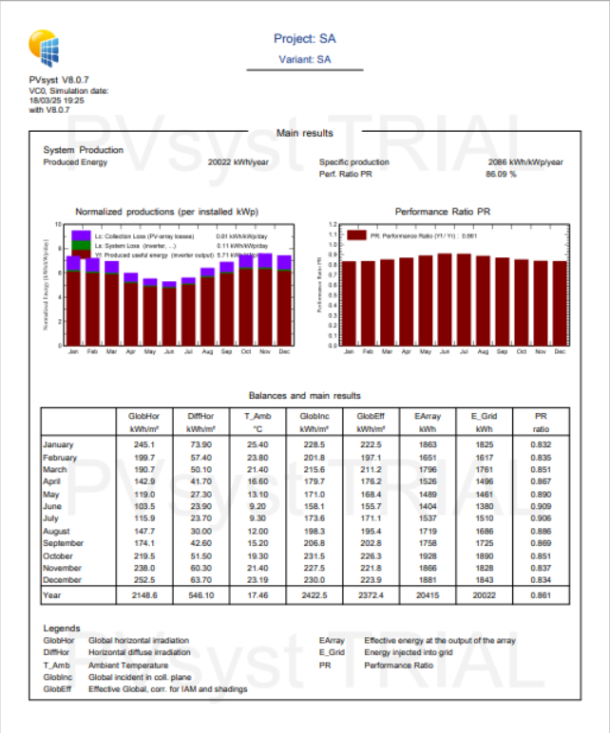
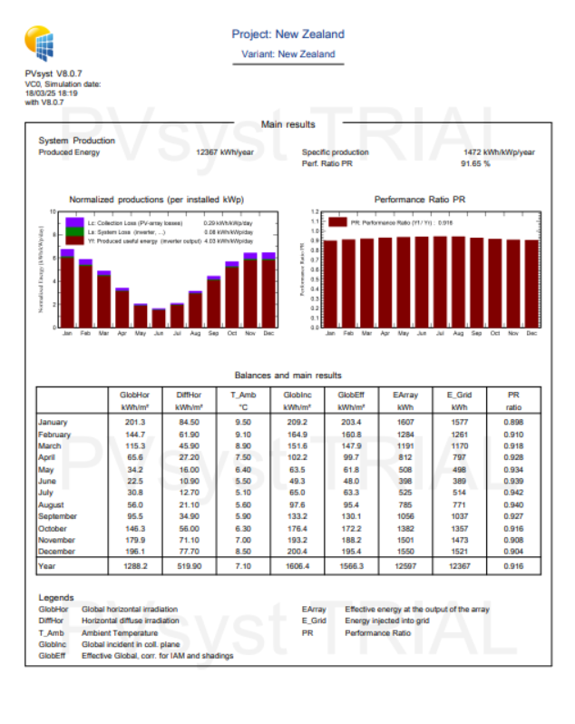
Simulations Results cont.

Slide 8
Results
Country | Energy Produced Annually
England | 8548.5 kWh
Scotland | 8065.4 kWh
Wales | 30612 kWh
Northern Ireland | 8145.2 kWh
South Africa | 20022 kWh
Chile | 18728 kWh
New Zealand | 12367 kWh
From the simulations we can see that in terms of energy output there is a direct correlation with location. RenewableDevelopmentWales (ND) makes mention that the South of Wales similar to that of the south coast of England, receives the highest level of radiation in the UK which results in efficient and productive solar energy generation.
This can also be seen within the table as that helps illustrate the amount of energy generated within a year across said countries:

Slide 9
Limitations
As we can see from the results of the simulations, the impact of location is one of the most significant factors that can affect a solar farm's energy generation capacity
This is only made more apparent within the Wales, New Zealand, Chile and South Africa results, as we see that areas with more solar irradiance produce more energy
Within the UK the main limitations would be that of land ownage in relation to how much would be required for exceptional energy output, as it would cost more to acquire.

Slide 10
Recommendations
Based on research, including the results generated in the simulation section, it would be most optimal to make a solar farm in either that of Wales for a UK based solar farm, Chile, New Zealand and or South Africa for an offshore solution.
With the main issues being location, the main recommendation that could be made for a solar farm project would be that of a reliable energy storage. As certain areas exhibit higher solar irradiation, clearly leading to highe energy generated, a suitable storage method would be useful, to switch that of solar renewable energy during certain months than others until a point were true sustainable energy can prevail.

Slide 11
Conclusions
In conclusion this presentation explored how one could make a small-scale solar farm that could be used as a substitution to fossil fuels in the future.
As a solar farm helps provide clean renewable energy to that of the UK’s national grid, powering homes and boosting that of sustainable energy, it can indeed be the solution needed.
Through the simulation of different countries, it was illustrated that the best locations for a solar farm would be that of Wales, New Zealand, Chile and South Africa
With that in mind the most probable thing would be to invest in a company that would either make theser contracts between countries for land ownage/rentage in order to construct a solar farm and transfer that energy back to the national grid for a grand scale approach.

Slide 12
THANK YOU FOR LISTENING
QUESTIONS?

Slide 13
References
Repsol (ND), Available at: https://www.repsol.com/en/energy-and-the-future/future-of-the-world/solar-farm/index.cshtml#:~:text=Known%20as%20a%20solar%20park,more%20environmentally%2Dfriendly%20energy%20system
Sunsave (2025), Available at: https://www.sunsave.energy/solar-panels-advice/solar-energy/largest-solar-farms-uk
RenewableDevelopmentWales (ND), Available at: http://rdwales.co.uk/why-welsh-solar.htm#:~:text=South%20west%20Wales%20is%20one,and%20productive%20solar%20energy%20generation.

