Slide 1
Johnny Trojan Horse’s Rootin’ Tootin’ Journey To The Centre Of The CPU
By Reece Dickens

Slide 2
The Problem:
A lot of people complain about games holding the players hand too much with tutorials and hand-holding.
Is there a better way to teach the player without explicitly telling them?
Improves the player experience because it holds their attention never slowing the pace but still feels fair and teaches the player knows everything they need.
The problem is finding a way to clearly covey every mechanic without dialogue and see how you can use this to prepare the player for more complex of said mechanics.

Slide 3
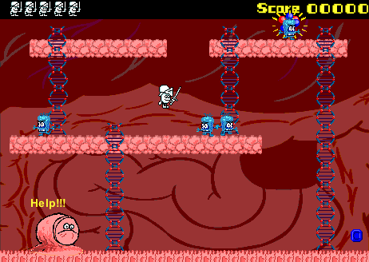
Game Overview:
A 2D action platformer where you play as a virus trying to infiltrate a computer and destroy it from within.
Inspired by Mega Man and Shovel Knight in terms of gameplay and level design.
Game atmosphere inspired by Ed, Edd n Eddy flash game “Infect-Ed”.

Slide 4
Research plan
For my game research I recorded myself playing the first level of 5 different 2D platformers that I own.
From these platformers I wrote down my feelings of how the game taught the player mechanics and how they controlled

Slide 5
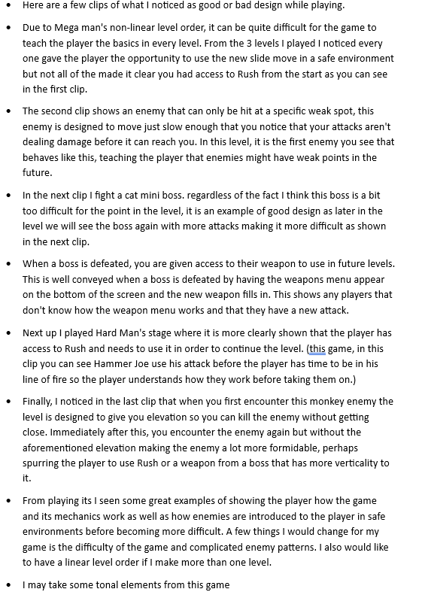
Game 1: Mega Man 3
In summary,
its hard to pick a tutorial level for mega man 3 because you can do the levels in any order
Start in a safe environment
Rush access is unclear
Enemies with weak points should be obvious
Recurring level elements with iteration are good
Weapon menu cutscene shows menu well
Needing rush to continue is good, forces player to establish a mechanic
Making enemies harder with level design is good

Slide 7
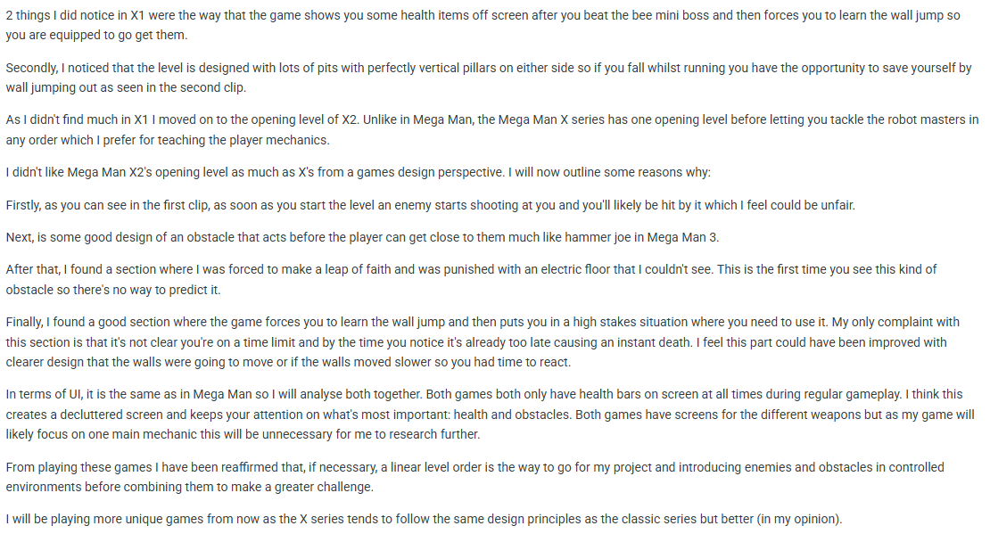
Game 2: Mega Man X and X2

Slide 9
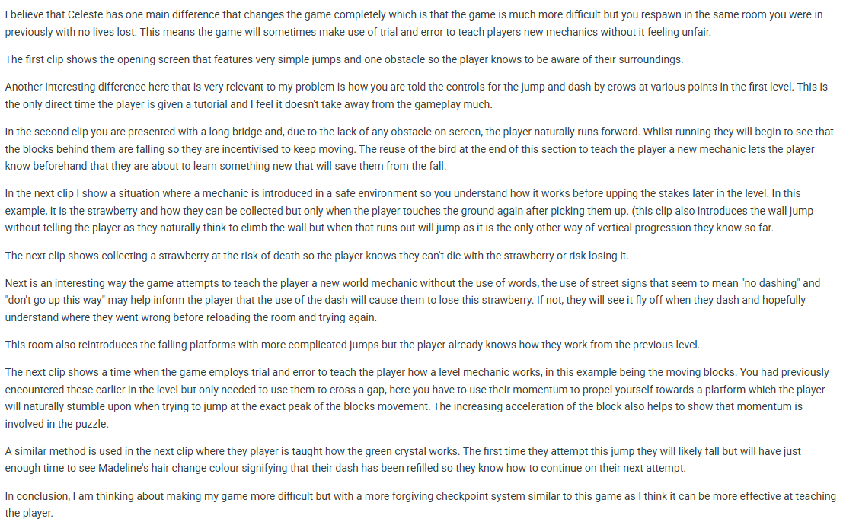
Game 3: Celeste

Slide 11
Game 4: Pizza Tower
I understand why the game is taught to you this way due to its very complicated nature but this goes against the problem I am trying to solve. The overly tutorialised opening level and very complicated control scheme makes it hard to take anything from this game that I could incorporate into my game. I want my game to be slower paced like some of the earlier games I played.

Slide 12
Game 5: Super Meat Boy

Slide 14
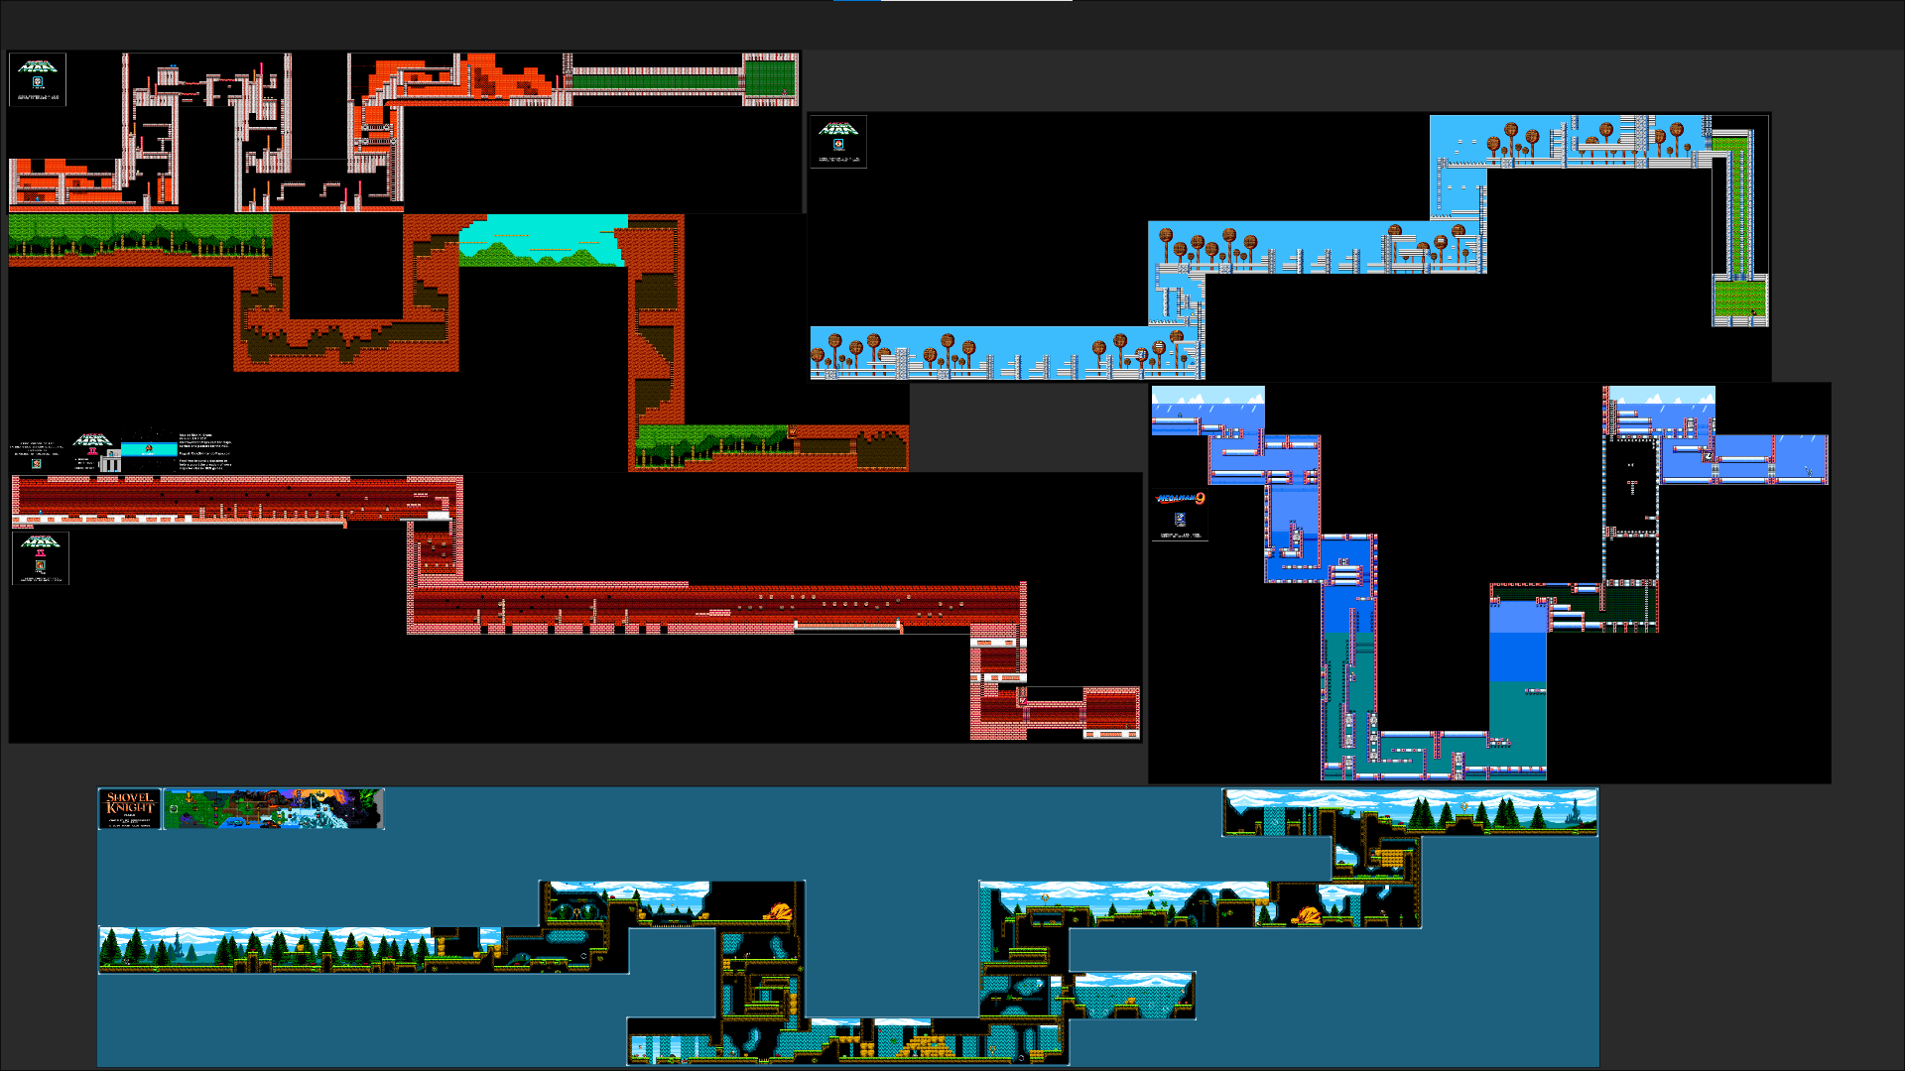
Level Design
After looking at these games I took a step back and looked at how some games maps were laid out so I could get an idea of what mine should look like.

Slide 15
Mechanics Design
After conducting my research, I began to design the core mechanics of my level.
This included the character mechanics and obstacle mechanics

Slide 16
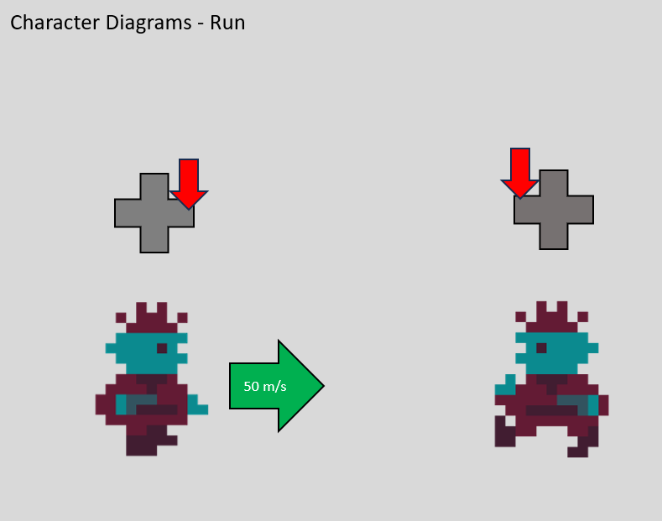
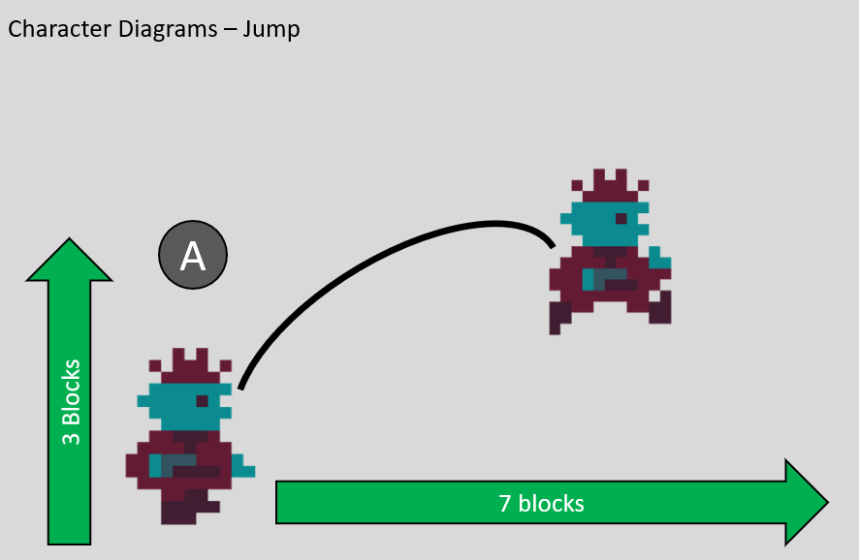
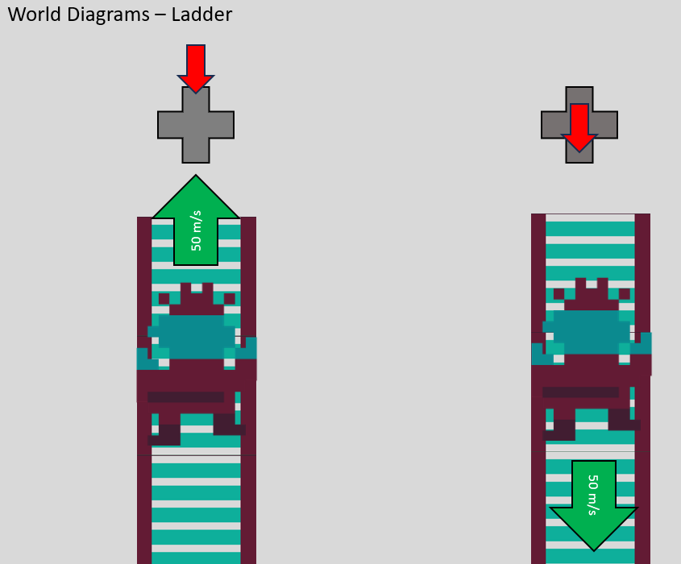
Player Movement:
Ladders are used to transition the player from one screen to the next vertically and will be covered more in the camera section.

Slide 17
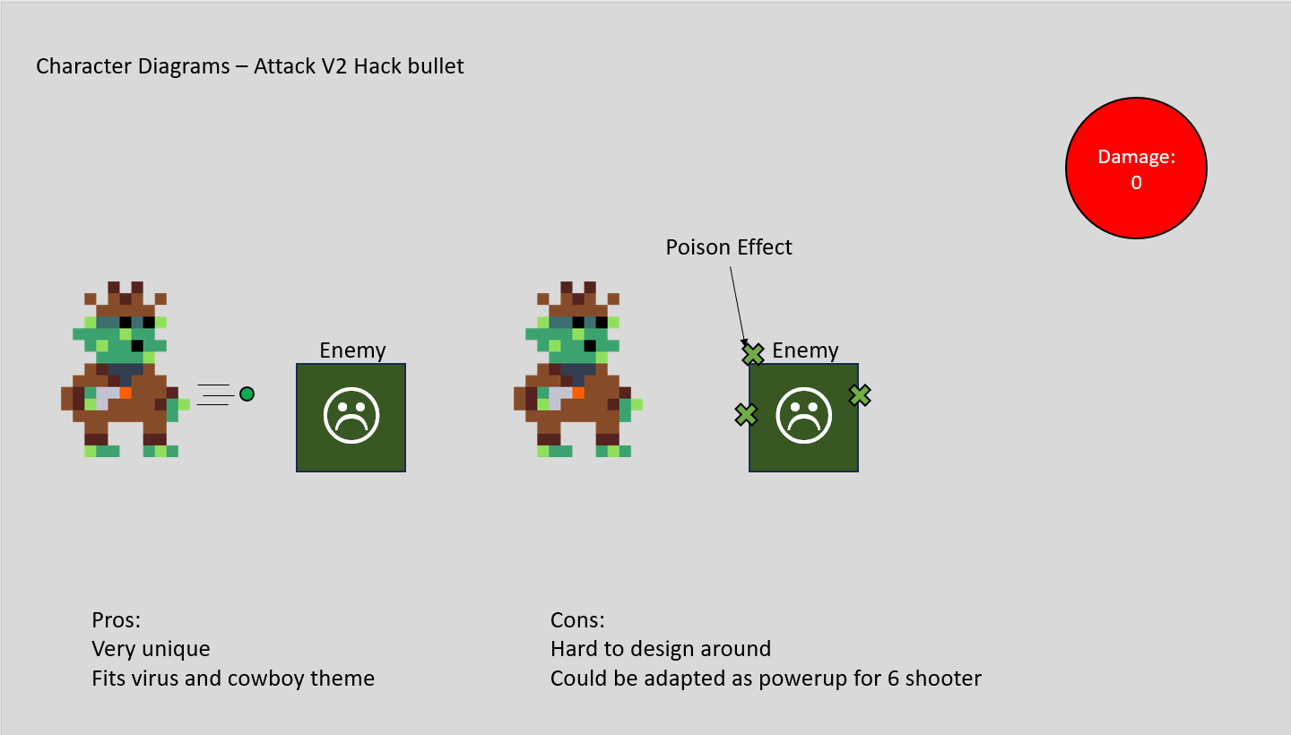
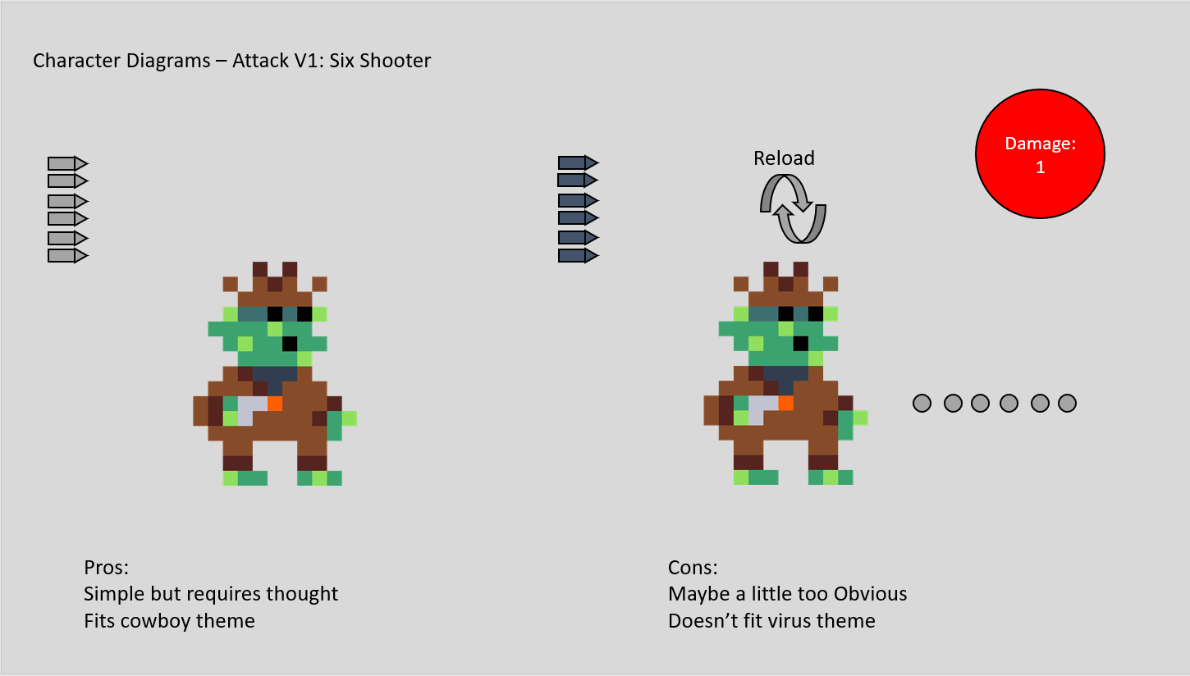
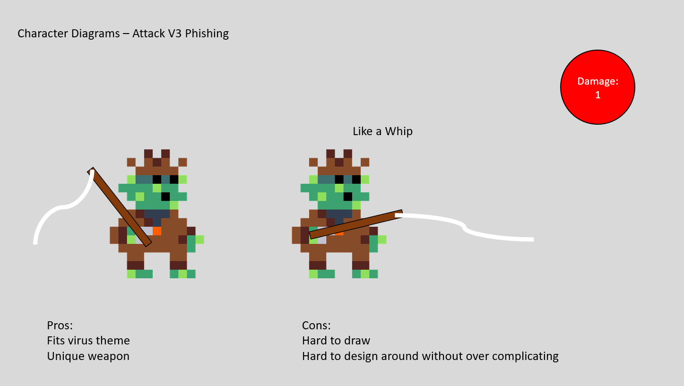
Player Attacks:
The player attack went through several design ideas:

Slide 18
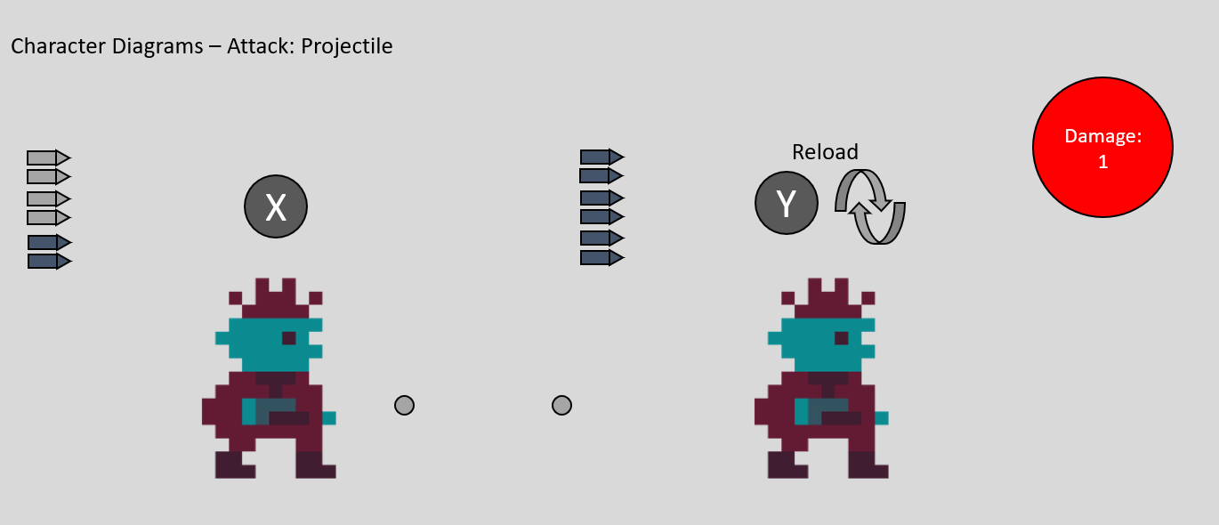
Player attacks:
In the end I decided to go with the first idea as it was the least complicated and was the most engaging.
This design would have elements altered after some testing.

Slide 19
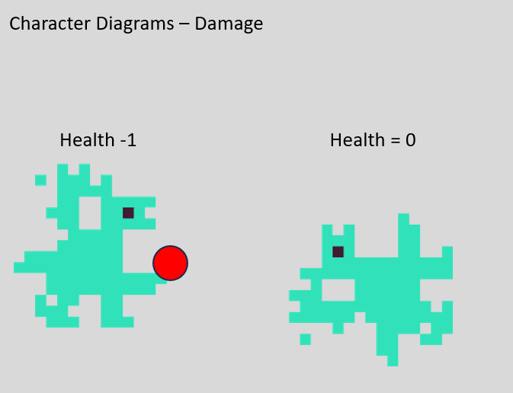
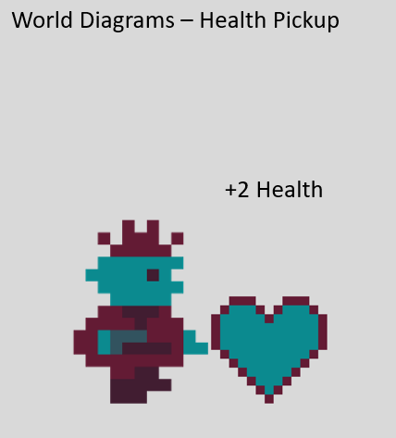
Player Damage:
The player has always had 10 health and dies when they hit 0.
All attacks do 1 damage except the buses which do 10.

Slide 20
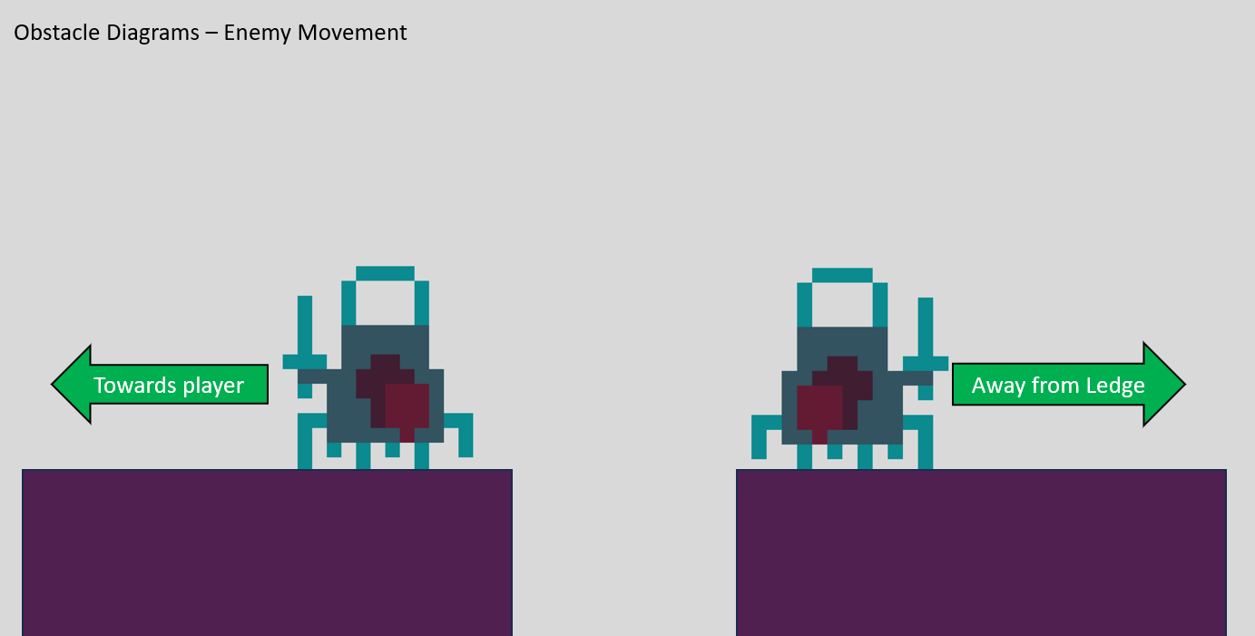
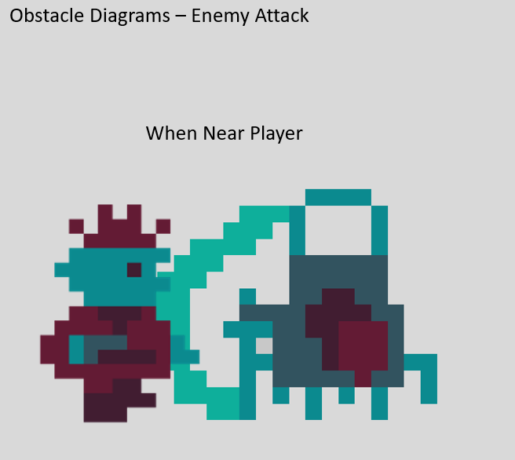
Enemy design:

Slide 21
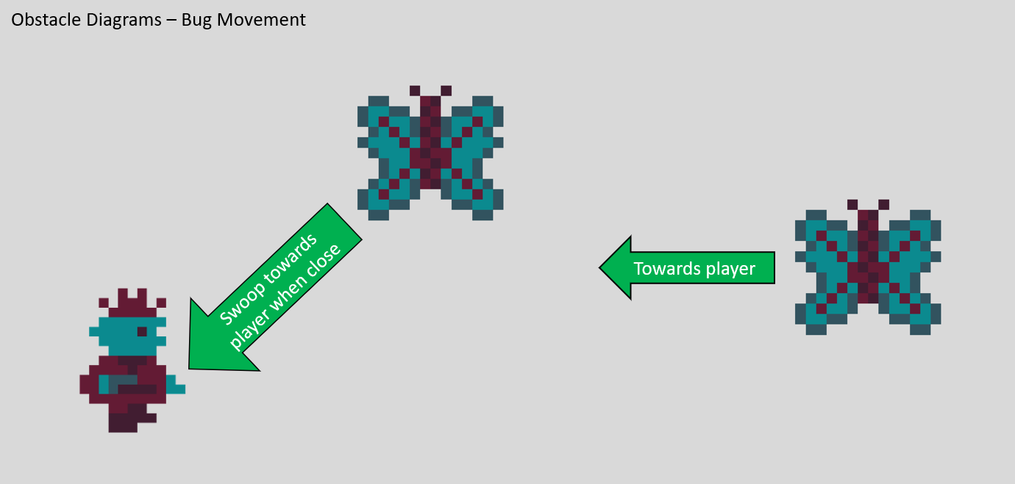
Flying Enemy Design:

Slide 22
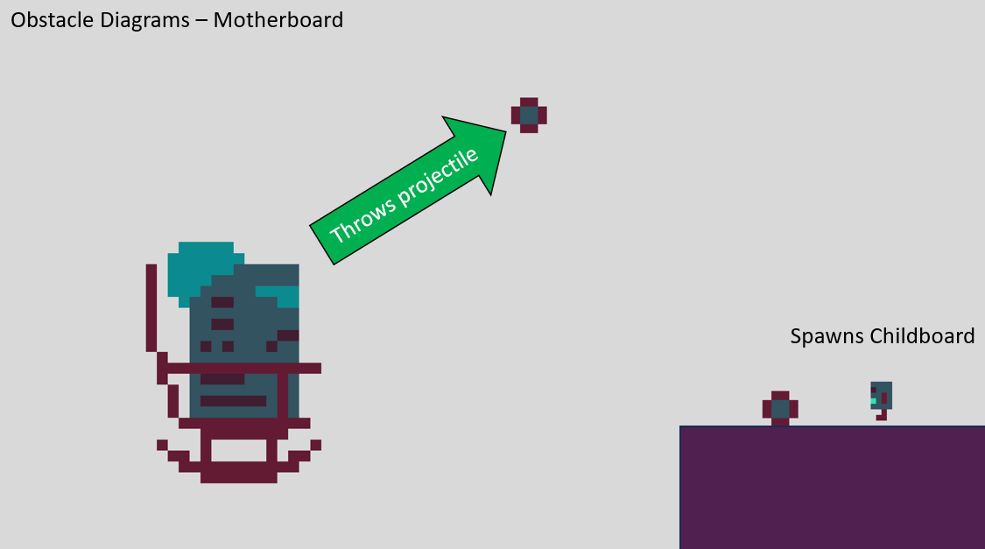
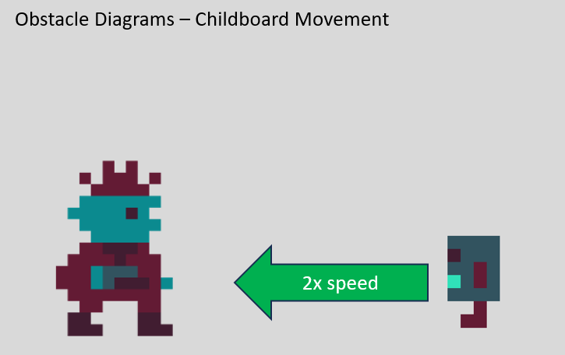
Stationary Enemy Design:

Slide 23
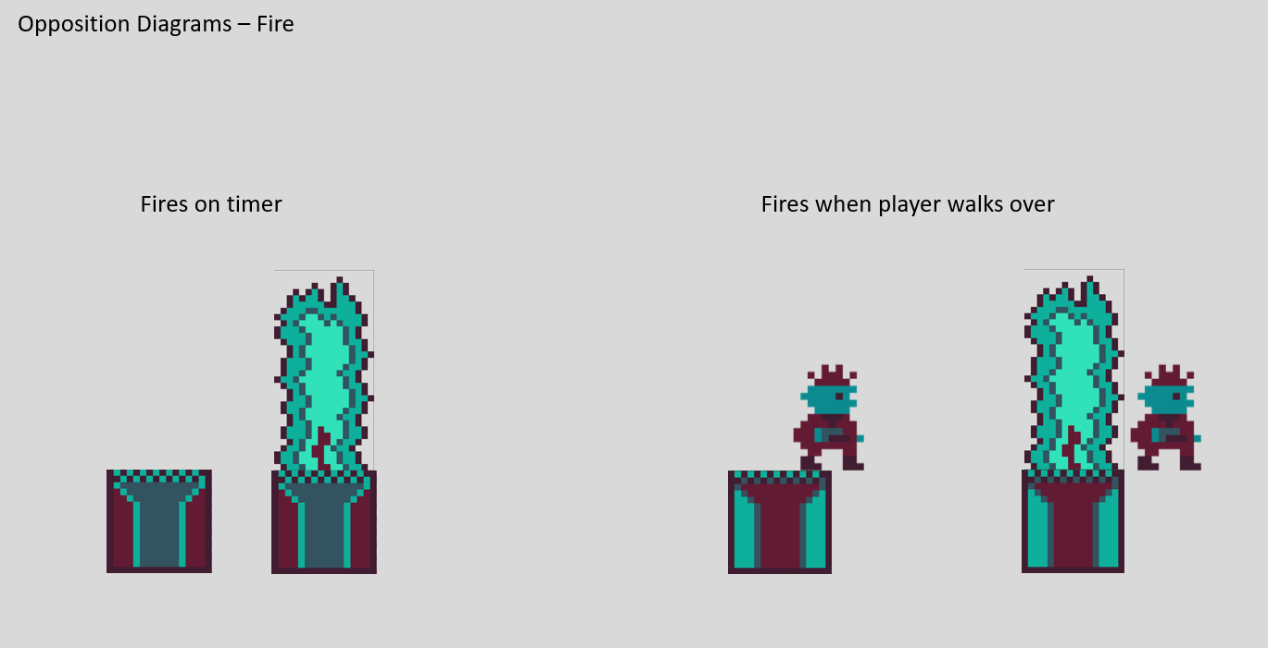
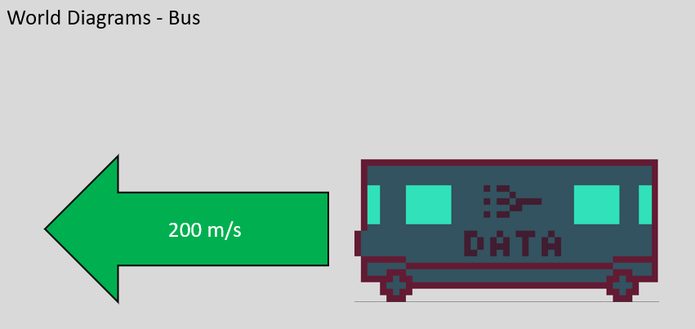
Obstacle Design:

Slide 24
Level development: Character
The first part of the game I made was a functional character.
This iteration features walking, jumping, attacking and damage.

Slide 25
Level development: Camera
Cameras only move in one direction at a time. Typically, only left and right but sometimes up and down too.
At this point, it still needed some work as transitions were a little stiff and I would eventually changes how moving vertically functioned.

Slide 26
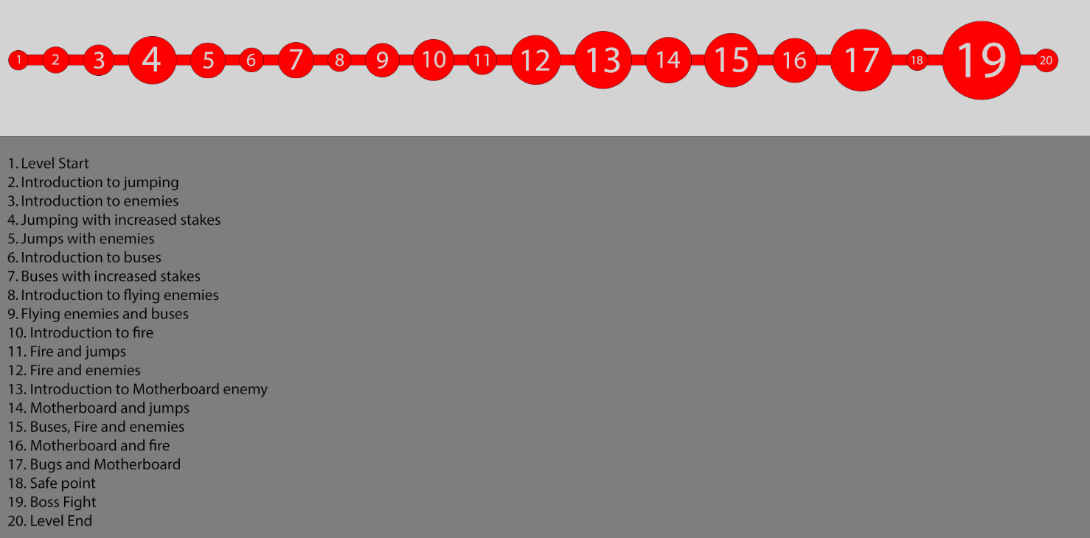
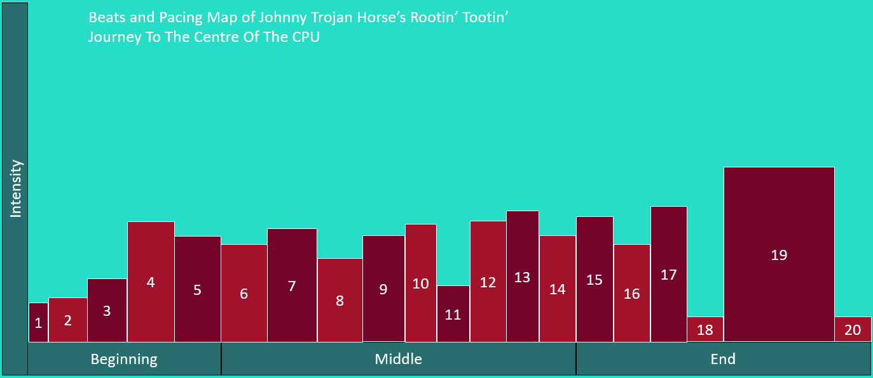
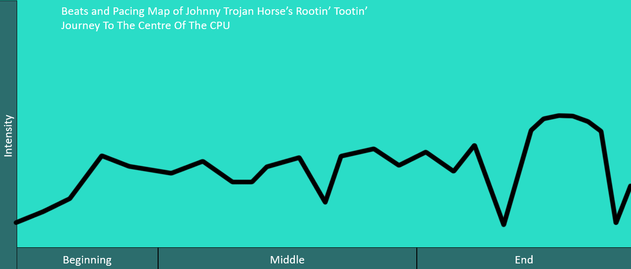
Level development: World
Now that I had all my mechanics designed and my character working, I could begin developing the level.
This begins with a bubble map and a beats and pacing diagrams:

Slide 27
Level development: Obstacles
Next up, I had to implement my designed mechanics into the game.
I had to do this so I would know how they work before designing a level around them.

Slide 28
Level development: Palette
At this point in development everything was working as intended but things still felt off.
This is when I had a conversation with my supervisor and people I knew about palette.
I made the decision to cut my palette down to just 6 colours.

Slide 29
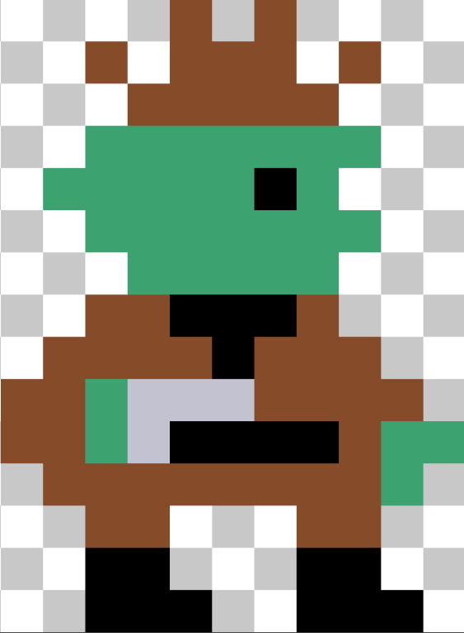
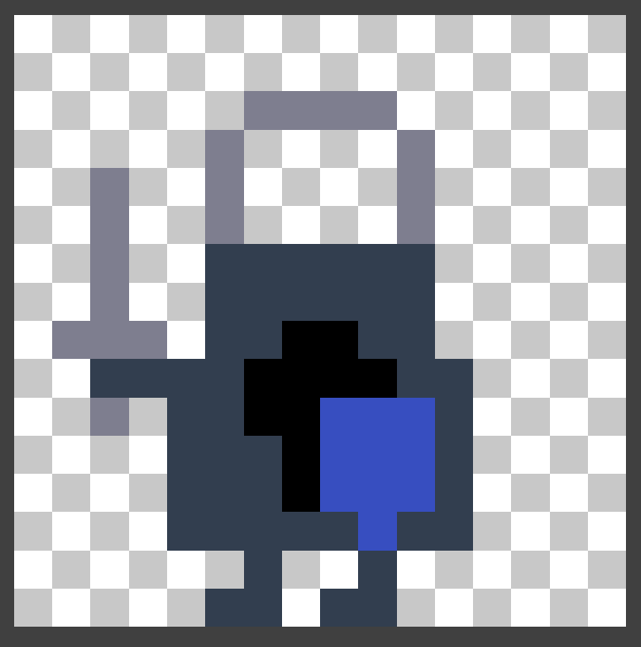
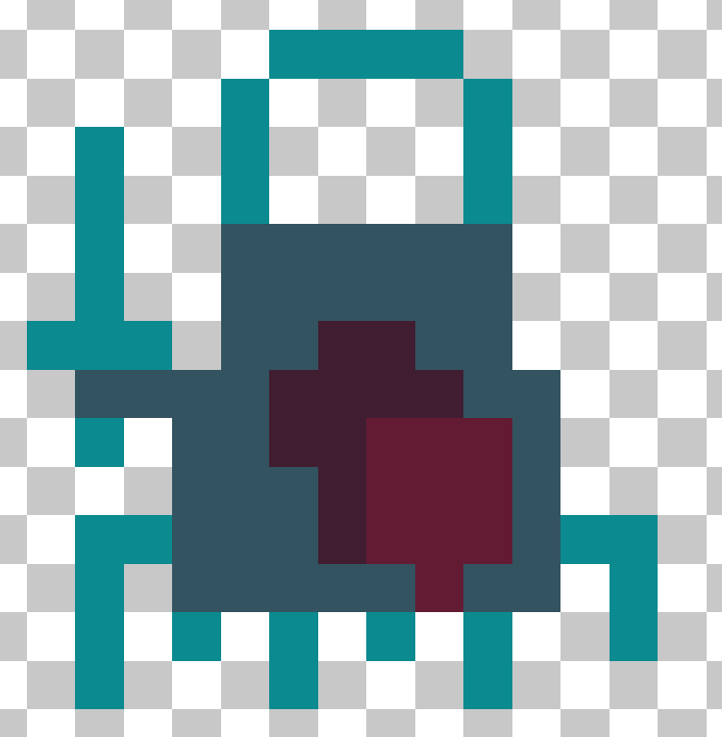
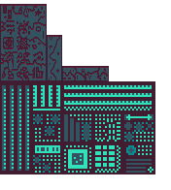
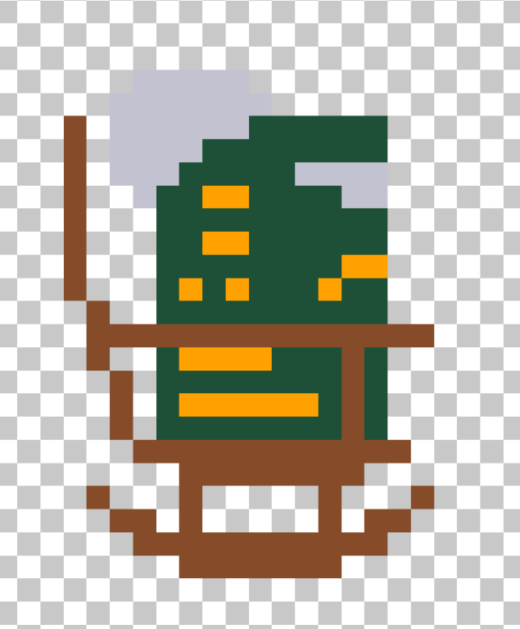
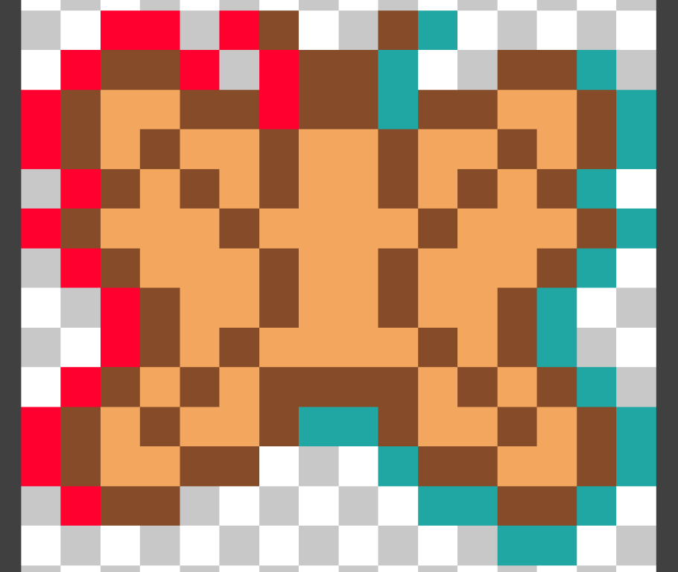
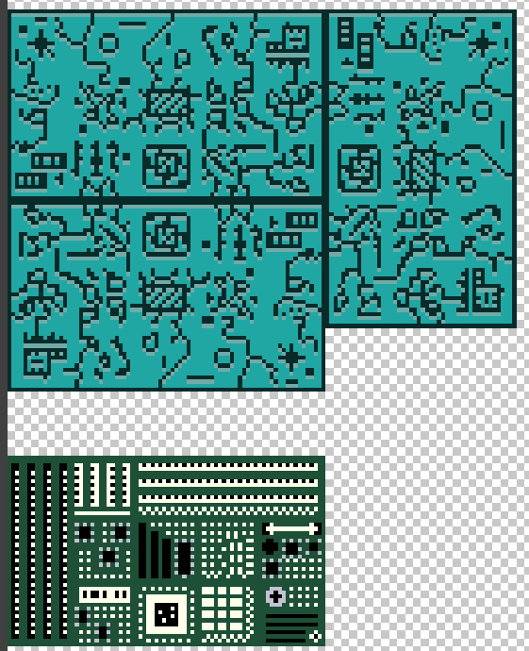
Before: After:

Slide 30
Level development: Polish
camera more zoomed in
moves vertically one screen at a time
The character moves faster and falls faster

Slide 31
Level development: Level Map
From here, I made a pixel map. This meant it was finally time to start working on the level.
Completing a first iteration of the level would allow me to begin testing and iterating on the deign

Slide 32
Level Development: Level Build
Over the next week I built my level using the assets I had finished.
This meant that certain features would not be implemented in the first iteration of the level.
Video 1 shows me playing the completed level until I hit a jump that is impossible and needs changing
Video 2 shows me flying through the rest of the level to demonstrate its completion.

Slide 33
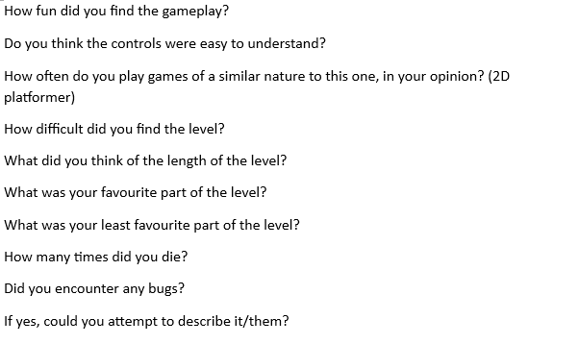
Level Development: Testing Plan 1
I have written up 10 questions that will be given to my testers to complete once they finish the level:

Slide 34
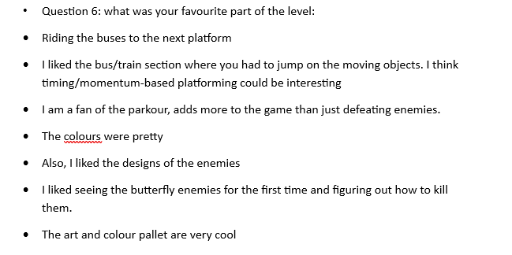
Level Development: Testing Results 1.1
I will be keeping the art design the same from here and trying not to change the buses too much or jumping mechanics.

Slide 35
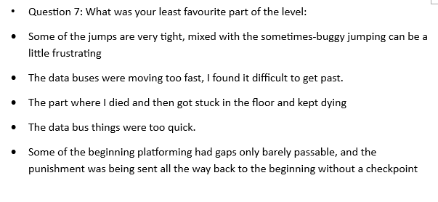
Level Development: Testing Results 1.2
I noticed that a lot of the jumps at the start required a perfect jump to cross. To fix this I reduced most of them in size by 1 tile.
The data buses moving too fast was a bug created right before I packaged the build when I was trying to stop them de-spawning on screen. It will be fixed easily.
Getting stuck in the floor was just because of an issue where one checkpoint was too low in the world. Luckily, this was my first tester and I fixed it before anyone else had a chance to play.

Slide 36
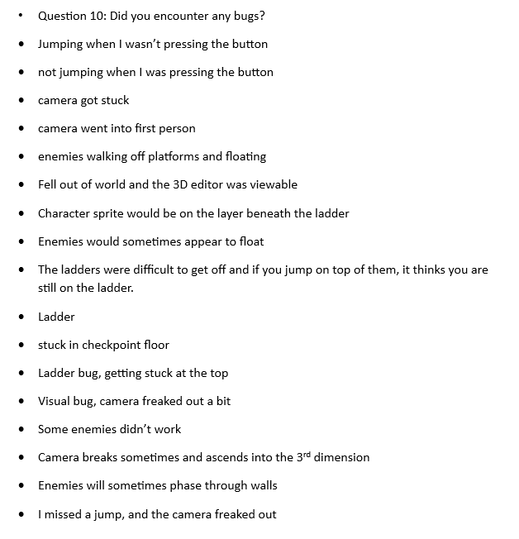
Level Development: Testing Results 1.3
Jumping bug fixed
Camera issue fixed
Enemies walking where they’re not supposed to fixed
Appearing under ladder too hard to replicate to fix
Fixed issue with ladder moving left and right and falling half way up
Enemies coded

Slide 37
Level development: Changes
As well as the changes on the previous page I also changed the level design of a few areas to make it clearer where to go.
The game now also has full controller support

Slide 38
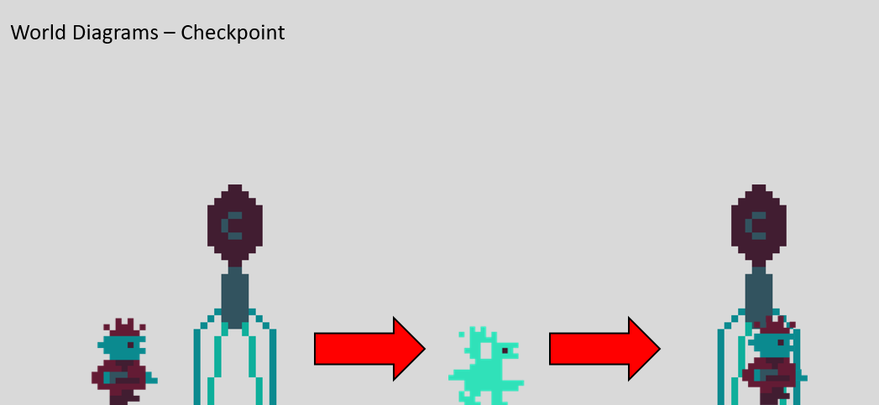
Level development: Checkpoints
Checkpoints were present in the first iteration of the level but they only reset the player location.
They now reset the enemy spawns too.

Slide 39
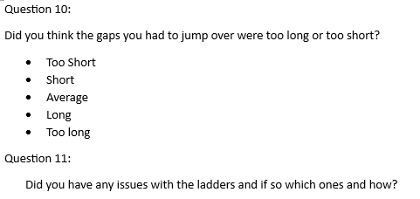
Level development: Testing plan 2
2 new questions were added this time in response to issues from last time all other questions stayed the same:

Slide 40
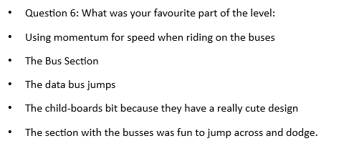
Level development: Testing Results 2.1
It seems the changes to the buses from last iteration made it one of the most popular mechanics and the new enemy type is also popular.

Slide 41
Level development: Testing Results 2.2
Fixed Fire issue
Ending will come later

Slide 42
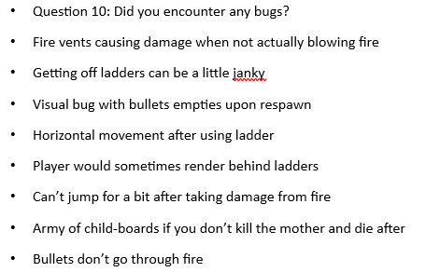
Level development: Testing Results 2.3
Already covered fire issues
Ladder visual bug fixed
Bullet visual bug fixed
Motherboard issue fixed

Slide 43
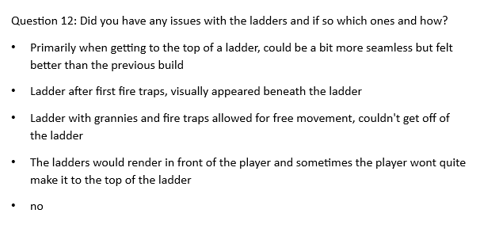
Level development: Testing Results 2.4
There is an issue where the only way off ladders is to jump but right now the only alternative is falling when you reach the top. I will try to fix this.
I will look at the specific ladder mentioned for a fix

Slide 44
Level development: Changes 2
Changed reload button on keyboard to be R instead of E
Added the boss for the level: HALT-9800.

Slide 45
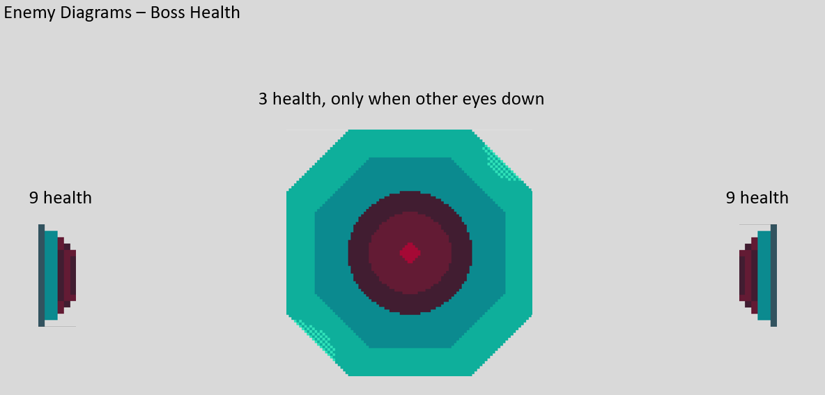
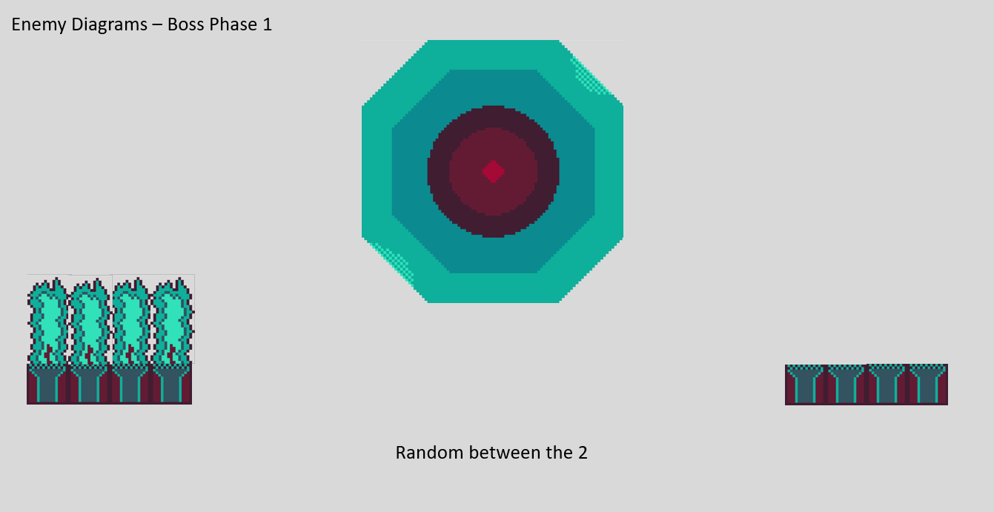
Level development: The Boss
The boss has 21 hits total that is represented by a health bar with 7 points, every 3 hits it goes down by one. The boss has a shield that covers his main eye until both smaller eyes have been destroyed.

Slide 46
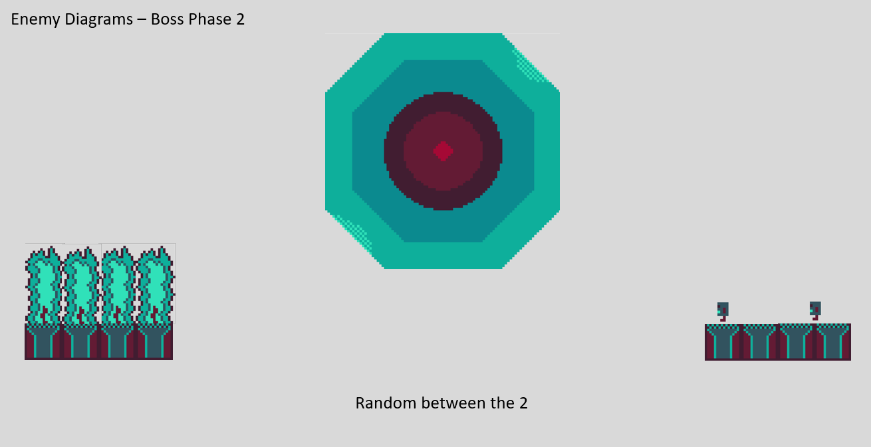
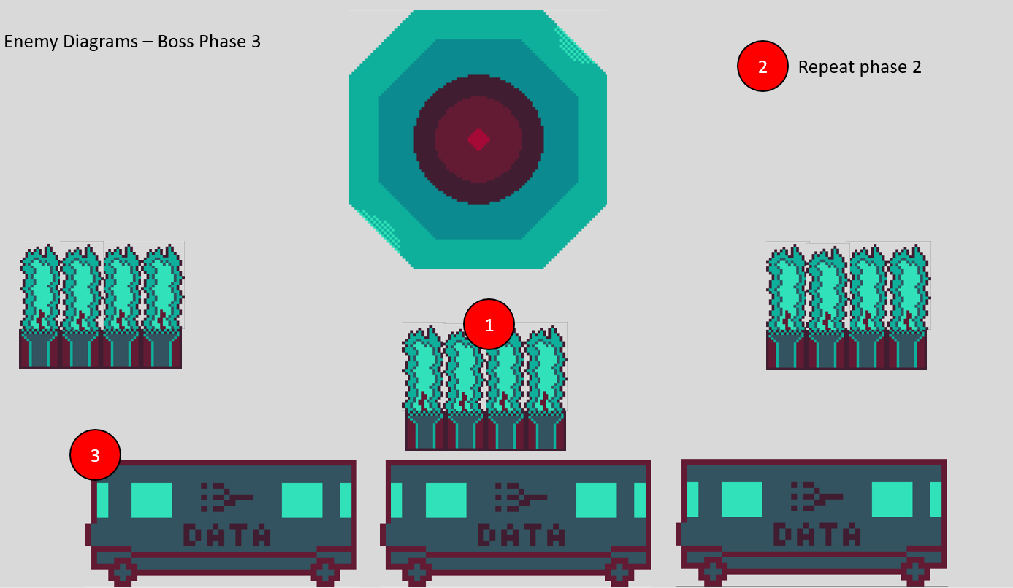
Level Development: The Boss Part 2

Slide 47
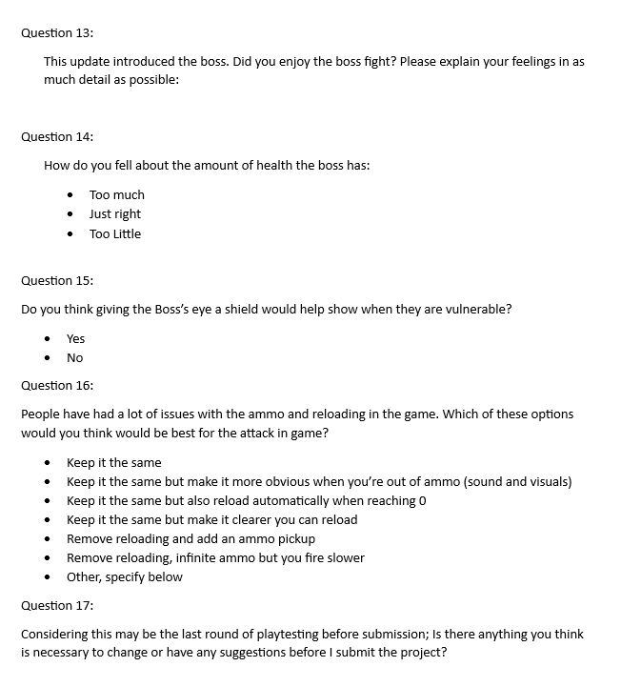
Level development: Testing Plan 3

Slide 48
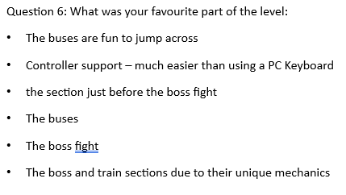
Level development: Testing Results 3.1
I’m happy to see that a lot of people liked the boss even if it needs work. The buses remain popular and controller support was a large improvement.

Slide 49
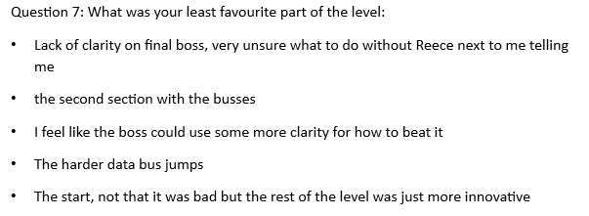
Level development: Testing Results 3.2
Slowed second buses
The boss needs work that I will cover later
The start is fine being lacklustre in comparison

Slide 50
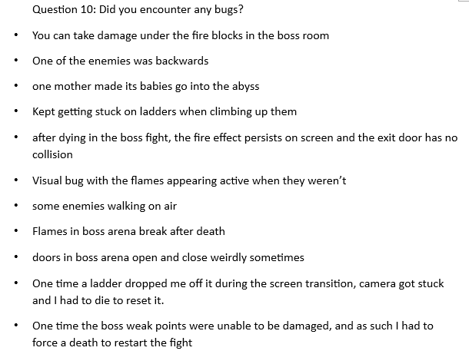
Level development: Testing Results 3.3
Reduced fire collision
Fixed backwards enemy
Fixed motherboard position
Fixed Ladders
Fixed boss on behaviour upon death
Fixed fire visual bug
Fixed enemy walking issues
Fixed boss visual bug

Slide 51
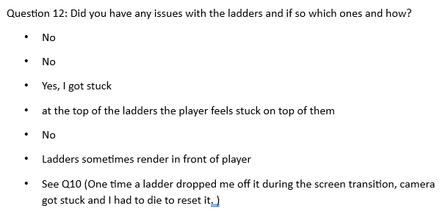
Level development: Testing Results 3.4
Really good to see more people had no issues with the ladder than last time. I will still be looking over the ladders again in an attempt to improve them.

Slide 52
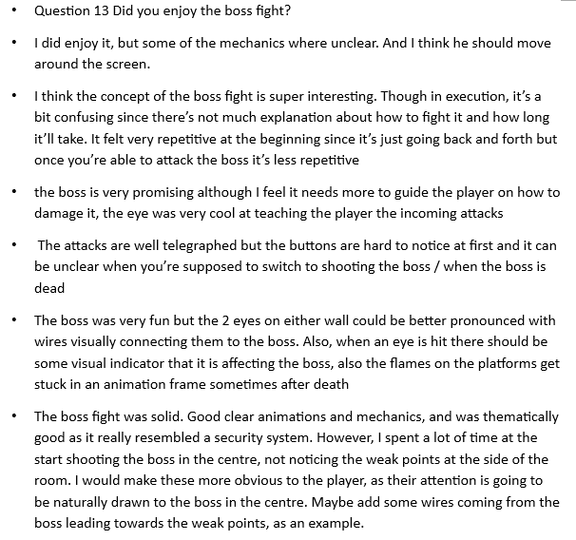
Level development: Testing Results 3.5
Boss shows weak points better
Boss will not move
Boss health bar added
Boss not dying fixed

Slide 53
Level development: Testing Results 3.6
Added most popular option
Also added second most popular option

Slide 54
Level development: Testing Results 3.7
Fixed bugs
Changed reload
Added sound effects
Increased invincibility frames
Added ending
See response to question 13

Slide 55
Level development: Changes
After this round of testing the game was basically done.
I added a start screen and an ending
Fixed any issues highlighted.
Added boss health bar
Added boss shield

Slide 56
Level development: Overall Testing results: Question 1: How fun did you find the gameplay?
This shows a consistent fun level between all 3 iterations. I believe results may have been higher in the first iteration as that was most people’s first experience with the level and they were probably getting tired of it by iteration 3. These results are satisfactory.

Slide 57
Level development: Overall Testing results: Question 2: Do you think the controls were easy to understand?
The change between the iteration shows a general increase in how easy the controls are to understand. A new player may still have some trouble though as they would playing any game for the first time.

Slide 58
Level development: Overall Testing results: Question 3: How often do you play 2D platformers
This shows the wide spread of different skill levels my testers had in each iteration.

Slide 59
Level development: Overall Testing results: Question 4: How difficult did you find this level?
From iteration 1 to iteration 3 there is clearly a consolidation of opinion towards the average difficulty which is where I wanted the level to be. I am glad the addition of the boss did not make it too hard.

Slide 60
Level development: Overall Testing results: Question 5: What did you think of the length of the level?
My testers generally agreed that the length of the level did not need changing so it remained the same throughout testing.

Slide 61
Level development: Overall Testing results: Question 8: How many times did you die?
There seems to be a decline in number of deaths as the level progressed in development. I believe this is both due to the balancing of mechanics and general improved skill level of my testers

Slide 62
Level development: Overall Testing results: Question 10: Are the jumps too long?
From iteration 2 to iteration 3 I did not change any jump lengths so maybe players got better at gaging when to jump

Slide 63
Level development: Overall Testing results: Question 14: How’s the boss’ health?
The boss is shown here to have a good amount of health and it will not be changed

Slide 64
Level development: Overall Testing results: Question 15: Shield for boss eye?
The results of this question were unanimous. I will add a boss shield to the game.

Slide 65
Level development: Sound
I added 4 sound effects into the game following testing:
A jump sound
A shoot sound
An “out of ammo” sound
And a Damage sound

Slide 66
Level development: Start and End
I added start and end screens to help with flow
This end screen purposefully breaks the palette to surprise the player

Slide 67
Video playthrough:

Slide 68
Level development: The Future
I will be presenting this project at GradEx as my main project. Before then I will be making improvements to the game that I do not have the time to do now or cannot justify taking priority over the game design. Here are the main changes I wish to make:
Add original music – I wish to compose several original music tracks to play over various parts of the game.
Original sound effects – Currently the game makes use of stock sound effects, I wish to replace these with sound effects of my own.
Better menus – I want the title screen to be easier to interact with as there is currently no controller support.
New Title Screen – As the title screen was not part of the level design the current one is temporary and I am not happy with it. I would like to design a new one before GradEx.
Fix Bugs – All the bugs I have found so far have been fixed but it is always possible that I will find more before GradEx, I plan to fix these.

Slide 69
Reflection
I believe that I have achieved my goal of making a level for a game with no written tutorial that is fun to play and easy to understand.
I was very proud of how well everything came together in the end. I gave this project everything I’ve got and I think it shows.
Every part of my game is polished and I took equal care in all areas from tech, to art and design.
I am impressed I was able to program and draw something I’m proud of by myself with only nudges in the right direction from people more experienced than me.
I think my early testing could have been improved as I wrote the questions for iteration 1 before I began development on the level making them very general and not that helpful.
I think I could have spent a little more time on research but when I had such a clear vision in my head I didn’t need much influence.
Overall, I think I’d be hard pressed to do much better than this.

