Slide 1
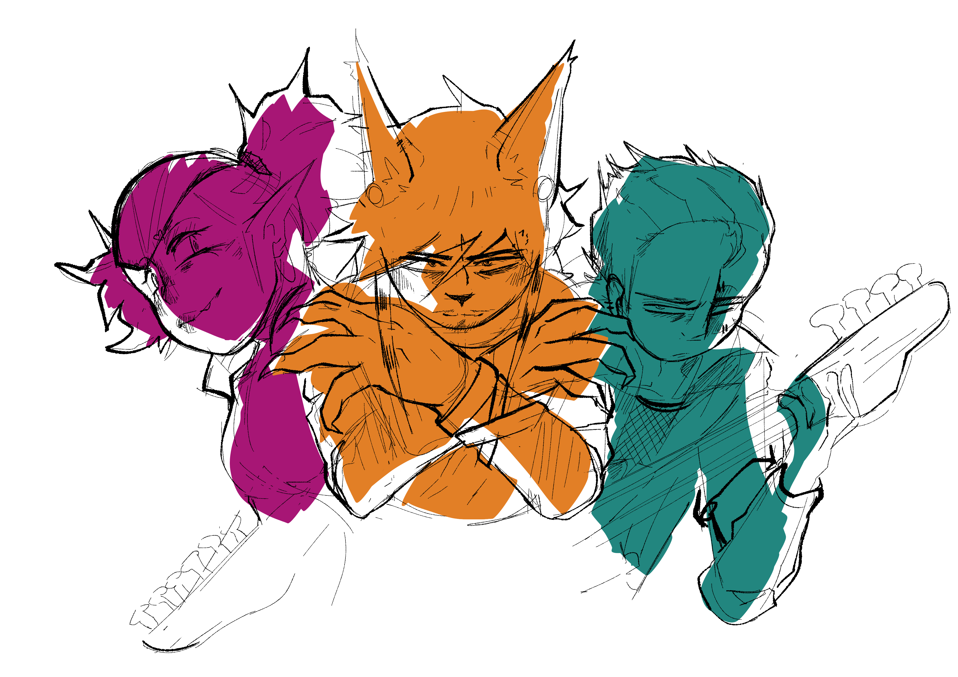
Press to continue

Slide 3
Hello! Welcome to the Mon*Starz Day 0 demo!

Slide 4
What you’re about to play is essentially a tech demo
As such, some assets may appear unfinished!

Slide 5
Please keep an open mind moving forward!
If you find any bugs, please report them using the home screen!

Slide 6
I hope you enjoy playing!

Slide 7
Prologue

Slide 8
Dying came a bit quicker than I thought it would.

Slide 9
I thought maybe after all of this I could finally.. You know.

Slide 10
..Rest In Peace.

Slide 11
But...

Slide 12
Seems like even the after life likes to taunt me.

Slide 13
Waking up.. Looking down at myself..

Slide 14
..Not seeing myself.

Slide 15
That was the strangest part.

Slide 16
I thought the afterlife would be like those stories you hear.

Slide 17
You know.. Either you’re greeted by angels..

Slide 18
Or thrown southern to be taunted for all eternity..

Slide 19
But no.

Slide 20
Even ghosts have to live a normal life once more.

Slide 21
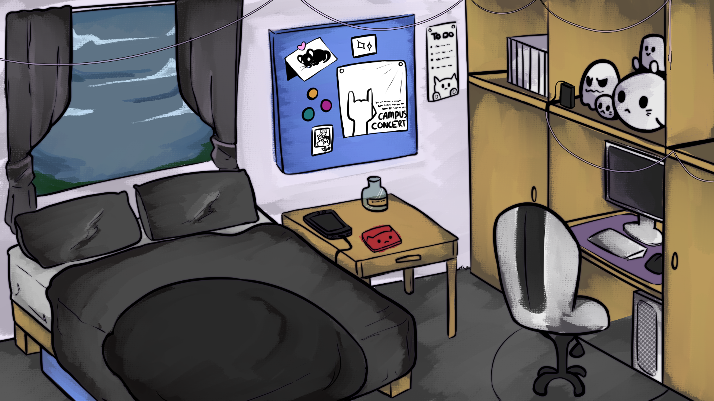

Slide 22
BEEP BEEP. BEEP BEEP.

Slide 23
Ghosts still have to wake up to blaring alarms too..

Slide 24
The alarm on your phone is silenced, silence lulling
back into the room.

Slide 25
The weather never seems to change much here..
The wind is always blowing loudly past the window.

Slide 26
The curtains are flung open, revealing the car-park
of the building you found yourself in since your
sudden move.

Slide 27
It’s been weird to adjust.
But considering you’re dead, it’s made it hard to care.

Slide 28
You’ve made a couple friends around town though.
One being.. Well.

Slide 29
A little eccentric.

Slide 30
Hey hey hey! Gooood morning! :D

Slide 31
Hey hey hey! Gooood morning! :D
Okay, listen, I found a cute café! Wanna
come with?

Slide 32
Hey hey hey! Gooood morning! :D
Okay, listen, I found a cute café! Wanna
come with?
I’ll pick you up! I’ll even pay if you want!

Slide 33
Hey hey hey! Gooood morning! :D
Okay, listen, I found a cute café! Wanna
come with?
I’ll pick you up! I’ll even pay if you want!
Please?

Slide 34
Okay, listen, I found a cute café! Wanna
come with?
I’ll pick you up! I’ll even pay if you want!
Please?
Please please please !!

Slide 35
I’ll pick you up! I’ll even pay if you want!
Please?
Please please please !!
Geez… Seems like they have unlimited texts in the afterlife too…
Pretty please?

Slide 36
Okay, listen, I found a cute café! Wanna
come with?
I just woke up…
I’ll pick you up! I’ll even pay if you want!
Who is this…?
Please?
[Ignore the messages]
Please please please !!

Slide 37
I’ll pick you up! I’ll even pay if you want!
Please?
Please please please !!
Give me an hour. I just woke up

Slide 38
Please please please !!
Give me an hour. I just woke up
Yay! Here’s the address! See you soon!

Slide 39
Give me an hour. I just woke up
Yay! Here’s the address! See you soon!
[Meet Visp]

Slide 40
I’ll pick you up! I’ll even pay if you want!
Please?
Please please please !!
…who are you again?

Slide 41
Please please please !!
…who are you again?
What?! It’s Visp! The vampire that helped
you move in a few weeks ago!

Slide 42
…who are you again?
What?! It’s Visp! The vampire that helped
you move in a few weeks ago!
I can’t believe you forgot me already :’(

Slide 43
I can’t believe you forgot me already :’(
Well, it’s early, we can blame that! Meet
in an hour? It’s urgent!
[Meet Visp]

Slide 45
…the messages seem to have stopped…

Slide 46
Maybe you can get a little more shuteye-

Slide 47
CRASH !!

Slide 48
..maybe not.

Slide 49
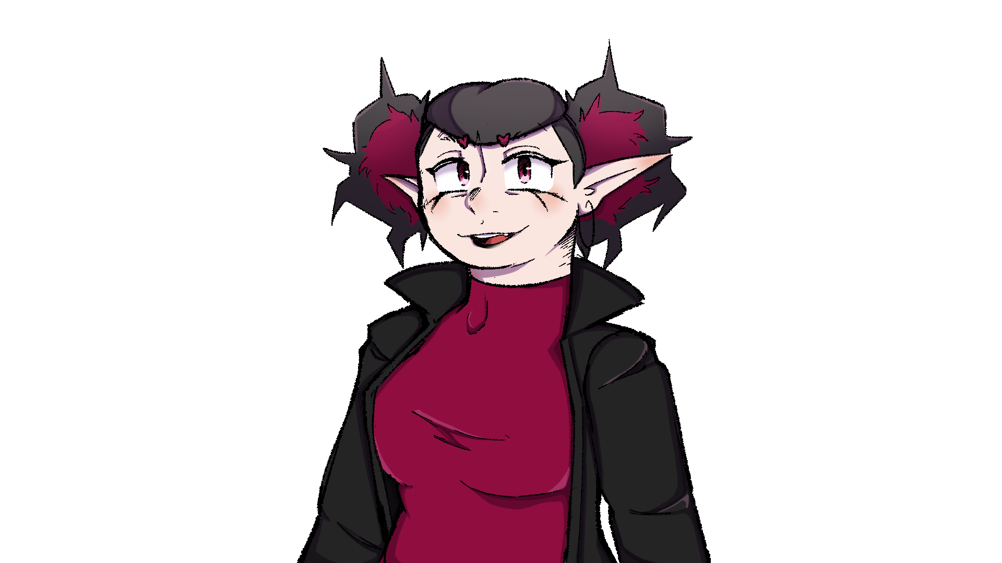
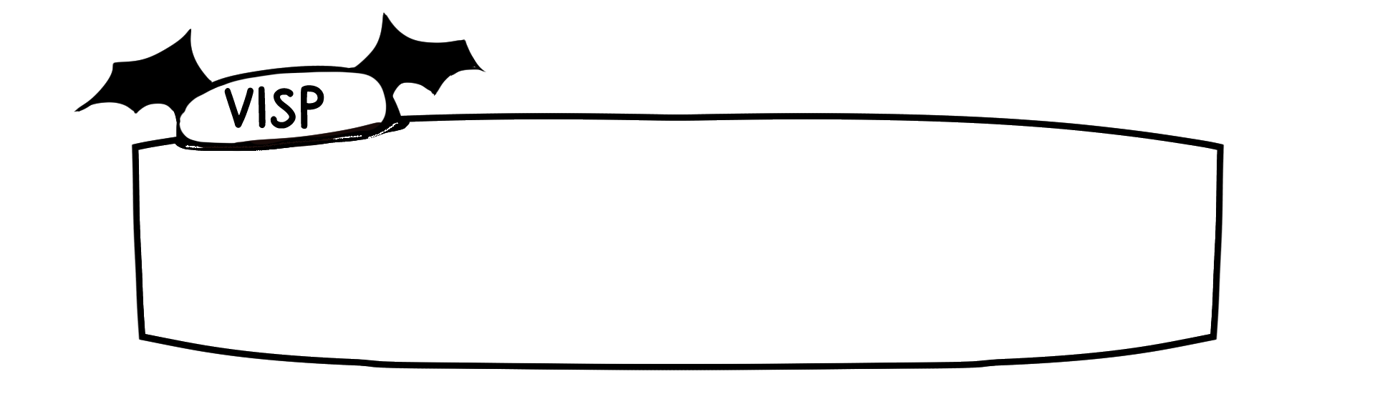
Heeeey sleepyhead!!

Slide 50
What? Don’t be shocked! You left your tracking on
on your Hex Messenger!

Slide 51
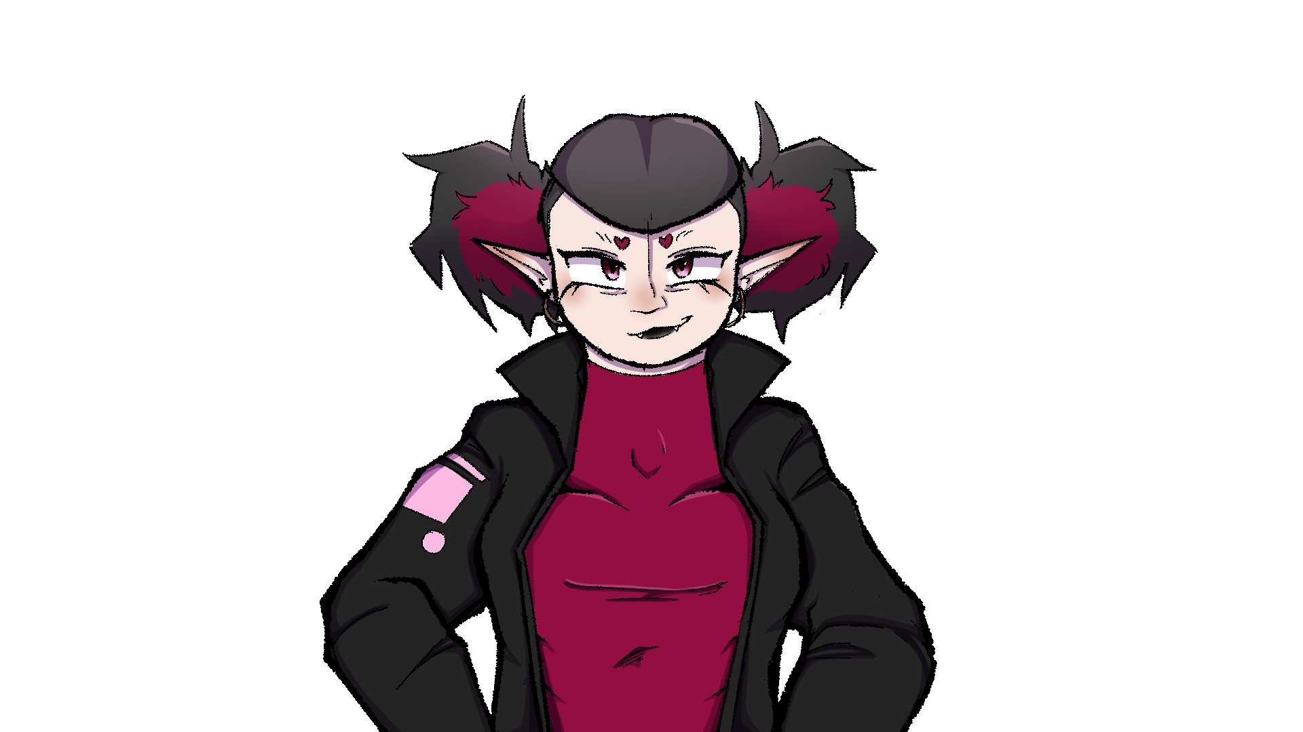
I might not be tech savvy, but I know how to track
people!

Slide 52
I’ve got plenty of experience!

Slide 53
..I thought vampires needed permission to enter
someone’s home..

Slide 54
Oh-! I have a trick for that too!

Slide 55
Turns out if I move fast enough, it doesn’t
really affect me!

Slide 56
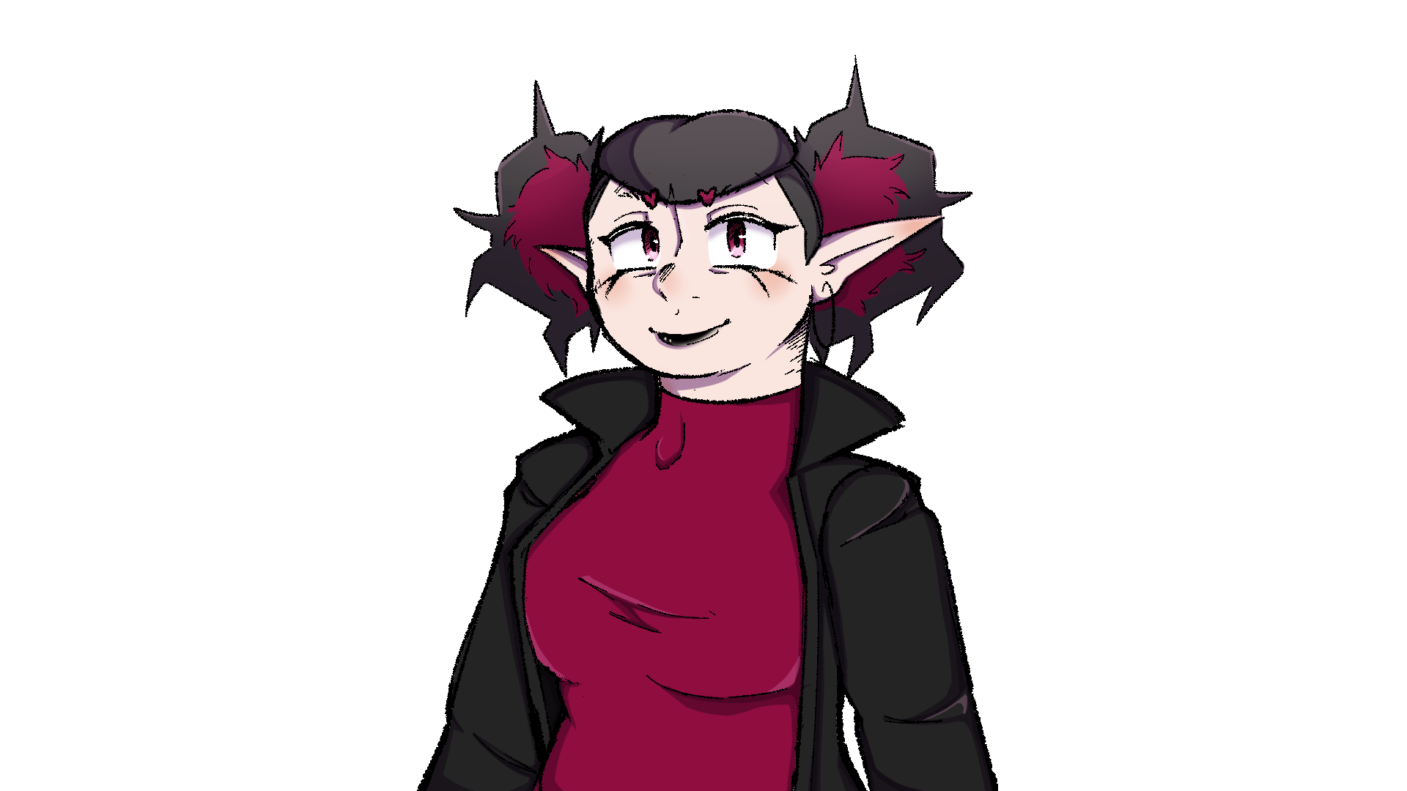
Pretty neat, huh?

Slide 57
Anyway, hurry that little ghost butt out of bed!
I wanna talk to you!

Slide 58
And before you say anything, it must be at a cute
cafe! All the best work is done at cute cafes!

Slide 60
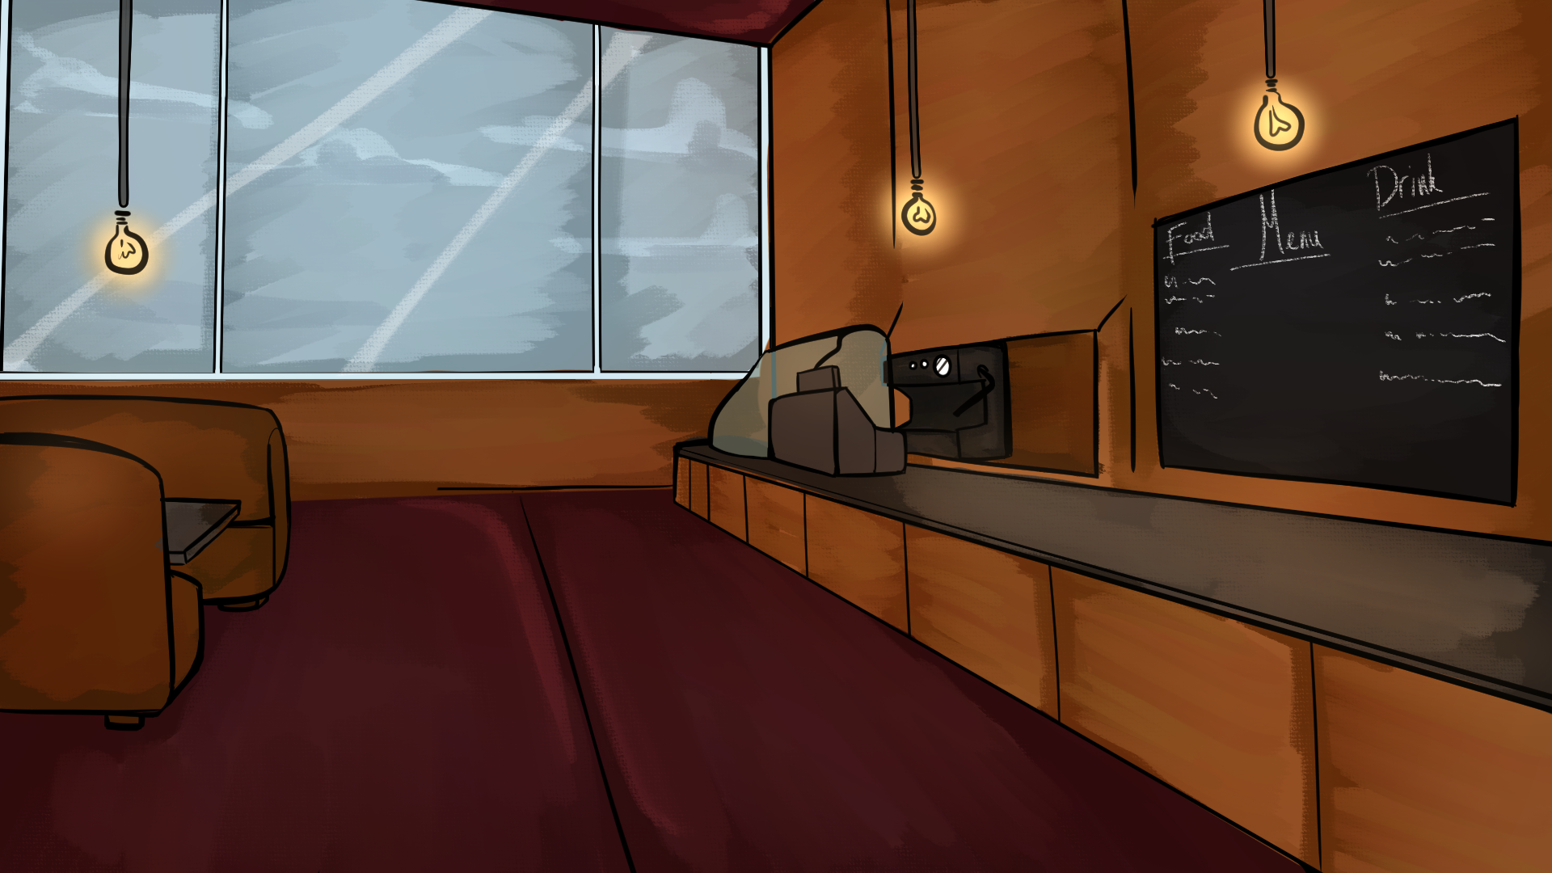

Slide 61
The café seemed to be pretty quiet and quaint..

Slide 62
If nothing else, her cute café recommendations are
pretty reliable.

Slide 63
Visp had already run off ahead, ordering just about
every dessert she could fit on her tray.

Slide 64
I’ll go and grab us a seat, you go ahead and order!

Slide 65
With as much vigour as ever, she moves off to grab
a booth seat.

Slide 66
I guess I should order something…

Slide 67
Black Coffee
Hot Chocolate
Sweet Iced Tea

Slide 68
Yeah.. A coffee sounds good right now.

Slide 69
It doesn’t take too long for the drink to be done,
settling down at the table Visp chose.

Slide 70
Though really the table could’ve done with
being a bigger one..

Slide 71
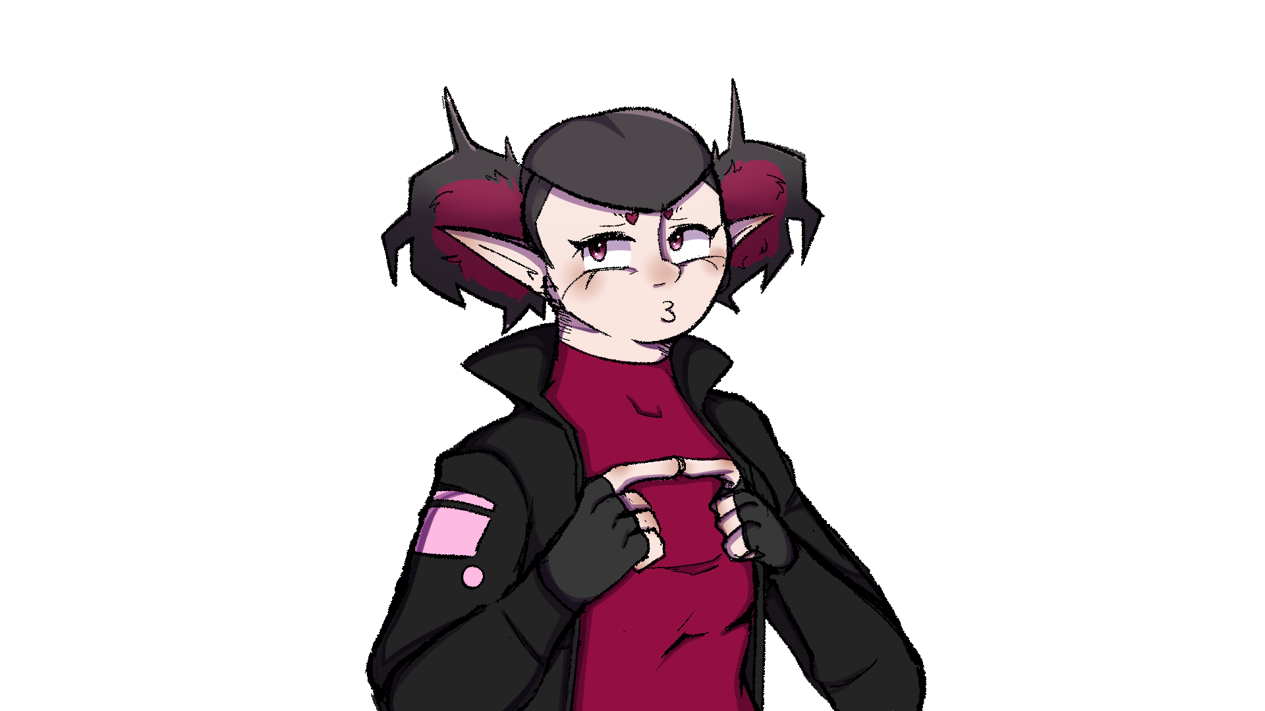
Sorry! I ordered a little bit too much..
Feel free to scoot some stuff around!

Slide 72
Just a drink huh? Well I guess ghosts.. Don’t really
have stomachs, huh?

Slide 73
What did you get..? Ooh, an espresso?

Slide 74
My friend Vince would approve of that! He’s a big
coffee fan! Says it keeps him charged up.

Slide 75
Yeah.. A hot chocolate sounds good right now.

Slide 76
It doesn’t take too long for the drink to be done,
settling down at the table Visp chose.

Slide 77
Though really the table could’ve done with
being a bigger one..

Slide 78
Sorry! I ordered a little bit too much..
Feel free to scoot some stuff around!

Slide 79
Just a drink huh? Well I guess ghosts.. Don’t really
have stomachs, huh?

Slide 80
What did you get..? Ooh, a hot chocolate?

Slide 81
My friend Rowan would approve of that! He’s a
secret sweet tooth! Keeps it a secret better than me!

Slide 82
Who’s that..?

Slide 83
Yeah.. An iced tea sounds good right now.

Slide 84
It doesn’t take too long for the drink to be done,
settling down at the table Visp chose.

Slide 85
Though really the table could’ve done with
being a bigger one..

Slide 86
Sorry! I ordered a little bit too much..
Feel free to scoot some stuff around!

Slide 87
Just a drink huh? Well I guess ghosts.. Don’t really
have stomachs, huh?

Slide 88
What did you get..? Ooh, an iced tea!

Slide 89
My personal favourite! I’m glad we both have good
tastes in drinks.

Slide 90
..mm. It’s pretty nice in here. I’ll need to invite the guys sometime.

Slide 91
Your friends..?

Slide 92
Oh- right sorry! They’re my good friends, I’ve known
‘em for years!

Slide 93
They’re my bandmates! Pretty cool right?

Slide 94
I didn’t know you were in a band.. That’s cool.

Slide 95
The guitar case isn’t just for show, y’know!
Here, take a look!

Slide 96
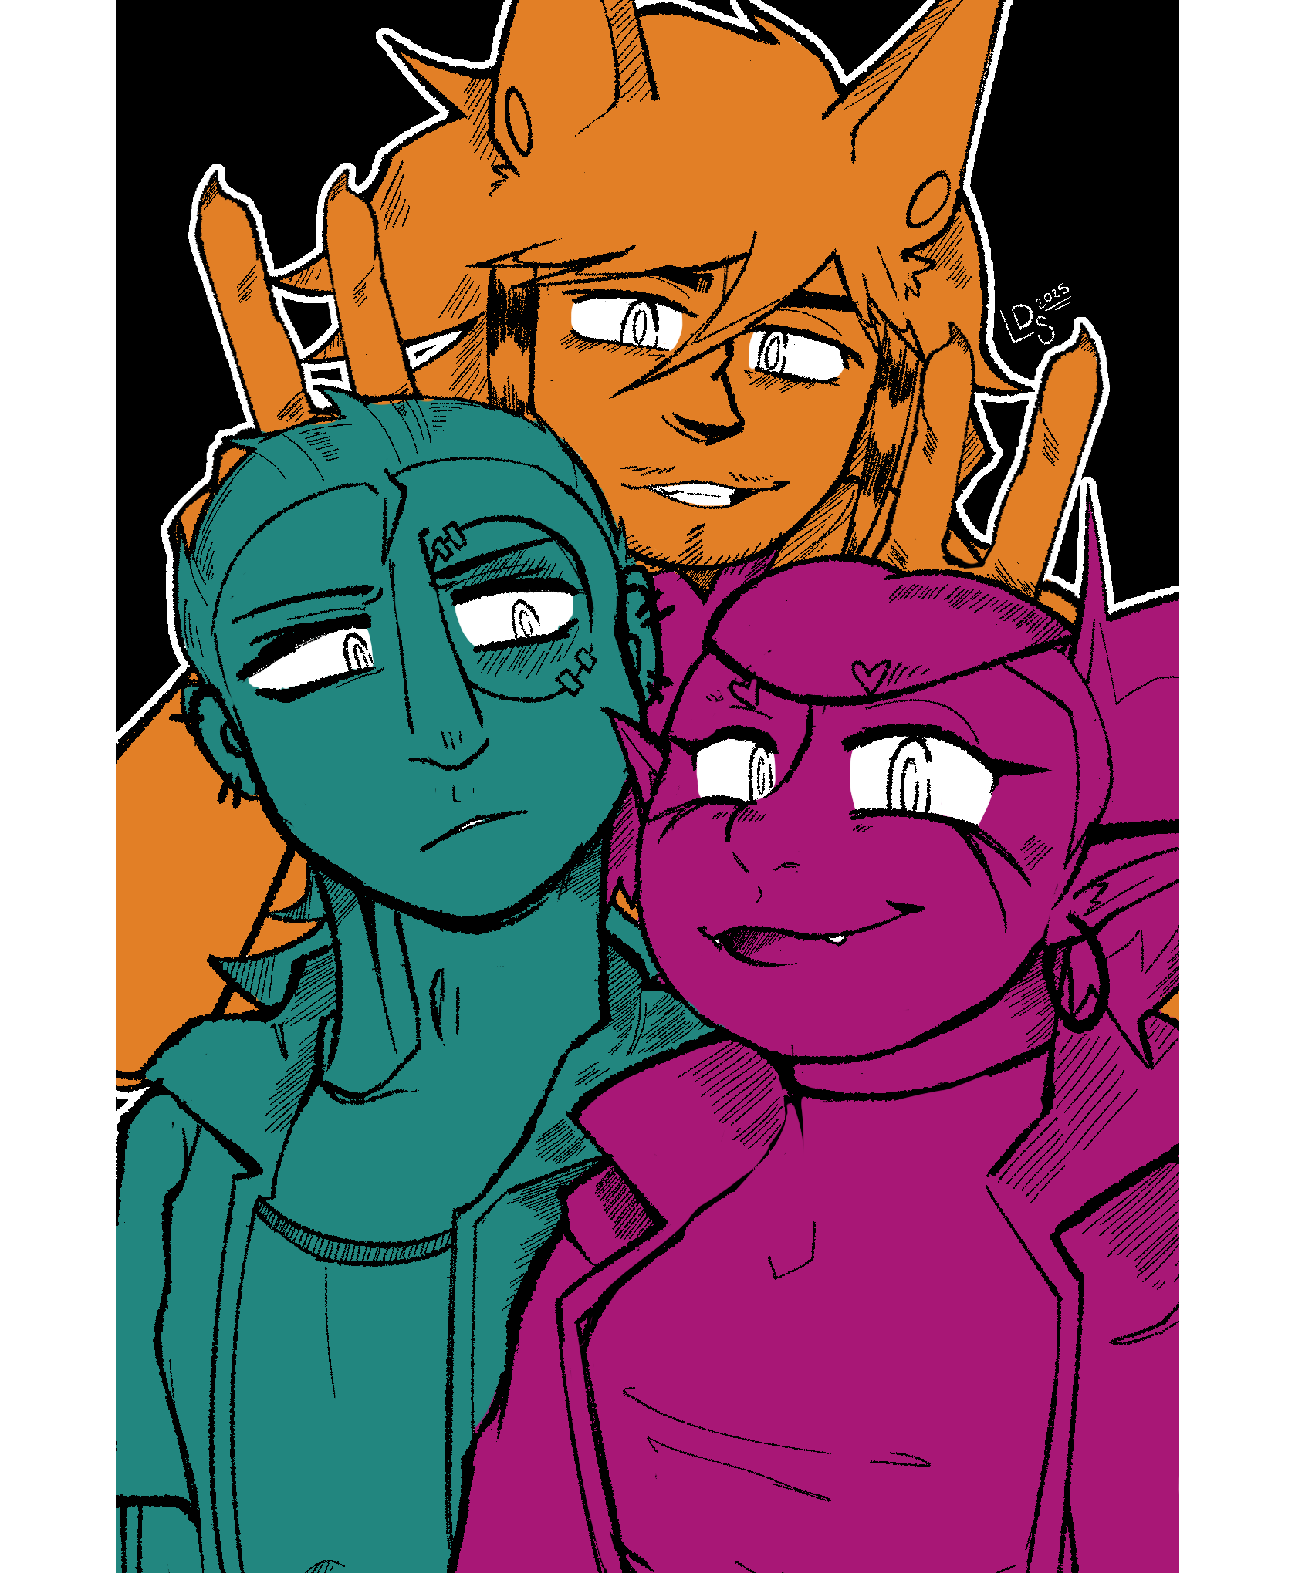

Slide 97
…a picture of three monsters… that’s obviously Visp
but… I don’t think I’ve seen the others around town yet.

Slide 99
Truth be told, we might not be for much longer..

Slide 100
We’ve been butting heads a lot recently..
It’s really not good for morale.

Slide 101
I guess it’s because our personalities clash a bit..
I love them to the undead but.. God they can be
insufferable sometimes..

Slide 102
Rowan’s a laid back guy.. Sometimes a little too laid
back. But when he gets going he’s incredible!
He’s one of the best drummers I know!

Slide 103
And Vince is.. Well. They’re Vince. Quiet. Stubborn.
Apprehensive.. They keep their walls up a lot, so it
makes it difficult to know what he’s thinking..

Slide 104
And then there’s me, obviously! The ever charismatic
and lovely lead guitarist! I can’t think of what I could
have done to cause any conflict!

Slide 105
Visp takes a loud sip of her drink..
Seems like they’ve got some creative differences.

Slide 106
That sucks…

Slide 107
Yeah.. If only we had someone to act as a mediator
or something..

Slide 108
..

Slide 109
……

Slide 110
…heeeey…

Slide 111
…I don’t like that look…

Slide 112
Oh come on, I haven’t even said anything yet!

Slide 113
Come with me to meet them! I bet that they’ll
love you!

Slide 114
Maybe a fresh face is what we need!

Slide 115
Well… I can’t exactly play any instruments… but
I guess I count as a decent writer..

Slide 116
Her face twisted into a smile again, a chuckle
escaping her throat.

Slide 117
Something tells me I’ve gotten myself into
something I can’t get out of here…

Slide 119
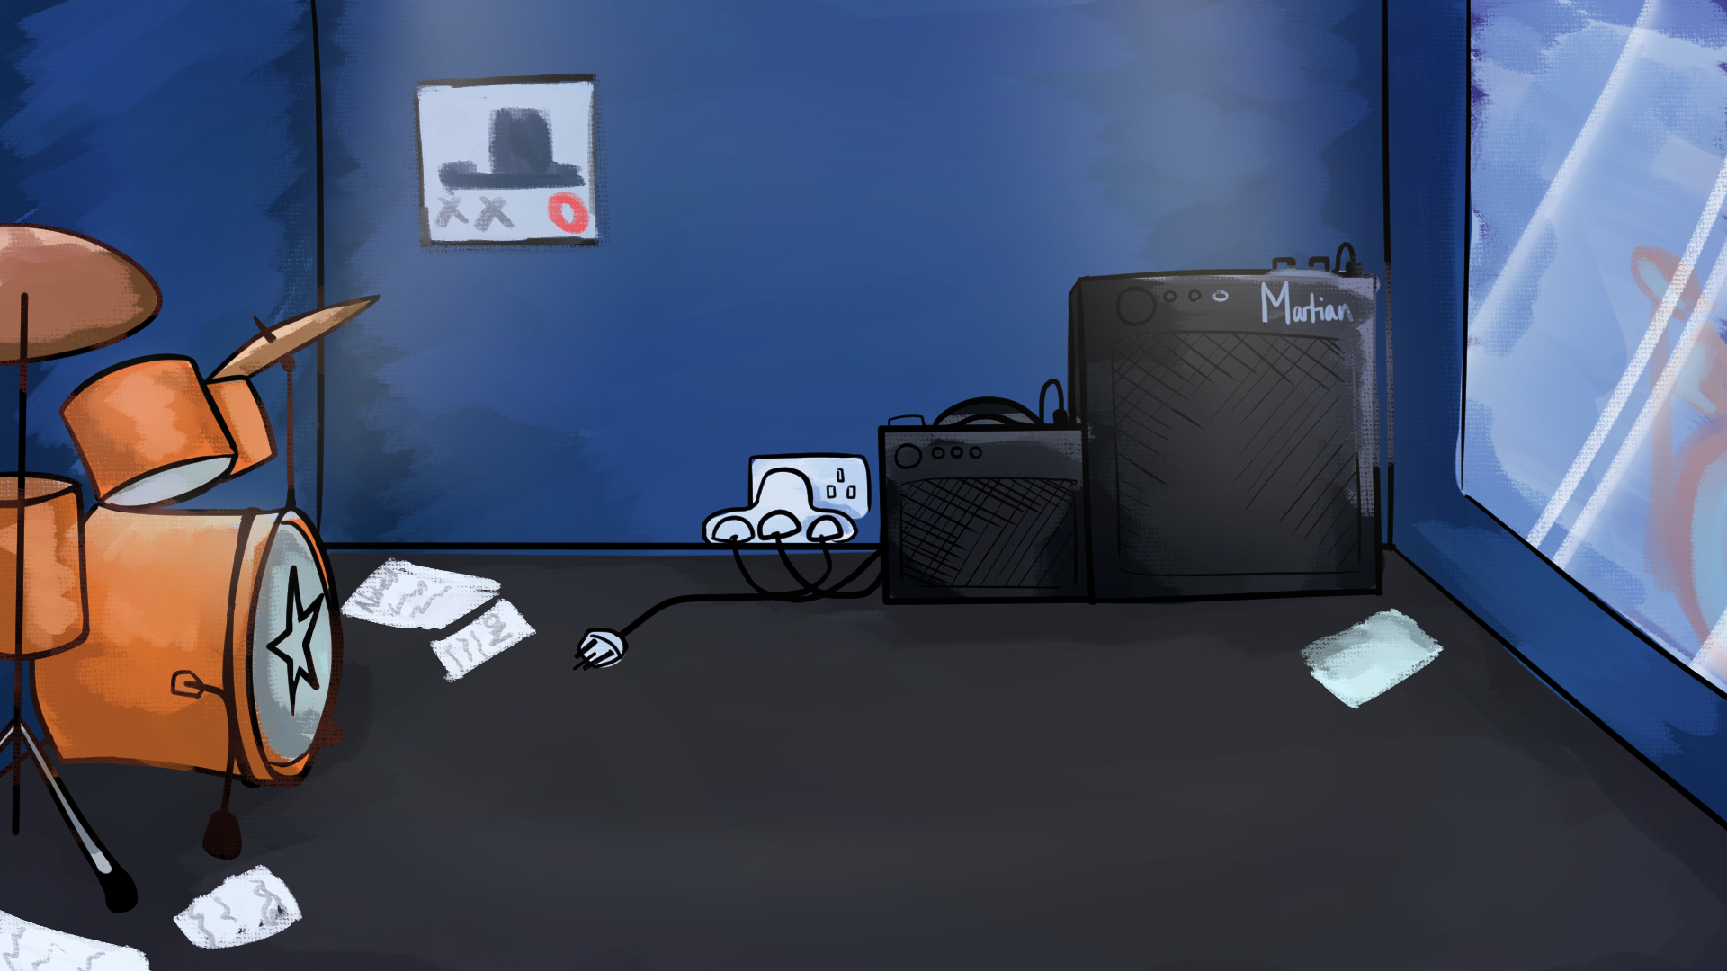

Slide 120
Soon enough, I found myself in a University
I’ve never heard of.

Slide 121
Visp dragged me through the campus as literally
as she could, forcing my hand to become
corporeal somehow..

Slide 122
I’ll need to ask how on earth she did that…

Slide 123
Soon enough we were in the music block the sound
of lively drums coming from one of the studios,
accompanied by a low, smooth bass line…

Slide 124
Hey, they’re already practicing!

Slide 125
Well whatever… I’m sure they won’t mind a
minor interruption.

Slide 126
She scans her keycard, opening it with a flourish not long after.

Slide 127
…the guys inside look a little startled by her
sudden entrance.

Slide 128
We’ve got company!

Slide 129
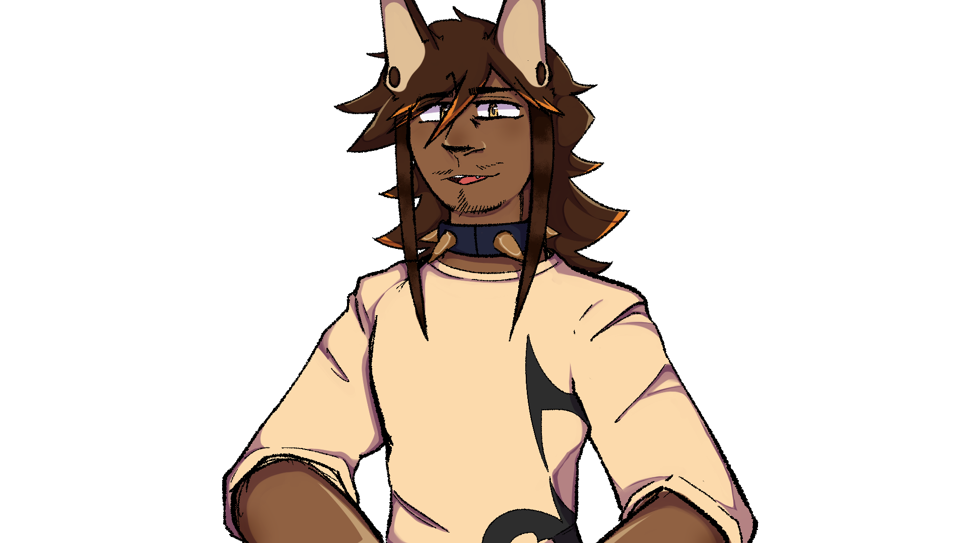
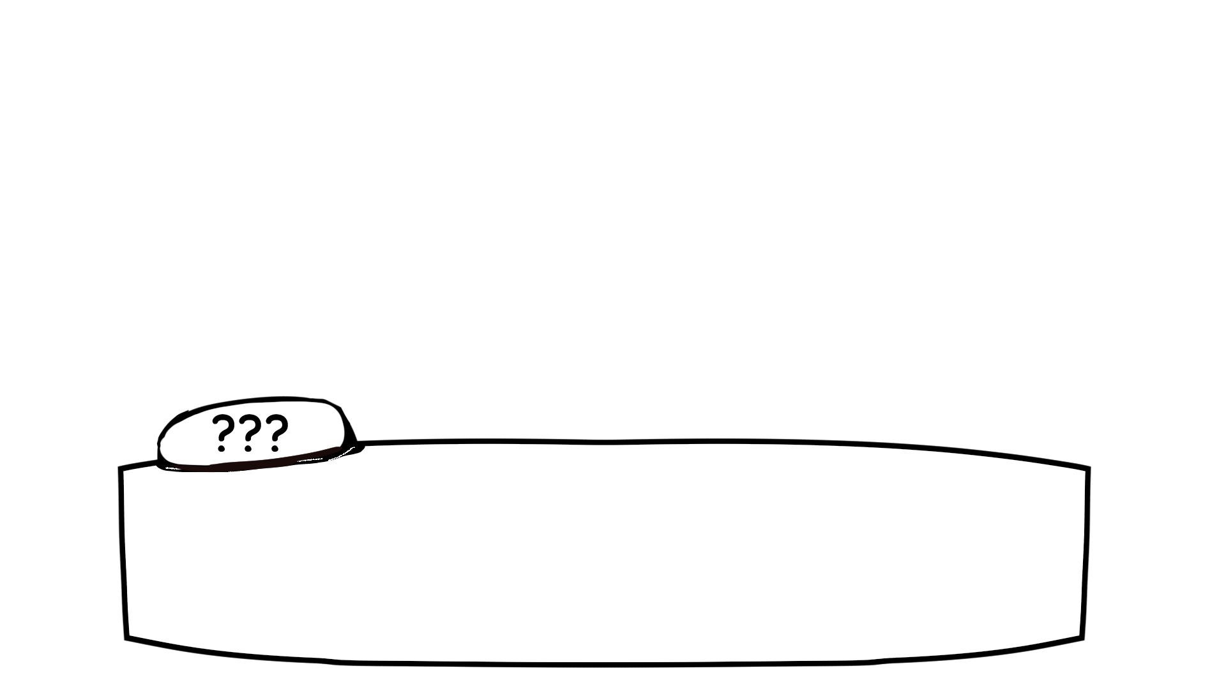
Woah, Visp! Way to make an entrance!

Slide 130
Hehe, sorry! And sorry I didn’t give an ETA…
I’ve got someone you should both meet!

Slide 131
Ooh.. Some fresh meat, huh?

Slide 132
Or.. Wait, maybe I shouldn’t say that..
Ghosts don’t really have flesh do they..?

Slide 133
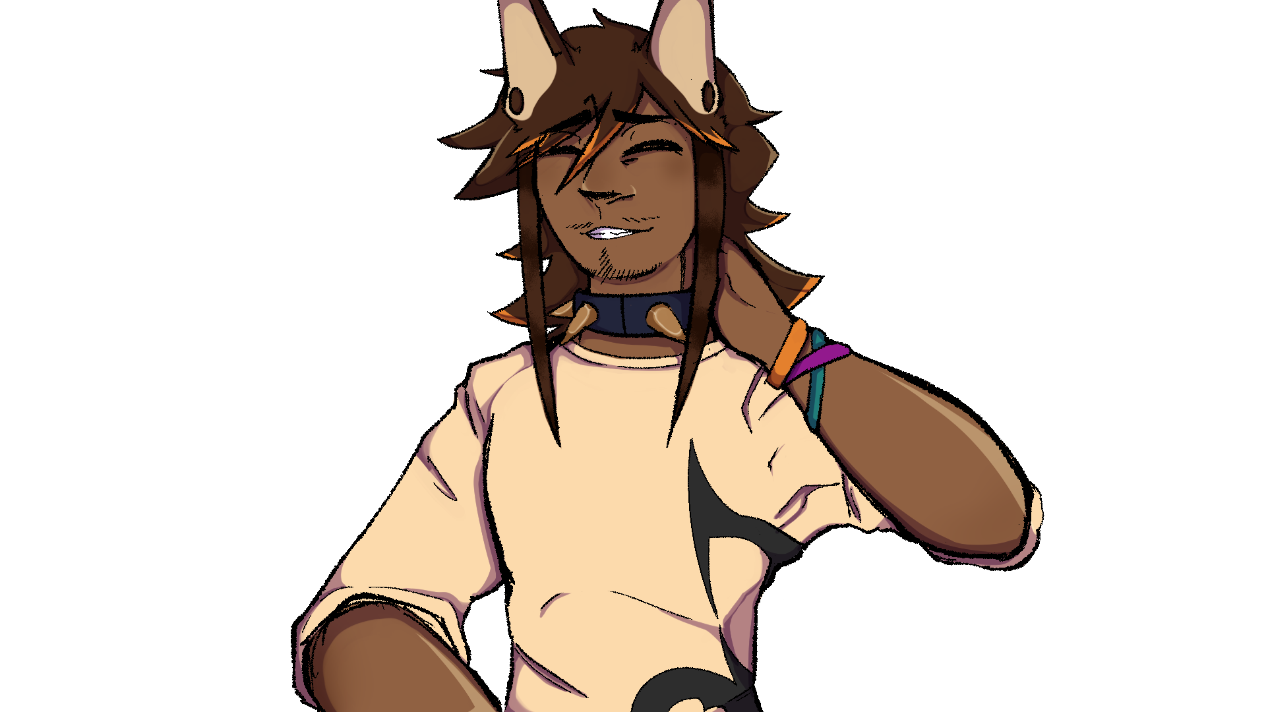
Hah! Imagine that.. A ghost with skin..-

Slide 134
The werewolf in front of me babbled on for a little
longer.. Much like Visp, he sure knows how to talk..

Slide 135
With even less of a filter.

Slide 136
It was hard for me to take my focus off of him
honestly.. But I soon landed on the other person
in the room.

Slide 137
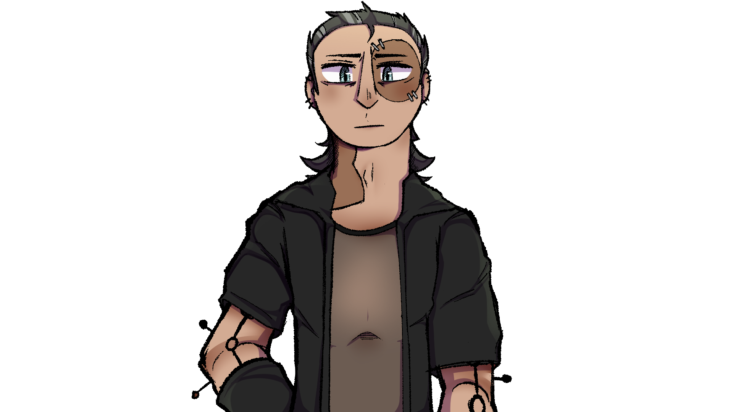
Tall… moody… frankly kind of scary…

Slide 138
He has pins in his arms… and it looks like some of
his skin isn’t even his own…

Slide 139
What a presence…

Slide 140
…

Slide 141
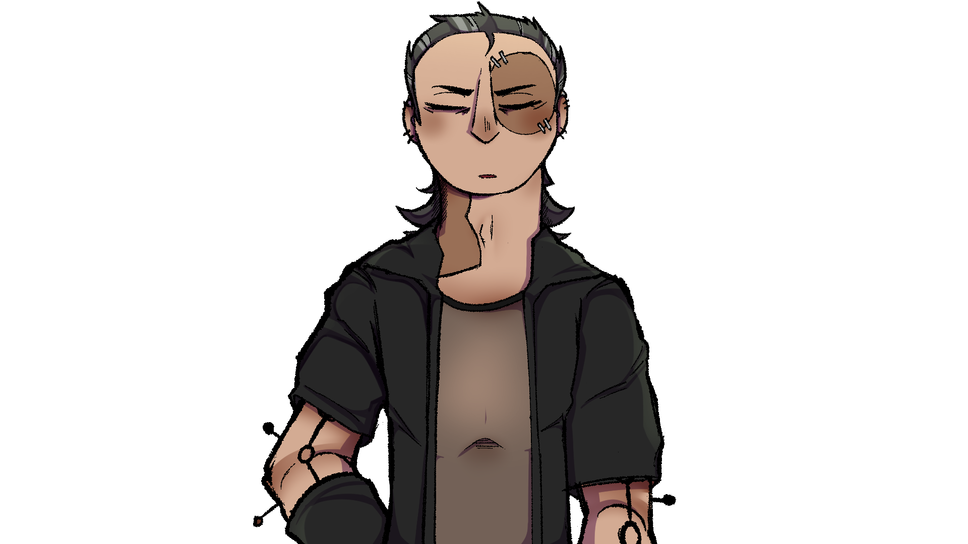
……

Slide 142
……hi.

Slide 143
…Hi… Sorry for interrupting your practice…

Slide 144
…you’re not interrupting.

Slide 145
Well his voice is nice to listen to… I wonder if
he’s a singer.

Slide 146
So, Visp! Who’s your friend?

Slide 147
Oh-! This is the ghoul I mentioned like… 3 weeks
ago? Helped ‘em to move into their new place!

Slide 148
They managed to keep it from me that they’re a bit
of a poet, so I brought them along!

Slide 149
I never said that…

Slide 150
Ooh, so you’re a writer huh?

Slide 151
…now I see why you brought them.

Slide 152
You think they’re gonna be our magic ticket to
getting us to working together again, don’t you Vispy?

Slide 153
…Whaaaaat?!

Slide 154
…yeah okay you got me…

Slide 155
But- look. I really think this one might work!

Slide 156
We should at least give them a chance right?
I mean, what’s the worst that could happ-!

Slide 157
…they completely tear the band apart?

Slide 158
VINCE!! You can’t just say that!

Slide 159
…I mean he might have a point…
The other third parties you’ve brought along didn’t
exactly work out..

Slide 160
Rowan, I’m telling you, this one’s gonna be the one!

Slide 161
They’re cute, they’ve got good fashion sense, AND!
They can be our literal ghost writer!
How funny would that be?

Slide 162
…and you trust them because of that?

Slide 163
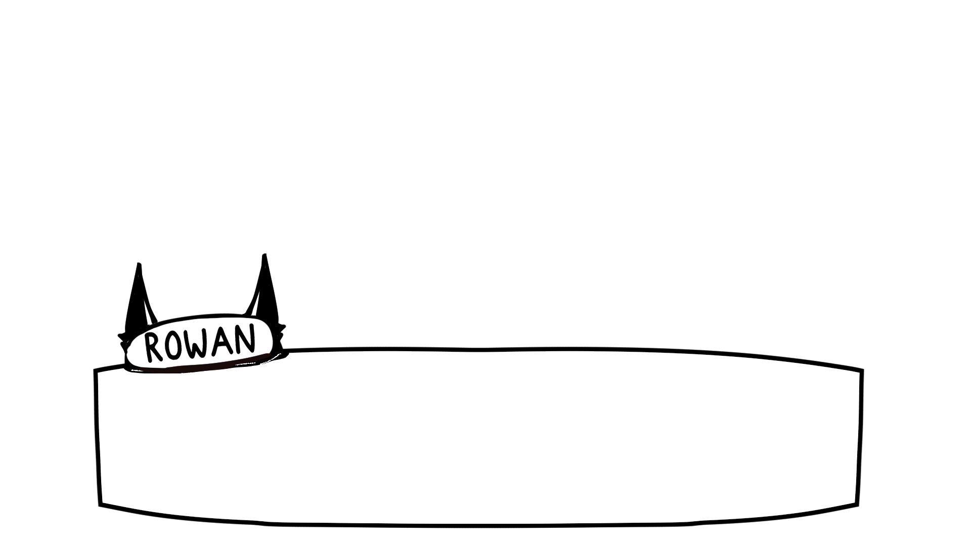
…well… it is pretty funny at least.

Slide 164
Plus, it would lighten up the load on all of us if we
have some help on board who knows what they’re
doing.

Slide 165
It’s not like we’d be the only band leaving the
decisions to someone who’s technically not a member.

Slide 166
Rowan gets it! C’mon, even you can admit you’re
tired of having to rack your brain!

Slide 167
…

Slide 168
…unlike you, I quite like using my brain.

Slide 169
…theeeen… why don’t you work togeth-

Slide 170
No.

Slide 171
…aha… as harsh as always, Vin.

Slide 172
Don’t take it personally, Vince has always been a bit
of a loner. Ain’t that right, bud?

Slide 173
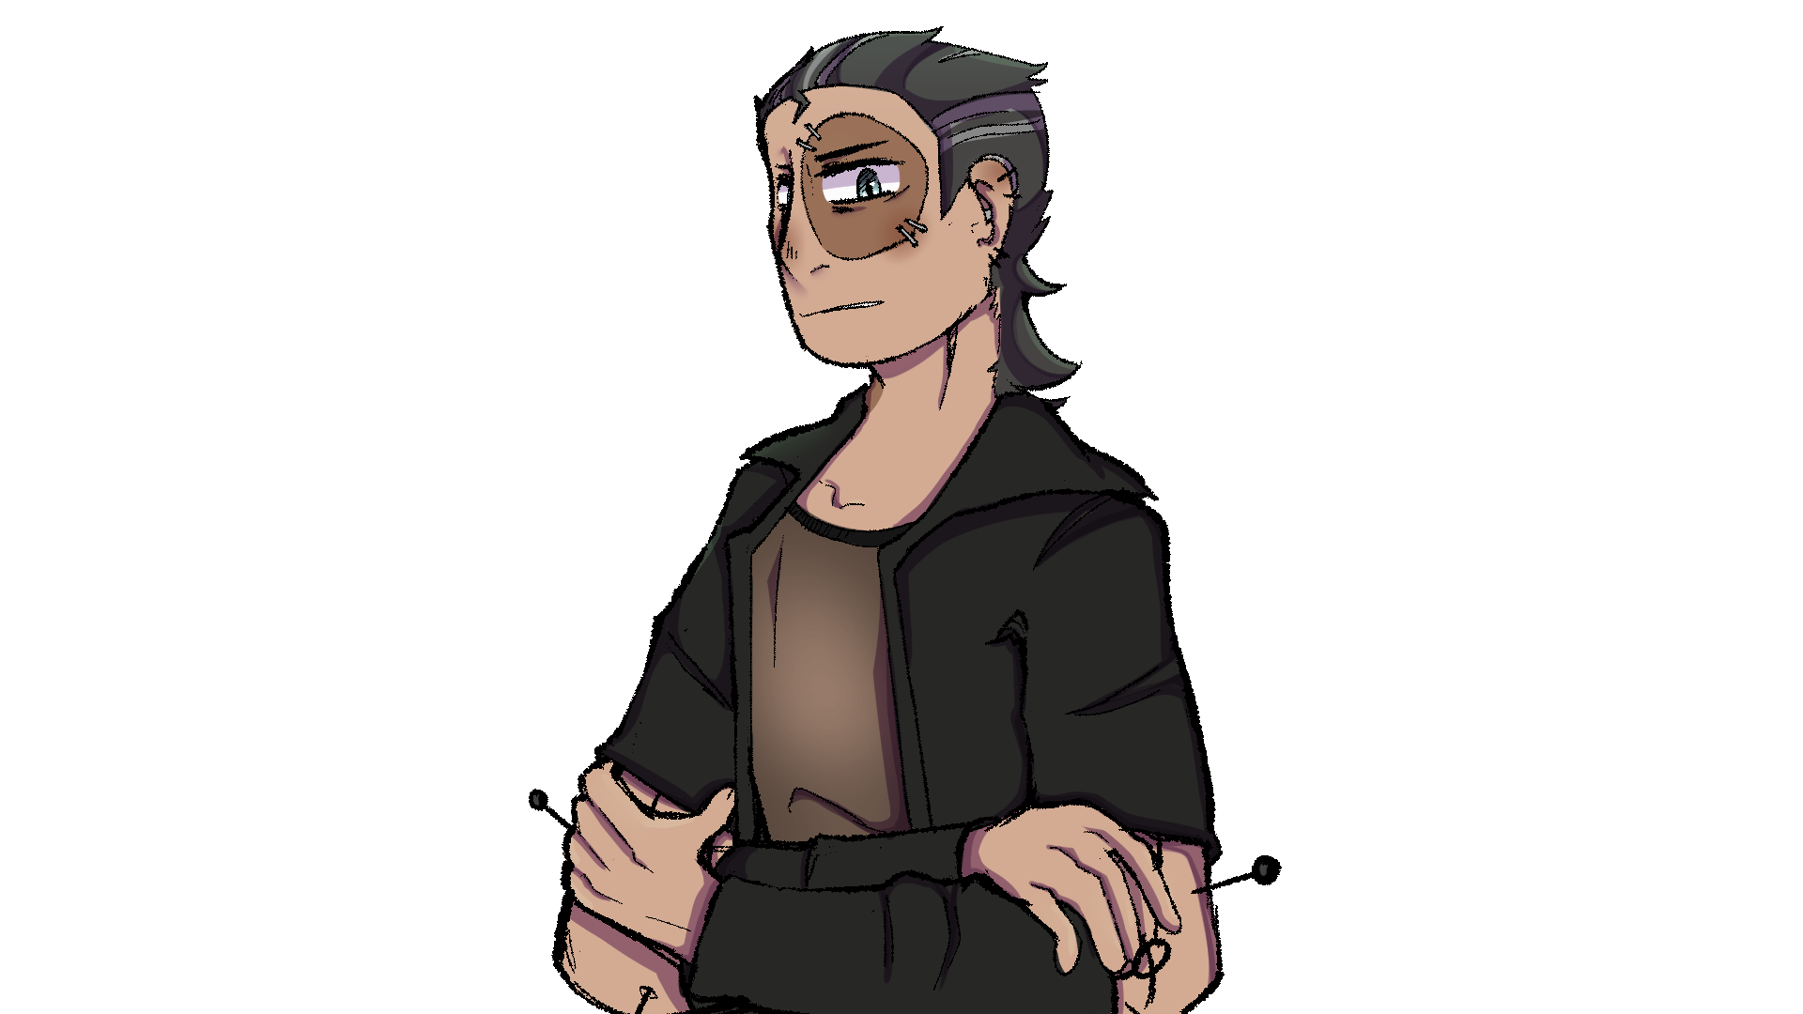
…I told you to stop calling me that.

Slide 174
C’mon Vinny, this is all riding on you!

Slide 175
We really do need all of the help that we can get!
I think it’s best if we give them a chance!

Slide 176
…

Slide 177
…if everything goes to hell because of this, I’m not
coming back to practice.

Slide 178
Yeeeeees!!! Oooh, thank you Vin! I really do
love you sometimes!

Slide 179
Gh-!

Slide 180
Visp basically throws herself onto Vince, the
mash-up monster looking less than thrilled.

Slide 181
As that’s going on, Rowan approaches me from behind the drumkit.

Slide 182
So, you’re a bit of a lyricist huh?

Slide 183
I wouldn’t say that…

Slide 184
I’d say I’m just a half decent writer.

Slide 185
Not to brag- did pretty well in my GCE’s.
(ghostly certificates of education)

Slide 186
Hah! Nice one. Might as well use it before you lose
it right?

Slide 187
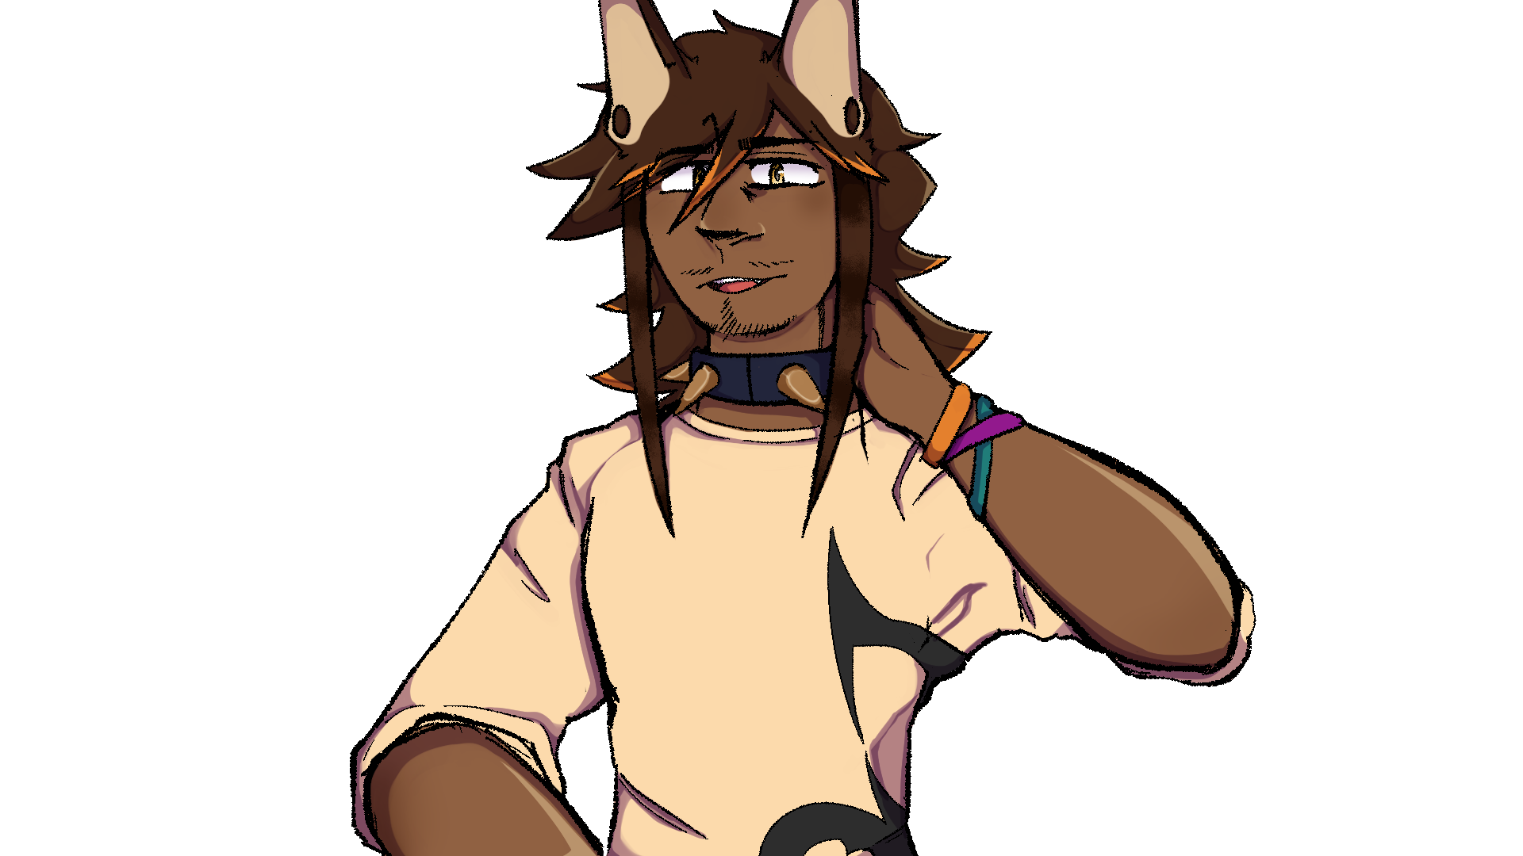
It’s nice having someone new here honestly..
Get’s a little stuffy with just those two all the time.

Slide 188
Yeah, Visp told me you guys have been clashing…
I guess now I can see why.

Slide 189
Yeah, don’t get me wrong, these guys are
basically like my family.

Slide 190
But y’know… family gets strained.

Slide 191
We could all do with someone fresh on the team
who will actually take it seriously…

Slide 192
So… honestly? I’d really appreciate it if you could
give us a shot.

Slide 193
Here. You’ve already got Visp’s number right?
Here’s mine.
Shoot me a message later if you want, yeah?

Slide 194
Doesn’t have to be about the band…
If you just wanna talk that’s cool too.

Slide 195
Rowan flashes me a toothy grin.
Looks like he’s doing his best to cash in on the
slacking off part.

Slide 196
I’ll give it to him… it’s pretty convincing.

Slide 197
…guess this means I’ve got until later to make my decision.

Slide 198
Anyway, why don’t you sit and listen to us jam for
a while?

Slide 199
Might as well see and hear what you’re getting
yourself into, right?

Slide 200
Just don’t judge the lyrics too hard, ‘kay?

Slide 201
It’s hard finding stuff that sounds good that’s not
all just flowery nonsense.

Slide 202
Sure, that’ll be fun.

Slide 204
I decided to stick around for about an hour before
calling it a night.

Slide 205
Honestly they didn’t sound bad at all…
They’ve got the skill, that’s for sure.

Slide 206
It’s be a shame for them to fall apart…

Slide 207
I’ll need to do my best here!

Slide 208
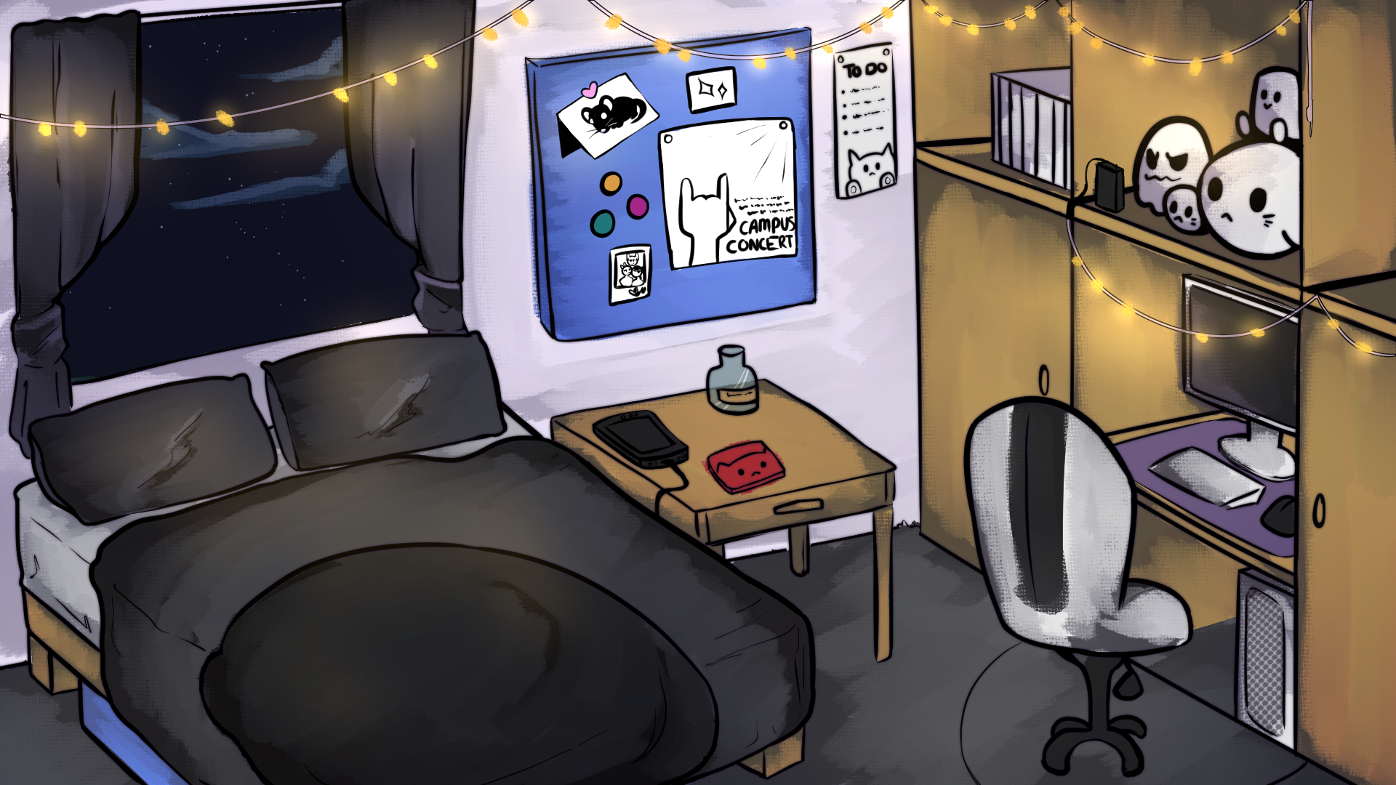
I managed to get home safely.
Though as soon as I was in, I feel my phone buzz.

Slide 209
..that feels purposeful somehow.

Slide 211
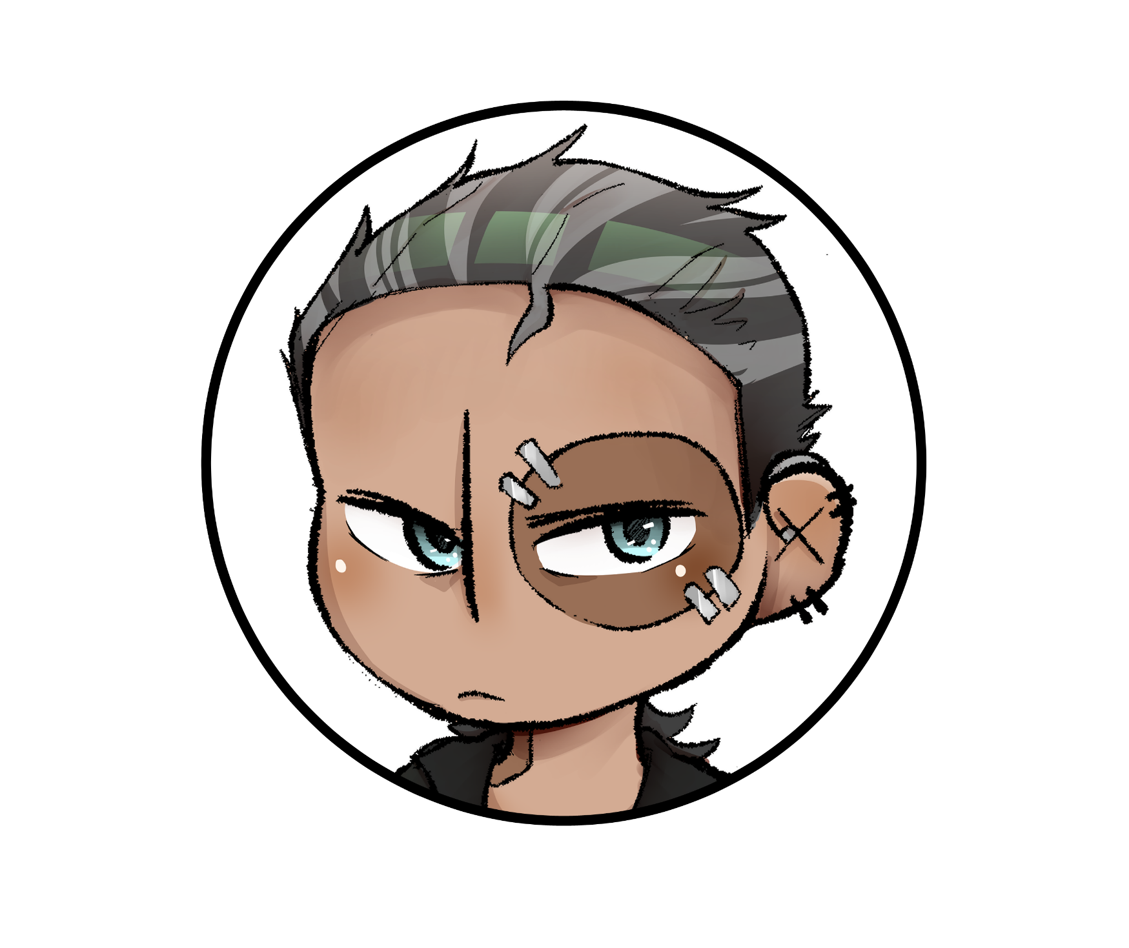
Hey hey hey! New group chat to
welcome our new friend!

Slide 212
Hey hey hey! New group chat to
welcome our new friend!
Woop woop!

Slide 213
Hey hey hey! New group chat to
welcome our new friend!
Woop woop!
?!

Slide 214
Woop Woop!
?!
Let’s do our best starting tomorrow!
Meet at 6 like always!

Slide 215
?!
Let’s do our best starting tomorrow!
Meet at 6 like always!
Sounds good! See you tomorrow!

Slide 216
Let’s do our best starting tomorrow!
Meet at 6 like always!
Sounds good! See you tomorrow!
Got it.

Slide 217
Prologue

Slide 218
Good luck, Newbie!

