Slide 1
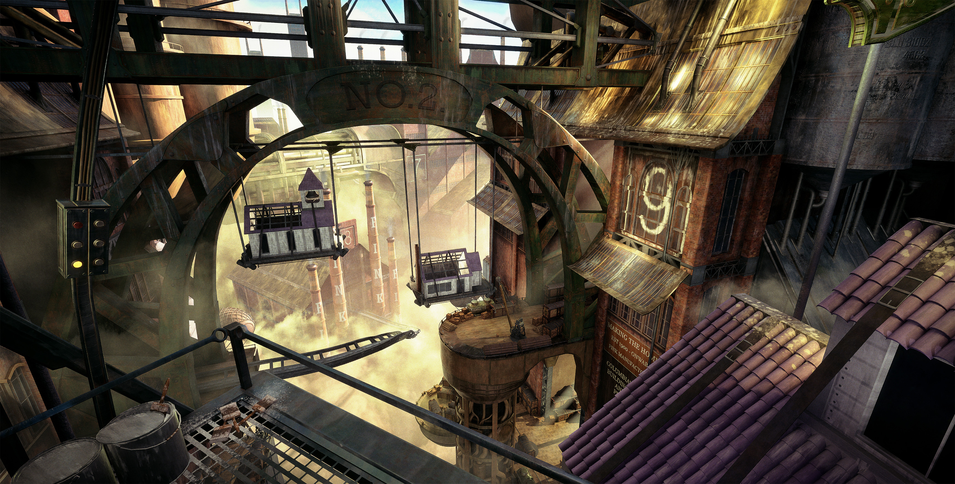
Renders

Slide 2
Renders

Slide 3
Renders

Slide 4
Renders

Slide 5
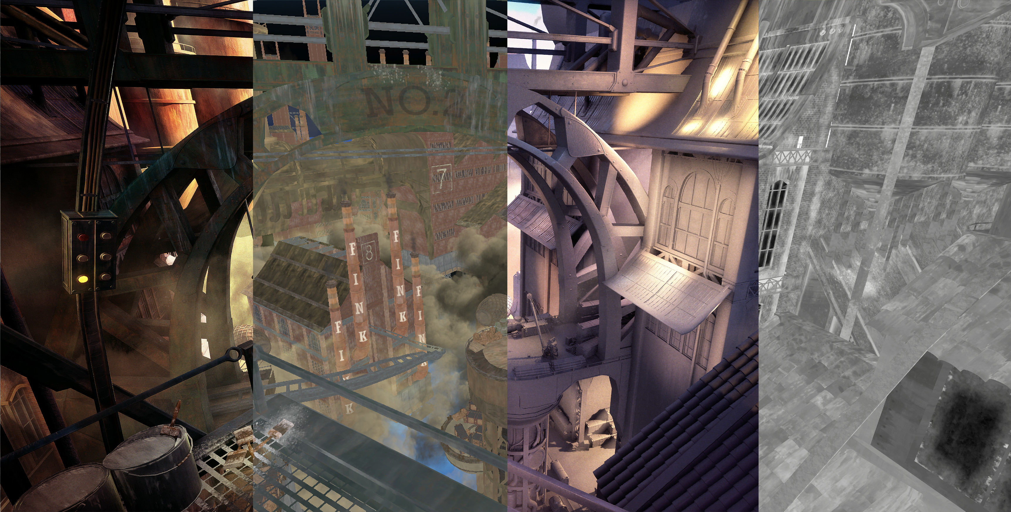
Renders

Slide 6
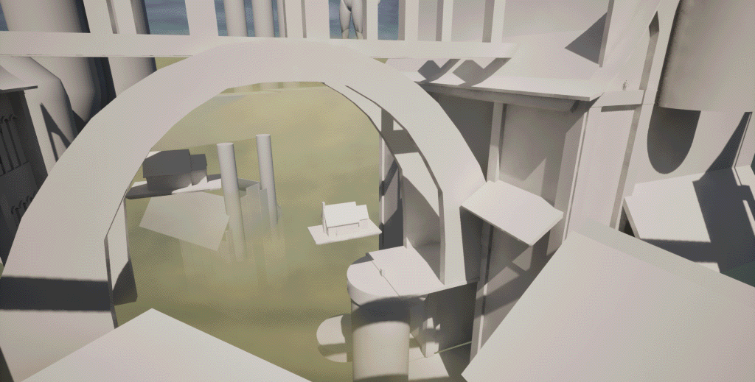
Renders

Slide 7
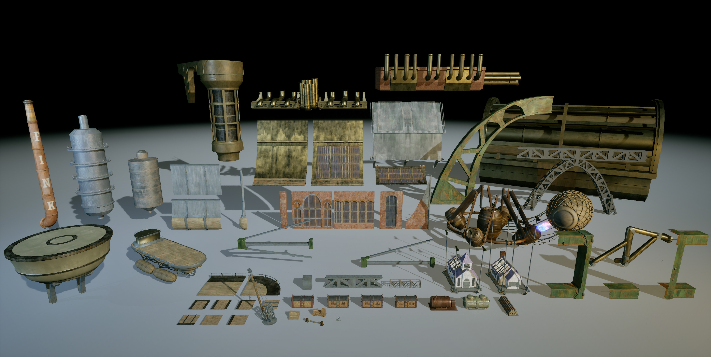
Renders

Slide 8
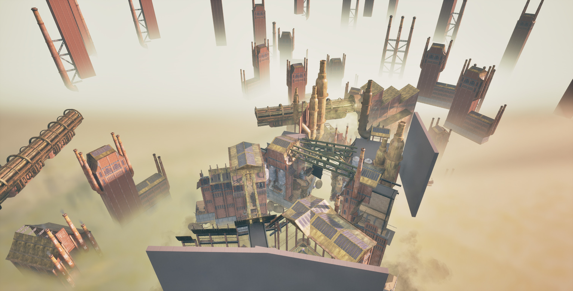
Renders

Slide 9
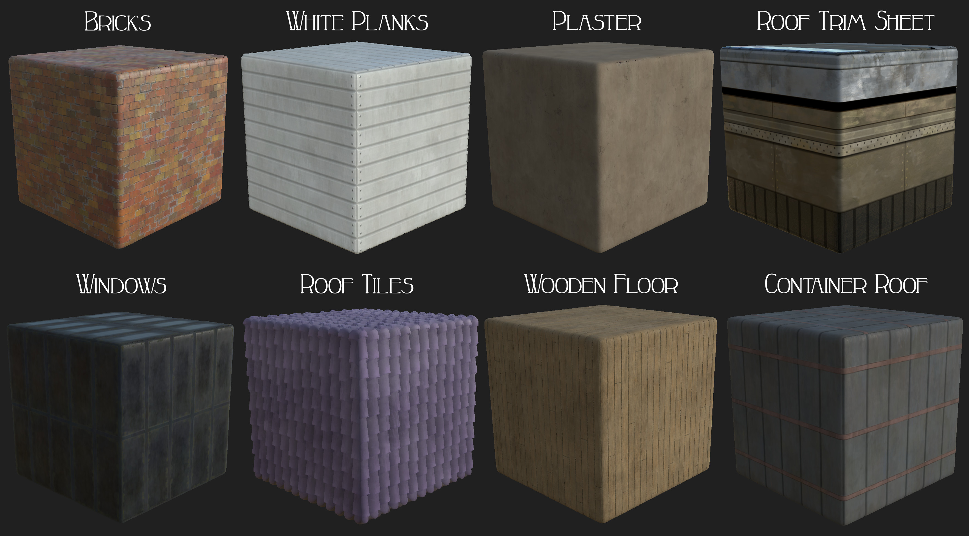
Renders

