Slide 1
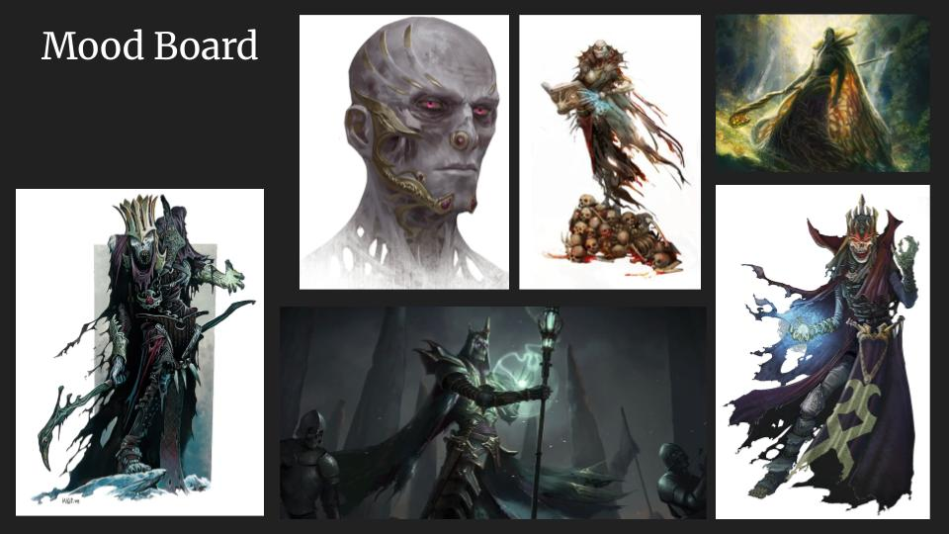
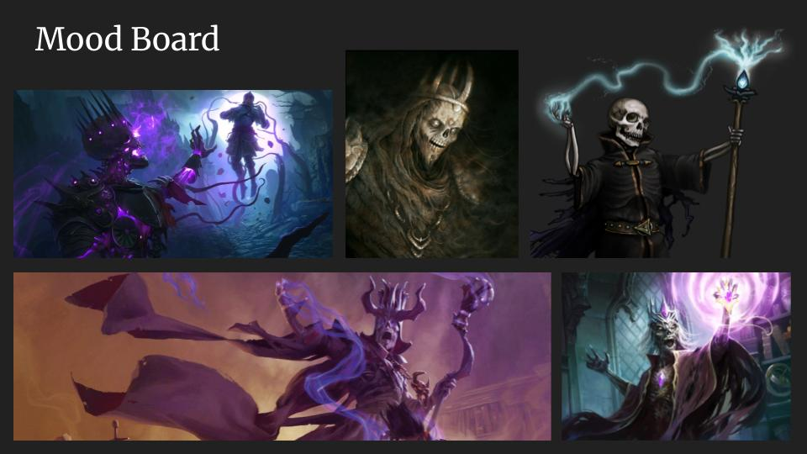
Initial Design Decisions
Some solid research went into the generation of the character, looking into a variety of thematic villains and similar antagonists as a basis for the design. The mood boards of species and characters primarily goes over antagonistic races and designs, settling quickly on a Lich design and some more research could have been placed into hero designs for inspiration. The technical research was extensive, going over sculpting requirements, texturing techniques, and later methods for rigging, skinning and applying morph targets to the character.

Slide 2
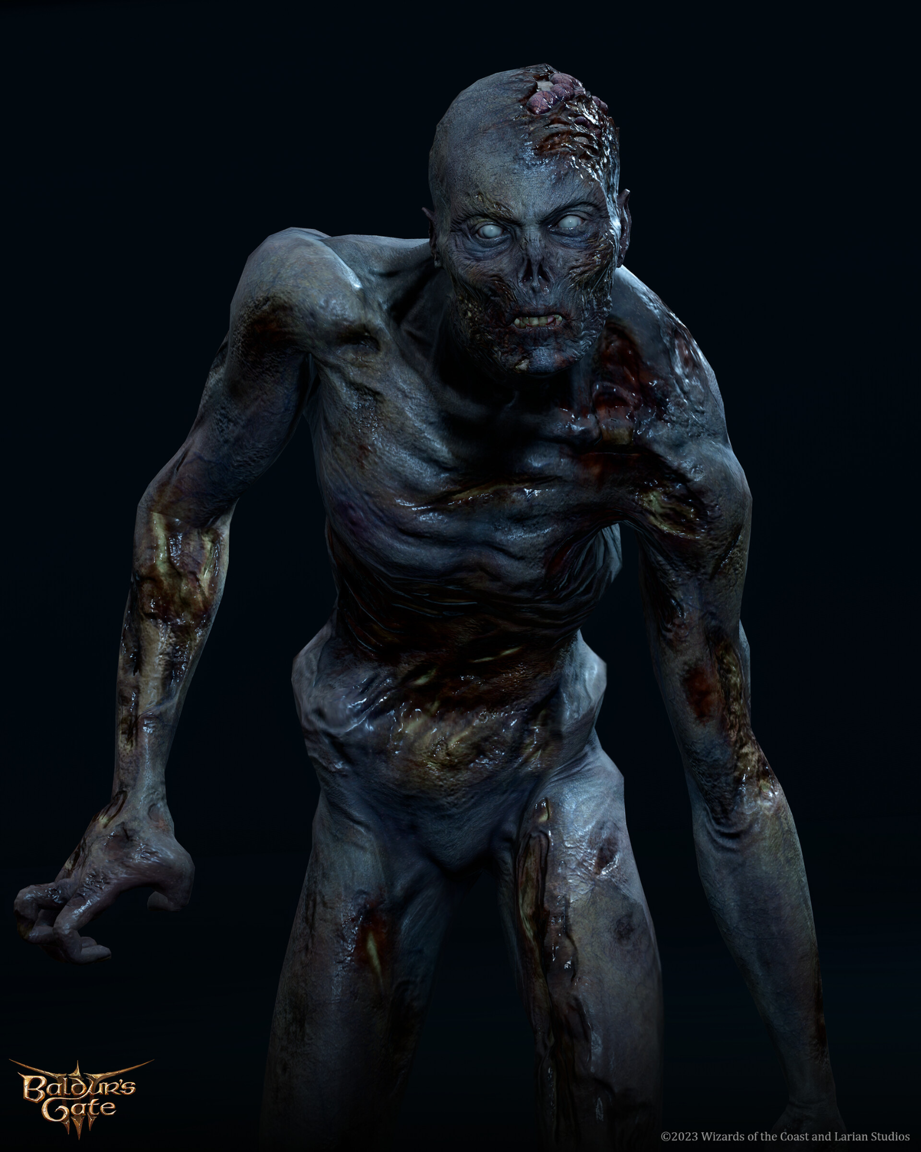
Main Design
The character’s design draws from a range of influences, primarily that of Dungeons and Dragons Liches as well as the Vecna design. I took care to make the design unique, with the large collar and regal robes building a theme of decaying royalty. The body itself is significantly more detailed than the clothing, with the high poly showing much more surface information while most of the clothing detailing was added during texturing.
The design takes some elements of undead characters from Baldur’s Gate - when compared to other lich and undead characters found in Baldur’s Gate, the character has much more colour and vibrancy to create the sense of a ‘new’ undead not long after death and decay.
ArtStation. (2025). Zombie Connor - Baldur’s Gate 3 , Luna Wullaert. [online] Available at: https://www.artstation.com/artwork/4932zn

Slide 3
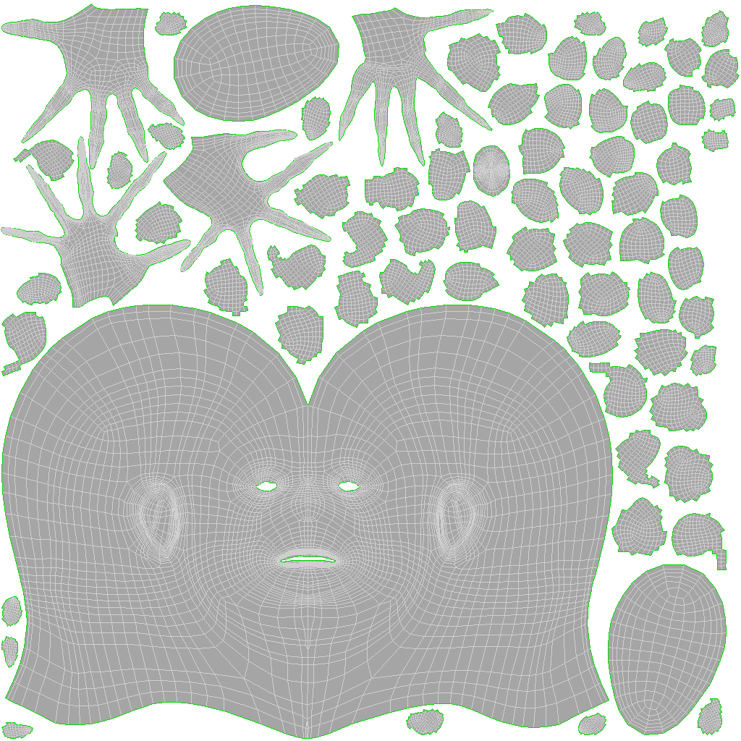
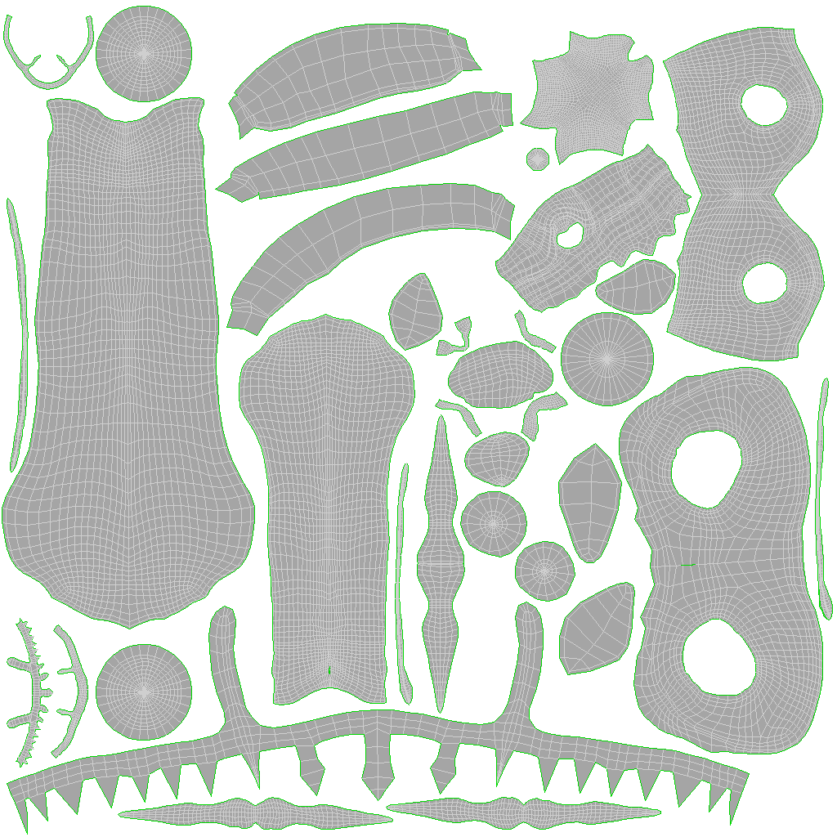
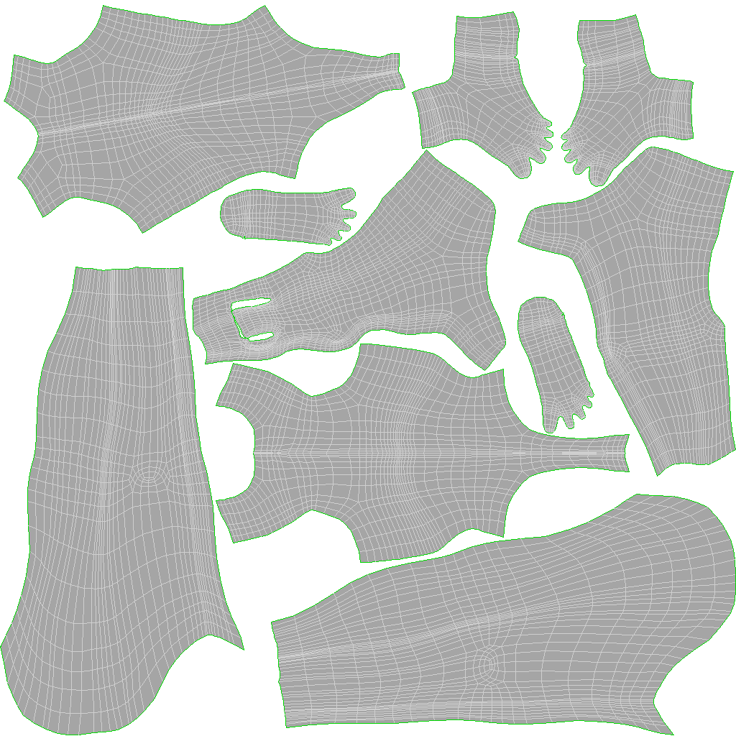
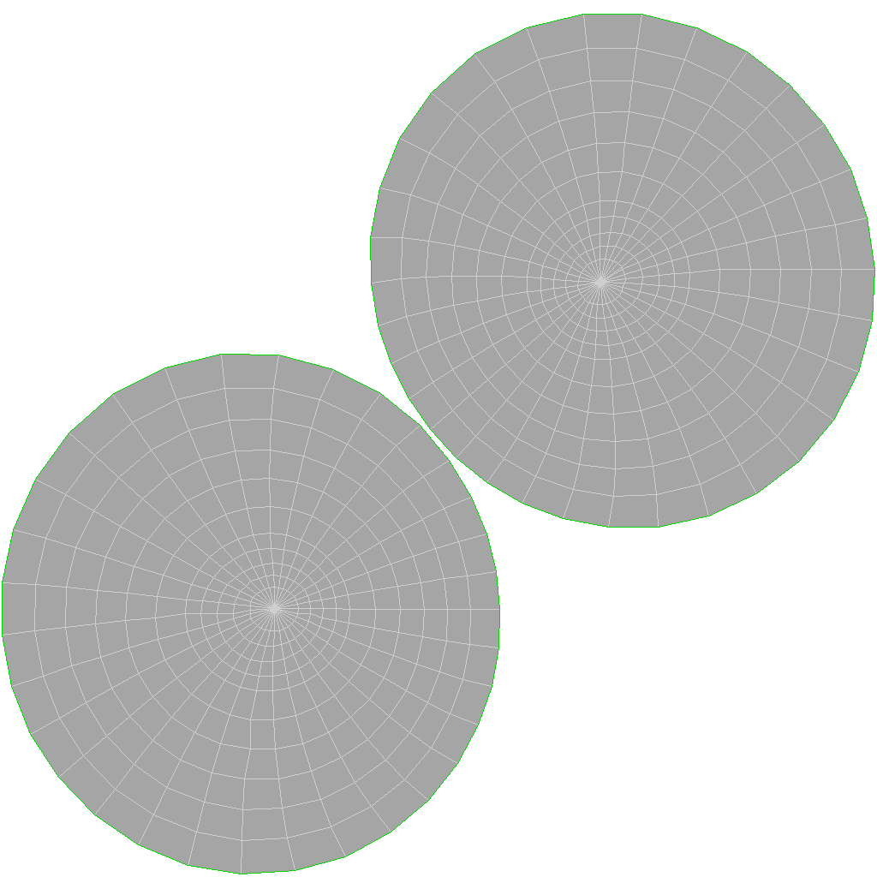
UV Space
The UV islands have been well distributed, with the UV space utilised as much as possible. Areas of high detail, like the head and hands, have been given a sufficient amount of UV space, while smaller less vital components like the teeth have been made smaller and packed around the larger objects to improve optimisation. The provided UV space has been split up into four texture maps, broken up into the head, body, clothing and eyes.
Optimising the UV space was a point of focus, as in previous work I had struggled with having large areas of empty space that could not be filled. In this project I wanted to ensure that the UVs were used efficiently and spent a lot of time using a combination of the auto-packing tools and manual placement to get the UV space used as efficiently as I could.

Slide 4
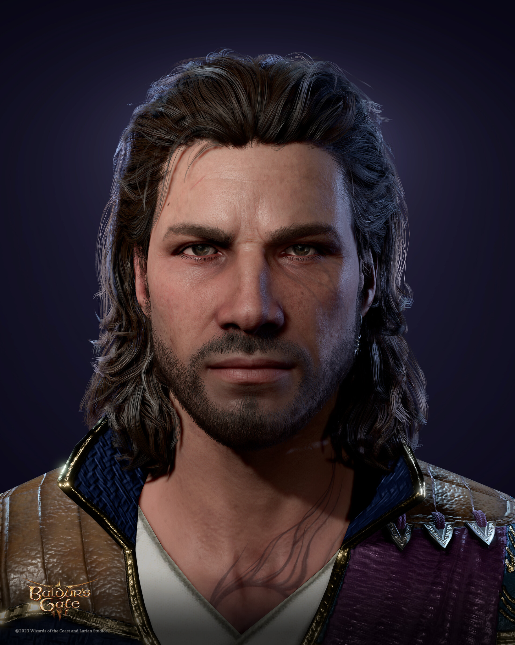
Texturing
Texturing followed a normal PBR workflow, with the inclusion of emissive materials as well as subsurface scattering maps following the normal albedo, roughness, metallic and normal maps. The colour and roughness have significant variation, with effort to include a range of realistic roughnesses across the body, as well as distributed across the metallic components. The roughness is kept to an adequate level to avoid a high amount of reflection, as found in the Baldur’s Gate franchise. Height and normal maps have been used to help break up the surface and add even further detailing. Using multiple layers of musculature/skin details, then painting out masks allowed for musculature to be exposed and giving the impression of thinning skin.
ArtStation. (2025). Gale Head Baldurs Gate 3, Alena Dubrovina. [online] Available at: https://www.artstation.com/artwork/PXJ9Vr.

Slide 5
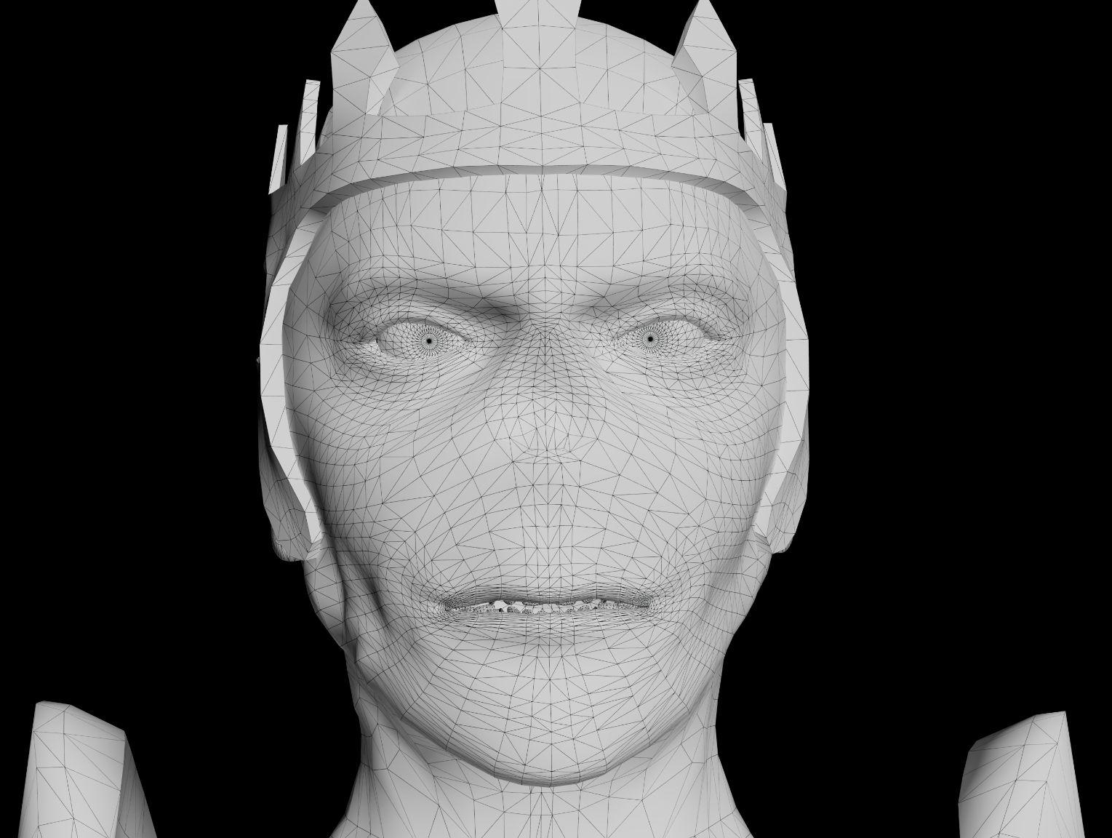
Topology
The topology across the body is fairly uniform. Loops have been placed to support complex movement, including around unusual areas such as the exposed bones on the right forearm. Deformation loops are present on the fingers, elbows, shoulders, knees, ankles, waist and head, allowing for a range of motion both through the skeletal mesh and later morph targets. The total poly count sits at 44,670 which is around standard for a complex character of this level. Some areas could have been further optimised, namely the cape which likely has a much higher poly count than needed for a model its size. This would have allowed polygons to be redistributed to areas that require them more, such as the lips and cheeks for use with morph targets. All floating topology has deformation loops where necessary to allow for the body and arms to move. Hard surface areas also have the appropriate strong edge flow.

Slide 6
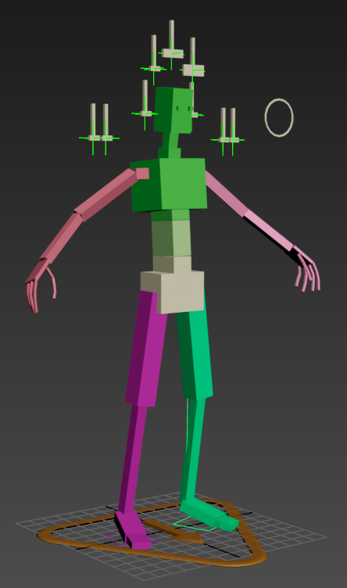
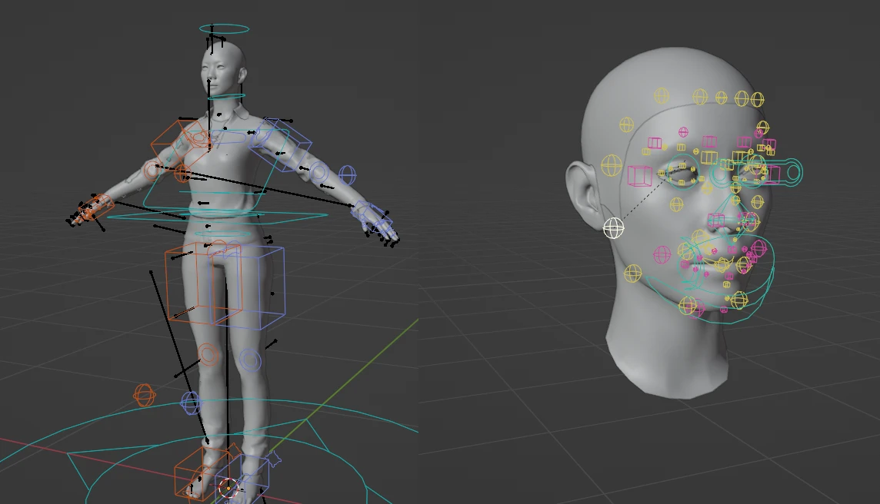
Rig and Animations
The rig is appropriately placed and scaled for the proportions of the character, with bones in place for animating the feet, fingers and head properly. The bones have been weighted properly to avoid overlapping or distortion during movement, as shown in the animation. Hard surface areas like the pauldron and crown have been skinned to a single bone, preventing any warping or bending during movement. Due to the pauldron the character does not have a great vertical range of motion on his left arm, as the pauldron will clip into the collar and shoulder topology, however this is due to the design of the character and the outfit rather than an issue with the rig itself.
The inclusion of a control rig for the facial morph targets was useful, but as this was not exported out successfully it was less effective as a tool for speeding up animation. Further research will be needed in future to implement this as a game-ready system.
Bryan Noter (2024). Baldurs Gate 3 - Mindflayer Animations. [online] Artstation. Available at: https://www.artstation.com/artwork/qeYG9e

Slide 7
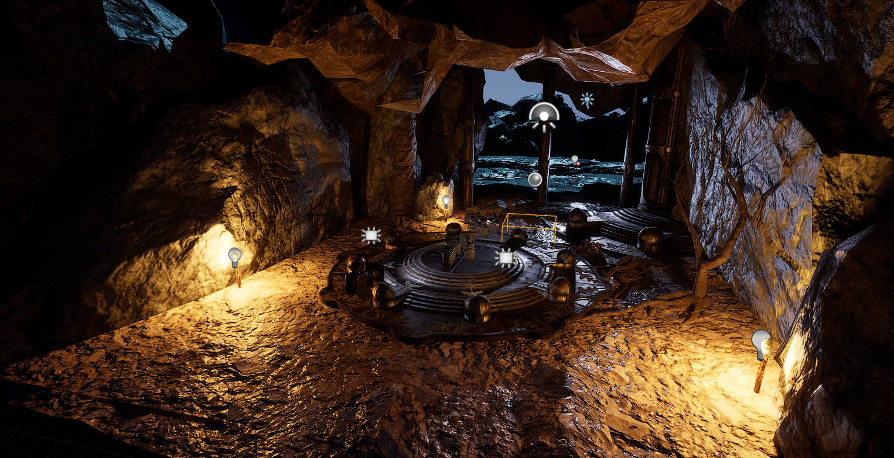
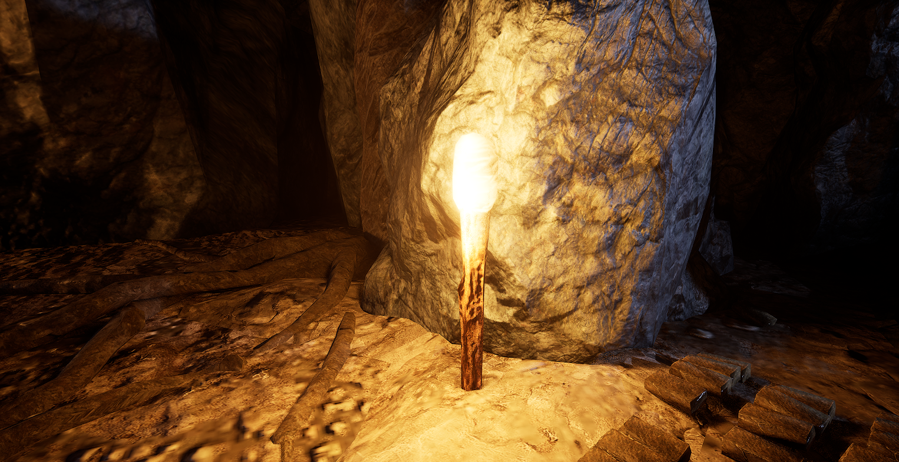
Unreal Engine 5 Scene
Attribution free FAB assets were used to block out the full environment, with a variety of rocks, rubble, and structures like pillars placed to create a scene resembling an abandoned temple in a cave. A 3-point lighting setup was incorporated into the scene organically, using torches scattered around the environment as a key and back light and using the skysphere as a fill light. This helps the character organically blend into the environment and sells the renders as it being a real character in a real space. An idle animation has been incorporated into the turnaround, alongside a close-up ‘hero’ animation of the character reacting to the camera, both complete with facial animations and emissives. These are relatively rudimentary but help to show off the facial topology as well as give the character personality, helping to blend the character into the world of Baldur’s Gate which heavily features character animation and expression due to its nature as a character RPG. The animations feature wide gestures and strong expressions, all of which are common features in Baldur’s Gate 3.

Slide 8
Conclusion
All the components come together to create a unique model that largely fits into the art style and theme of Baldur’s Gate. Due to the fairly unique nature of the character, being a newly undead, there are some issues that come about due to a lack of references. Had the character lent more into typical depictions of liches, using primarily bone and metal rather than loose flesh, more references could have been directly utilised to help inform the character direction. As it is, the character fits the style but lacks direct references for comparison, as Wither’s from Baldur’s Gate 3 is the only direct source of comparison.
Some of the lacking areas, such as the quality of the clothing, lack of experience with fabric simulations and Niagara, can be used as a platform to improve in future work, combined with the application of facial animations and emissive texture blending to help create realistic and animated characters in future.

