Slide 1
The project is about a Film that I created for a charity is called Carmel rock.
This Film will show how a young person goes through in their life and how they become successful in the end. Having a purpose and meaning when the audience looks at it.
This is show how it even effects the world we live in today of how the lower class and upper class in like. If you're in the lower class in society you can still change your life for a better future. To inspire the young people to uplift themselves in difficult times in their lives. Can change life for the better.
To show that everyone is equal regardless of their class and show in through my work. I have been personally going though issues of money, and I want to talk which will be easier in a film to show my ideas.
Am passionate about the differences in these two individual lives and how will portray them in the film.

Slide 2
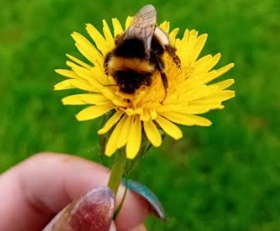
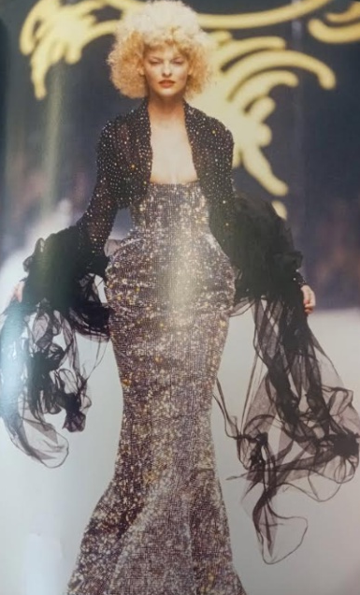
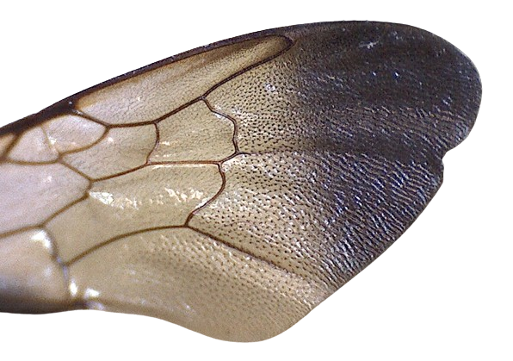
A "Bee” typically symbolises responsibility and a take charge attitude, often associated with royalty or wealth, while "Hive" represents the working class, symbolising those who are less advantaged and lie at the bottom of society
Notes:
This is Visual Mood-boards I created to show what the project is about. Because these are my old designs that I picked was called Bee and Hive. Linking to the classes in society and how bee’s have different classes. For, example worker, drone and queen in the hive. These were my ideas at the start of the project just gathering them up and replacing the images in order.

Slide 3
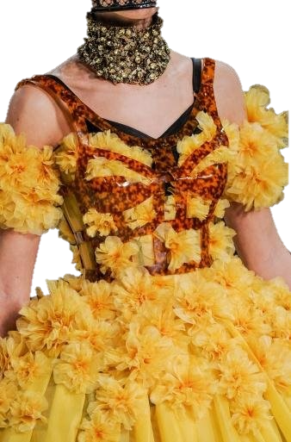
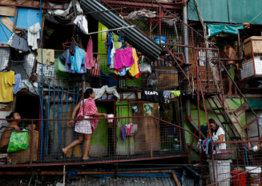
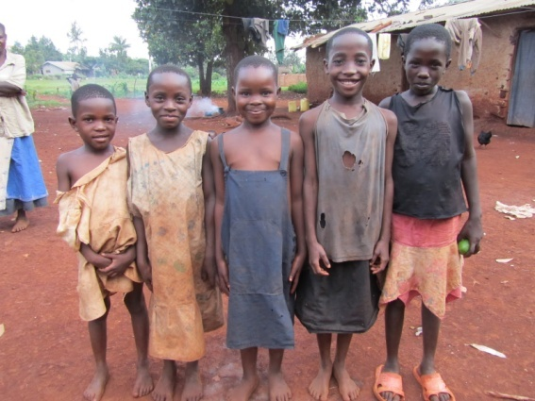
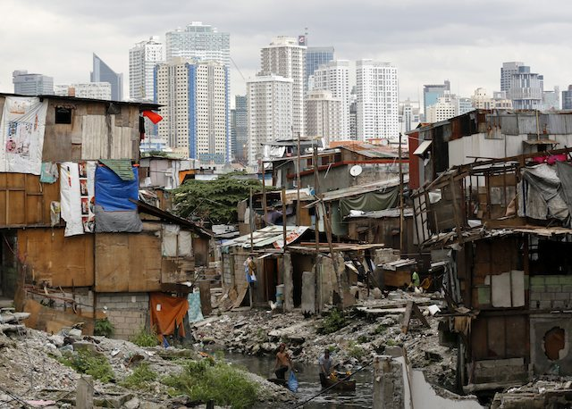
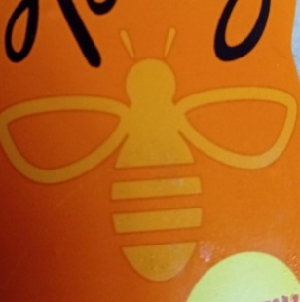
In an ideal world, Society should be equal
Notes:
Also, created more visual designs as can see in this image. Having them replaced into the colours, images and also having words to explain what’s going on the slides. This will make it easier to understand the picture.

Slide 4
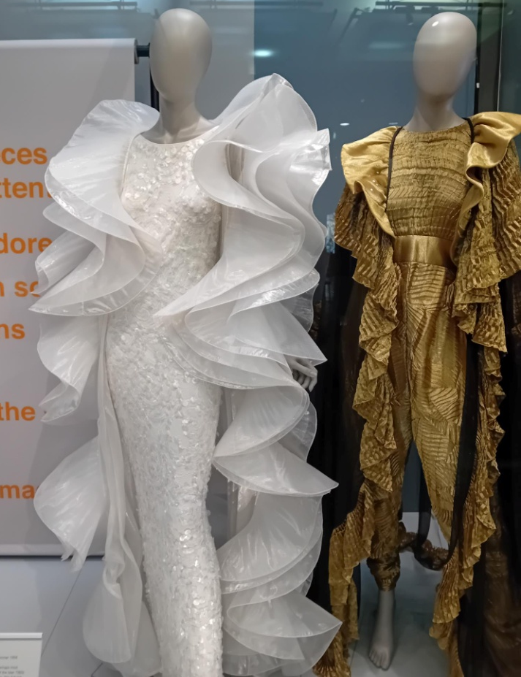
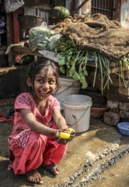
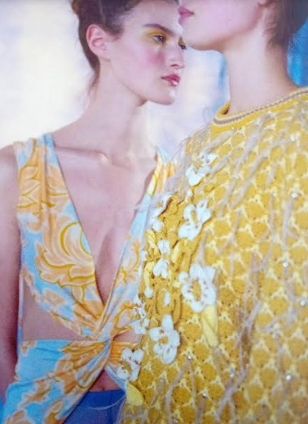
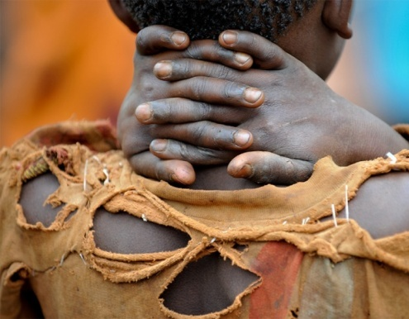
Manchester Art Gallery
Notes:
More visual mood-boards I created.

Slide 5
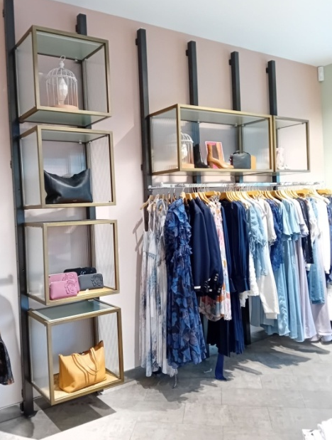
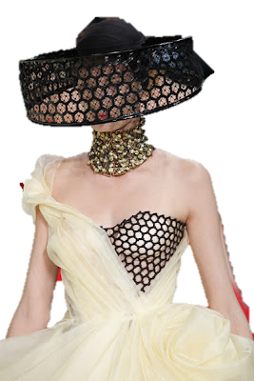
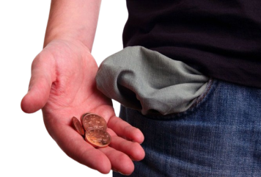
Representing society as we live, visualising a contrast in poorer groups in society, and the wealthy taking charge

Slide 6
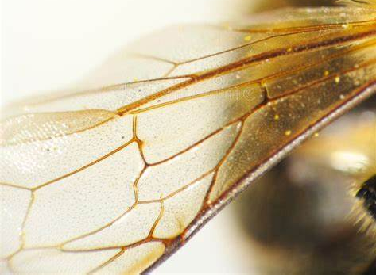
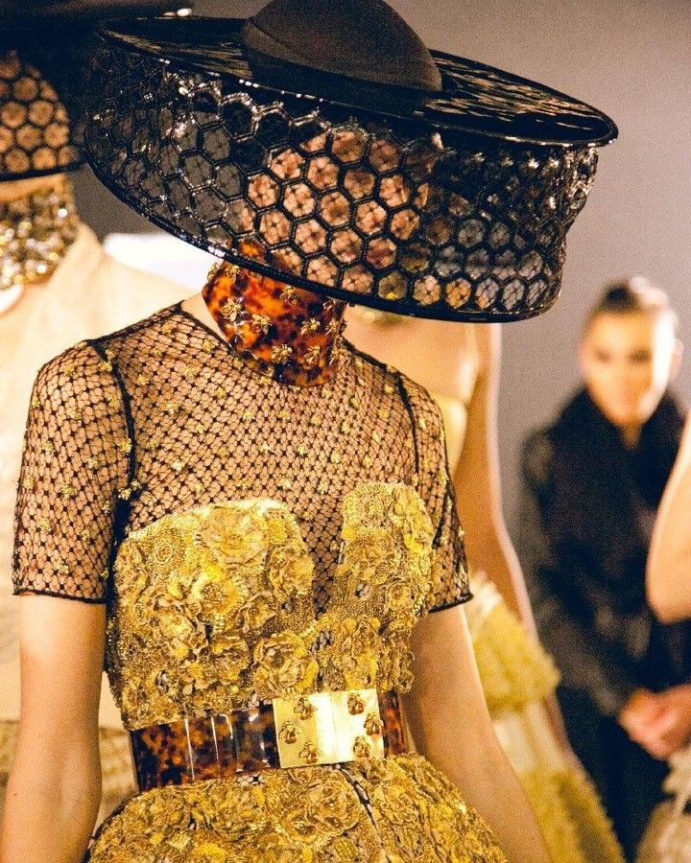
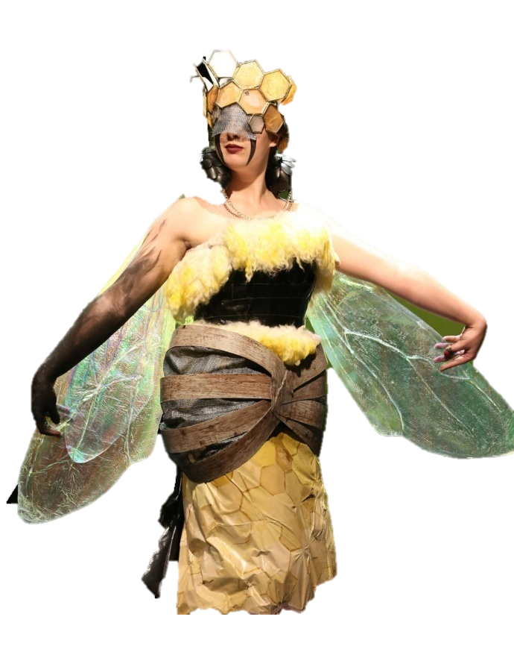
CUSTOMER
Age: 18+
Gender Neutral
Interests: Nature, Fashion, Arts and Beauty
Income: All
Customer behaviour: Supply quality/luxury items to less fortunate groups as well as wealthier groups to minimise inequality
Boost confidence of those less fortunate
Lifestyle: Busy, Hard working, Confident in themselves
Brand line: Its Bridge line

Slide 7
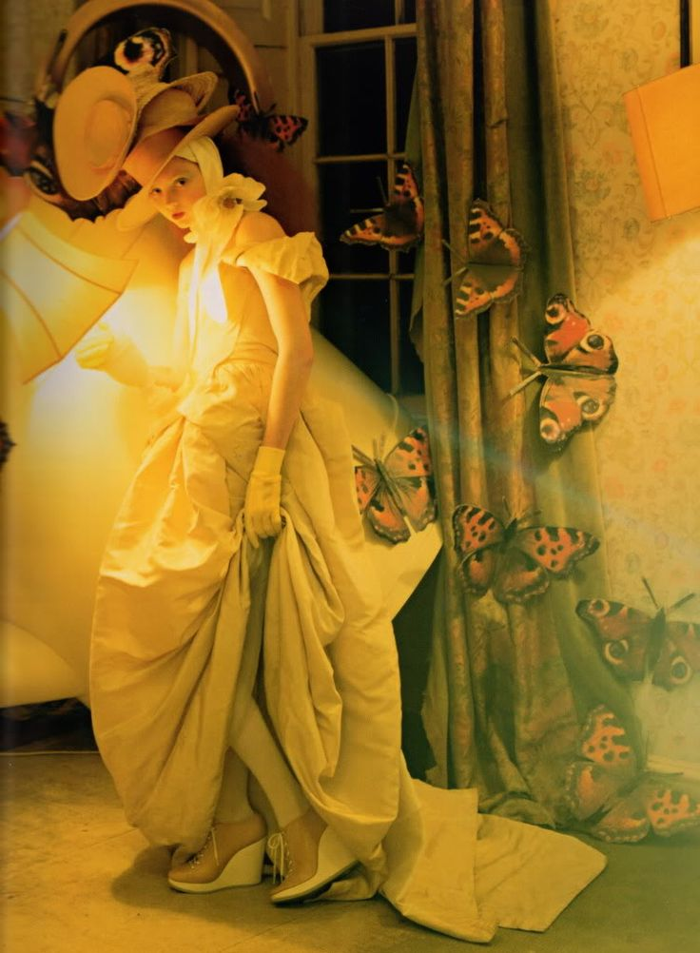
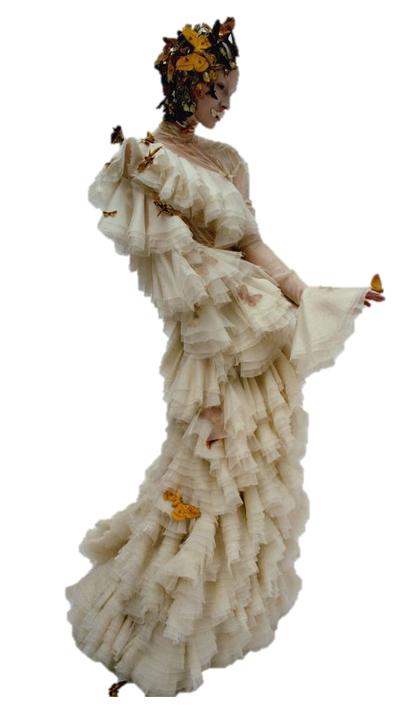
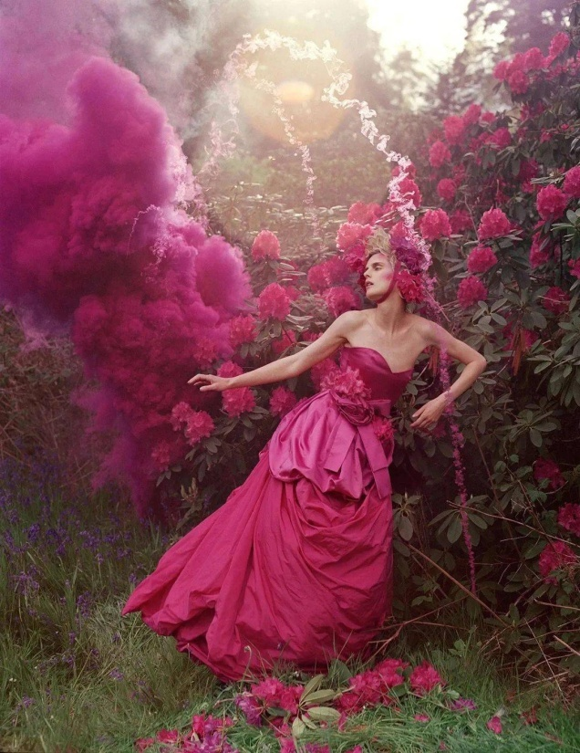
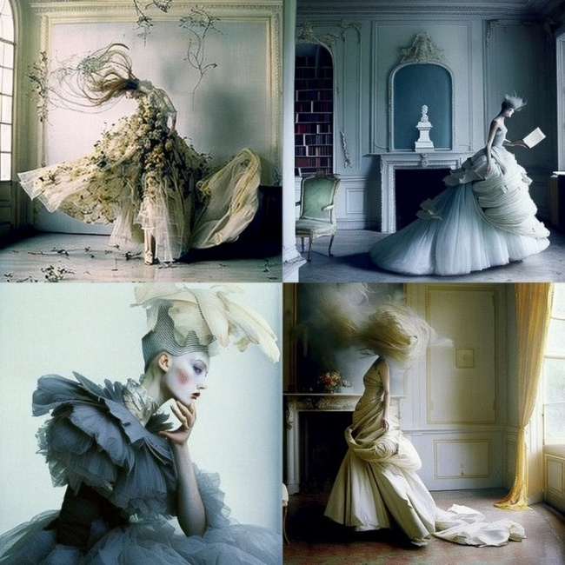
Tim Walker

Slide 8
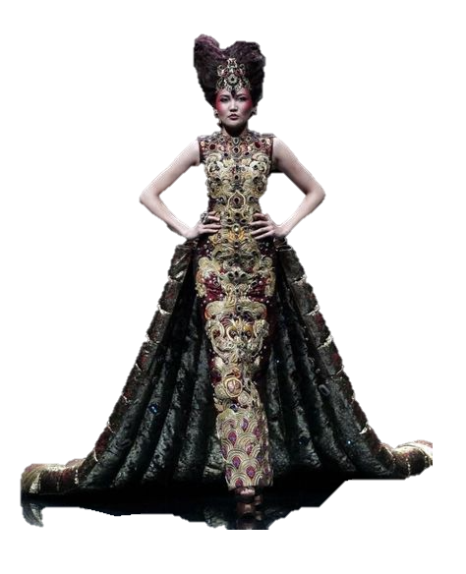
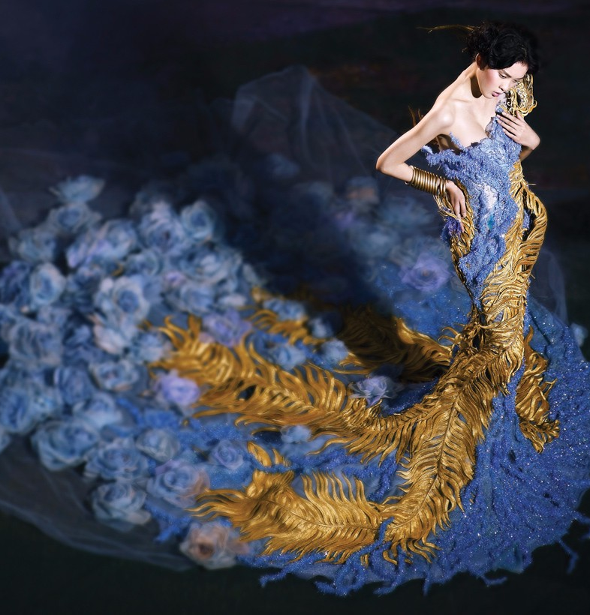
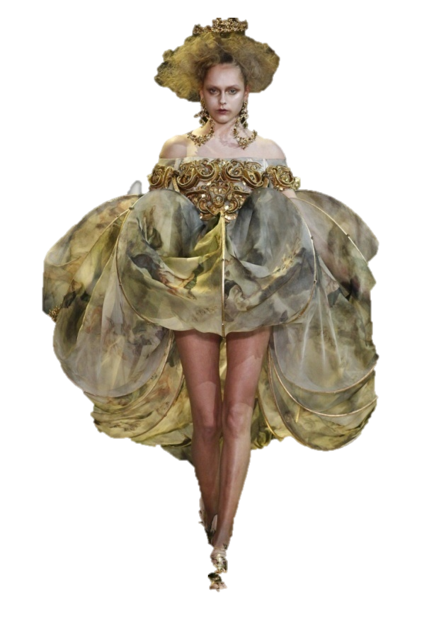
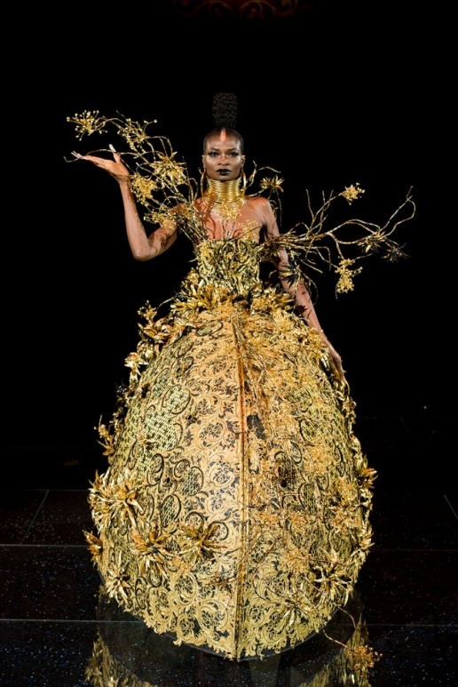
Guo Pei

Slide 9
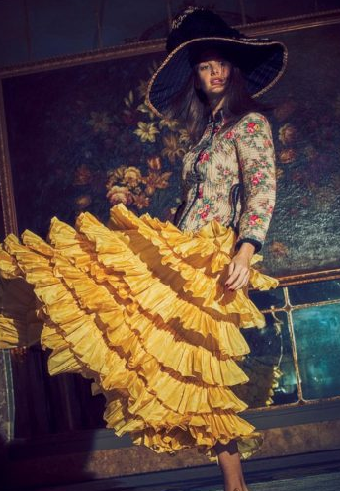
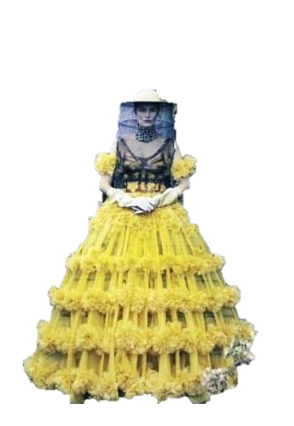
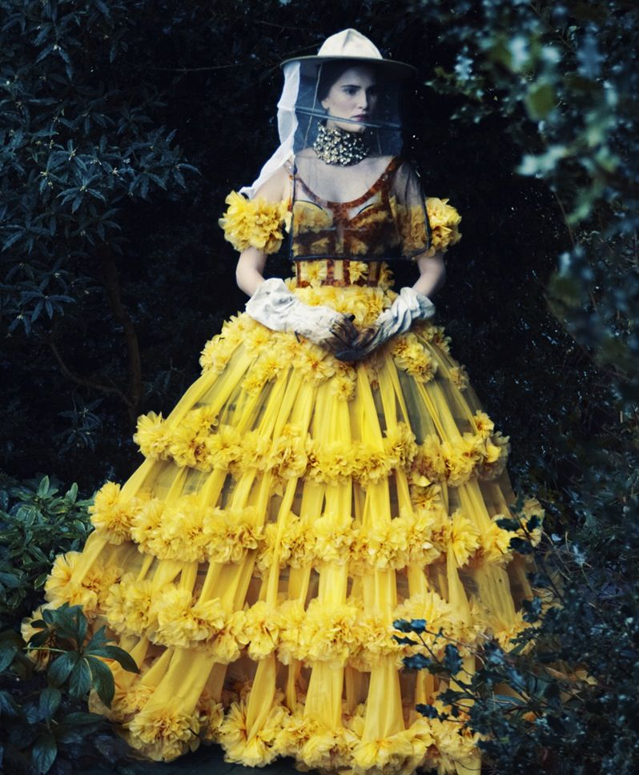
Harper Bazaar

Slide 10
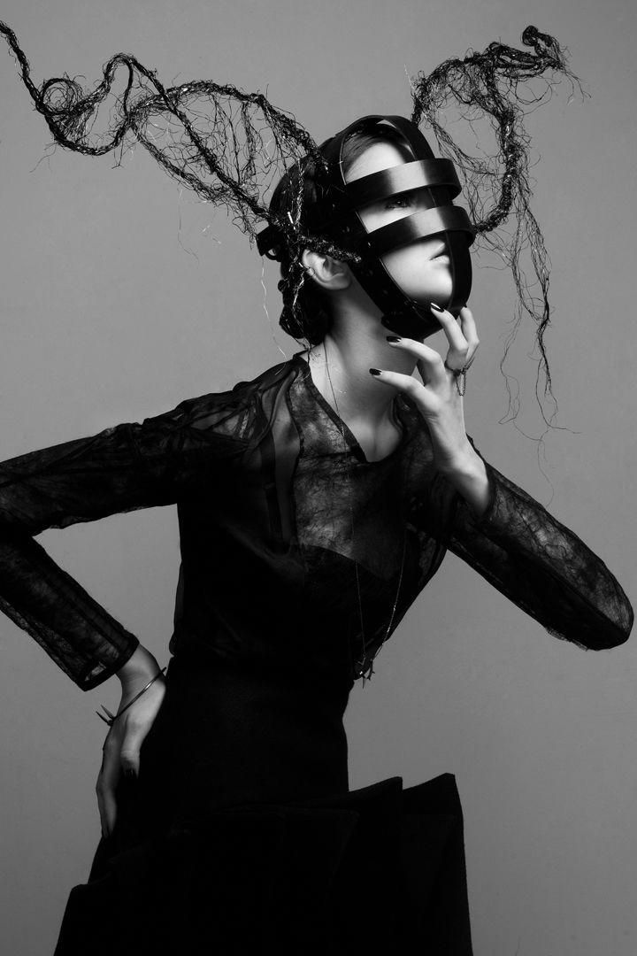
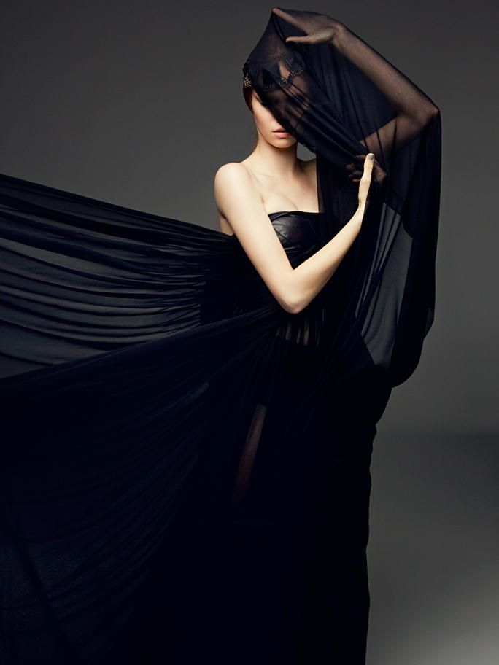
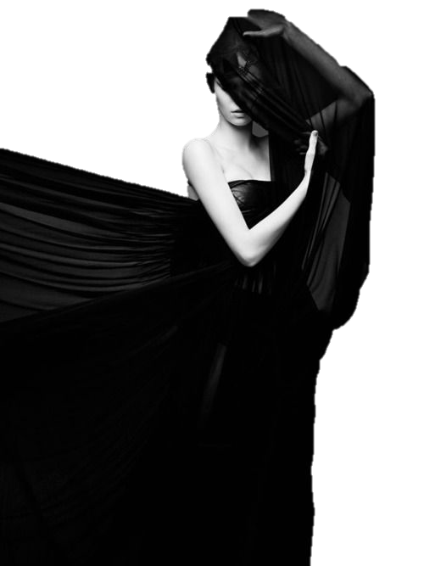
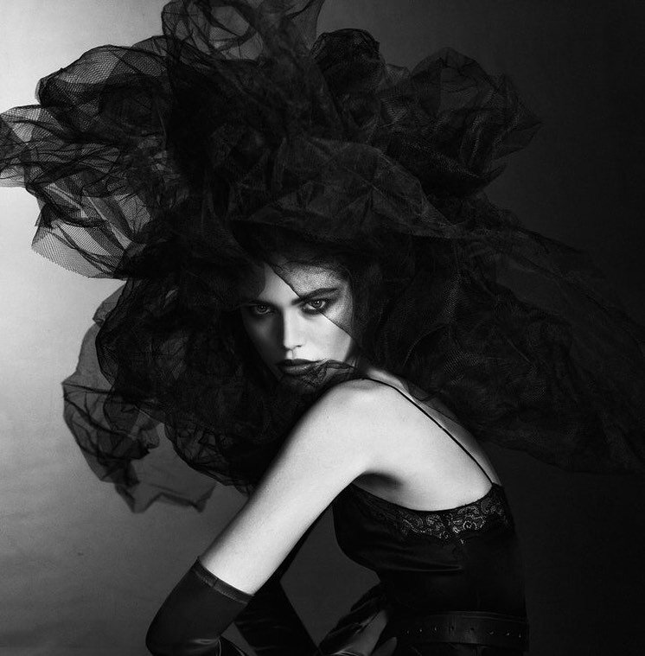
Poses
Notes:
These are ideas to show the poses and how would like the model to pose for my concept. This is a good way to show how will form in a visual way and it’s easy to understand.

Slide 11
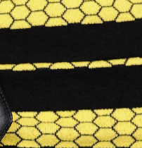
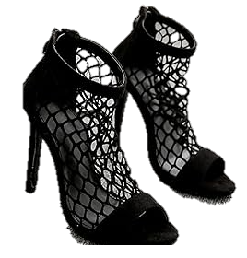
Styling ideas
Notes:
The images of was thinking my project to look like in the start for the styling ideas.

Slide 12
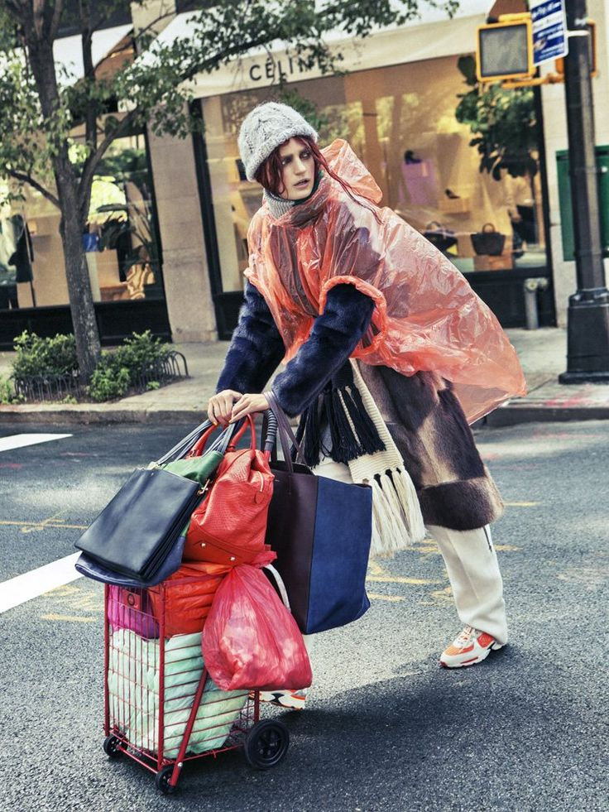
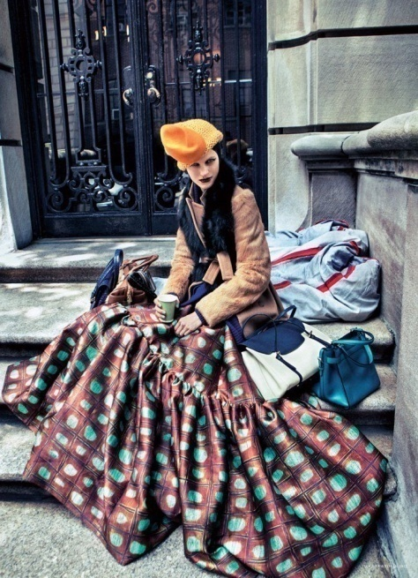
Vogue Sebastian Kim's
Notes:
These images are artist research of what I want the images to form. This one was for the lower class and how the artist portray it in a way for their shoot.
Want this to look like for my fashion film that am create in the final.

Slide 13
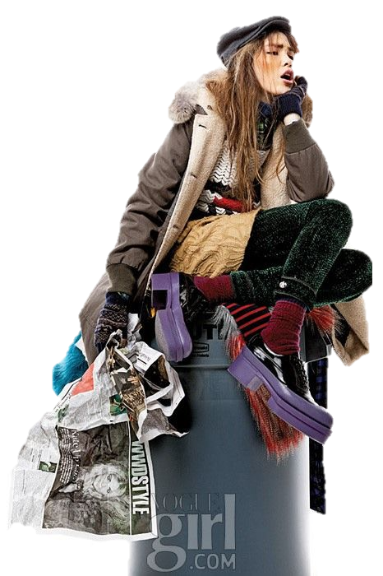
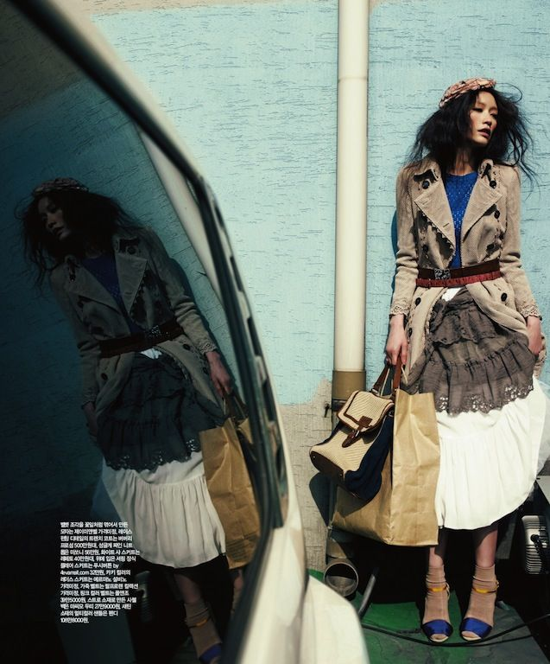
Homeless Chic by Kim Je Won
Notes:
More visuals on artist research on these pages below as can see.

Slide 14
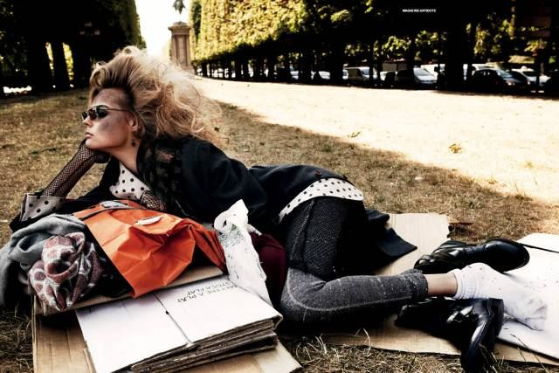
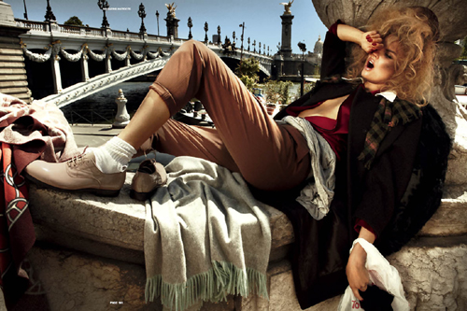
Sgura for Antidote Magazine

Slide 15
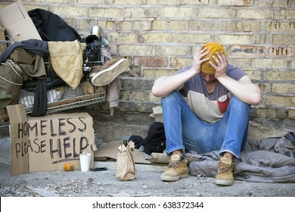
The image of the homeless man really visualises the emotions of sadness and hopelessness. The style of this could be used in my photoshoots to portray these emotions.
This however creates a clear contrast, showing a confident and empowering woman. Creating a divide in luxury and social class.
Notes:
These are about the contrast about the two characters that I will be showing in the film. Their two different lives of the upper and lower class in society and who they are. By also writing the two different people and having visual image to back up my ideas on the subject of classes.

Slide 16
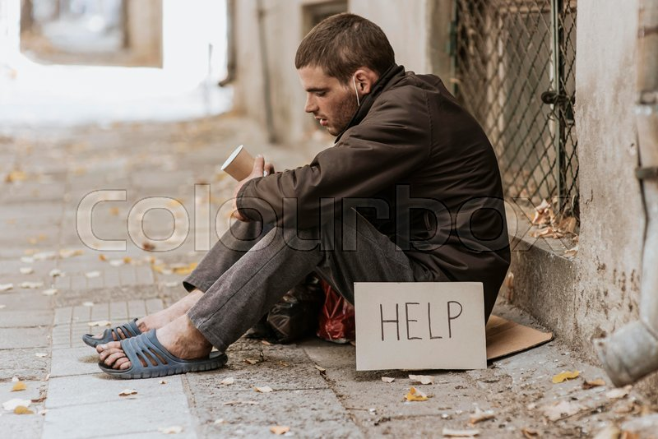
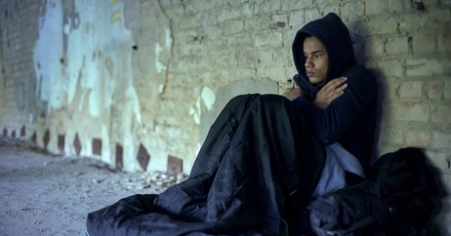
Showing how the working class is affected by financial stress
No nope/ no direction
Notes:
Having visuals to show the lower classes and what the film will be based upon.

Slide 17
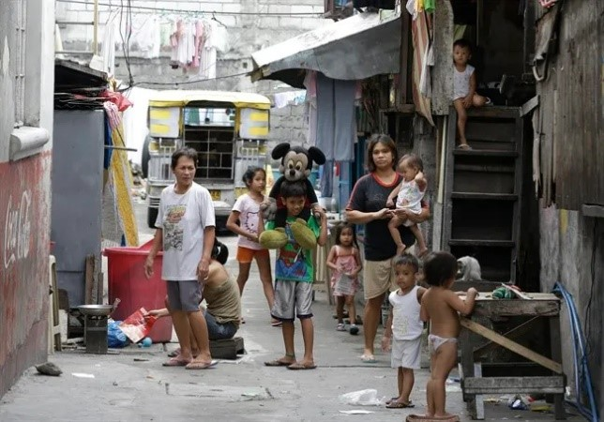
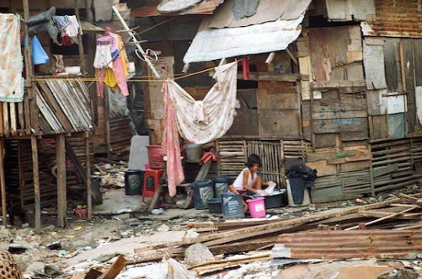
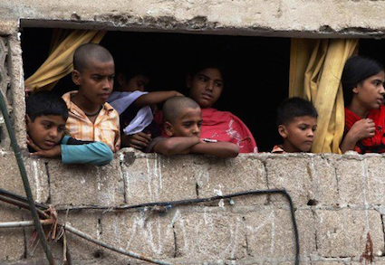
The Working class and less Privileged
Working class= low pay, homeless, less educated, poverty, rural areas living, farms, villages, living in isolated areas, having to survive, mostly are children and old people, lack of something, unemployment, they smell bad, having darker complexion, to be skinny due to lack of food, lazy, living on the streets, people that are addicted to drugs, alcohol and smoking. Look dirty. Low vibe. Undeveloped countries.
Notes:
Explaining about the working class and who they are so having information about these people and say who they are.

Slide 18
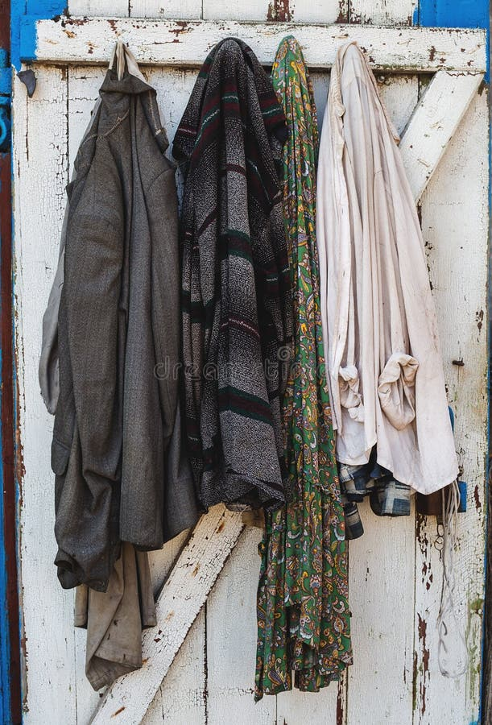
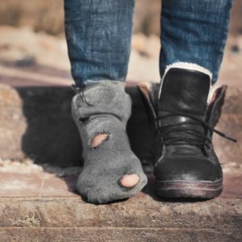
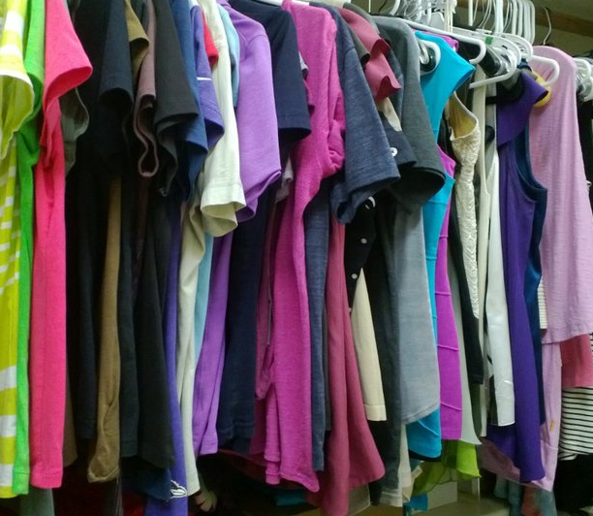
The Working class
Messy clothing = dull colours
Dirty not well put together
Notes:
What clothes do the working class have by giving visuals out.

Slide 19
Middle class
Middle class= Having a family, have education, living in cities and urban places, someone who is police , doctor or teacher. Just in the middle balanced, have lighter complexion, having a normal living life, can have holidays, have good healthcare, owning their own home and car.
Notes:
Saying about the middle class people and explaining who they are.

Slide 20
Middle Class
More style and classy clothes
Looks
Satisfying
Notes:
Showing middle class clothes and what they wear in a visual board.

Slide 21
The Upper Class
Upper class= get everything because of their parents, spoiled, get everything handed by them, posh, well educated, owning properties, thinking that they are the best, having a private jet, ships, look beautiful, smell like perfume, having the best wines, the highest life going places, biggest houses having be grand. Businessmen.
Notes:
Researching the upper class and who they are. By having these information I will have a better understanding for the characters that I will portray for the film.

Slide 22
Upper Class High End clothes
Has way more thought in the clothing and looks so beautiful
It’s a collection of the garments for the seasons.
Well planned colour scheme
Notes:
Having upper class visual clothes and what they wear.

Slide 23
Poses
Notes:
Having poses for visuals.

Slide 24
Fashion film
It’s personal film
Film on phone using editing app
Confident in
themselves
Comparing = upper and lower class
To be
Relatable
Fashion Film
Emotional film
Two different locations
Dramatic at the end
Change the scenes
Empowered
Giving a different way of thinking about lower class
Notes:
Having a Mind-map to say what my Fashion Film will be about by getting ideas across.

Slide 25
Caramel Rock top 3 No.1
Aims= To help the next generation of young people to have access of opportunities and work experiences through fashion course. And to give young people a second chance.
What do they do= Help young people to seek intervention for this charity. Also, to empower and support the young people.
Campaign= Volunteering to help young people to join in.
Notes:
Researching charity that picked is called Carmel Rock. Why is because they help young people that don’t have a good life and to have a second chance.
Which will help the young to succeed in fashion.

Slide 26
Have lots of courses, programs
Can even contact them
Caramel Rock
Helps young people
Can even volunteer for them
Mind-Map
Chairty Collaboration
They help young people to support them and empower them.
Help adults and young people for the future
Improving skills and work experiences
Notes:
This is a Mind-map of the charity and what collaborations they do.

Slide 27
To empower and help young people to be themselves
Will be like a story about them and how they change and grow
Making it personal advert by giving emotion to the film.
Caramel rock= A campaign
Advert =
Marketing campaign
Will be unique and creative
To show fashion as a booster for young people to get inspired in this advert
To help people who are struggling and shed light to them.
Will give awareness to the young people and make them independent.
To also wok as a team of like-minded people

Slide 28
What my Fashion Film will be like = Visuals
Notes:
More visual ideas of how I want the film to look like and to portray.

Slide 29
Working Class Character Boards
Always having to worry and stress over things.
Bad choices affect them= leads to addictions.
No Goal/Ambition
Uneducated= poverty
Unemployment/ low effort.
Notes:
Description of the working class with visuals.

Slide 30
Working Class Styling Boards
Having tents to live in. = small and space.
And signs to say something to commutate with others . = For help,
Sleeping bags that
they sleep having no
where to go in the
streets.
Using cup as sign of reserving help and support.
Notes:
Ideas for working class style boards.

Slide 31
Working Class Poses
Slouching and sloppily positing sides
Deformed body and weak
More inside and broken.
Smaller body and is more regret.
The body is more reserved and is closed as a ball.
Notes:
What I want the poses to form for the film of the working class.

Slide 32
Middle Class Character Boards
All simple and has a good job to pay their bills
Can travel freely and can express themselves better than the working class
Family oriented and togetherness
Can make decisions and is basic quality of living
Notes:
Description of the middle class and who they are in visuals and annotations.

Slide 33
Middle Class Styling Boards
Is educated from collage and school
Goes to restaurants, coffee shops and parties.
Nice family with a house and car
Normal basic work and nice family.
Notes:
Styling board for the middle class and how I want them to look like for the film.

Slide 34
Middle Class Poses
Happy and enjoying themselves
Friendly and active people
Busy and bustling
Volunteering in their community.
Have the basic needs that human needs= Food, shelter, clothes ect.
Notes:
The poses for the Middle class and what I want it too look like visually.

Slide 35
High End Class Character Boards
Confidence
Hard – working
Resilience
Action taker
Change
Strong
Ambition
Smart
Brave
Unique/different
Success
Snobby
Notes:
Annotations of the high end class and who they are.

Slide 36
High End Class Poses
Not really caring and shows off their clothes and themselves
The poses are all about ME ME ME and shock value poses to get others attention
Very confident poses
And striking them in a unique way
Wider and more open body poses
Notes:
What I want the poses to form as high end class in society for my Film concept.

Slide 37
Mood board of Character 2 Successful Female)
Notes:
Mood- Board ideas for upper class Successful woman.

Slide 38
Research Campaign in Dept Caramel Rock
It is a fashion and art education that helps young people though training and opportunities.
Giving them the experiences they need for the future.
Their goals are to help young adults to become in fashion employment and giving them the skills they need.
Notes:
Researching the campaign and who they are.

Slide 39
Their collaborations
They worked with refugees and asylum seekers that to help in the local community that is called Refugee Fund Newham
Giving them support though difficult issues in their lives
To engage with others when
help is needed
Notes:
Cameral rock collaboration and who they are.

Slide 40
Another Collaboration
This collaboration is with West Field East Bank Creative Future Fund that helps young people who are in issues that involve street crime.
To help others that need in education, training and employment.
Notes:
More collaborations about them.

Slide 41
Act 1 = Programme
Is an after-school program that helps young people to be creative though project.
To engage with making garments for each person having meaning when designing them.

Slide 42
Social Media For Caramel Rock Advert
Address 17-18 Lower Dock Walk,
London E16 2GT
Email= admin@carmelrock.com
Phone = 440207 7476 3222
They are on Twitter/X, Instagram and Facebook
Notes:
Researching their social media accounts of Caramel rock.

Slide 43
What are you waiting for
Encouraging Empowerment
Empowering and supporting young people
Thrive within
Carmel Rock
For the Tag line use three words
Start Young go hard
Young empowerment
Rise above Now
Empower , success , creative
No limits
Notes:
A mind-Map of the charity.

Slide 44
Storyboard 1 (Young change )
Opening Scene is when see a young woman is running away from home to a park begging on the bench.
Then a rich businesswoman goes and gives her business card and note to the young woman.
But instead of the money it’s paper in the cup= saying the words of confident, empowering and independent.
She decides to call them on the business card.

Slide 45
Storyboard 2
When she calls them, they pick up and she starts to change her life by going to collage.
Starts to change by the person who gave her the note. Gets inspired by what the businesswoman gave her in the park.

Slide 46
Storyboard 3
Jessica begins to work hard in collage so she can get a job to change her future for the better as you can see in the scene.
To prove herself that she can do this even though she had so many problems in her life.
No matter what she gets herself together and works for her dream job.

Slide 47
Storyboard 4
Then you see Jessica going to a job interview she goes in.
She passes the interview and gets her first job that she dreamed of getting into fashion. She gets happy with the results.

Slide 48
Storyboard 5
She comes out and is totally different version of herself having more confident in herself and way better approach to life than before as a homeless person
She walks with heels, beautiful dress on and hair long and strong woman
Walks in the park all changed

Slide 49
Storyboard 6
Her walking see a homeless person the same way she was brought up than decides to give them her business card and note to the person on the bench.
They start to get it out of the cup Jessica gave and starts to read the note and the business card.
Circle repeats itself.

Slide 50
Visual Story Board
Young woman
Difficult
Changing
For a better Future
Confidence
Independent
Un-worthy
Notes:
Visual of the lower class.

Slide 51
Visual Story Board
Self- Improvement
My Future
My Life
Woman Empowerment
Changing for the better
Notes:
Another Visual mood-board for the upper class.

Slide 52
Character profile = A working class
Personality= Underprivileged , Tired, Annoyed, Unfriendly
Traits= Addicted, Cold/ Angry,
Appearance= Not attractive, Dirty, tired and struggling
Gender= Female
No Job/ hopeless
Notes:
Information about their character profile and who they are.

Slide 53
Character profile = Upper class
Personality= Confident, Not really caring, bossy,
Traits= Posh, lavish, power driven, hard working,
Appearance= Beautiful, Attractive, through out well
Gender= Female
Occupation= Businesswoman
Notes:
Another one for the information about their character profile and who they are.

Slide 54
Styling ideas and clothes
Will be a suit and the other design will be trouser and shirt.
To show the different contrast of the two sides.
Showing variation of the two individuals.
This will highlight the differences of the two by the clothes.
Notes:
Having the styling and clothing ideas of what I want it to protray.

Slide 55
Poses and gestures
To be confident and bold.= freer / spread.
Other one to be lazy and low/ less spread-out body down showing smaller frame
This will show the difference of the two
Notes:
Having the gestures and poses for the film ideas.

Slide 56
Lighting
But also using edits using apps to change the styling
Also, having a gaffer and photography director helping me with the shoot.
To have the effects of camera of editing them at the end.
Notes:
What will use for the lighting for the film by also annotating above.

Slide 57
Makeup and hair
For the upper class
Hair= will be natural in a bun at the start of the film.
Makeup = Natural look that will be for the film shoot at the end than change when it’s progressed.
Notes:
Describing the makeup and hair how will look like for the film. Having it look natural form for the shoots.

Slide 58
Final locations / Reason why I’ve changed them
5 Locations= Hanley Park, student accommodations area, Inside the fashion rooms in University and another area the catalyst building
Hanley park was close and easier to do the shoot. Instead of going far which would be difficult to shoot them.
Also, using the university area was giving more personal dept to the film that young people can relate to.
Notes:
Getting the final locations and explaining why I changed them.

Slide 59
Final Styling shoots / Reason why I’ve chosen them
This shows the how beautiful and confident in this scene of the successful woman at the end
Becomes more professional when Jessica the actor is in an interview.
Other older woman having business clothing on to show how success and confident she is to pass it on Jessica for the final ending.
The start having her not wearing the best of clothes and bag giving sense of none hope.
Notes:
Also, having the final styling shoots and reasons why I chosen them by annotating it above.

Slide 60
Mood board for your chosen charity and the message
START YOUNG
GO HARD
Message is to
Start Young go hard for the slogan
Notes:
Getting ideas for the slogan and message for the charity.

Slide 61
Mood board for your chosen charity and the message
Start young go hard
The line below will say “ This will make you successful within life and make your own decision.”
Or say, “ Because this will make your life easier and your destined to success.”
I changed this by having the intro as Young change and the slogan as What are you waiting for.
Notes:
Having the message for my mood-board.

Slide 62
Storyboard
1. They are homeless not having a good life. Which is shown in a way of confusion and no purpose.
2. But this will change very quick. By a cup having money and a paper to say something positive. This will influence them to get a better direction.
3. Then gets more shown through this person’s life. By her walking more confident and successful. The middle of the scene. Shift scene.
4. Totally different person and much better than before. Due to that message, she read and is a different version of herself.
5. This scene will be her carrying beautiful bags. She is beautiful. But than her walking she see the person who was like her back than.
6. She starts to get emotional than decides to give her money/ paper. Homeless woman gets happy, and she begins to feel better about her situation. The cycle repeats.
Notes:
A storyboard with words written on.

Slide 63
The shoot images behind the scenes
To show how the shoots will look like as you can see. Showing the sound and the lighting
Give an understanding of what's going on.
Notes:
Having behind the scenes images of what they look like by working with everyone in the film.

Slide 64
The old script
Notes:
Having the old script for the Film.

Slide 65
New script
Notes:
Now changed to the new script.

Slide 66
Visual story board of final film
Notes:
Having a Final Visual board for the Film.

