Slide 1
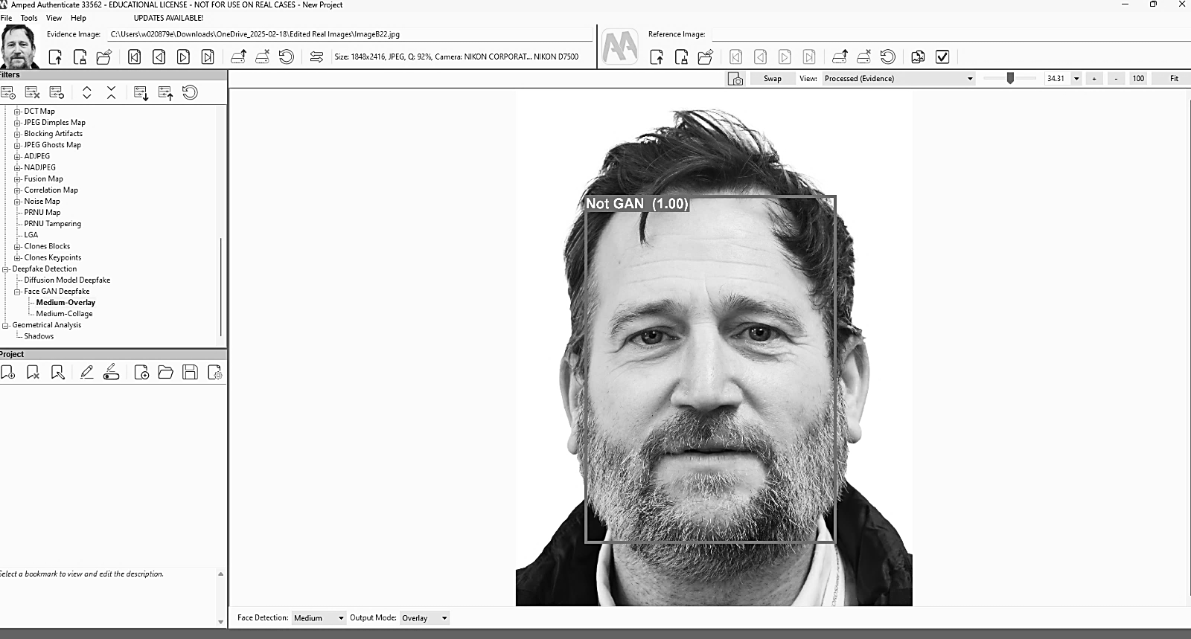
An Analysis of Amped Authenticates Accuracy in Detecting
AI-Generated and Real Facial Profiles for Criminal Investigations
Rhiannon Watkins, Dean Northfield
School of Health, Education, Policing & Sciences, University of Staffordshire, ST4 2DF
Introduction
The growing sophistication and accessibility of deepfake and image manipulation technologies have significantly weakened the reliability of multimedia evidence in criminal investigations. Once requiring specialised skills, digital content can now be convincingly falsified with AI-based tools, posing serious challenges to authenticity and legal admissibility (Hydara et al., 2024; Sencar et al., 2022). Beyond forensic concerns, deepfakes have been exploited in political, commercial, and criminal contexts, causing substantial harm—as seen in Arup’s $25 million scam in 2024 involving deepfake impersonations (Zubiri, 2024). Given that images and videos often serve as vital legal evidence, developing robust verification tools is essential. This study evaluated Amped Authenticate, a forensic software designed to detect digital manipulation, by testing its accuracy and reliability on controlled image sets. The research aimed to inform best practices and support forensic integrity in the age of advanced AI-driven deception.
Methodology
AI and Participant Image Testing
Each image was uploaded individually onto AA as a single artifact.
A ‘Smart Report’ was generated which provides a traffic light system triage report on the authenticity of the image. An image may be classified as red, amber or green. These results were noted in a table.
The GAN filter was then applied to the image. The software provides a confidence score ranging between 0-1 as well as providing a classification of GAN, Uncertain or Not GAN. These results were then added to the table.
In total there were 90 AI generated images, and 22 participant images tested
Methodology
Participant Questionnaire
Participants were invited to complete a voluntary questionnaire to assess their ability to distinguish between genuine and AI-generated facial images.
The questionnaire included 20 AI-generated images, representing a mix of sex, age, and ethnicity, all previously used for software testing.
Only AI-generated images were included due to ethical considerations.
Participants provided their immediate reactions to the images, as AI and genuine images are rarely shown side by side in real life.
A total of 38 participants completed the questionnaire.
GAN Filter Confidence Score
Fig 1: GAN Filter
Conclusion
This study aimed to evaluate the value and accuracy of the image authentication software Amped Authenticate for use in criminal investigations. The objectives were met through a literature review, software testing, and user trials. The review highlighted the growing need for reliable forensic verification tools, while testing with both AI-generated and genuine images offered insights into the software’s capabilities. Results showed that the GAN filter often misclassified AI-generated images as real, with higher confidence scores for "Not GAN" classifications. Similarly, the Smart Report produced inconsistent results, casting doubt on its reliability. These outcomes support the null hypothesis: Amped Authenticate cannot consistently detect AI-generated images. User testing further revealed that most participants struggled to identify AI-generated faces, with 51.85% believing the images depicted real people and only 40.45% correctly identifying them as artificial. These findings echo existing research and underline the difficulty both humans and software face in detecting image manipulation. Despite its limitations, Amped Authenticate adds value to investigations by offering support in a task that is increasingly beyond human capability alone.
Results and Discussion
AI Images
All 90 AI-generated images underwent identical processing yet received mixed GAN classifications. Several images were incorrectly classified as ‘Not GAN’ with full confidence (1.0), highlighting a risk of misclassification. On average, ‘Not GAN’ scores exceeded ‘GAN’ scores, suggesting the software is more likely to deem AI images as authentic. Smart Report classifications also varied between ‘amber’ and ‘red’ without clear justification, despite identical workflows. No ‘green’ scores were recorded, as expected for non-camera-original images.
Participant Images
The GAN filter classified all 22 participant images as “Not GAN” with high confidence, supporting the alternative hypothesis that Amped Authenticate (AA) can correctly identify camera-original images. The Smart Report returned no ‘green’ ratings—expected due to background edits—but most were classified as ‘amber,’ indicating metadata changes without signs of tampering. A few images were rated ‘red’ despite identical processing, raising concerns about consistency. Overall, the results suggest AA reliably recognises authentic images, even after minor editing.
Participant Questionnaire
51.85% of participants believed that the images were depicting a real person.
40.45% of participants believed that the images were depicting an AI generated person.
5.95% of participants stated that they were unsure.
Participant responses were analysed to identify trends and possible reasoning behind their classifications. Most participants classified the AI images as real, with two individuals believing all AI images depicted real people. This highlights the increasing realism of AI-generated images, aligning with Verdoliva (2020), who noted the growing difficulty in distinguishing between authentic and manipulated multimedia.
These findings show that the filters used cannot reliably detect AI-generated images. However, the GAN filter and Smart Report may still offer a useful starting point for analysts, guiding further investigation with additional filters rather than serving as standalone authentication tools. However, given that Amped describes the Smart Report as a triage tool for handling large volumes of media, its value is questionable when both ‘red’ and ‘amber’ classifications appear to serve similar functions. This raises the question: could a simplified system—such as just ‘red’ and ‘green’—better support investigative workflows? Further research is needed to clarify the basis for these classifications and determine their practical relevance.
References
Hydara, E., Kikuchi, M and Ozono, T (2024). 'Deepfake Detection System for Facial Evidence Verification in Criminal Justice and Its Legal and Ethical Implications', 23rd International Conference on Intelligent Systems Design and Applications, ISDA 2023, Olten, 11 December 2023 through 13 December 2023. Available at doi: 10.1007/978-3-031-64650-8_10 (Accessed: 25/10/24).
Sencar, T., Verdoliva, L and Memon, N. (2022) Multimedia Forensics. Singapore: Wiley. Available at: https://library.oapen.org/viewer/web/viewer.html?file=/bitstream/handle/20.500.12657/54043/978-981-16-7621-5.pdf?sequence=1&isAllowed=y (Accessed: 24/10/24).
Verdoliva, L. (2020) ‘Media Forensics and DeepFakes: An Overview,’ in IEEE Journal of Selected Topics in Signal Processing, vol. 14, no. 5, pp. 910-932. Available at: 10.1109/JSTSP.2020.3002101. (Accessed: 17/12/24).
Zubiri, P. (2024). Top 5 Cases of AI Deepfake Fraud From 2024 Exposed | Incode. [online] Incode. Available at: https://incode.com/blog/top-5-cases-of-ai-deepfake-fraud-from-2024-exposed/. (Accessed: 04/04/25).
Fig 2: Results

