Slide 1
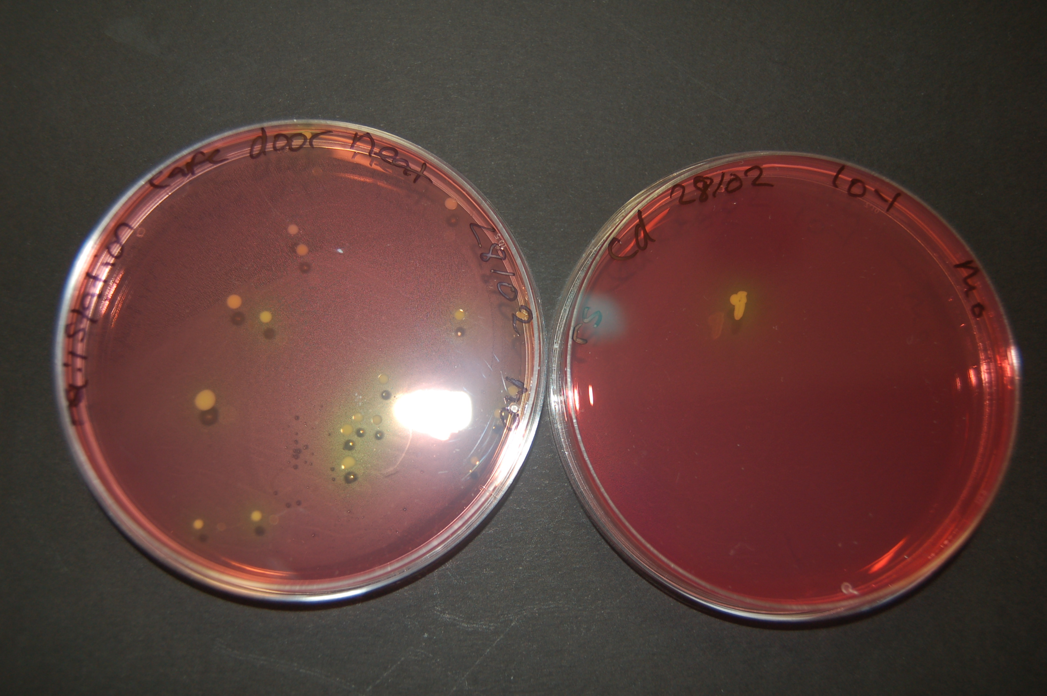
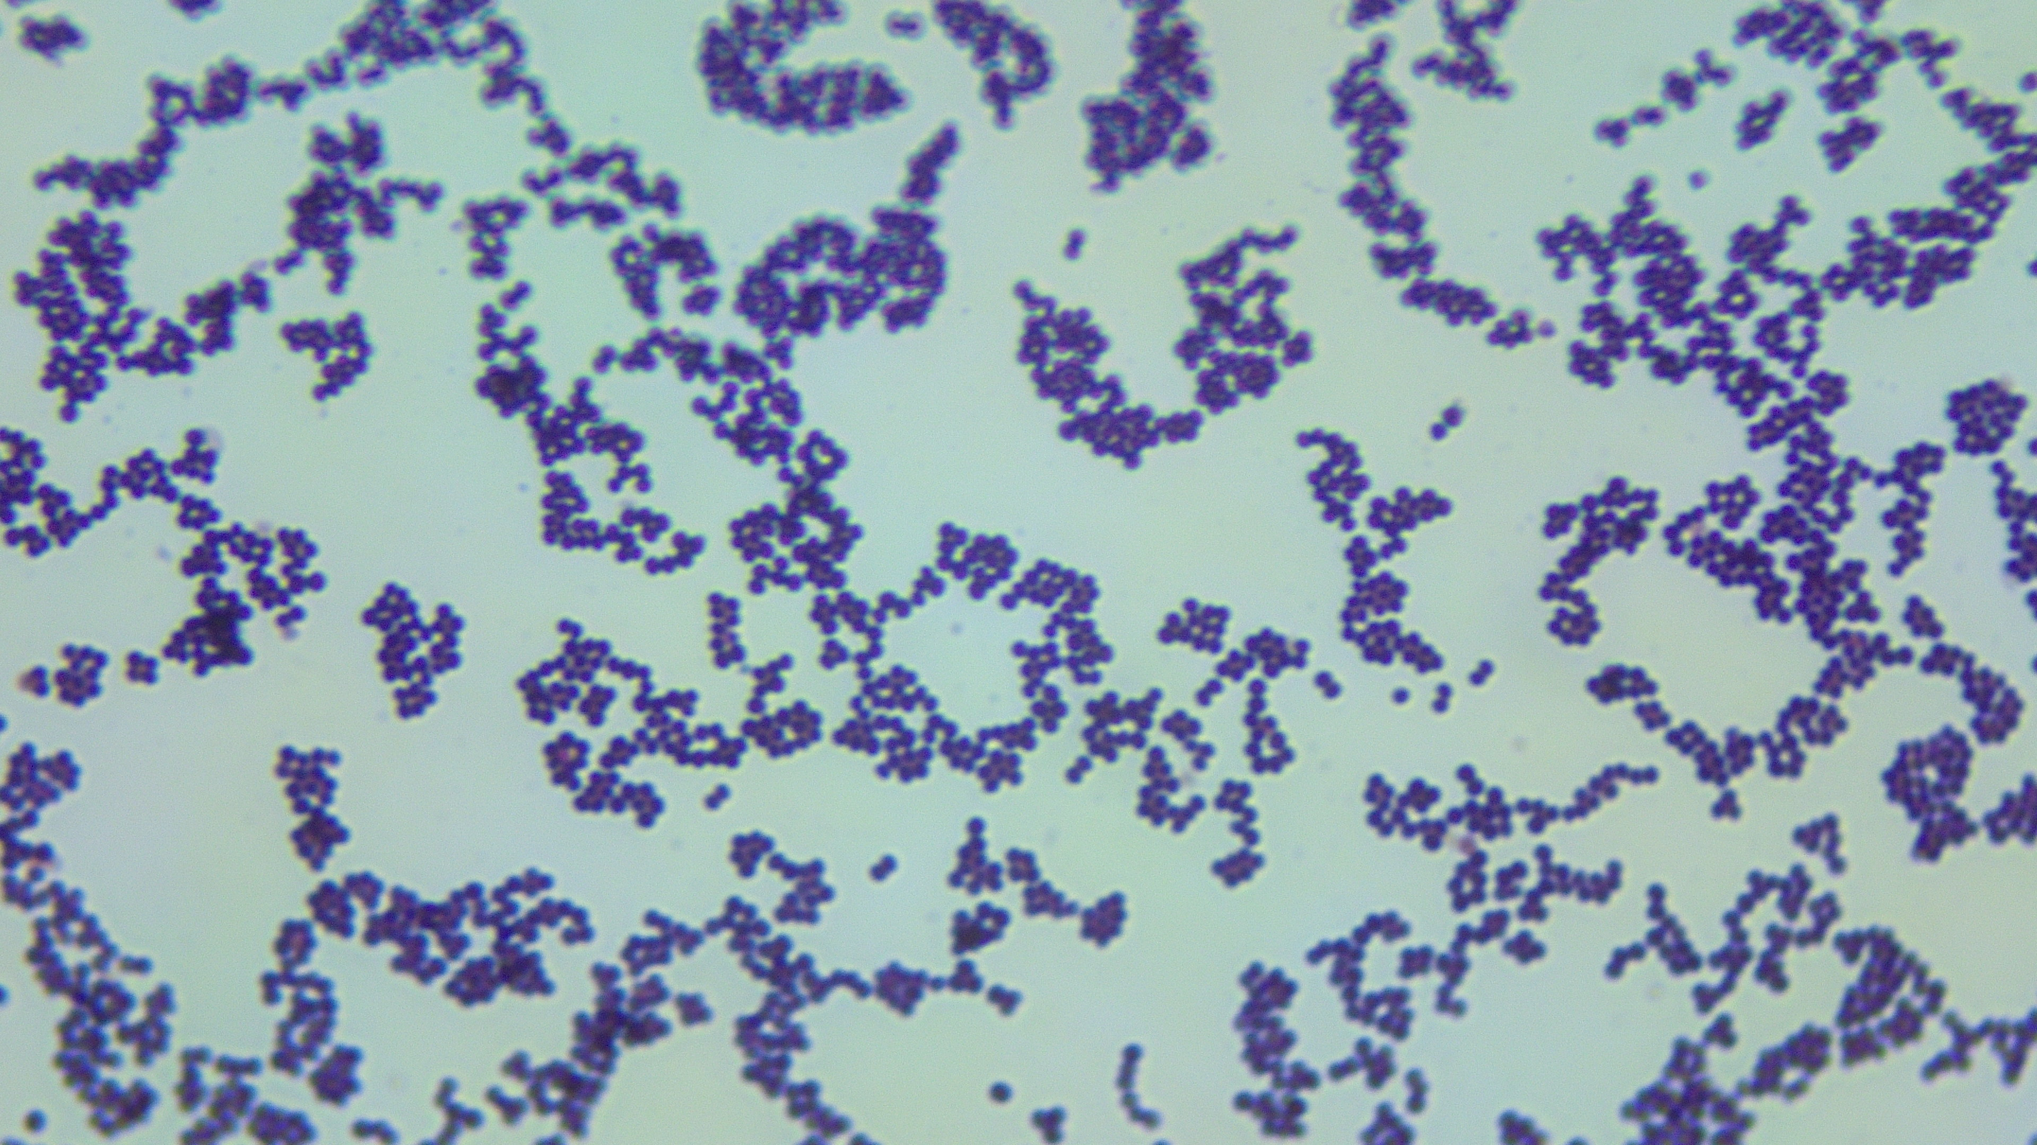
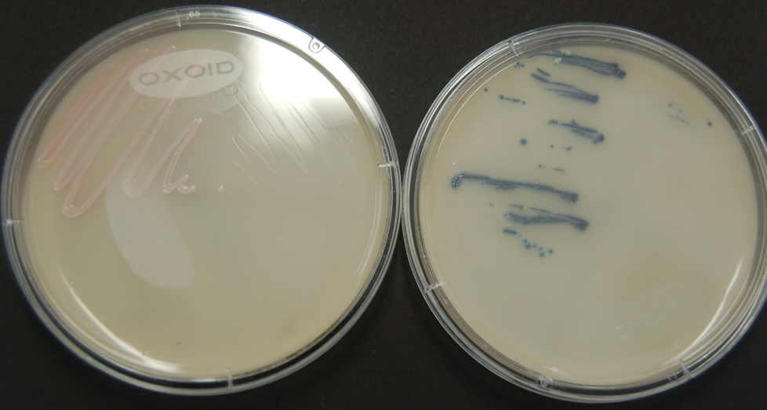
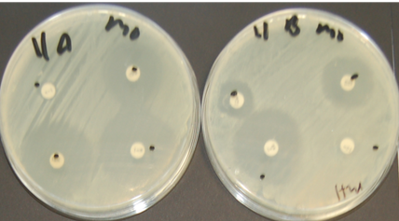
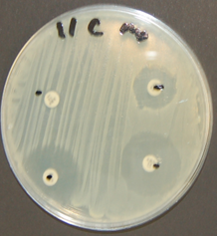
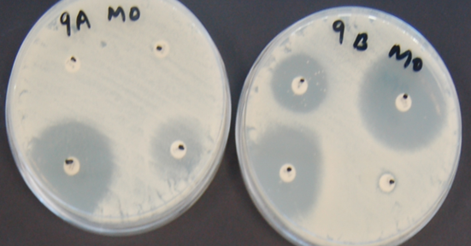
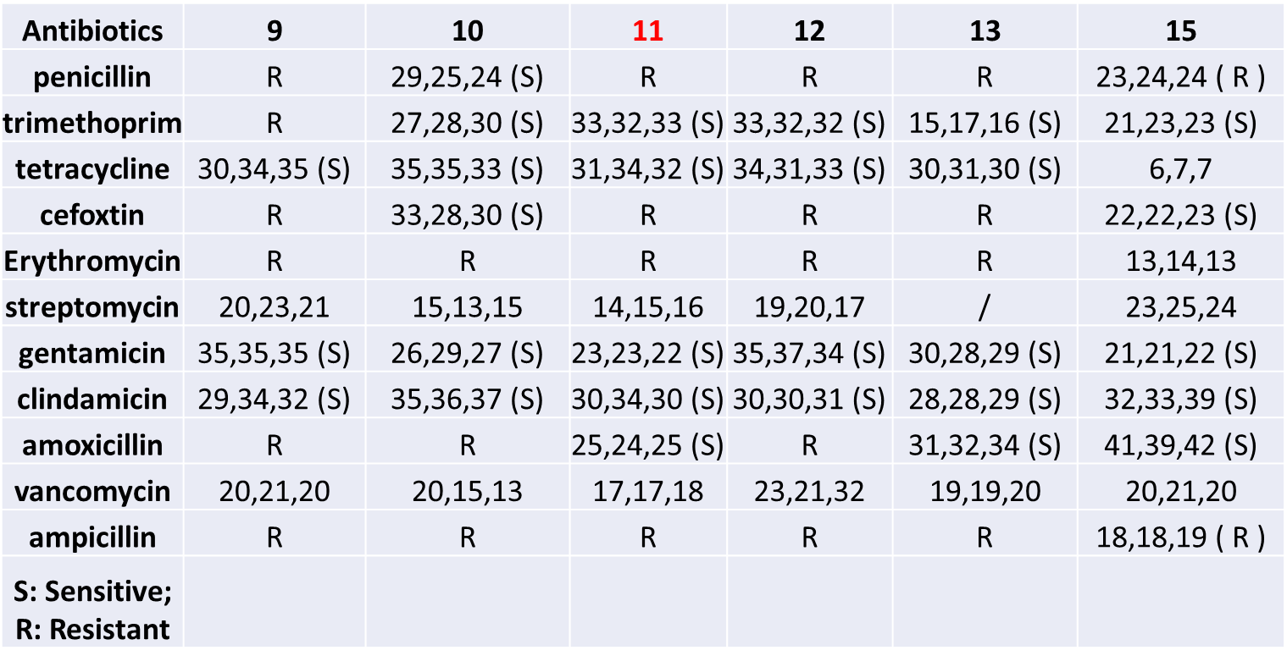
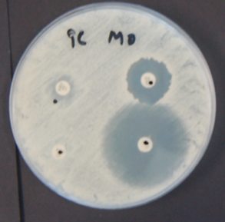
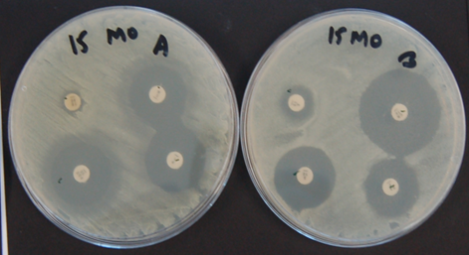
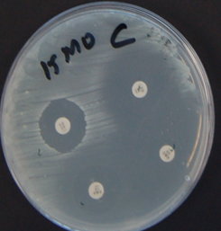
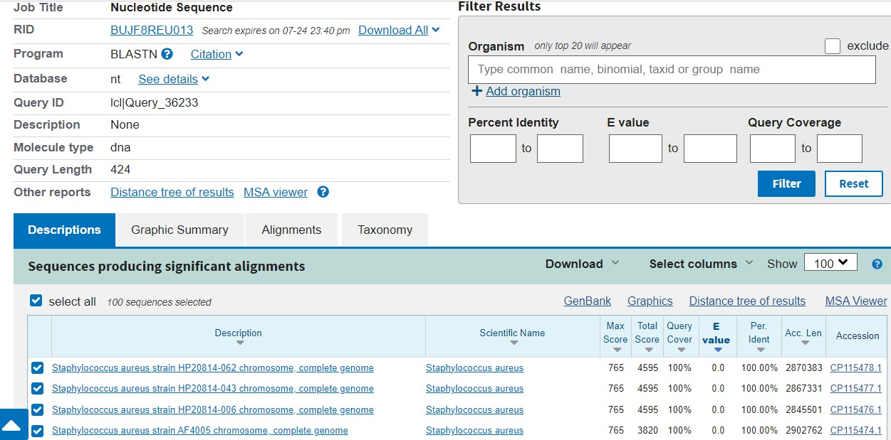
To investigate the prevalence of antibiotic-resistant Staphylococcus aureus on fomites, namely door handles and sinks: impact of the study on human health
Mercy Owoade, B. Sc. (Hons) Biomedical Science, Staffordshire University
Supervisor: Dr Ruchi Gulati Marwah
INTRODUCTION
Antibiotic resistant Staphylococcus aureus (S. aureus)
S. aureus is a common non-motile, gram-positive coccus shaped bacterium, part of normal human microbiota being generally harmless. Around 30% of the world's population is colonised with it, with skin and mucus membranes the major sites (Tong et al., 2015).
S. aureus being the most pathogenic strain among various staphylococcal species, can however cause very mild skin infections to fatal infections such as pneumonia, endocarditis and bacteraemia.
Since the discovery of Methicillin-resistant S. aureus, there has been an increase in infections due to it in hospitals and communities, respectively, called (HA-MRSA) and (CA-MRSA), owed to the presence of mecA gene. Strains resistant to last resort antibiotics are also becoming prevalent (Jaradat et al., 2020).
S. aureus has multiple virulence factors that allow it to thrive in different hosts and environments because of its secret enterotoxins and haemolysis, which increases its pathogenicity (Tong et al., 2015).
Fomites and S. aureus transmission
Fomites are inanimate objects that can transmit pathogens in hospital, clinical or community settings. Apart from human-to-human transmission via skin-skin contact, skin-fomite transmission is considered one of the most plausible routes for the survival and transmission of S. aureus. Various objects such as kitchen knives, mobile devices, currency, door handles & knobs, kitchen and toilet sinks, can potentially be contaminated in both healthcare settings and communities (Shittu et al., 2020).
RESULTS
CONCLUSIONS
1. High prevalence of presumptive S. aureus (23 yellow isolates) was observed on sampling door handles and sinks from 10 sinks and 13 door handle samples (Fig. 1 & 2).
2. However, an important observation is that all bacterial colonies giving yellow zones cannot be considered as presumptive S. aureus. This is because many isolates ( e.g. 9, 15..) despite giving a yellow zone were coagulase negative staphylococci (Fig. 4). Further molecular sequencing should be considered mandatorily for the confirmed identification. This contradicts the common belief that mannitol salt agar can help in selective isolation of S. aureus. (Thakur et al., 2017).
3. Only three isolates (9, 11 and 15) were successful in producing good Sanger sequences. The bioinformatic analysis revealed that the isolates were S. haemolyticus, S. aureus and S. equorum, respectively. This is not surprising because all these are skin commensals and can be easily transferred to the fomites via skin-fomite contact. However, very few reports are there for S. haemolyticus and S. equorum being mannitol fermenting.
3. Isolate 11 showed potential for being MRSA due to positive chromogenic, and resistance against cefoxitin (Fig. 6 & Table 1). The presence of mecA gene needs to be confirmed by molecular analysis in this isolate as this is the gold standard for this. Both tube and slide coagulase test should be performed for confirmation of the coagulase reaction. This comprehensive approach will help to increase the accuracy and reliability of the results obtained.
4. Because of time limitation, repeats could not be performed for biochemical tests and molecular identification, and this may impact the statistical significance of the study outcome.
5. However, the study is significant from a public health perspective as it shows high prevalence of Staphylococcus species on fomites, many of which are potential pathogens. These strains can easily be acquired by people with low immunity like the elderly and the young children. Basic hygiene measures such as hand washing, periodic disinfection of fomites can help in limiting the survival and spread of pathogenic staphylococcal strains in the community. This awareness needs to be increased among the general public.
Sample processing and selective isolation
Fig. 1 Presumptive S. aureus (yellow) growing on mannitol salt agar
Fig. 2 A few purified yellow isolates on TSA
Microscopic & biochemical and chromogenic agar tests
Fig. 3 All the presumptive isolates were Gram positive cocci in clusters
Fig. 4 All the presumptive isolates were Catalase positive (arrow)
Fig. 5 Only one isolate (no. 11) was coagulase positive (arrow) and rest all coagulase negative staphylococci
Fig. 6 Only one isolate (no. 11, right) grew as a blue colour colony on Brilliance II chromogenic agar , indicating it to be MRSA. Rest all isolates (e.g. no. 9 on left) were methicillin sensitive.
Antibiotic susceptibility testing of the presumptive S. aureus isolates against a panel of antibiotics (EUCAST, 2024)
AIM & OBJECTIVES
Thus, the present study aimed to investigate the prevalence of S. aureus on common fomites namely door handles and sinks, considered as a very common source for acquiring the bacterium, with the following goals:
Collect samples from doors and sinks.
Process samples using selective mannitol salt agar culture medium for preliminary isolation of S. aureus.
Preliminary identification of the presumptive S. aureus isolates using microscopic and biochemical tests.
Determine the antibiotic susceptibility profiles of the isolates.
Selection of highly resistant isolates.
Perform molecular identification of the selected isolates.
Data analysis to understand the impact of the study on public health.
Fig. 7 & Table 1 Zone of inhibition around the antibiotic discs on Mueller Hinton agar plates swabbed with the presumptive isolates; isolate nos. 9, 11 and 15
Based on microscopic, biochemical, chromogenic high antibiotic resistance, 6 isolates-9, 10, 11, 12, 13, and 15 were selected for further study involving molecular identification of the isolates.
MATERIALS AND METHODS
Molecular identification of the selected isolates by 16s rRNA gene sequencing and bioinformatic analysis
Sample collection
Fomites- door handles and laboratory and toilet sinks were swab sampled
Sample processing
Isolation of staphylococci on mannitol salt agar
Purification of isolates on TSA
Maintenance of cultures at 4 ⁰C
LITERATURE CITED:
EUCAST, 2024. EUCAST disc diffusion test methodology. Available at https://www.eucast.org/ast_of_bacteria/disk_diffusion_methodology. (Accessed on 27th April, 2024).
Jaradat, Z.W., Ababneh, Q.O., Sha’aban, S.T., Alkofahi, A.A., Assaleh, D. and Al Shara, A., 2020. Methicillin resistant Staphylococcus aureus and public fomites: a review. Pathogens and Global Health, 114(8), pp.426-450.
Shittu, A.O., Mellmann, A. and Schaumburg, F., 2020. Molecular characterization of Staphylococcus aureus complex from fomites in Nigeria. Infection, Genetics and Evolution, 85, p.104504.
Thakur, P., Nayyar, C., Tak, V. and Saigal, K., 2017. Mannitol-fermenting and tube coagulase-negative staphylococcal isolates: unraveling the diagnostic dilemma. Journal of laboratory physicians, 9(01), pp.065-066.
Tong, S.Y., Davis, J.S., Eichenberger, E., Holland, T.L. and Fowler Jr, V.G., 2015. Staphylococcus aureus infections: epidemiology, pathophysiology, clinical manifestations, and management. Clinical microbiology reviews, 28(3), pp.603-661
.
Performing culture-based microscopic and biochemical test
Gram staining
Slide coagulase test
Catalase test
Chromogenic brilliance agar for MRSA detection
Isolate 9 sequences showed that it was Staphylococcus haemolyticus
Antimicrobial susceptibility profile of the presumptive S. aurues isolates
Disk diffusion method based on EUCAST (2024)
Selection of the potential bacterial isolates for further analysis
PCR based molecular identification of the selected isolates by 16s rRNA gene partial sequencing involving automated Sanger sequencer
Isolate 11 sequences showed that it was Staphylococcus aureus
ACKNOWLEDGEMENT
I would like to express my sincere thanks to my supervisor, Dr Ruchi Gulati Marwah, for her constant guidance and support throughout my research journey. Her unwavering commitment to my success has been a constant inspiration and motivation for me. I am also grateful to all the lab technicians who have contributed to this research work. I extend my special thanks to Vicky McQuillan, Jade Williams, Leah, Saxon Costello, and Robin Parsons for their valuable expertise and insights that have played a crucial role in shaping the outcome of my research. Lastly, I would like to thank my family and friends for their unwavering support and encouragement throughout my undergraduate degree.
Bioinformatic analysis using ncbi blast for identification of selected bacteria isolates
Isolate 15 sequences shown that it was Staphylococcus equorum

