Slide 1
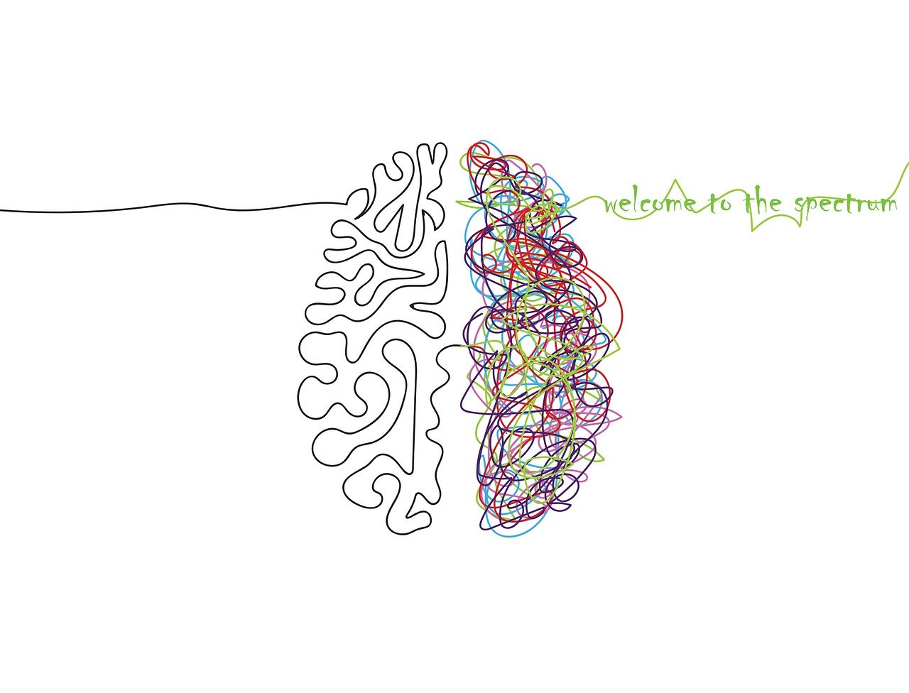
Experiences of fathers of children diagnosed with autism
Psychology Student Conference 2024
Your name: Marina – Alexandra Tudor
Supervisor name: Samantha Littlemore

Slide 2

Background Research, Rationale and Methodology
Fathers are underrepresented in autism related research (Braunstein, 2013; George‐Levi et al., 2023)
Fathers experienced both negative and positive feelings related to their children’s diagnosis (Camilleri, 2022; Kang et al., 2022)
Methodological inconsistencies in qualitative studies in this area (Lashewicz et al., 2017; DePape & Lindsay, 2014; Bohadana et al., 2021; Braun & Clarke, 2006)
My study explored fathers experiences using Reflexive Thematic Analysis (Braun & Clarke, 2022, 2019)

Slide 3

Themes that emerged from data
Fathers’ experiences interlinked with the familial context
Fathers’ journeys as individuals
The right support made a difference in my journey
My child is different from other children

Slide 4

Conclusions
Fathers expressed having similar and different experiences to findings in literature (Camilleri, 2022; Kang et al., 2022)
A strength of my study was methodological transparency
A limitation of my study was not collecting demographic information aiming to follow BPS guidelines for ethics and identity protection (Oates et al., 2021)
A direction for future research could be linked to fathers and their engagement with online communities
My journey

Slide 5
References
Bohadana, G., Morrissey, S., & Paynter, J. (2021). Self-Compassion in Mothers of Children with Autism Spectrum Disorder: A Qualitative Analysis. Journal of Autism and Developmental Disorders. https://doi.org/10.1007/s10803-020-04612-2
Braun, V., & Clarke, V. (2022). Thematic analysis: A practical guide. Sage.
Braun, V., & Clarke, V. (2006). Using Thematic Analysis in Psychology. Qualitative Research in Psychology, 3(2), 77–101. https://www.tandfonline.com/doi/abs/10.1191/1478088706QP063OA
Braunstein, V. L., Peniston, N., Perelman, A., & Cassano, M. C. (2013). The inclusion of fathers in investigations of autistic spectrum disorders. Research in Autism Spectrum Disorders, 7(7), 858–865. https://doi.org/10.1016/j.rasd.2013.03.005
Camilleri, L. J. (2022). Exploring the Lived Experiences of Fathers of Children on the Autism Spectrum: A Narrative Inquiry. SAGE Open, 12(2), 215824402210899. https://doi.org/10.1177/21582440221089927
DePape, A.-M., & Lindsay, S. (2014). Parents’ Experiences of Caring for a Child With Autism Spectrum Disorder. Qualitative Health Research, 25(4), 569–583. https://doi.org/10.1177/1049732314552455
George‐Levi, S., Laslo‐Roth, R., & Ben Yaakov, L. (2023). Vulnerability to loneliness among fathers of children with autism spectrum disorder: The role of interpersonal and familial resources. Family Process. https://doi.org/10.1111/famp.12877
Kang, V. Y., Kim, S., & Thomas, M. K. (2022). Experiences of Korean Fathers of Children With Autism in the United States. Inclusion, 10(3), 183–200. https://doi.org/10.1352/2326-6988-10.3.183
Oates, J., Carpenter, D., Fisher, M., Goodson, S., Hannah, B., Kwiatkowski, R., Prutton, K., Reeves, D., & Wainwright, T. (2021). BPS Code of Human Research Ethics. BPS Code of Human Research Ethics, 978-1-85433-792-4. https://doi.org/10.53841/bpsrep.2021.inf180

