Slide 1
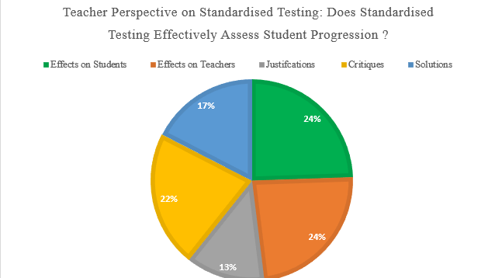
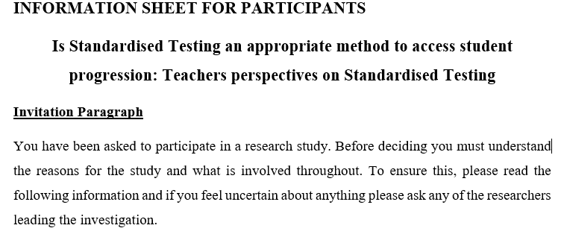
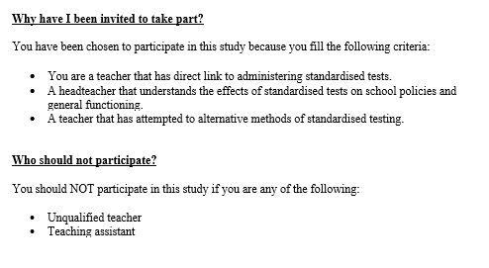
Qualitative Analysis of Teacher Perspectives on Standardised Testing: Does Standardised Testing Effectively Assess Student Progression?
Hattie Lathe
BSc [Sports Coaching] and Physical
Education
INTRODUCTION
The key function of standardised testing is to measure students' retention in core subjects and test their ability to recall and answer factual questions. This measurement is then used as an indicator to educators of their student achievement levels (Higgins, 2009) against predetermined attainment targets (Brindley 1998). Moreover, the pressure of this concept enforced by governing bodies has begun to significantly shape the educational environment, teacher approaches, and institutional standards due to increased accountability (Armstrong, 2010). One of the prominent concerns revolves around the ideology that, to keep up with increasing demands, educators have begun modifying their teaching methods to align with test formats, to ensure desirable grades are achieved by students and therefore reflect well on themselves. This tailoring and notion of teaching to test discredits subjects that are not included in assessments, such as art and physical education, and promotes significant amounts of time being allocated to preparing students with the correct techniques and basic knowledge to pass the standardised testing format. Therefore, disregarding engagement with students subsequently damages their learning experiences (Phelps 2011). Moreover, by facilitating preparation over learning, teachers are narrowing the curriculum and fixating on implementing low-level skills, specifically covered on the test (Popham, 2003).
Figure 1 Overview of Responses from Survey Questions
METHODOLOGY
Surveys were utilised as the primary data collection method with schools being actively recruited through a combination of email and phone calls. The utilisation of ten teachers allows a nuanced examination of results, thereby prohibiting a deeper analysis and substantial discussion. The selection process selects individuals who have dealt firsthand with distributing standardised testing within a primary school setting, this will be able to provide sufficient insight into the effects on pedagogy and student learning and thus teaching experience. Any participants lacking will be removed from the research project, the only exemption made will be to accommodate headteachers. thematic analysis was utilised during the examination to highlight reoccurring themes, valuable insights, and outliers
Figure 2 Information Sheet and Purposeful Sampling
CONCLUSIONS
The research provides sufficient insight into the challenges caused by current procedures. Through this exploration, the findings offer valuable insights for policymakers, educators and fellow researchers to interpret and develop their understanding of current procedures' limitations and justifications, thus improving student learning experiences. Additionally, the research contributes to the existing body of knowledge surrounding the limitations of standardised testing.
RESULTS
The majority of results indicated a negative perspective on current testing procedures with a recognition of the increased stress faced by students and teachers that have begun to change classroom dynamics. For those critiques, solutions were provided to encourage policymakers to create a better representation of student progression instead of the traditional methods. Nevertheless, justifications for current methods were still included, as shown in Figure 1.
REFERENCES
Brown, G. T., & Hattie, J. (2012). The benefits of regular standardized assessment in childhood education. Contemporary debates in childhood education and development, 287-292.
Cairns, R. (2021). Exams tested by COVID-19: An opportunity to rethink standardized senior secondary examinations. Prospects, 51, 331-345.
Federick, A. (2020). Finland education system. International Journal of Science and Society, 2(2), 21-32.
Mathison, S., & Freeman, M. (2006). Teacher stress and high stakes testing. Understanding teacher stress in an age of accountability, 43-63.

