Slide 1
LA 2028 OLYMPICS

Slide 2
LA 2028 OLYMPICS

Slide 3
LA 2028 OLYMPICS

Slide 4
LA 2028 OLYMPICS

Slide 5
LA 2028 OLYMPICS

Slide 6
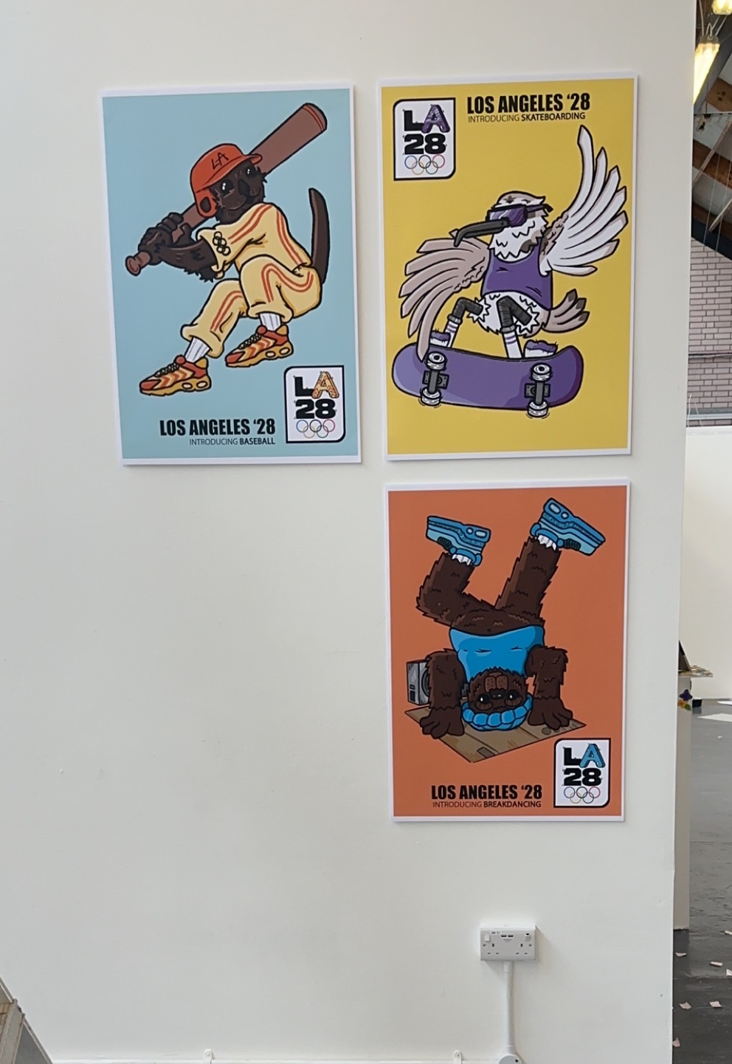
LA 2028 OLYMPICS

Slide 7
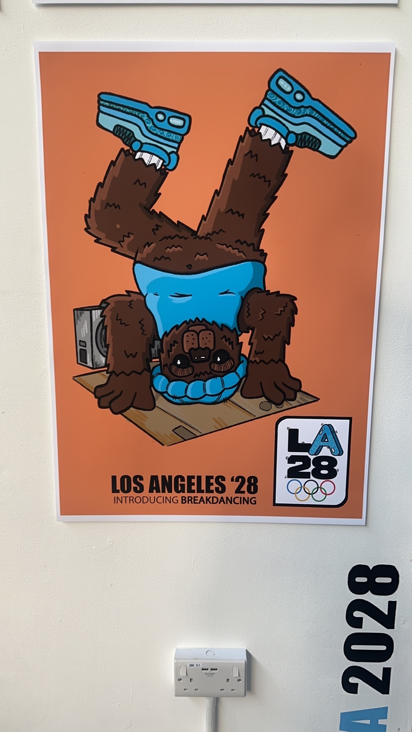
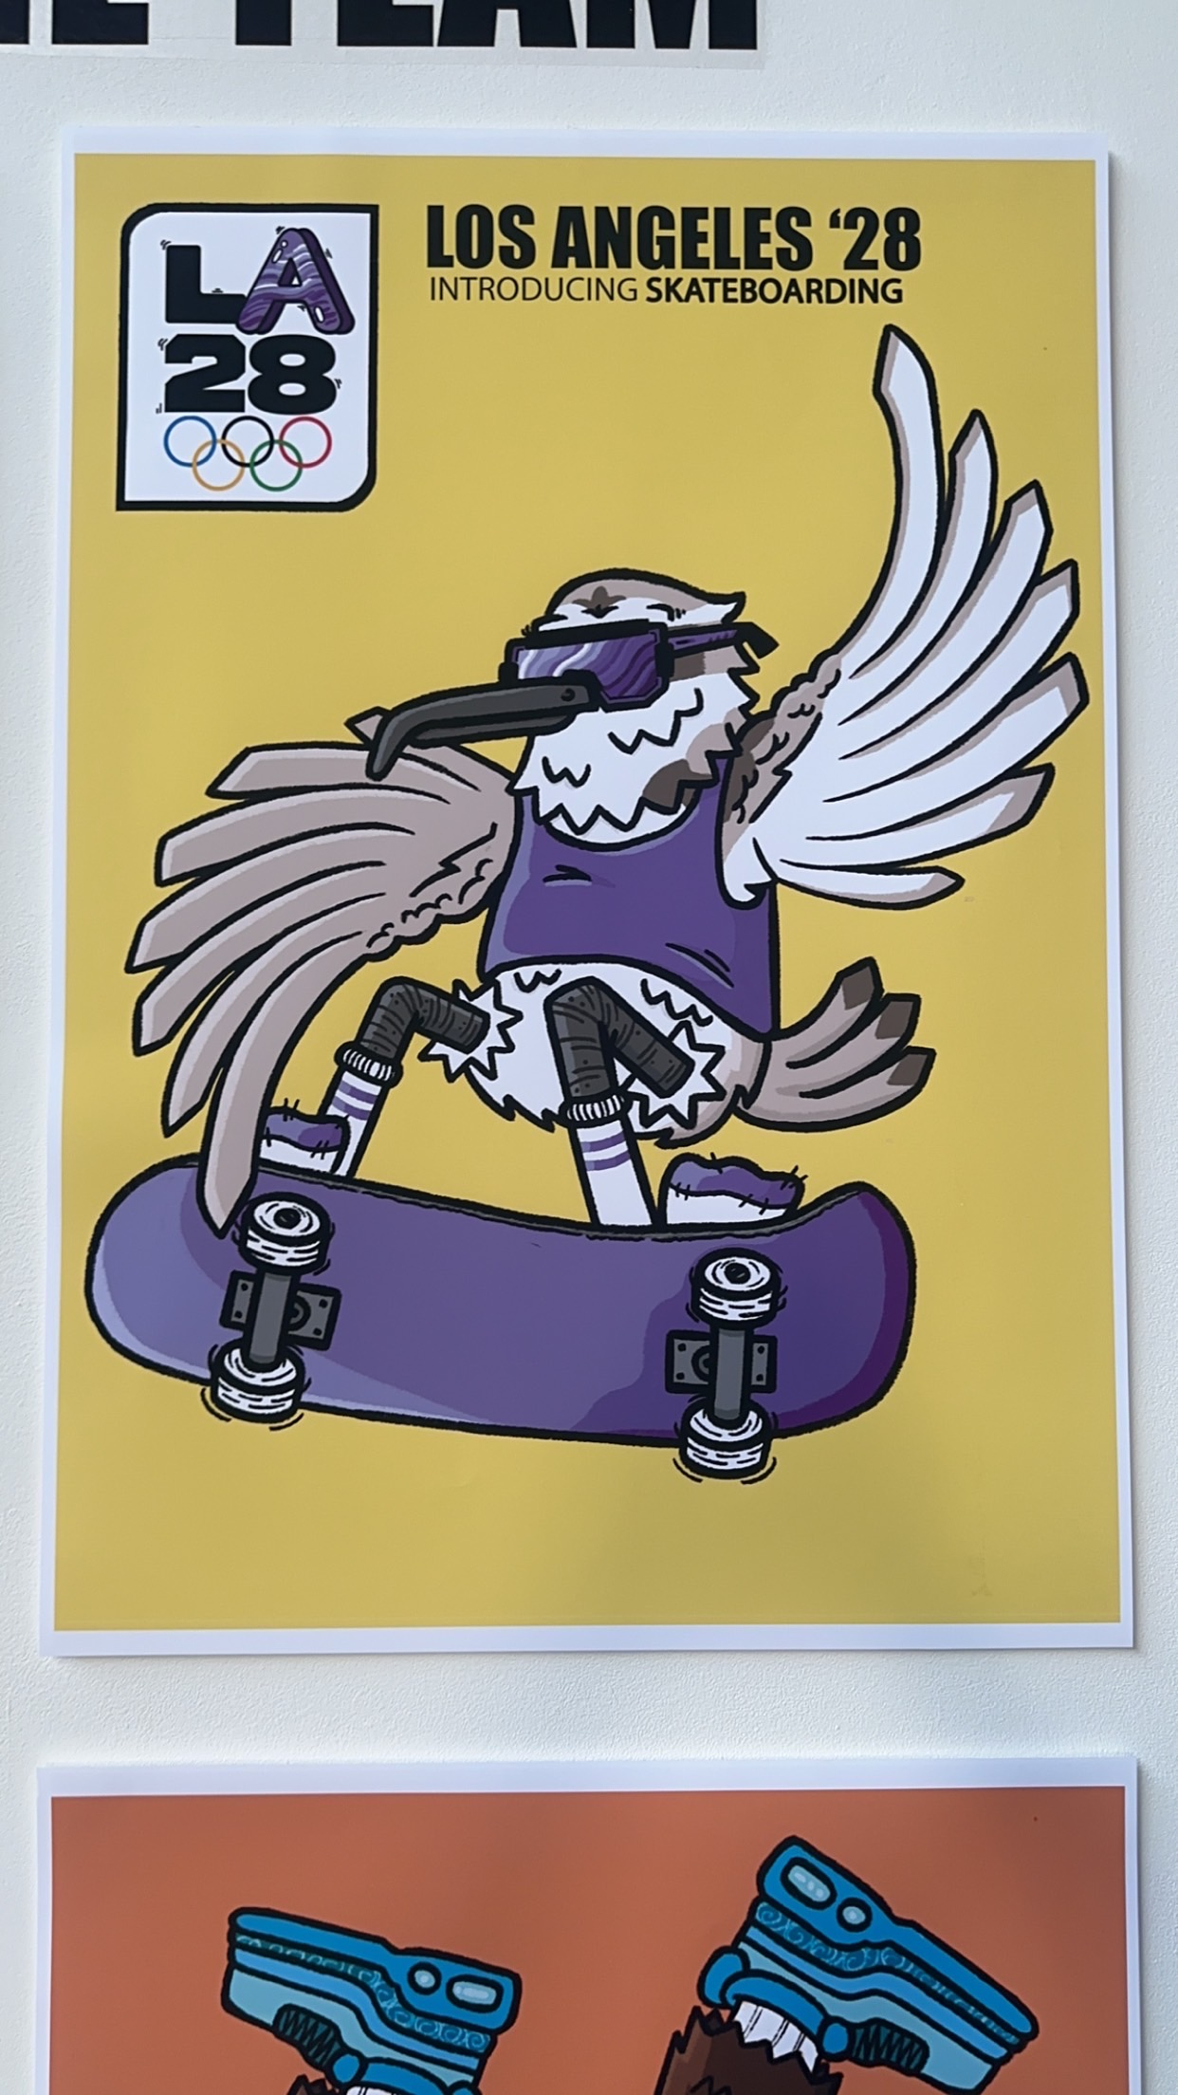
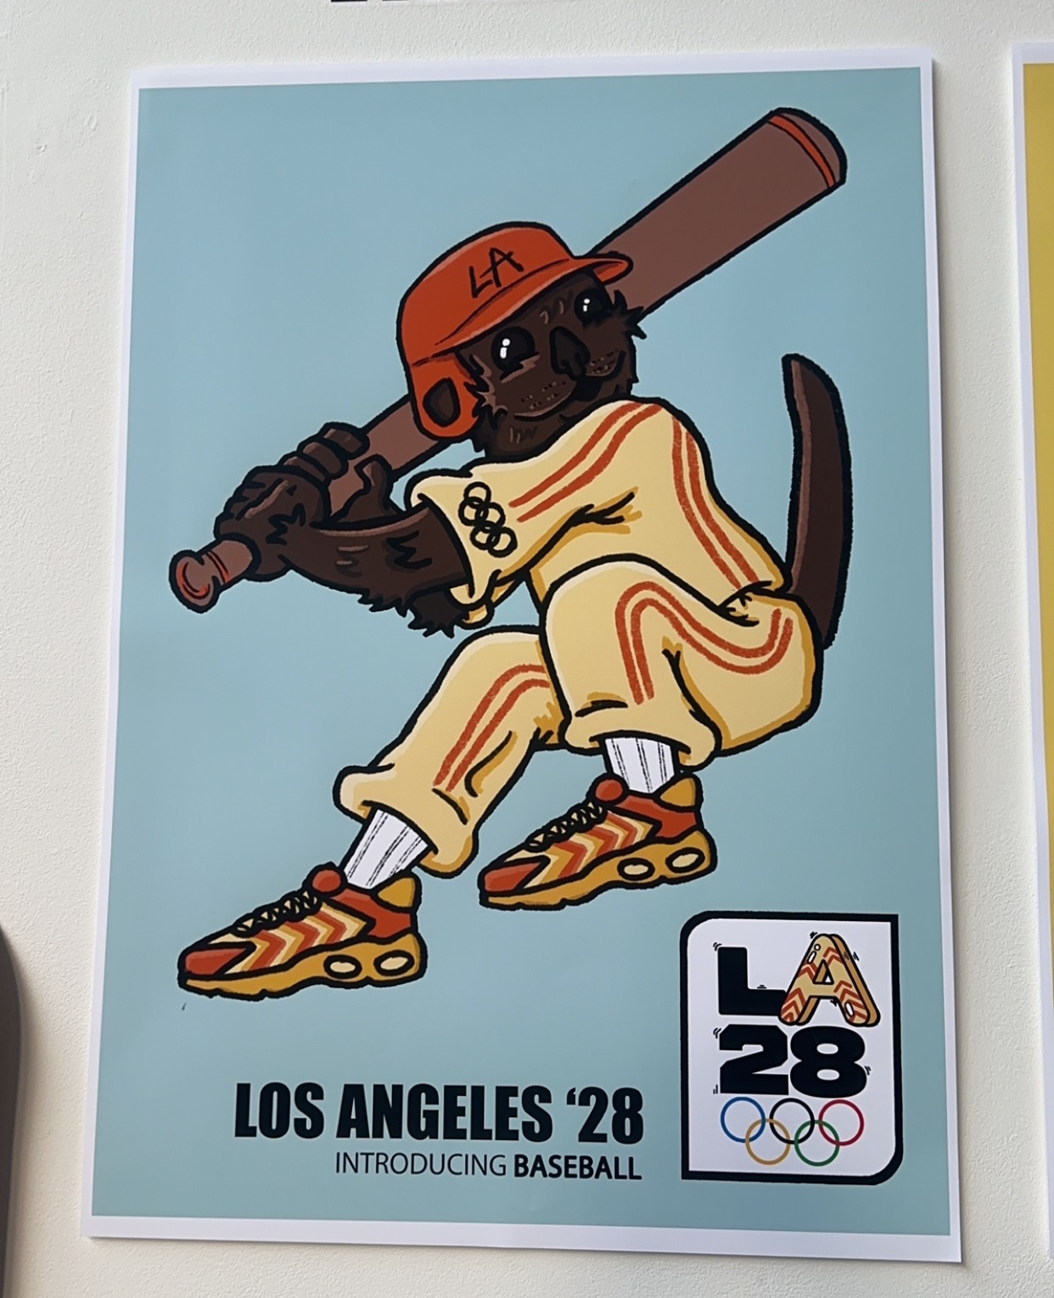
LA 2028 OLYMPICS

Slide 8
LA 2028 OLYMPICS

Slide 9
LA 2028 OLYMPICS

