Slide 1

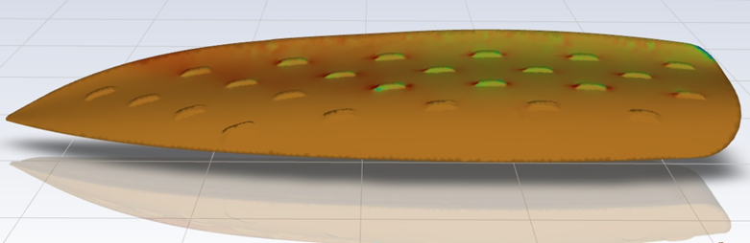
Biomimetic boat hull design, utilizing engineering tools to increase efficiency
Name: Alexios Makarezos
Student ID: 21012496
Module Code: ENGG61010
Module Title: Individual Engineering Project
Award Title: BEng Mechanical Engineering
Supervisor: Redent Tonna
Submission Date: 08/05/2024

Slide 2

The project
This project investigates the relationship between boat hull optimisation and biomimicry through design, simulation, and analysis.
Boat hull optimisation is crucial for improving marine transportation efficiency and sustainability.
Biomimicry, inspired by nature, offers innovative solutions for optimizing boat hull designs.
The goal is to create a new boat hull design by combining advanced engineering tools with insights from nature's designs, aiming for greater efficiency and environmental consciousness in maritime transportation.

Slide 3

Aims/Objectives
Create a new, efficient boat hull inspired by nature.
  Research existing hulls & biomimicry applications in the marine environment.
  Use CAD & CFD to design and analyse a hull with minimal drag & optimal flow.
  Optimize biomimicry features based on results for maximum efficiency (considering software/hardware limitations).
Continuously improve biomimicry for boat hulls.
  Research biomimicry & hull design to develop innovative drag-reduction methods.

Slide 4
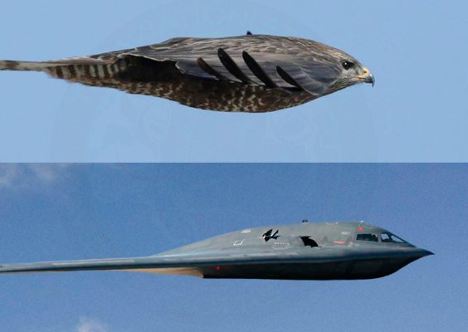
Explaining Biomimicry
Biomimicry encompasses structural, aerodynamic, and hydrodynamic designs inspired by nature's principles.
It promotes collaboration between biologists and engineers to utilize nature's secrets for modern engineering challenges.
Biomimicry is known by various terms like bionics and biomimetics all aiming to innovate by learning from nature.
Two primary approaches to biomimicry include problem-based, where designers tackle specific human challenges by studying biological adaptations, and solution-based, focusing on functions found in nature and applying them to various problems.

Slide 5
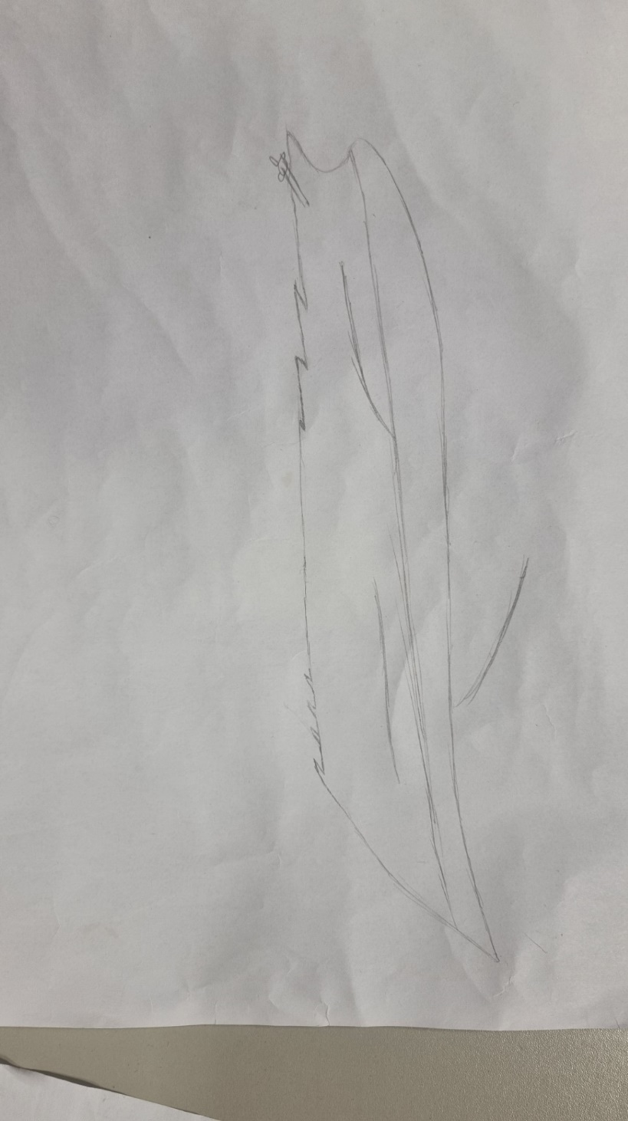
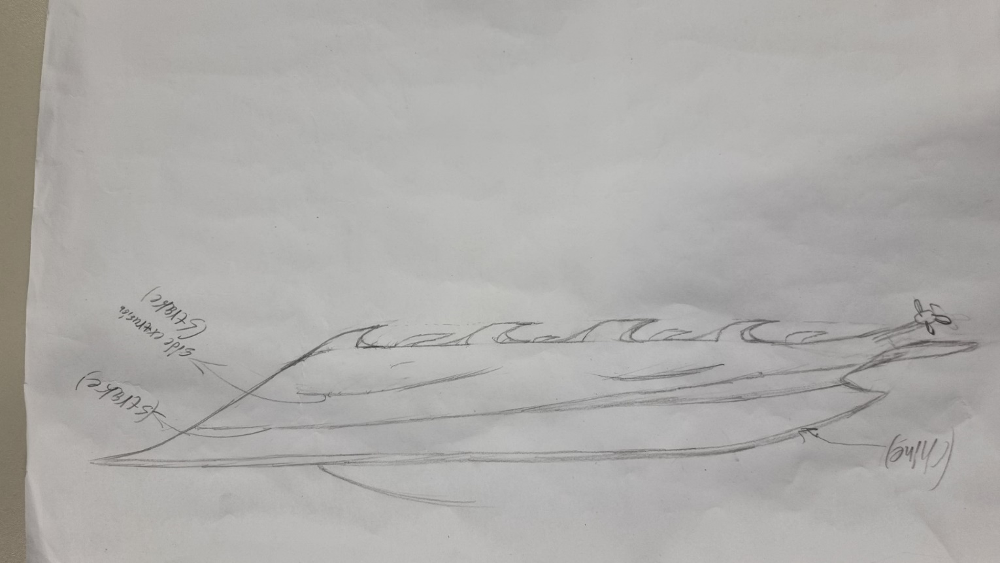
Concept Art
A few hand drawn designs were created.

Slide 6



CAD
Taking inspiration from the concept designs, seven different designs were created in Autodesk Inventor Professional, each with unique characteristics.
Due to insufficient computational power more complex designs were not able to be executed.
Features of every hull design:
  Fins (imitating shark fins).
  Dimples (Using as inspiration humpback whale tubercles).
  Stern of the boats ( Inspired by blue whale tail).
  Strakes (Inspired by sperm whale throat grooves).

Slide 7
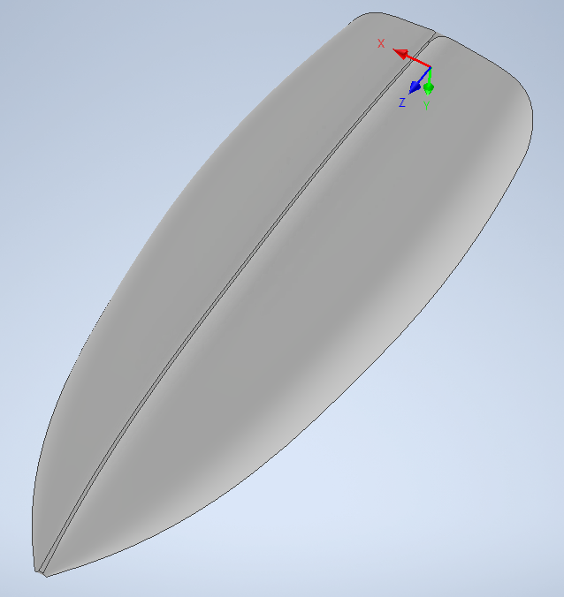
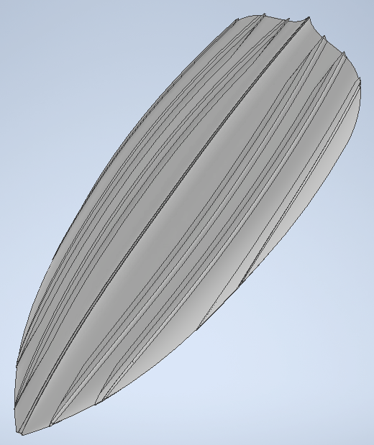
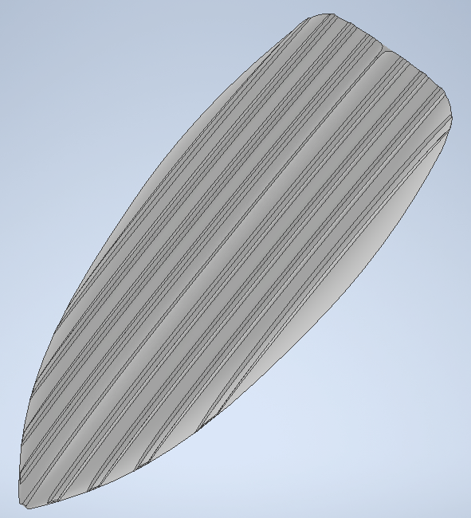
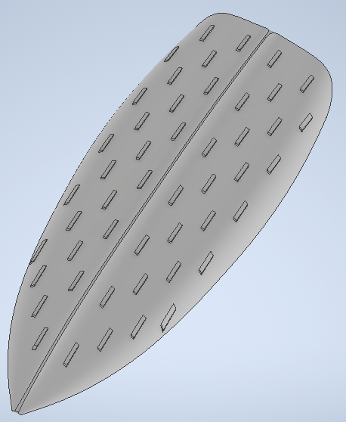
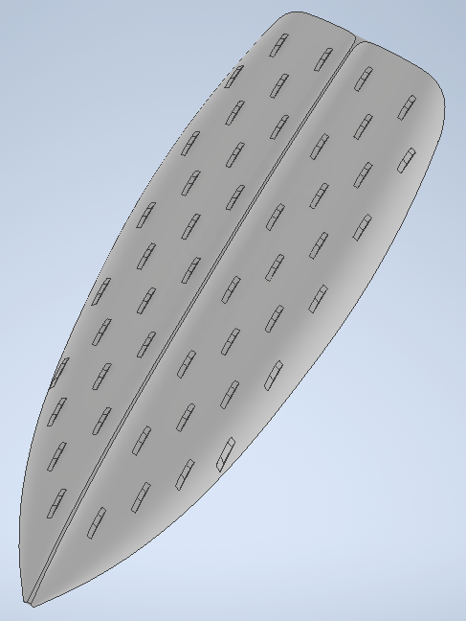
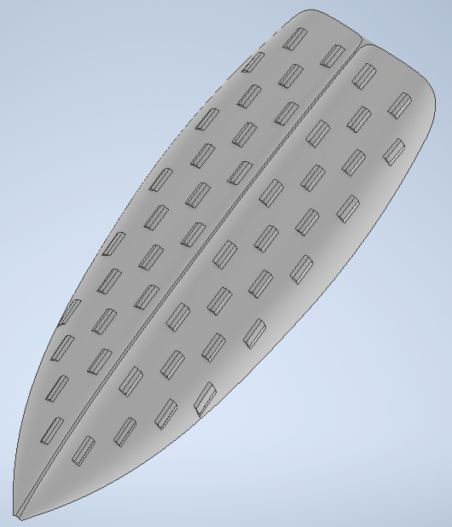
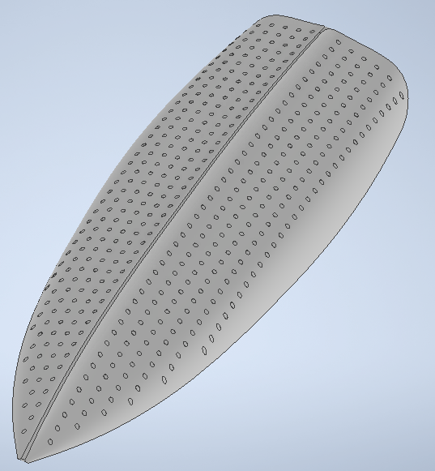
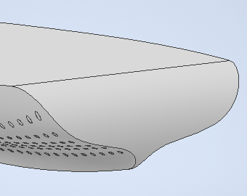

Slide 8
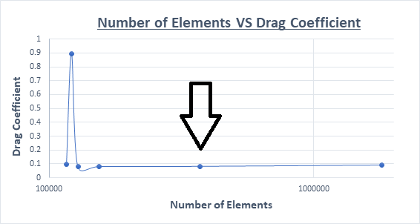
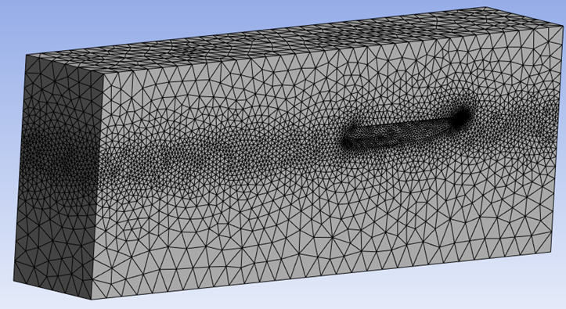
Choosing the right mesh
In order for the most applicable mesh size to be selected, a mesh independence study was conducted in the base boat hull design 1.0.

Slide 9
CFD
The CFD simulation aimed to measure the drag coefficients and drag forces.
Aerodynamics: Concerned with air interaction with objects like planes and buildings, noting air's lower density compared to water.
Hydrodynamics: Focuses on water's interaction with ships, submarines, etc., highlighting water's higher density and viscosity compared to air.
Water aerodynamics are assessed differently, utilizing surface area rather than cross-sectional area as in air.

Slide 10
Discussion
Simple geometric changes like fins, strakes, and dimples significantly affect drag force and drag coefficient.
Hull design 5.0 exhibits the lowest drag coefficient (0.0418) among all designs, featuring shark fins with fillets, front and back, that contribute to significant drag reduction compared to the baseline design 1.0 (0.0802).
Among shark fin designs (4.0, 5.0, and 6.0), fillets notably reduce drag, as seen in hull design 5.0.
Comparison of pressure and flow between hull designs 4.0 and 5.0 reveals smoother flow and reduced pressure in 5.0 due to fillets.

Slide 11
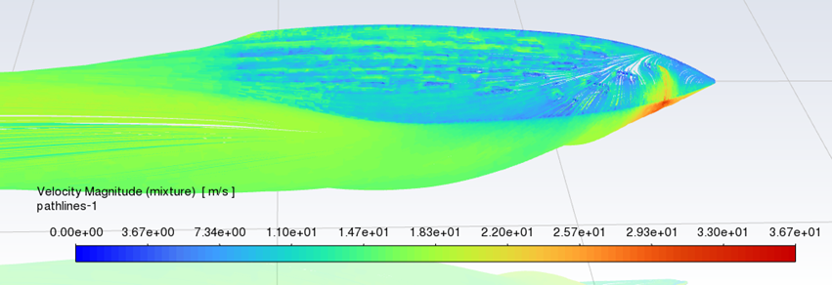
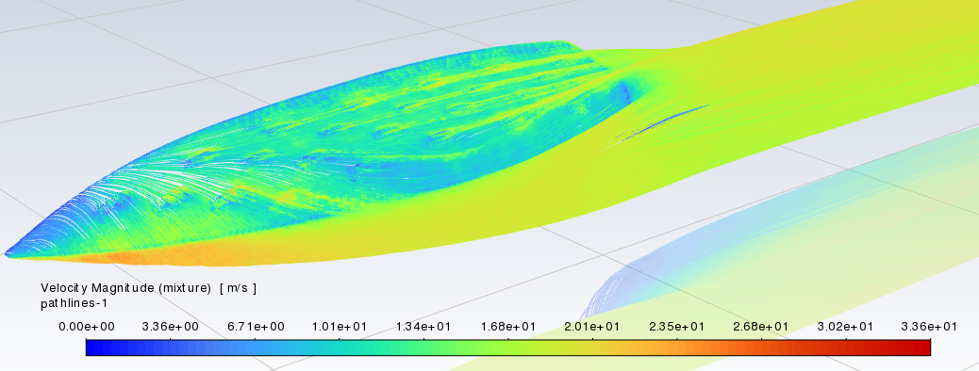
Comparison Of Hull designs 4.0 & 5.0

Slide 12

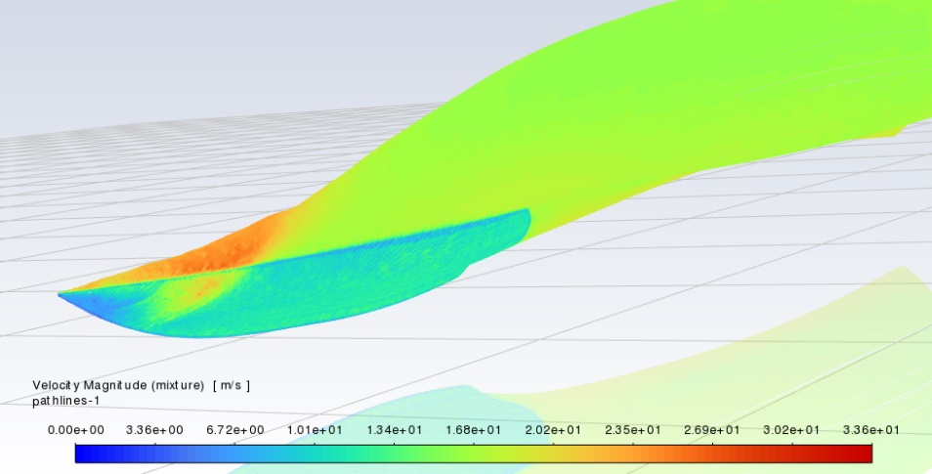
The other Designs
Strakes inspired by blue whale throat grooves in designs 2.0 and 3.0result in drag coefficients lower than the baseline but are not the most effective designs. 0.073 & 0.0828 respectively.
Hull design 7.0, featuring inward dimples inspired by humpback whales, achieved a lower drag coefficient (0.0535) than baseline design 1.0.

Slide 13
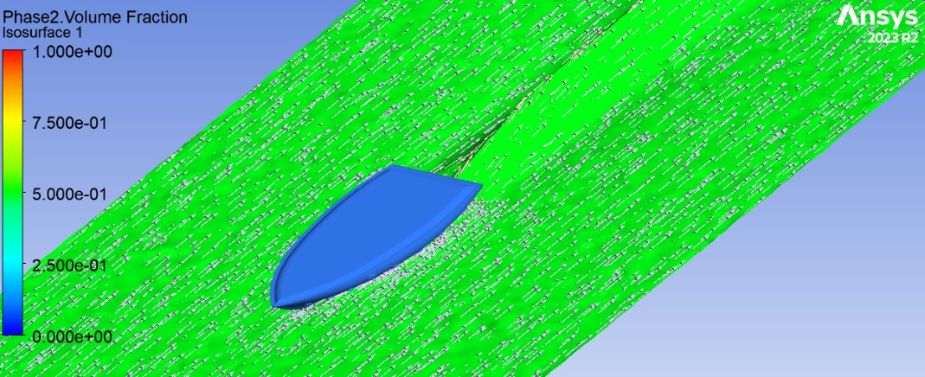
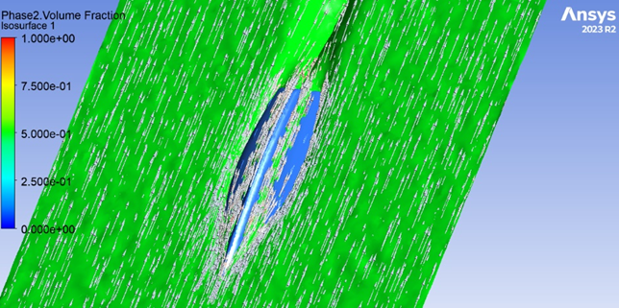
The water flow of hull design 5.0

Slide 14
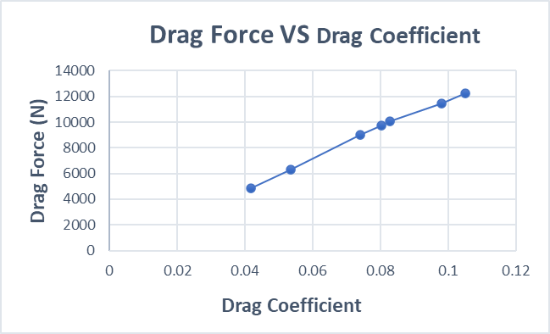
Drag Force VS Drag Coefficient

Slide 15
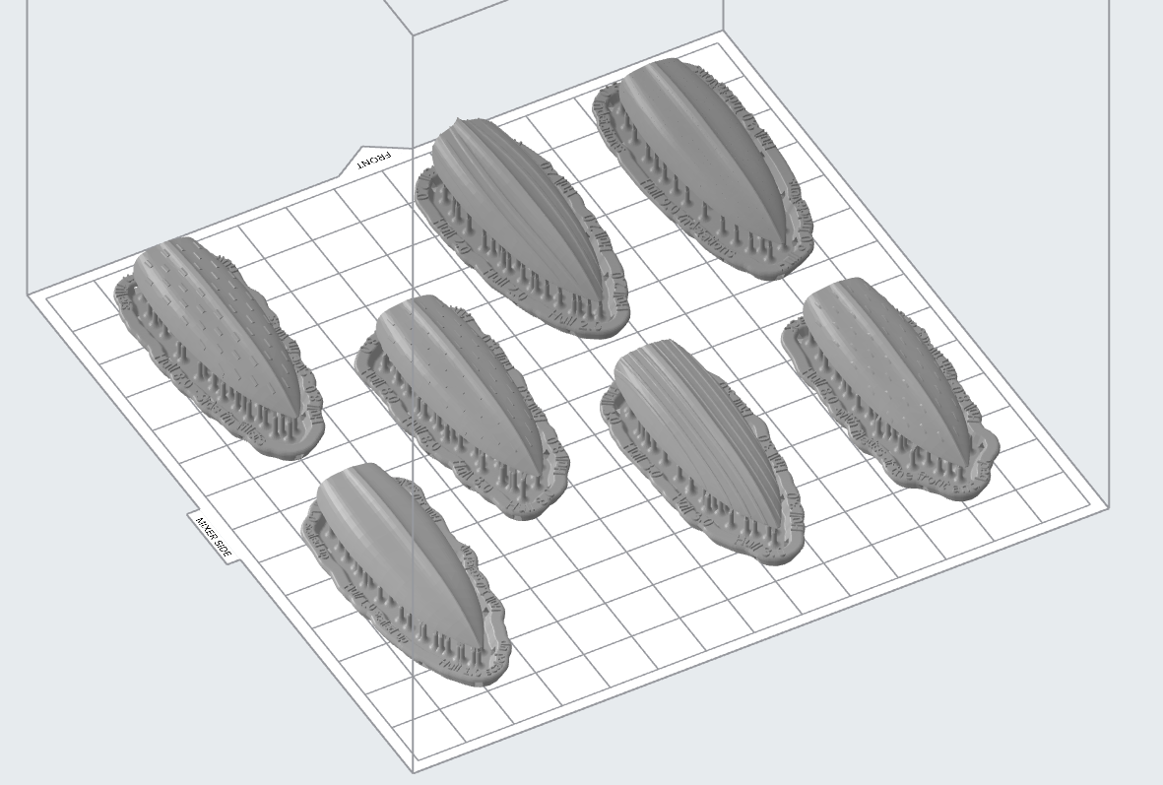
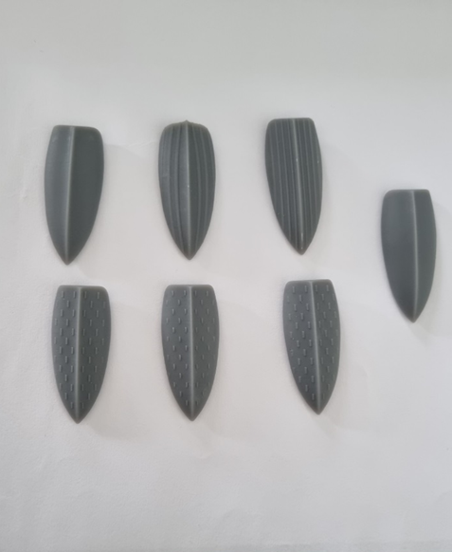
3D Printing
The seven designs were also 3D in the University printing labs, using resin as the material.

Slide 16
Conclusion & Recommendations
Biomimicry enhances boat hull designs, improving performance and efficiency. Hull design 5.0 demonstrates significant drag reduction, highlighting the benefits of the biomimetic features.
Explore more biomimetic features for hull design optimization.
Validating the designs, especially hull design 5.0, through real-world testing. Collaborate with industry or universities for validation.

Slide 17

Thank you very much for your attention.

Slide 18
References:
NERDS Inc. (n.d.). Biomimicry: Boston Dynamics. [online] Available at: https://www.nerdsinc.com/blog-1/2017/3/11/biomimicry-boston-dynamics.

