Slide 1
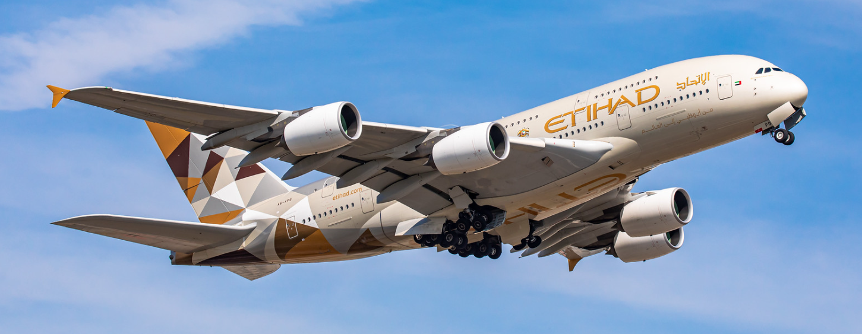
Developing and Evaluating a morphing winglet to reduce wake turbulence on the Airbus A380.
Student ID: 21029735
Module Code: ENGG61010
Module Title: INDIVIDUAL ENGINEERING PROJECT
Award Title: BEng (Hons) Aeronautical Engineering
Supervisor: Dr. Siva Marimuthu

Slide 2
Introduction
The aviation industry faces the problem of meeting growing travel demands while minimizing environmental effects. Aviation accounts for roughly 2.5% of global carbon emissions, as per the IEA (no date). Despite a temporary decline due to the COVID-19 pandemic, demand is expected to rebound by 2030, emphasizing the importance of long-term solutions.
Efforts have been directed towards enhancing aerodynamic performance to reduce emissions and fuel consumption. A key focus is on managing the induced drag concerning wingtip vortices. Various factors, including wingtip geometry and atmospheric conditions, influence vortex formation.
The Airbus A380, the largest passenger aircraft with a wingspan of just under 80 meters, generates notable vortices leading to wake turbulence incidents, as stated by the FAA (2023), such as the Challenger 604, which, during a flight from Male to Dubai, encountered wake turbulence from an A380, resulting in loss of control and a rapid descent of 10,000 feet followed by an emergency landing.
Winglets work to reduce drag and maximize overall aerodynamic efficiency by introducing secondary vortices that interrupt primary vortices. Traditional fixed winglets, on the other hand, may not provide the best performance during all phases of flight due to their static design, which is optimized for a particular operating condition.
With the capacity to dynamically adjust their shape to changing light conditions, morphing winglets have emerged as a transformative solution to overcome these limits. Morphing winglets provide unmatched performance in a variety of flight phases, including take-off, cruise, and landing, by continuously adjusting their geometry. This holds immense promise for improving aircraft’s overall performance and reducing wake vortices.

Slide 3
Aim
Design and analysis of a morphing winglet for the Airbus A380 wake turbulence reduction.
Objectives
• Analysing the current aircraft winglet of the A380 using computational fluid dynamics
The existing A380 wing and winglet drawing will be sourced, and a CAD model will be created, CFD simulation will be conducted to analyses the induced drag and vortex pattern establishing baseline values.
• Design morphing winglet that dynamically adapts to excel in varying flight conditions, including speed and altitude.
A new morphing winglet will be developed with variable geometry cant angle. This design aims to enhance adaptability and optimize aerodynamic performance.
• Evaluating a morphing winglet design on the Airbus A380 to reduce wake turbulence and cut drag.
The new morphing winglet will be integrated with the Airbus A380 wing and CFD simulation and analysis will be conducted to evaluate its aerodynamic characteristics.
• Comparing and analysing the morphing winglet design to the original a380 wingtip fence
The baseline values of the original wing tip and the new morphing winglet will be compared, and an assessment will be conducted as to whether the is an observable improvement.
• Enhance lift-to-drag ratio and improve operation efficiency.
An analysis will be performed, including calculations to evaluate any change to the lift-to-drag ratio and overall efficiency. the objective is to determine if the morphing winglet has indeed resulted in tangible improvement for the aircraft.

Slide 4
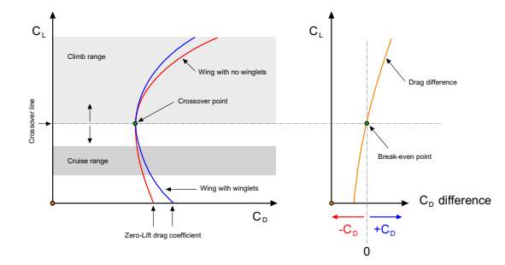
Literature review
Recent studies in aircraft aerodynamics have been motivated by increased concerns about sustainability, with a particular emphasis on induced drag and wingtip vortices. In flight, the four essential forces, including lift, drag, weight, and thrust, play a vital role, with the lift being crucial for sustaining flight as it is produced due to the difference in pressure between the bottom and top surfaces of the wing.
There are two main types of drag: parasitic drag and induced drag. Induced drag arises from the generation of lift and is caused by the pressure differential between the wing surfaces. induced drag significantly influences the generation of wingtip vortices. Accidents like the Challenger 604 encounter with wake turbulence have shown that controlling these vortices is critical for safety and improving efficiency.
Efforts to reduce induced drag involve understanding the ground effect phenomena that suppress wingtip vortices and investigating other wing designs such as enhanced aspect ratios and winglets to minimize vortex generation. While winglets offer significant benefits in minimizing induced drag and improving aerodynamic performance,.
According to Guerrero et al. (2018), the addition of widgets must balance the reduction in lift-induced drag with the potential increase in parasitic drag. Their viability depends on whether the total drag is lower with the winglet, as indicated by a crossover point in the drag coefficient. In a follow-up paper by Guerrero et al. (2020), further exploration of morphing winglets regarding substantial aerodynamic efficiency enchantments across different flight phases and Mach numbers contributed to a better understanding of aerodynamic performance under various conditions.
These findings align with global efforts to enhance aviation sustainability by reducing fuel consumption and emissions, highlighting the potential of variable cant-angle winglets to address critical challenges in the aerospace industry. Innovations such as the morphing winglet, where the cant angle can be altered mid-flight, Morphing winglets are a novel approach that provides a dynamic modification to the cant angle to maximize aerodynamic efficiency and performance. Computational studies show that these morphing winglets have the potential to significantly lower emissions and fuel consumption, as well as reduce the size of the vortex produced.

Slide 5
Cad Modelling
Three different types of aerofoils are included in the A380 wing design. Ghaith and Haque (2014) recommend using NASA SC(2) 0610 for the root and middle aerofoils and NASA SC(2) 0606 for the tip aligned with the A380 supercritical wing characteristics.
Supercritical aerofoil design as described by NASA(1990) aims to delay the onset of wave drag at transonic speeds through features like a flattened upper surface and have a cambered aft section and a large leading-edge radius.
The CAD model which was designed using Fusion 360 and technical drawings from Airbus Aircraft (2023) features a wing that is 36.42 meters in length and 18.23 meters in chord length. the wing model was reduced in size to a 1:10 proportion measuring 3.63 meters in length with a chord length of 1.82 meters to address the computing challenges brought about by the size of the A380. This allowed for a denser mesh to be used to achieve accurate results.

Slide 6
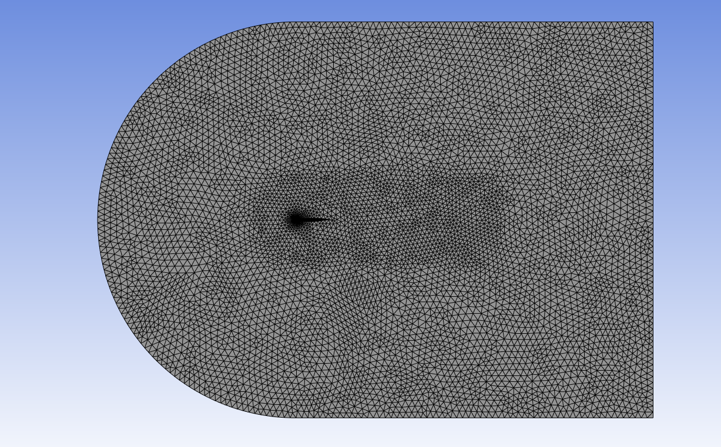
Ansys Pre-Processing
The CAD model is imported into Ansys Design modeler and the mesh boundary is a C-type domain that extends 10 meters in front and 18 meters behind the wing. Lutton (1989) highlights the effectiveness of the C-type grid in resolving flow perturbation and wake regions thus justifying its use in the mesh design.
Additionally, a body of influence is added near the wing to refine the mesh in that region for better results. The entire domain is converted to fluid setting up the simulation for airflow around the wing model The wing model is then subtracted from the domain using a Boolean creating a void where the airflow will interact near the wing.
In Ansys meshing the primary element is set to 0.2 meters with 0.15 meters applied to the body of influence to refine the mesh area around the wing. Face meshing is used to precisely mesh the wing's surface geometry and an inflation layer is added to appropriately resolve the boundary layer.
The mesh is predominantly composed of tetrahedral cells which convert to prismatic cells towards the wing for increased resolution and boundary layer modelling. The mesh has an average skewness of 0.24 and an average orthogonal quality of 0.75 suggesting high mesh quality. Lower skewness values imply less distortion and greater orthogonal quality values indicate better alignment of adjacent mesh cells. The metric indicates that the mesh is of high quality

Slide 7
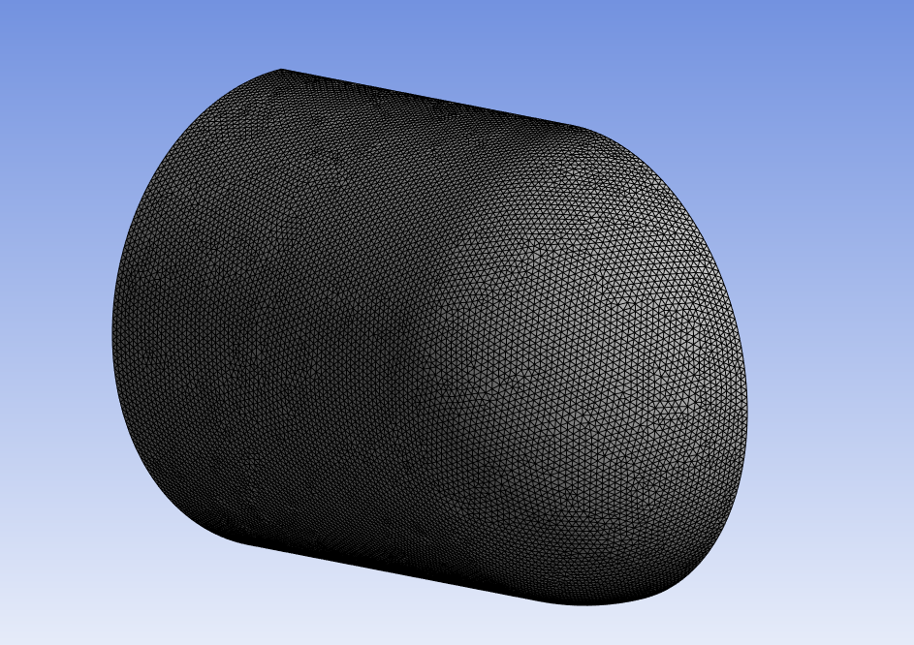
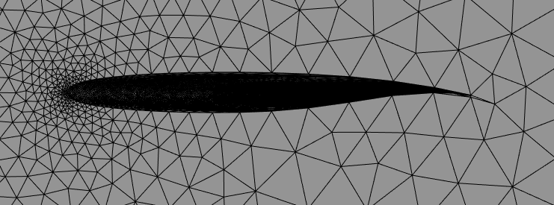
Ansys Pre-Processing

Slide 8
Ansys Processing (Fluent Solver)
Reynolds Averaged Navier stoke (RANS) models which are commonly used in engineering simulations simplify equations by time averaging turbulent variations resulting in realistic velocity averages. Andersson et al(2012) describe models that use one or two equations. The K-ω SST turbulence model commonly used in engineering accurately predicts turbulent flows, especially near-wall phenomena crucial for boundary layer conditions and flow separation.
Fluent solver setting optimises computational efficiency with density-based solvers and steady-state simulations reducing processing time. Material properties of air are estimated using the ideal gas model while boundary conditions simulate typical A380 flight conditions.
Proper wall Y-plus values are essential for accurately capturing and resolving the boundary layer. The Reynolds number guides turbulence model selection ensuring accurate simulation results in fluent.

Slide 9
Results
The new modified winglet at a zero-degree cant angle shows notable gains; the coefficient of lift rises to 0.802, a 3.75% increase; however, the coefficient of drag also increased by 6.89% to 0.063.
As the cant angle is increased to fifteen degrees, the coefficient of drag has increased by 5.172%, but there is a noticeable change to the coefficient of lift. Moving the cant angle to 45 degrees, the coefficient of drag does not vary much, but the coefficient of lift has decreased by 34.9%. Finally, at an eighty-degree cant angle, the coefficient of lift has decreased again by 4.663% without any noticeable change in the coefficient of drag.
At higher cant angles like forty-five and eighty degrees, while the coefficient of drag remains relatively stable, there's a noticeable decrease in the coefficient of lift. This suggests a trade-off between lift enhancement and drag reduction, where higher cant angles might sacrifice lift efficiency for reduced drag.
An essential metric in aircraft aerodynamics is the lift-to-drag ratio (L/D ratio), which measures how effectively an aircraft generates lift relative to the drag it experiences. Across various cant angle variations, the L/D ratio remains relatively consistent, indicating that while modifications may affect individual aerodynamic parameters, the overall balance between lift and drag is preserved.
Objectives
Computational fluid dynamics analysis of the A380 current winglet produced a lift coefficient of 0.772 and a drag coefficient of 0.058.
Using Fusion 360 a morphing winglet capable of adjusting cant angles (0,15,45,80 degrees) dynamically to suit varying flight conditions.
Conducted Ansys simulation on morphing winglet models to assess performance at cursing conditions highlighting the 80-degree cant angle for producing the smallest vortex
Compared the morphing winglet design to the original A380 wingtip revealing smaller wake vortices at 15,45 and 80-degree cant angles
The Lift to Drag ratio remained constant at 13 .Analysis showed overall efficiency improvements despite the consistent lift-to-drag ratio with the original wingtip fence configuration.
06

Slide 10
Results
The velocity magnitude bar indicates airflow velocity ranging from 0 (dark blue ) to the highest velocity of 494 m/s (dark red).Examining contour plots reveal the wingtip's role as a barrier preventing higher-pressure air from below the wing from flowing to the top of the wing. This is clearly seen when the morphing winglet is at a 0-degree cant angle. As the cant angle, increases the amount of air flowing onto the top surface is greatly reduced. Minimal vortices at an 80-degree cant angle demonstrate how well the winglet works to reduce airflow disturbance and streamline airflow to maximise aerodynamic performance. The actual size of the vortex is significantly reduced at the 80-degree cant angle

Slide 11
Limitations
Single angle of attack – The Study only considered an angle of attack of 3.06 degrees which limits the analysis of the winglet performance at various angles of attack. The performance could be drastically different at the other angles of attack
Scaled model – A 1:10 scaled-down wing model was used due to computing limitations which may have resulted in results that differ from the full-scale analysis. As a result, such results do not accurately reflect performance in real-world conditions
Turbulence Modelling - the choice of a two-equation Reynolds-Averaged Navier Stoke (RANS) turbulence model over more advanced methods like large Eddy Simulation (LES). This was due to time constraints and higher equations that would need to be considered. RANS model may not provide the most accurate representation of vortices as compared to LES.
Steady State – The simulation was conducted in a steady state where the simulation is time-dependent as opposed to a transient simulation where the simulation is time-dependent. Time-dependent simulation is more effective at capturing the unsteady flow such as vortices.
Research Gap – The absence of a reliable source containing comprehensive data on the performance characteristics of the A380 wing presented significant hurdles. Without this critical data accurately modelling the wing and confirming the coefficient values becomes difficult. Because of this, it is challenging to translate the result into a real-world application to reduce wake turbulence on the A380.

Slide 12
Recommendations
Explore multiple angles of attack – The study focused solely on a 3.06-degree angle of attack which is typical for the cruise phase of flight. To ensure peak performance at every stage of light such as take-off climb descent and landing it is recommended to analyse morphing winglets at various angles of attack. Extending the study to cover multiple angles of attacks ensures morphing winglets are optimised for maximum performance throughout the entire range of flight operations.
Full-scale model analysis – investing in computation resources capable of conducting simulation at full scale offers several benefits. Full-scale simulations provide a more accurate representation of real-world aerodynamic behaviour capturing intricate details that may not be apparent in a scaled-down version This degree of accuracy ensures that the results obtained are reliable and can be easily translated into real-world applications.
LES and transient simulations – Advanced turbulence models such as large eddy simulation (LES) provide a more precise depiction of turbulent flows. In contrast to other simpler models LES resolves a broad range of turbulent flow which differs from an in-depth understanding of boundary layer transition and vortex shedding In addition using a transient simulation setting improves accuracy by taking into account time-dependent flow. Together these techniques could prove a highly realistic simulation and results.
Experimental analysis – The study was conducted using only computational methods. An experimental analysis using a wind tunnel would be able to offer more accurate results. Computational methods could have errors that arise from factors such as the mesh size and density as well as the boundary conditions and turbulence models. Therefore, conducting a real-world experiment would provide a more accurate understanding of the behaviour of morphing winglets.

Slide 13
Conclusion
In conclusion, the comparative analysis between the original Airbus A380 winglet and the proposed morphing winglet designs offers valuable insights into their aerodynamic advantages and trade The study reveals notable gains in lift coefficient with the morphing winglet particularly evident at a 0-degree cant angle but at the expense of increased drag.
Significant differences in the lift and drag coefficient occur with the different cant angles but the lift-to-drag ratio stays constant suggesting overall efficiency in comparison to the original wingtip fence.
For long-haul flights like those undertaken by the A380, maintaining a high L/D ratio is crucial for sustaining flight over extended durations while minimizing fuel consumption. Therefore, understanding the nuanced effects of winglet modifications on aerodynamic performance is vital for optimizing aircraft efficiency and performance in real-world operational scenarios.
With their capacity to dynamically adjust the cant angle of the morphing winglet to improve operational flexibility and fuel efficiency. His adaptability optimises aerodynamic performance across diverse flying conditions aiming to mitigate wake turbulence and improve operational safety to prevent past incidents like the challenging wake turbulence encounter .
Reductions in wake vortex generation notably at higher cant angles of 45 and 80 degrees highlight the potential benefits of morphing winglets.
The study does acknowledge research limitations such as using a scaled model and simpler turbulence models for simulations. Despite these constraints, the project efficiently reduces induced drag and wake turbulence reduction needs on the A380. Further advancements in this area could significantly contribute to a more sustainable aviation future.

Slide 14
Refercences
Abramowski, T. (2007) ‘Numerical investigation of airfoil in ground proximity’, Journal of Theoretical and Applied Mechanics [Preprint].
Airbus Aircraft (2023) Autocad 3-View Aircraft Drawings, Airbus Aircraft. Available at: https://aircraft.airbus.com/en/customer-care/fleet-wide-care/airport-operations-and-aircraft-characteristics/autocad-3-view-aircraft-drawings (Accessed: 23 April 2024).
Anderson, J.D. (2017) Fundamentals of aerodynamics. 6th edn. New York, New York: Mcgraw-hill Publishing Co.
ANDERSSON, B., ANDERSSON, R. and HAKANSSON, L. (2012) Computational Fluid Dynamics for Engineers. Cambridge: Cambridge University Press.
EASA (2021) Assignment of ICAO aircraft types to RECAT-EU Wake Turbulence categories, EASA. Available at: https://www.easa.europa.eu/en/assignment-icao-aircraft-types-recat-eu-wake-turbulence-categories (Accessed: 02 April 2024).
Ghaith, F.A. and Haque, M.F. (2014) ‘Elastodynamic modeling and simulation of the Airbus A380 wing’, Volume 8: 26th Conference on Mechanical Vibration and Noise [Preprint]. doi:10.1115/detc2014-34010.
Guerrero, J.E., Sanguineti, M. and Wittkowski, K. (2020) Variable cant angle winglets for improvement of aircraft flight performance - meccanica, SpringerLink. Available at: https://link.springer.com/article/10.1007/s11012-020-01230-1 (Accessed: 30 April 2024).
Airways, E. (no date) Airbus A380: Etihad Airways, Etihad Global. Available at: https://www.etihad.com/en/fly-etihad/our-fleet/airbus-a380 (Accessed: 07 May 2024).

Slide 15
Thank You

