Slide 1
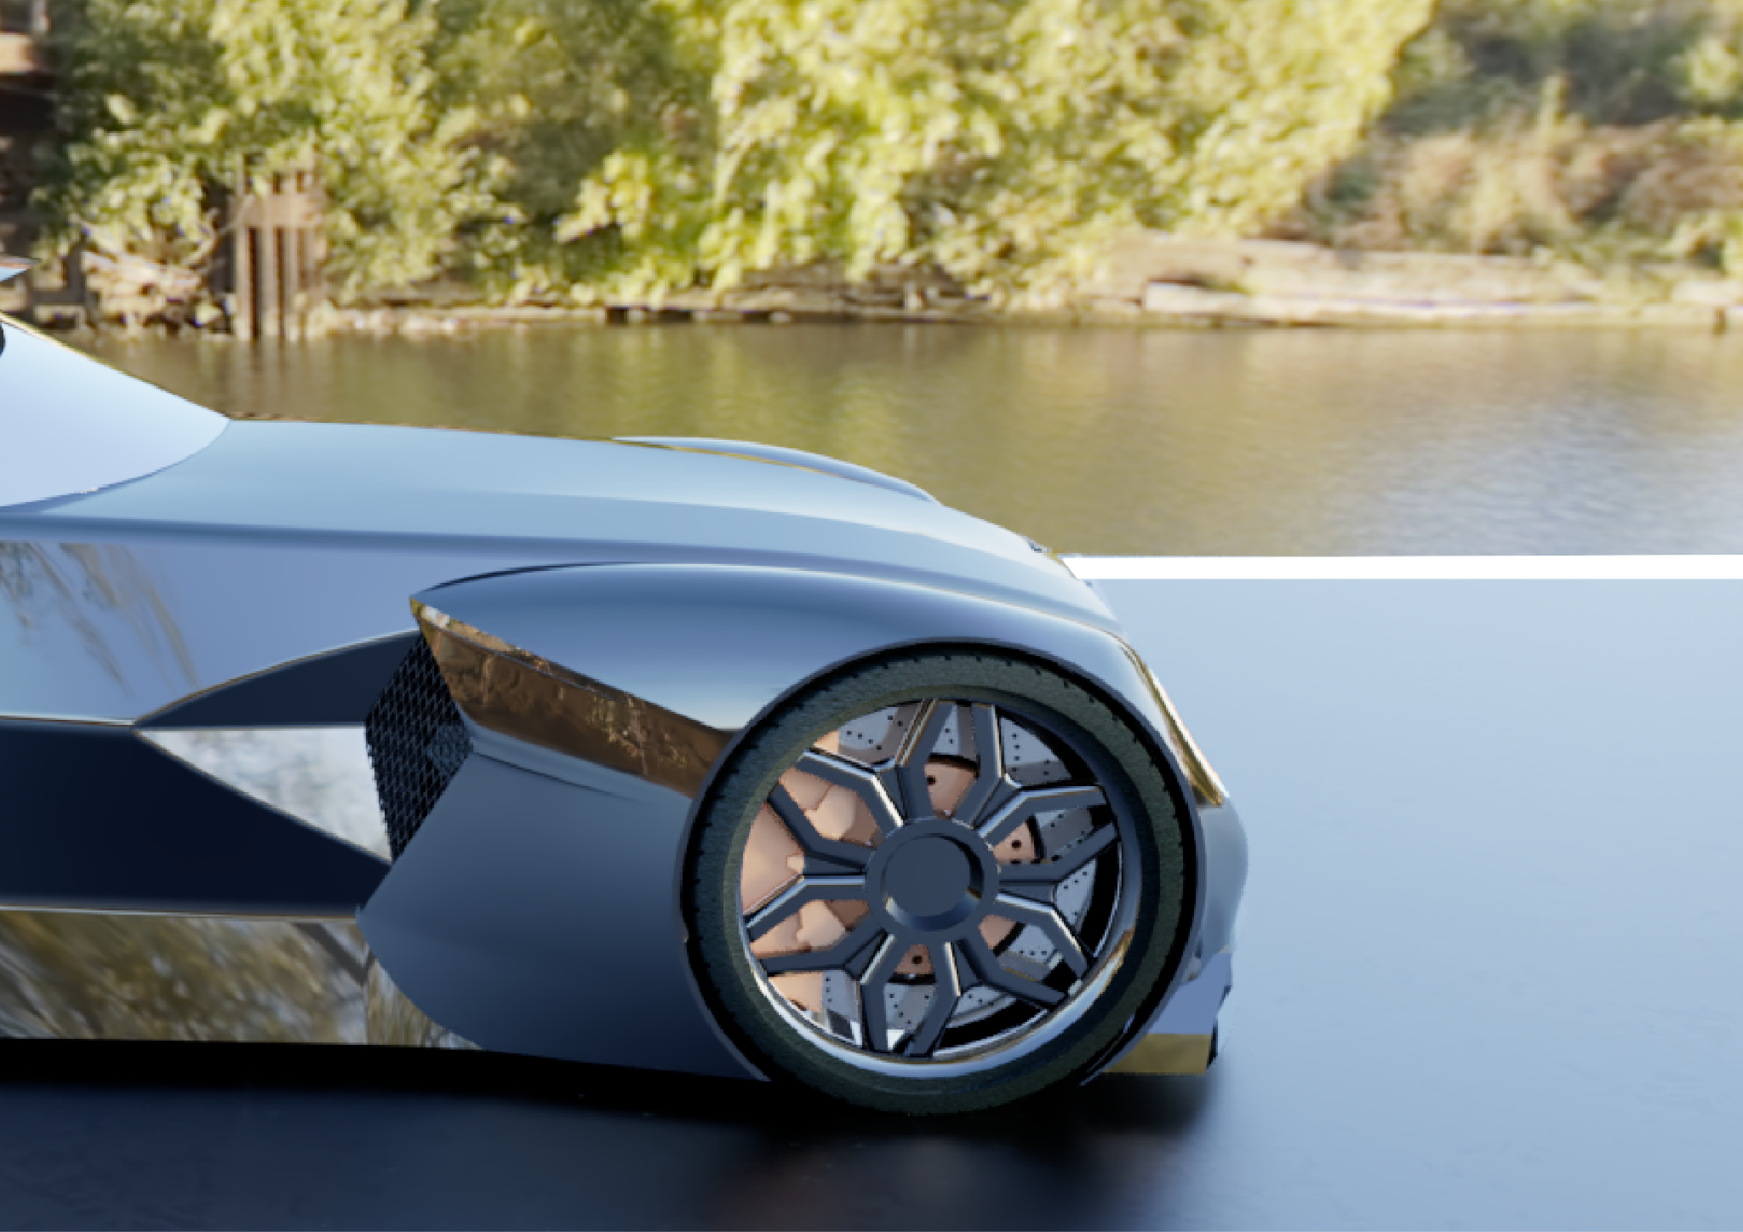
ANTON TOTH
BENTLEY SPEED SIX
(THE BLUE TRAIN)

Slide 2
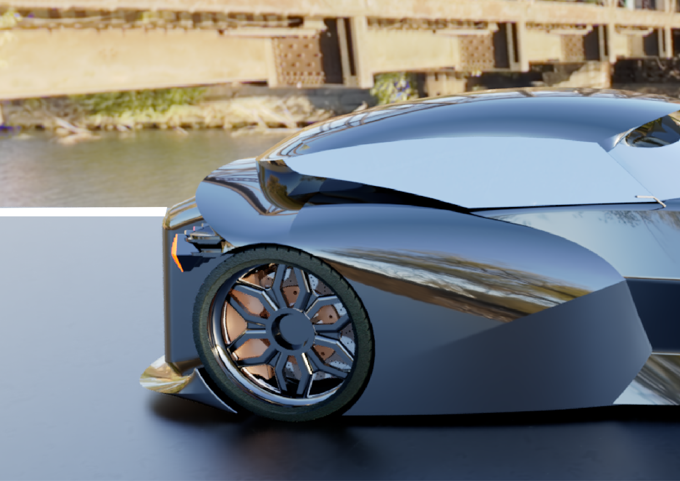

Slide 3
ANTON TOTH
BENTLEY SPEED SIX
(THE BLUE TRAIN)

Slide 4
Content:
Intro
Storyboard
Vision & Mission
Design & Innovation
Ideation
Concept development
Visualisation

Slide 5
2

Slide 6
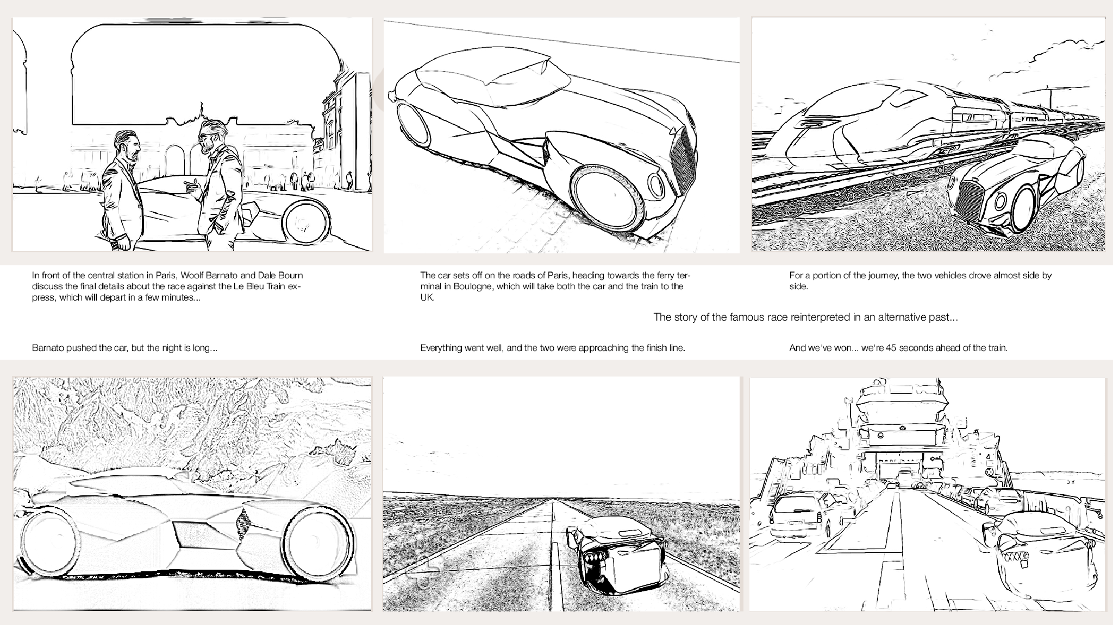

Slide 7
4

Slide 8
5

Slide 9
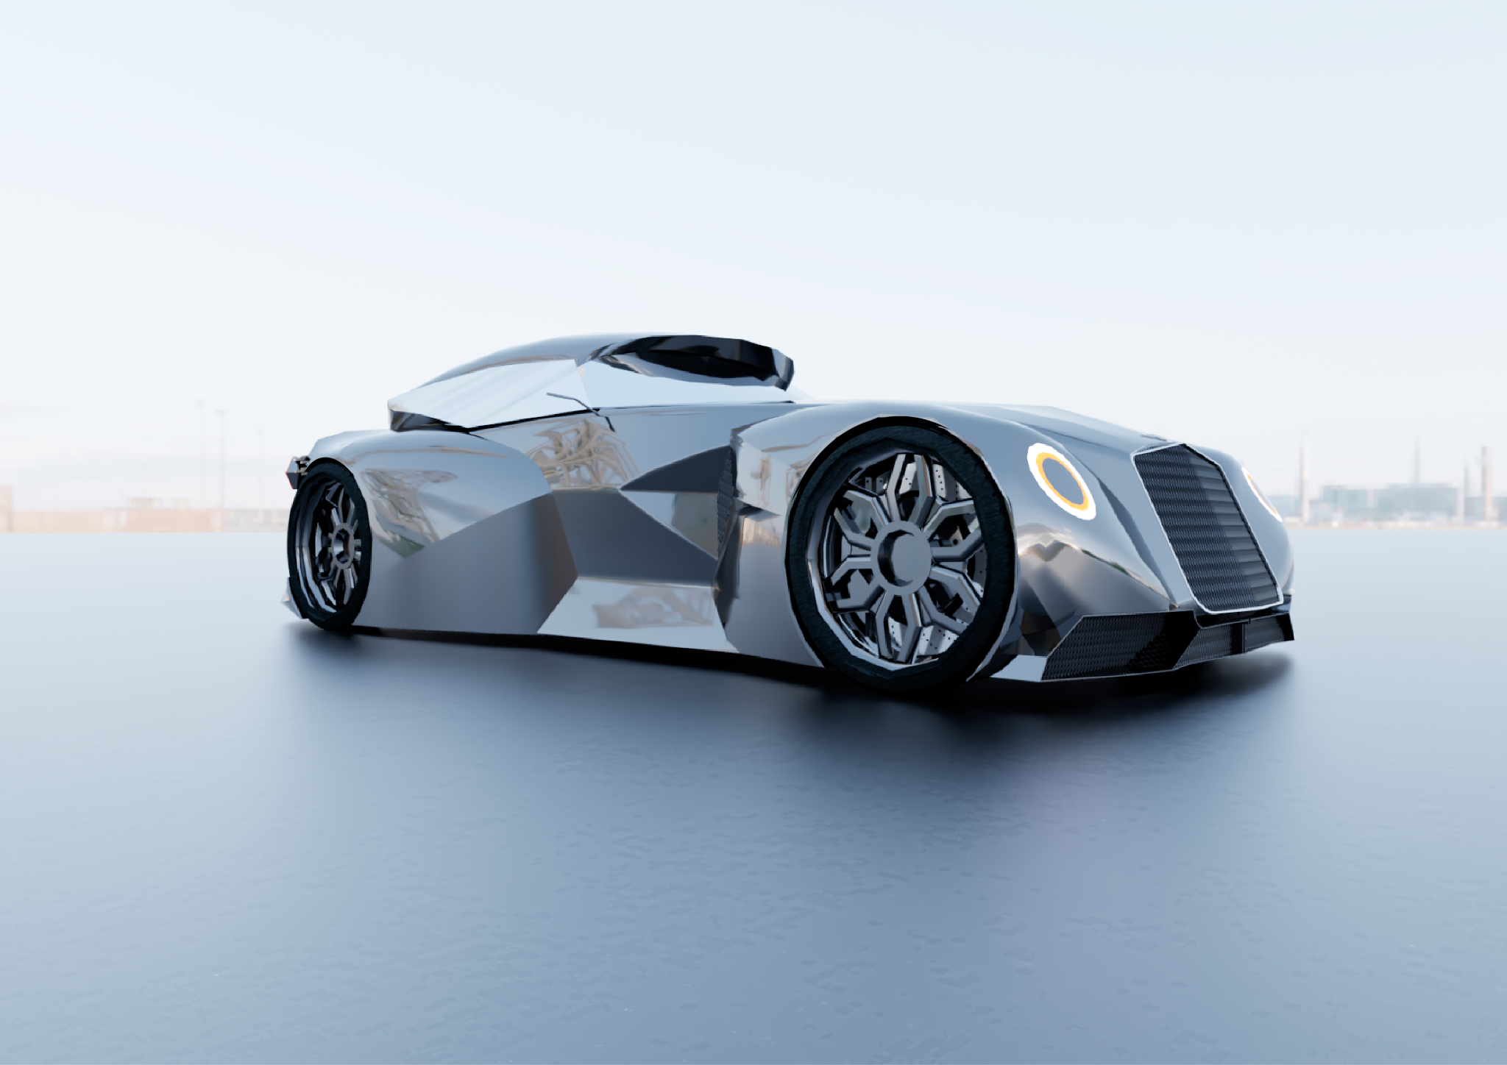

Slide 10
7

Slide 11
8

Slide 12
9

Slide 13
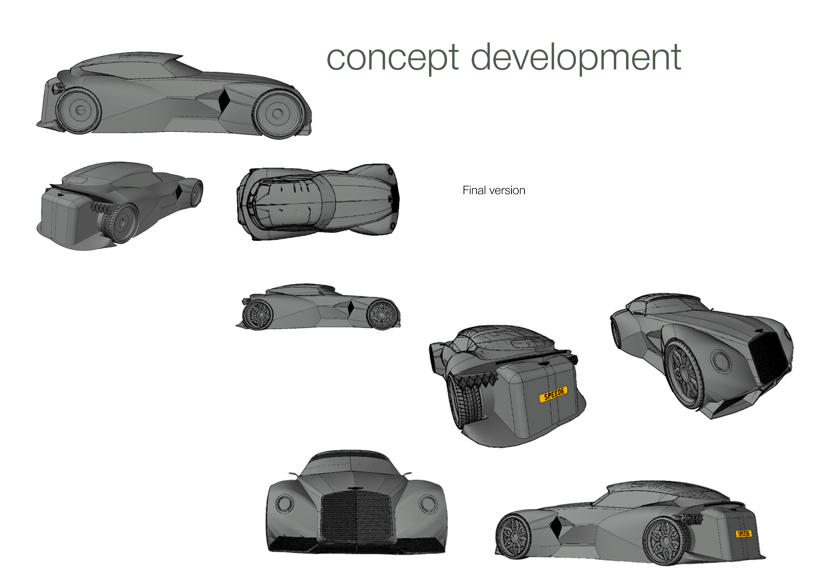
10

Slide 16
13

Slide 17
14

Slide 18
15

Slide 19
16

Slide 20
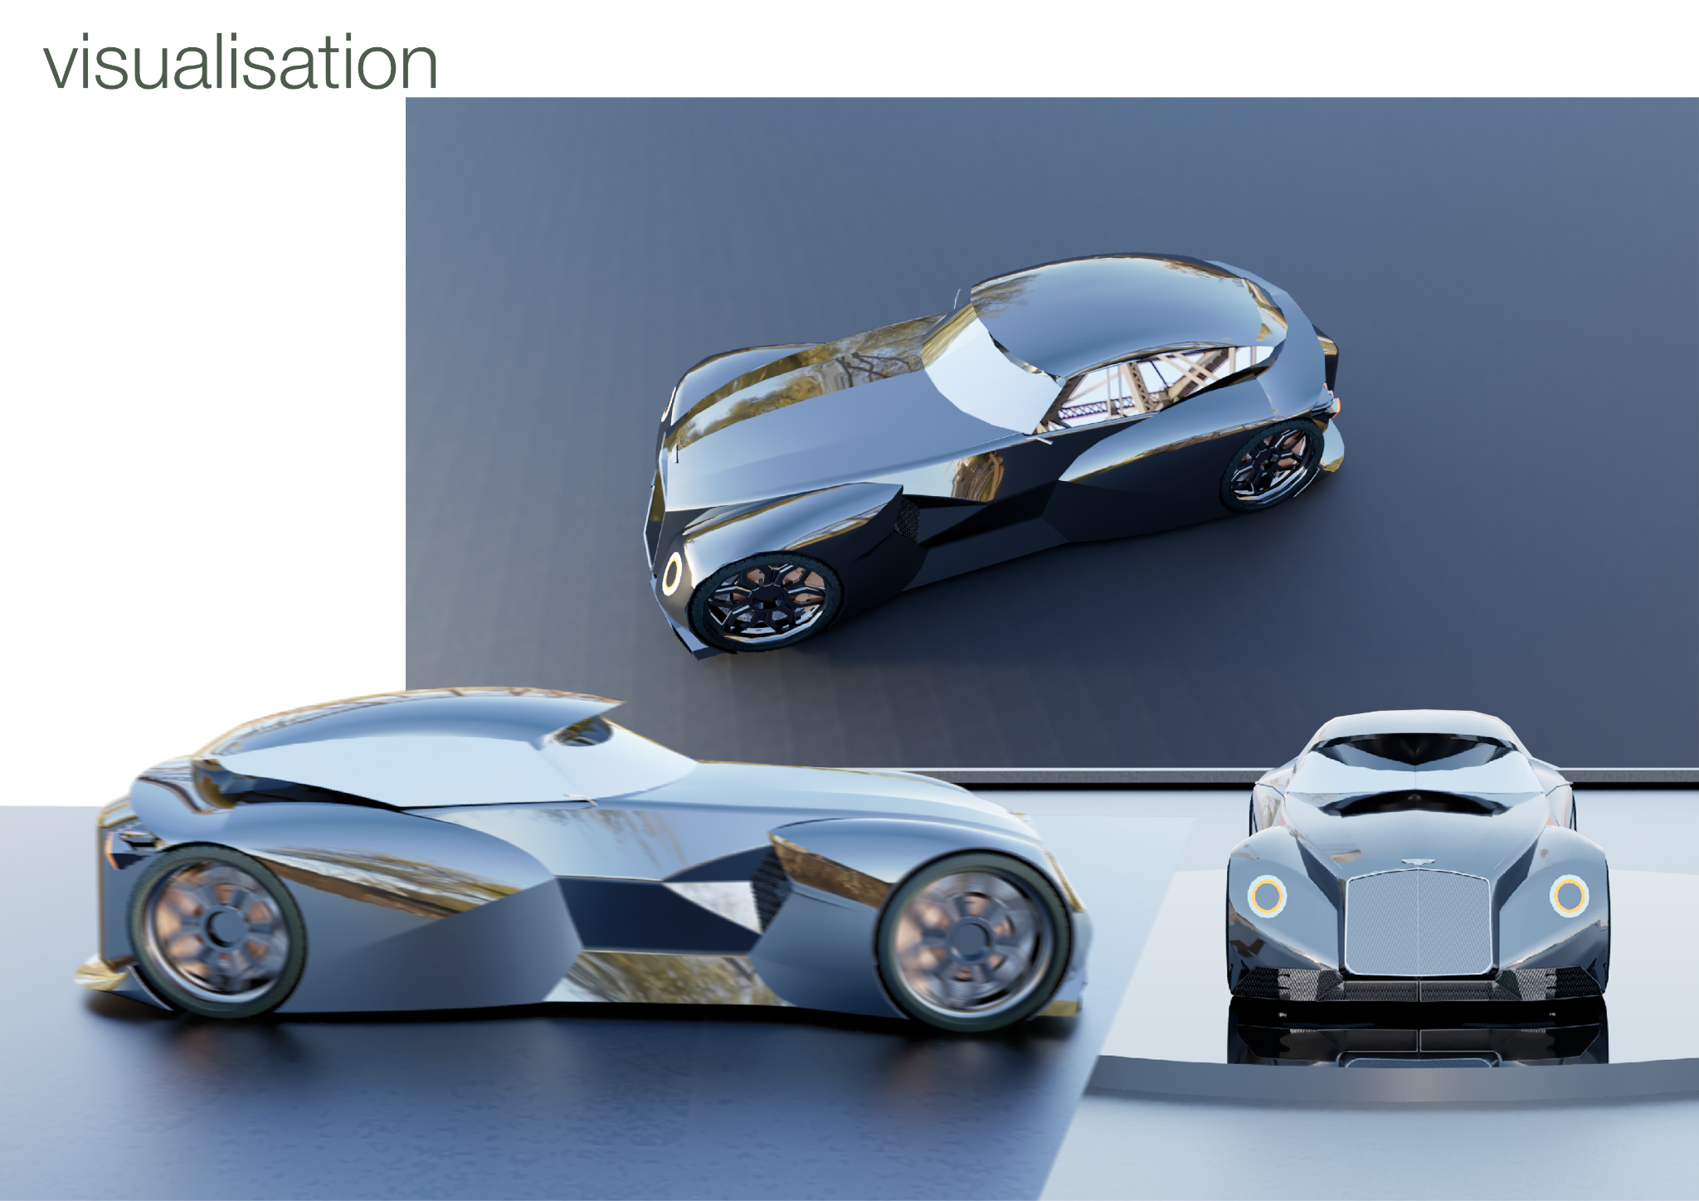
17

Slide 21
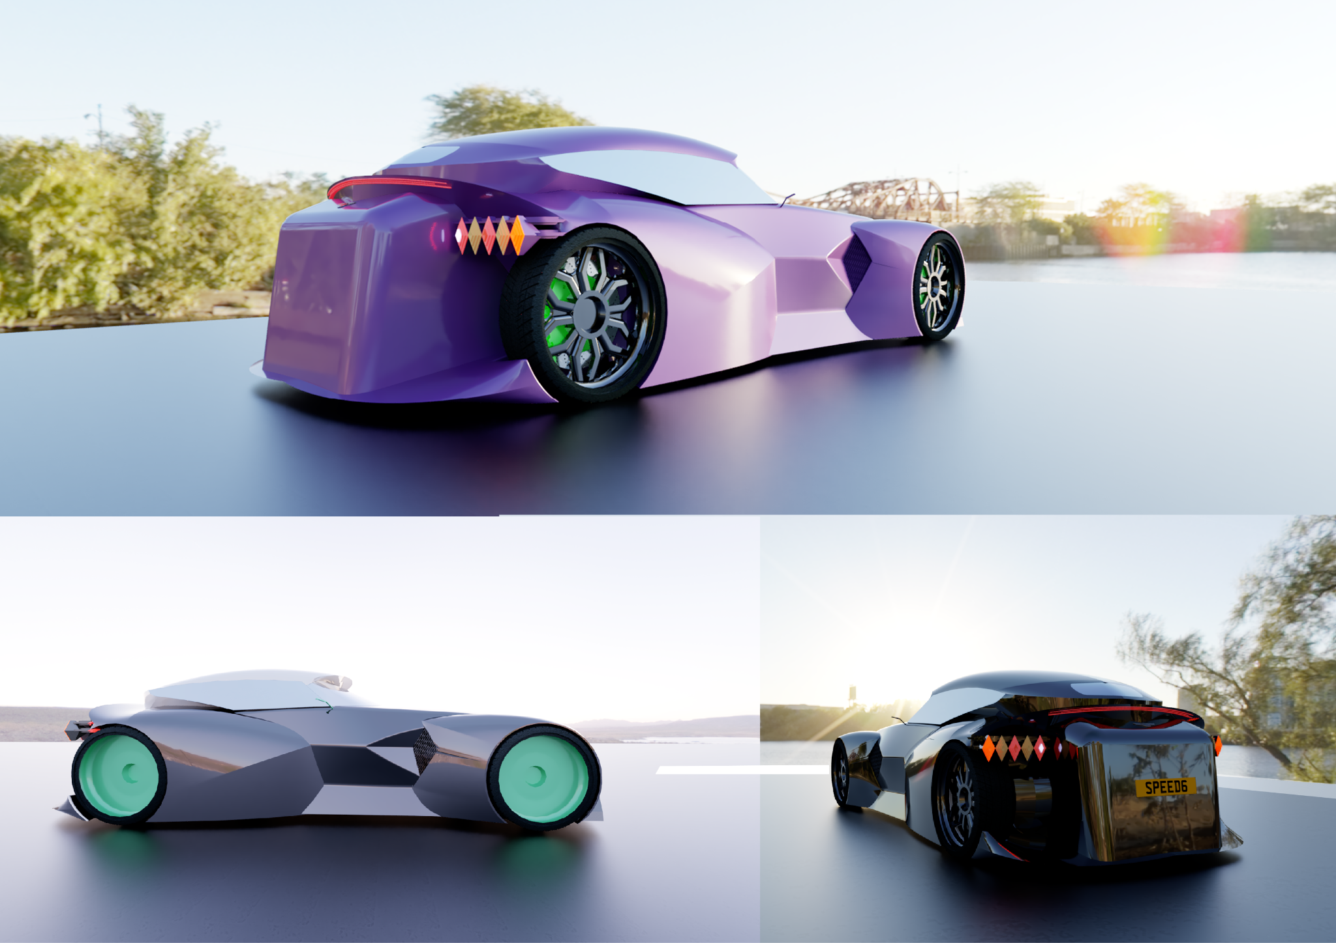
18

Slide 22
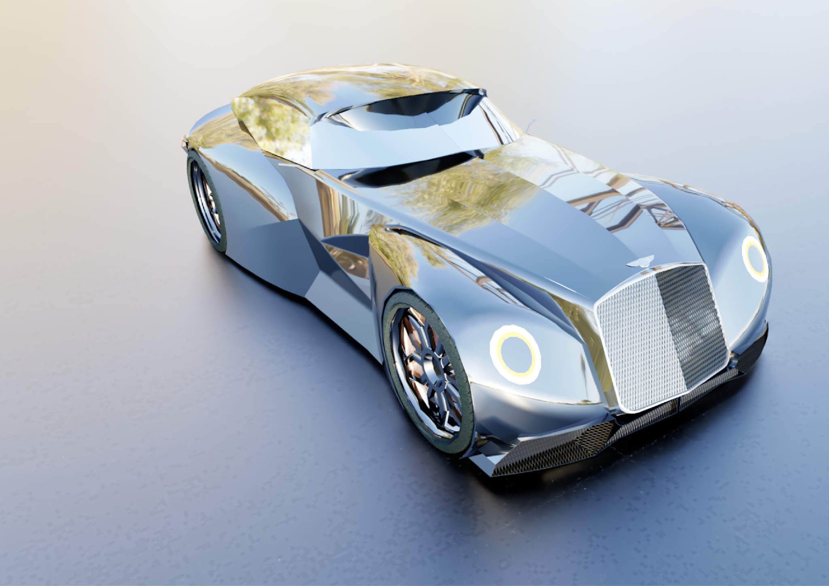
19

