Slide 1
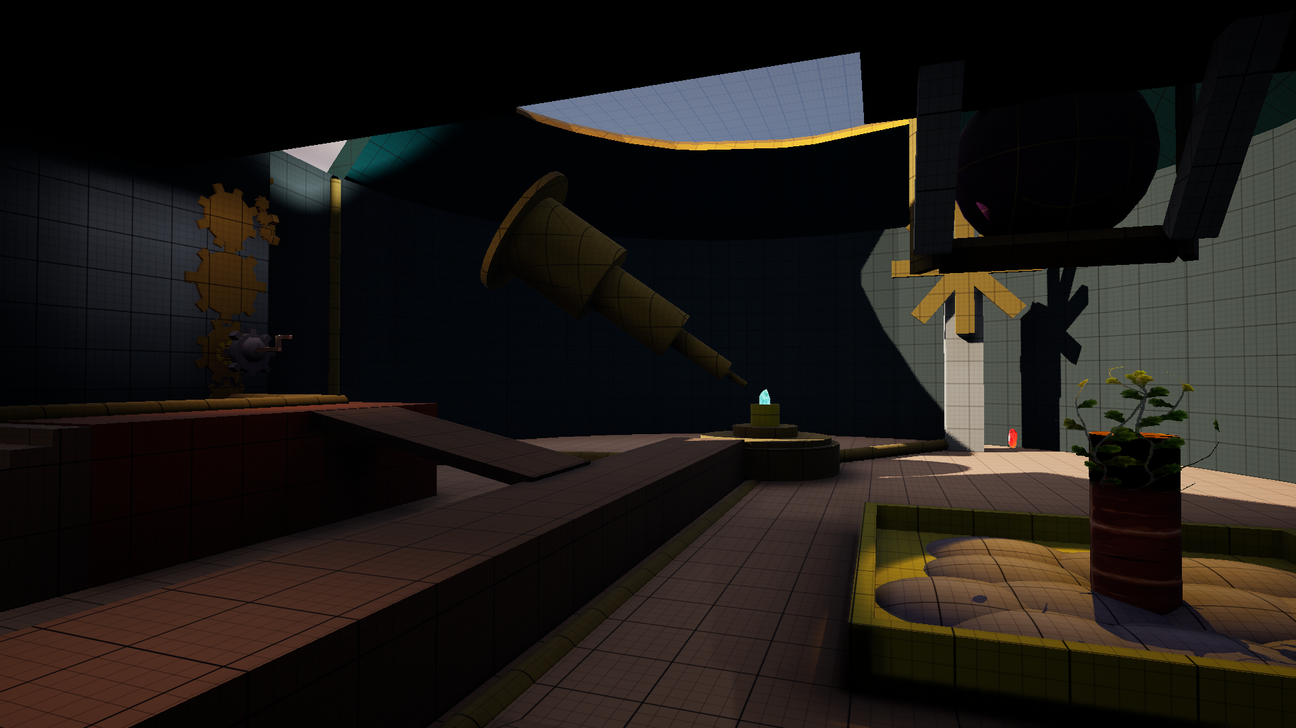
Weighted Spire
[Level Design]
Khai Whyte

Slide 2
Overview
Proposed
Project Aim

Slide 3
Proposed: Final Stages
Project Aim
A level focused on player perspective and discovery.
Development of my current understanding Level Design principles and knowledge.
Learning new techniques and applications.
A theme of magic and fantasy.
Utilising my current skills and developing them.
Hints and ideas that reveal the true nature of items throughout the level, providing the necessary context for puzzles.
Learning new skills and methods of communication to the players through the level and developers through the.

Slide 4
Objectives
High Level Medium Level Low Level

Slide 5
High Level
Lock and Key Puzzles
Obvious
Simple Lock and key puzzles that require little direct interaction to show effects and progress.
Some of the puzzle may become too obvious and end up not being interesting.
Space
Space provided for the player to understand the goal , and parts of the puzzle.
Player Autonomy > Agency
?
Player Getting Lost
?
The player should feel autonomously directed and moved through the space and puzzles.
A lack of affordance, and guiding may become an issue.
?
?
?
Player Perception
The player should perceive the space to be connected some way to the puzzle and world, theses should all be compatible with each other.

Slide 6
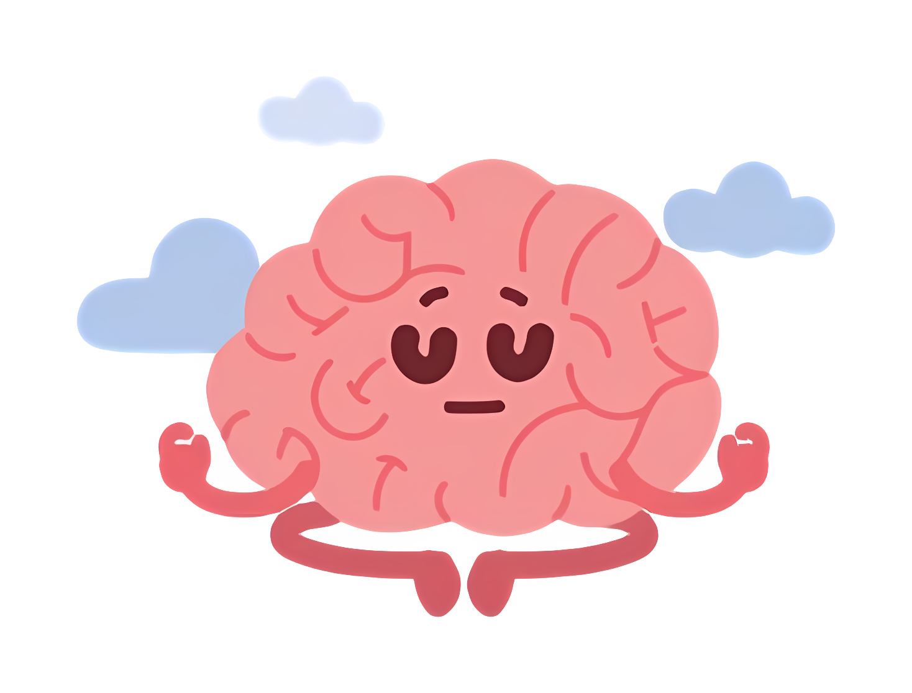
Medium Level
Player Awareness(Space)
Too Much Misdirection
This Way
The space provided should give the player awareness of their location, contextually and physically.
Too much misdirection can alter the players need to continue and their intrinsic motivation.
This Way
Awareness (Space)
This Way
What the problem is should be presented and how to complete it should be provided.
Forced Movement
Intrigue in the world (Player Autonomy)
Forcing the player through an area without any context can feel restrictive from the perspective of gameplay when the player doesn’t feel as though it was their choice.
The player should want to understand the world naturally by design and flow.
This Way
This Way
Planned Misdirection (Player Perception)
The player perception is to be altered and manipulated in a way to misdirect them meaningfully, for narrative or gameplay purposes
This Way
This Way

Slide 7
Low Level
Unintuitive puzzles
&
Easy Affordance (Player Autonomy)
Context Reliance
The affordances of items, objects and the world should be easy to recognise and communicable.
The puzzles are simple but can still end up requiring players to have context that is never given.
Intuitive Puzzles
Through affordances, the puzzles should feel intuitive and make sense to player after completion.

Slide 8
Design Research
Optical Illusions
Perspective

Slide 9
Optical Illusions and Perception
[Article: Ioanna Symeonidou - Anamorphic Experiences in 3D Space: Shadows, Projections and Other Optical Illusions]
“If not standing at the vantage point, the viewer will only perceive fragmented shapes.”
Optical illusions take advantage of a person's perception of their space.
I wanted to use this as the core of understanding and developing my project around how a player perceives the game world.
“In 3D space, optical illusions usually refer to our ability to perceive perspective views, the understanding of light and shadow as well as our wrongly perceived distance from certain objects.”
Lighting is an important aspect of how optical illusions affect people. The level itself ensures no misdirection is created through the lighting and the player can perceive what is necessary.
Lighting in a level design use case can also help with guiding the player and highlighting necessary paths.

Slide 10
Perspective
[Book: Robert Pastrana – Simplifying Perspective Chapters 1 - 4]
“…give your viewer enough visual information so they can easily tell what your object is and what it’s doing.”
The player will require the necessary visual information when entering a room to discover the puzzle, problem and the solution.
This extends to the affordance of the level and how the player should navigate it.
“When you lose or minimize any of these major planes you’ve hindered the readability of the form.”
Readability of the level extends to players view as well as a development team. The player should be able to learn and read how they should move and interact within the space.
Artists, modelers etc. They will be able to get an idea at a glance the important pieces of the set and how to go about developing the visual style to match the level’s meaning.

Slide 11
Perspective
[Book: Robert Pastrana – Simplifying Perspective Chapters 1 - 4]
“High contrast attracts the eye and pushes things forward in space”
As mentioned, lights can help with affordances, the light can create high contrast and focus the main aspect of a room.
“A little distortion isn’t necessarily a bad thing; when it’s done with control, we call it exaggeration.”
Player perspective and how an area is presented can allow for certain elements to be exaggerated for affect.
It could be used to exaggerate a threat or the objective such as a main interaction point.

Slide 12
Experimentation [Metrics]
Scale Player

Slide 13
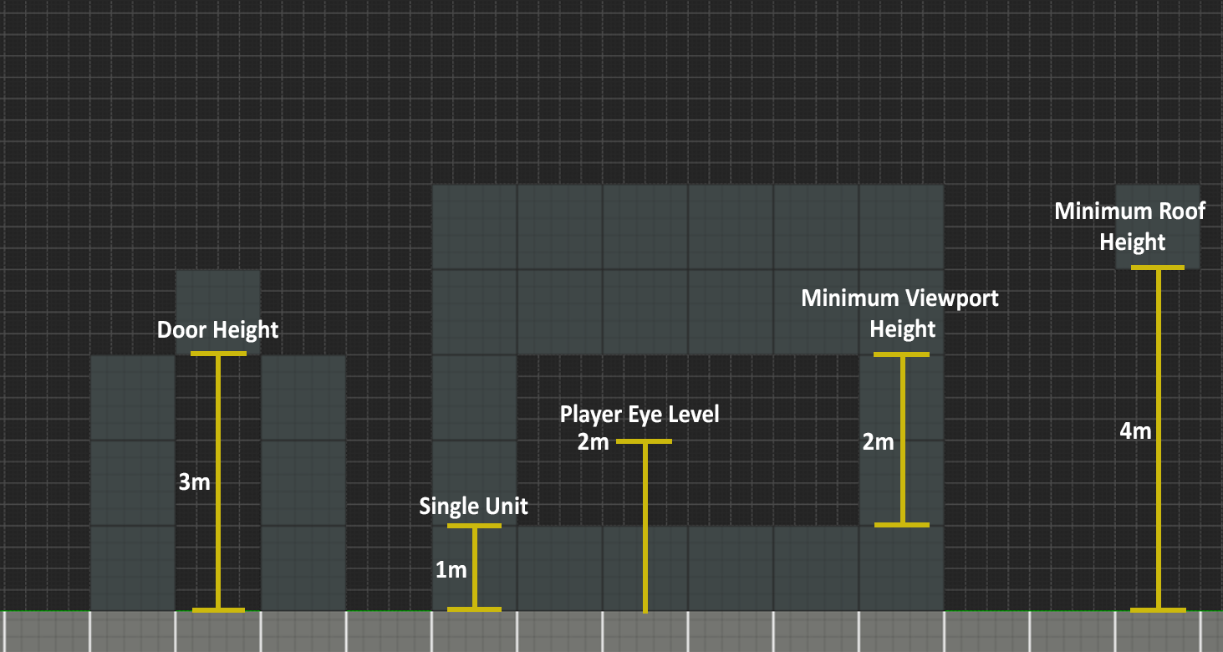
Player Scale
The player metrics keep the level consistent in the basics of its geometry.
Basic Metrics

Slide 14
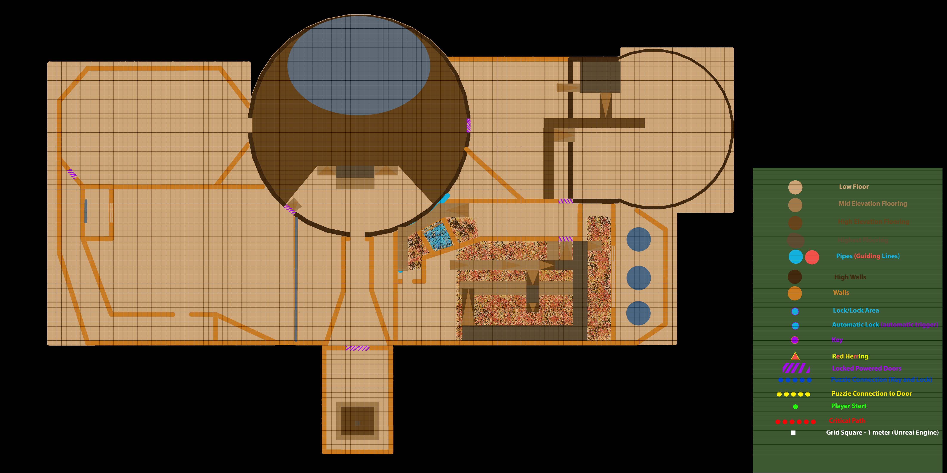
Layout and Floorplan
Maps & Layouts

Slide 15
High Level Understanding
After the initial research – I had an idea of how I wished to set up puzzles.
The need for the player to have the correct spaces to view or interact with the puzzles is vital. (Player Perspective).
The use of perception and perspectives are mandatory to the player solving the puzzles and misdirection.

Slide 16
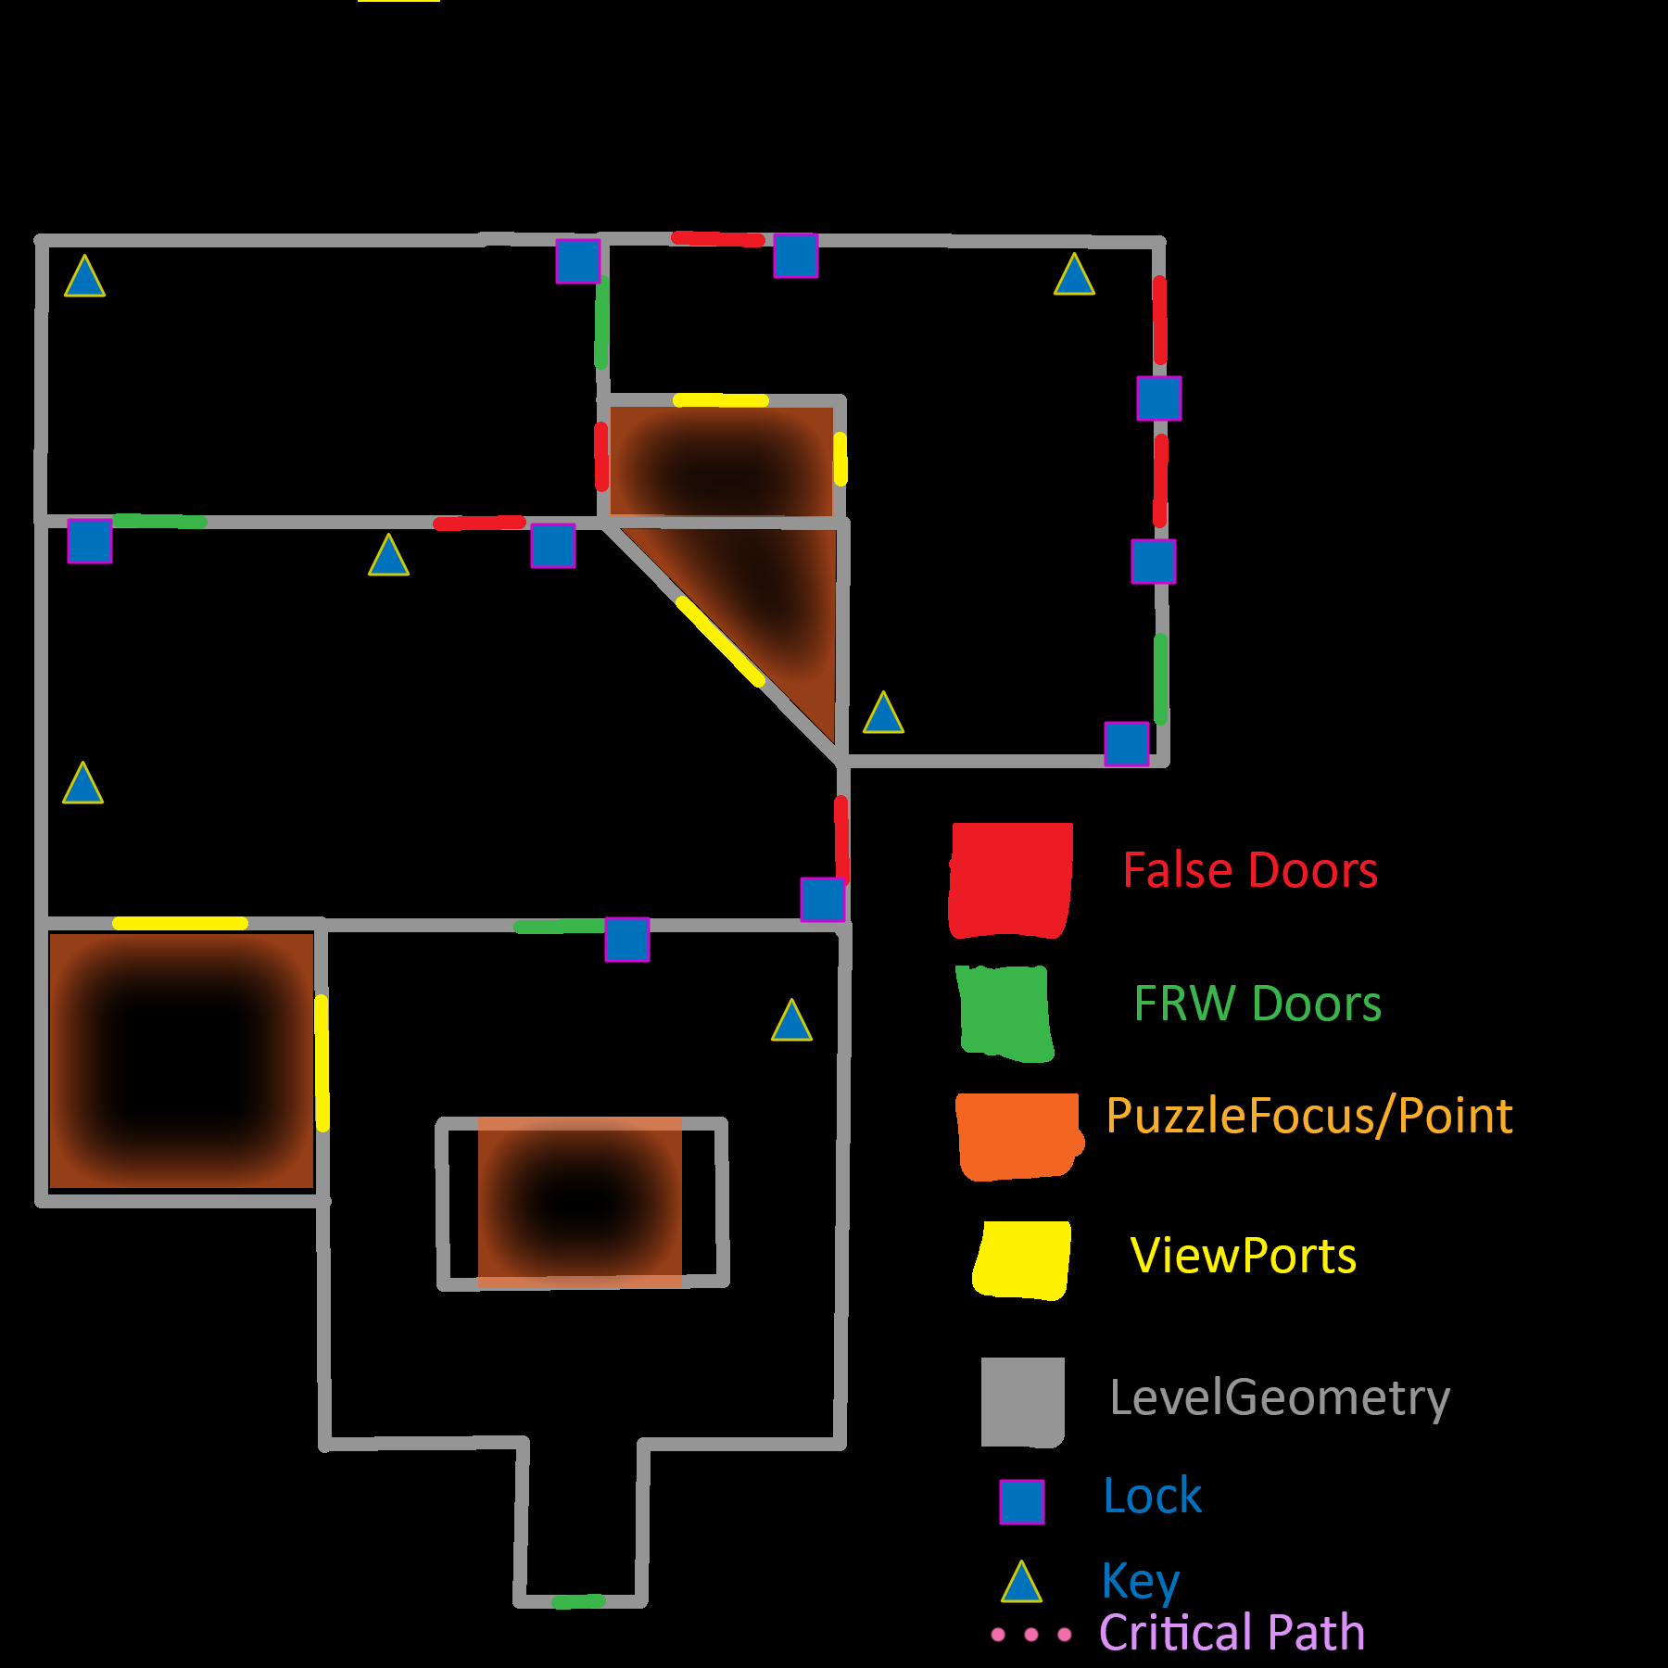
Sketch Itteration1
Puzzle focus ideas:
A room with a light switch on the outside. This would change the colour of the room, using colour contrast techniques a hint and/or the answer will be revealed to the player.
A metaphorical puzzle, the player must think metaphorically about the hint to understand the puzzle better. E.g.. Which is the true key
A 3-Dimensional Ambigram, viewed from two different sides showcase a different word or hint.
A vantage point hint – from the correct angle, another hint is revealed. The player must utilise the space within the room to figure this out.
1
2
3
4

Slide 17
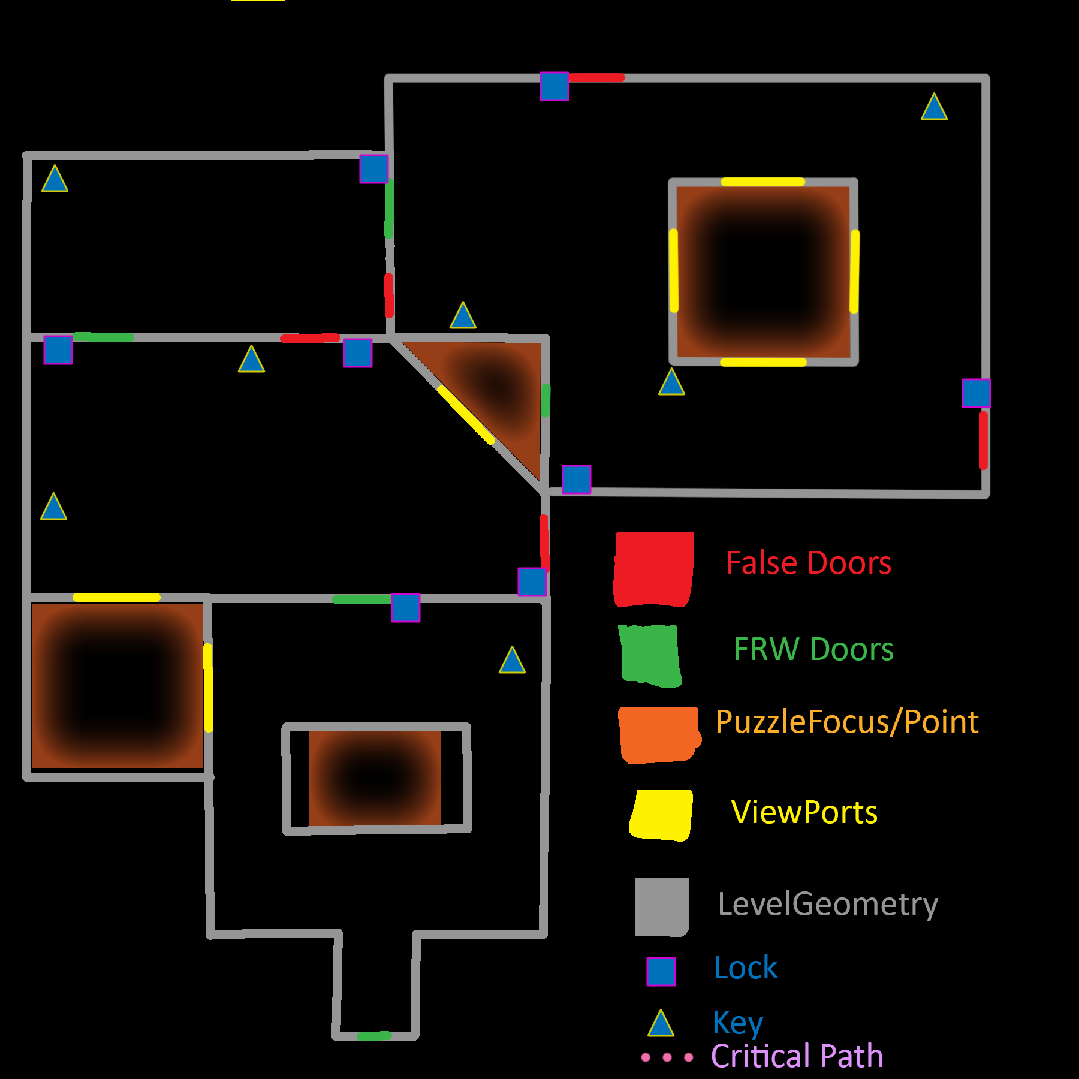
Sketch Itteration2
Puzzle focus ideas:
A room with a light switch on the outside. This would change the colour of the room, using colour contrast techniques a hint and/or the answer will be revealed to the player.
+ A 3dimensional Ambigram. – the light switch idea will be taught in the room before.
The rest of the puzzles kept the same.
1
2
Reason for changes:
Previous Final Section had too many false doors
Final section should challenge what the player has learned
Better use of space and ideas earlier on in the levels.
3
4

Slide 18
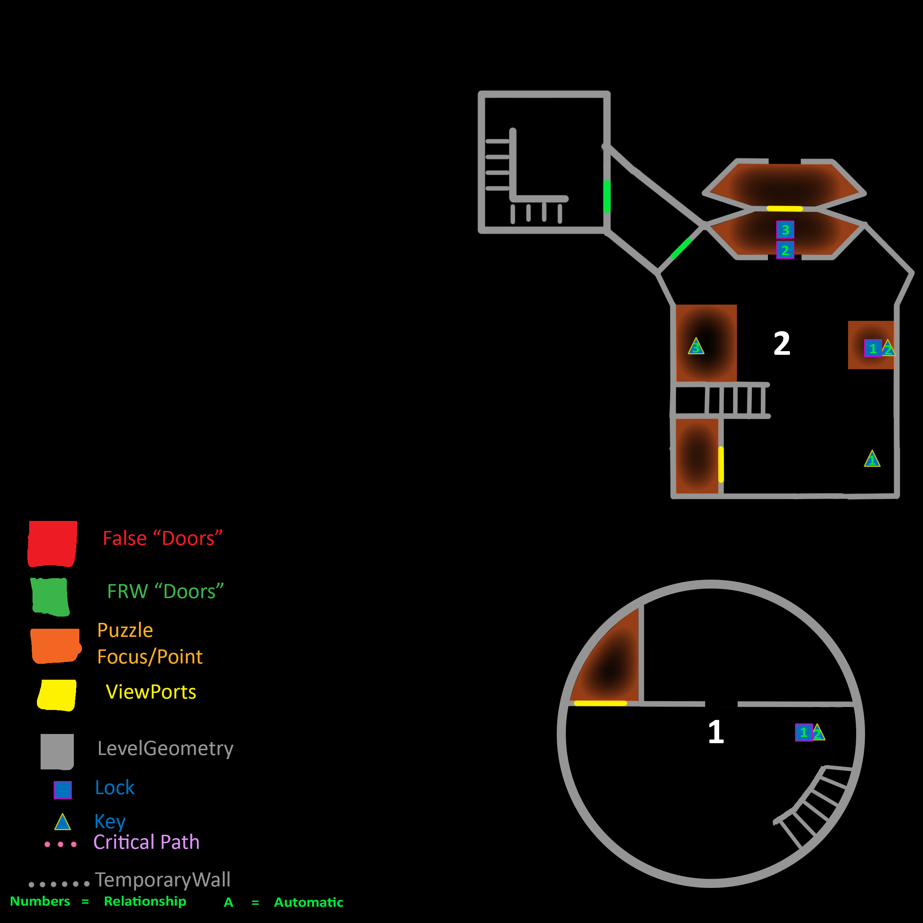
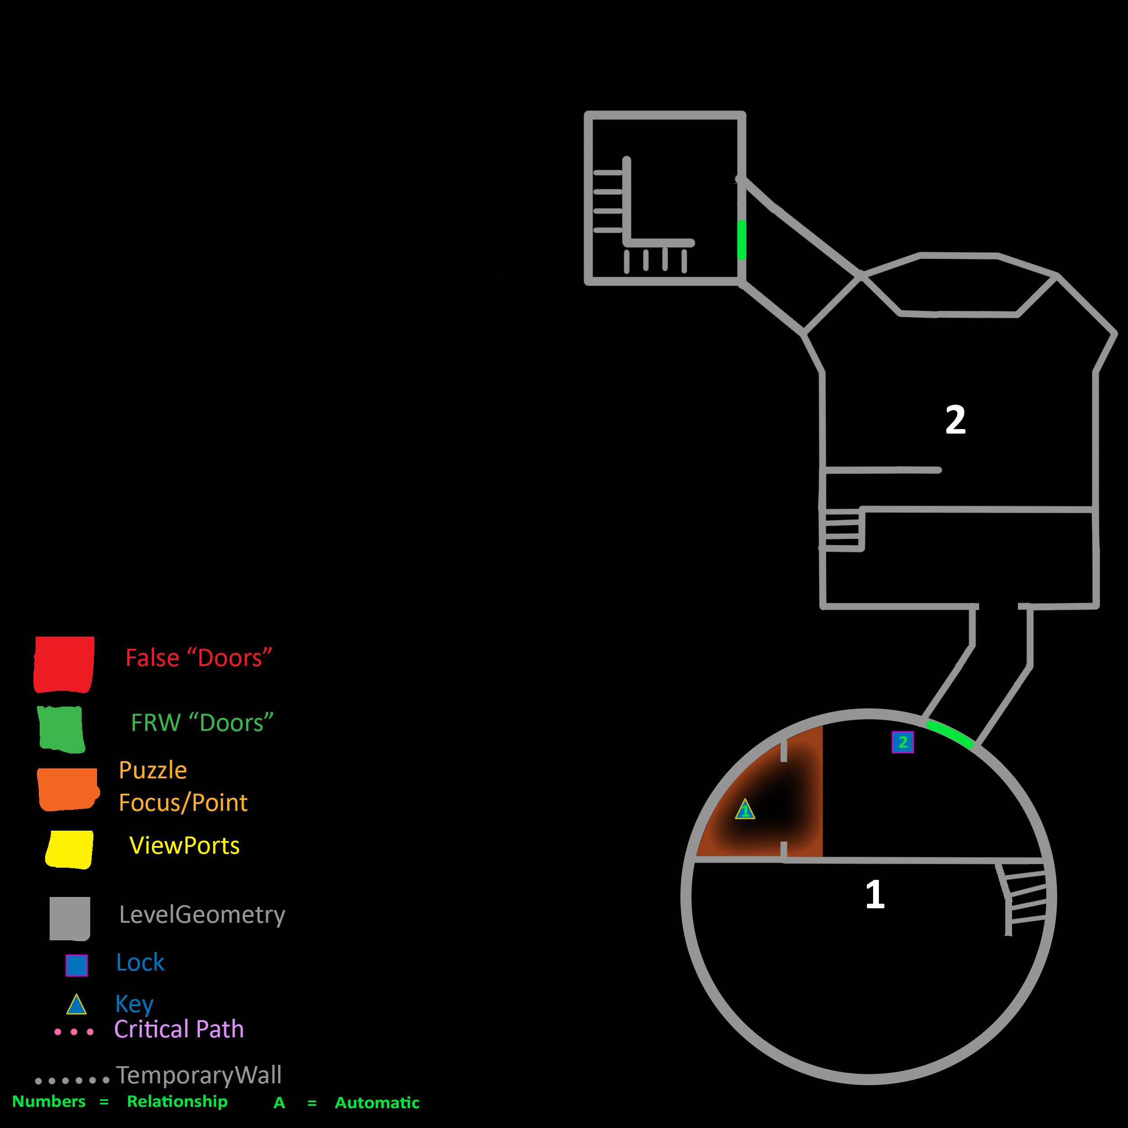
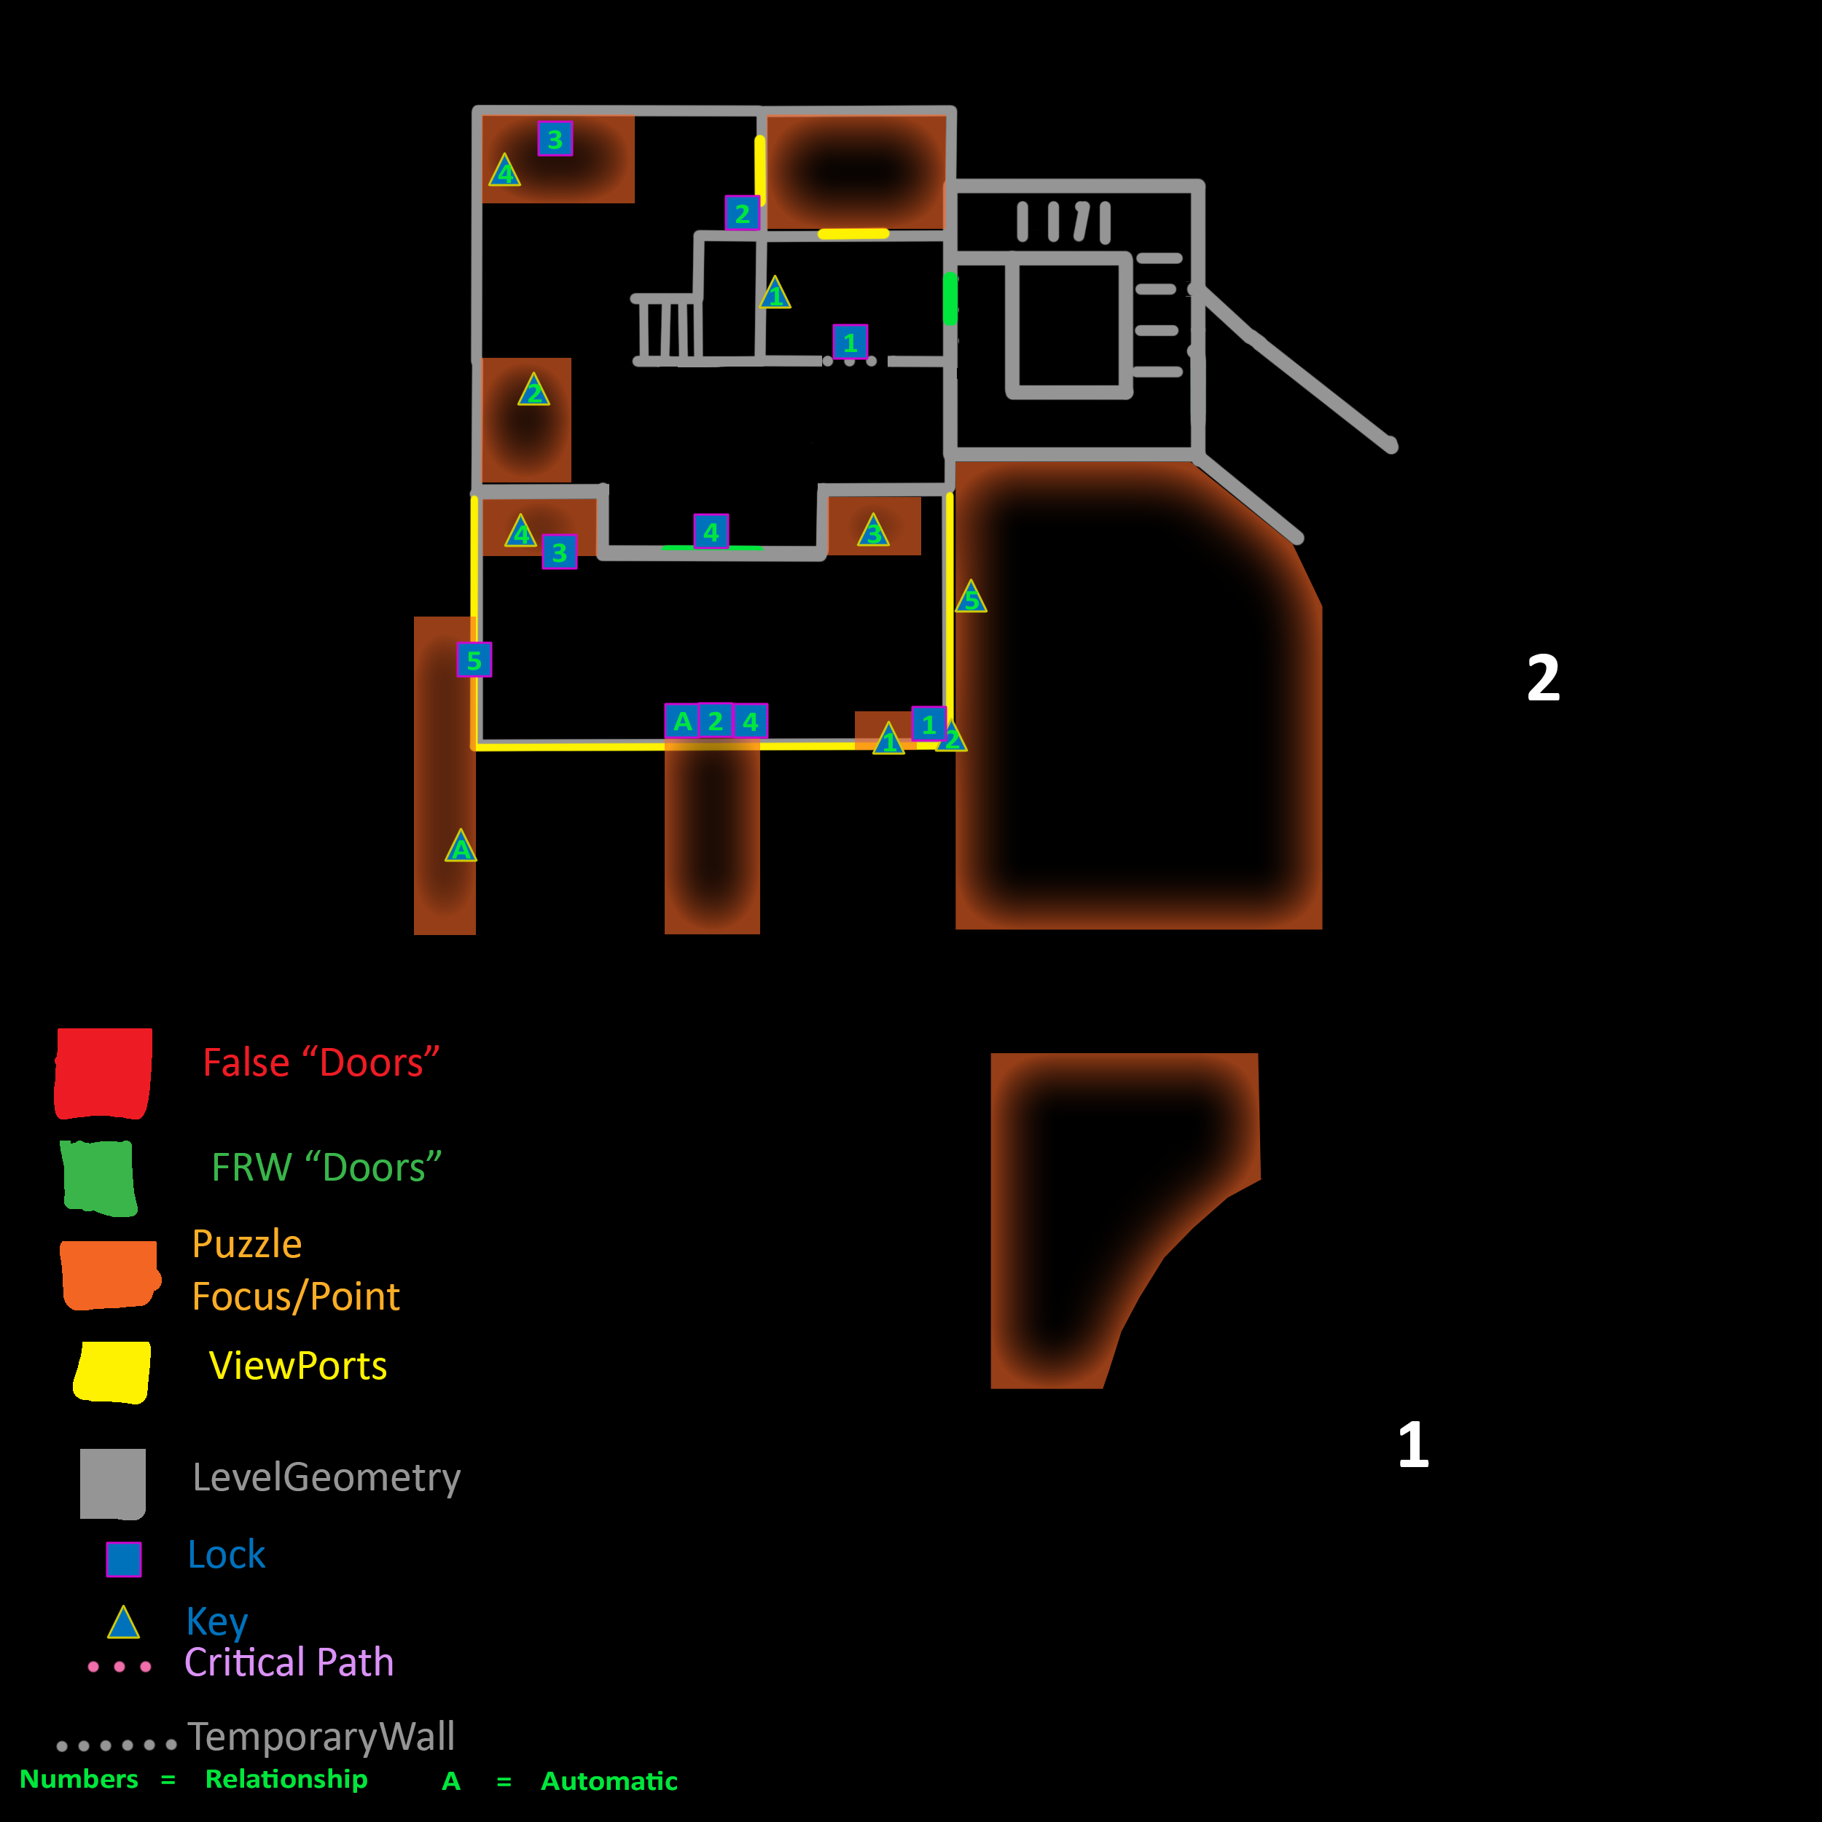
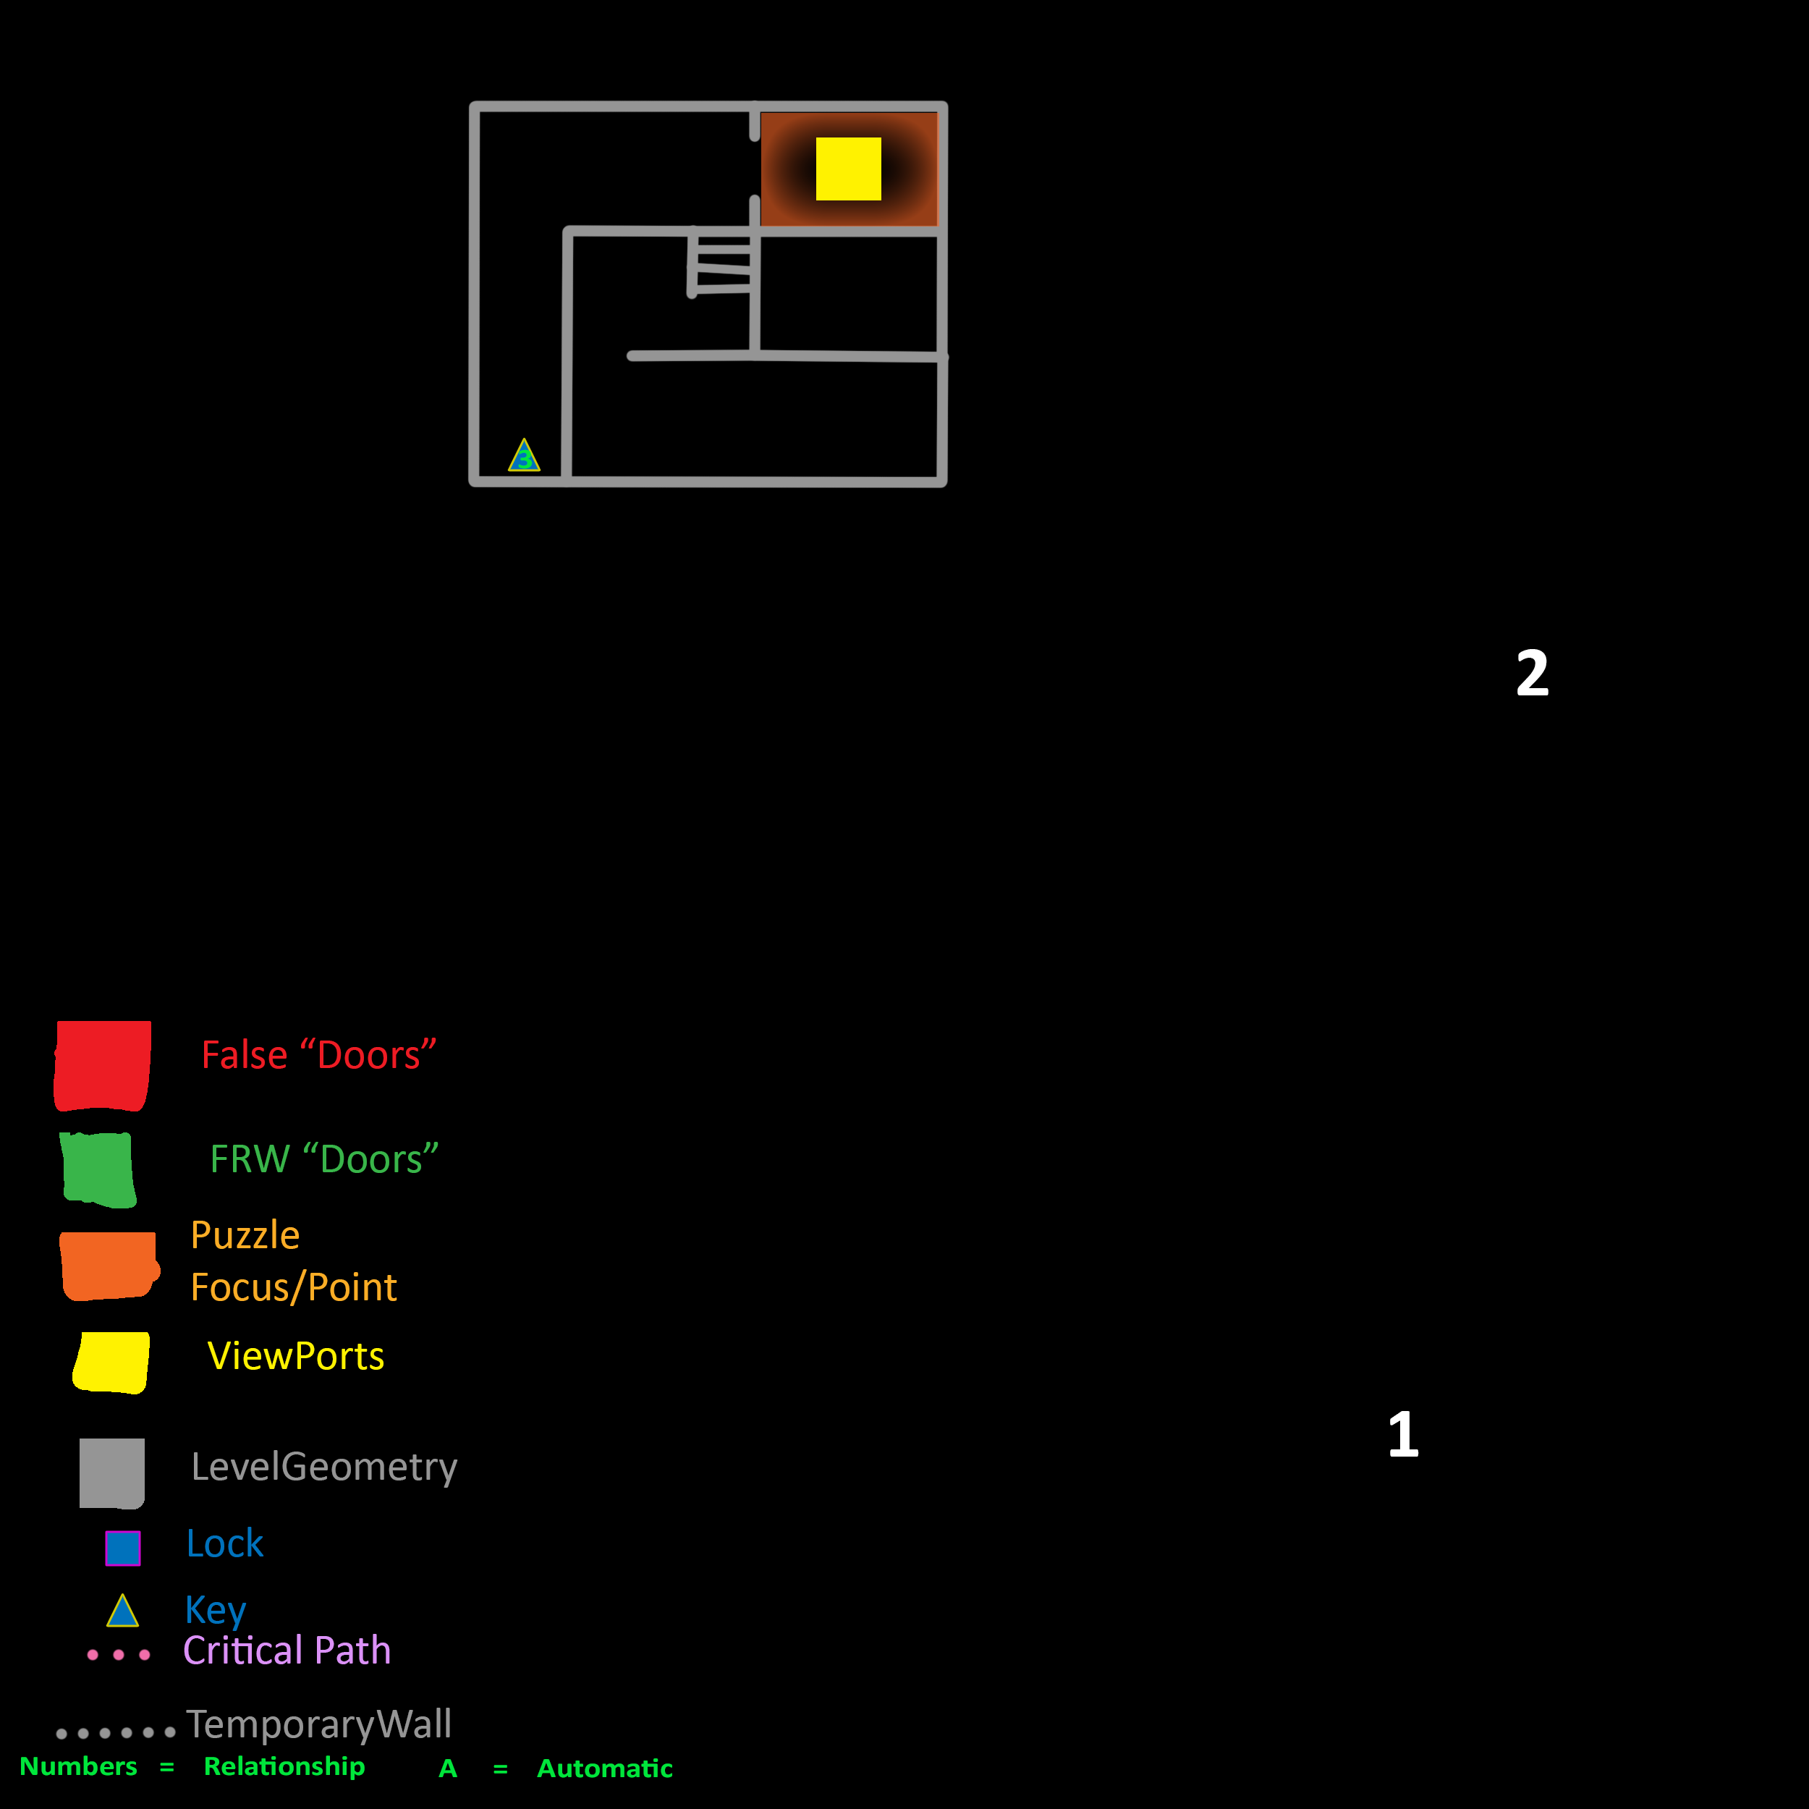
Sketch Itteration5 (Wizard Tower)
2
1
Main Iteration 1
Layout and Design:
The Wizard Tower is present, the cylindrical area is a confined closed section that allows the player to focus on understanding how the game should.
The next section showcases a larger room and the objective encased within glass. An unknown to the player as to what it does. Exploration in this section is necessary to get through.
The next section is the personal area for the wizard and strange potion making is done to gain accessed to the balcony. The player can now see that they were underneath a large cauldron to begin with.
Creating a large spectacle to the player.
3
4

Slide 19
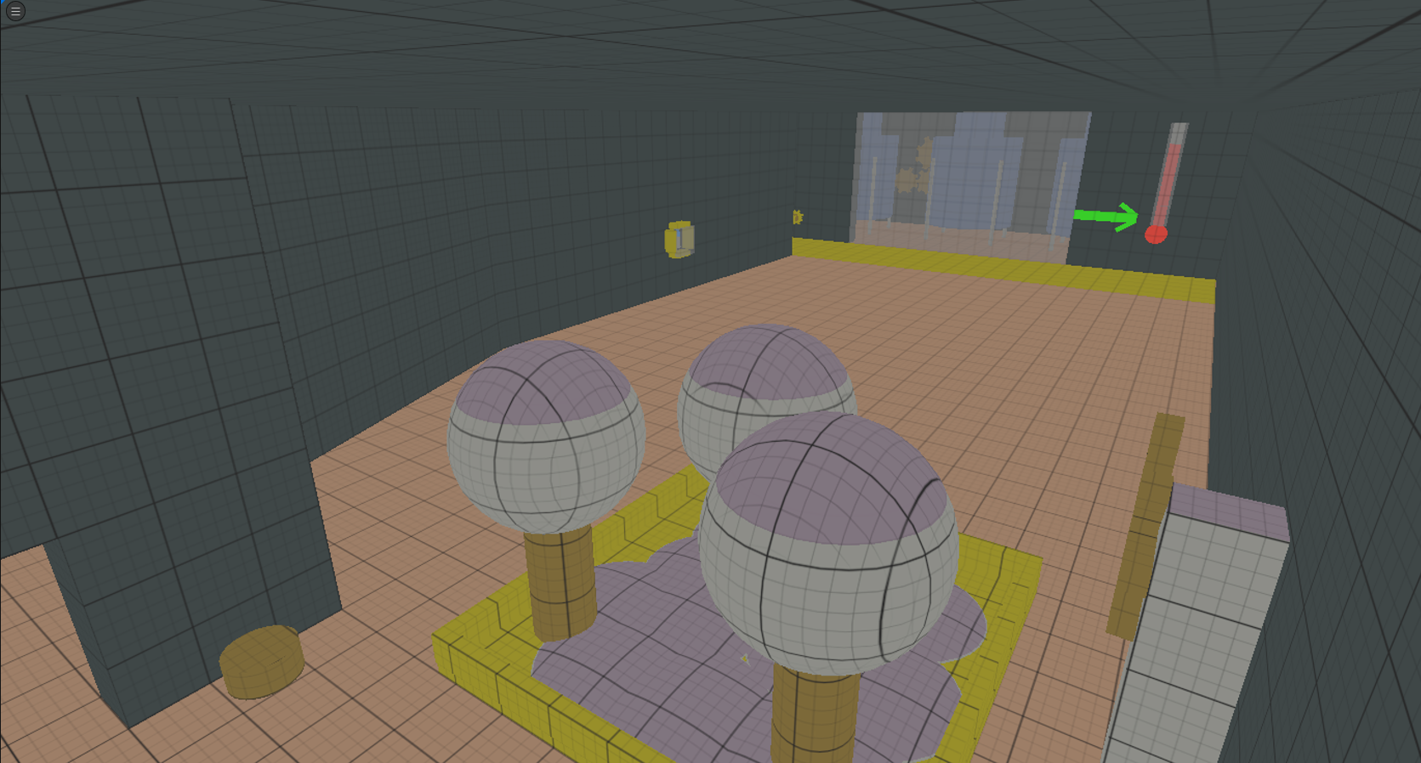
Playtesting and Iteration
Block out
Production Analysis
How Results Application

Slide 20
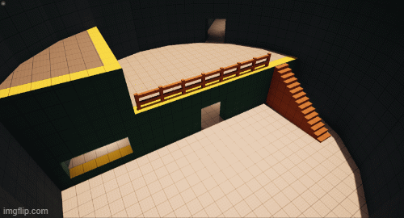
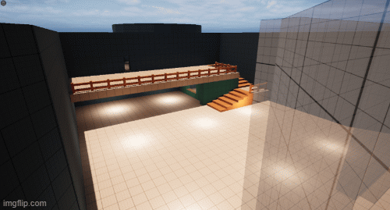
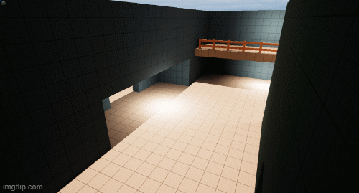
Production of Main Iteration 1
The interior is built to resemble the unnatural theme of a wizard and the magic they would possess.
Multiple spaces have narrative and hints into the completion of the puzzle within the room.
Multiple spaces have narrative and hints into the completion of the puzzle within the room.

Slide 21
Playtest 1 (Self)
Positives
Negatives
Puzzles rely too much on context that is never taught or is too out of the box.
Use of Waypoint and objective within the second room.
The final area warps the player’s perception of what they did.
The reliance on assets to guide the player and hint to them what they need to do is ineffective and not the aim of the project.
Attempts made to guide the player naturally.
Limited use of Level Design Techniques.

Slide 22
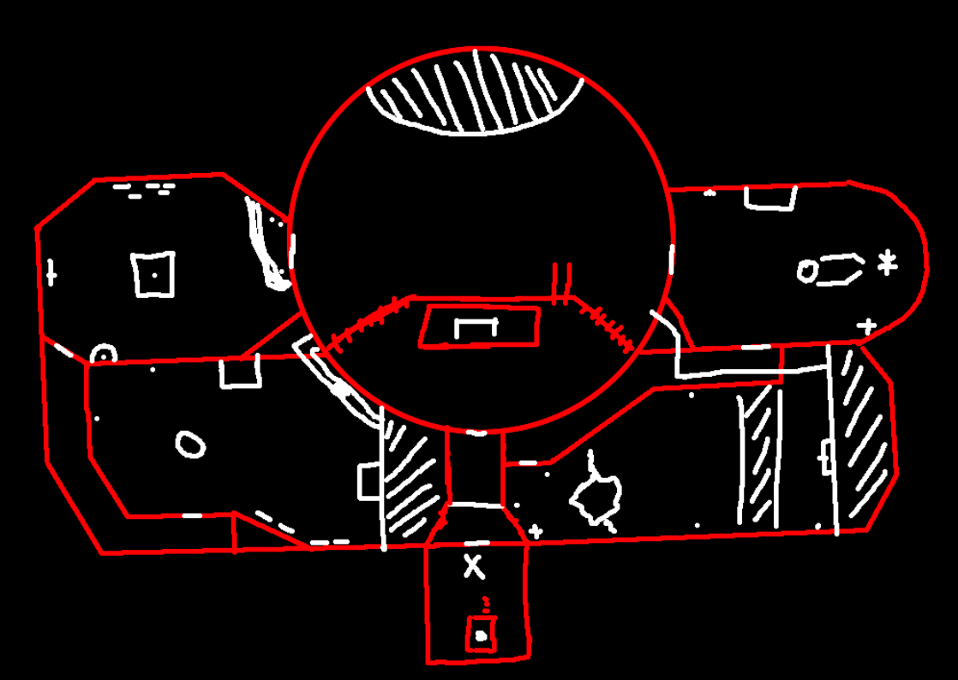
Playtest 1 (Self)
Plan for next Iteration
Re do the level entirely to match the Project aim.
Clearer Guiding and Teaching of context.
Apply more Level Design Techniques.

Slide 23
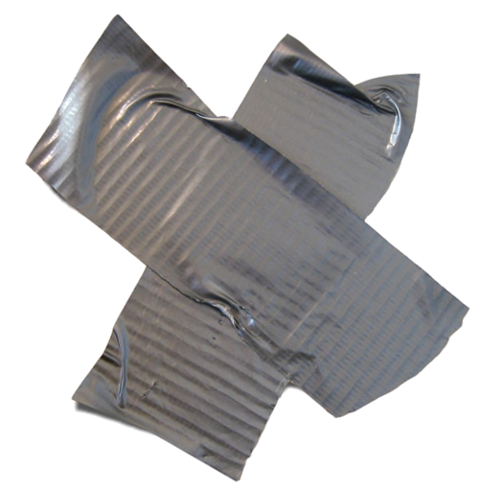
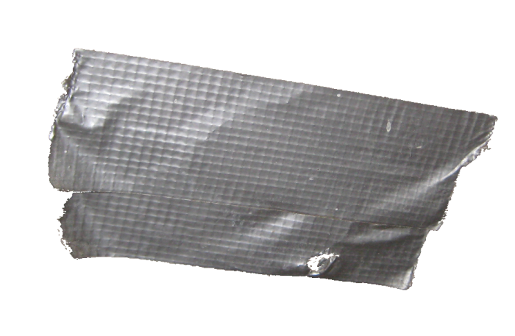
Application (Iteration 2)
Production Analysis

Slide 24
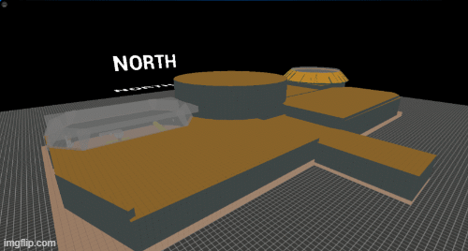
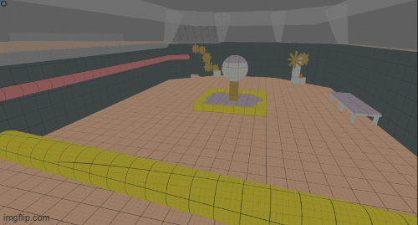
Production (New Layout)
The new layout provided more space for the puzzles to be seen by the player. Nothing was hidden or in areas that required previous context.
The player is gated at the start to teach the visual context needed for the puzzles in the later part of the level.
The player space provided much more visual context and space for the player attempt to come a conclusion on how to solve the puzzle.
The player space provided much more visual context and space for the player attempt to come a conclusion on how to solve the puzzle.

Slide 25
Playtest 2 (Unsupervised)(Anonymous Results)
Positives: From the Results
Negatives: From the Results
Clear atmospheric language and effect.
Players did get lost more often, due to lack of clear changes when puzzles completed.
Context taught early on for items and elements within the level.
Unclear as to what could be interacted within certain areas.
The player seeing the goal in the final section, the perspective was affective.
The observatory section lacked direction for the player to understand the changes they made.
Helped with player autonomy and agency to find the solution to the puzzle.
Lack of elevation, very flat.

Slide 26
Playtest 2 (Unsupervised)(Anonymous Results)
Plan for next Iteration
Add elevation to some of the areas.
Using some more obvious light to help show the player the importance of an item or event.
Try and make it clearer what can and cannot be interacted with.

Slide 27
Application (Iteration 3)
Production Analysis

Slide 28
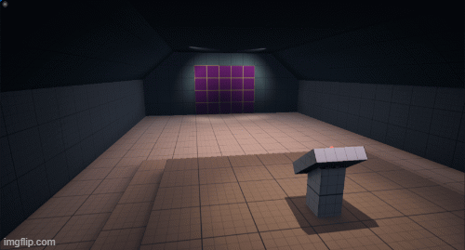
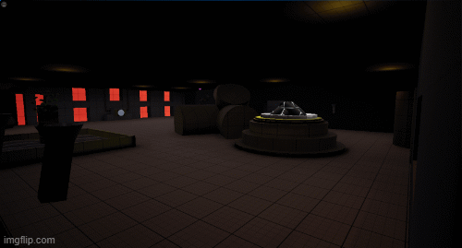
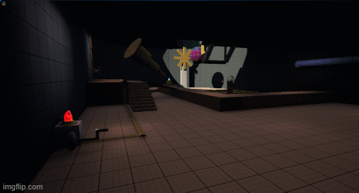
Production
The next version provided the variation in elevation in some of the rooms to keep it interesting.
The elevation also allows the player to be guided naturally and some space for the to view the changes they make from completing the puzzles.
The use of elevation drastically changes the players perception of a room, the feeling and how they choose to progress.

Slide 29
Playtest 3 (Unsupervised)(Anonymous Results)
Positives: From the Results
Negatives: From the Results
The context through the levels design and environment is still on the correct path for each section.
Accidental Misleading, incorrectly timed event.
The Blue and Red Cystal's are both taught in their respective sections and can be understood, making it plausible for further puzzle development if this were to be a full game with multiple levels.
A major part of the puzzle was accessible, but players didn’t realise it was due to it being behind a panel.
The need to go back to the main Cauldron isn’t obvious enough and needs to be made clearer after the third section is completed
More natural backtracking

Slide 30
Playtest 3 (Unsupervised)(Anonymous Results)
Plan for final Iteration
Make the backtracking the Cauldron more obviously needed.
Fix minor issues present through the playtest results.
Add a more spectacular finish, to represent the major perspective shift outlined the beginning of the project.

Slide 31
Final 2D map

Slide 32
Basic Grid

Slide 33
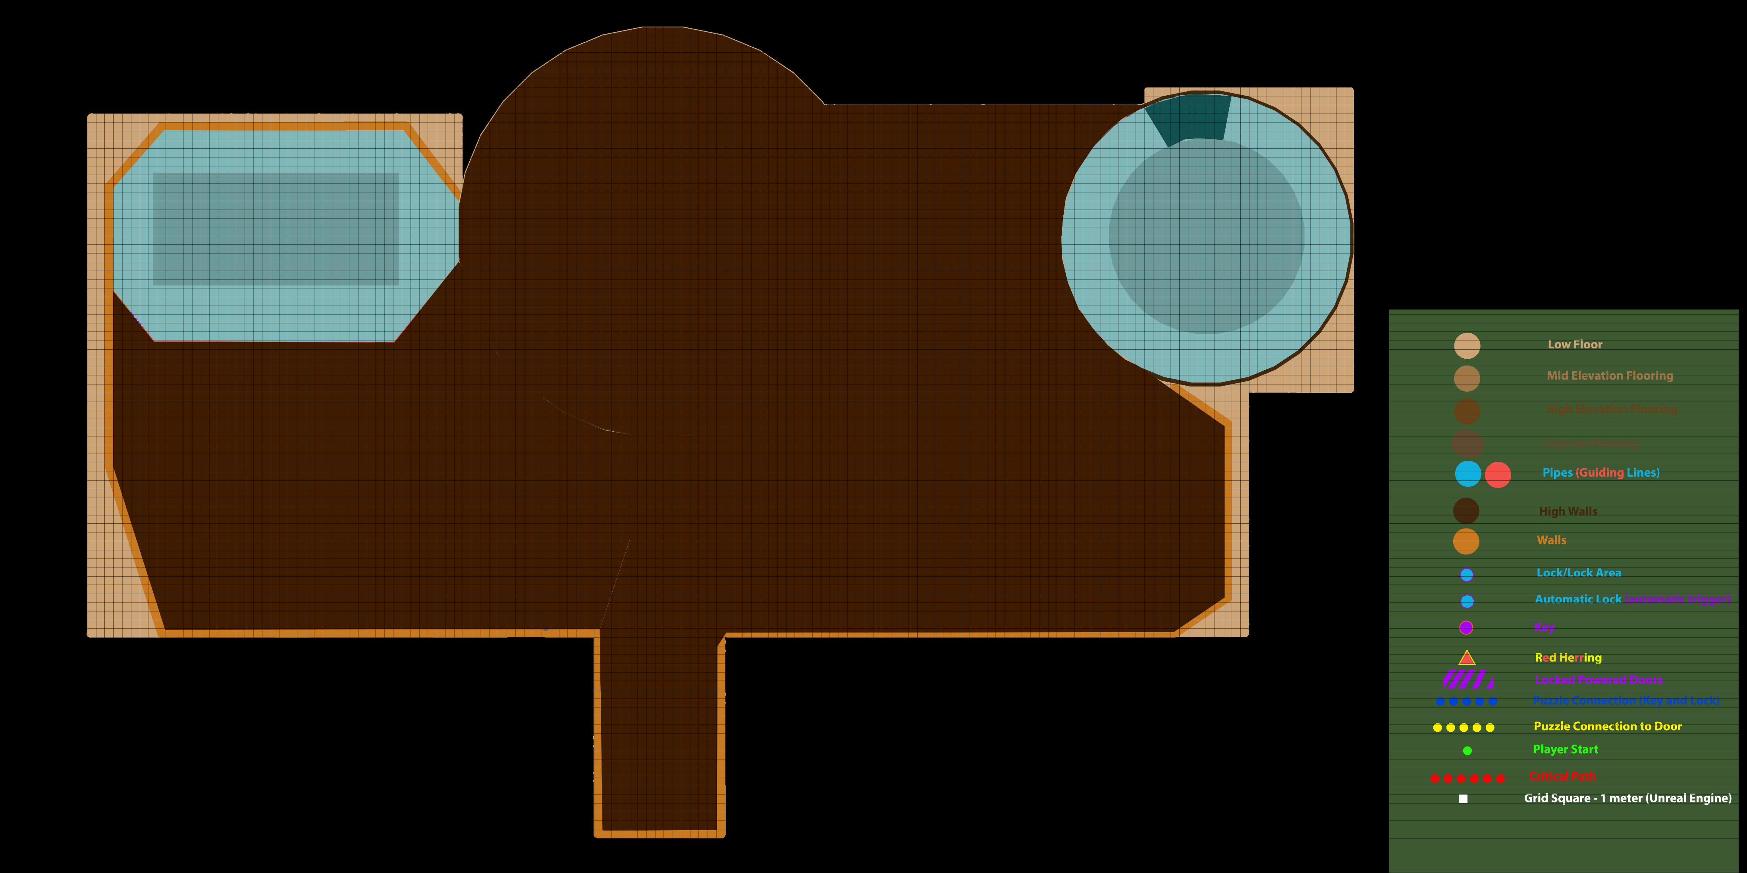
Roof

Slide 34
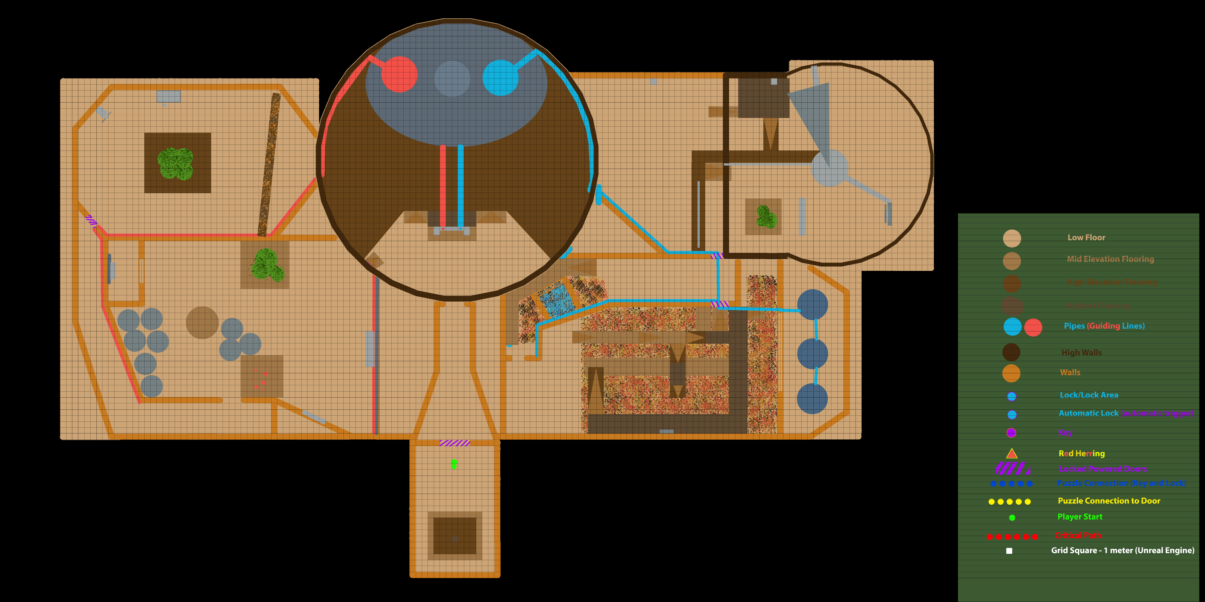
Highest
Ground

Slide 35
Average Ground

Slide 36
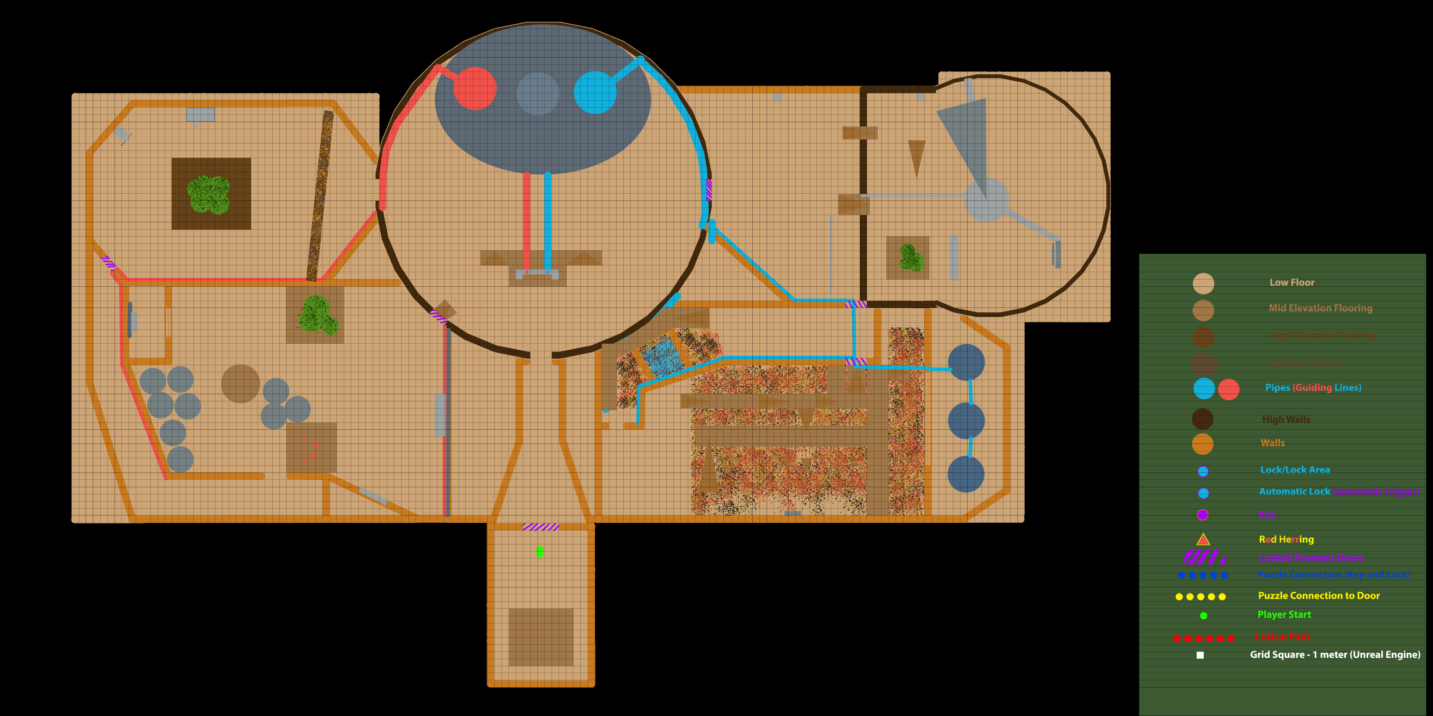
Lowest
Ground

Slide 37
Puzzle Relationship

Slide 38
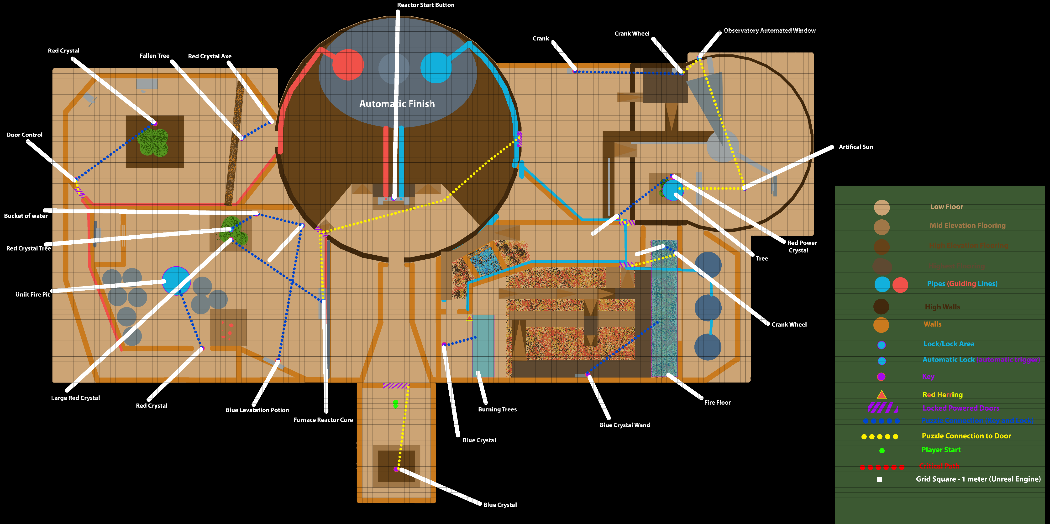
Puzzle Label

Slide 39
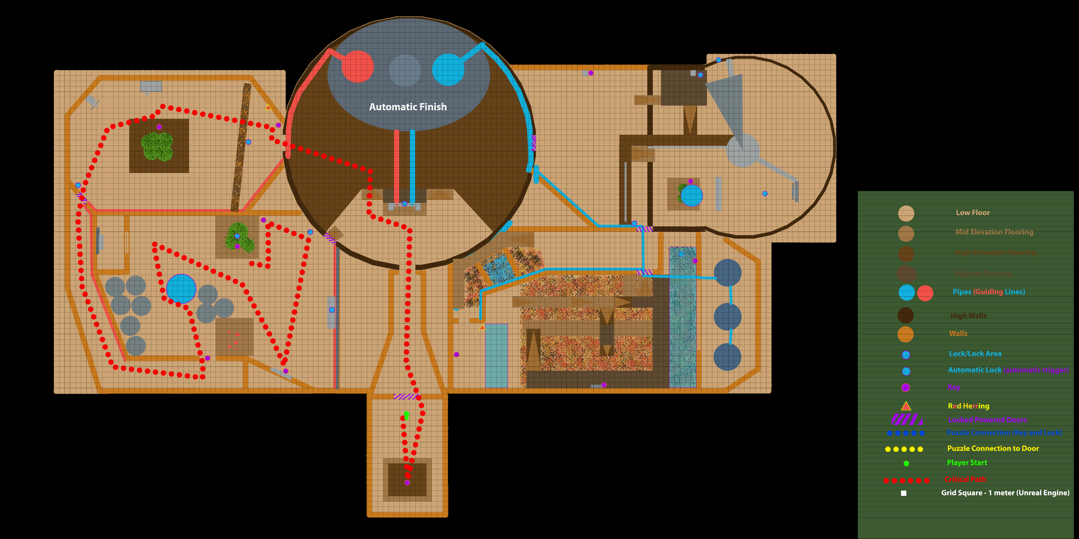
Critical Path pt1

Slide 40
Critical Path pt2

Slide 41
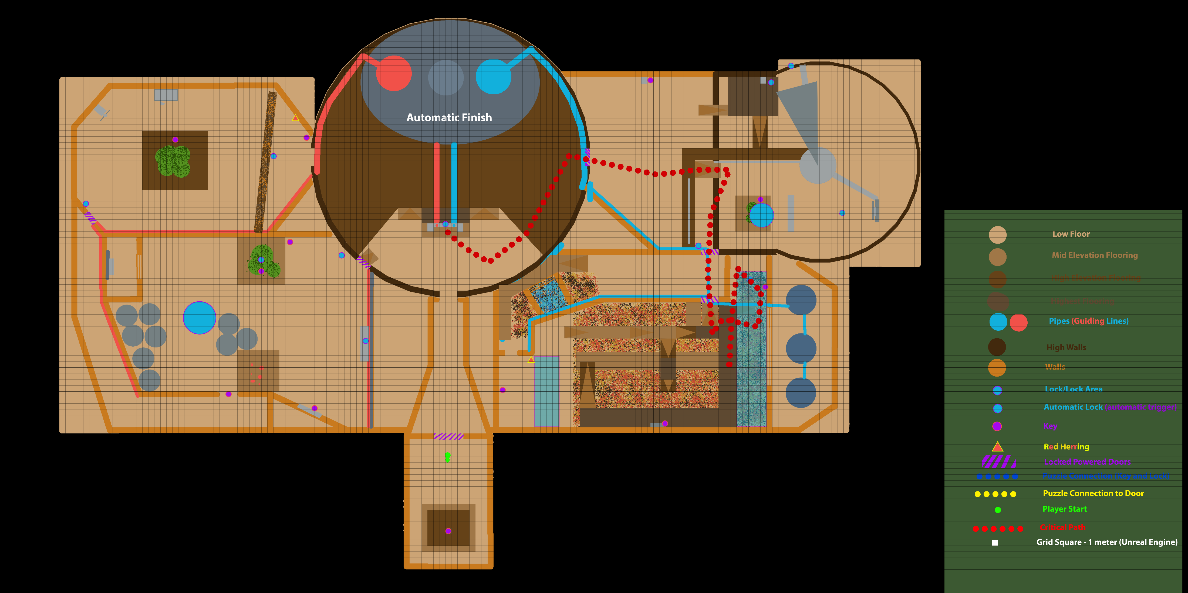
Critical Path pt3

Slide 42
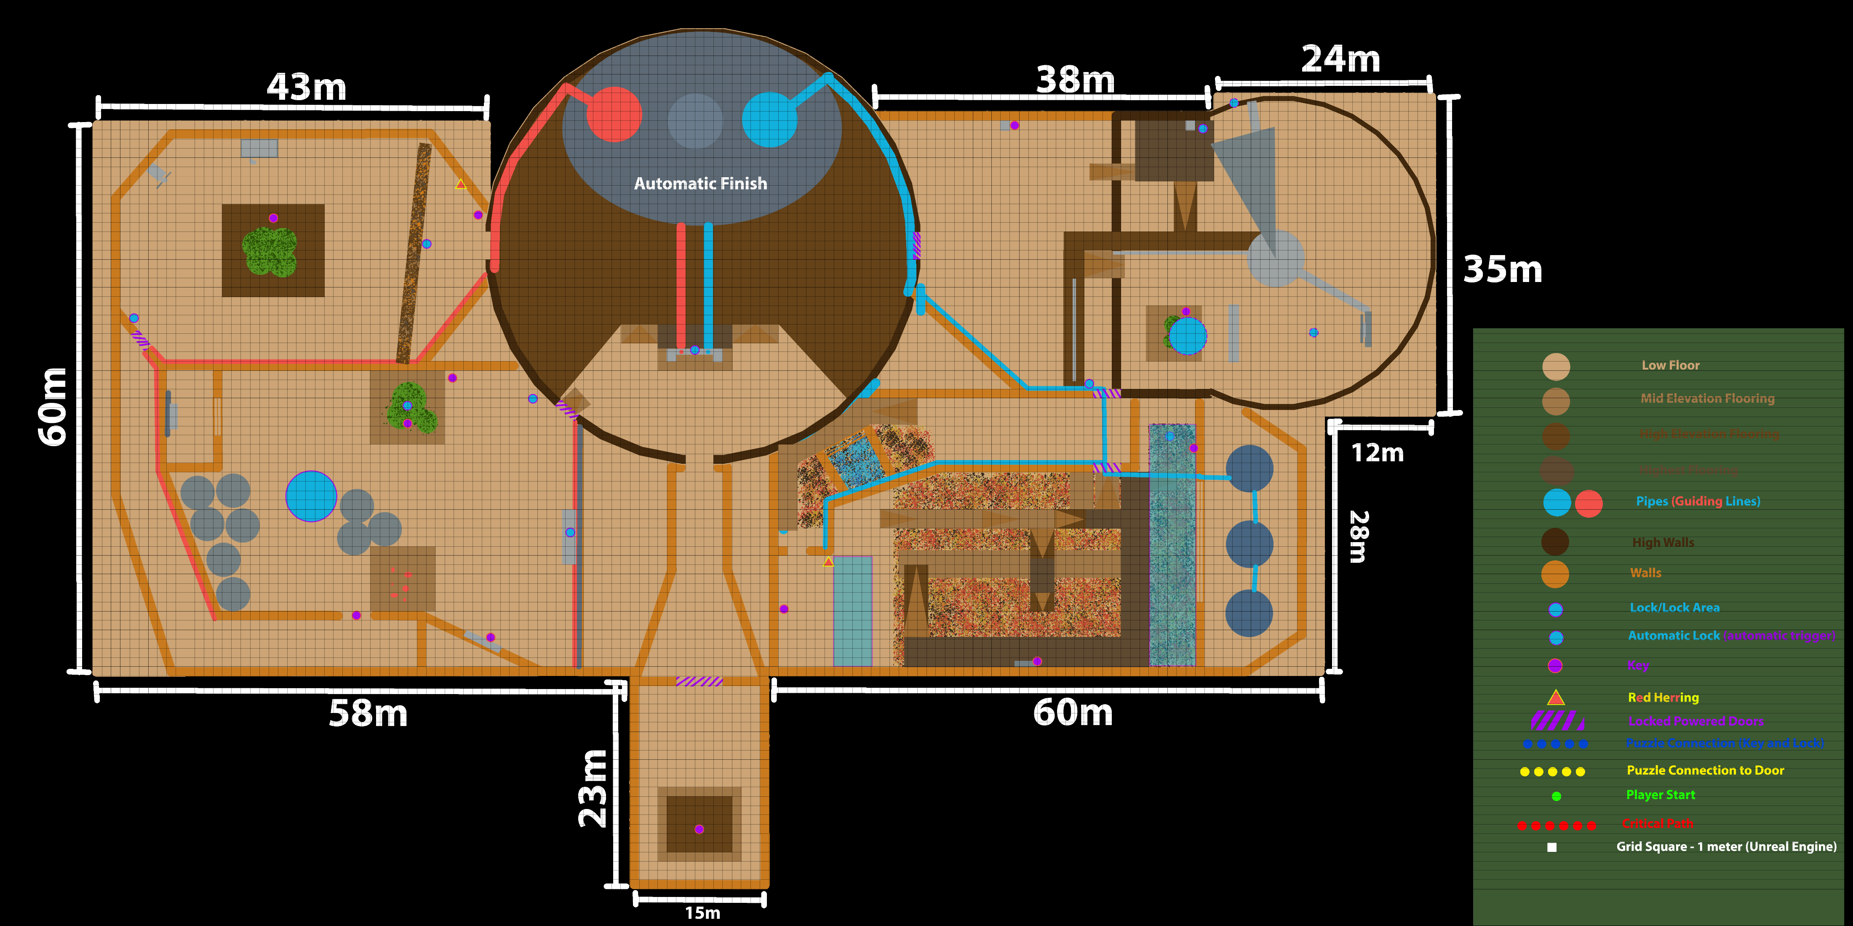
Basic Measurements

Slide 43
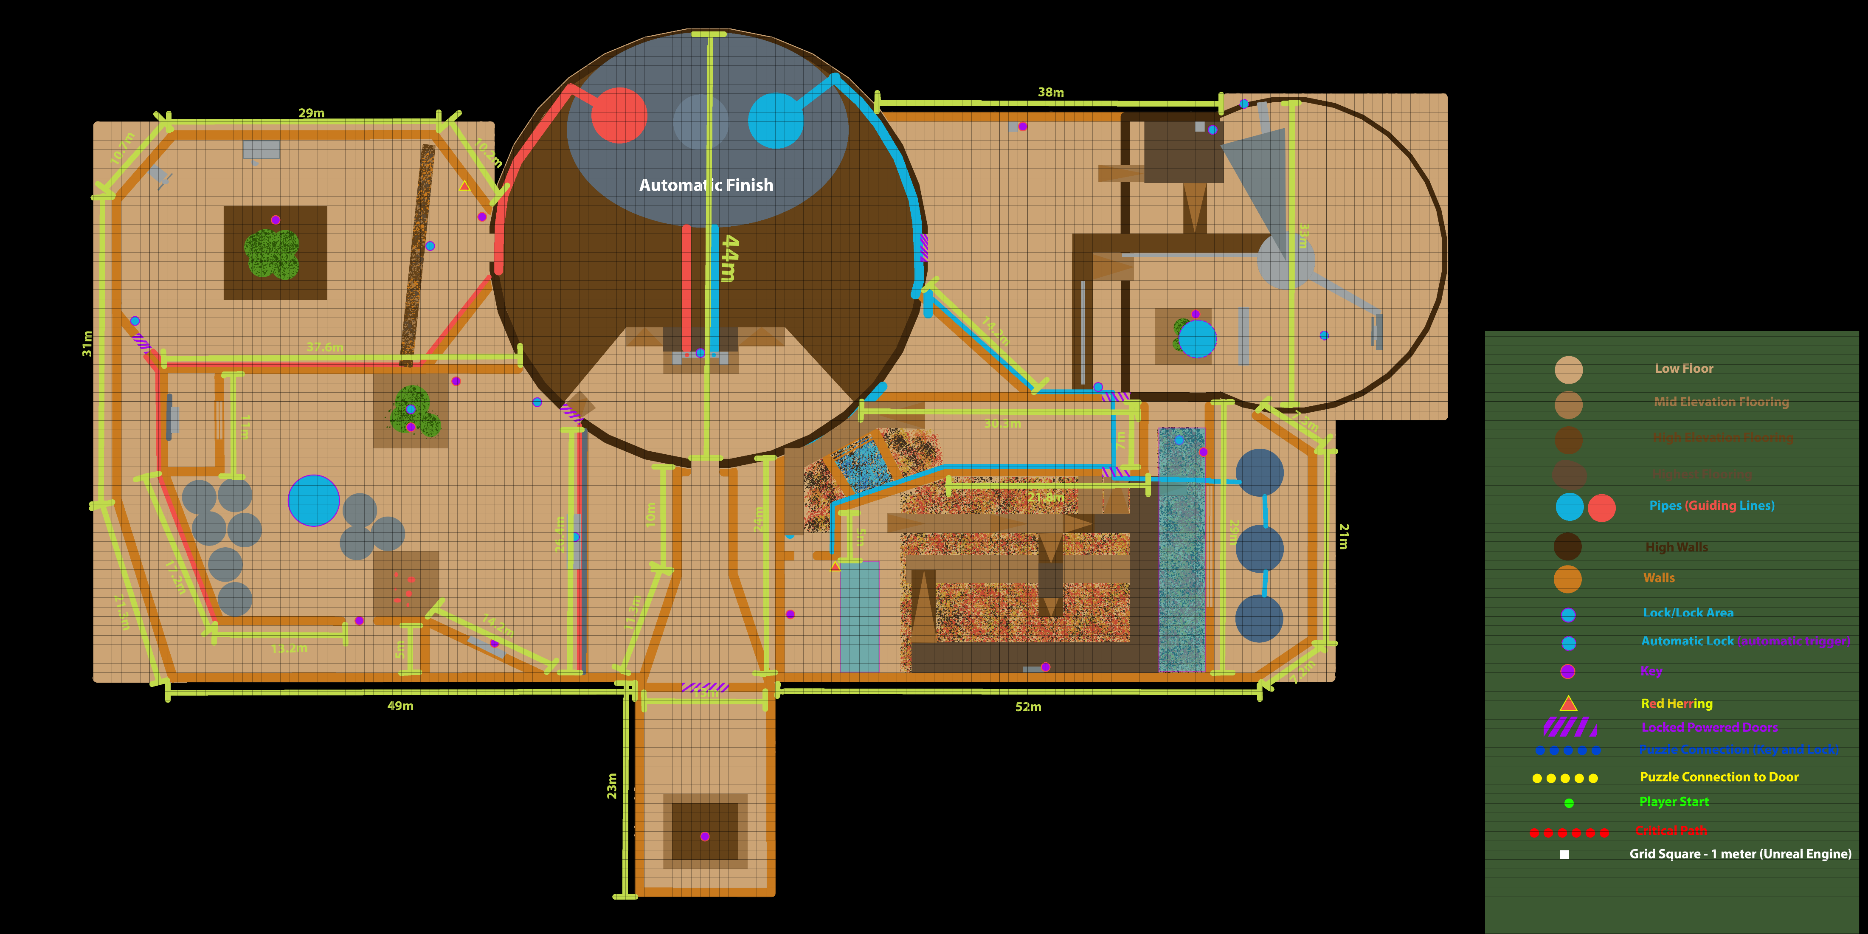
Detailed Measurements

Slide 44
Design Reflection
Critical Analysis Progression

Slide 45
Critical Analysis of Project and Level
Research
Proposal
Testing
Majority of design research was focused on the first iteration and initial proposal, but because of the sources I took from, it is still applicable directly to level design.
Not ending up as exactly as I wanted, no wizard tower, but a cauldron of sorts was created.
Through testing the level was able to develop the player experience the most and define where the refinements need to go.
Not able to produce the entirety of what was proposed, less use of Viewports and direct optical illusions.
The core of the project is still present “Level focused on perspective and discovery”.
The overall outcome of the project proposal was to develop my skills. It has taught me more about how to design levels correctly and intuitively using iteration.
From the play testers that did help I got very valuable feedback, but I do wish I had a larger pool of players.

Slide 46
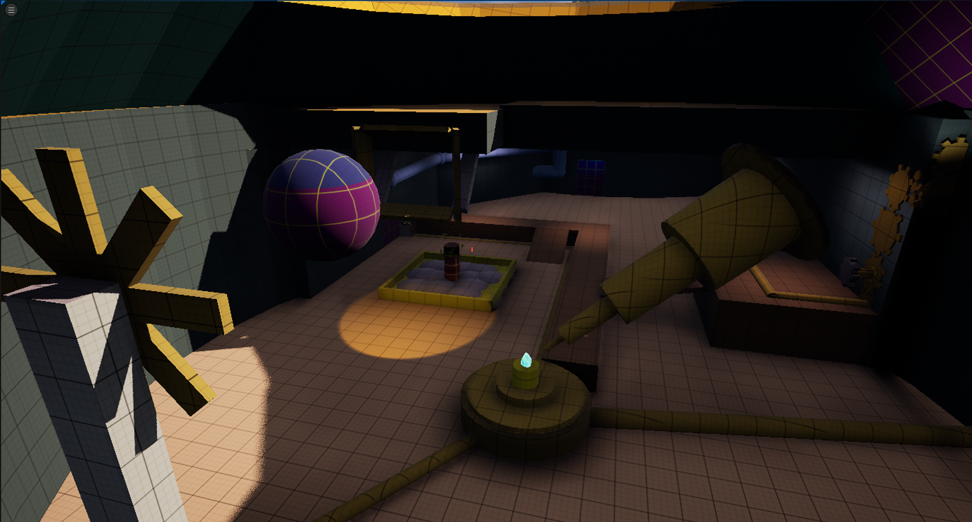
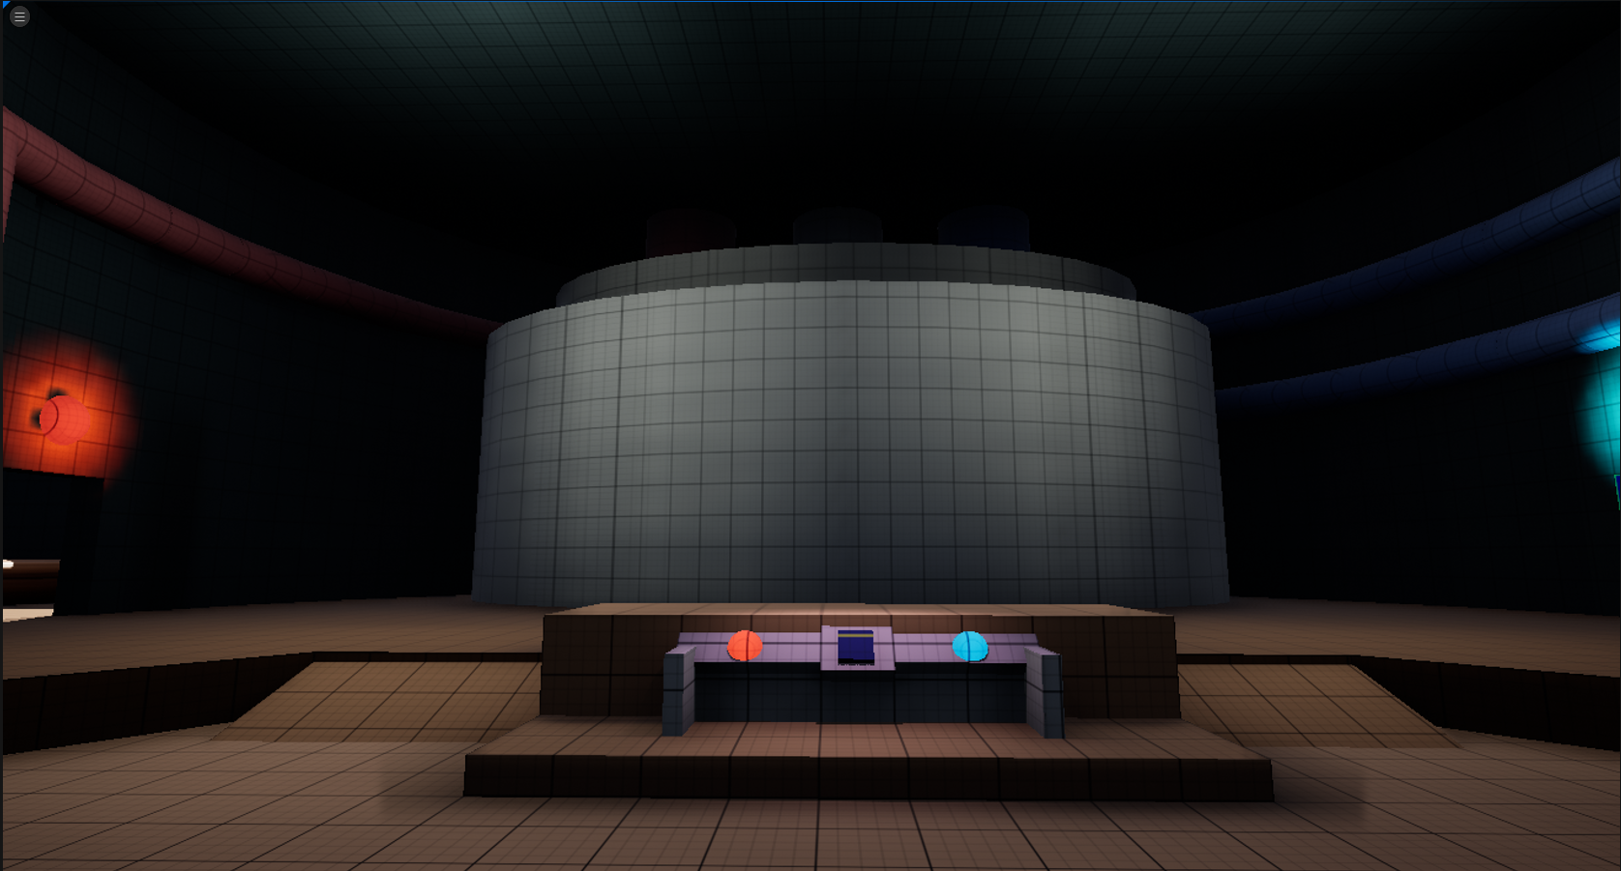
Critical Analysis of Project and Level
Development
The Level
The very first version of my map was okay, but I misdirected myself with the reliance on assets initially, which was never the intention of the project, nor would it help me learn to use techniques most effectively.
My favourite section is the observatory. The space opens itself to showcase all the player needs and provides them with the correct visual information.
Through testing, iteration and critical analysis I manage to produce something I’m proud of and resembles the ideas and techniques I wished to develop about player perspective and perception of space.
The transition from small space to large space in between the very first puzzle and the cauldron grant a better effect for the larger area.

Slide 47
Skills Progression and Learning
Understanding Player Perception of space
I have learned that players will perceive spaces in various ways depending on how they can interact with it. The final iteration of the level was designed based off the player experience and how they perceived each area, some areas needed more elevation and variety, inducing the feeling of exploration. Other spaces need obstacles to have the player move through the area willingly to learn more about the room and how the puzzle works.
Using space to inform and guide a player
The various techniques for level design to inform a player through space is very important. Having a large space is not enough to guide them through a puzzle. How the area uses space and what’s found within it will guide them differently. In the first iteration the space for main areas where large, but didn’t inform the player correctly about the puzzle or the solution
Player Perspective and Guidance
From a player’s point of view the space will lend itself to how it should be used, as ana re to move through or to spend time in. A room full of various objects will seem interesting, and insitctivly a player might want to interact with it all, space with little clutter sparks less curiosity and lends to the player moving through the space to be presented with something else.

Slide 48
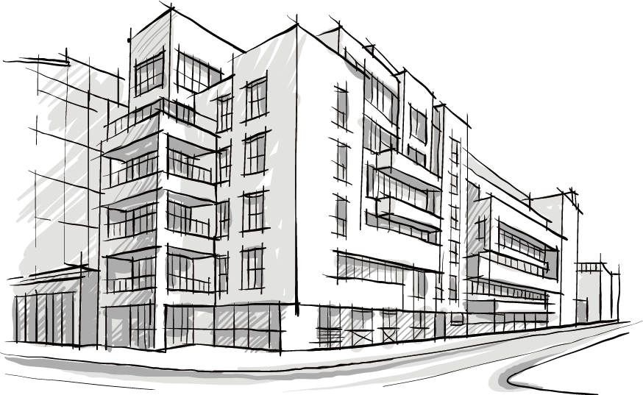
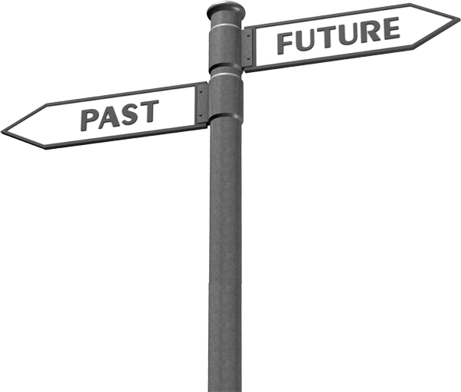
Future Learning
Looking at level design from and architectural perspective. How does architectural theory apply to the creation of levels?
Gameplay wise, narratively and for simple player experience.
Looking at the real world and experiencing how the areas we live in are created to make us feel. How the cultural inspiration for the architecture and use case defines the space.
Using what I learned from this project in future projects and further developing and experimenting with what I know and how they might work.

